Slide 1
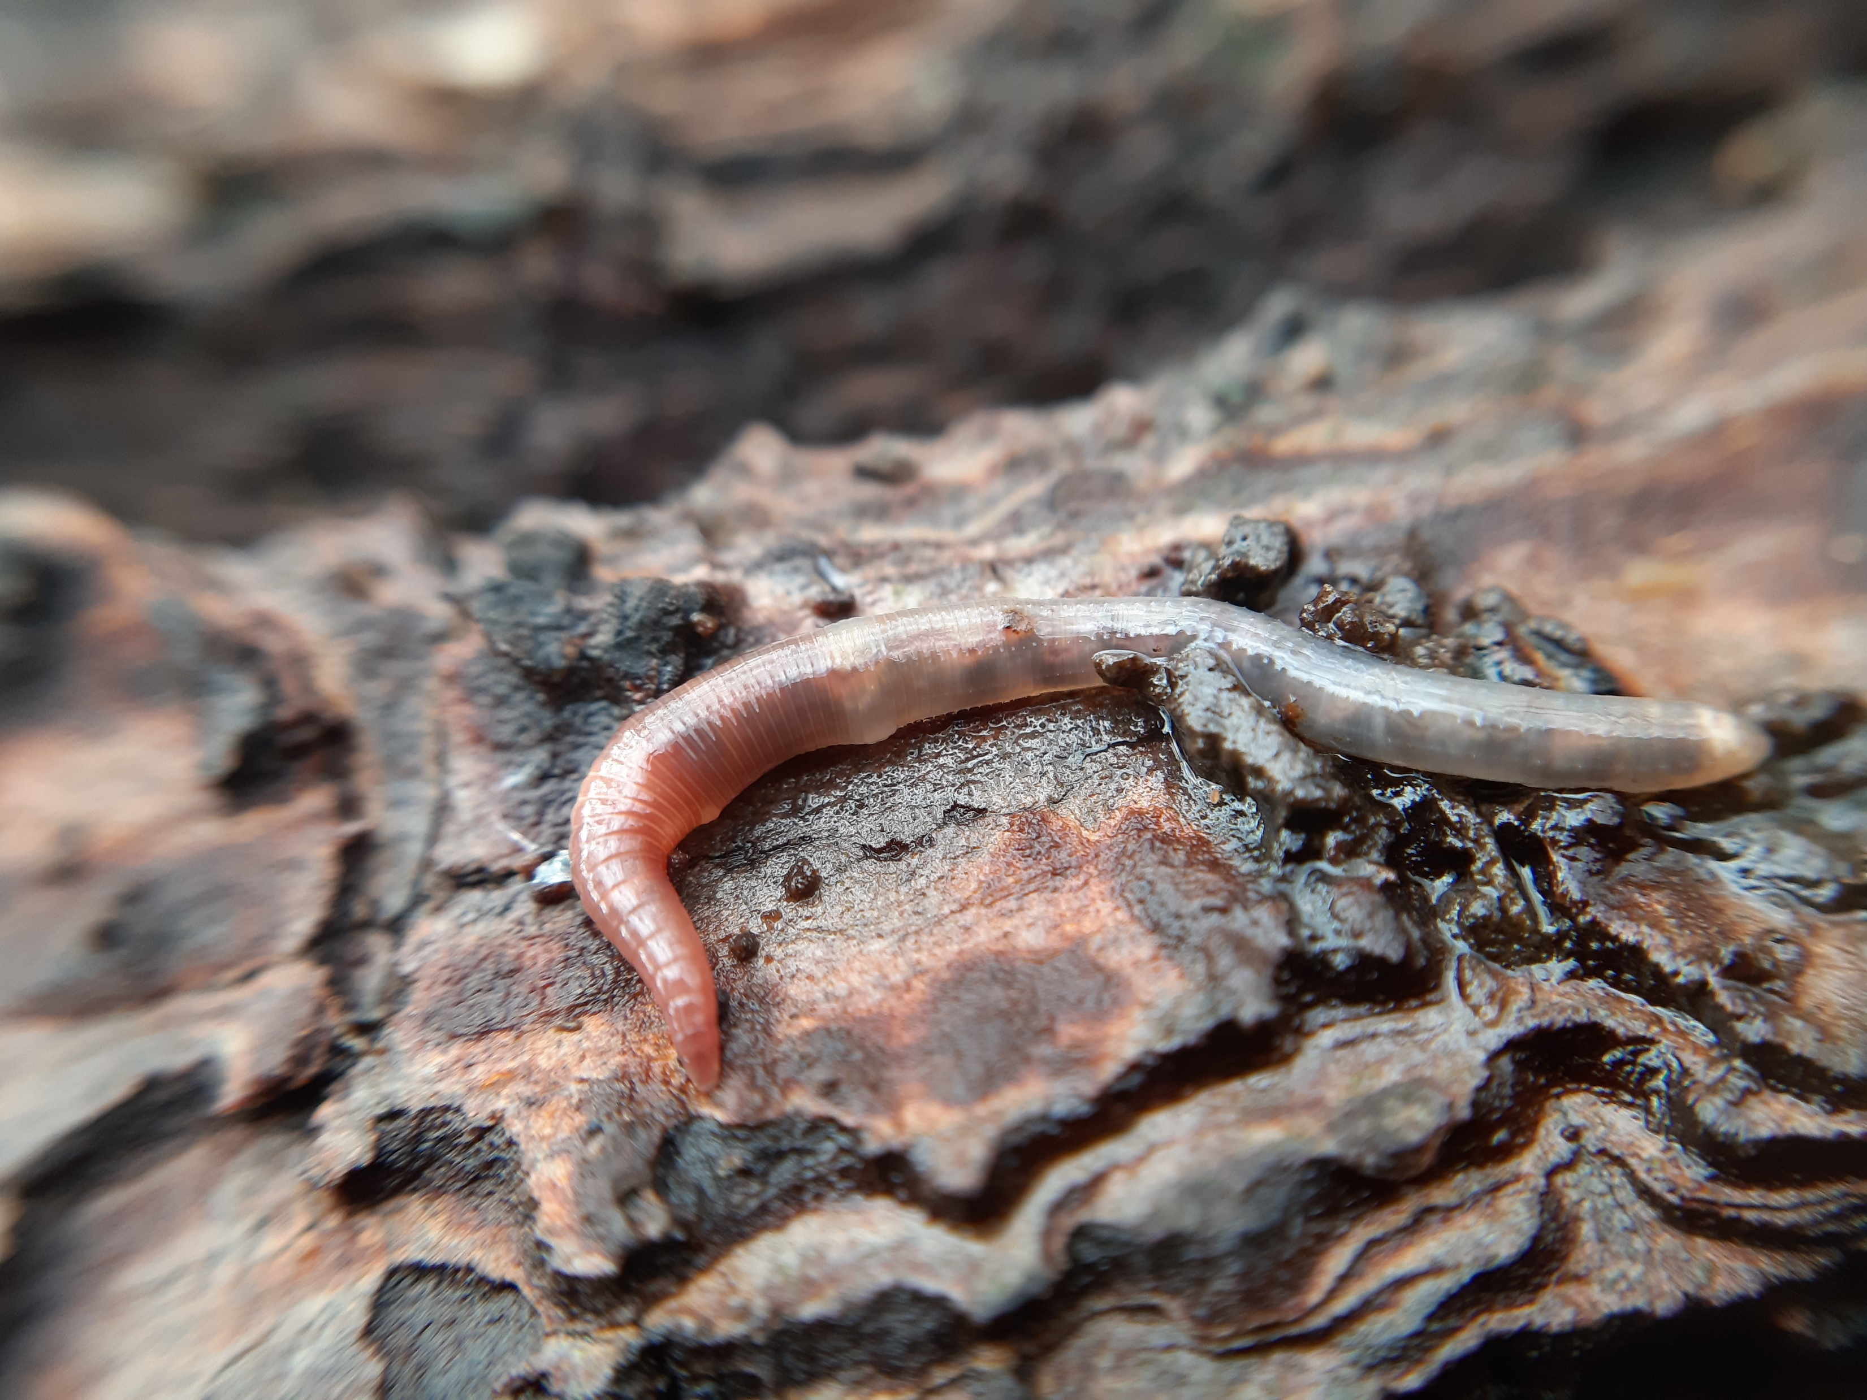
Positive feedback loop between burrowing earthworms and soil pH reinforces litter effects on belowground functioning
Ellen Desie, Koenraad Van Meerbeek, Hans De Wandeler, Helge Bruelheide, Timo Domish, Bogdan Jaroszewicz, François-Xavier Joly, Karen Vancampenhout, Lars Vesterdal, Bart Muys
Dendrobaena attemsi (picture by Jan Soors)

Slide 2
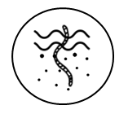

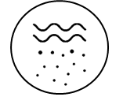
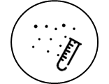
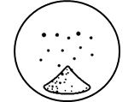



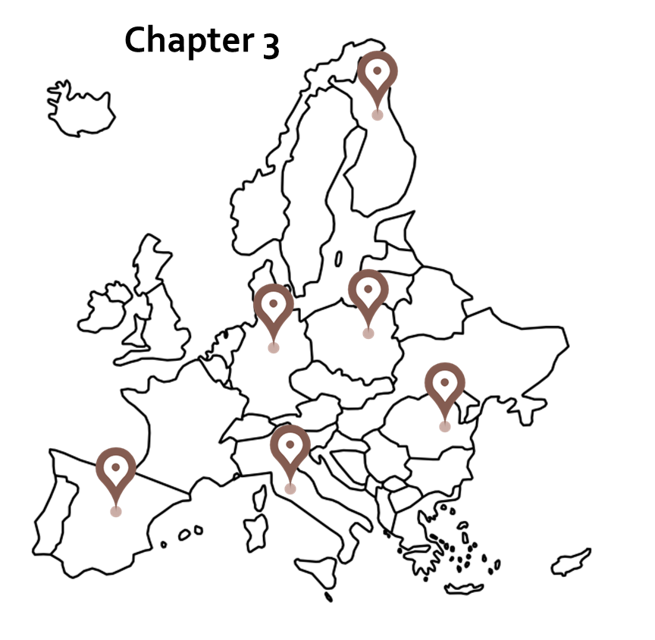
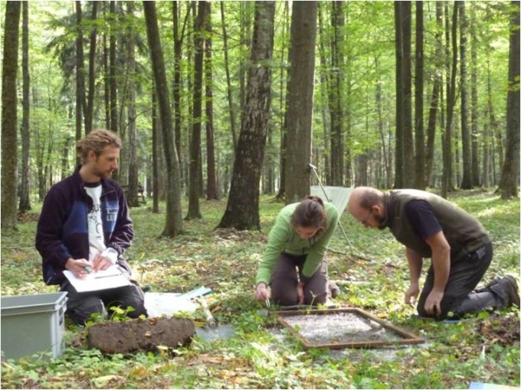
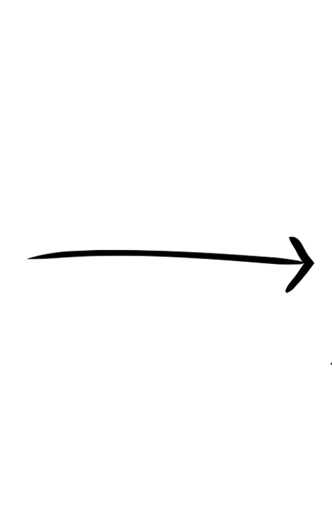
Study sites (FunDivEurope)
Earthworms
Humus
Soil
Litter

Slide 3
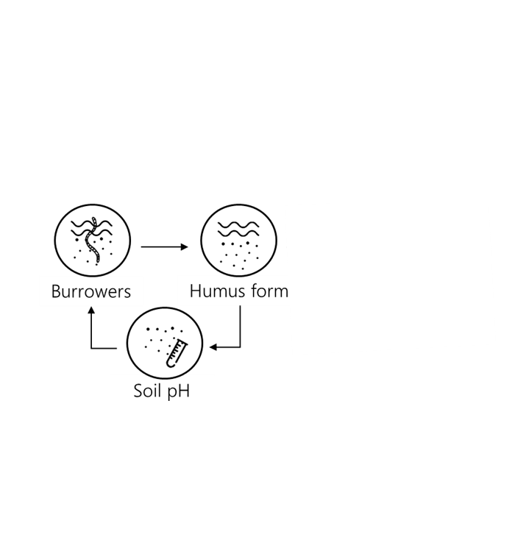
Hypothesis

Slide 4
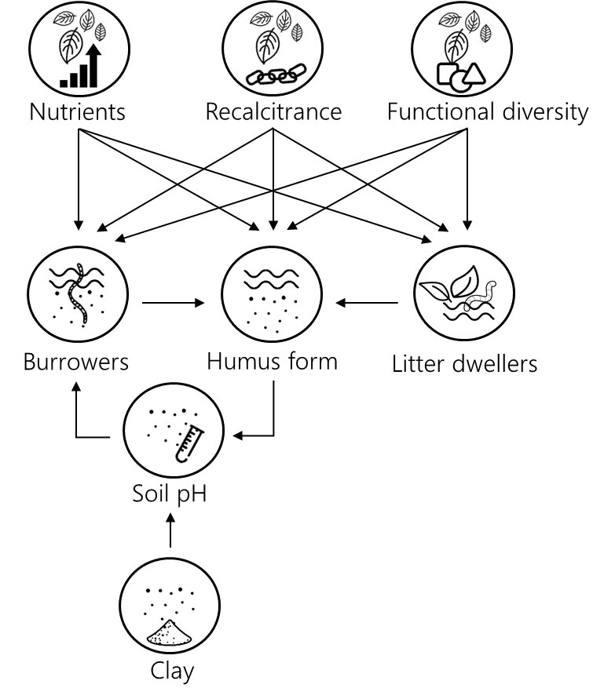
Hypothesis

Slide 5
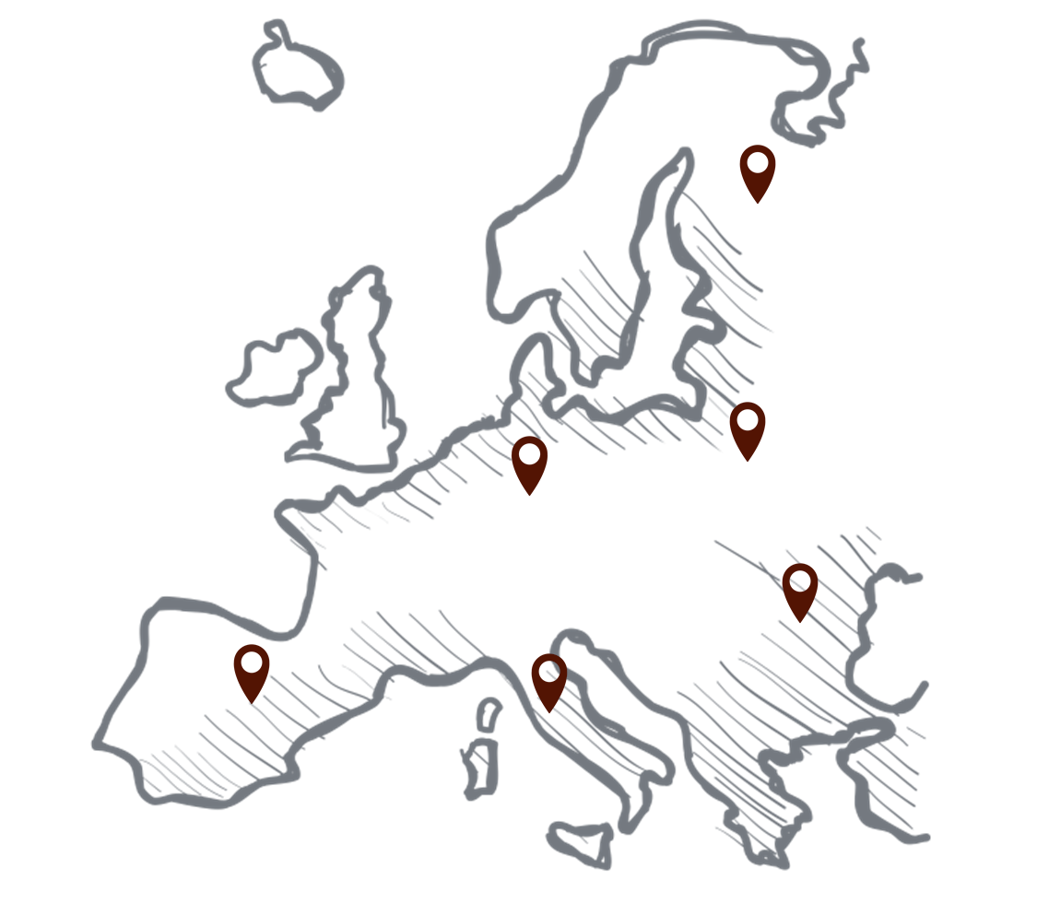
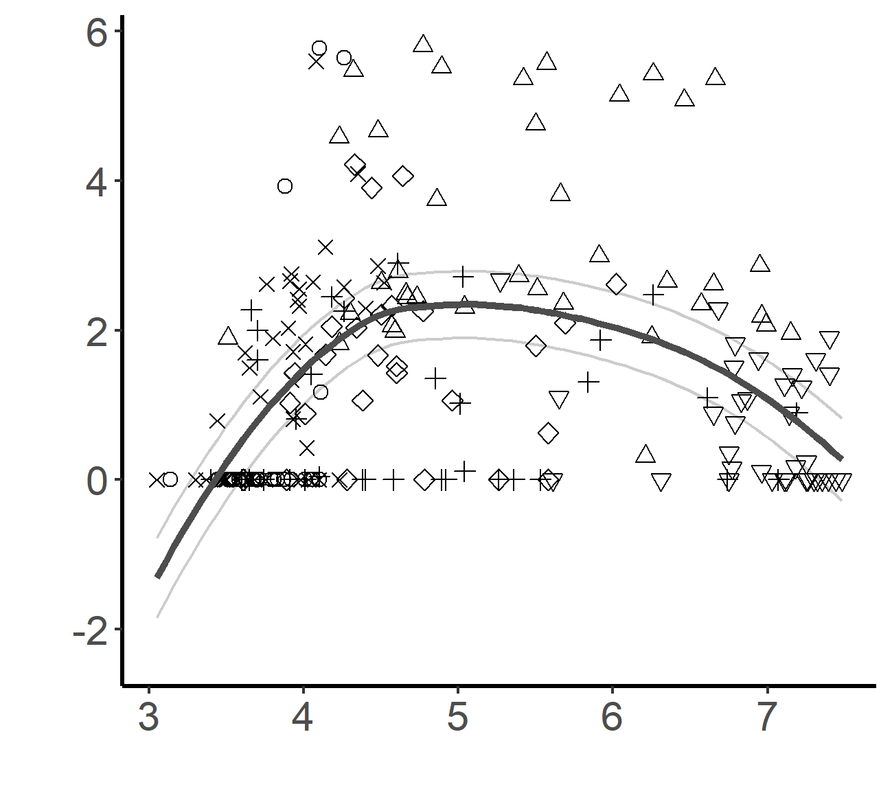
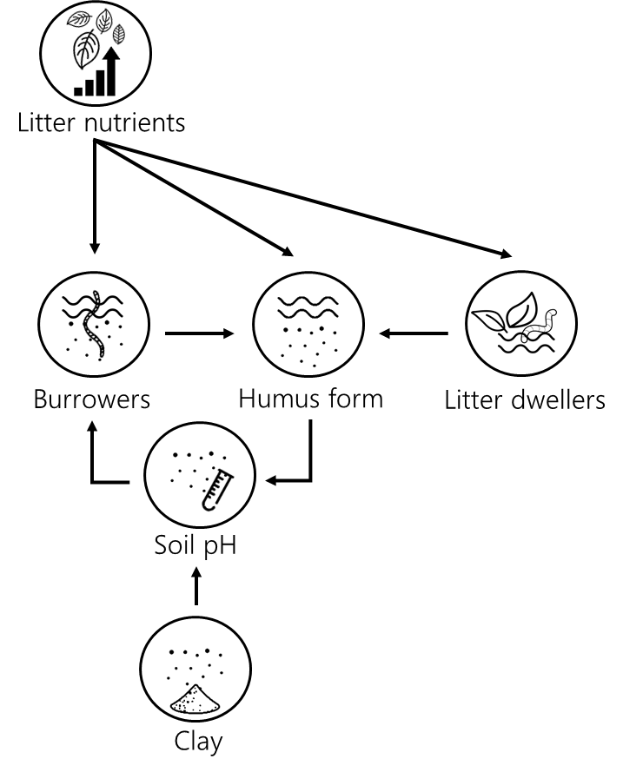
Full model
Burrowers (g/m²) McCune log transformed
pH – CaCl

Slide 6

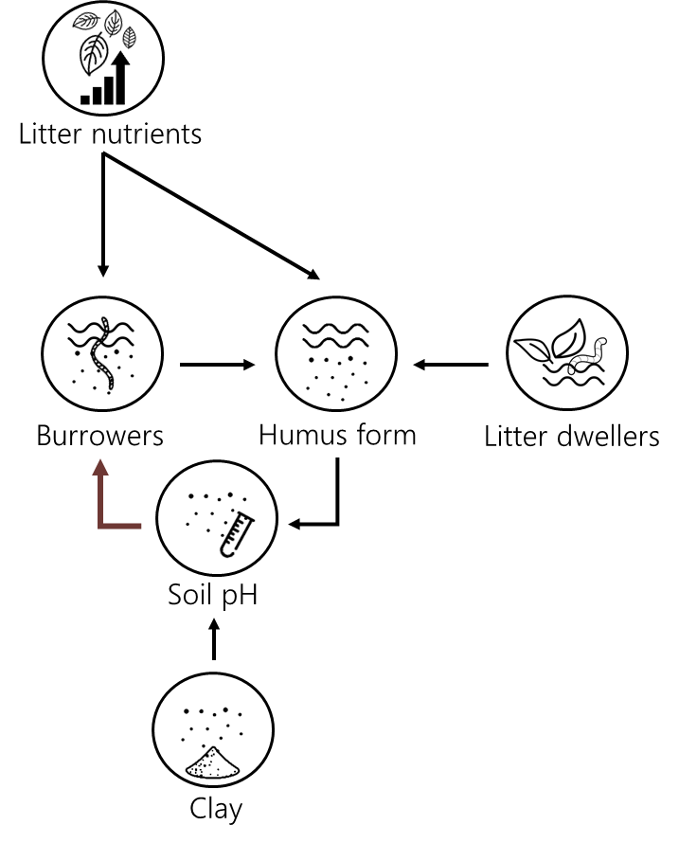
Full pH gradient
pH ≤ 5
Positive feedback loop
Desie et al., 2020. Functional Ecology.

Slide 7
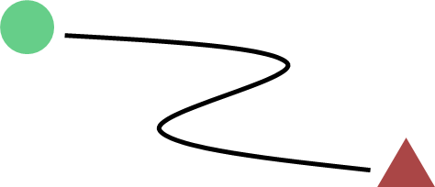
Context matters…
Non-linearity in soils
Edaphic thresholds shape litter effects

Slide 8
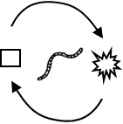
Context matters…
Non-linearity in soils
Mechanisms mitigating or amplifying threshold behavior
Edaphic thresholds shape litter effects
Earthworms reinforce threshold behavior

Slide 9
The more, the merrier!*
(* only applicable at acid conditions)
Dendrobaena attemsi (picture by Jan Soors)

Slide 10
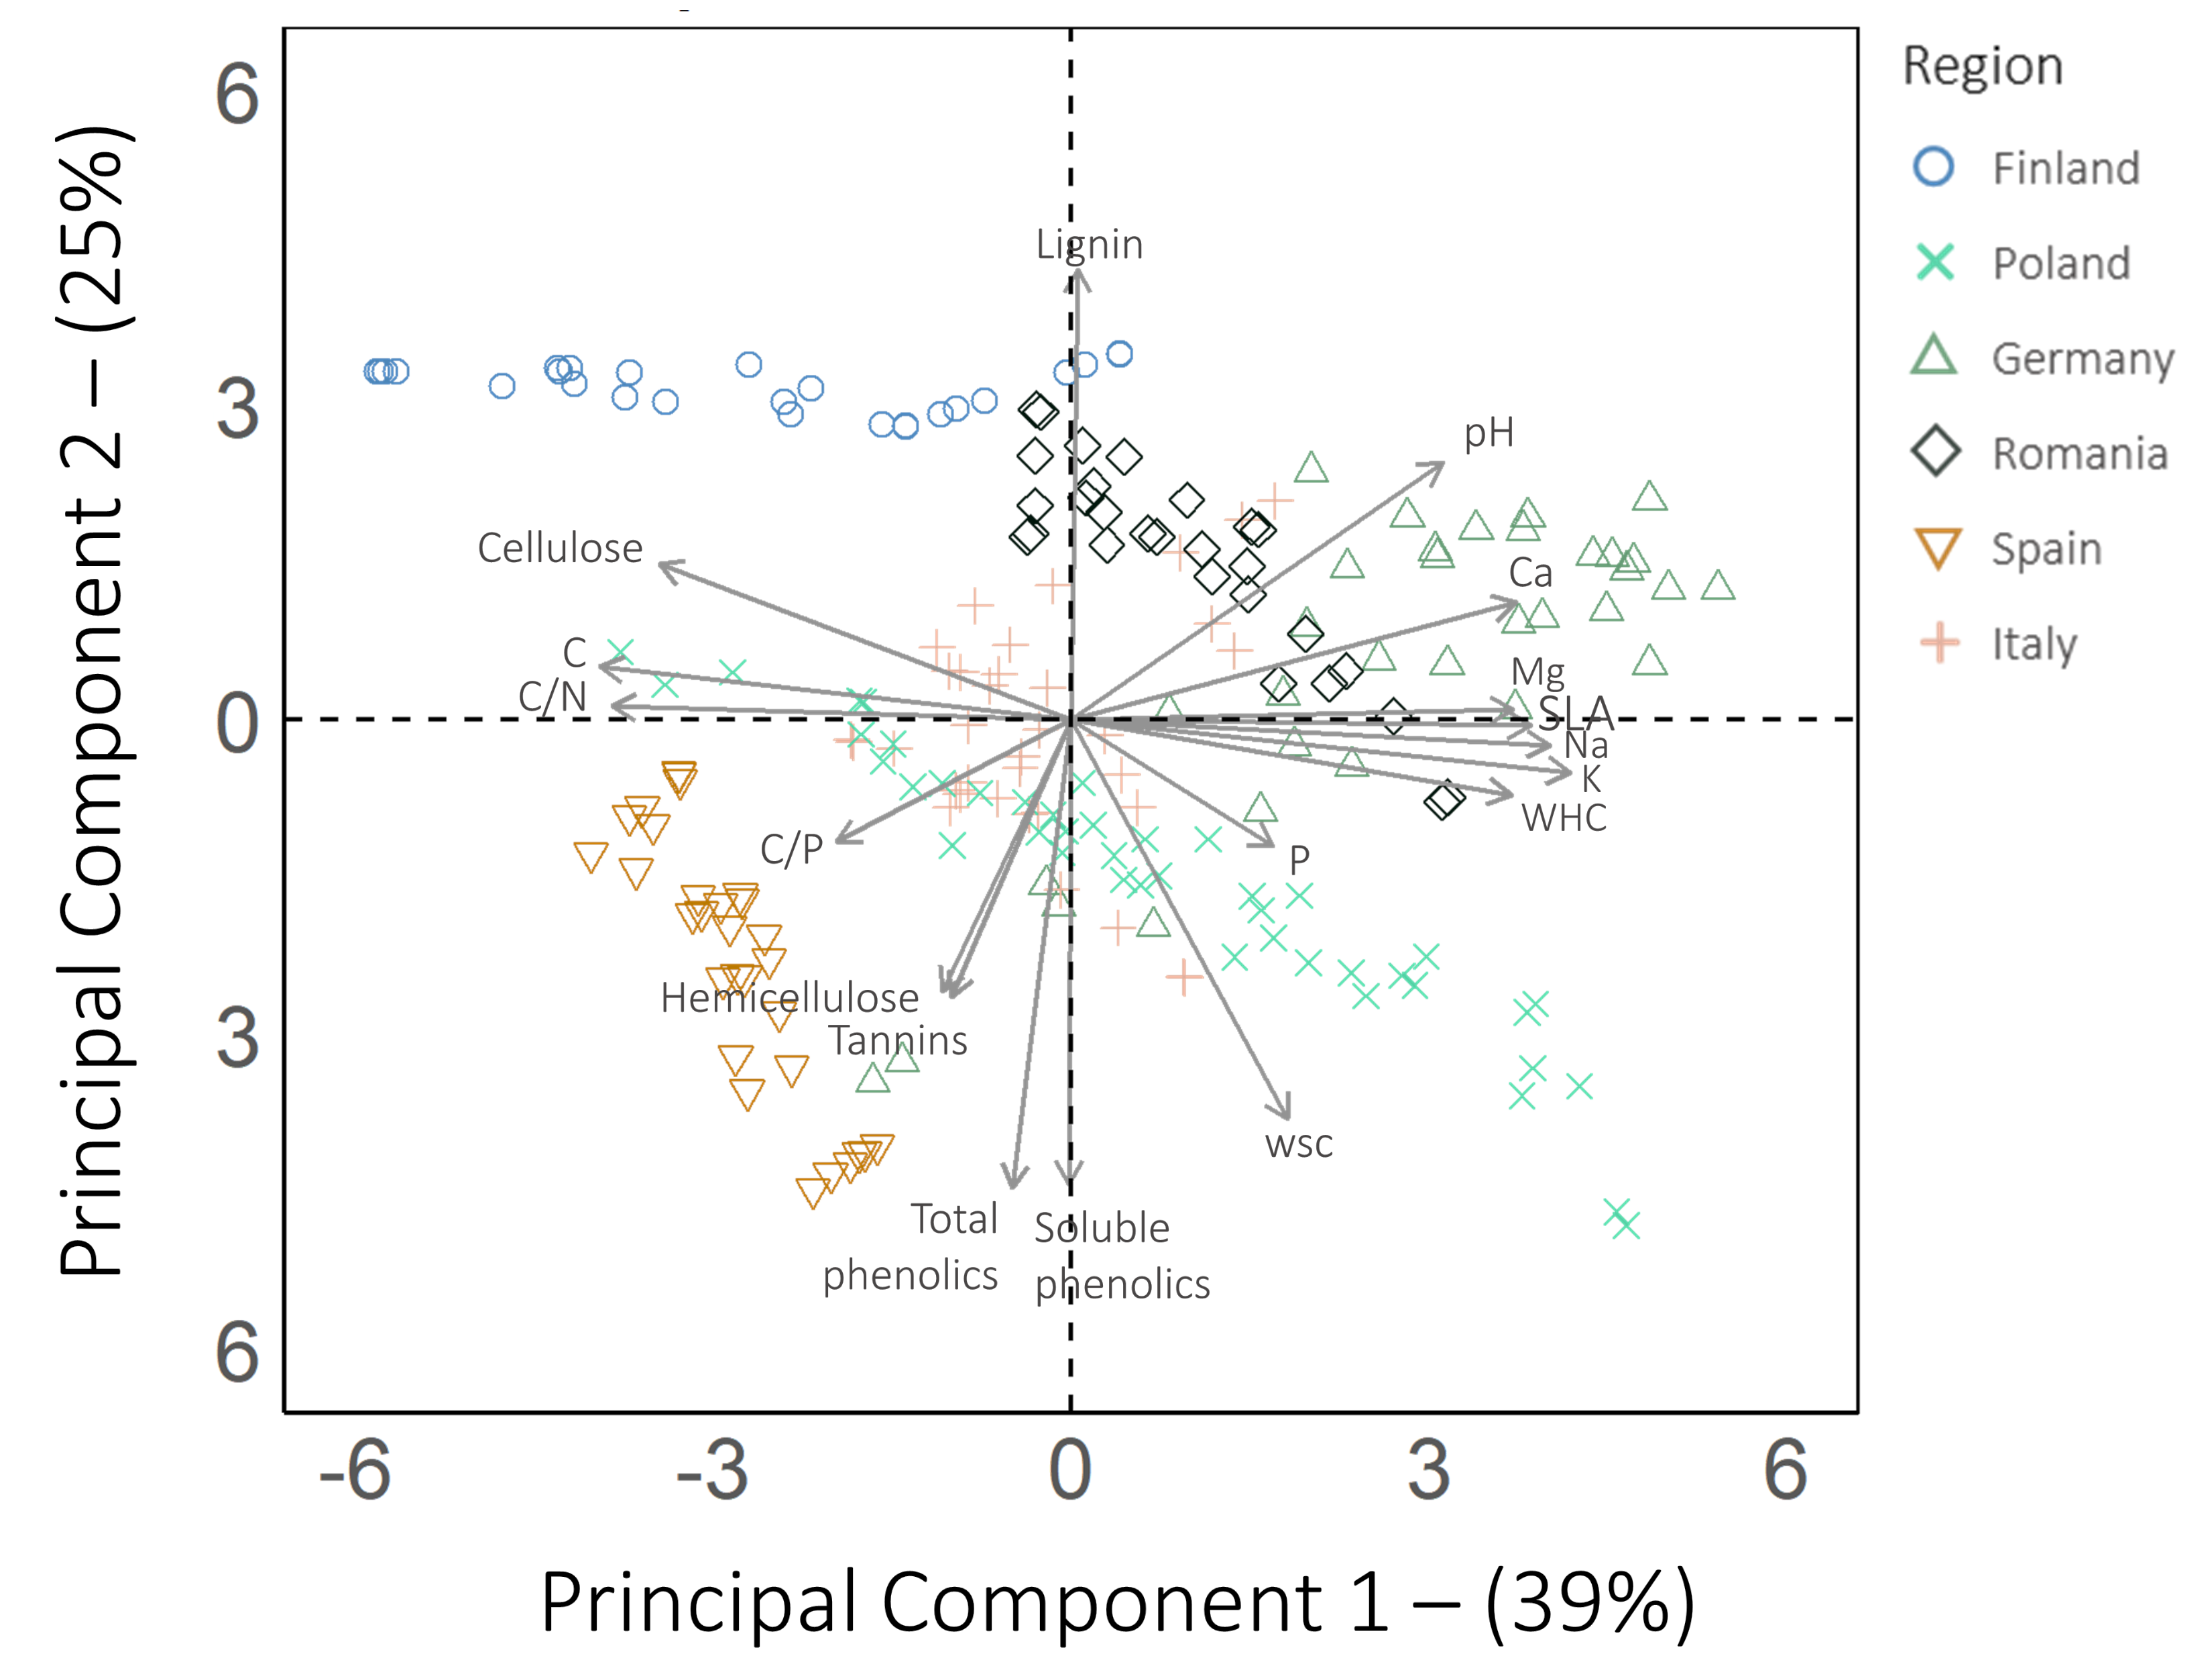
Reduction of dimensions
Litter structural recalcitrance
Litter nutrients
Humus form

Slide 13
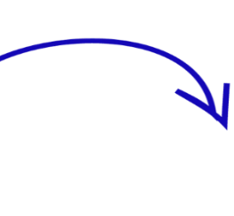
Pedogenic threshold around 4.5
active feedback loop
Soil pH
Carbonates
Base cation exchange
4.5
Hydroxy-Al
PEDOGENIC THRESHOLD
Hydroxy-Fe
Cumulative input of H⁺
Desie et al., 2021. Frontiers in Forests and Global Change

