Slide 1

Optimal design of nature-based solutions in highway runoff management based on resilience to climate and pollution load changes
By
Mehrdad Ghorbani Mooselu, Helge Liltved, Mohammad Reza Alizadeh, and Sondre Meland
May 2022

Slide 2
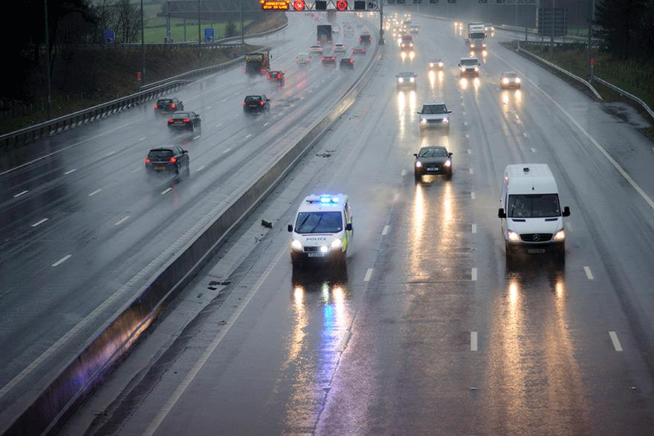
Highway runoff
Site-specific features (traffic volume, roadway design and maintenance practices, surrounding land use, regional climate) influence pollutant composition and quantity.

Slide 3
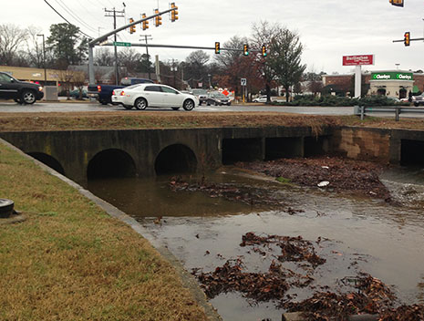
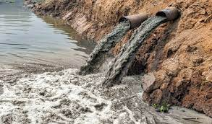
Highway runoff
Polluted aquatic ecosystems may pose serious threats to sustainability:
Economic (treatment, fishing, tourism)
Social (ecosystem services e.g., esthetic and recreational problems)
Environmental (water quality, damage to plants, fish mortality, habitat alteration, and biodiversity loss)

Slide 4
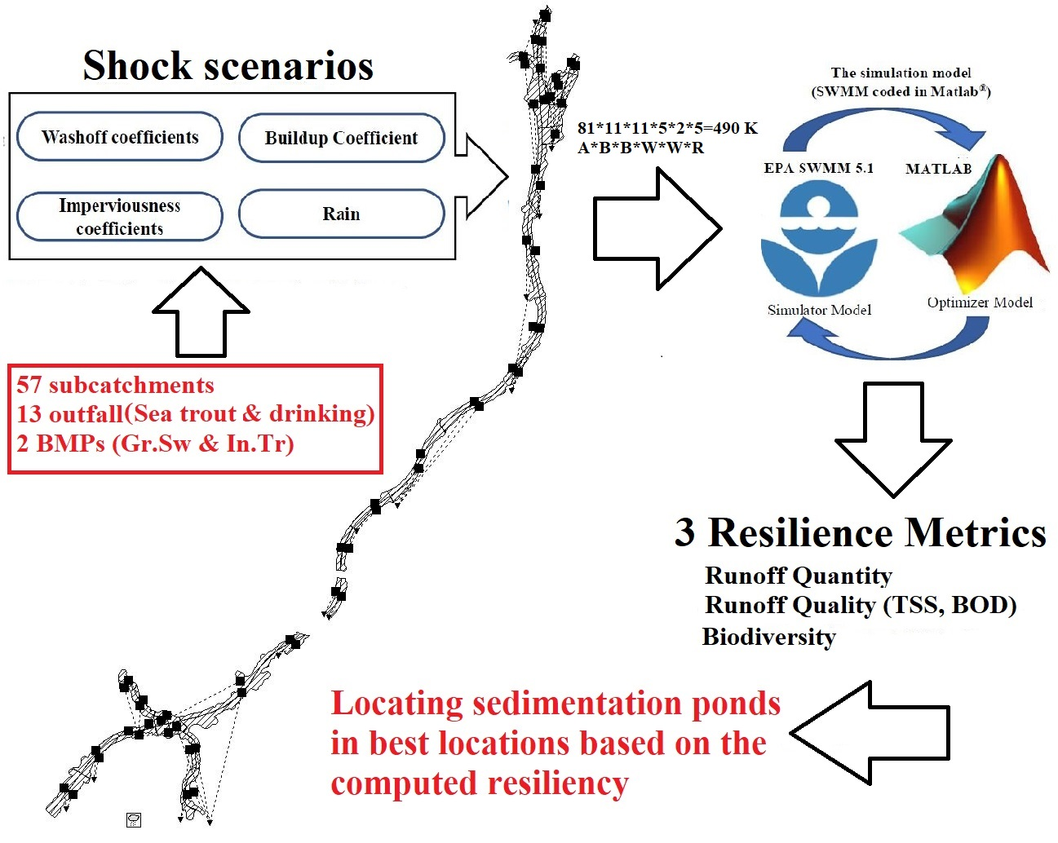

Slide 5


