Slide 1





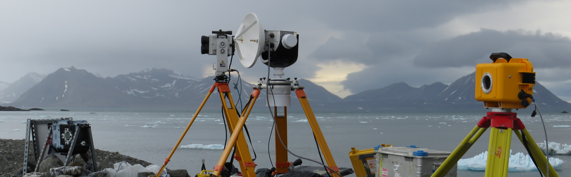






Millimetre-wave radar observations of glacier calving at Hansbreen (Svalbard) correlated with TLS, time-lapse camera images and seismic record
William D. Harcourt
Duncan A. Robertson, David G. Macfarlane, Brice R. Rea, Matteo Spagnolo, Doug Benn, Michael R. James, Dannielle Pearce, Wojciech Gajek, Penelope How

Slide 2
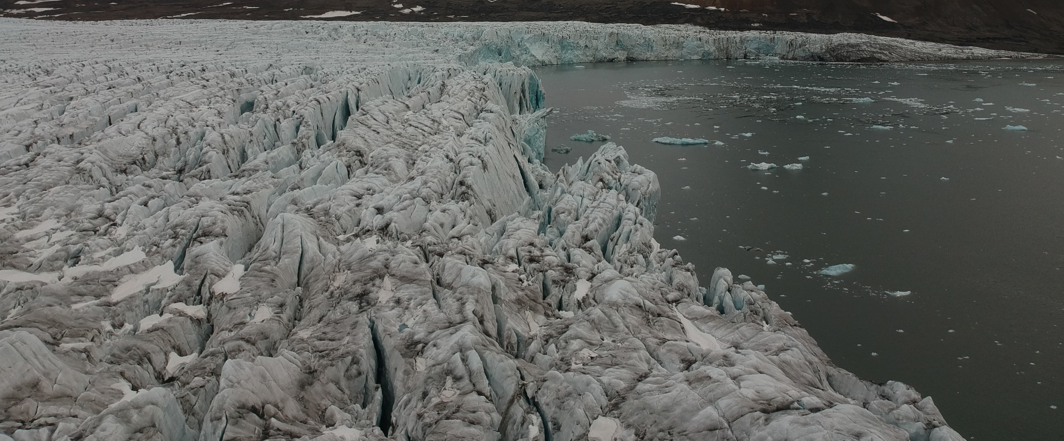


Tidewater Glacier Mass Balance
Frontal Ablation = Iceberg Calving + Submarine Melting
Evaluate new techniques for monitoring tidewater glaciers
1
2
Investigate short-term calving variability
25/05/2022 EGU
@will_harcourt
www.williamharcourt.co.uk
Mass Balance
Fieldwork
Time Series
Melt Undercutting
Summary

Slide 3
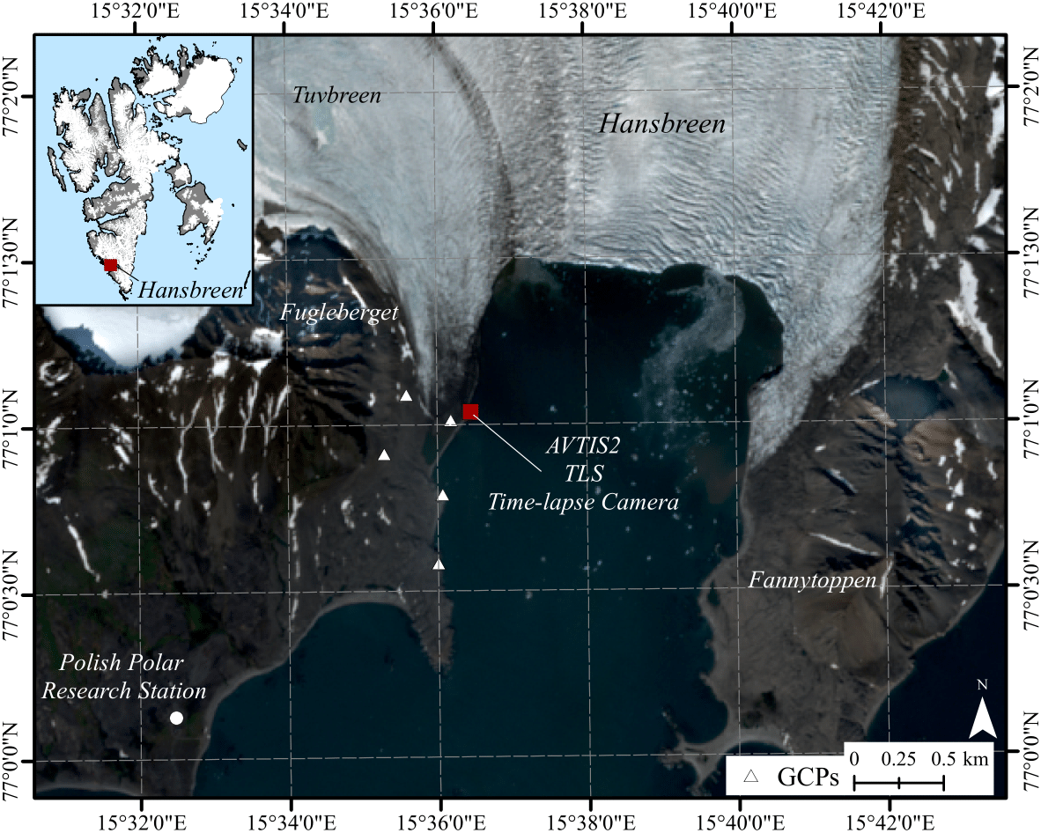
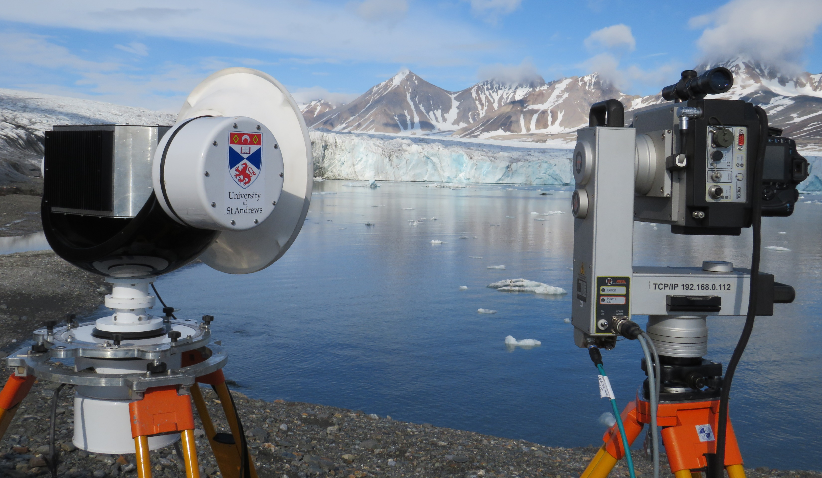
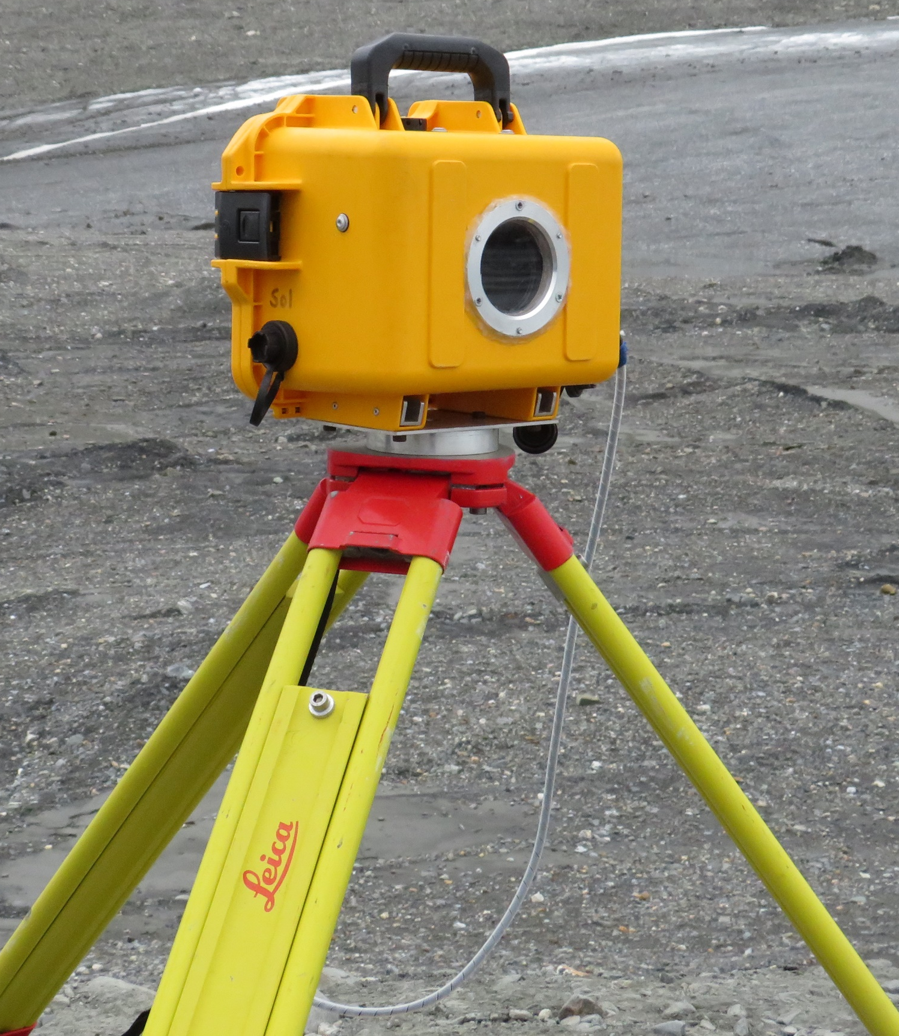
Field Measurements
TLS
AVTIS2 94 GHz Radar
3D Measurements
Terminus Position
Iceberg volumes
Glacier velocity
Time-lapse Camera
Calving time series
25/05/2022 EGU
@will_harcourt
www.williamharcourt.co.uk
Mass Balance
Fieldwork
Time Series
Melt Undercutting
Summary

Slide 4
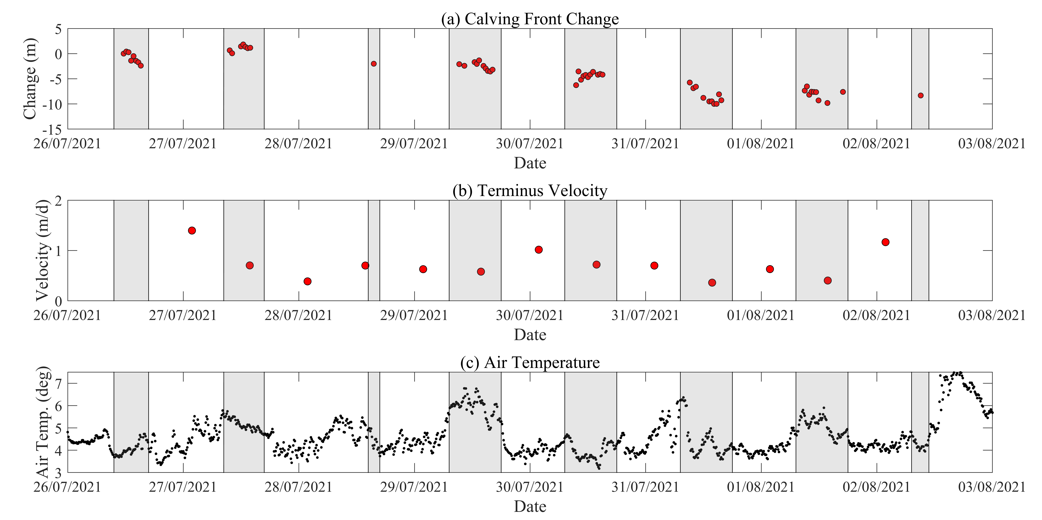

Time Series of Calving Front Change
$U_{c}=1.53$ m/d
25/05/2022 EGU
@will_harcourt
www.williamharcourt.co.uk
Mass Balance
Fieldwork
Time Series
Melt Undercutting
Summary

Slide 5
Time Series of Calving Front Change
Retreat
$U_{c}=1.53$ m/d
Stable
25/05/2022 EGU
@will_harcourt
www.williamharcourt.co.uk
Mass Balance
Fieldwork
Time Series
Melt Undercutting
Summary

Slide 6
Time Series of Calving Front Change
Retreat
$U_{c}=1.53$ m/d
Stable
25/05/2022 EGU
@will_harcourt
www.williamharcourt.co.uk
Mass Balance
Fieldwork
Time Series
Melt Undercutting
Summary

Slide 7
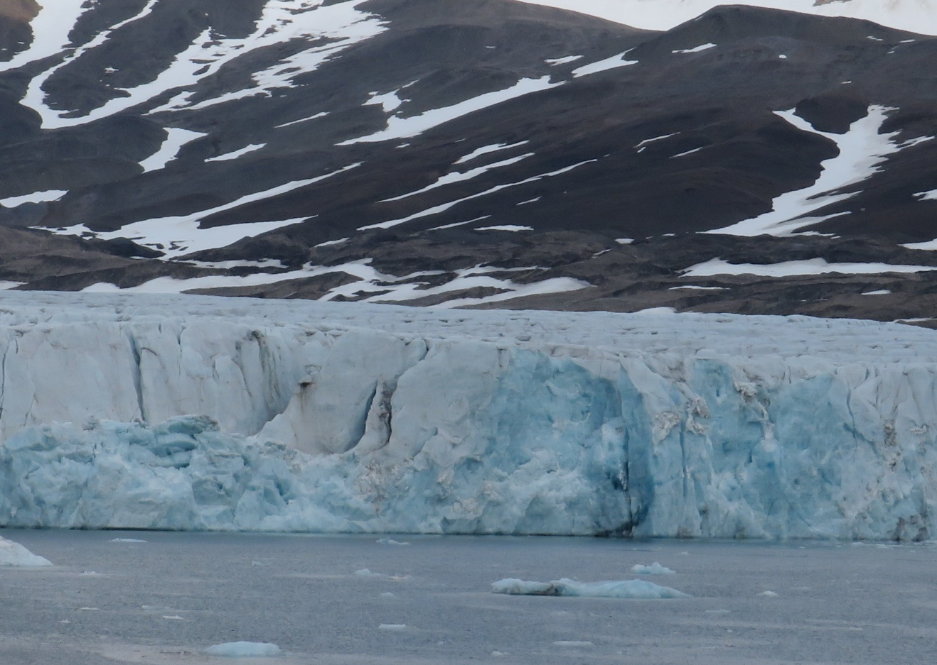
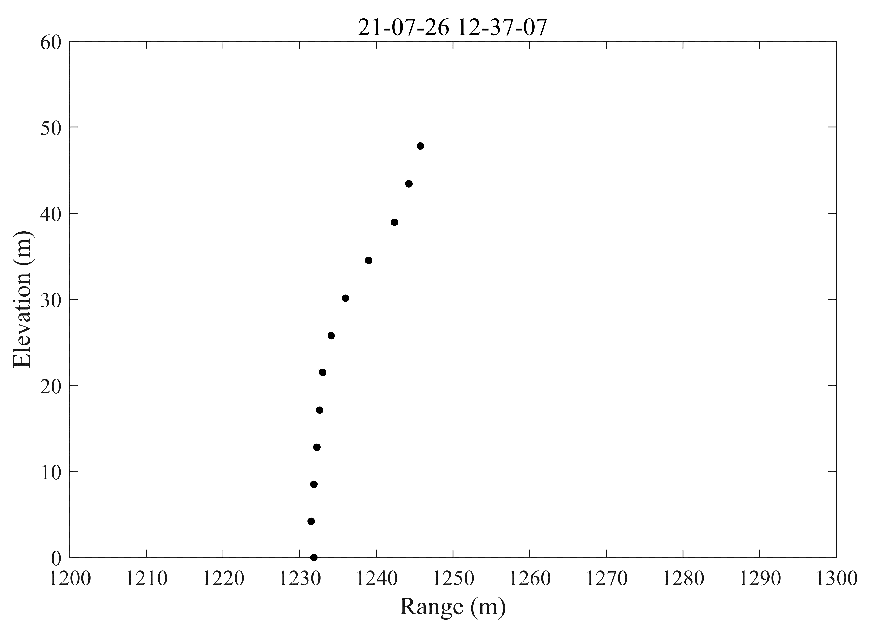
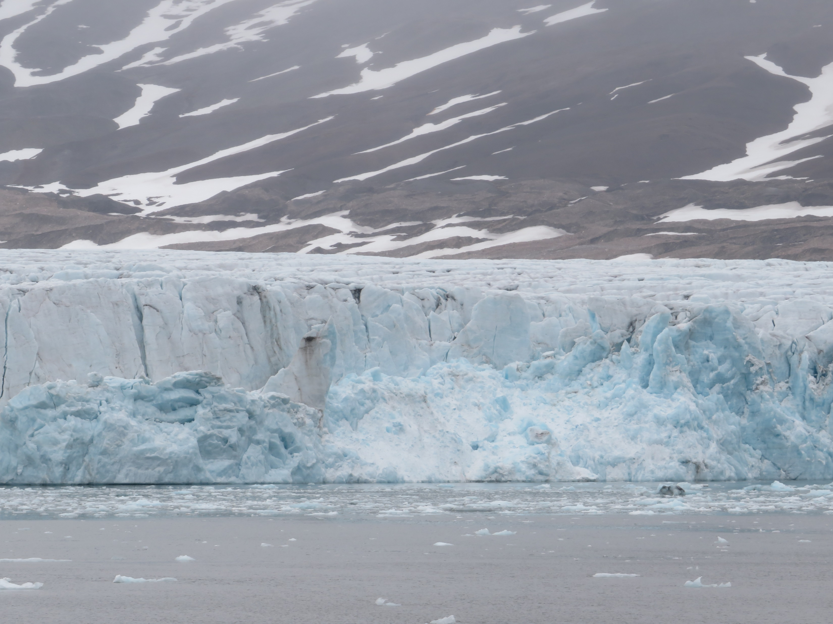
Calving Front Instabilities Caused by Melt Undercutting
Calving driving by melt undercutting
Advance
Retreat
Before
After
25/05/2022 EGU
@will_harcourt
www.williamharcourt.co.uk
Mass Balance
Fieldwork
Time Series
Melt Undercutting
Summary

Slide 8

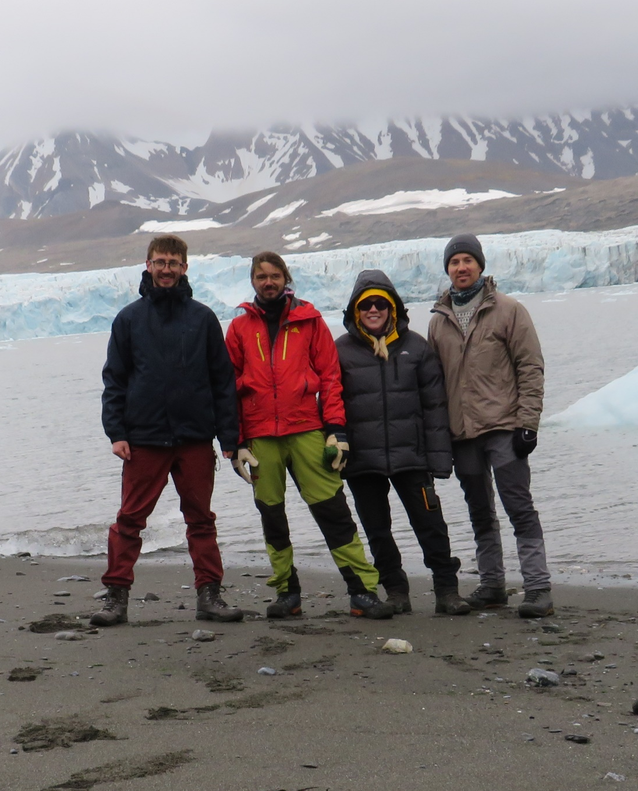

Summary
Demonstrated capabilities of 94 GHz for monitoring glacier calving fronts
High resolution estimates of glacier calving rates
Calving front instabilities driven by melting undercutting
Please contact me if you are interested to hear more!
@will_harcourt
www.williamharcourt.co.uk
wdh1@st-andrews.ac.uk
25/05/2022 EGU

