Slide 1


Dynamic effects of Tibetan Plateau on the sustained drought in southwest China
-PRESENTATION ON EGU22-
The Third Pole Environment under Global Changes
Yiwei Ye——yeyiwei21@mails.ucas.ac.cn
Rongxiang Tian——trx@zju.edu.cn
School of Earth Sciences, Zhejiang University, Hangzhou, China
2022.5.25

Slide 2
CONTENT
content
PART A
PART B
PART C
PART D
Introduction
Methods
Results
Discussion

Slide 3
A
Introduction
Drought in Southwest China
Tibetan Plateau

Slide 4
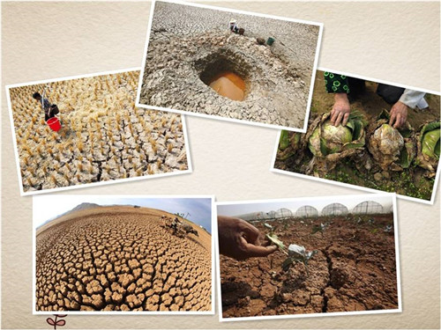
A Drought Event in Southwest China
2009-2014 continuous drought event in winter and spring in southwest China
long duration; wide range; severe damage

Slide 5
Previous Studies
Anticyclonic circulation anomalies over the tropical western Pacific; stronger southwest airflow on China's southeastern coast; southwest China was behind low trough with northwest airflow and downdraft (rong-hui huang, etc., 2012; Wang Xingju et al., 2012)
Negative anomaly of the Arctic Oscillation (AO), weakened the cold air arriving in southwest China (Huang Ronghui et al., 2012; Yang Hui et al., 2012; Hu Xueping et al., 2015; Zhou Li et al., 2018; Zhong Yaham, 2020)
An abnormal cyclone in the Northwest Pacific caused by the unconventional El Nino (Zhang et al.,2013)

Slide 6
B
Methods
EOF Analysis
Regression Analysis

Slide 7
Data
Dynamic field data of Tibetan Plateau——JRA-55
1.25°×1.25°
1960.1-2020.2
Precipitation data of southwest China——http://data.cma.cn
Weather stations

Slide 8
Methods
Empirical Orthogonal Function analysis (EOF)
Regression analysis

Slide 9
C
Results

Slide 10
1-Drought Event in Southwest China in 2009-2014
d
Fig.1 Percentage of Precipitation Anomaly in southwest China during Spring, Autumn and winter periods from 2009 to 2014(%).

Slide 11
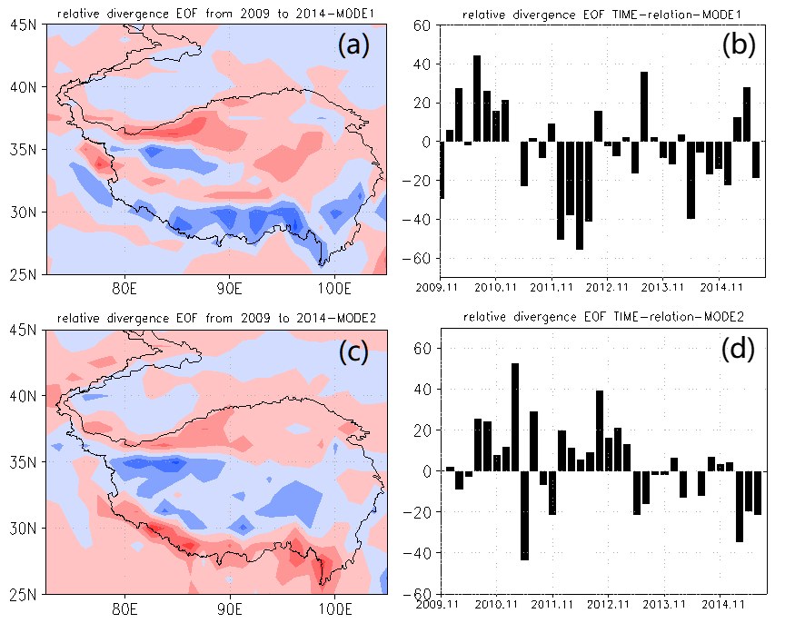
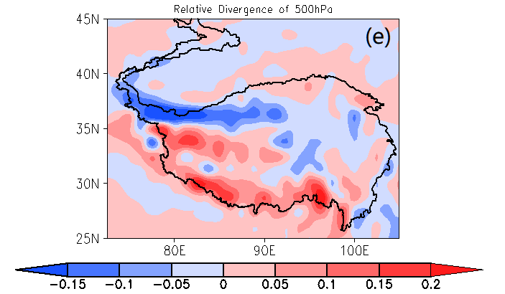
2-Dynamic anomaly on Tibetan Plateau in 2009-2014
Relative Divergence at 500hPa
18.06%
12.25%
Fig.2 EOF of the relative divergence anomaly field of the relative divergence at 500hPa over Tibetan Plateau from November to April from 2009 to 2013 and Mean field from 1960-2019 (10⁻⁴ s⁻¹).
Opposite to the Mean Field

Slide 12
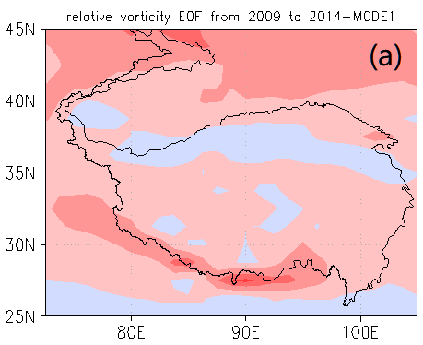
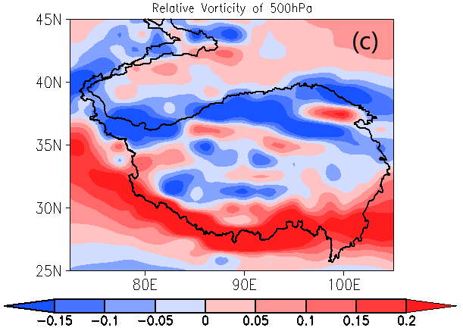
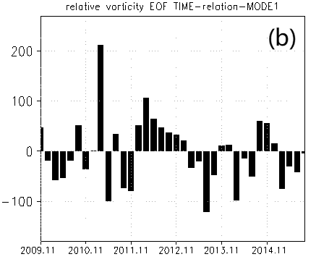
2-Dynamic anomaly on Tibetan Plateau in 2009-2014
19.68%
Relative Vorticity at 500hPa
Fig.3 EOF of the relative vorticity anomaly field of the relative vorticity at 500hPa over Tibetan Plateau from November to April from 2009 to 2013 and Mean field from 1960-2019 (10-4 s-1).
Opposite to the Mean Field

Slide 13
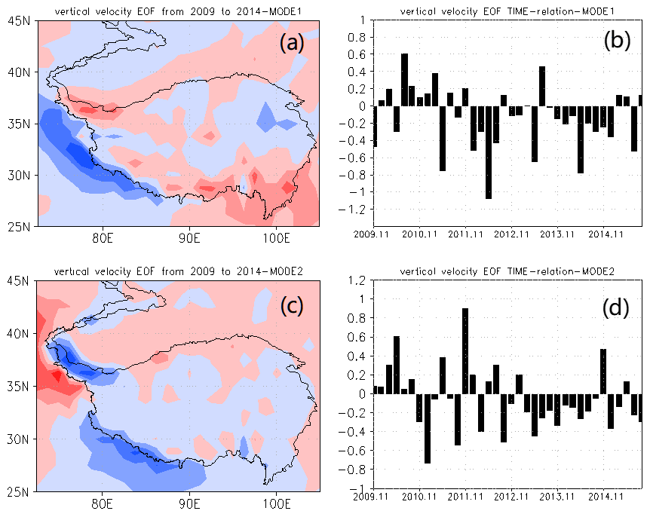
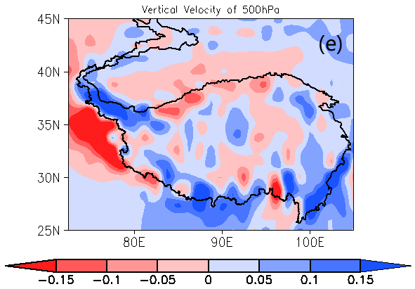
2-Dynamic anomaly on Tibetan Plateau in 2009-2014
Vertical Velocity at 500hPa
22.68%
17.58%
Fig.4 EOF of the vertical velocity anomaly field of the vertical velocity at 500hPa over Tibetan Plateau from November to April from 2009 to 2013 and Mean field from 1960-2019 (Pa/s).
Downdraft weakened

Slide 14
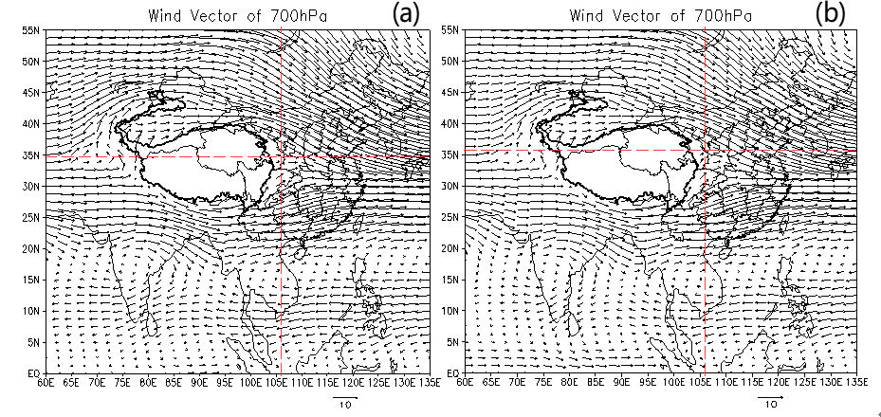
3-The flow of westerly wind and the intersection of cold and warm air
Wind Vectors at 700hPa
Fig.5 Mean wind field at 700hPa over east Asia (m/s). (a) Mean field from November to the next April during 1960-2019, (b) Mean field from November to the next April during 2009-2013. The red line refers to the boundary between south and north wind.
The intersection of north and south wind moved to north

Slide 15
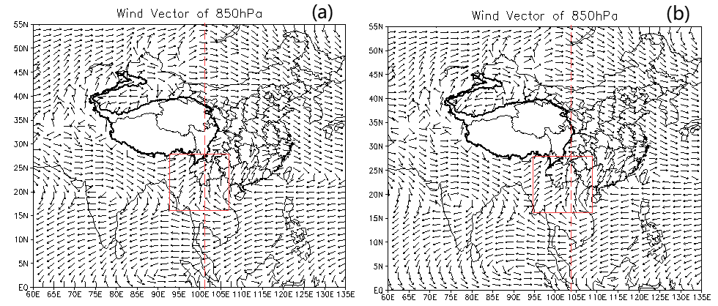
3-The flow of westerly wind and the intersection of cold and warm air
Wind Vectors at 850hPa
(a)
(b)
Fig.6 Mean wind field and wind speed anomaly at 850hPa over east Asia (m/s). (a) Mean field from November to the next April during 1960-2018, (b) Mean field from November to the next April during 2009-2013.
The intersection of west and east wind moved to east

Slide 16
3-The flow of westerly wind and the intersection of cold and warm air
Dew-point Depression Anomaly
Fig.7 Dew point depression anomaly over east Asia from 2009 to 2013 (K). (a) 700hPa, (b) 850hPa
The relative humidity was lower

Slide 17
D
Discussion

Slide 18
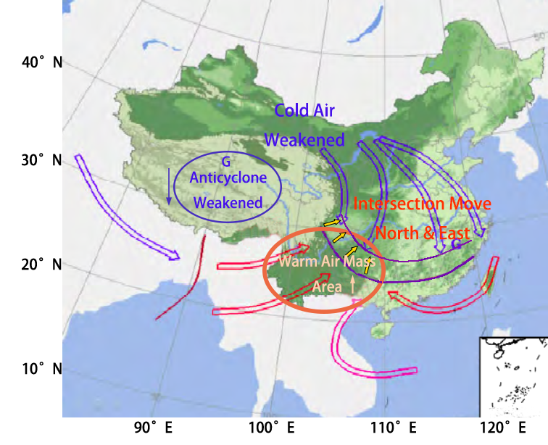
The possible mechanism of dynamic effects of Tibetan Plateau influencing the drought
Fig.8 Conceptual Model of dynamic effect influencing drought in southwest China

Slide 19
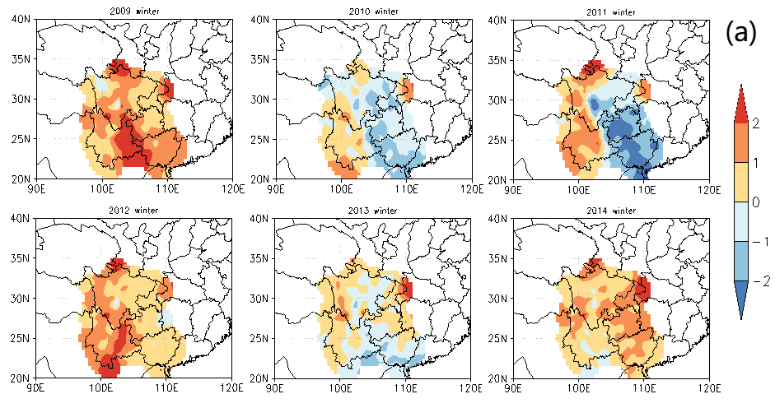
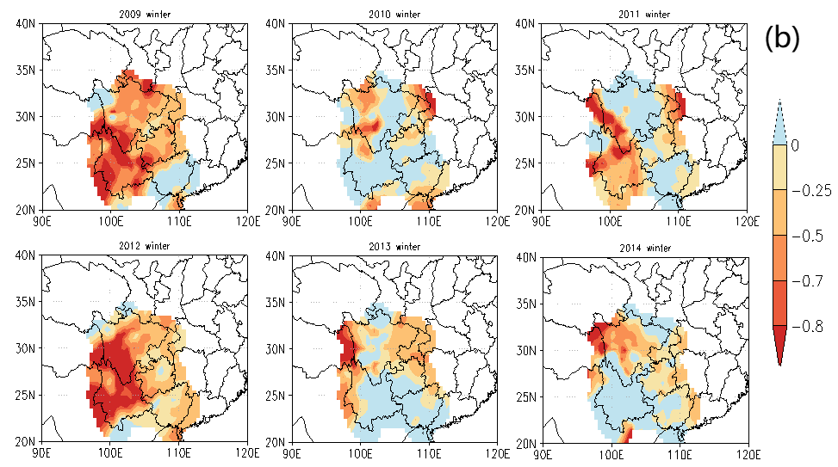
The possible mechanism of dynamic effects of Tibetan Plateau influencing the drought
Temperature Anomaly and Percentage of Precipitation Anomaly
Fig.10 Temperature anomaly and percentage of precipitation anomaly in southwest China in winter of 2009-2014. (a) Temperature anomaly (℃), (b) Percentage of precipitation anomaly.

Slide 20
Thanks!
-PRESENTATION ON EGU22-
2022.5.25

