Slide 1
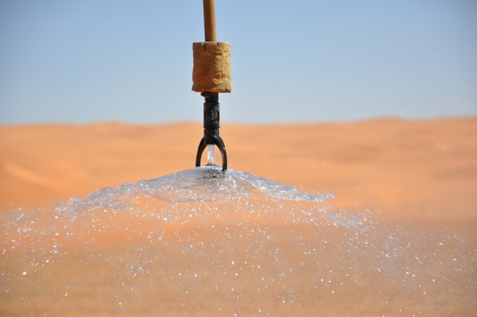


Evolvement of irrigation-induced impacts on near-surface climate under future scenarios
Yi Yao and Wim Thiery
Vrije Universiteit Brussel
23/05/2022, Brussels
Image from imaggeo.com

Slide 2
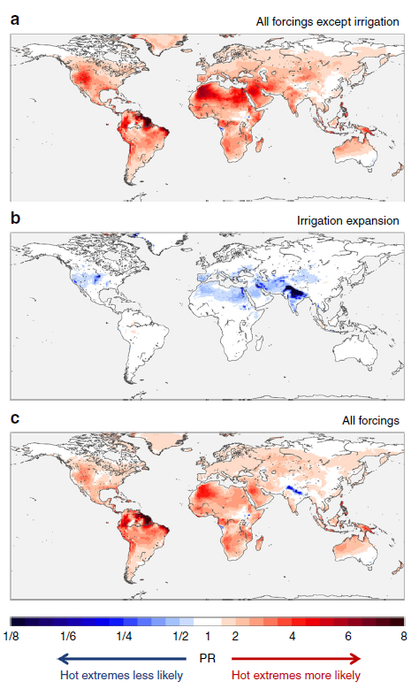
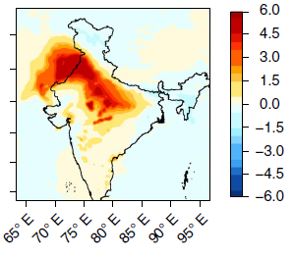
IRRIGATION-INDUCED IMPACTS
Irrigation-induced impacts on wet bulb temperature (Mishra et al., 2020)
Changes in the probability of hot extremes from expanding irrigation and other forcings (Thiery et al., 2020)
2

Slide 3
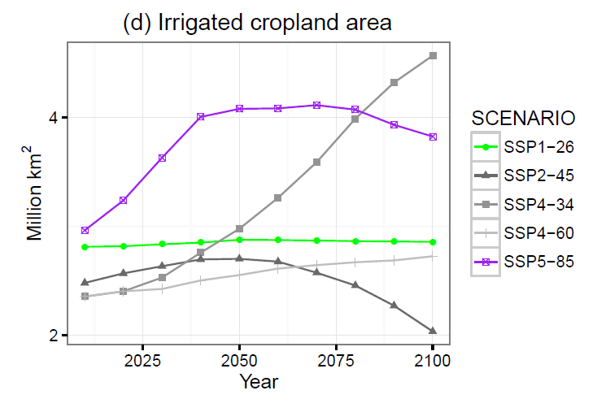
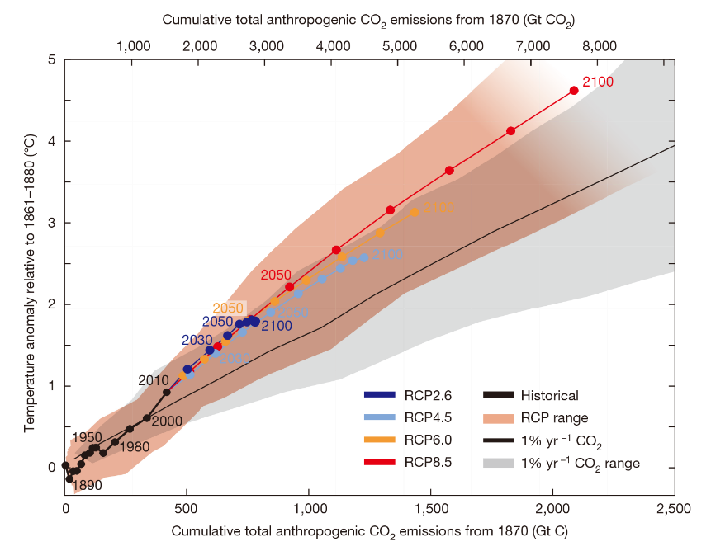
Future changes
Cumulative anthropogenic CO² emissions from 1870
(Seneviratne et al., 2016)
Projected irrigated cropland area (Lawrence et al., 2016)
3

Slide 4
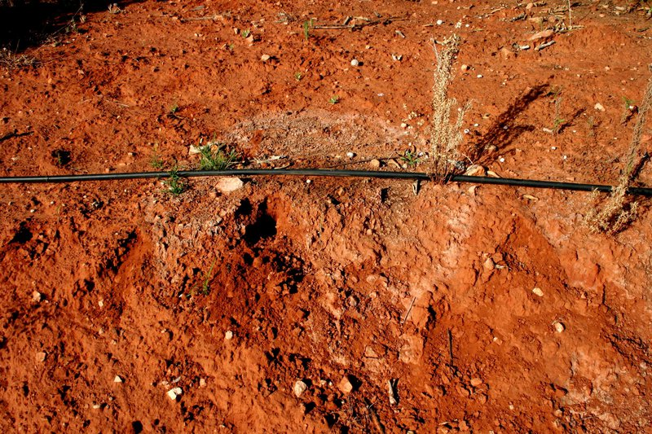
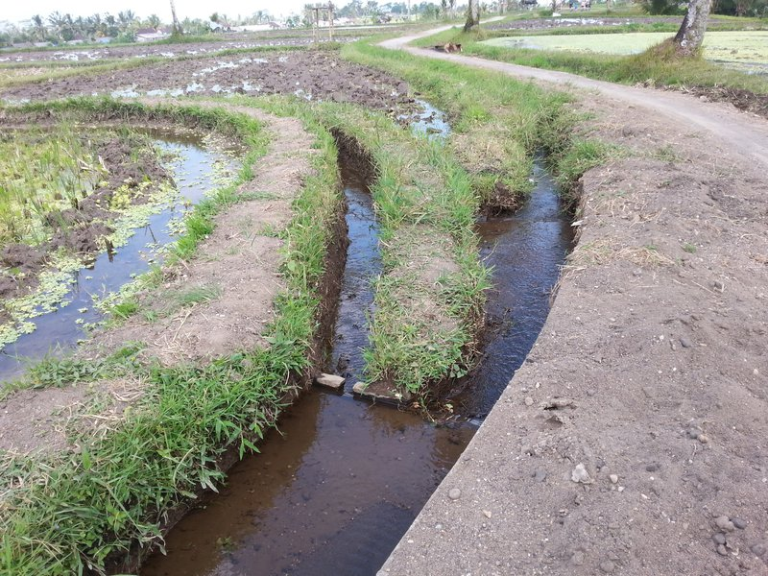
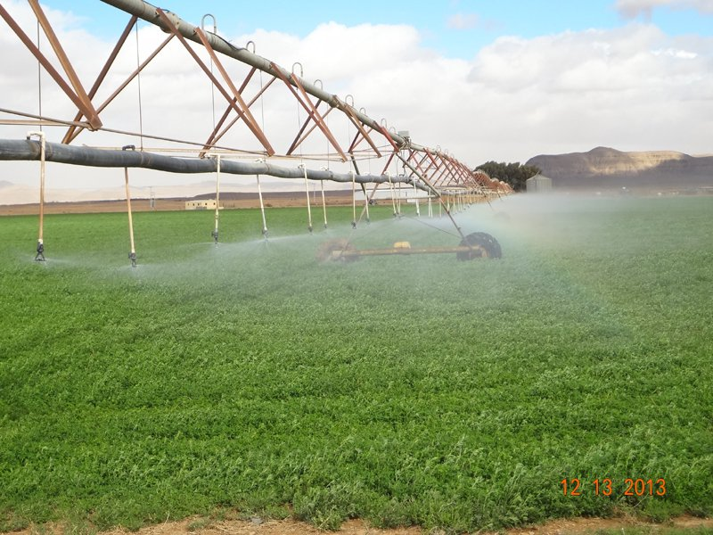
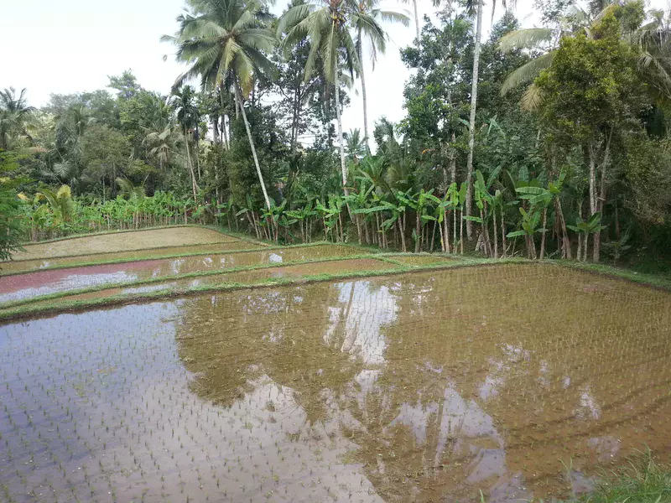
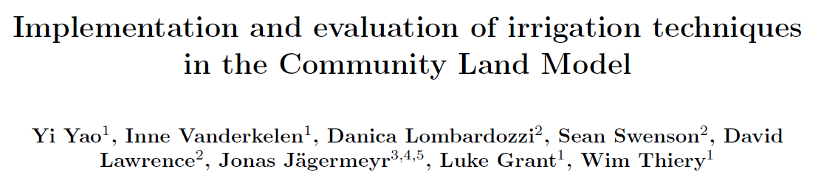
IRRIGATION techniques
Drip
Flood
Sprinkler
Paddy
4

Slide 5
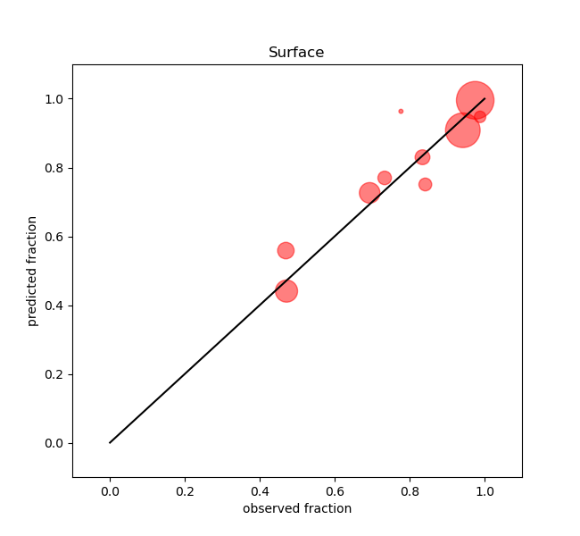
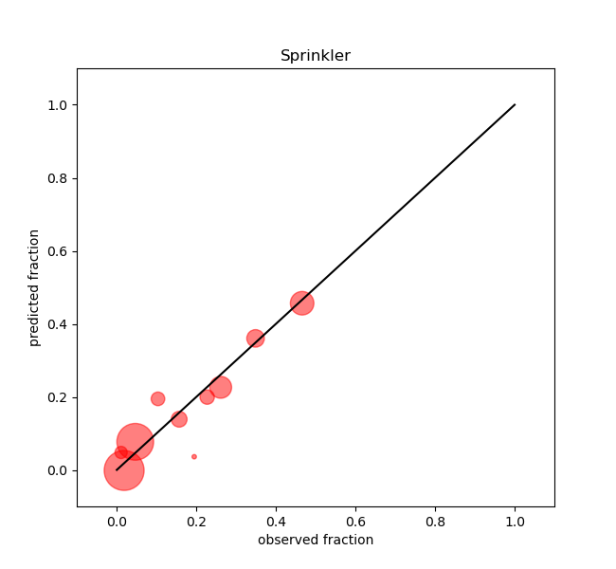
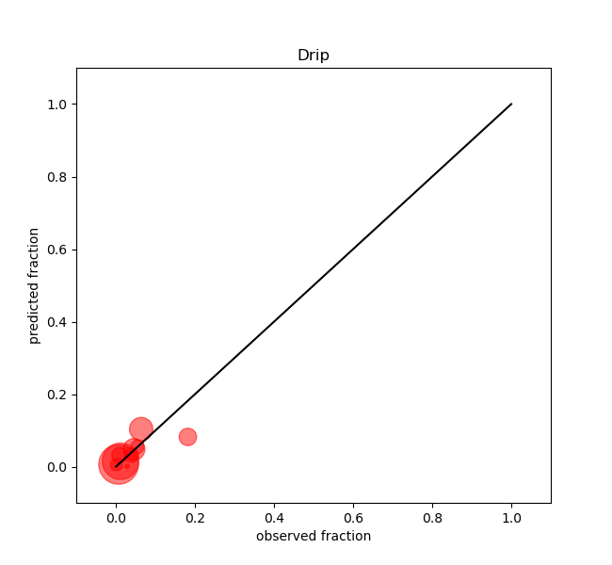
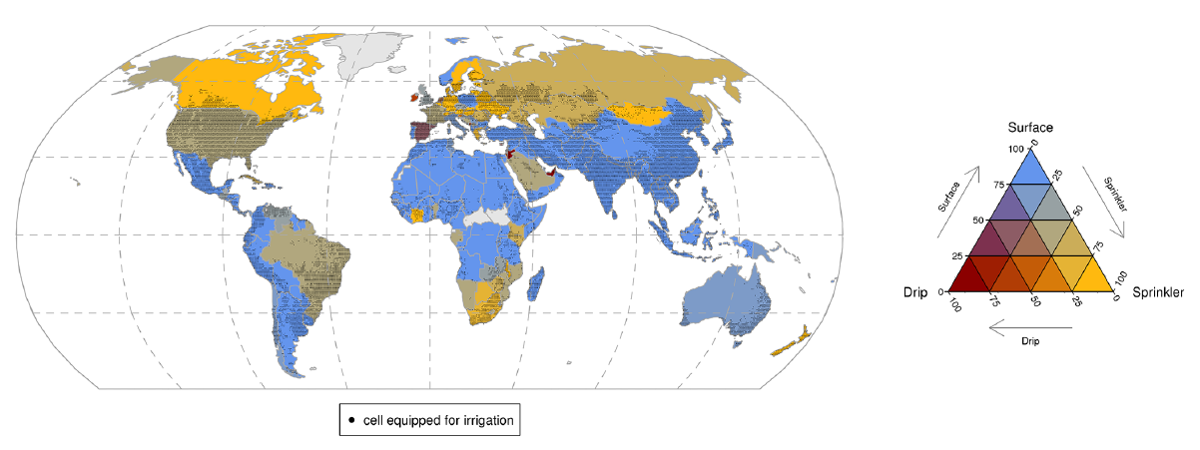
Irrigation techniques
Predicted irrigation fraction
Surface
Sprinkler
Drip
Observed irrigation fraction
Coefficients of regression
Fraction | GDP (dollars) | URB (%)
Surface irrigation | -0.94 * 10e-6 | -4.27 * 10e-5
Sprinkler irrigation | 7.49 * 10e-6 | 3.63 * 10e-5
Drip irrigation | 1.91 * 10e-6 | 0.65 * 10e-5
Country scale irrigation techniques distribution (Jägermeyr et al., 2015)
5

Slide 6
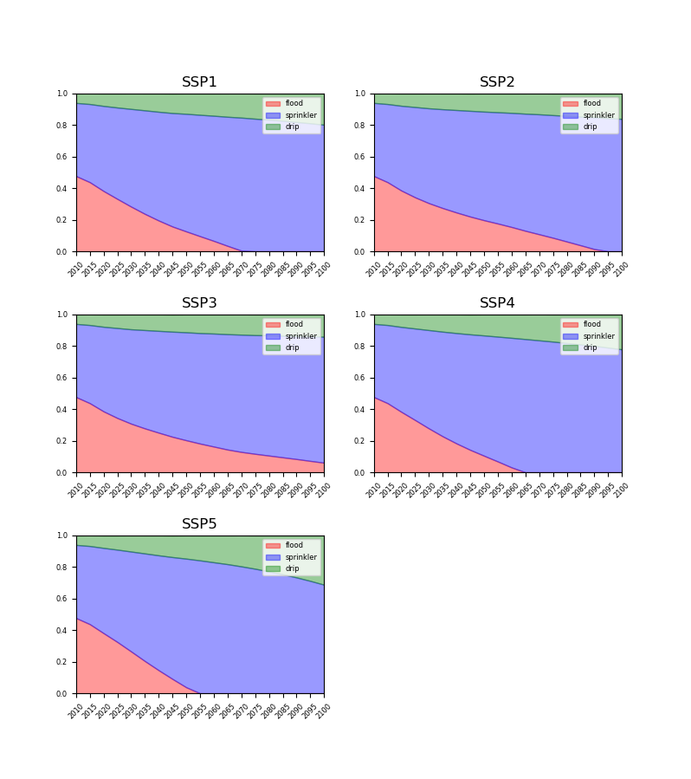
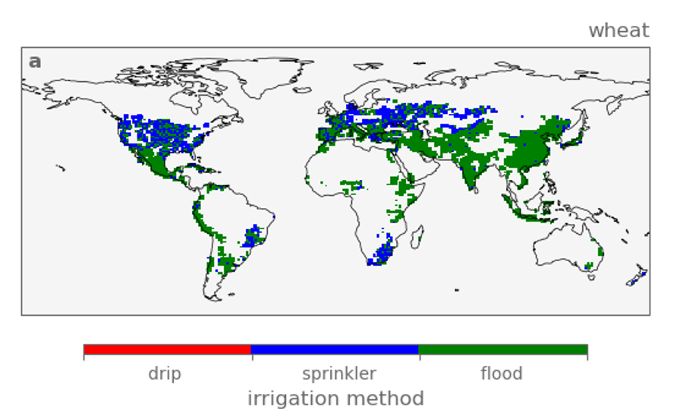
Create irrigation technique timeseries map
USA
Drip
Sprinkler
Flood
6

Slide 7
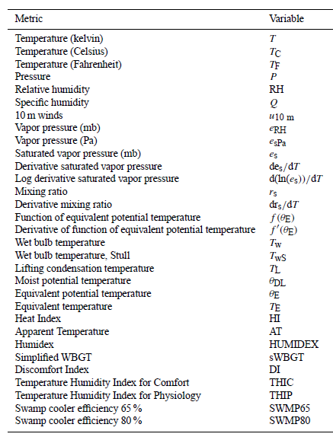
Simulations and analysis
Future SSP1-2.6
Transient land cover and irrigation techniques
Other forcings (Fossil Fuels) transient
Historical CTL present day land cover and irrigation techniques
Other forcings (Fossil Fuels) transient
Future SSP3-7.0
Transient land cover and irrigation techniques
Other forcings (Fossil Fuels) transient
Moist temperature variables and heat stress metrics
(Buzan et al., 2015)
7

Slide 8

Thanks!
Contact: yi.yao@vub.be
Twitter: @Yi_Yao_
Linkedin: Yi Yao
Image from imaggeo.com

Slide 9
reference
Thiery W, Davin EL, Lawrence DM, Hirsch AL, Hauser M, Seneviratne SI. Present-day irrigation mitigates heat extremes.
J Geophys Res Atmospheres. 2017;122(3):1403–22.
Thiery W, Visser AJ, Fischer EM, Hauser M, Hirsch AL, Lawrence DM, et al. Warming of hot extremes alleviated by expanding
irrigation. Nat Commun. 2020 Jan 15;11(1):290.
Lawrence DM, Hurtt GC, Arneth A, Brovkin V, Calvin KV, Jones AD, et al. The Land Use Model Intercomparison Project (LUMIP)
contribution to CMIP6: rationale and experimental design. Geosci Model Dev. 2016 Sep 2;9(9):2973–98.
Seneviratne SI, Donat MG, Pitman AJ, Knutti R, Wilby RL. Allowable CO2 emissions based on regional and impact-related climate
targets. Nature. 2016 Jan;529(7587):477–83.
Mishra V, Ambika AK, Asoka A, Aadhar S, Buzan J, Kumar R, et al. Moist heat stress extremes in India enhanced by irrigation.
Nat Geosci. 2020 Nov;13(11):722–8.
Jägermeyr J, Gerten D, Heinke J, Schaphoff S, Kummu M, Lucht W. Water savings potentials of irrigation systems: global simulation
of processes and linkages. Hydrol Earth Syst Sci. 2015 Jul 10;19(7):3073–91.
Buzan JR, Oleson K, Huber M. Implementation and comparison of a suite of heat stress metrics within the Community Land Model
version 4.5. Geosci Model Dev. 2015 Feb 5;8(2):151–70.

