Slide 1



How much can we simplify irrigation in an integrated modelling purpose? A case study in southern France
Myriam Soutif-Bellenger^{1,2}, Guillaume Thirel²,
Olivier Therond³, Jean Villerd³
¹AgroParisTech, 75005, Paris, France
²Université Paris Saclay, INRAE, UR HYCAR, Antony, France
³Université Lorraine, INRAE, LAE, F-68000, Colmar, France

Slide 2
PhD research issues
How to build local adaptation solutions to deal with climate change emergency?
1st issue: How to take into account irrigation demand in a parsimonious hydrological model? How much can we simplify irrigation in an integrated modelling purpose?
Objective: Temporally and spatially accurate estimation of irrigation with a parsimonious irrigation model

Slide 3
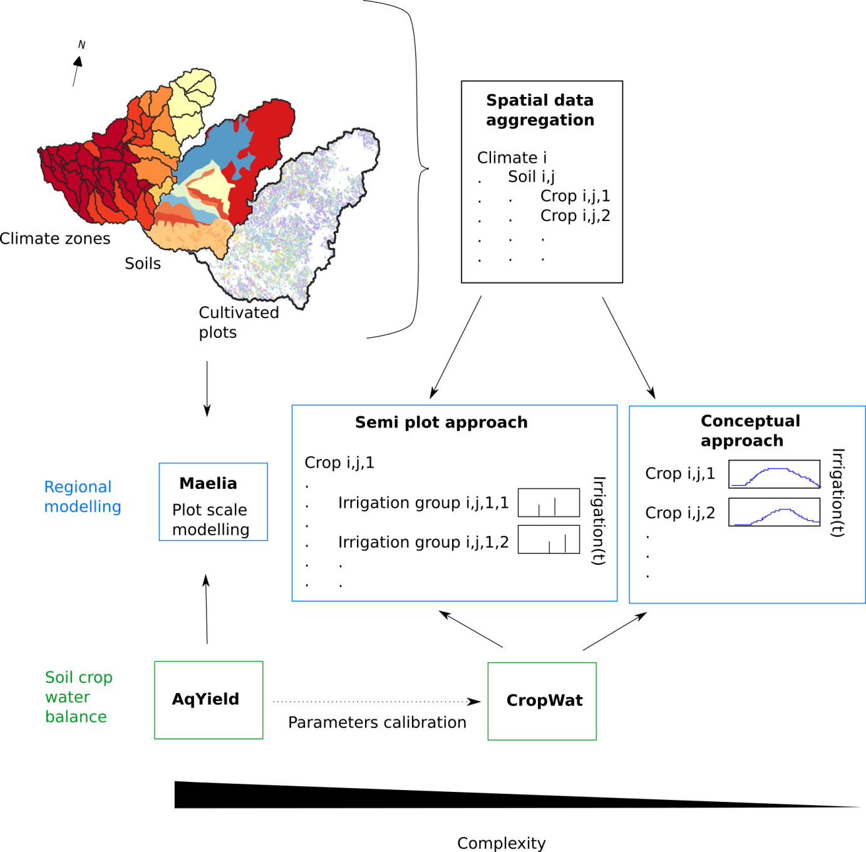
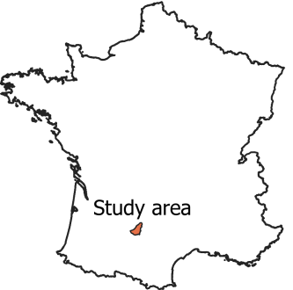
Irrigation water demand sensitivity analysis
Study area: downstream portion of Aveyron catchment
Comparison of three approaches
(Myriam Soutif-Bellenger et al., under review)

Slide 4
Irrigation water demand sensitivity analysis
Variance decomposition between different modelling hypotheses on indicators characterizing:
irrigation volumes
irrigation frequency
period of interannual mean highest irrigation
mean annual highest irrigation
irrigation daily variability
accuracy compared with reference irrigation simulation
crop water stress

Slide 5
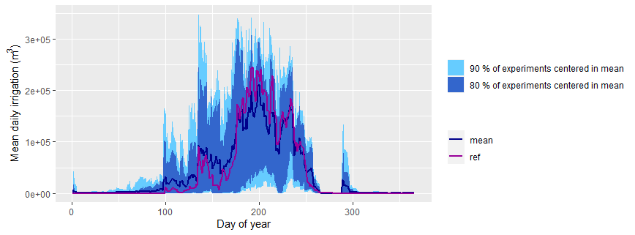
Irrigation water demand sensitivity analysis
Figure - Distribution of irrigation interannual regimes over all experiments
The simplified approaches are consistent with the Maelia reference
High range of variation: 136 out of the 352 simplified experiments obtained KGE > 0.7 (compared with MAELIA)
(Myriam Soutif-Bellenger et al., under review)

Slide 6
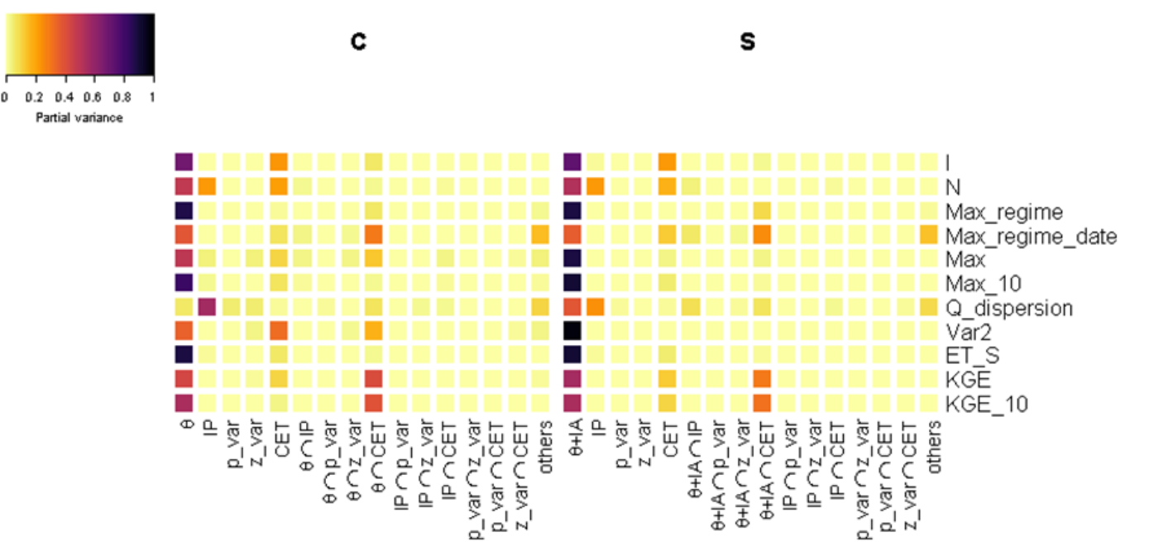
Irrigation water demand sensitivity analysis
Conceptual approach
Semi plot approach
Figure - Partial variance of different hypothesis for different indicators
High impact of irrigation modelling hypotheses θ (soil depletion threshold for irrigation) and IA (irrigation amount).
(Myriam Soutif-Bellenger et al., under review)

Slide 7
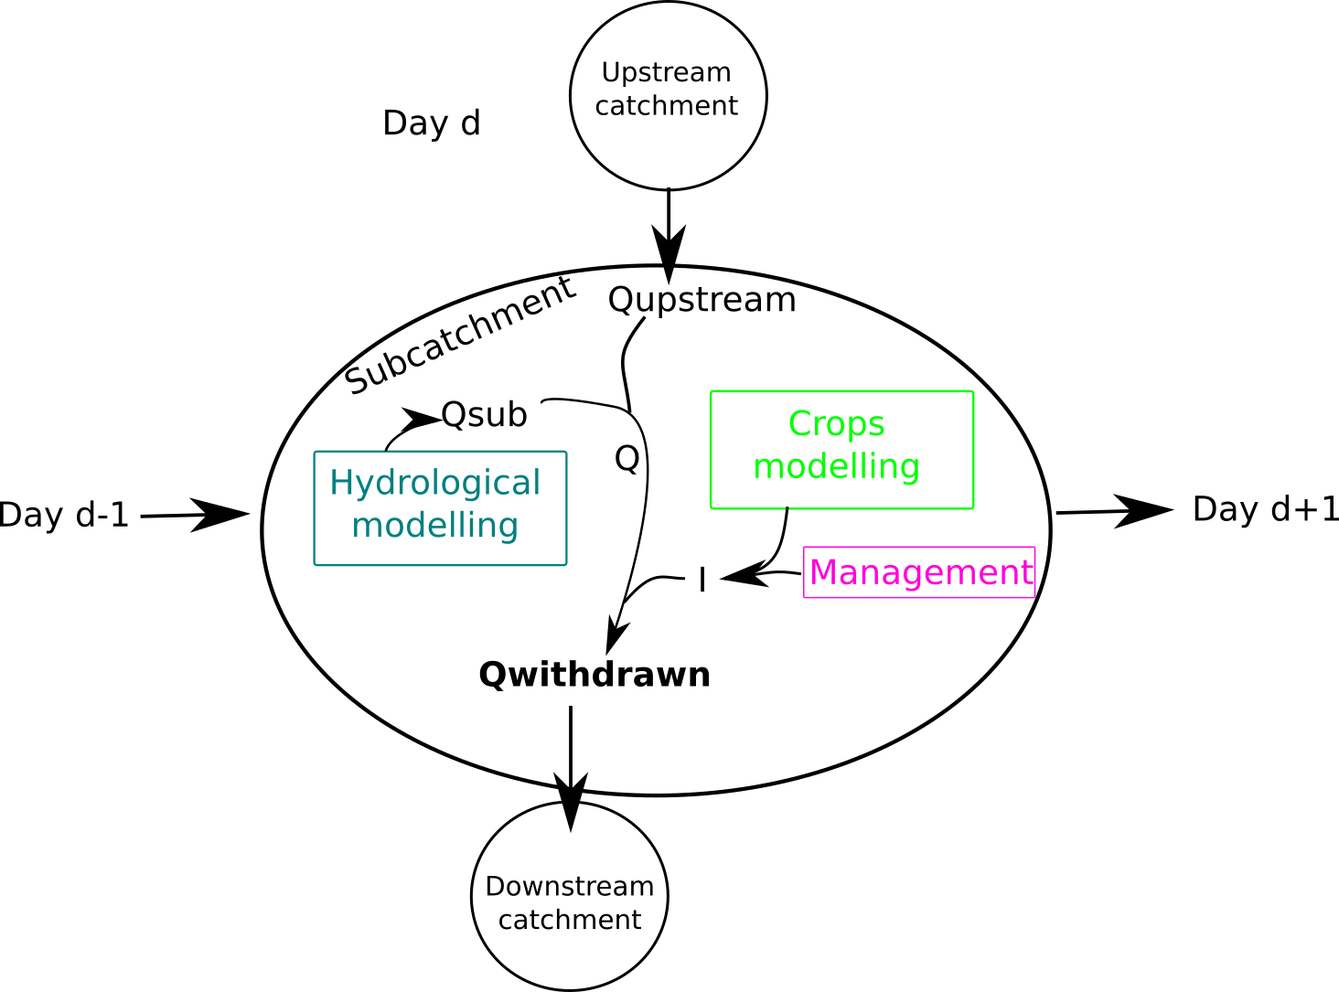
Conclusion: next steps
1
2
Use of airGRiwrm-crop in a participative foresight approach to build climate change adaptation strategies
Figure - Agro-hydrological integrated model : airGRiwrm-crop (in development)

Slide 8
Thank you for listening!
More information in the forthcoming article:
Soutif-Bellenger, M., Thirel, G., Therond, O., Villerd, J., As simple as possible but not simpler? The case of irrigation modeling at catchment scale in southwestern France, under review.
Any question?

