Slide 1
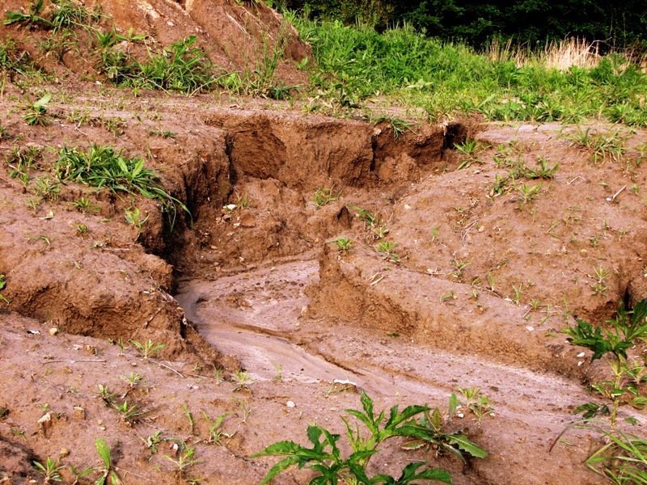



EGU General Assembly 2022
Spatial Variability of Rainfall Erosivity Over India
Ravi Raj
Research Scholar
HydroSense Lab
Civil Engineering Department
IIT Delhi, India - 110016

Slide 2
Outline
Introduction
Motivation
Materials and methodology
Results and Discussions
Conclusions
References
HydroSense Lab, IIT Delhi

Slide 3
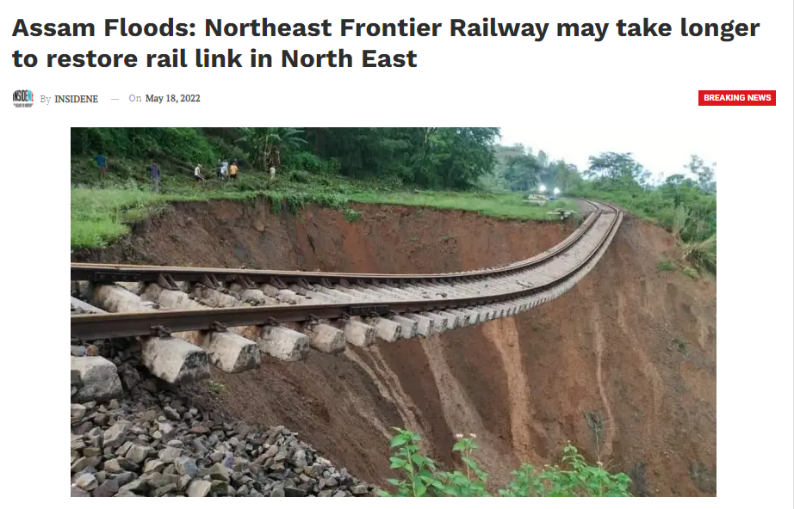
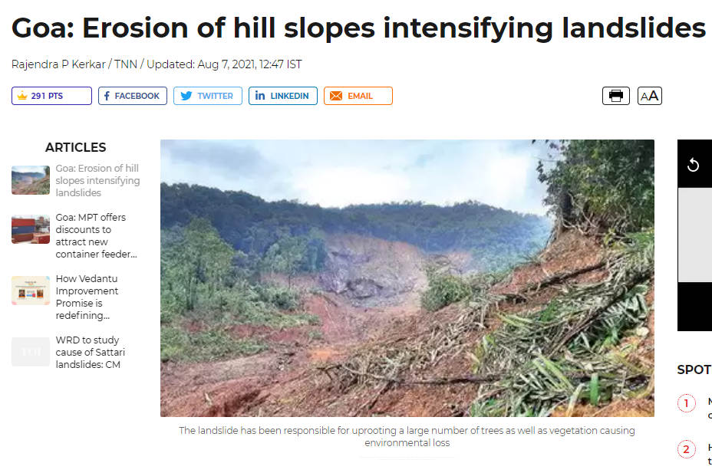
Introduction
Soil erosion is removal of the upper layer of soil (topsoil) by different agents – particularly water, wind, and mass movement – causing its deterioration in the long term.
Soil erosion is a significant environmental problem, in agricultural productivity, soil fertility, landslides, and water resources (Kazamias and Sapountzis, 2017; Rahman et al., 2009).
Excessive variation in LULC configuration, infrastructural development and unplanned land utilization for increasing population exposed it to erosion induced by water (Gomiero, 2016, Razali et al., 2018).
Monitoring and estimating soil erosion at the site are very tedious, costly, and restricted to small experimental in situ setups.
Figure 1. Impact of Soil erosion
HydroSense Lab, IIT Delhi

Slide 4
Introduction
India is worst affected by soil erosion, especially due to erosion induced by rainfall.
A factor of Universal Soil Loss Equation (rainfall erosivity factor) needs to be estimated throughout the country to assess the soil erosion in the country.
Indian climate is dominated by monsoons, and their intensity and distribution vary significantly throughout the country.
Rainfall erosivity is solely derived from the rainfall intensity, which is a function of climatic properties.
In this study, the distribution and variability of the rainfall erosivity factor (R factor) had been analyzed in different regions and sub-divisions of India as classified by India Meteorological Department (IMD).
HydroSense Lab, IIT Delhi

Slide 5
Motivation
Soil erosion is one of the leading environmental problems in India, and rainfall erosivity which leads to the erosion induced by water is affecting major portion of the total eroded soil.
Soil erosion affects the farmers mostly where it erodes the topmost fertile layer of the soil.
We could not find any national study or map of rainfall erosivity.
National scale rainfall erosivity map will be helpful for policy makers and experts in soil management sector to prioritize the watershed management programs in the identified most vulnerable regions.
HydroSense Lab, IIT Delhi

Slide 6
Materials and Methodology
IMDAA (Indian Monsoon Data Assimilation and Analysis) (Indirarani et al., 2021) hourly rainfall data having 12 km spatial and 1 hour temporal resolution for 40 years (1979-2018) was processed to map rainfall erosivity over India.
Rainfall erosivity was estimated using the concept that the product of total kinetic energy of a storm to its hourly maximum rainfall intensity (KE x I60) is expressed as rainfall erosivity (R-factor).
Well known precipitation index MFI (Modified Fourier Index) was also calculated in this research.
Relationships between R-factor and MFI over major regions defined by IMD (India Meteorological Division) were also proposed in Indian condition.
HydroSense Lab, IIT Delhi

Slide 7
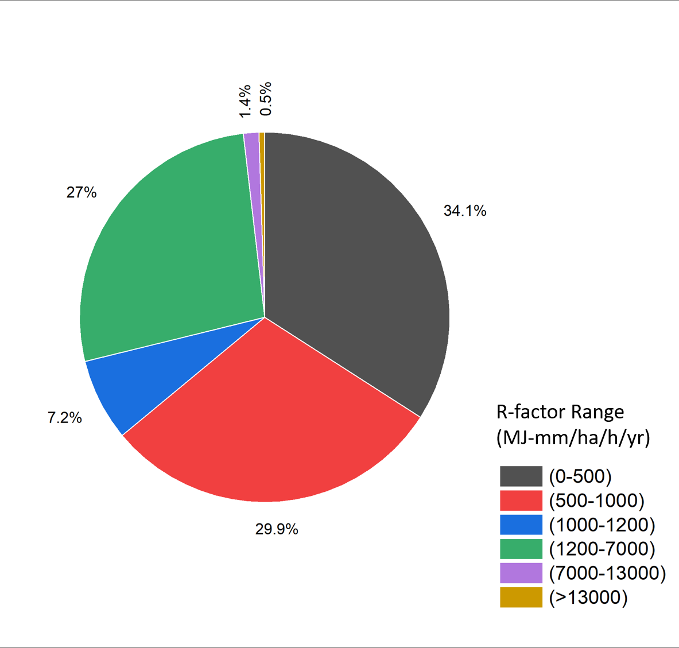
Results and Discussions
The average R-factor value estimated for India is 1200 MJ-mm/ha/h/yr, while maximum rainfall erosivity value 23909.21 MJ-mm/ha/h/yr was spotted in the Laitknsew and Cherrapunji region of East Khasi Hills in Meghalaya state, and minimum value of 8.10 MJ-mm/ha/h/yr in the Shahi Kangri mountain region of Ladakh area.
About 71.2% of the total point values taken into analysis are less than average value of R-factor (1200 MJ-mm/ha/h/yr).
Around 34.1% of total point samples had values less than 500 MJ-mm/ha/h/yr and 64% samples had values less than 1000 MJ-mm/ha/h/yr.
Only 1.95% R-values estimated were greater than 7000 MJ-mm/ha/h/yr and 0.5% values greater than 13000 MJ-mm/ha/h/yr.
Figure2. A pie-chart showing the distribution of total point stations taken, grouped with the cumulative percentage of R-factor values
HydroSense Lab, IIT Delhi

Slide 8
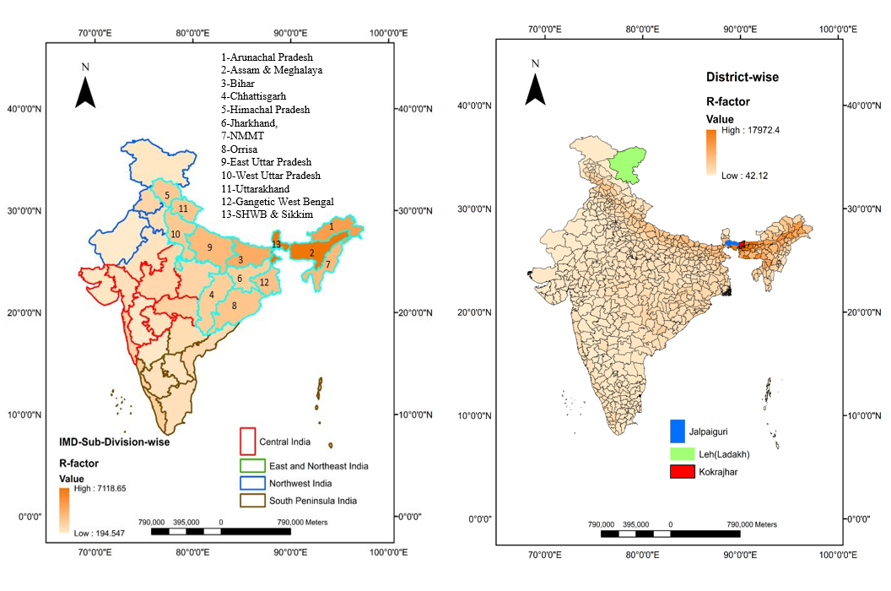
Results and Discussions
Assam & Meghalaya sub-division has the highest average R-factor value (7643.09 MJ-mm/ha/h/yr) while Jammu and Kashmir have the lowest (318 MJ-mm/ha/h/yr).
Out of 36 sub-divisions defined by IMD only 13 have average R-factor values greater than national average rainfall erosivity value (1200 MJ-mm/ha/h/yr).
Kokrajhar district of Assam & Meghalaya sub-division is more vulnerable having 17972.38 MJ-mm/ha/h/yr average R-factor value while Leh (Ladakh) district is least vulnerable with lowest (42.12 MJ-mm/ha/h/yr) rainfall erosivity factor.
A total of 265 districts have average R-factor values greater than the national average rainfall erosivity factor.
Figure 3. Spatial distribution of average R-factor values in IMD subdivisions as well as districts of India respectively.
HydroSense Lab, IIT Delhi

Slide 9
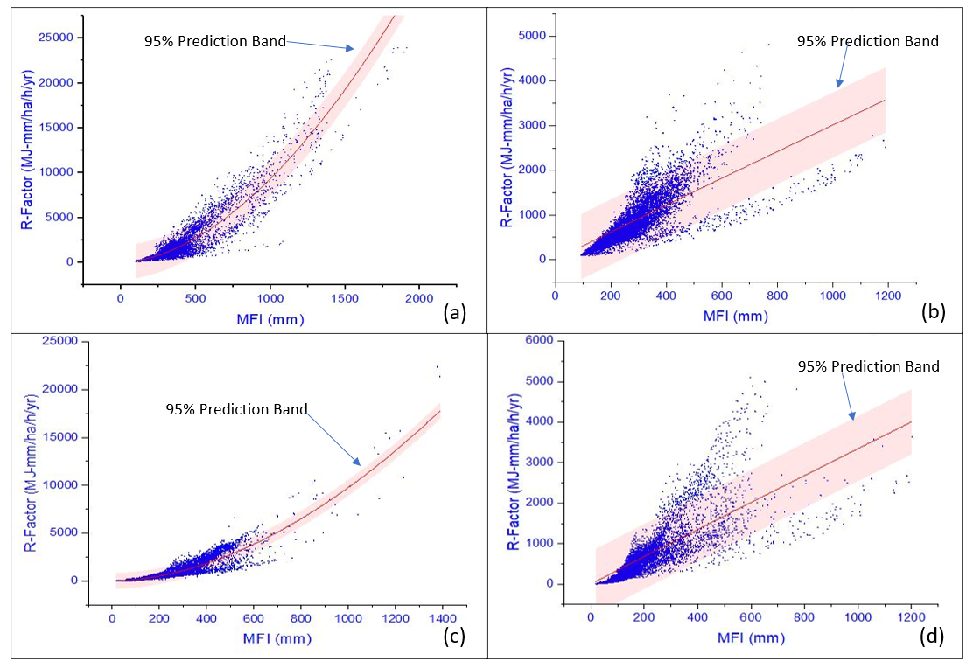
Results and Discussions
Considering variation in climate conditions of the nation, four equations were suggested to estimate rainfall erosivity factor with the help of MFI for each regions defined by IMD (Central, East and North-east, North-west, and Peninsula India) in the form of a simple power-law formula (R=α MFI^β)
Sr No | IMD Regions | α | β | r2 | Error in α | Error in β
1 | Central India | 3.371 | 0.984 | 0.56 | 0.0761 | 0.004
2 | East and Northeast India | 0.041 | 1.785 | 0.89 | 7.80 e^-04 | 0.003
3 | Northwest India | 0.033 | 1.826 | 0.81 | 8.19 e^-04 | 0.004
4 | South Peninsula India | 3.618 | 0.989 | 0.62 | 0.0738 | 0.003
Figure 4. Relation between R-factors (MJ-mm/ha/h/yr) and Modified Fournier Index (MFI) based on IMDAA hourly data for 1979-2019 for East & Northeast, Central, Northwest, and South Peninsula regions defined by IMD (n=171484)
HydroSense Lab, IIT Delhi

Slide 10
Conclusions
The average R-factor value estimated for India is 1200 MJ-mm/ha/h/yr, while maximum value spotted was 23909.21 MJ-mm/ha/h/yr in the Laitknsew and Cherrapunji region of East Khasi Hills in Meghalaya state and minimum value in the Shahi Kangri mountain region of Ladakh area as 8.10 MJ-mm/ha/h/yr.
Kokrajhar district of Assam & Meghalaya sub-division is more vulnerable to rainfall erosivity having 17972.38 MJ-mm/ha/h/yr average R-factor value while Leh (Ladakh) district is least vulnerable with lowest (42.12 MJ-mm/ha/h/yr) rainfall erosivity factor.
About 71.2% of the total point values taken into analysis are less than average value of R-factor (1200 MJ-mm/ha/h/yr).
Four power law equations (R=α*MFI^β) were also recommended to estimate rainfall erosivity with the help of MFI in the absence of high-resolution precipitation datasets as an alternative method to estimate rainfall erosivity for each region identified by IMD.
This is the first national-scale assessment of rainfall erosivity over India using gridded precipitation, which will be helpful for experts in soil conservational sector to apply this rainfall erosivity map of the country as an additional database for incorporating safety measures to minimize soil erosion.
HydroSense Lab, IIT Delhi

Slide 11
References
Gomiero, T., 2016. Soil degradation, land scarcity and food security: Reviewing a complex challenge. Sustainability 8, 281
Indirarani, S., Arulalan, T., George, J.P., Rajagopal, E.N., Renshaw, R., Maycock, A., Barker, D.M., Rajeevan, M., 2021. IMDAA: High-resolution satellite-era reanalysis for the indian monsoon region. J. Clim. 34, 5109–5133. https://doi.org/10.1175/JCLI-D-20-0412.1
Kazamias, A.P., Sapountzis, M., 2017. Spatial and temporal assessment of potential soil erosion over Greece 315–321.
Rahman, R., Shi, Z.H., Chongfa, C., 2009. Soil erosion hazard evaluation-An integrated use of remote sensing , GIS and statistical approaches with biophysical parameters towards management strategies Author ’ s personal copy Soil erosion hazard evaluation — An integrated use of remote sensing , G. https://doi.org/10.1016/j.ecolmodel.2009.04.004
Razali, A., Ismail, S.N.S., Awang, S., Praveena, S.M., Abidin, E.Z., 2018. Land use change in highland area and its impact on river water quality: a review of case studies in Malaysia. Ecol. Process. 7, 1–17.
HydroSense Lab, IIT Delhi

Slide 12

This study is a part of the Journal article published in CATENA.
Ravi Raj, Manabendra Saharia, Sumedha Chakma, Arezoo Rafieinasab, “Mapping rainfall erosivity over India using multiple precipitation datasets,” CATENA, Volume 214, 2022, 106256, ISSN 0341-8162, https://doi.org/10.1016/j.catena.2022.106256
Indian Rainfall Erosivity Dataset (IRED) is released on Zenodo: https://zenodo.org/record/6470233#.Yl61qOhBxPY
Contact
Ravi Raj
Research Scholar
HydroSense Lab
Department of Civil Engineering
Indian Institute of Technology Delhi
Email: Ravi.Raj@civil.iitd.ac.in
Please visit us: https://hydrosense.iitd.ac.in/

Slide 13
Thank You!
HydroSense Lab, IIT Delhi

