Slide 1


Contribution of the analysis of borehole, gravity and VES data in the study of the geological structures of the Bahira basin (Morocco)
EGU General Assembly 2022 from 23 to 27 May 2022 in Vienna, Austria (HYBRID)
Charbaoui A.⁽*¹⁾, Jaffal M.^{(1,2)}, Kchikach A.^{(1,2)}, Eljabbar B.⁽¹⁾, Bodinier J., L.^{(1,3)}, Rochdane S. ⁽¹⁾, Khadiri O. ⁽⁴⁾, Jourani E ⁽⁴⁾.
(1) Mohammed VI Polytechnic University, Geology and Sustainable Mining (GSM), Benguerir, Morocco
(2) Cadi Ayyad University, Georessources, Geoenvironment & Civil Engineering Laboratory, Marrakech, Morocco
(3) University of Montpellier & CNRS, Geosciences Montpellier, Montpellier, France.
(4) OCP Group, Casablanca, Morocco
*Email: anas.charbaoui@um6p.ma

Slide 2

Introduction
Subsurface geophysical imaging is an efficient tool for the recognition of sedimentary basins at different scales.
The integration of subsurface and surface geological information has clear implifications for geological modeling and resource exploration.
The High-resolution seismic (HRS) method is one of the most commonly used techniques for imaging the subsurface (Ahokangas et al., 2020).
This work is concerned with the study of the Bahira basin which hosts some of the most important phosphate deposits of Morocco.
It is concerned with the compilation of geophysical and geological information about the Bahira basin through the analysis of the available data to have a good knowledge of the geology of this basin.
The General Assembly of the European Geosciences Union 2022 (EGU22’ )- https://egu22.eu/

Slide 3
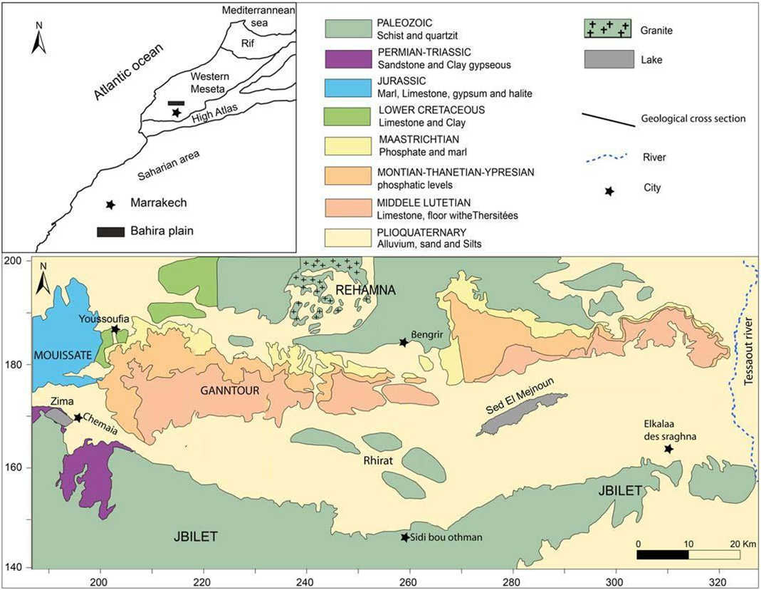
Geographical situation
The Bahira plain is located in central Morocco. It extends over an area of about 5000 km² between 31°55’ and 32°20’ N Latitudes and between 7°15’ and 8°50’ W Longitudes (Fig. 1).
Figure 1. Location and geological map of the Bahira basin.
The General Assembly of the European Geosciences Union 2022 (EGU22’ )- https://egu22.eu/

Slide 4
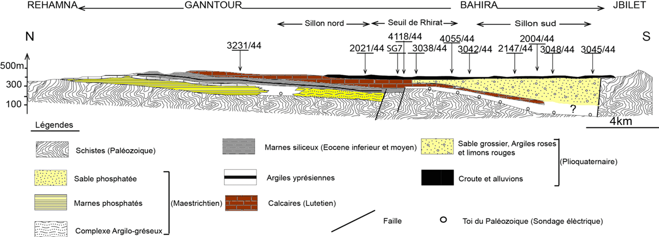
Geological setting
The Bahira plain is part of the Western Meseta structural domain of Morocco. It constitues a sedimentary cover made of Secondary to Quaternary deposits laying on a Paleozoic bedrock (Michard, 1976) (Fig. 2).
Figure 2. Geological cross-section of the Bahira basin.
The General Assembly of the European Geosciences Union 2022 (EGU22’ )- https://egu22.eu/

Slide 5
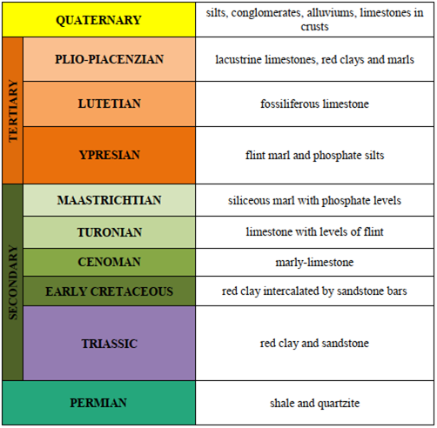
Lithostratigraphy
The lithostratigraphic series if the Bahira basin presents a progressive transition from the Paleozoic to the Quaternary (Fig. 3).
Figure 3. Stratigraphic log of the Bahira basin.
The General Assembly of the European Geosciences Union 2022 (EGU22’ )- https://egu22.eu/

Slide 6
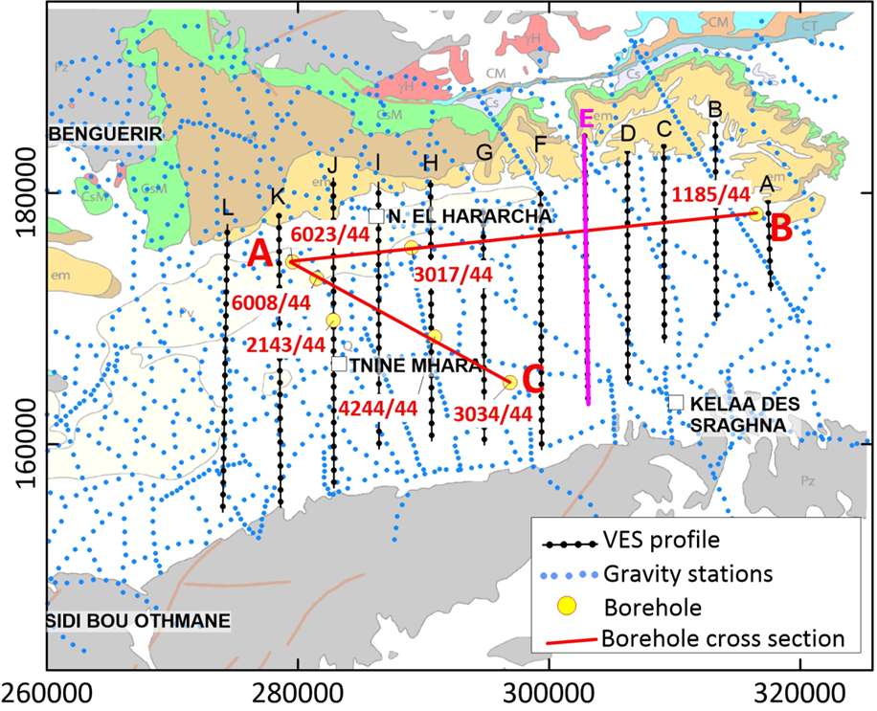
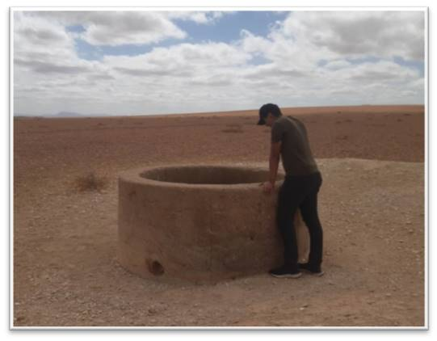
Methodology
Borehole data (Fig. 4)
Geophysical data (Fig. 4)
The regional gravity and vertical electrical sounding (VES).
Figure 4. Location of the geophysical surveys and the boreholes correlation profiles of the Eastern Bahira basin.

Slide 7
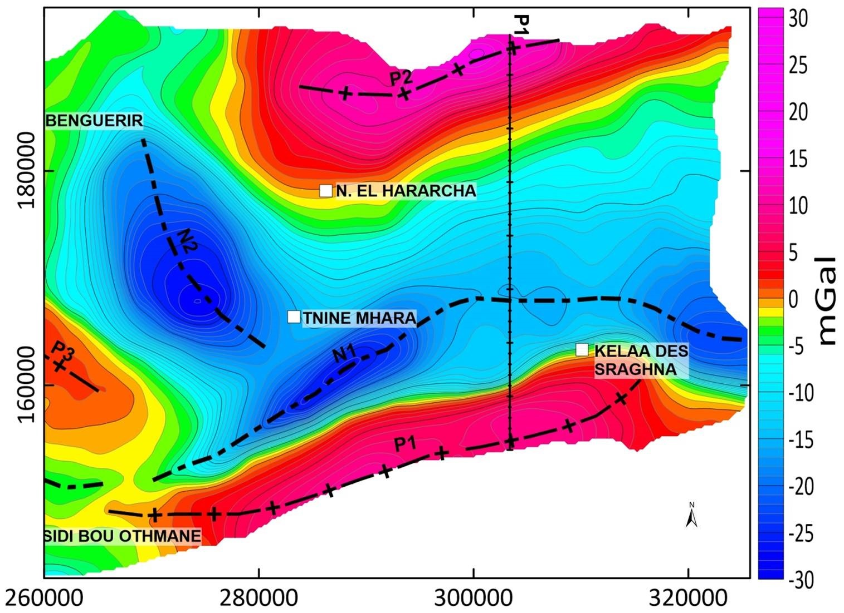
Results and discussion
Figure 5. Gravity map of the Bahira basin: Residual anomaly (interval of 5 mGal).
The General Assembly of the European Geosciences Union 2022 (EGU22’ )- https://egu22.eu/

Slide 8
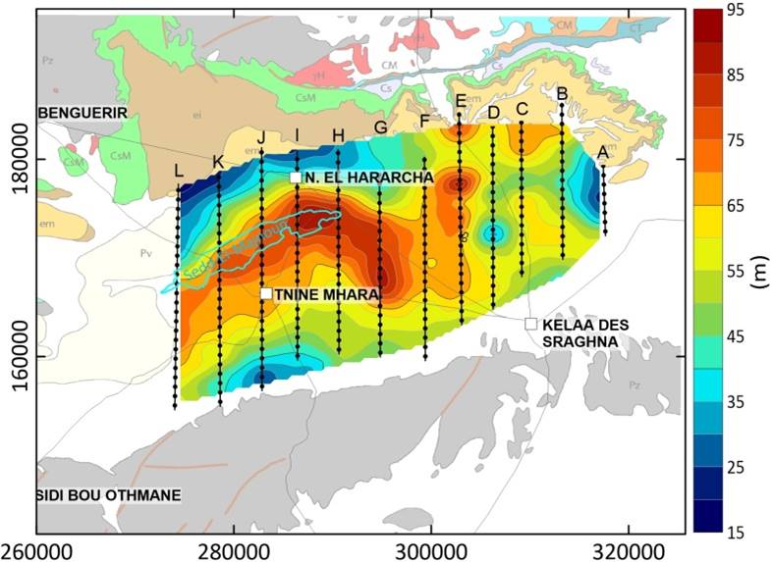
Results and discussion
Figure 6. Electrical map of the Bahira basin showing the Eocene thickness.

Slide 9
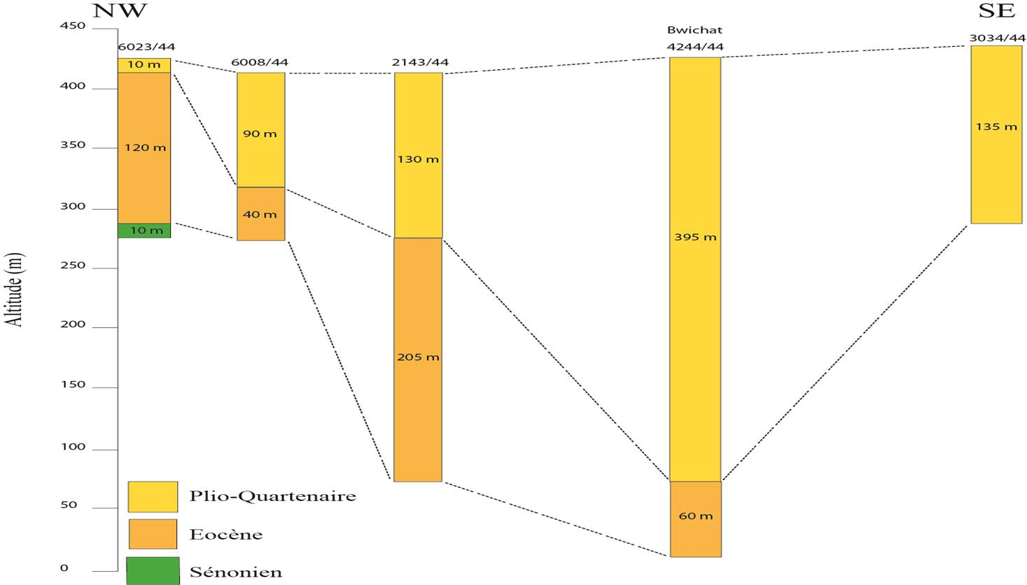
Results and discussion
Figure 7. Correlation section A-C.
The General Assembly of the European Geosciences Union 2022 (EGU22’ )- https://egu22.eu/

Slide 10
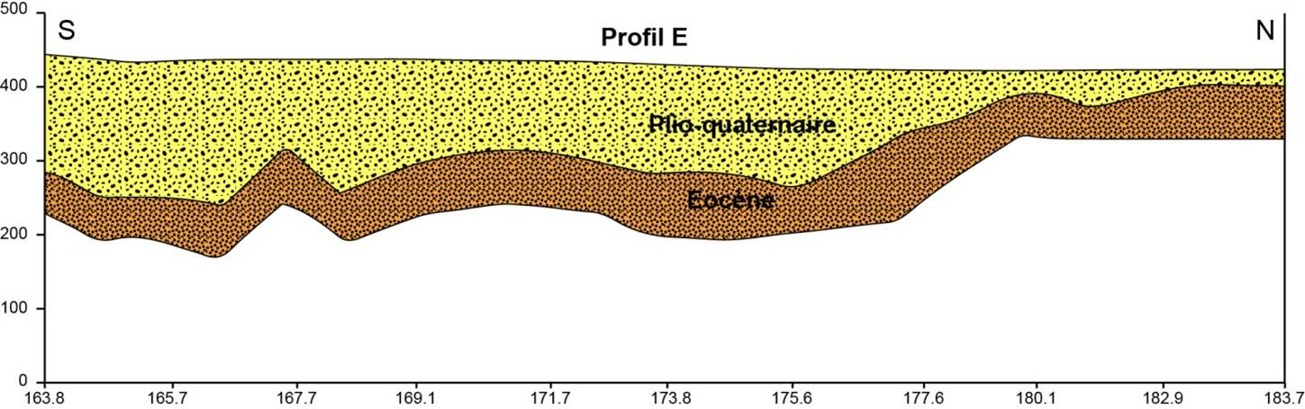
Results and discussion
Figure 8. Geoelectrical section from profile E.
The General Assembly of the European Geosciences Union 2022 (EGU22’ )- https://egu22.eu/

Slide 11
Conclusion
This study provides a better understanding of the geological context of the Bahira basin, based on combined analysis of gravity, electrical and boreholes data.
It also provides precisions about deep structure of the phosphatic series of the Bahira basin, in terms of deepening and thickness lateral change.
These results would help to identify the areas that should be targeted by the high resolution seismic surveys.
The General Assembly of the European Geosciences Union 2022 (EGU22’ )- https://egu22.eu/

Slide 12
References
Ahokangas, E., Mäkinen, J., Artimo, A., Pasanen, A., & Vanhala, H. 2020. Interlobate esker aquifer characterization by high resolution seismic reflection method with landstreamer in SW Finland. Journal of Applied Geophysics, 177.
Michard, A. 1976. Eléments de géologie marocaine, Note et mémoires du service géologique du Maroc, (399 pages).
The General Assembly of the European Geosciences Union 2022 (EGU22’ )- https://egu22.eu/

Slide 13
Thank you for your attention
The General Assembly of the European Geosciences Union 2022 (EGU22’ )- https://egu22.eu/

Slide 14
Contribution of the analysis of borehole, gravity and VES data in the study of the geological structures of the Bahira basin (Morocco)
EGU General Assembly 2022 from 23 to 27 May 2022 in Vienna, Austria (HYBRID)
Charbaoui A.⁽*¹⁾, Jaffal M.^{(1,2)}, Kchikach A.^{(1,2)}, Eljabbar B.⁽¹⁾, Bodinier J., L.^{(1,3)}, Rochdane S. ⁽¹⁾, Khadiri O. ⁽⁴⁾, Jourani E ⁽⁴⁾.
(1) Mohammed VI Polytechnic University, Geology and Sustainable Mining (GSM), Benguerir, Morocco
(2) Cadi Ayyad University, Georessources, Geoenvironment & Civil Engineering Laboratory, Marrakech, Morocco
(3) University of Montpellier & CNRS, Geosciences Montpellier, Montpellier, France.
(4) OCP Group, Casablanca, Morocco
*Email: anas.charbaoui@um6p.ma

