Slide 1
Deciphering the changes associated with Western Disturbances impacting “Karakoram Anomaly”
EGU General Assembly 2022
23rd May 2022
Aaquib Javed
Climate and Glacier Modeling Lab, IISER Bhopal, India

Slide 2
Objectives of the study?
To examine the role of WDs in controlling the overall regional glacier mass-balance variability.
Understand the influence of WDs behind the emergence and continual presence of the "Karakoram Anomaly" in recent decades.
Quantify the contribution of WDs to regional precipitation regimes during the accumulation period.
Identify the key behavioral changes in WD frequency and intensity (in terms of precipitation and wind-speed), along with their subsequent impact in modulating the eventual mass-balance estimates, and
Explore the possible dynamical changes controlling the formation and propagation of WDs in recent decades.

Slide 3
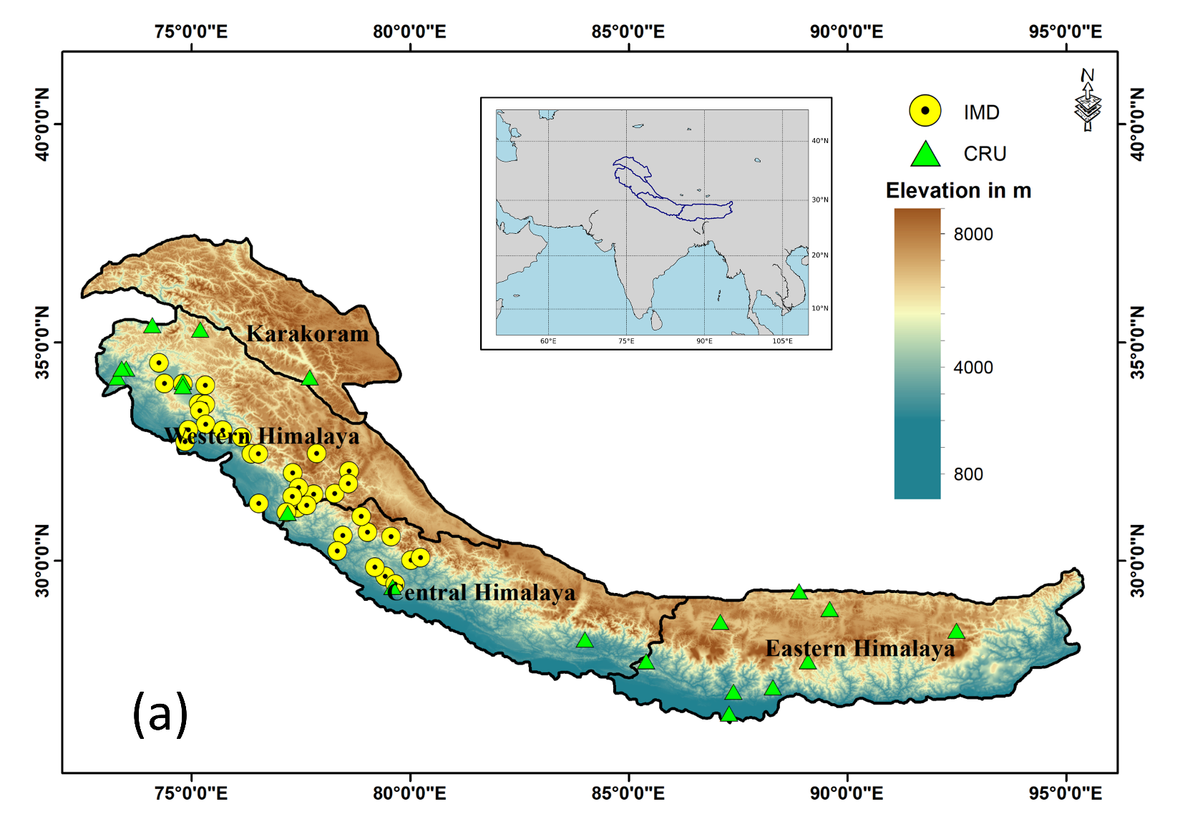
Study Region and Boxes
Extent of Impact Boxes:
KR: 33°N-37.5°N and 72.3°E-80°E WH: 30.2°N-36°N and 72.6°E-82.2°E CH: 27°N-31.7°N and 76.8°E-86.5°E EH: 26°N-30°N and 84.3°E-95.6°E
Extent of Genesis Box: 20°N-50°N and 20°W-60°E
Extent of Himalayan Box: 26°N-37.5°N and 72.3°E-95.6°E
Javed et al., 2022; Journal of Climate

Slide 4
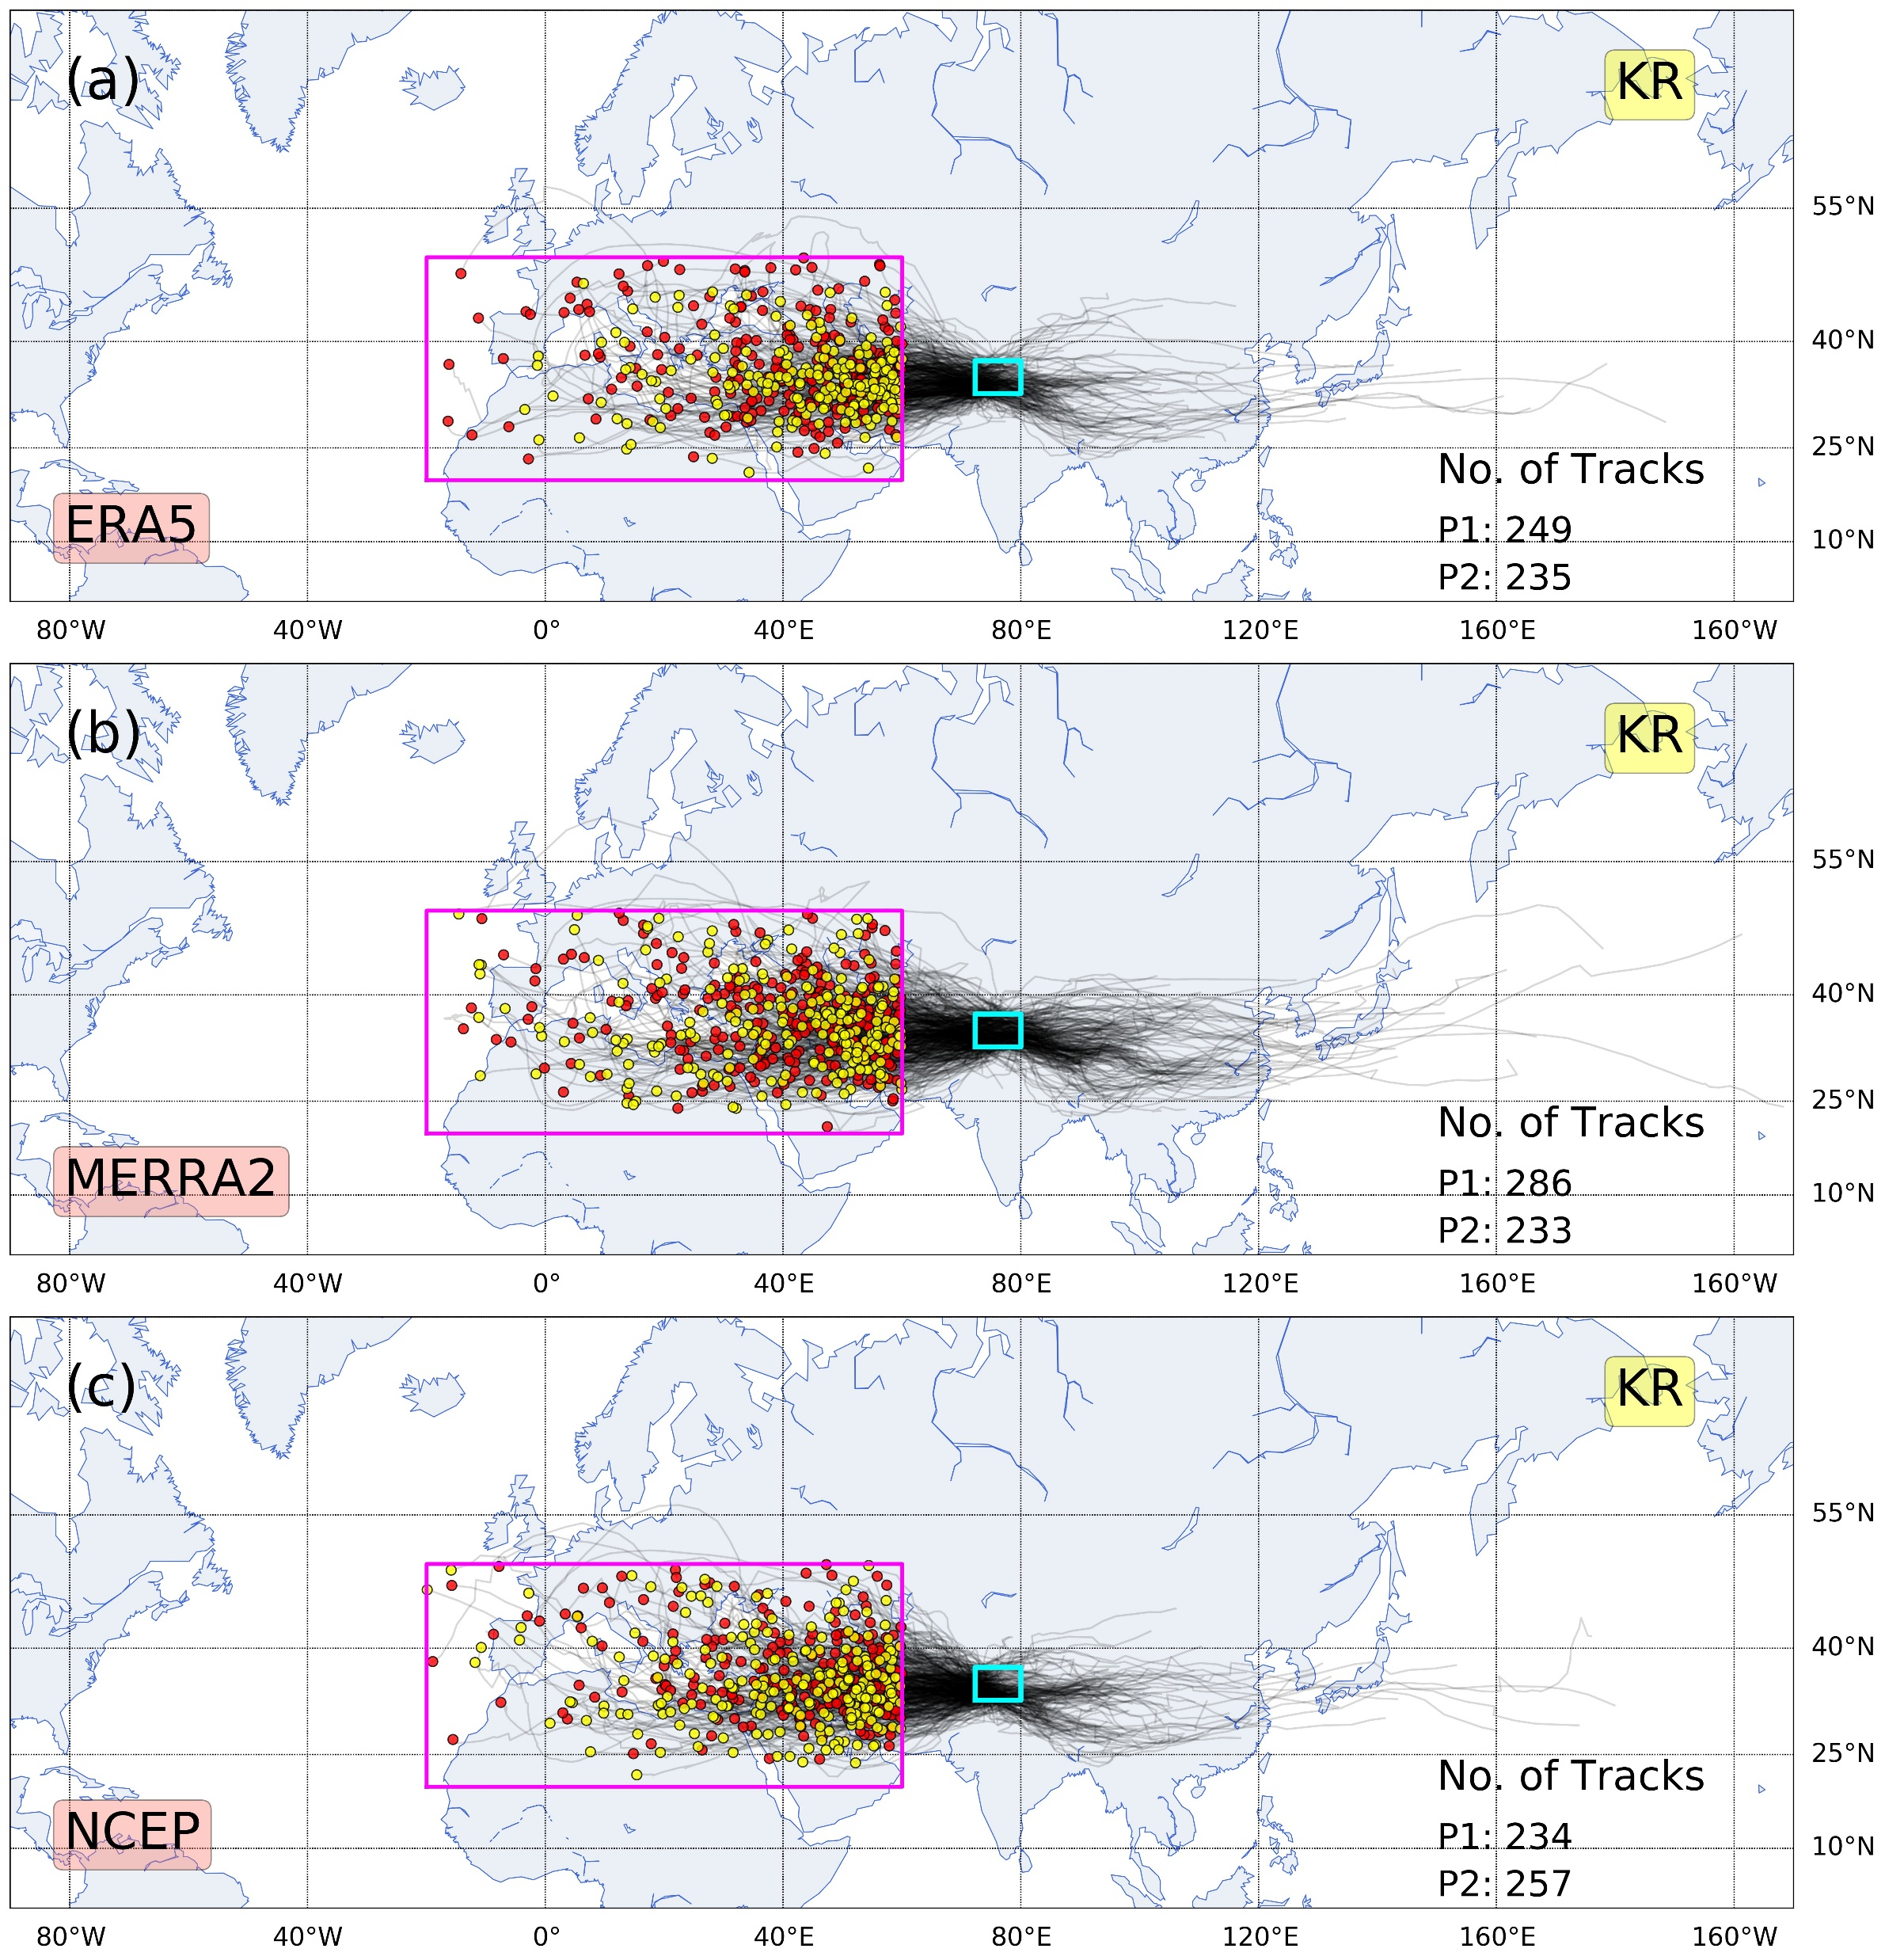
Methodology – WDs Tracking Algorithm
The study period (1980-2019) has been divided into two sub-periods: P1 (1980-2000, red dots) and P2 (2001-2019, yellow dots). After tracking, the following 3-level filtering criteria was applied:
Firstly, only those tracks that sustained themselves for at least one day and travelled a minimum distance of 1000 Kms are considered for the study.
The filtered tracks obtained at level-1 then go through the second round of filtering, which involves identifying those tracks which pass through Impact Boxes.
The tracks from level-2 having their genesis in and around primary moisture source for these storms, i.e., the Mediterranean Sea, the Black Sea, and the Caspian Sea, (Genesis Box) are filtered out to obtain the final product.
The present study uses three independent reanalysis datasets viz. ERA5, MERRA2 and NCEP-CFSR to generate WD storm tracks and their associated statistics using a tracking algorithm for the period 1980-2019 (Nov-Mar).
This tracking algorithm called “TRACK” has been developed by Dr. Kevin Hodges (University of Reading) and has been extensively used in various tracking studies.
Javed et al., 2022; Journal of Climate

Slide 5
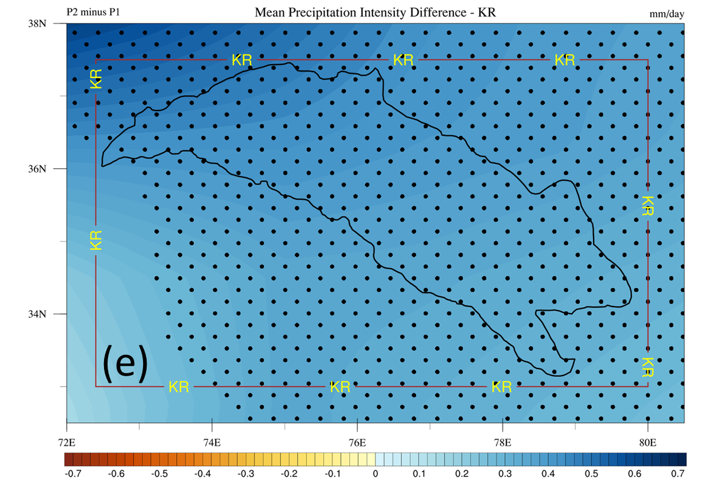
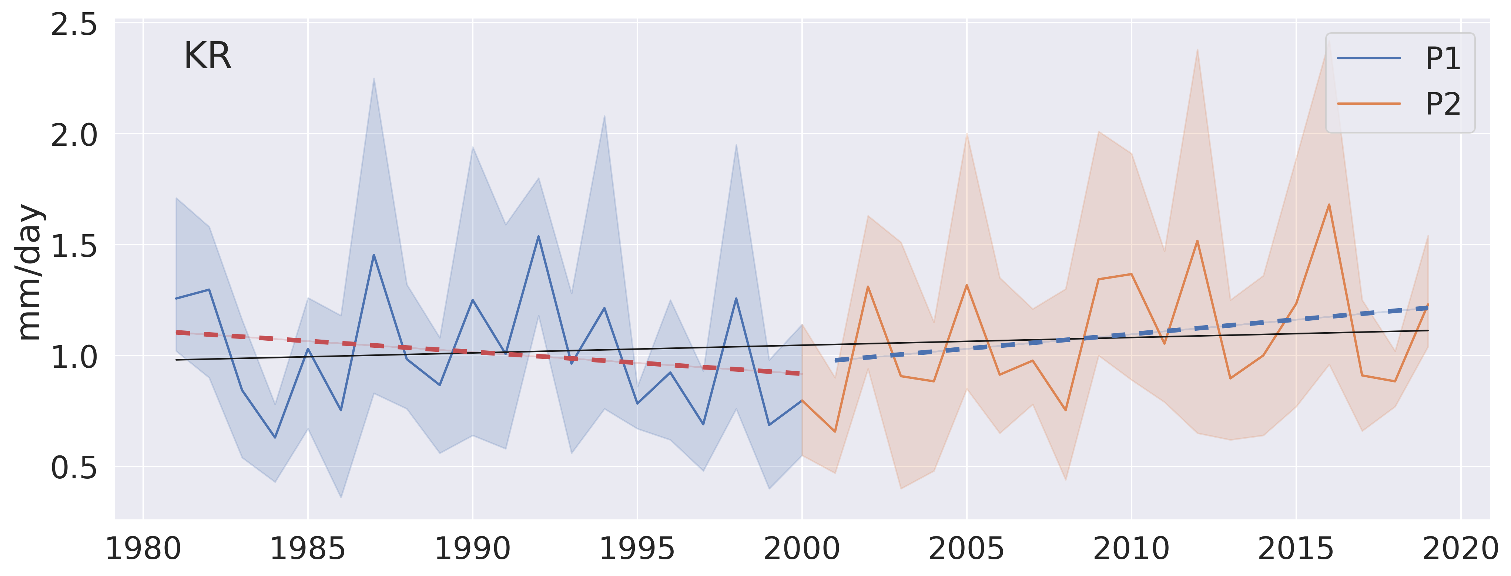
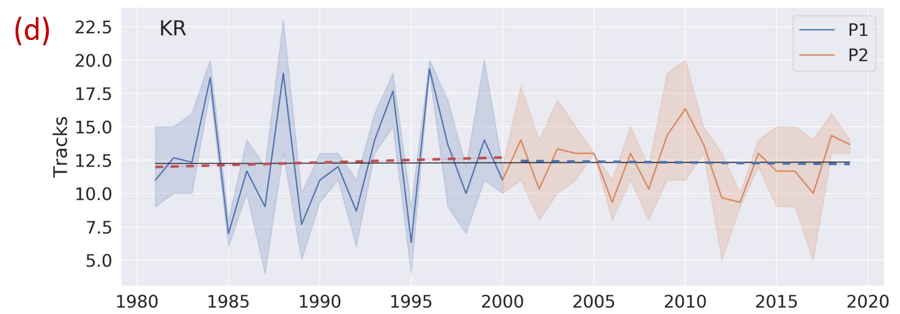
Frequency & Intensity of WD associated precipitation
Mean precipitation intensity is found to be increasing in P2
Depicts little to no change in the frequencies of WDs impacting KR.
KR saw a rise of about ~10% in mean precipitation intensity
Difference in mean precipitation intensity between P1 and P2
Javed et al., 2022; Journal of Climate
Completely dominated by significant positive differences

Slide 6
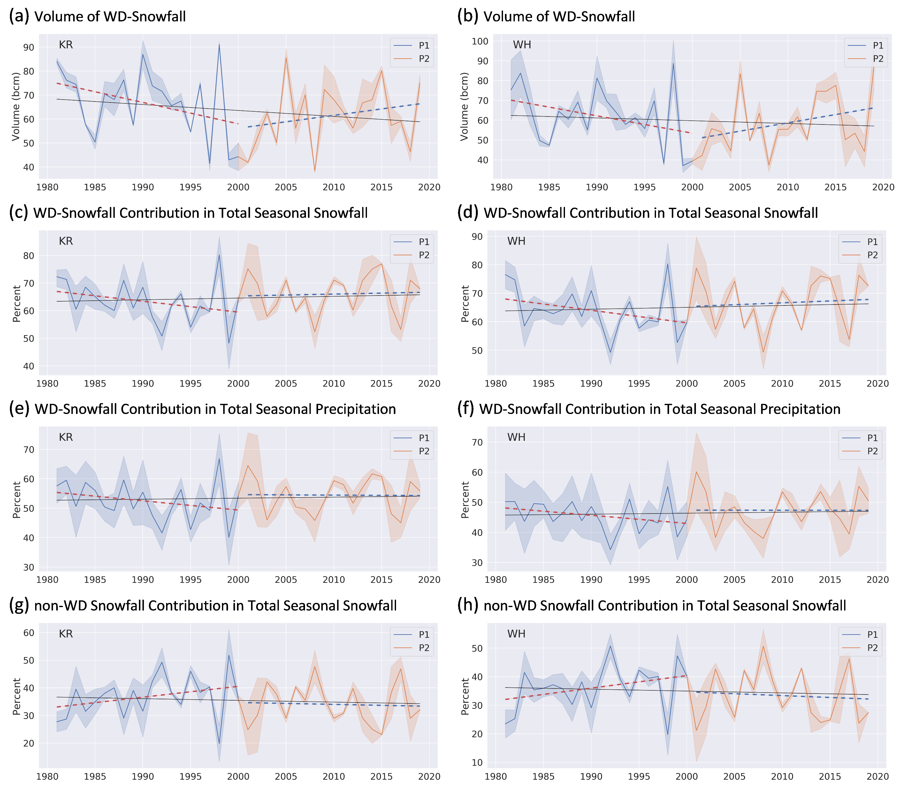
Volume of WD associated precipitation
A noticeable rise in the contribution of WDs in total precipitation and snowfall was observed for KR along with an statistically significant decline in contribution from non-WD sources. This key finding coincides with the Karakoram Anomaly period.
Javed et al., 2022; Journal of Climate

Slide 7
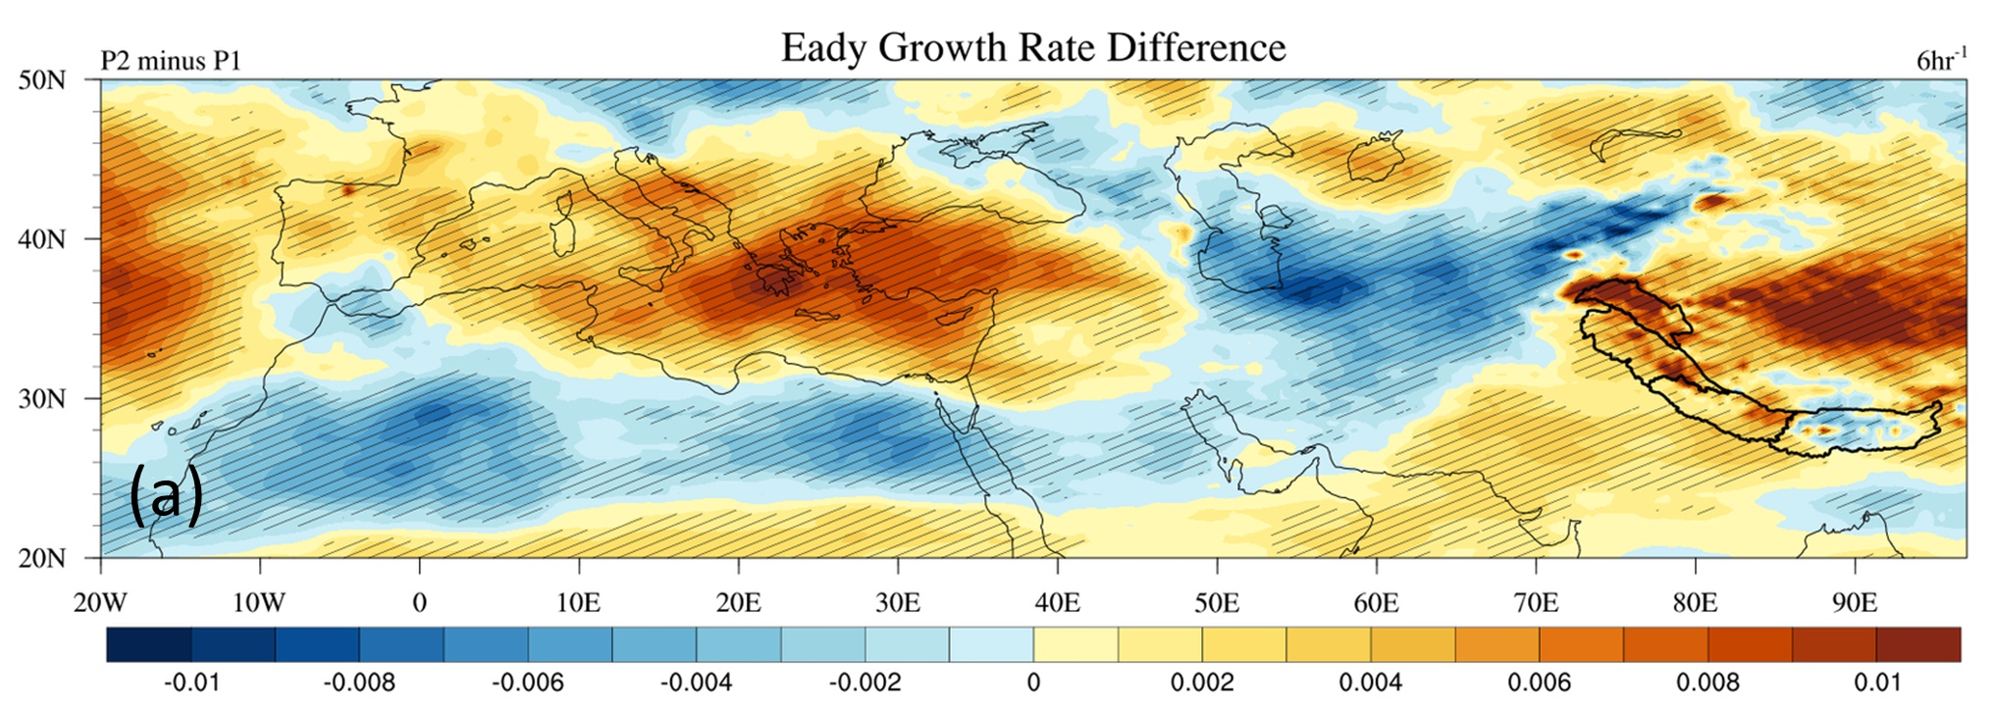
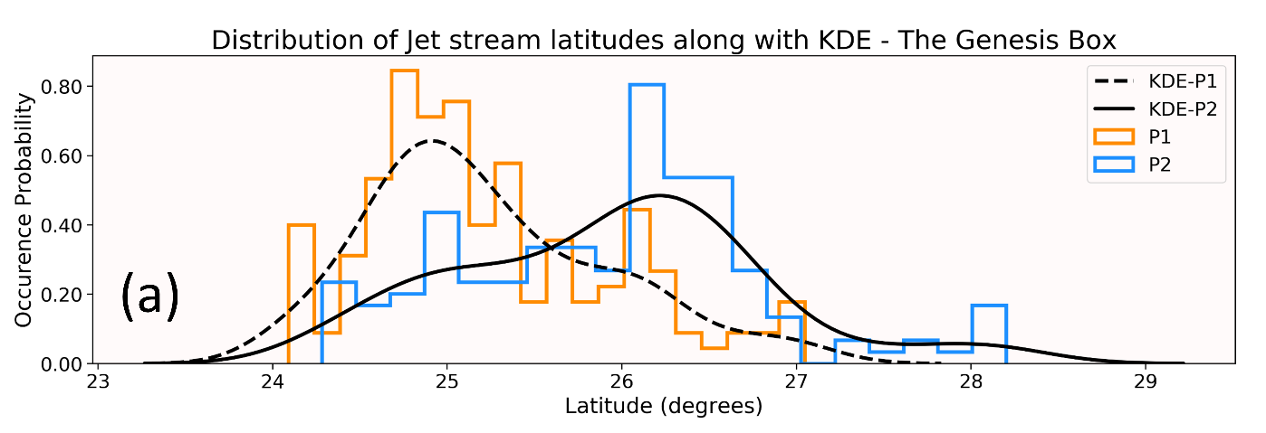
Dynamics controlling the genesis of WDs
An increase in the upper tropospheric baroclinic instability over Mediterranean Sea has been linked to increased genesis activity over the region.
A significant poleward shift of the jet stream has facilitated the genesis of stronger WDs, impacting their intensity if not frequency.
Javed et al., 2022; Journal of Climate

Slide 8
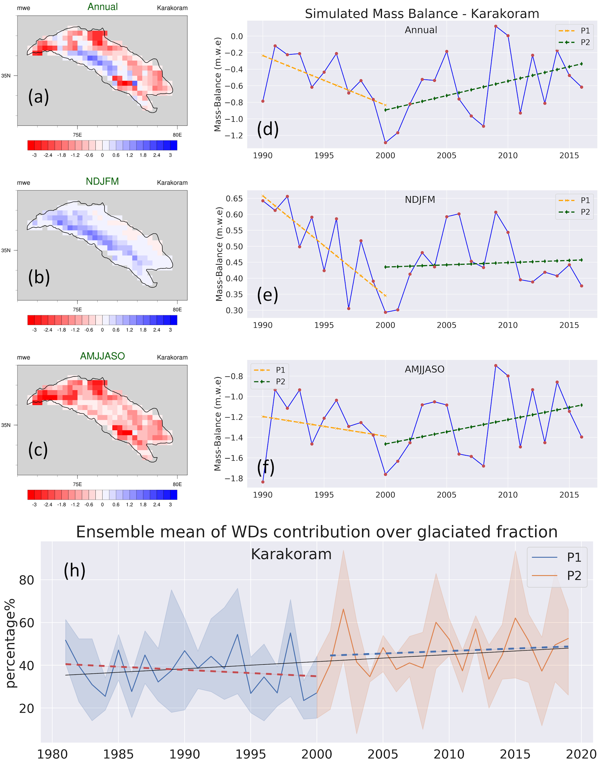
The “Karakoram Anomaly” connection !
REMO_{glacier}
1989-2016
Accumulation during the NDJFM season plays a vital role in the annual mass budget estimation for Karakoram.
The ensemble mean contribution of WDs over the glaciated region rose from ~37% in P1 to about ~47% in P2, a relative jump of about ~27%.
Javed et al., 2022; Journal of Climate

Slide 9
Thank You
Javed, A., Kumar, P., Hodges, K. I., Sein, D. V., Dubey, A. K., & Tiwari, G. (2022). Does the recent revival of Western Disturbances govern the Karakoram Anomaly?, Journal of Climate (published online ahead of print 2022). Retrieved May 22, 2022, from https://journals.ametsoc.org/view/journals/clim/aop/JCLI-D-21-0129.1/JCLI-D-21-0129.1.xml
Questions?

