Slide 1


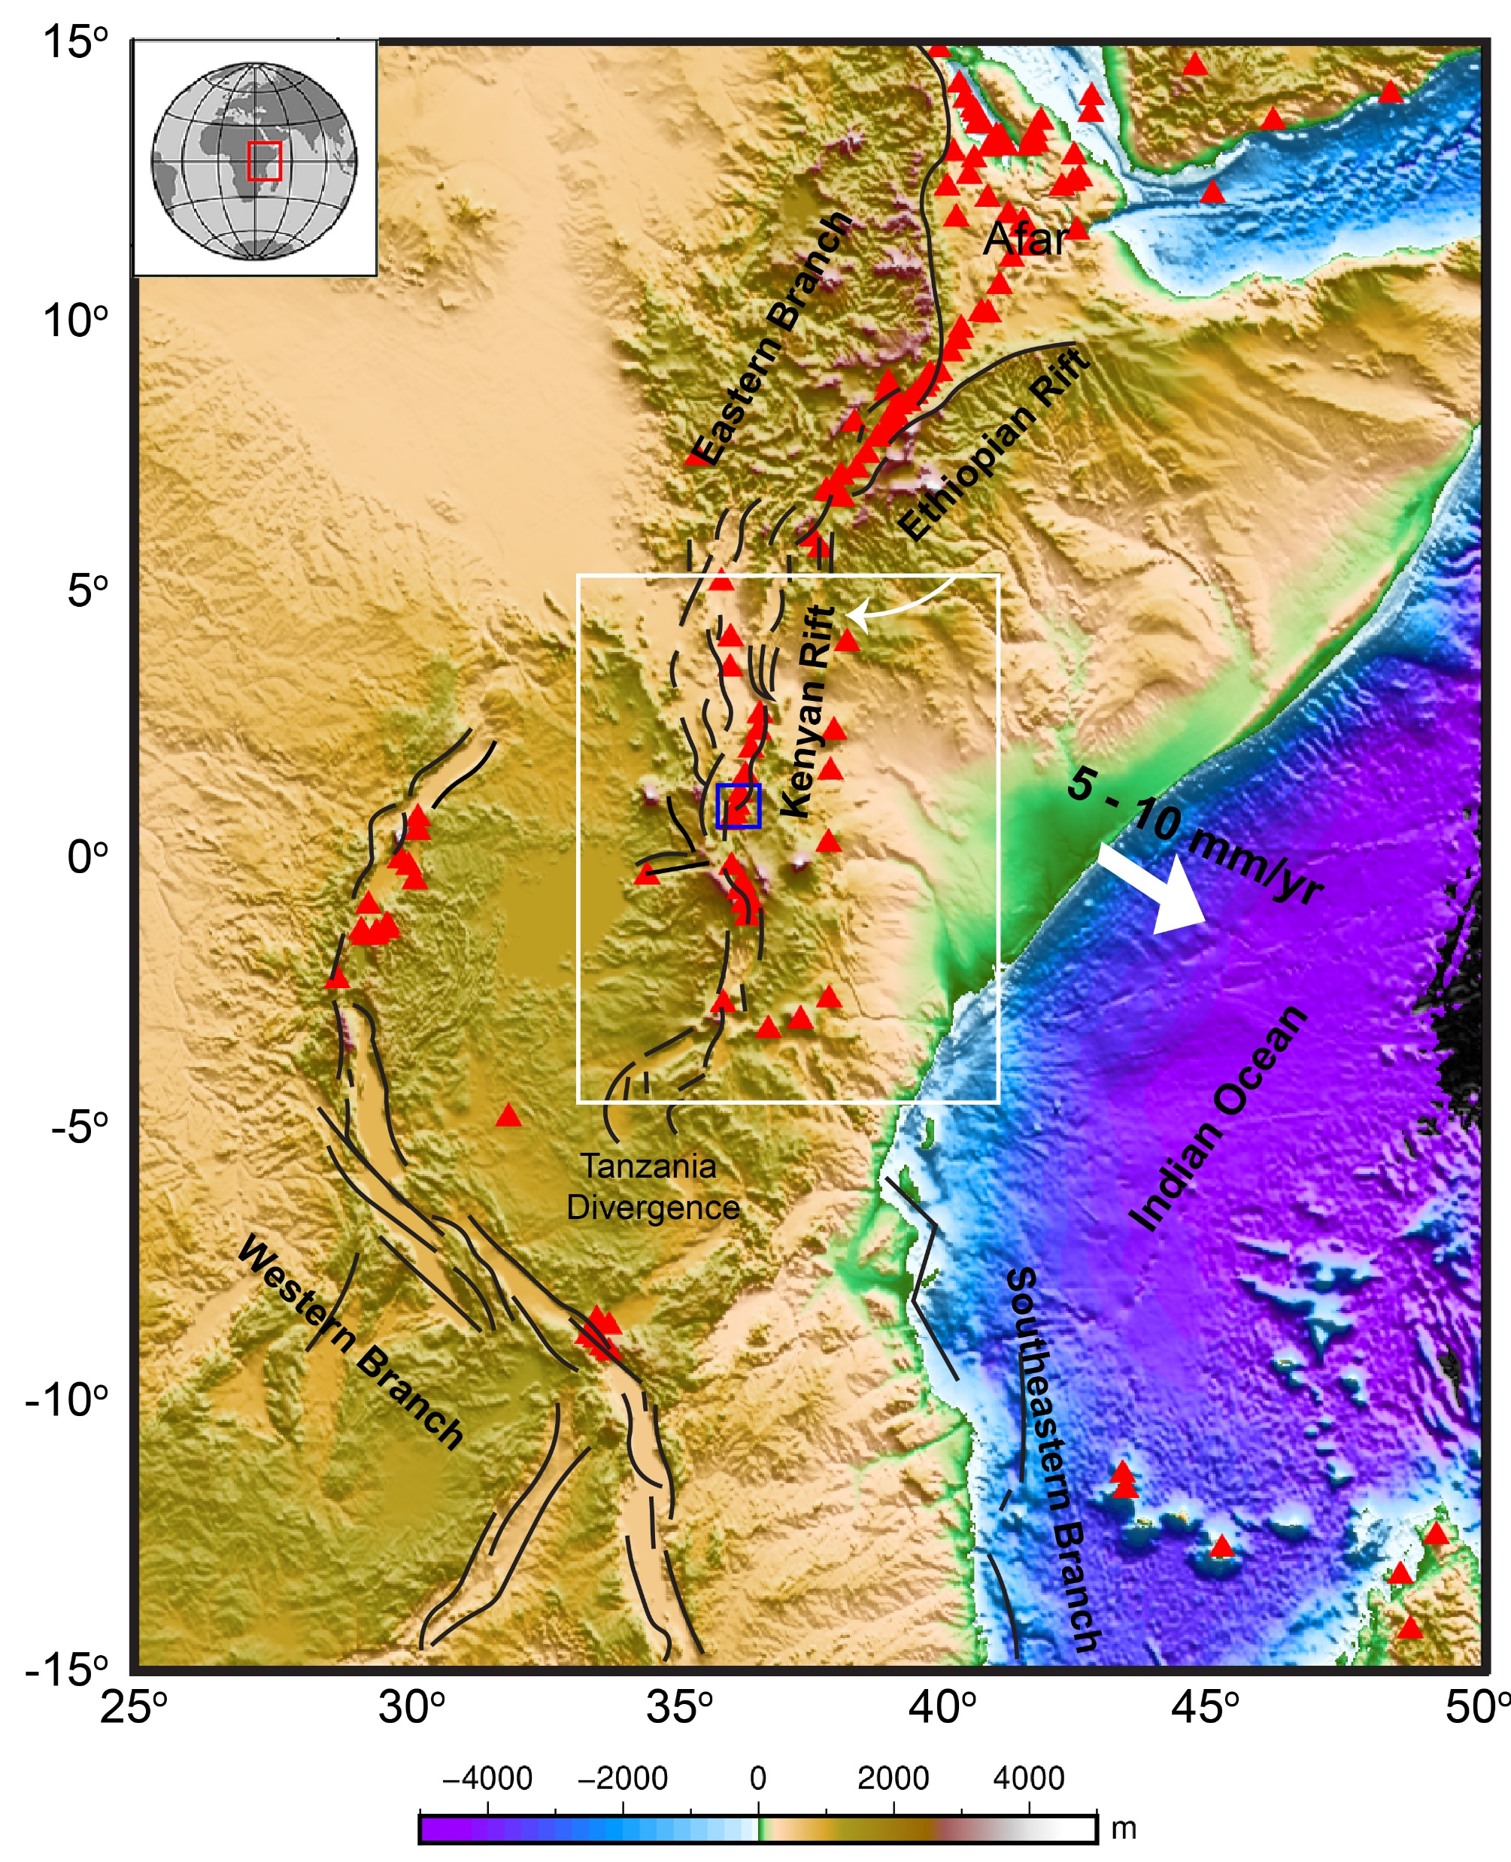
S-wave velocity structure in Kenyan potential geothermal fields inferred from ambient seismic noise data analysis
Chanmaly Chhun (Kyushu Univ.)
Takeshi Tsuji (Kyushu & Tokyo Univ.)
Tatsunori Ikeda (Kyushu Univ.)
Supported by:
Leading Enhanced Notable Geothermal Optimization (LENGO) of SATREPS (JICA-JST)
Japan Society for the Promotion of Science (KAKENHI grant JP20H01997)

Slide 2
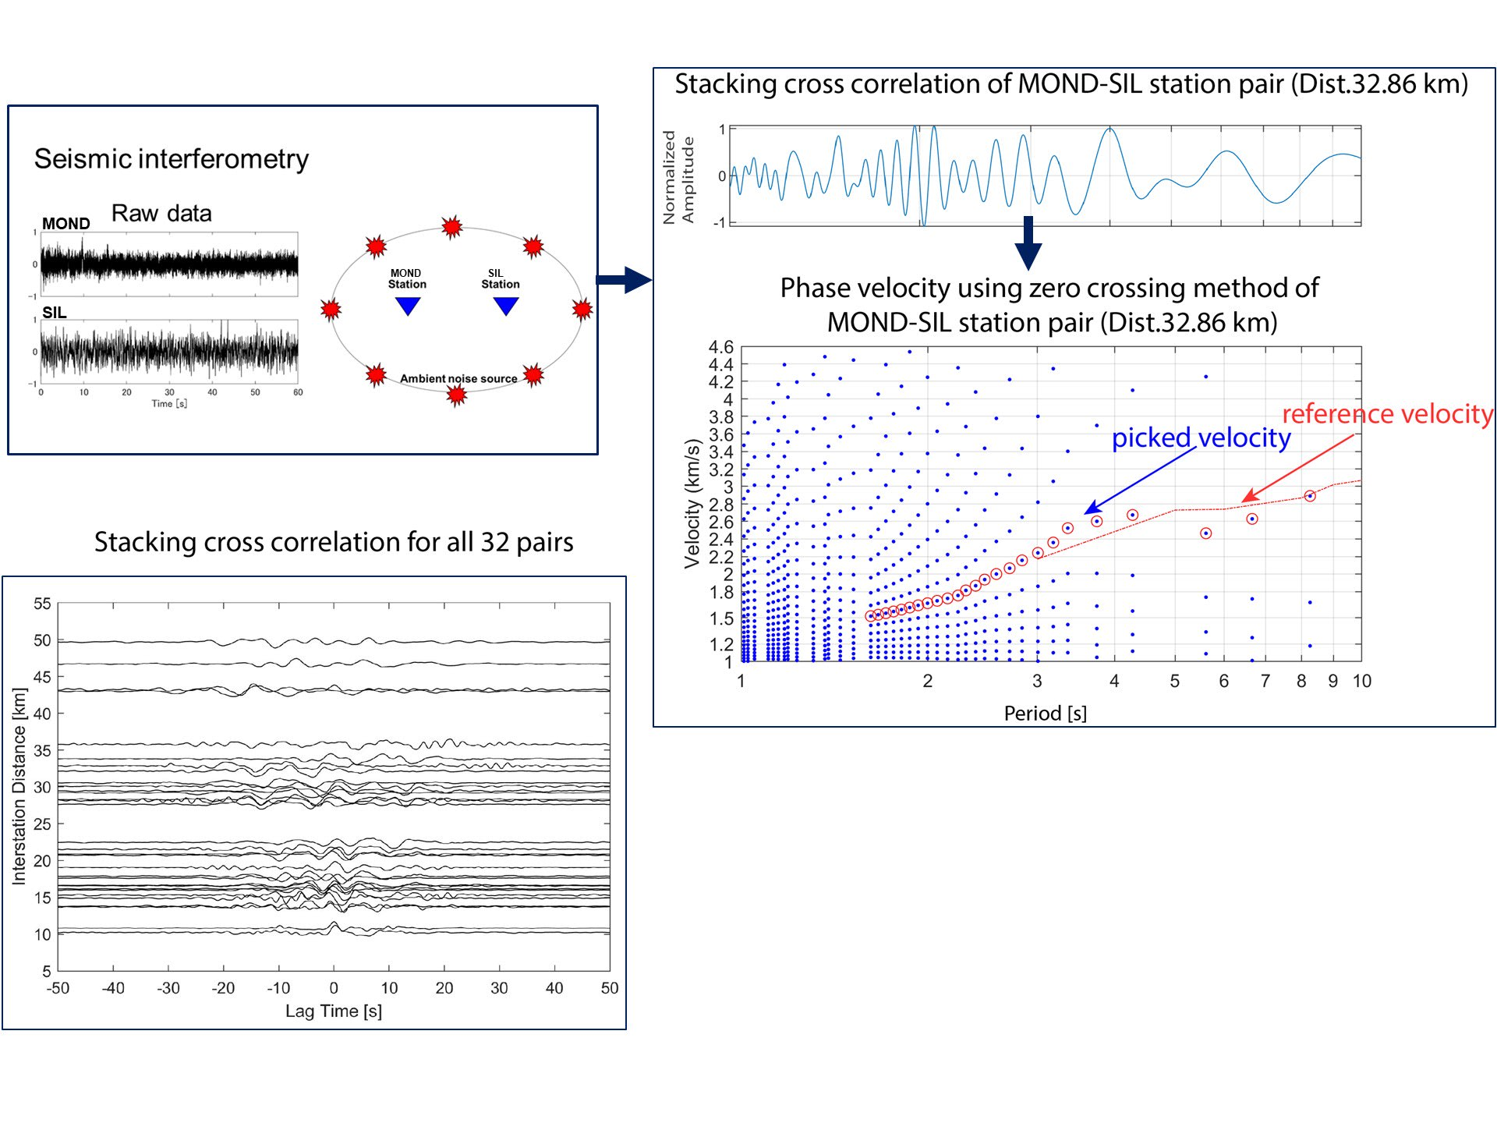
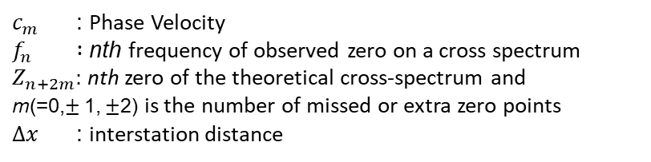

Methods: Surface wave dispersion measurement & S-wave inversion
To locate heat source and geothermal energy accumulations controlled by structure
from ambient noise data analysis.
(Velasco et al., 2011)
$$c_{m}\left(f_{n}\right)=\frac{2πf_{n}Δx}{Z_{n+2m}}$$
$c_{m}$ : Phase Velocity
$f_{n} :$ nth frequency of observed zero on a cross spectrum
$Z_{n+2m}:$ nth zero of the theoretical cross-spectrum and
m(=0,$±$1, $±$2) is the number of missed or extra zero points
$Δx$: interstation distance
(DSurfTomo, Fang et al., 2015)
(Ekström et al., 2009; Sadeghisorkhani et al., 2018)

Slide 3
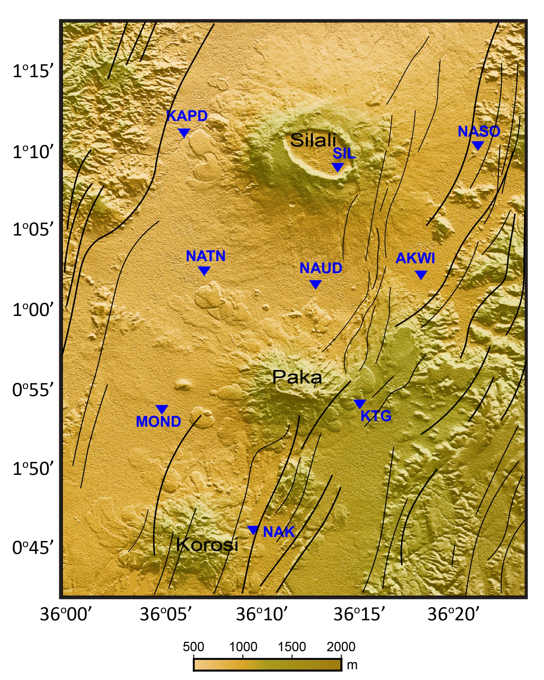
Results: Rayleigh Wave Phase Velocity
(Data: October 13, 2012 - April 09, 2013)

Slide 4
Results: S-wave Velocity Structure (Vs)
Low velocity anomalies >> potential geothermal pathways >> Geothermal fluid accumulations

Slide 5
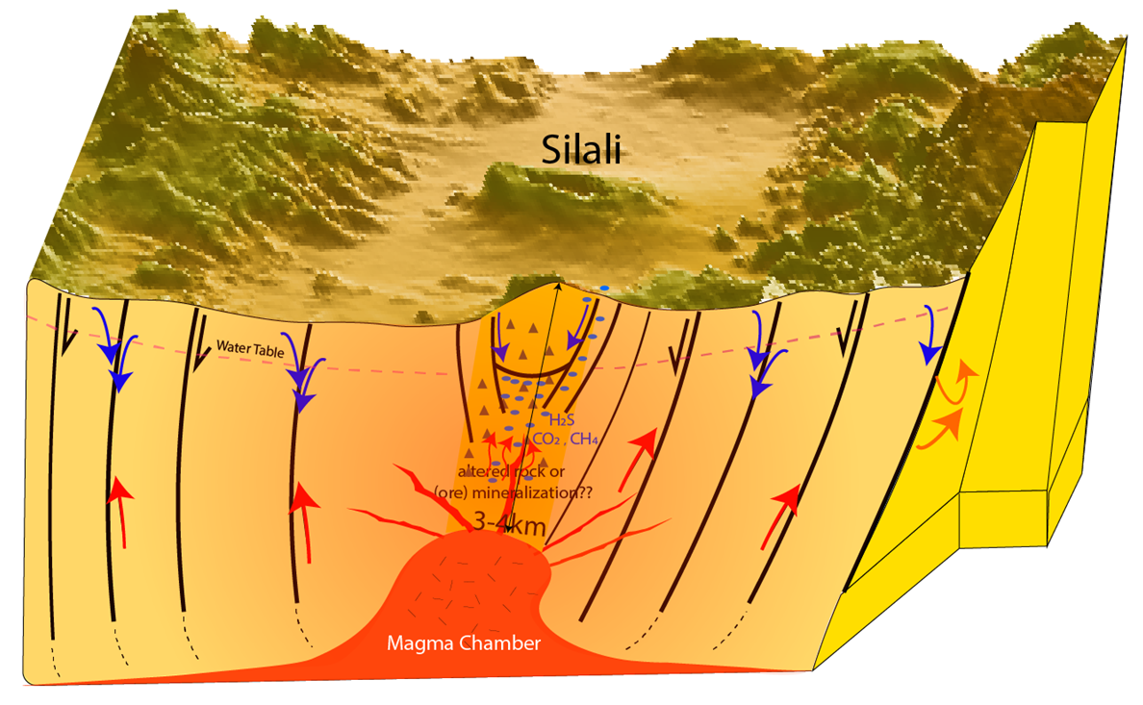
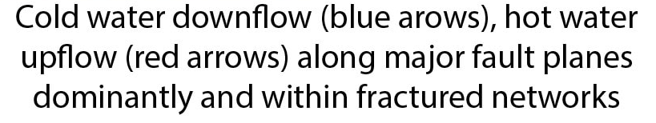
Results & Discussions: Magma and Geothermal Fluid Accumulations
Top of magma chambers (3-4km beneath Silali, and
probably ~3km beneath Paka).
Potential geothermal fluid accumulations mostly at
depths < 3-4km beneath calderas and below rift floors.

