Slide 1
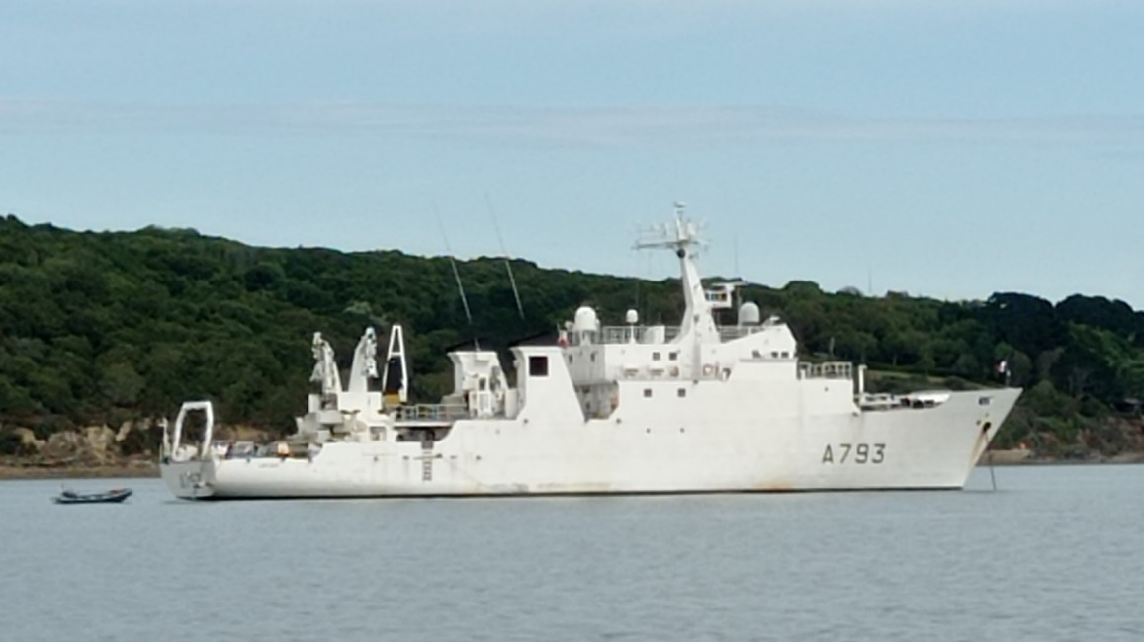



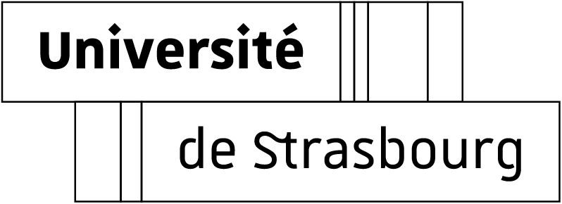
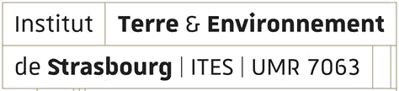
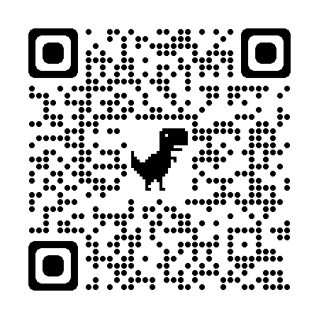
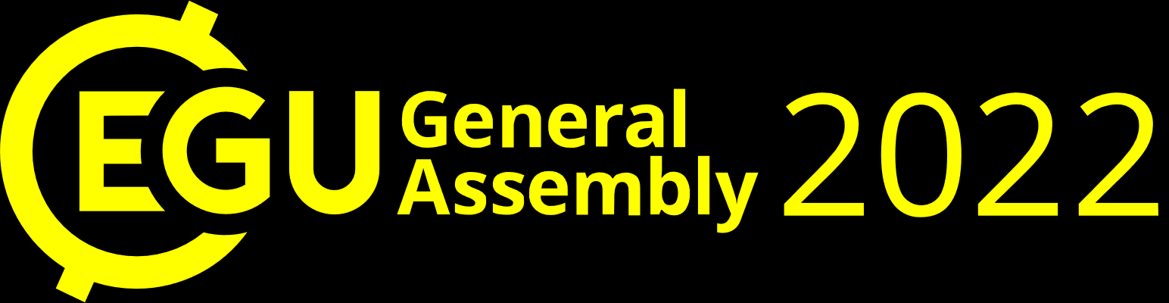
Comparison between towed absolute and shipborne 3C fluxgate magnetic measurements in shallow waters. Applications for marine geophysical survey.
Hugo REILLER¹, Jean François OEHLER², Guy MARQUIS¹, Sylvain LUCAS², Didier ROUXEL², Marc MUNSCHY†
¹ Institut Terre et Environnement de Strasbourg (ITES), UMR 7063, Université de Strasbourg/EOST, CNRS, Strasbourg, France; ² Shom (French Hydrographic and Oceanographic Service), Brest, France
Contact : h.reiller@unistra.fr

Slide 2

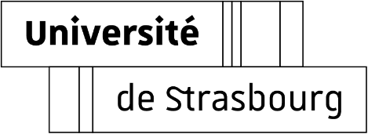
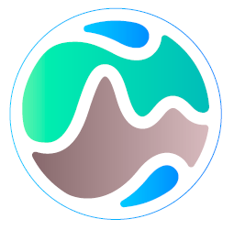
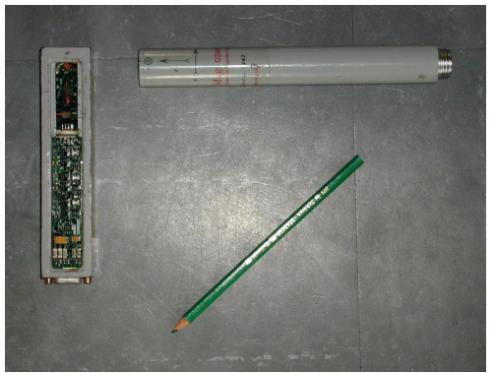
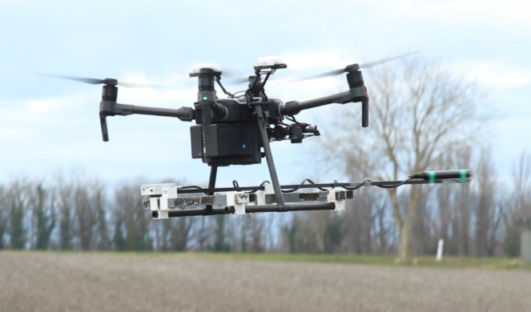
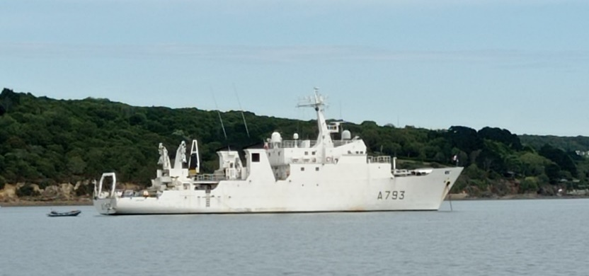
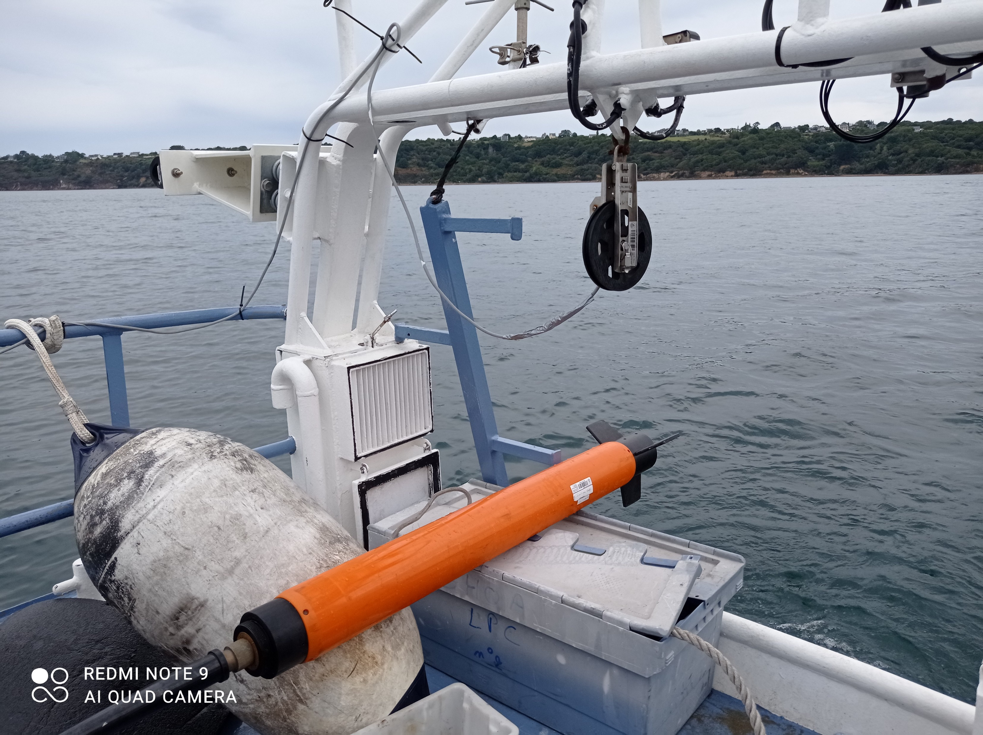
INTRODUCTION
MAGIDRO project (Mesures MAGnétiques Innovantes par DROnes) :
ITES
Partnership
Expertise in vector magnetic measurement
(calibration of fluxgate and compensation of magnetic perturbation due to operator).
Expertise in marine geophysics measurements.
Objective :
Develop new marine magnetic measurement methods.
ITES’s magnetic survey experience
Shom’s marine magnetic survey experience
Efficient marine magnetic survey
with ships and drones
+
=
Bartington 3C fluxgate magnetic sensor
DJI M210 RTK AUV with SENSYS 3C fluxgate sensor
BH2 Laplace during Shom’s DETEX1 survey
SeaSPY (Marine Magnetics)

Slide 3

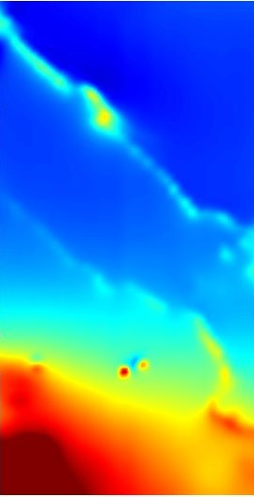
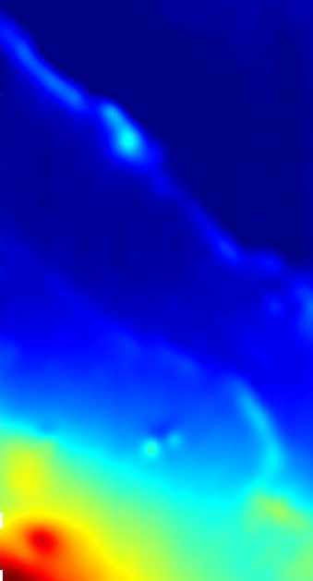
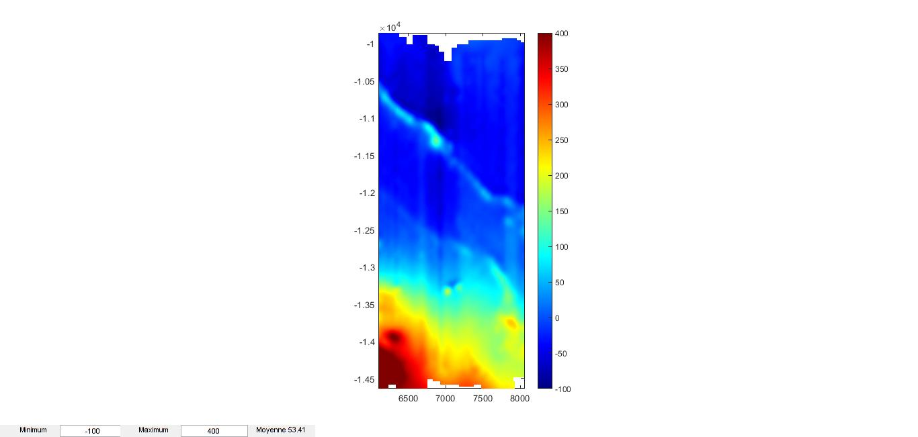
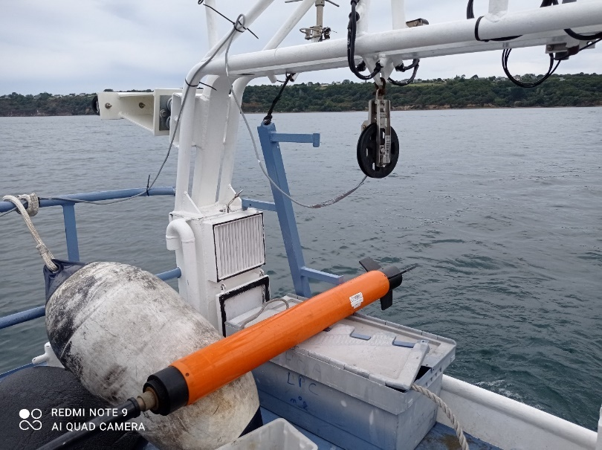
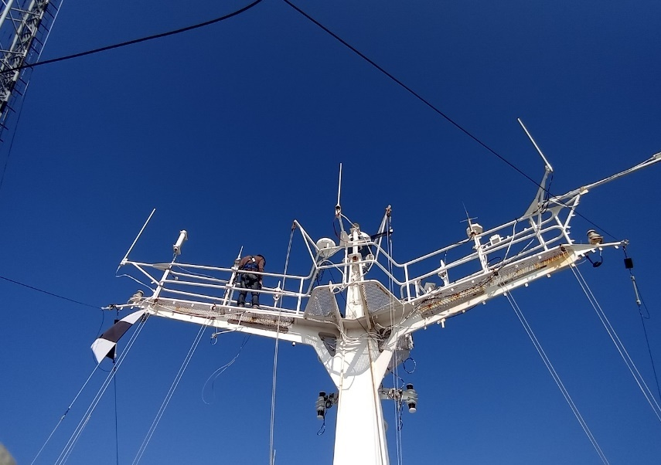
CASE STUDY 1
Comparison of absolute and 3C fluxgate anomaly maps:
Shom’s DETEX1 (2021) survey on BH2 Laplace
Scalar magnetic anomaly
Vector magnetic anomaly
Towed absolute sensor (SeaSpy, Marine Magnetics) | Marinized shipborne 3C fluxgate system (Sensys)
Scalar sensor | Vector sensor (3 components)
No calibration | Need of calibration loop
No filtering | Low-pass filtering
Std dev.: 3,4 nT | Std dev. : 3,7 nT
Positioning by layback correction/adjustement | GNSS positioning
Measurements at sub-surface | Measurements in mast
Constraining to set up | (Relatively) Easy to set up
Upward-continued to the altitude of the mast
400 nT
Scalar data processing
(Shom’s methodology)
Shifting to sensor position and layback adjustments
Correcting from IGRF
Reducing external variations from local reference station
300 nT
200 nT
Vector data processing
Scalar calibration (Leliak, 1961)
Reducing external variations from local reference station
Reducing high frequency residuals due to ship’s attitude with a low-pass (20s, ~80m)
Levelling and removing the median
100 nT
0 nT
- 100 nT
1 000 m
Same magnetization contrasts with vector and upward-continued scalar data
Same precision for both systems (according to the wavelength of the signal)

Slide 4
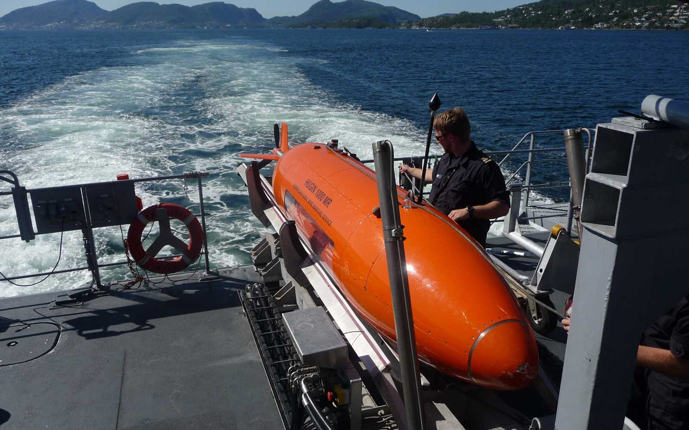
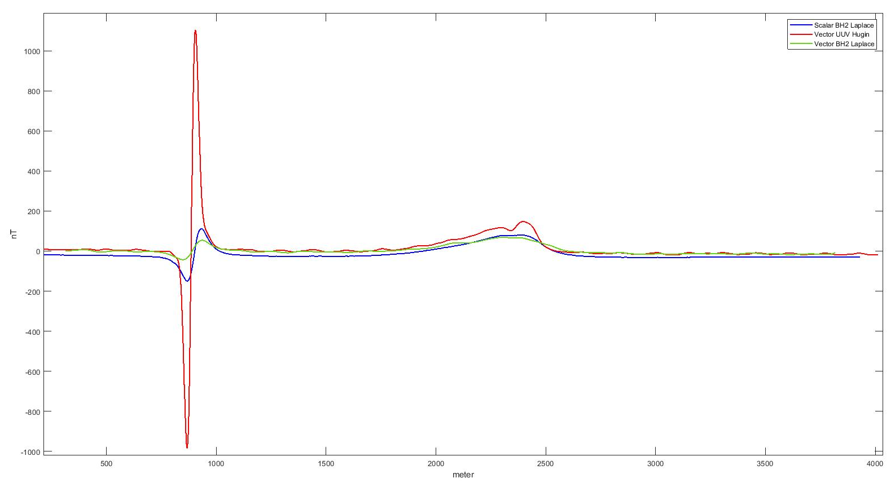
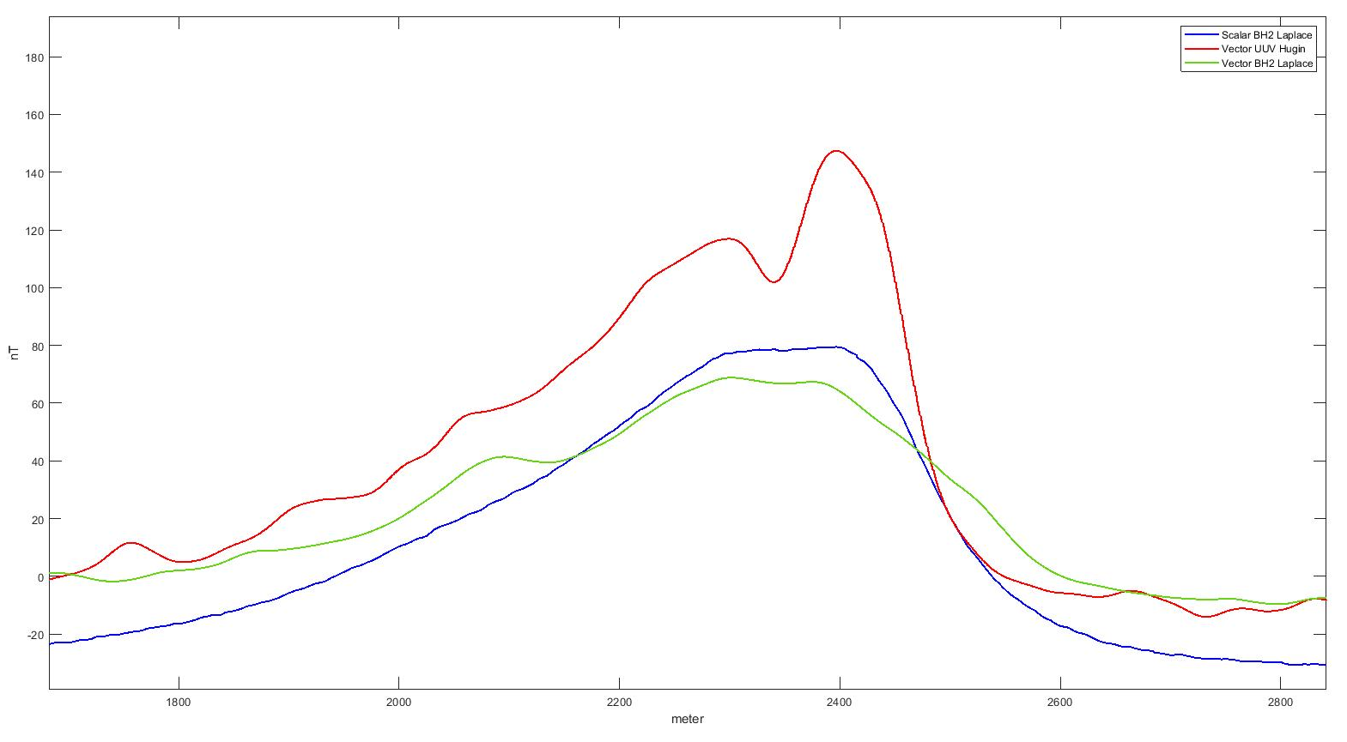
CASE STUDY 2
Benefits of using an UUV:
Shom’s survey (2021) with Hugin UUV system (Kongsberg)
Magnetic reference profile for comparison between data acquired during Shom’s DETEX1 (2021) survey on BH2 Laplace and with the OFG-SCM vector sensor embedded in a Hugin UUV.
www.kongsberg.com 06/05/2022
Highlighted potential wreck?
(only visible on UUV data)
Vector data allow to compensate
the magnetic effect of the UUV
Geological
anomaly
Navigation closer to the seafloor
(10th of meters in altitude), also at great depths
Known wreck
→ visible with all systems but best detection with UUV data
Average depths: 50 m
Best magnetic detection
UUV brings the magnetometer closer to sources : new targets are potentially detected.
Vector magnetometers allow to correct for magnetic effects of the UUV.

Slide 5
CONCLUSIONS
Unexpectedly high performance of shipborne 3C fluxgate magnetometers after calibration and post-processing :
⊕ Equivalent precision than scalar absolute towed systems after filtering and levelling
⊕ Highly beneficial for magnetic mapping in deep-sea areas with strong benefits in operational aspects
Pros/cons of magnetic surveys with UUV systems :
⊕ Greater power of detection as the system is closer to the sea bottom
⊕ Only embedded 3C fluxgate magnetometer allow to efficiently compensate UUV effects of the drone
⊗ Limitations: operational constraints, positioning, power supply, data storage, high pressure…
Sensor
Hugin UUV System
(www.kongsberg.com 06/05/2022)
Acknowledgements :
This study was carried out as part of the research contract MAGIDRO funded by the French Ministry of Defense / DGA through the project “EA APOGE”, CNRS and ITES and led by Shom.
Shom’s survey performed with Hugin UUV in 2021 was funded by the French Navy.

