Slide 1


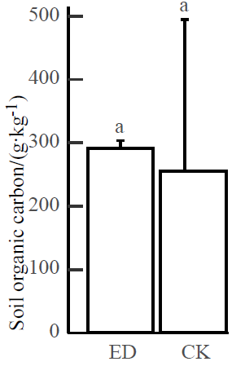
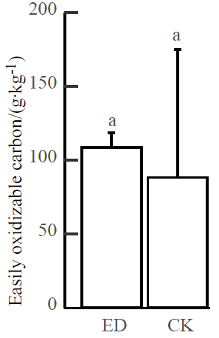
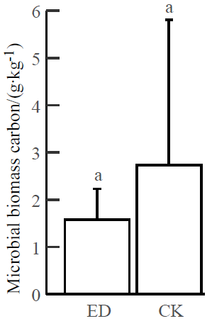
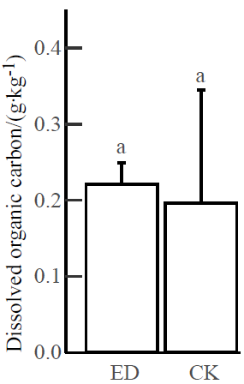
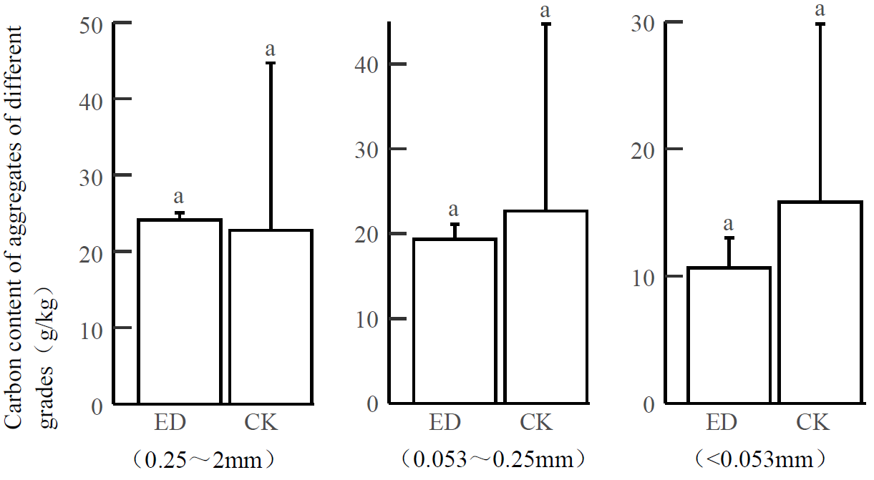
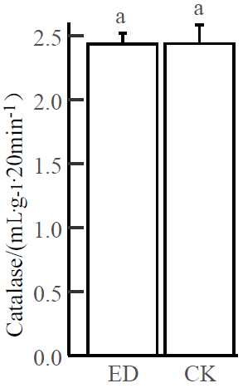
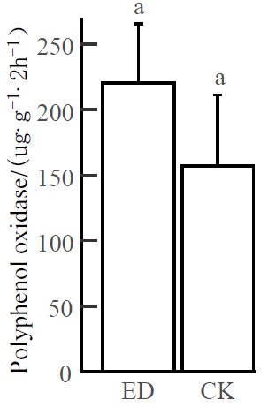
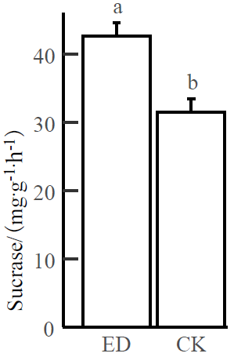
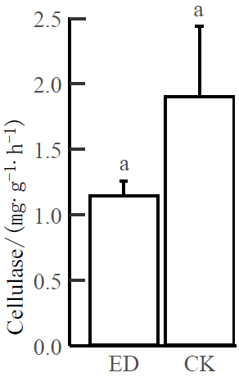
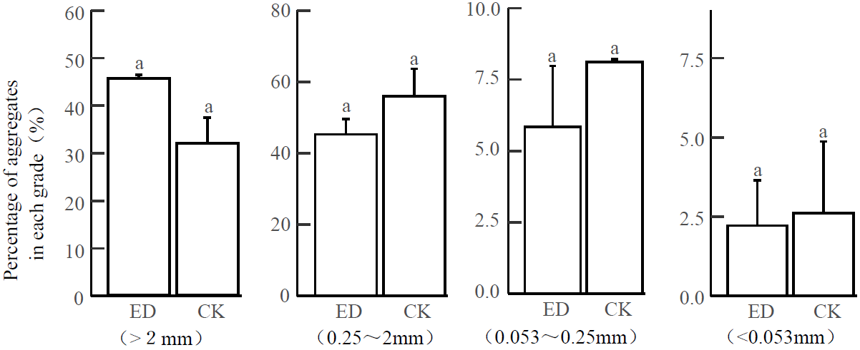
Effects of tunnel engineering construction on soil organic carbon stability
Runying Zhao¹, Xiaolu Tang¹ , Xiangjun Pei¹ , Lin Li¹
1 College of Ecology and Environment, Chengdu University of Technology, Chengdu, China
2022
Introduction
Soil organic carbon (SOC) stability is a sensitive index to evaluate the response of soil ecosystem to environmental changes.
Rectunnel construction ently, the impacts of on ecological environment have received increasing attention. However, there are few researches on the impact of tunnel construction on soil organic carbon stability.
Results
(1) The tunnel construction had no significantly effect the SOC and LOC (EOC, MBC, DOC ) content.
Conclusion
This study showed that the tunnel engineering construction did not change the amount of vegetation apoplast and did not significantly affect the input and output of SOC.
There were also no significant differences in soil enzymes, MBC and soil agglomerate composition between ED and CK areas, indicating that the tunnel construction also had no significant effect on the microbiological regulation mechanism of SOC stability and the physical protection mechanism of soil agglomerates, and no significant effect on SOC stability.
(3) The tunnel construction had no significant effect on the organic carbon content of the component agglomerates. The organic carbon was mainly distributed in the medium and for agglomerates.
Figure 1. Comparison the components of SOC and LOC in ED and CK. ED: disturbed area; CK: undisturbed region; a: The difference is not significant
Figure 3. Organic carbon content in soil aggregate components LOC in ED and CK. .
Methods
Engineering impacted area (ED) and non-impacted area (CK) monitoring sample plots were set up to investigate the effects of the tunnel engineering construction on SOC stability from the perspectives of soil reactive organic carbon (LOC), agglomerates and soil enzyme activity. The EOC, MBC, DOC was used to characterize LOC in the experiment.
(2) The tunnel construction had no significant effect on the distribution of soil agglomerate fraction, which is slightly lower than the CK area in the ED, with the highest percentage of agglomerate (0.25-2mm) fraction content 。
(4) The tunnel construction had a significant effect on sucrase and no significant effect on peroxidase, polyphenol oxidase, and β-glucosidase.
Figure 2. Soil organic carbon and labile organic carbon components in LOC in ED and CK.
Figure 4. Distribution of soil enzyme activity in ED and CK.

