Slide 1

Electromagnetic Ion Cyclotron Harmonic Waves
Generated via Nonlinear Wave-Wave Couplings
Dan Deng¹, Zhigang Yuan¹ , Shiyong Huang¹ , Zuxiang Xue¹ ,
Zheng Huang¹, and Xiongdong Yu¹
¹School of Electronic Information, Wuhan University, Wuhan, China

Slide 2
Outline
Introductions
RBSP observations of EMIC waves
Hybrid Simulations
Discussions about the role of the second harmonic
Conclusions

Slide 3
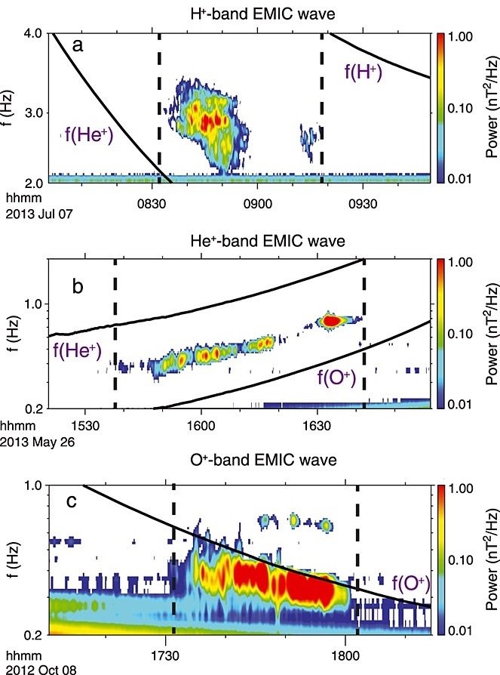
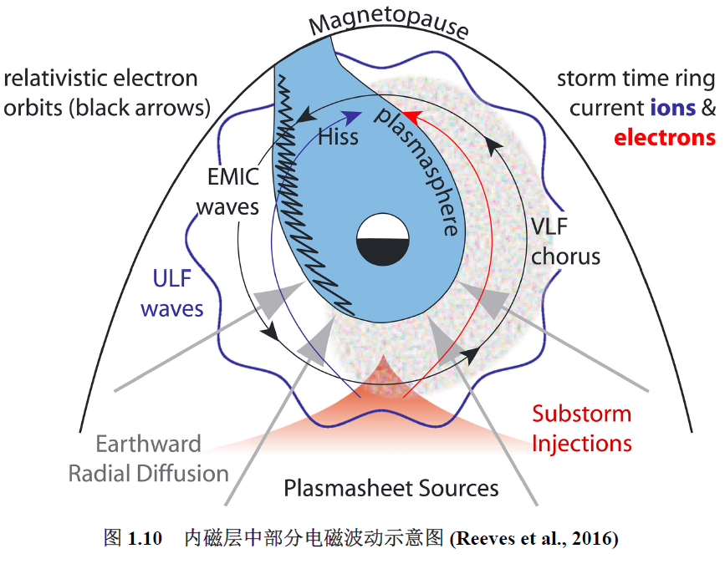
Introductions: EMIC waves
Electromagnetic ion cyclotron (EMIC) wave often appear near the magnetic equator with frequencies below the local proton gyrofrequency (Anderson et al., 1992; Jordanova et al., 1997; Loto'aniu et al., 2005). EMIC waves are generally considered to result from the cyclotron resonance instability driven by the ring current protons with temperature anisotropies (Cornwall, 1965).
Reeves et al., （2016）
Kozyra et al., （1984）

Slide 4
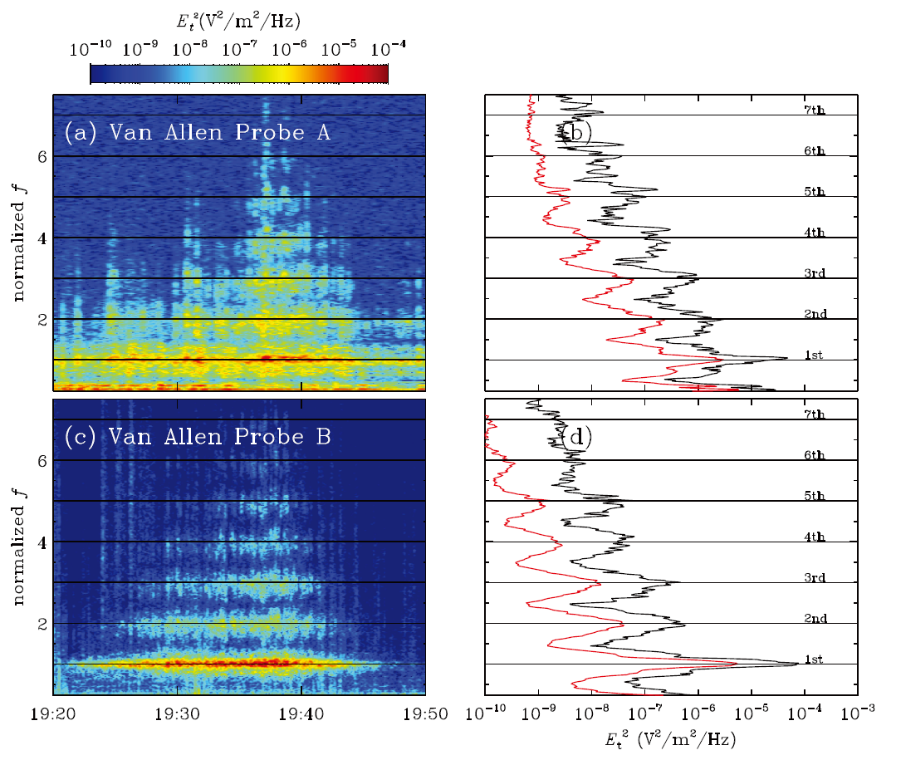
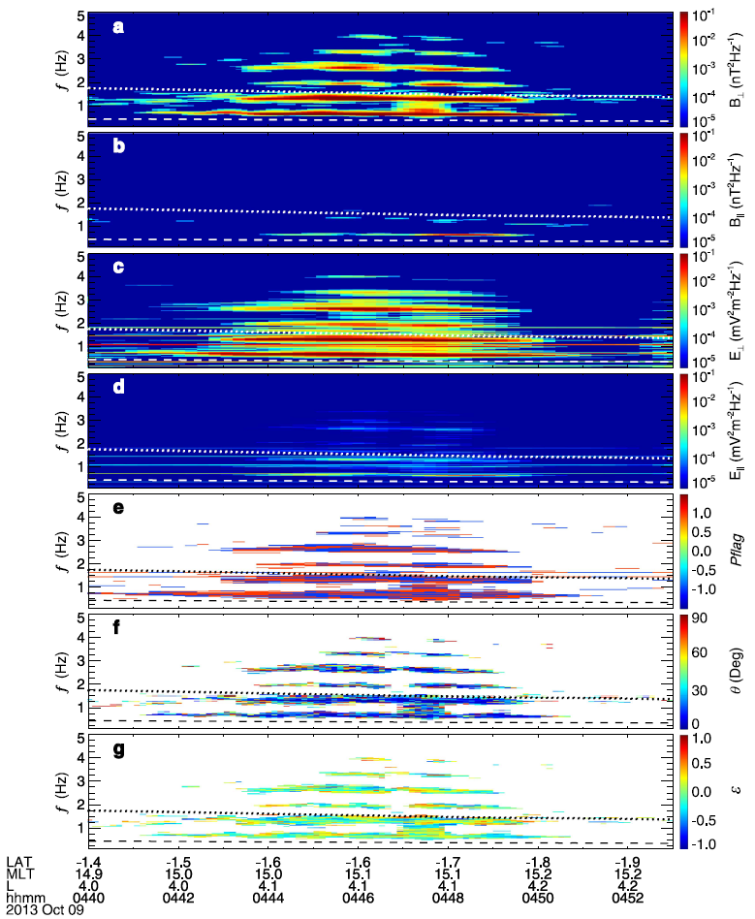
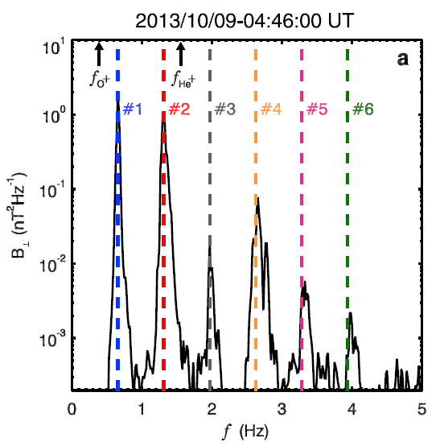
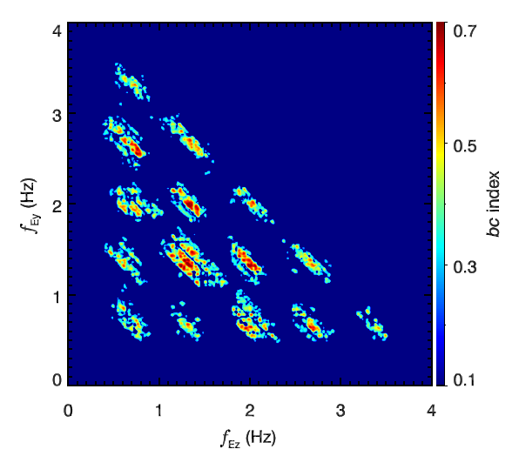
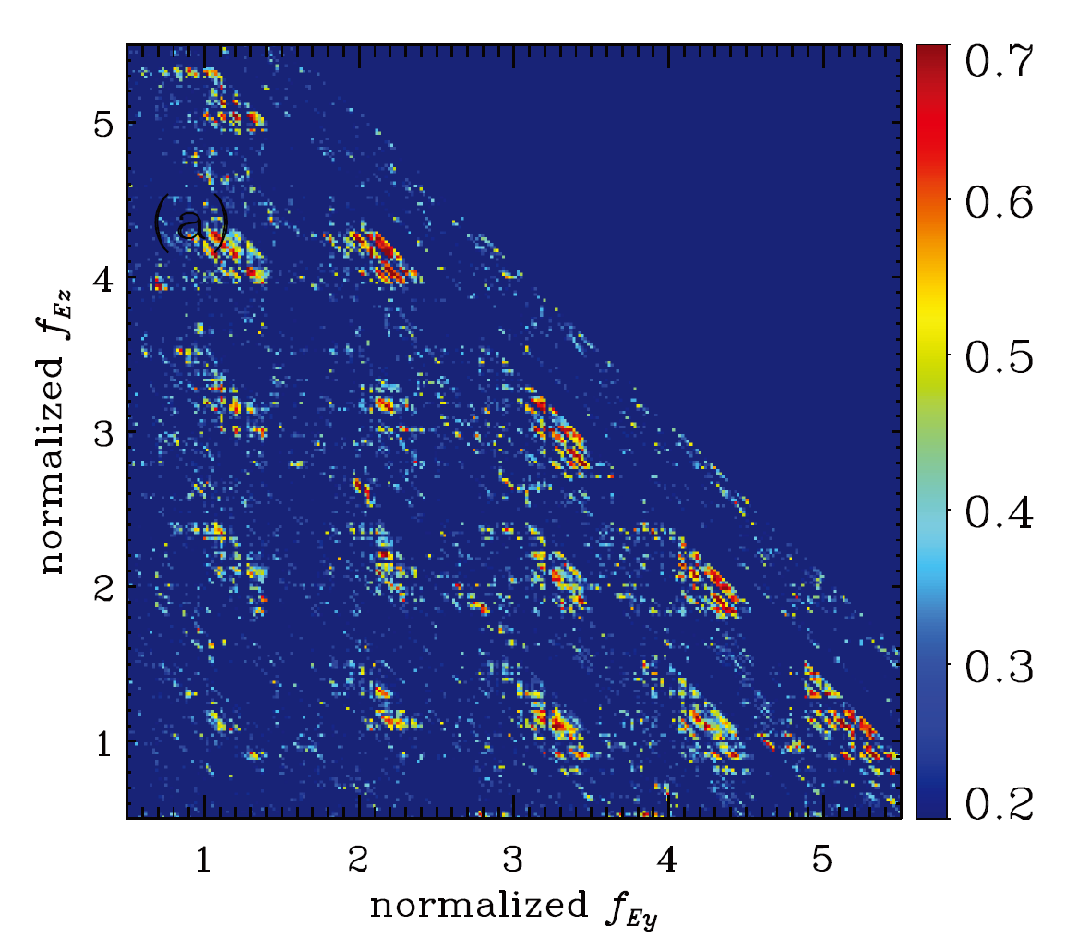
Introductions: nonlinear wave structures
Zhu and Chen et al. (2018)
Chen et al. (2018)

Slide 5
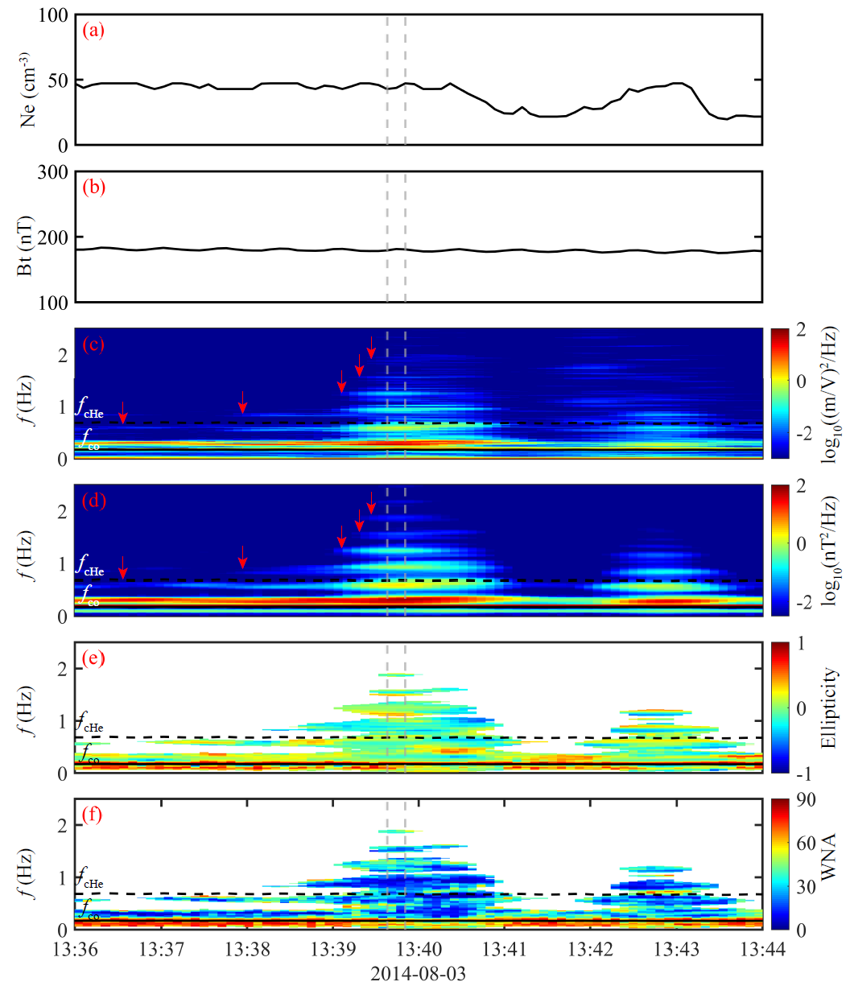
Observations: overview of EMIC case
lower density
six emissions are observed
frequencies between 0.2 and 2.5 Hz
linearly polarized (∼0, panel e)
quasi-parallel propagation (∼15◦ , panelf)
EMIC waves

Slide 6
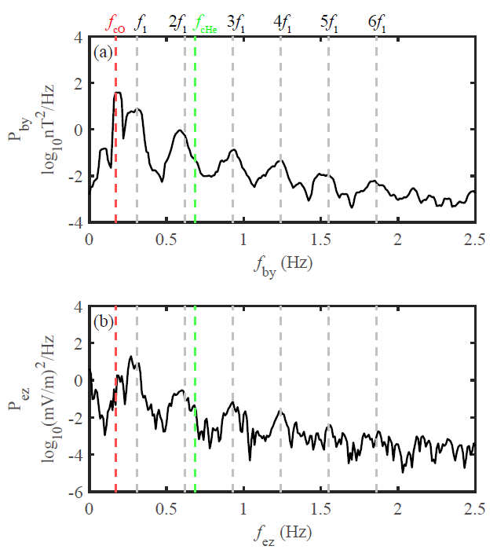
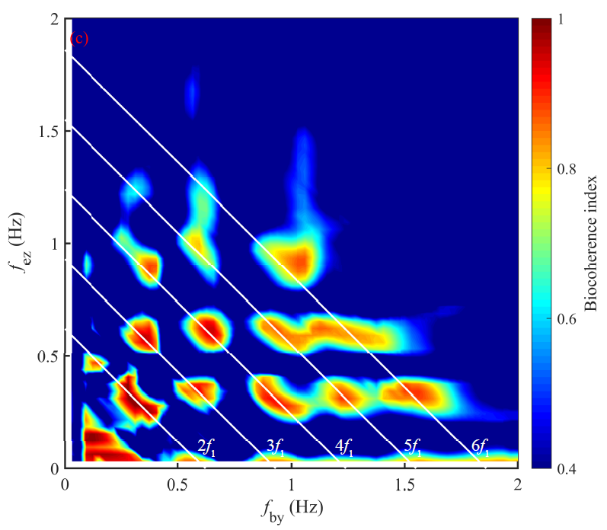
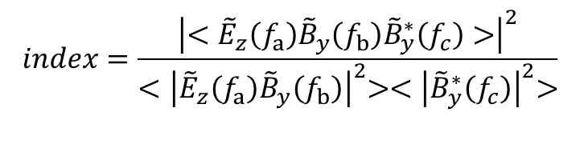
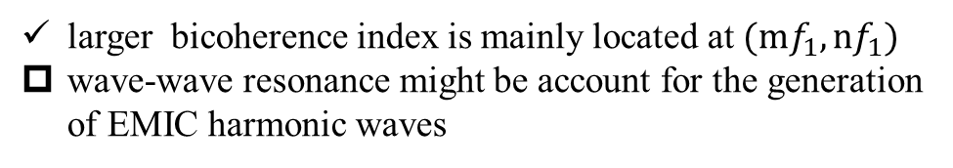
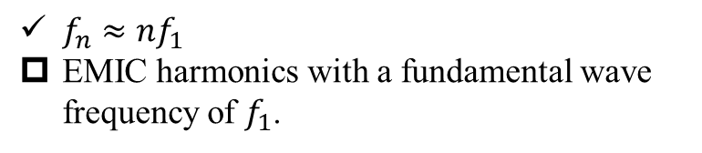
Observations: Bicoherent index
$$index=\frac{{\left|<{\tilde{E}}_{z}\left(f_{a}\right){\tilde{B}}_{y}\left(f_{b}\right){\tilde{B}}_{y}^{∗}\left(f_{c}\right)>\right|}^{2}}{{<\left|{\tilde{E}}_{z}\left(f_{a}\right){\tilde{B}}_{y}\left(f_{b}\right)\right|}^{2}>{<\left|{\tilde{B}}_{y}^{∗}\left(f_{c}\right)\right|}^{2}>}$$
$f_{n}≈{nf}_{1}$
EMIC harmonics with a fundamental wave frequency of $f_{1}$.
larger bicoherence index is mainly located at $(mf_{1},nf_{1})$
wave-wave resonance might be account for the generation of EMIC harmonic waves

Slide 7
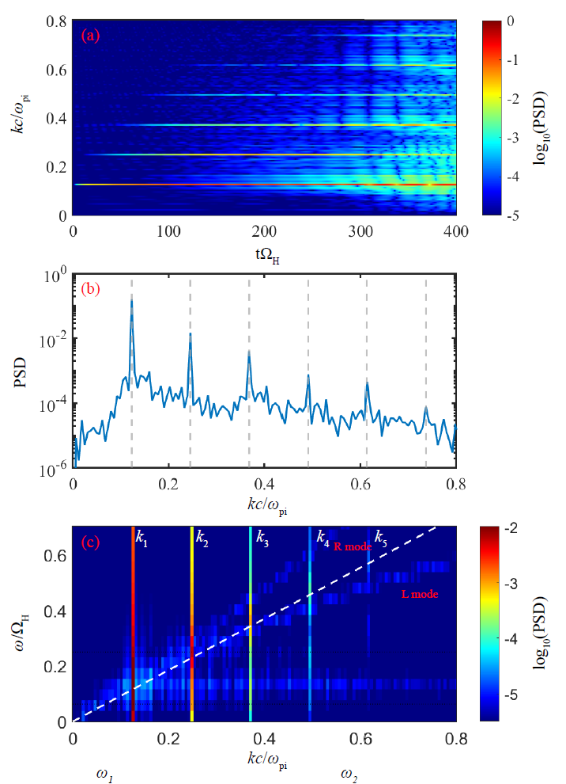

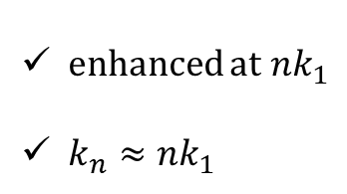
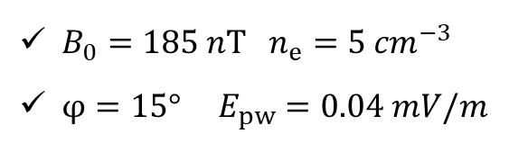
Hybrid Simulations
$B_{0}=185 nT n_{e}=5 {cm}^{−3}$
$φ=15° E_{pw}=0.04 mV/m$
harmonics are successively generated order by order
enhanced at ${nk}_{1}$
$k_{n}≈{nk}_{1}$
the second harmonic plays an essential role in the generation of higher harmonics

Slide 8
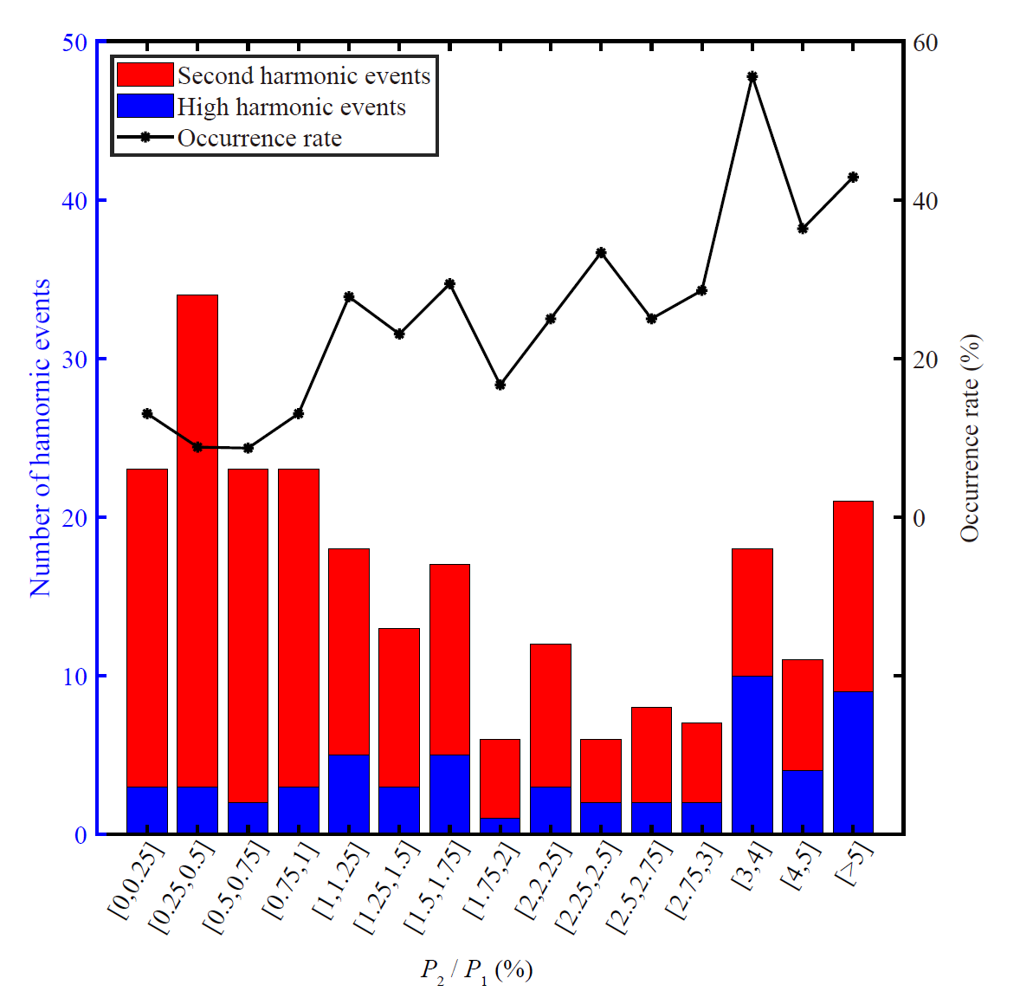
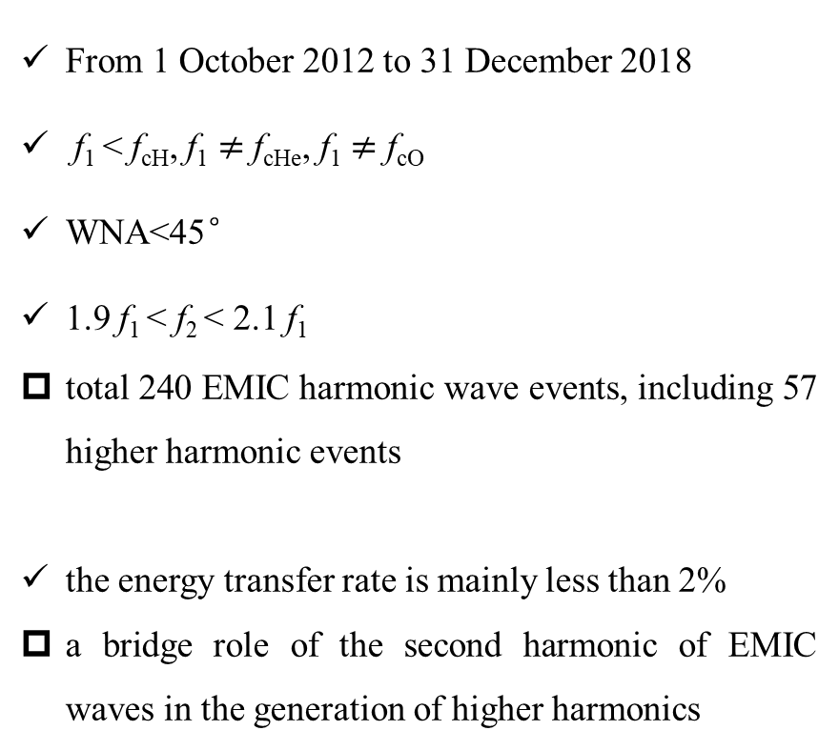
Discussions: the role of the second harmonic
From 1 October 2012 to 31 December 2018
f₁ < f_{cH}, f₁ $≠$ f_{cHe}, f₁ $≠$ f_{cO}
WNA<45°
1.9 f₁ < f₂ < 2.1 f₁
total 240 EMIC harmonic wave events, including 57 higher harmonic events
the energy transfer rate is mainly less than 2%
a bridge role of the second harmonic of EMIC waves in the generation of higher harmonics

Slide 9
Conclusions
With the help of Van Allen Probe B, we study an interesting event of electromagnetic ion cyclotron (EMIC) waves with up to sixth harmonics in detail.
An interesting observational event of EMIC harmonic emissions has been demonstrated to be generated via nonlinear wave-wave coupling.
(n + m)-th harmonic waves could be driven by nth harmonic and mth harmonic through the nonlinear wave-wave couplings
EMIC harmonics are successively generated order by order, implying essential role of the second harmonic in generation of higher harmonics.
Statistical results from satellite observations suggest a bridge role of the second harmonic of EMIC waves in the generation of higher harmonics.

Slide 10


Thank You !

