Slide 1
Degradation of PFAS by activated persulfate
Lin Qian ª, Sarah Sühnholz ^{a,b}, Julian Bosch ^{b}, Katrin Mackenzie ª, and Anett Georgi ª
ª Helmholtz-Center for Environmental Research - UFZ, Department of Environmental Engineering, Permoserstr. 15, D-04318 Leipzig, Germany
^{b} Intrapore GmbH, Katernberger Str. 107, D-45327 Essen, Germany
SSS 7.5
24th May 2022, EGU22

Slide 2

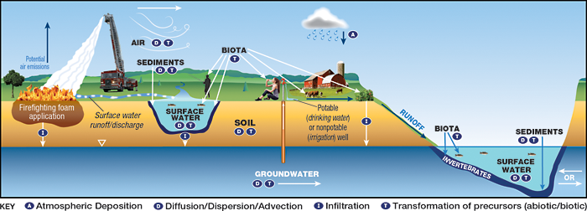



Introduction
Per- and polyfluoroalkyl substances (PFAS)
PFAS were reported to slip through wastewater treatment plants
Industrial and consumer products
Environmental Fate and Transport for Per- and Polyfluoroalkyl Substances (IRTC)
Perfluorooctanoic acid (PFOA)
Persulfate-based processes
Activation
$$S_{2}O_{8}^{2−}\underset{→}{ }2SO_{4}^{−}∙$$
Carboxylic group attack by one-electron transfer
$C_{7}F_{15}COO^{−}+SO_{4}^{−}∙\underset{→}{ }{ C}_{7}F_{15}COO∙+SO_{4}^{2−}$
Average D_{C-F} = 532 kJ mol⁻¹
Subsequent decomposition,
radicals and hydrolysis reactions
$${ C}_{7}F_{15}COO∙ { C}_{n}F_{2n+1}COO^{−}+CO_{2}+F^{−}$$
Resistant to conventional reduction, oxidation and biological degradation
Environment international 106 (2017): 37-47
Esircworldwide.com Greensciencepolicy.org

Slide 3
Strategy I
Degradation of PFOA by persulfate activation with FeS

Slide 4


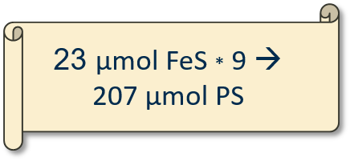
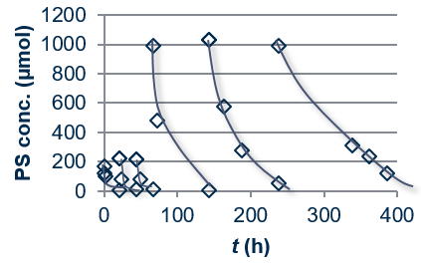
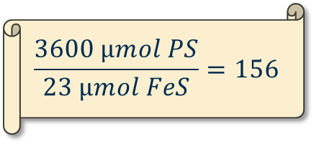
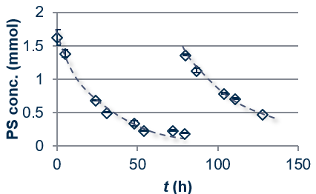
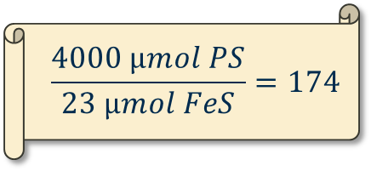
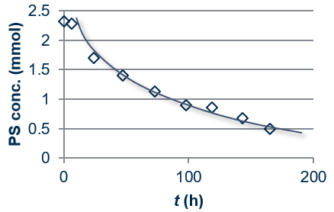

Degradation of PFOA by persulfate activation with FeS
Literature
pH=3
Sarah Sühnholz
pH=5
FeS can partially adsorb PFOA
pH=7
FeS is a catalyst
Sühnholz at al., Chem. Eng. J.(2021)

Slide 5
Degradation of PFOA by persulfate activation with FeS – Field Test
Field information:
Sum PFAS: 1.1 µg L⁻¹ (70 % sulfate radicals degradable compounds)
Contaminated by fire-fighting foam
Soil mainly fine and medium sand
Permeability coefficient was determined with k_{f} = 1.3 *10⁻⁴ m s⁻¹ (Flow velocity = 0.5 m d⁻¹)
Aquifer: floor distance of approx. 17 m and thickness of 5 m
pH = 5
Chromatography effects on the displacement of PFASs in groundwater
Normalized concentration of degradable vs. non-degradable PFAS

Slide 6
Strategy II
Degradation of PFOA by heat-activated persulfate with zeolite

Slide 7

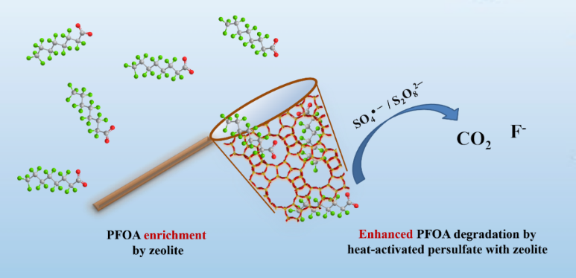
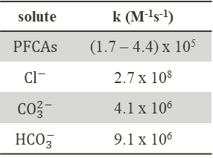
Degradation of PFOA by heat-activated persulfate with zeolite
Limitations: low efficiency in natural water matrix
Zeolite can enrich trace PFOA from water and promote the PFOA degradation by heat-activated persulfate
Rate constants for reaction of sulfate radicals with some solutes
solute | k (M⁻¹s⁻¹)
$$PFCAs$$ | (1.7 – 4.4) x 10⁵
$$Cl^{−}$$ | 2.7 x 10⁸
$$CO_{3}^{2−}$$ | 4.1 x 10⁶
$$HCO_{3}^{−}$$ | 9.1 x 10⁶
Lin Qian
Reaction conditions: 50 g L⁻¹ BEA35, 240 μM PFOA, 100 mM persulfate, pH₀=3.0, and T=70 ⁰C
Qian at al., Chem. Eng. J.(2022)

Slide 8
Cost estimation
Case: 10 m³ h⁻¹ of contaminated water with an inflow concentration of 10 µg L⁻¹ PFOA
For one regeneration step
Adsorber with on-site regeneration
Zeolite fixed-bed costs
Prevailing large-scale PFAS removal technologies with groundwater pump-and-treat units.
20-60 € kg⁻¹ for industrial BEA-type zeolites (36,000 - 108,000€)
10% PFOA breakthrough (C_{out}/C_{in} = 0.1) estimated after 43,000 m³ treated water (6 months)
Ion exchange | 0.8–1.7 € m⁻³
Activated carbon | 0.5–0.9 € m⁻³
Reverse osmosis | 1.7-2.2 € m⁻³
Sodium persulfate costs
25 € for each regeneration step
S₂O₈²⁻
Heat energy costs
35 € for each regeneration step
Zeolite
ΔT
Overall
0.08 – 0.25 € m⁻³ for 10 cycles
0.02 – 0.05 € m⁻³ for 50 cycles
Zeolite (99%)
Zeolite (96%)
PFOA-contaminated water
Periodically regenerated
Costs determined mainly by the investment costs for the zeolite based on its long-term stability
Treatment of PFOA-contaminated water in a realistic application scenario – zeolite fixed-bed adsorber
PFAS groundwater remediation: State of the art technology and comparison of costs - Handbuch Altlastensanierung und Flachenmanagement (HdA).

Slide 9


Thank you!
Acknowledgement:
Prof. Frank-Dieter Kopinke, Dr. Anett Georgi
Colleagues at Department of Environmental Engineering, Helmholtz-Center for Environmental Research – UFZ, Germany
Contact Info:
Email
lin.qian@ufz.de
LinkedIn

