Slide 1
Impact of climate change on heat related child (under 5s) mortality in Africa
Sarah Chapman, Cathryn Birch, John Marsham, Cherie Part, Shakoor Hajat, Matthew Chersich, Kristie Ebi, Stanley Luchters, Britt Nakstad, Sari Kovats

Slide 2
Aims
CHAMNHA project – climate change impacts on maternal and child health
How much heat related child mortality (HRCM) occurred in Africa between 1995 – 2020?
How much of this was due to climate change, and how much due to population changes and changes to all-cause mortality rates?
How much HRCM will occur between 2020 – 2050, considering climate change, population change and changing all-cause mortality rates?
Notes:
SSP2 is the mid range pop projection
GBD reference scenario is the mid range projection from GBD (Global Burden Disease)

Slide 3
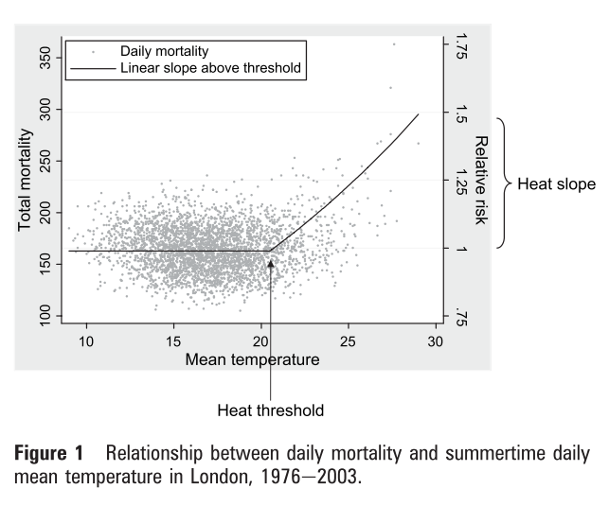
How to calculate heat related child mortality?
Use an exposure-response function which defines relationship between the response (mortality) and exposure (high temperatures)
In general, risk of heat related mortality increases once temperature rises above a certain threshold
Threshold and strength of temperature-mortality relationship vary geographically due to climate, but also due to demographic and socio-economic factors
Only 2 studies we can use for Africa – from Kenya and Ghana -> work should be considered a first estimate of scope of issue
Threshold: 75th percentile of daily mean temp
Relationship strength: 1% or 0.61% increase in child mortality for each 1ºC rise above threshold
(Hajat et al., 2010)
Notes:
A few other studies for children in Africa, but use different methods (i.e., look at monthly temperatures, rather than daily, look at tmax, rather than tmean, or use a different function without a threshold). These are the only two that I’m (and Shak and Sari I think) aware of that we can actually combine

Slide 4
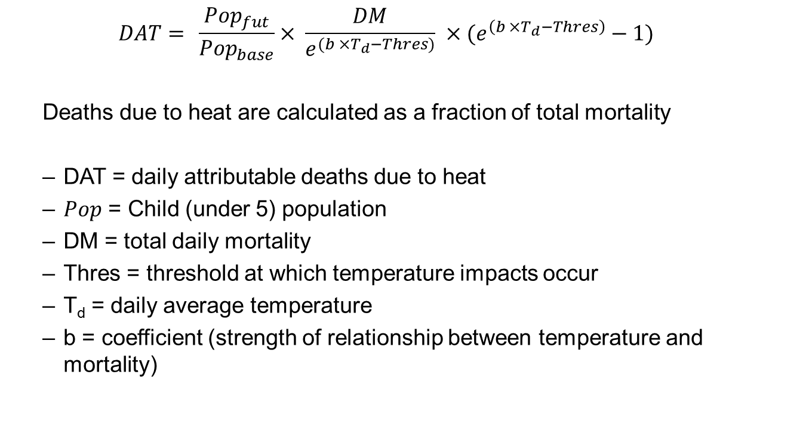
Approach
$$DAT= \frac{{Pop}_{fut}}{{Pop}_{base}}× \frac{DM}{e^{(b ×T_{d}−Thres)}} ×(e^{\left(b ×T_{d}−Thres\right)}−1)$$
Deaths due to heat are calculated as a fraction of total mortality
DAT = daily attributable deaths due to heat
$Pop$ = Child (under 5) population
DM = total daily mortality
Thres = threshold at which temperature impacts occur
T_{d} = daily average temperature
b = coefficient (strength of relationship between temperature and mortality)

Slide 5
Input data
Daily average temperature and threshold at which mortality starts to occur
Bias corrected CMIP6 models
Bias corrected using linear scaling and monthly correction factors, based on CRU
Scenarios
Attribution: Historical and hist-nat from DAMIP (no anthropogenic climate change)
Climate change impacts: SSP119, 245, 585
Population data
Present: WorldPop gridded (1km²) under 5 population
Future: SSP2 (mid-range) population projection (adjusted using linear scaling)
All-cause mortality
Present: UNICEF under 5 mortality
Future: Global Burden of Disease (GBD) Reference Scenario (extrapolated from 2040 to 2050 and adjusted using linear scaling)
Notes:
GBD mortality scenarios only go out to 2040 – extrapolated beyond that using a 2nd order polynomial

Slide 6
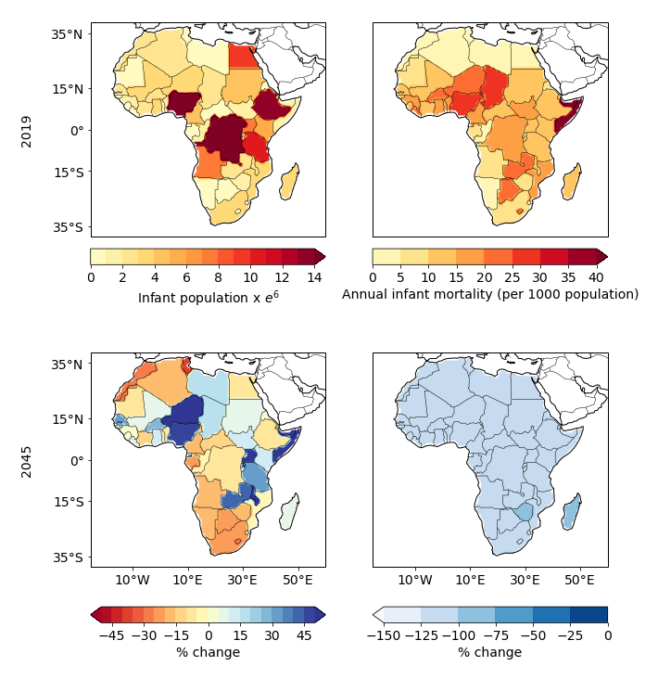
Input data
Generally, population is increasing over time and then slowly decreasing after about mid-century
Mortality rate is declining, assuming improved healthcare, socio-economic situation
For calculating mortality due to heat, population and mortality was distributed within countries based on 2019 population

Slide 7
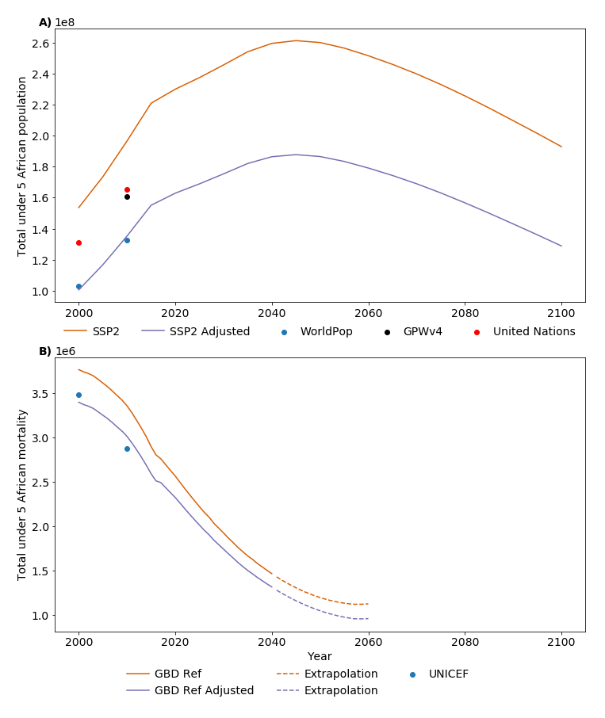
Input data
Future and present day population and mortality data don’t line up exactly
To avoid a large jump in mortality numbers for future, adjusted future mortality and population to be in line with present day values
Adjustment applied on an country by country basis
Result would generally be too decrease the total amount of heat related child mortality

Slide 8
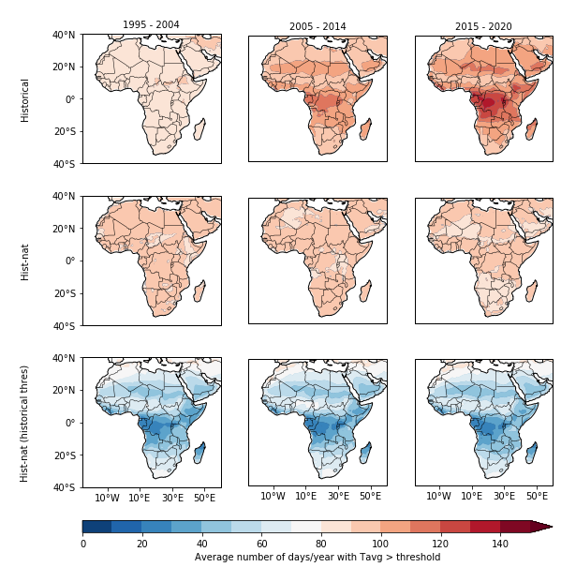
Climate data
How many days per year above 75th percentile of daily average temperature (1995 – 2010)
Can see that climate change already impacting temperatures

Slide 9
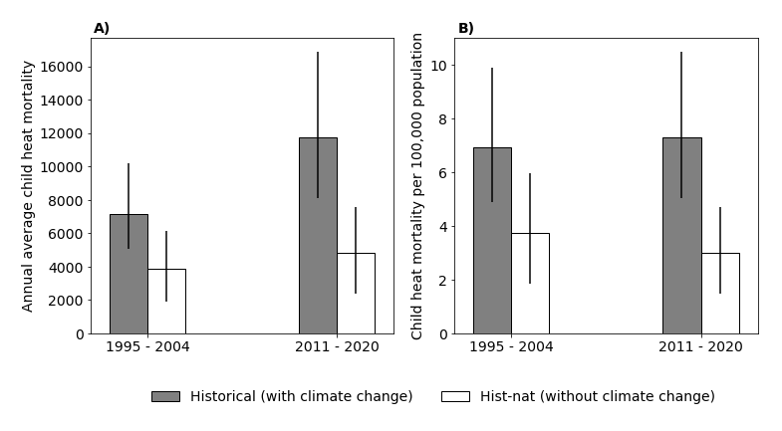
Change in heat related child mortality from 1995 - 2020
HRCM rate increases slightly with climate change
Larger increase in total HRCM with climate change…
…than without
Without climate change it would have declined

Slide 10
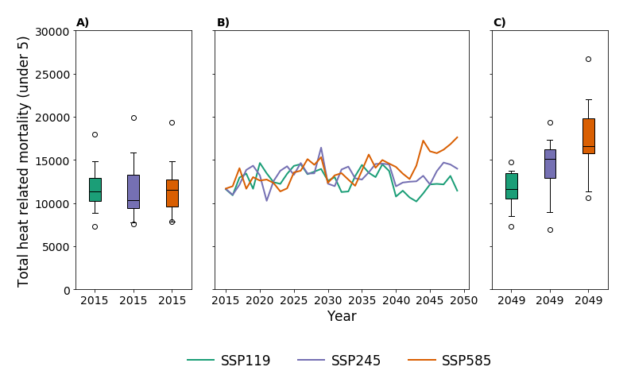
Future climate impacts
Lines show 5 – 95th percentile from CMIP6 ensemble
Heat related mortality increasing over time
SSP585 starts to diverge from the other scenarios after ~ 2040
2040s – heat related mortality beings to stabilize for SSP119 (continues to increase SSP585 and 245)
2049 SSP585 heat related mortality double average from 2005 – 2014
Avoiding SSP585 will save lives
SSP119 will save ~4 000 to 6 000 lives per year in 2040s, depending on sensitivity to heat
SSP245 will save ~2 000 to 3 000 lives versus SSP585
Notes:
Results for lower coefficient, same for higher, just larger numbers of deaths

Slide 11
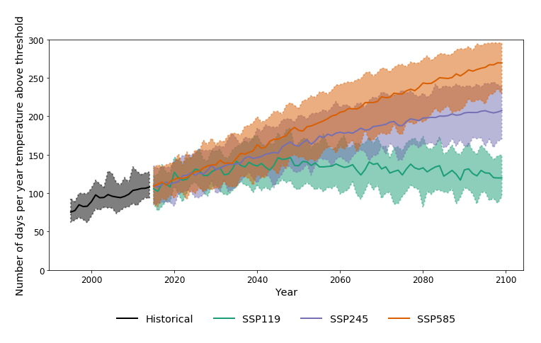
Heat related child mortality beyond 2050?
The climate in Africa is fundamentally different to the present day after 2050, particularly for SSP585
The heat-mortality relationship is unlikely to hold
Heat mortality is calculated as a component of total all-cause mortality.
All-cause mortality rate is assumed to decline over time due to improvements in socio-economic factors, however, this may not hold, particularly under a high-emission scenario
Even without quantifying heat related mortality past 2050, clear there will be benefits to keeping to SSP119 over 585 or 245.

Slide 12
Conclusions
Climate change is already increasing heat related child mortality
Climate change is likely to continue increasing heat related child mortality
Keeping to SSP119 or 245 will save lives, compared to a high emission scenario
We’ve only looked at Africa, but these results likely hold for other developing countries and for other vulnerable groups
Climate will be fundamentally different in the future, and present day heat-mortality relationships unlikely to hold
More research needed on heat-mortality relationship, particularly in developing regions

