Slide 1




G3.4
Overview of the seafloor geodetic observation conducted by the Japan Coast Guard using the GNSS-Acoustic ranging combination technique
Yuto Nakamura¹, Tadashi Ishikawa¹, Shun-ichi Watanabe¹, Yusuke Yokota²
1: Hydrographic and Oceanographic Department, Japan Coast Guard
2: Institute of Industrial Science, University of Tokyo
EGU2022 (May 23-27, 2022)

Slide 2
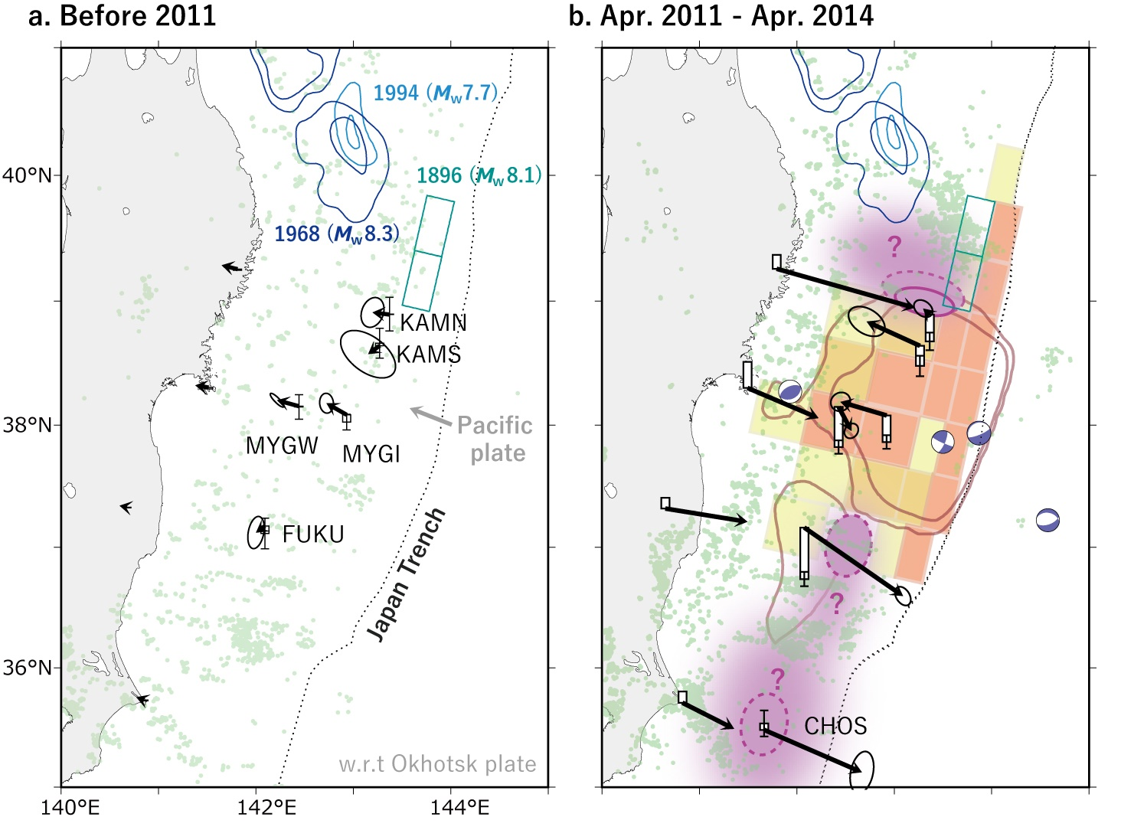
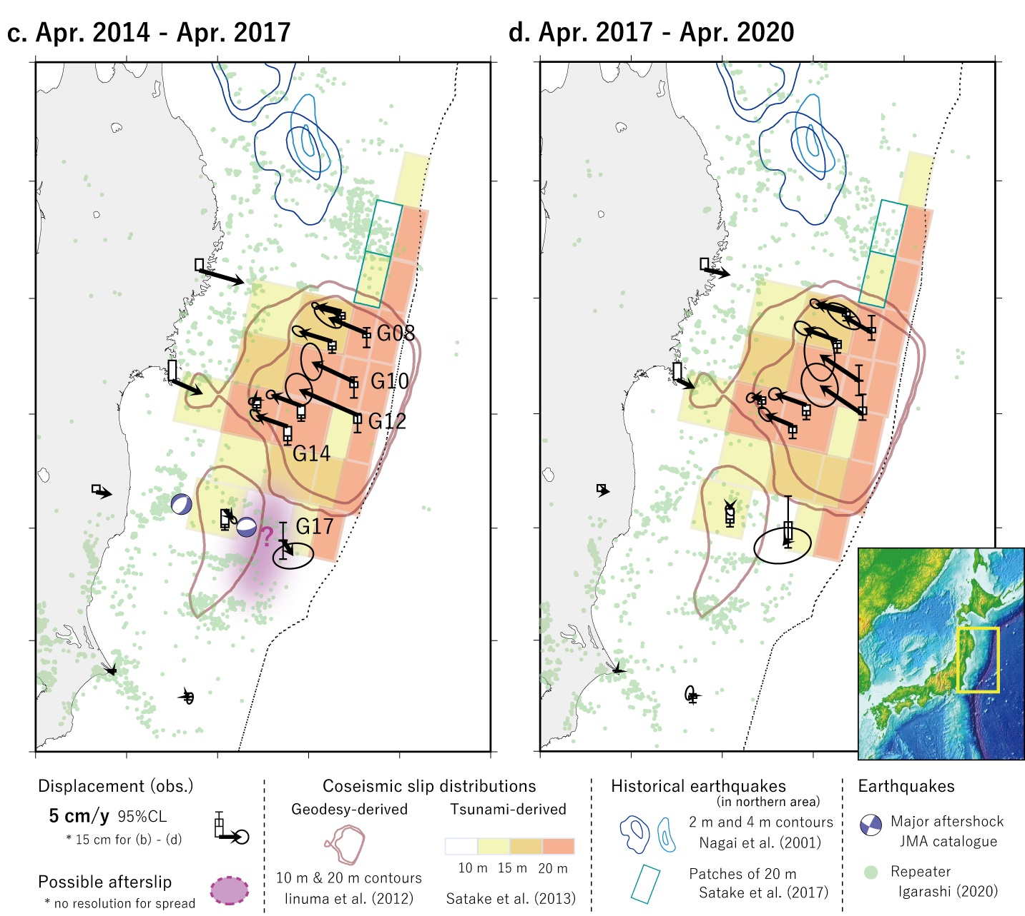
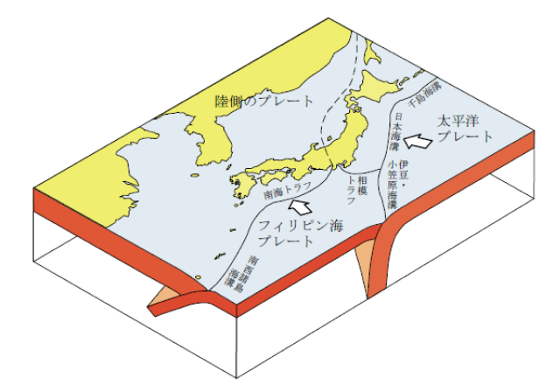
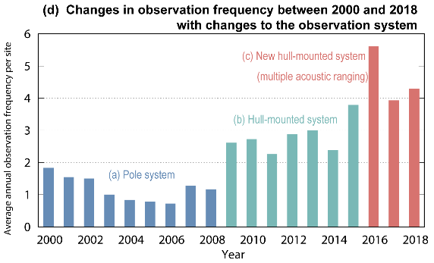

Graphical abstract
North American plate
“steady” backslip
“early” postseismic
“long-term” postseismic
Eurasian plate
(Amur plate)
(2)
Pacific plate
Nankai Trough
Japan Trench
Philippine Sea plate
Motivation of seafloor geodetic observation
Overview of GNSS-A and JCG’s sites (SGO-A)
Observation results, geophysics revealed from recent observations
Technological advancements and future works

Slide 3
Table of contents
Motivation of seismic/geodetic observations at Japan
Overview of GNSS-A, JCG’s sites (SGO-A) and data analysis
Observation results, geophysics revealed from recent observations
Technological advancements and future works

Slide 4
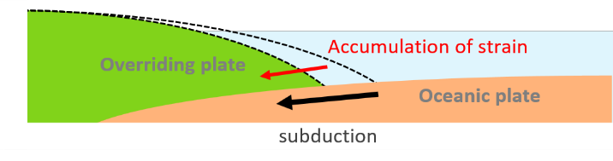
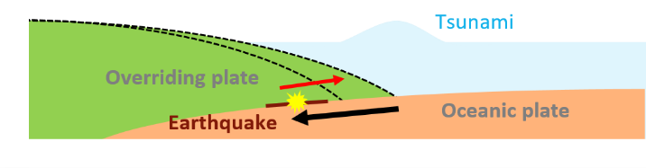
1. Motivation of seafloor geodetic observation
Japan: the tectonically active islands
Tectonic plate boundaries around Japan
Megathrust earthquakes
Eurasian plate
(Amur plate)
North American plate
Nankai Trough
Pacific plate
Philippine Sea plate
Japan Trench
The Japanese Islands are at a tectonically active zone where four tectonic plates meet.
Megathrust earthquakes occur along the subduction zones (e.g. 2011 Tohoku-oki Earthquake, $M_{w} 9.0$)

Slide 5
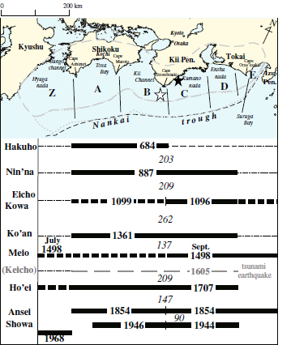






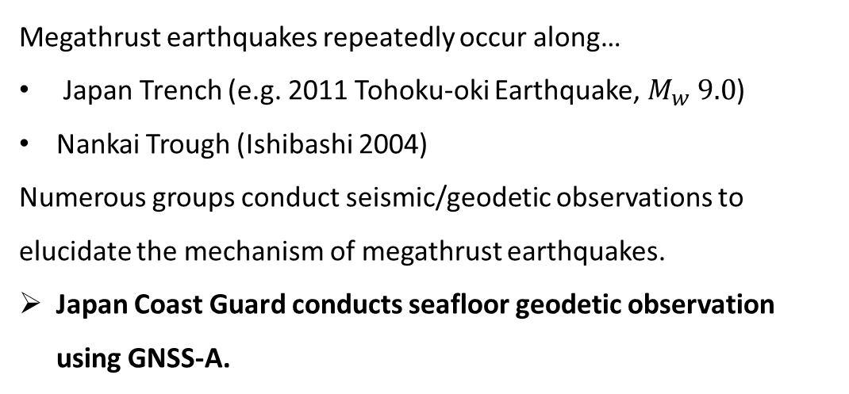
1. Motivation of seafloor geodetic observation
Megathrust earthquakes repeatedly occur along…
Japan Trench (e.g. 2011 Tohoku-oki Earthquake, $M_{w} 9.0$)
Nankai Trough (Ishibashi 2004)
Numerous groups conduct seismic/geodetic observations to elucidate the mechanism of megathrust earthquakes.
Japan Coast Guard conducts seafloor geodetic observation using GNSS-A.
Seafloor geodetic observation (us)
and more…
Earthquake history of Nankai Trough, from Ishibashi (2004)

Slide 6

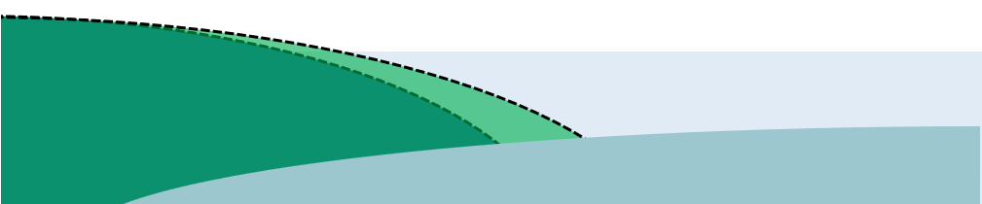
1. Motivation of seafloor geodetic observation
Monitoring seafloor crustal deformation: why is it important?
The source regions of megathrust earthquakes are mainly undersea.
Crustal deformation of the seafloor is important for elucidating megathrusts.
Coseismic slip of the 2011 Tohoku-oki earthquake: mainly undersea
Terrestrial GNSS observation
⇒GEONET (GSI)
Geodetic inversion
(Iinuma et al. 2012)
Tsunami waveform inversion
(Satake et al. 2013)
Overriding plate
Crustal deformation near the trough axis (undersea)
⇒seafloor geodetic observation (JCG)
Fault slip
Oceanic plate

Slide 7

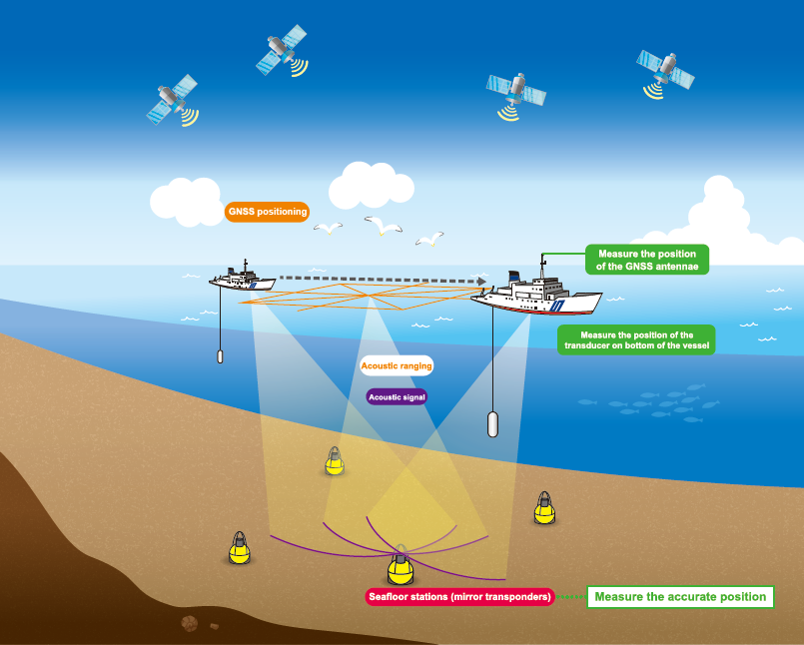
2. Overview of GNSS-A, JCG’s sites (SGO-A) and data analysis
Monitoring seafloor crustal deformation: GNSS-Acoustic (GNSS-A)
GNSS satellites
Underwater: use acoustic ranging to obtain the position of a seafloor benchmark→GNSS-Acoustic ranging (GNSS-A)
GNSS site
Radio wave signals
land
Land: GNSS observation (GEONET)
sea surface
×
seafloor
Seafloor: cannot be observed!

Slide 8
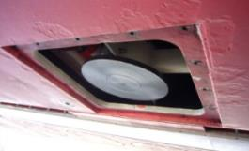
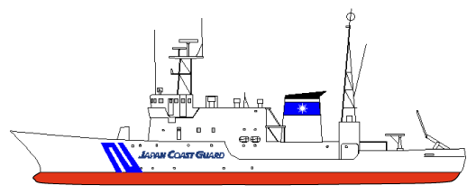
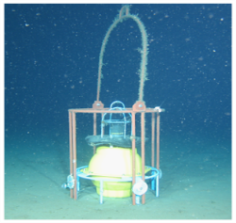

2. Overview of GNSS-A, JCG’s sites (SGO-A) and data analysis
JCG performs seafloor geodetic observation using the GNSS-Acoustic ranging combination technique (GNSS-A).
Positioning of seafloor stations by acoustic ranging
Sailing observation (ship-ship-transponder trilateration)
developed by JCG & Univ. Tokyo
Ship’s positions
are known by GNSS
Onboard transducer
Sail
Acoustic ranging
Unknown sound
speed perturbation
Transponder (seafloor station)
Round-trip travel time
solve with collection
of various slant ranges
transponder
(Photo by JAMSTEC)
Solve positions of each of transponder

Slide 9
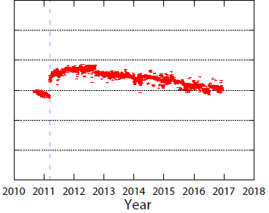
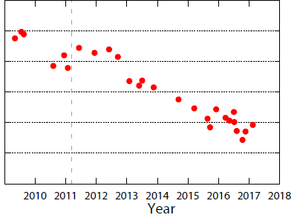
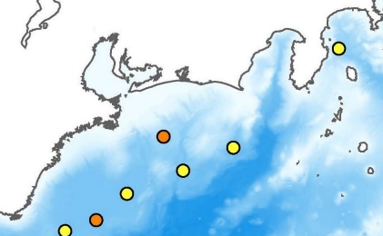
2. Overview of GNSS-A, JCG’s sites (SGO-A) and data analysis
Comparison between the terrestrial GNSS network GEONET operated by the Geospatial Information Authority of Japan (GSI) and GNSS-A observation by JCG and universities is shown on the table below.
Terrestrial GNSS vs. Seafloor GNSS-A
 | GNSS | GNSS-A
Number of sites in Japan | Approximately 1,300 GEONET sites (operated by GSI) | Approximately 60 sites (operated by JCG and universities)
Observation frequency | continuous | 3-4 times per year
Precision (horizontal component) | less than 1 cm (daily coordinates) | 2-3 cm (1σ)
Major error sources | Atmospheric (Ionospheric/tropospheric delay | Atmospheric delay + sound speed perturbation (mainly due to water temperature)
Example: GEONET vs. GNSS-A in the Tokai region
GEONET site “Omaezaki”
GNSS-A site “TOK1”
Omaezaki
~60 km
10 cm
10 cm
TOK1

Slide 10
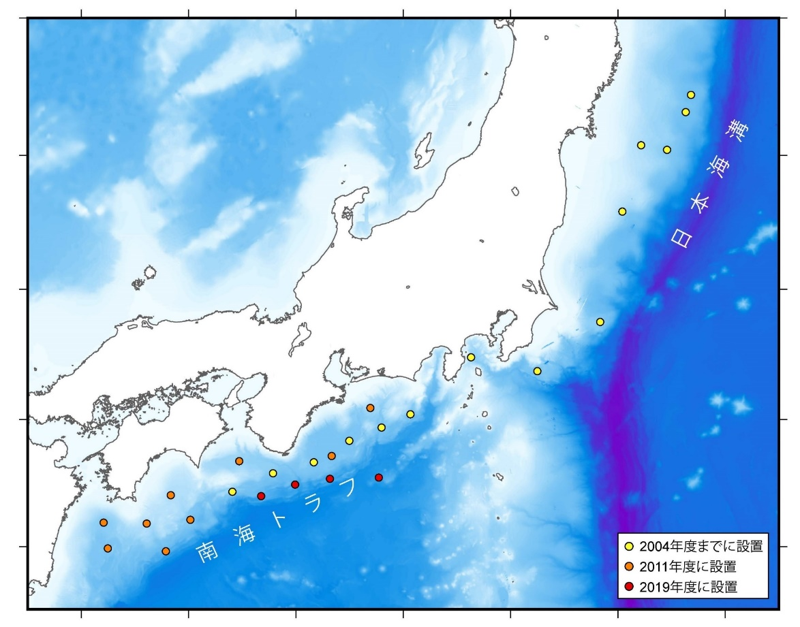
2. Overview of GNSS-A, JCG’s sites (SGO-A) and data analysis
JCG currently operates 27 GNSS-A observation sites along the Japan Trench and the Nankai Trough, named the Seafloor Geodetic Observation Array (SGO-A).
Map on the right shows the distribution of the SGO-A sites.
SGO-A was reinforced after the 2011 Tohoku-oki Earthquake (orange points).
Four sites were installed in FY2019 near the trough axis of the Nankai Trough (red points).
Sendai
Japan Trench
Tokyo
Kyoto
Hiroshima
Nankai Trough
SGO-A sites
● before 2004
● set in 2011-12
● set in 2019-20
Map of the SGO-A sites

Slide 11

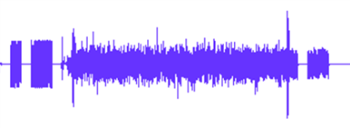
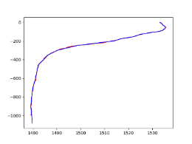






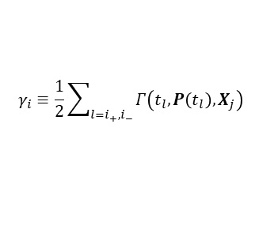

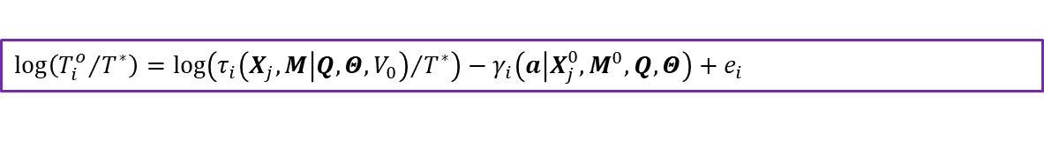


2. Overview of GNSS-A, JCG’s sites (SGO-A) and data analysis
Observables
Estimated parameters
JCG currently uses GARPOS (GNSS-Acoustic Ranging combined Positioning Solver; Watanabe et al. 2020) in the analysis routine.
GARPOS implements empirical Bayesian inversion and simultaneously estimates transponder positions and underwater sound speed structure.
$$T_{i}^{o}$$
$$V_{0}\left(u\right)$$
$$Q\left(t\right)$$
$$Θ\left(t\right)$$
$$M$$
Observed travel time
Reference sound speed profile
GNSS antenna position
Attitude of the sea surface platform
Antenna-transducer offset (relative position)
transmission
reception
$$X_{j}$$
Depth
Two-way travel time
Sound speed
Onboard transducer position
Transponders’ positions
Attitude
$$P\left(t\right)=Q\left(t\right)+R\left(Θ\left(t\right)\right)M$$
$$Γ\left(a\right)$$
The source code of GARPOS is open to everybody working on GNSS-A seafloor geodesy! Check our Zenodo repository:
GARPOS v1.0.1 (latest version)
https://doi.org/10.5281/zenodo.6414642
Reference (calculated) travel time
Correction coefficient (sound speed variation)
Sound speed perturbation model
$$τ_{i}=τ_{i}\left(P\left(t_{i_{+}}\right), P\left(t_{i_{−}}\right),X_{j},V_{0}\left(u\right)\right)$$
$$γ_{i}≡\frac{1}{2}\sum_{l=i_{+},i_{−}}{Γ\left(t_{l}, P\left(t_{l}\right), X_{j}\right)}$$
$$\log\left({T_{i}^{o}}/{T^{∗}}\right)=\log\left({τ_{i}\left(X_{j},M | Q,Θ,V_{0}\right)}/{T^{∗}}\right)−γ_{i}\left(a | X_{j}^{0},M^{0},Q,Θ\right)+e_{i}$$
Observation equation
Observation equation implemented in GARPOS

Slide 12


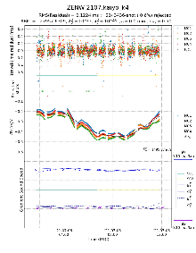
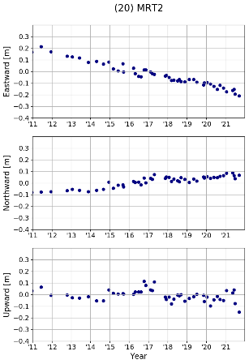
2. Overview of GNSS-A, JCG’s sites (SGO-A) and data analysis
GARPOS data
JCG’s analysis routine using GARPOS
Raw observation data files converted to GARPOS data format.
Single epoch analysis is performed using GARPOS to obtain the transponder array geometry of the latest observation epoch.
The mean transponder array geometry is computed from the single epoch analysis results of all epochs.
Assuming that the transponder array geometry is rigid, all observation epochs are reanalyzed by constraining the data with the mean array geometry computed in Step 3.
Finally, the time series of the site is created by computing the array centroid of each epoch, using the results from Step 4.
transmission
reception
Step 1
Two-way travel time
Step 2
Depth
Sound speed
Attitude
Raw data
Single epoch analysis
epoch 1
epoch 3
…
Step 3
epoch n
epoch 2
epoch 1
epoch 3
epoch 2
…
epoch n
Calculate mean array geometry
Time series
Step 5
Step 4
Analysis with array geometry constraint
Schematic diagram of JCG’s analysis routine

Slide 13
3. Observation results, geophysics revealed from recent observations
Horizontal velocity of last 4 years
(w.r.t. Eurasian plate)
Dark arrows: velocity of the SGO-A sites
Light arrows: velocity of GSI’s GEONET

Slide 14
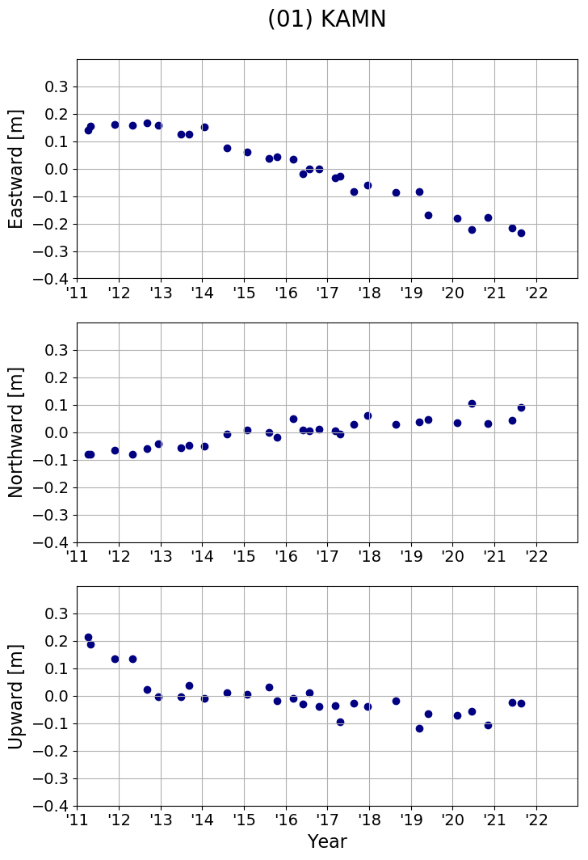
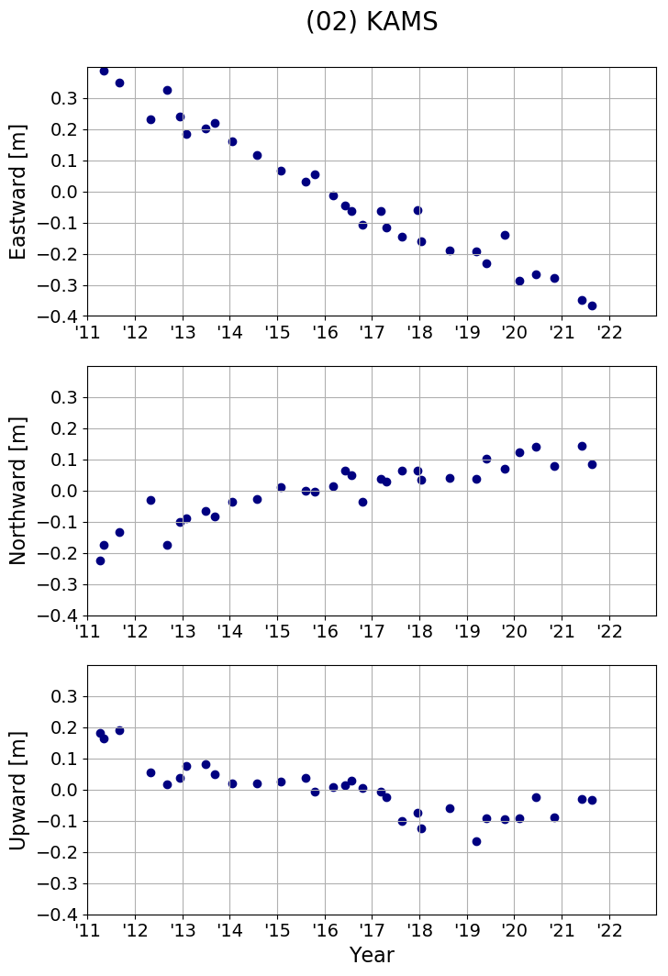
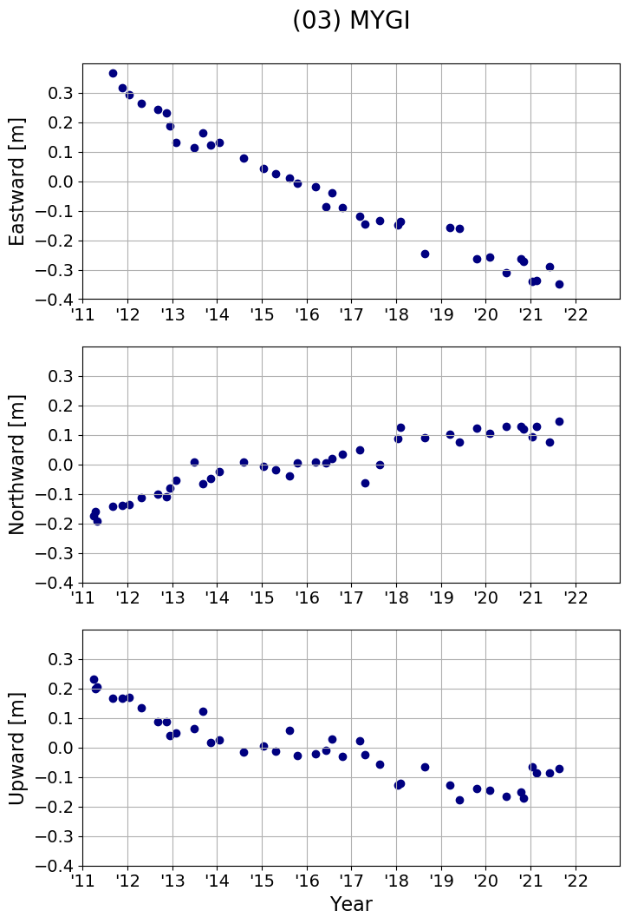
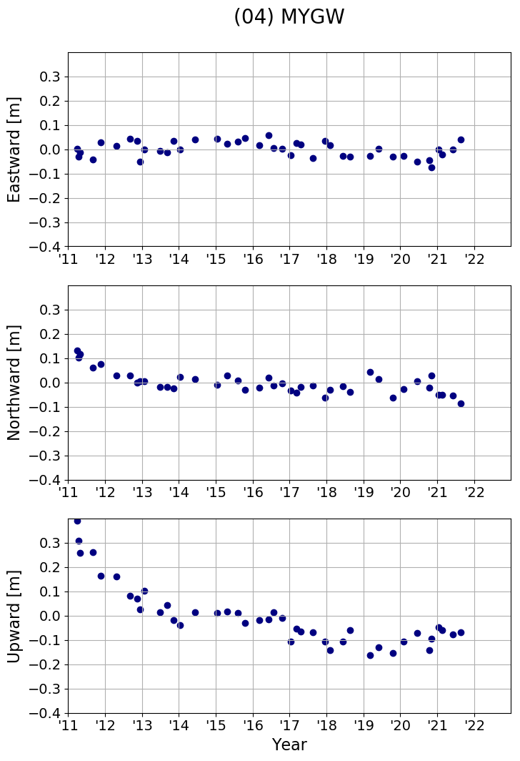
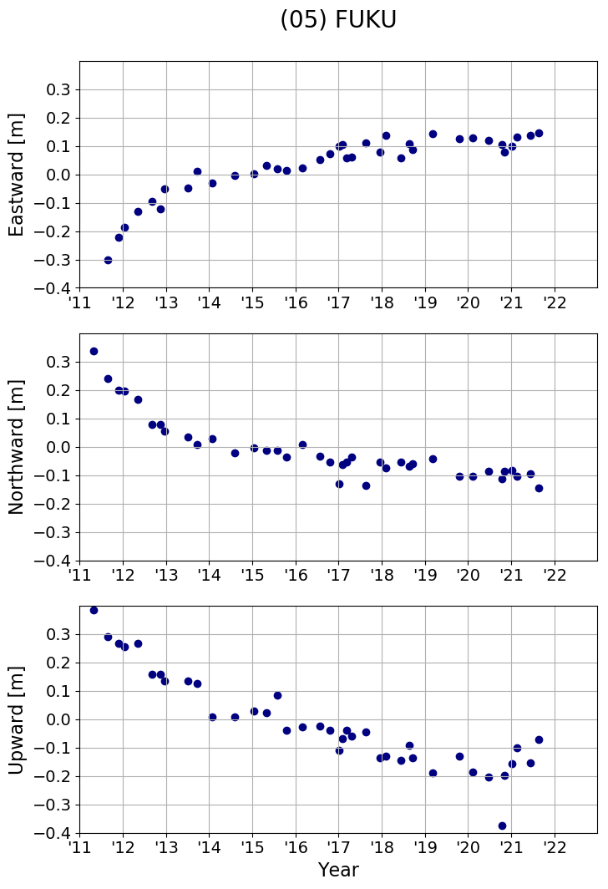
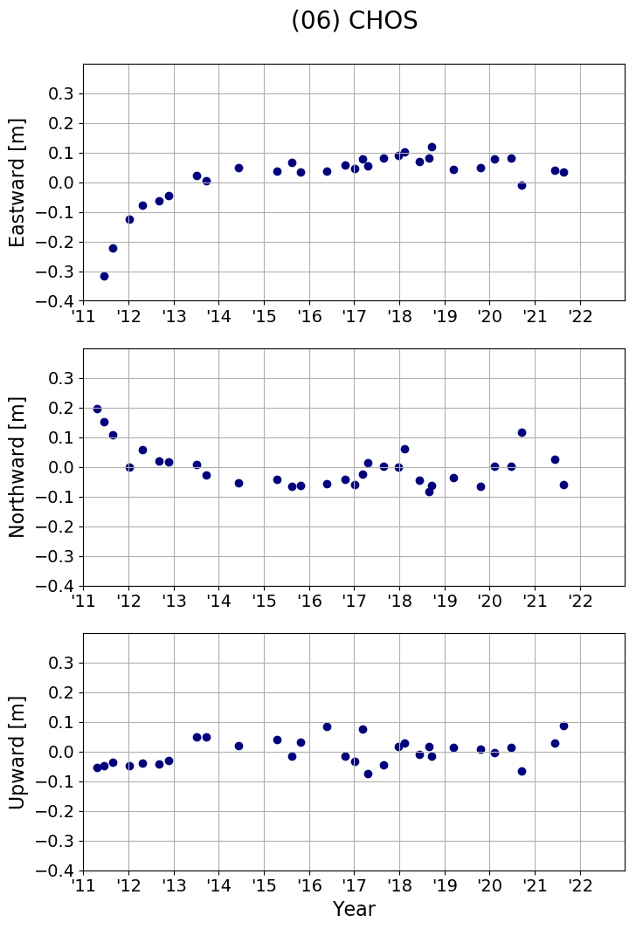
3. Observation results, geophysics revealed from recent observations
Latest observation results along the Japan Trench
(KAMN-CHOS)
KAMN
KAMS
Sendai
MYGW
MYGI
FUKU
Japan Trench
Tokyo
CHOS

Slide 15
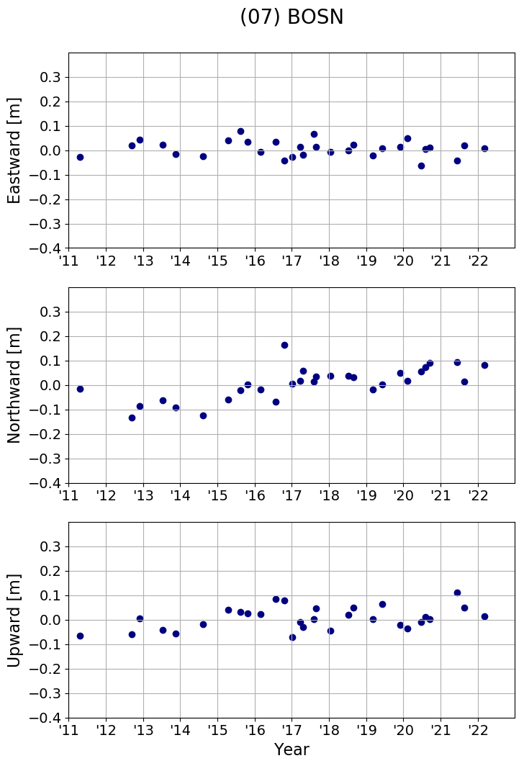
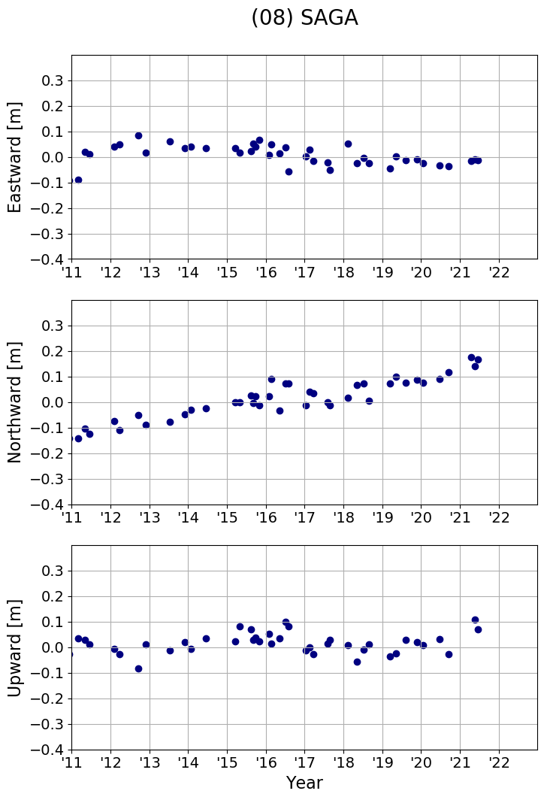
3. Observation results, geophysics revealed from recent observations
Latest observation results along the Japan Trench
(BOSN, SAGA)
Sendai
Japan Trench
Tokyo
SAGA
BOSN

Slide 16
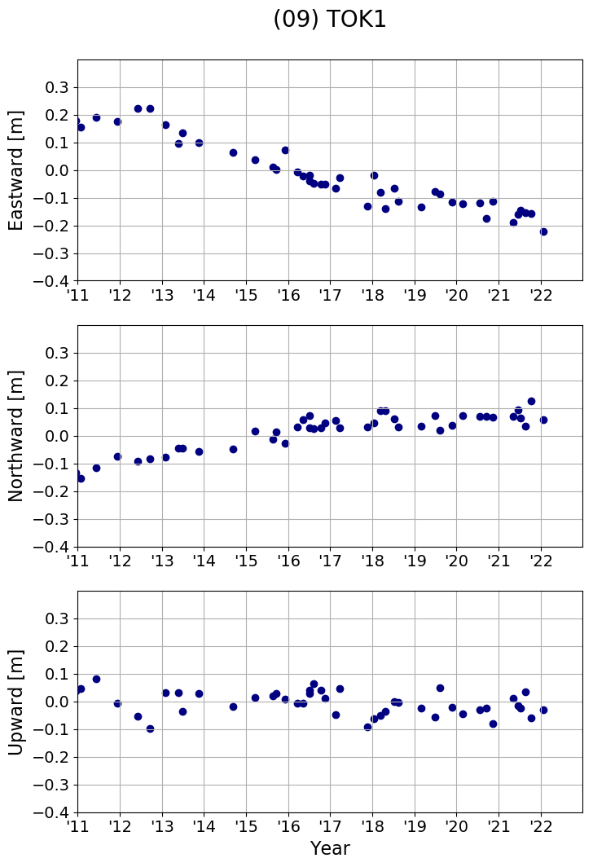
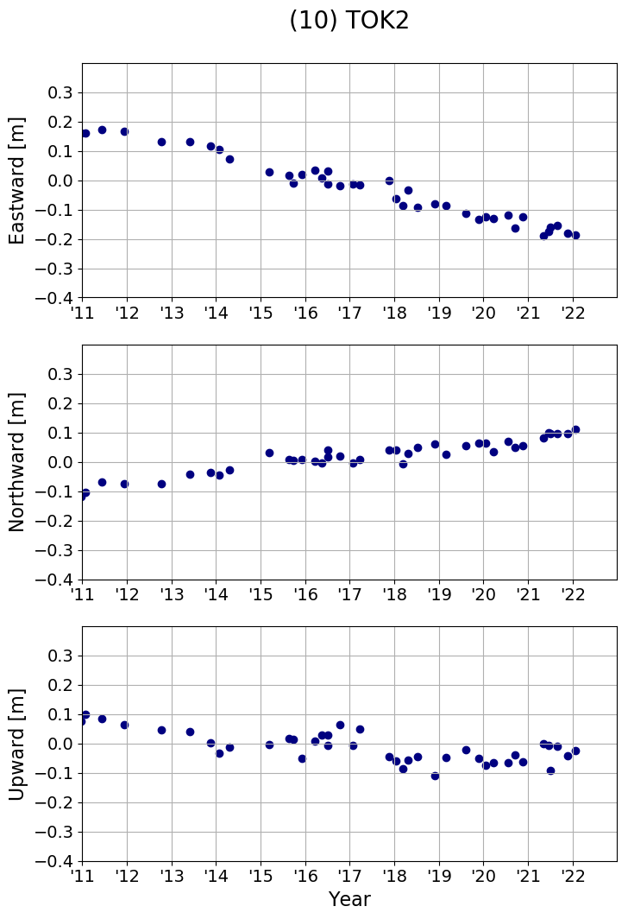
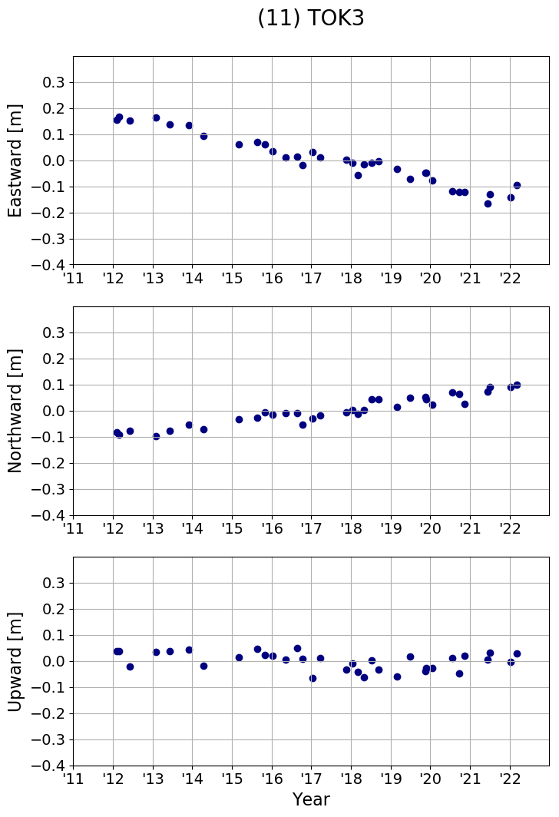
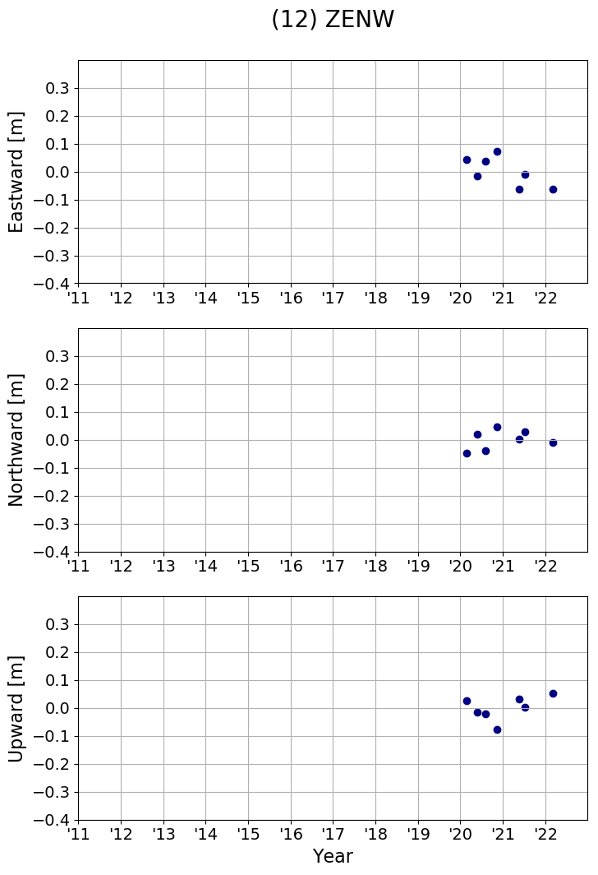
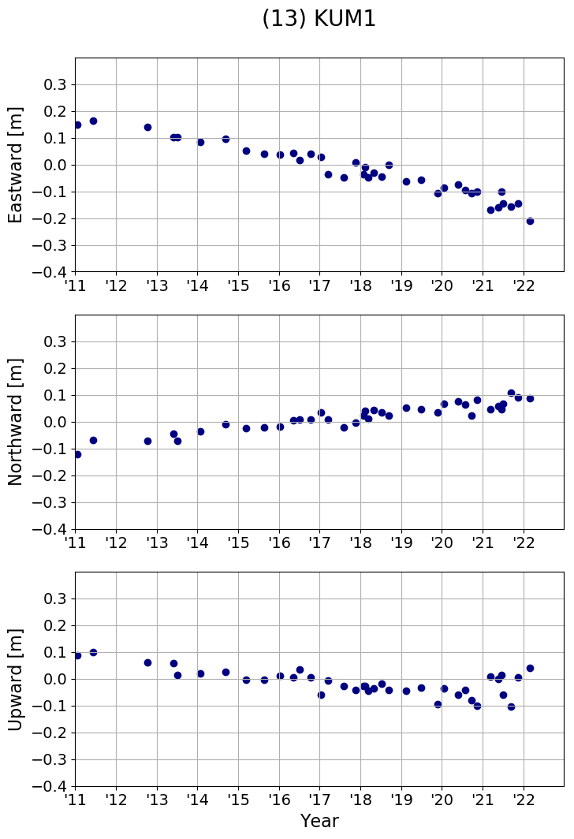
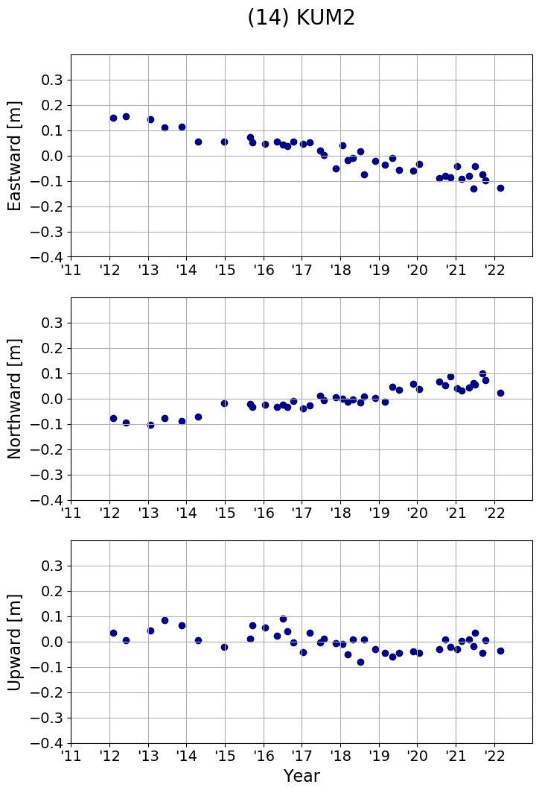
3. Observation results, geophysics revealed from recent observations
Latest observation results along the Nankai Trough
(TOK1-KUM2)
Kobe
Hiroshima
TOK3
KUM1
TOK1
KUM2
TOK2
Fukuoka
ZENW

Slide 17
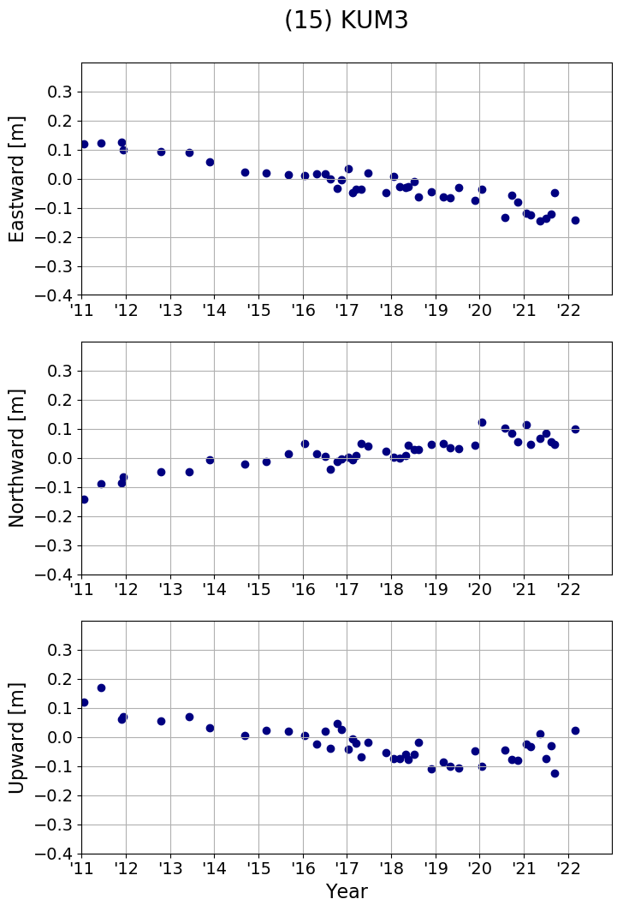
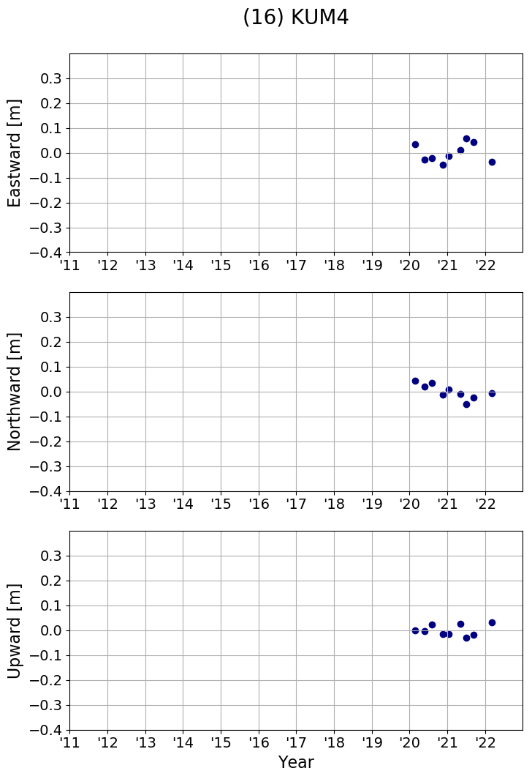
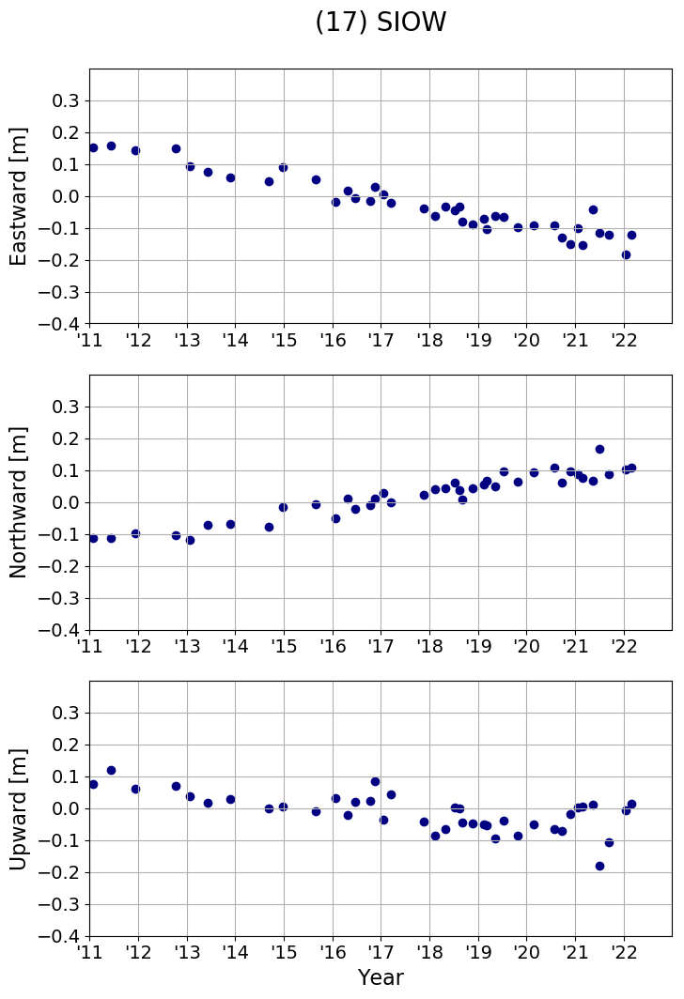
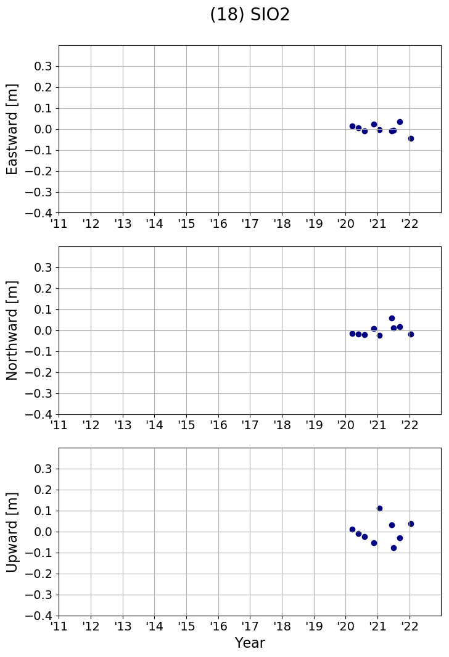
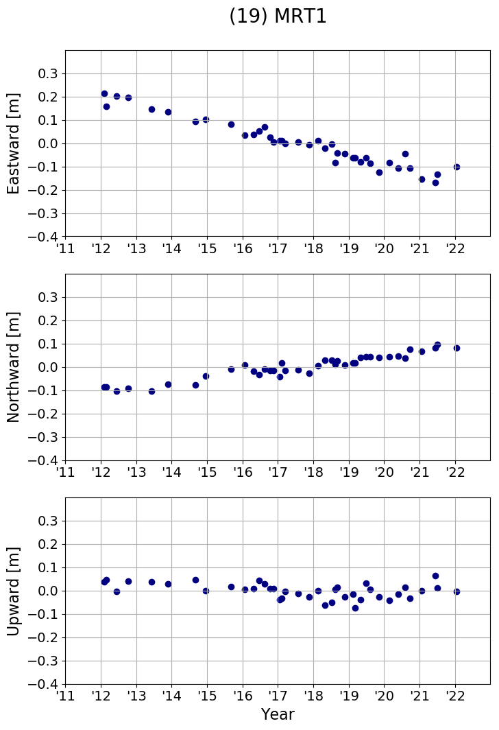
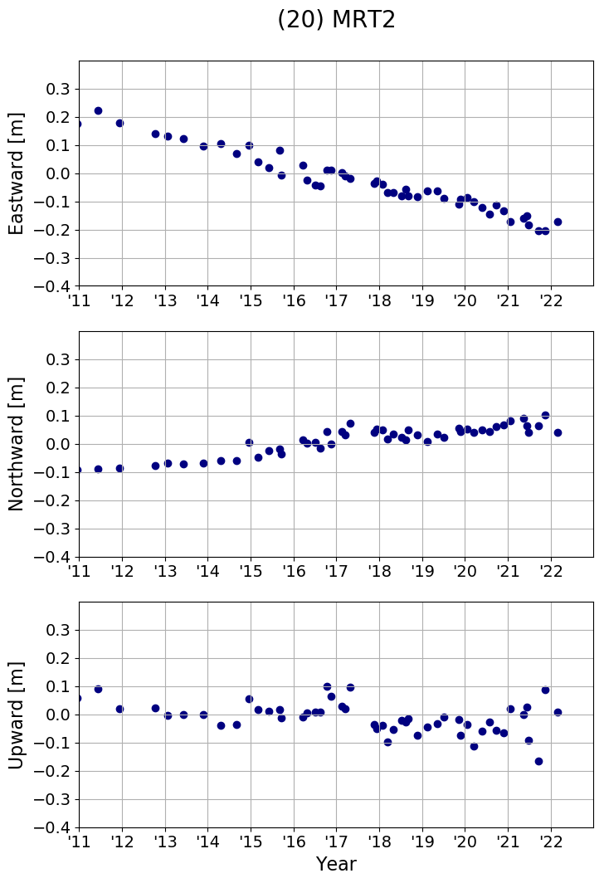
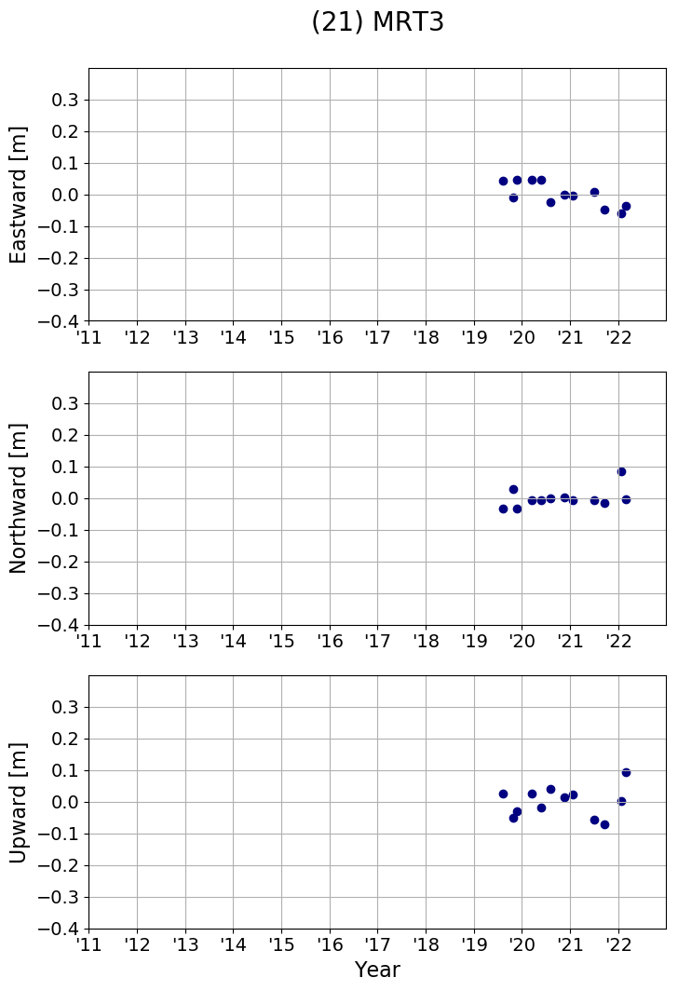
3. Observation results, geophysics revealed from recent observations
Latest observation results along the Nankai Trough
(KUM3-MRT3)
Kobe
Hiroshima
Fukuoka
KUM3
MRT1
SIOW
MRT2
SIO2
KUM4
MRT3

Slide 18
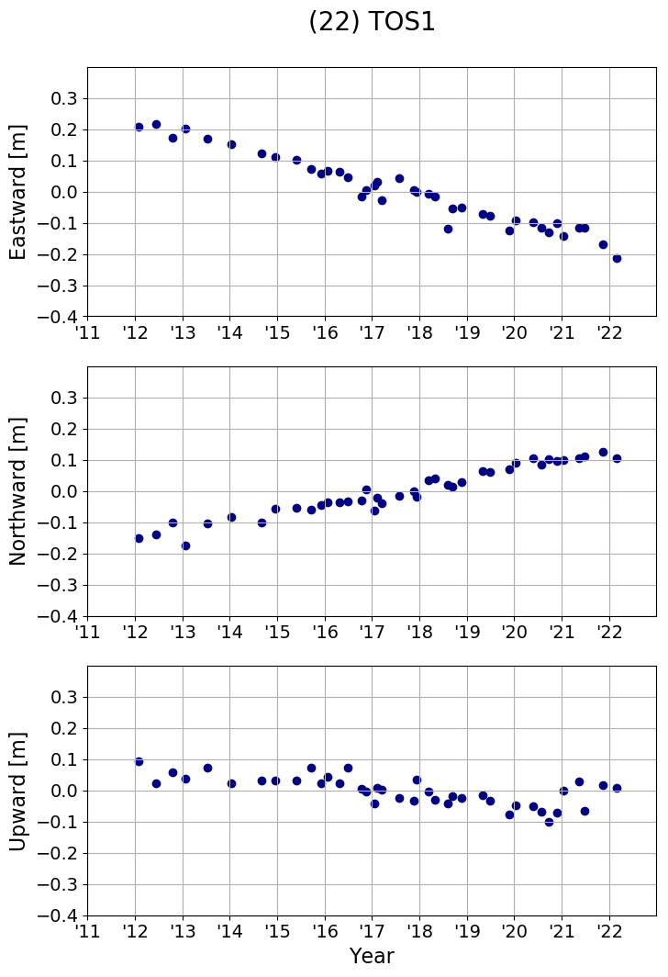
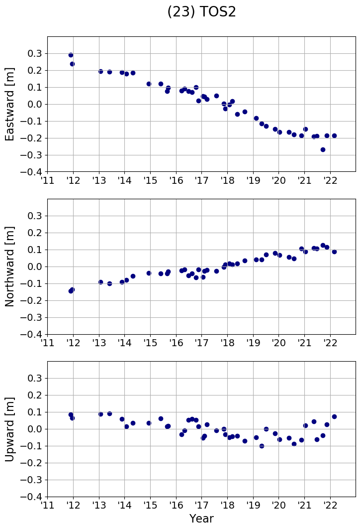
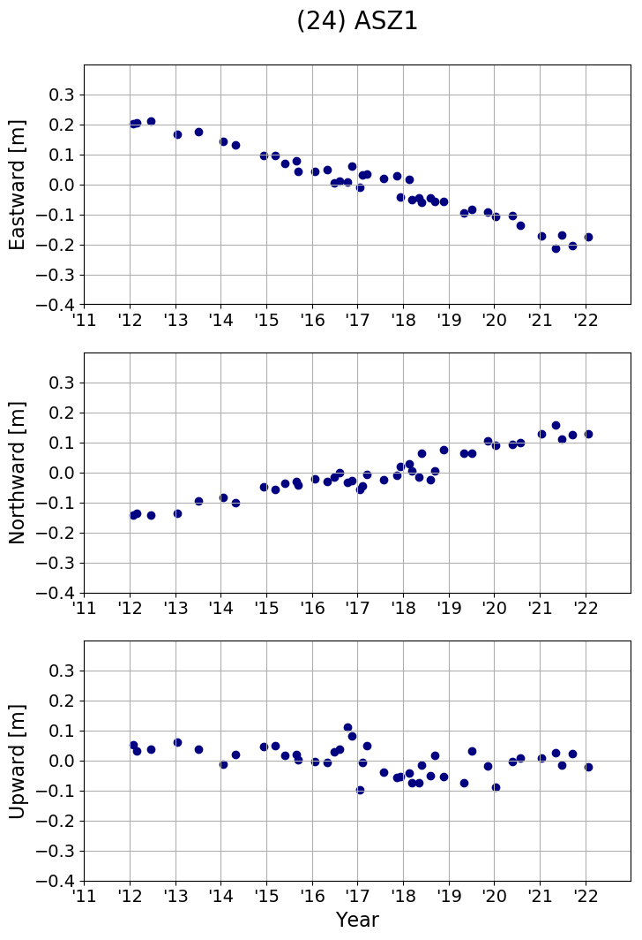
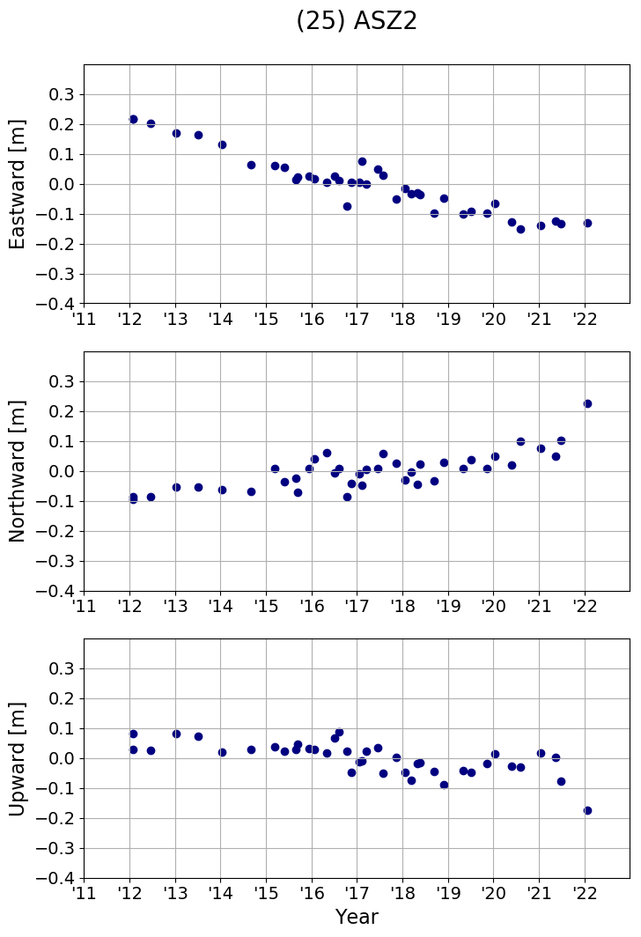
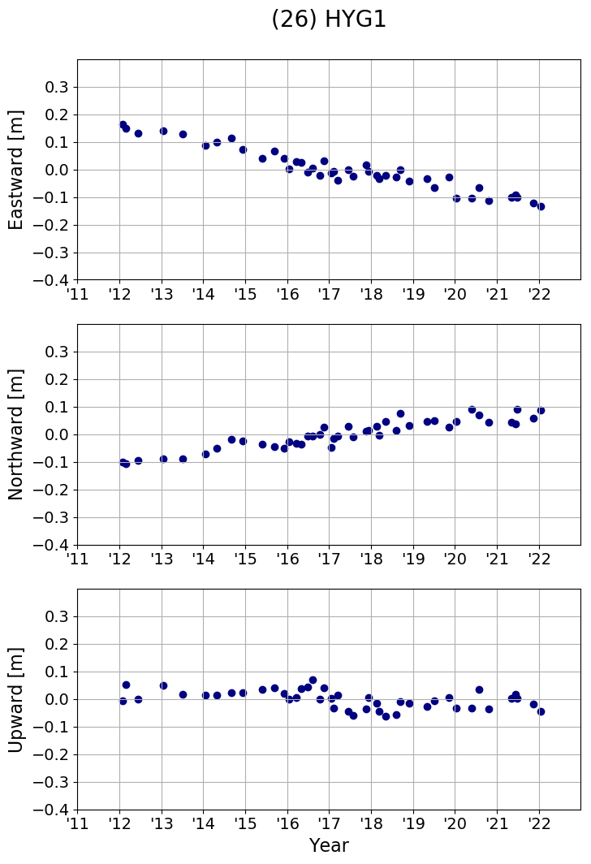
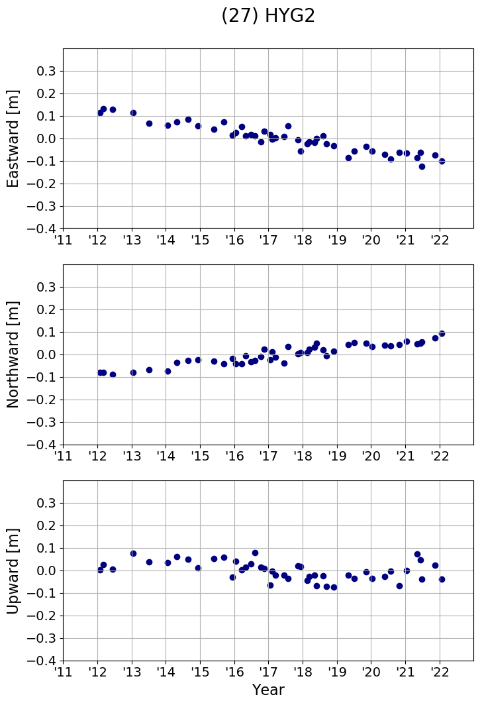
3. Observation results, geophysics revealed from recent observations
Latest observation results along the Nankai Trough
(KUM3-MRT3)
Kobe
Hiroshima
Fukuoka
TOS1
ASZ1
HYG1
TOS2
HYG2
ASZ2

Slide 19


3. Observation results, geophysics revealed from recent observations
Recent study on geophysics of the subduction zones around Japan using SGO-A
Decadal postseismic movement after the 2011 Tohoku-oki Earthquake (Watanabe et al. 2021)
Watanabe et al. 2021

Slide 20
3. Observation results, geophysics revealed from recent observations
Afterslip in areas adjacent to the coseismic slip (i.e. KAMN, FUKU)
Diminished in 1-3 years (-2014)
Persistent subsidence at FUKU
Possibly due to viscoelastic relaxation after coseismic displacement at offshore of FUKU?
Movement of the coseismic slip area after 2017: can be explained as a sum of viscoelastic relaxation and backslip
Watanabe et al. (2021)

Slide 21




3. Observation results, geophysics revealed from recent observations
Watanabe et al. 2021
Before 2014: afterslip is dominant at the north and south ends of the coseismic slip region (i.e. KAMN and FUKU).
After 2014: velocity is stable, but is faster than the velocity before 2011.
Viscoelastic relaxation is still present at the coseismic slip region.
Subsidence of FUKU can be explained by viscoelastic relaxation in the slip region offshore.

Slide 22


4. Technological advancements and future works
Observation frequency of the SGO-A sites: improving, yet far from continuous observation
Observation frequency: currently 3-4 times per year per site
Ishikawa et al. (2020)
Pole system (before 2009)
Hull-mounted system (2009-)
Multiple acoustic ranging (2016-)
Future ???
To further improve frequency:
need of a new sea surface platform?
Buoy?
ASV (e.g. Wave Glider)?
UAV (Unmanned aerial vehicle)?

Slide 23


4. Technological advancements and future works
Event detection capability of SGO-A
Numerical and statistical experiments were performed to evaluate the event detection capability
(Yokota et al. 2021)
It is necessary to improve observation frequency and spatial coverage of SGO-A to detect smaller events (especially far offshore).

Slide 24
4. Technological advancements and future works
Analysis strategy: from SGOBS to GARPOS
Fujita et al. (2006)
Watanabe et al. (2020)
SGOBS (-2021)
GARPOS (2021-)
Future ???
SGOBS (Fujita et al. 2006)
Alternative estimation of transponder positions and sound speed structure using linearized inversion
GARPOS-MCMC
Full Bayesian inversion using Markov Chain Monte Carlo (MCMC)
For details, see Watanabe et al. in this session!
(Watanabe et al. 2020)
Empirical Bayesian inversion
Simultaneous estimation of transponder positions and sound speed structure

Slide 25
4. Technological advancements and future works
Construction of GNSS-A data format: a GNSS-A “RINEX” format
# Site_name = CHOS
# Campaign = 1204.meiyo_m4
# Date(UTC) = 2012-04-19
# Ref.Frame = ITRF2008
# Latitude0 = 35.50277778
# Longitude0 = 141.66944444
# Height0 = 24.00
# Stations = M01 M02 M03 M04 M11 M12 M13 M14
# M01_dPos = -36.5030 698.5700 -1509.5790
# M02_dPos = 750.0060 -9.6570 -1548.1650
# M03_dPos = 9.6750 -781.3210 -1556.1690
# M04_dPos = -768.0610 -32.3080 -1519.3960
# M11_dPos = 75.2230 802.1480 -1497.9700
# M12_dPos = 854.5610 113.3070 -1539.5900
# M13_dPos = 116.8820 -666.7590 -1545.8500
# M14_dPos = -666.0480 68.5790 -1517.2000
# ATDoffset = 1.9452 -0.7653 21.3339
,SET,LN,MT,TT,flag,ST,ant_e0,ant_n0,ant_u0,head0,pitch0,roll0,RT,ant_e1,ant_n1,ant_u1,head1,pitch1,roll1
0,S01,L01,M01,2.271449,False,12998.546235,-8.76681,1474.63035,13.59756,186.4,-0.76,0.71,13001.87919,-8.50997,1465.94866,13.39895,186.19,1.95,-1.04
1,S01,L01,M02,3.027084,False,13008.54628,-8.62977,1450.56564,12.7152,188.86,-1.35,0.93,13012.63487,-9.15161,1440.50533,13.80715,189.16,-0.25,0.48
2,S01,L01,M03,3.593219,False,13028.546345,-11.55922,1401.97245,13.50447,191.2,2.0,-0.53,13033.20107,-12.29072,1391.65533,12.53032,191.93,-0.4,-0.86
3,S01,L01,M04,2.954364,False,13038.546375,-13.60719,1378.3708,13.4282,189.78,-0.5,-0.76,13042.562245,-14.65926,1368.03363,12.89624,189.59,1.44,0.93
4,S01,L01,M11,2.138648,False,13048.546455,-15.38928,1354.52261,13.03522,187.99,-2.41,1.43,13051.74661,-14.90793,1345.65016,13.46705,187.15,1.01,-1.35
5,S01,L01,M12,2.875131,False,13058.5464,-15.54531,1329.28916,12.57873,186.09,-1.22,0.2,13062.48304,-14.64234,1319.03164,12.79195,186.08,-1.47,-0.97
6,S01,L01,M13,3.360925,False,13068.5465,-15.8706,1303.541,12.93603,184.7,1.51,1.66,13072.96893,-14.26268,1293.26341,12.65954,185.87,-2.32,0.77
7,S01,L01,M14,2.740823,False,13078.546545,-13.77302,1277.97544,13.20333,183.7,1.21,-2.37,13082.348875,-14.39044,1269.76292,12.37441,183.87,1.02,1.79
8,S01,L01,M01,2.152039,False,13088.54653,-13.83453,1254.04902,13.82523,181.4,-0.75,4.7,13091.760075,-12.29386,1245.41211,13.31,180.52,2.56,-0.54
...
One can solve GNSS-A only with this file
(supporting information such as sound speed profile may be needed, but not essential)
Not only for GARPOS: a general format for GNSS-A
Campaign information
Site information & approx. parameters
Data for each acoustic signal
Time
Travel time
Ship position (transmit/return)
Ship attitude (transmit/return)
Positions of the seafloor transponders
GNSS-A data + configuration file (.ini)

Slide 26







4. Technological advancements and future works
Evaluating error sources of GNSS-A: for details, see Yokota et al. in this session!
Effects of observation scheme (transponder array size, survey line radius)
Evaluating effects of oceanographic disturbances
Survey line
L
R
D
L
Interpretation of sound speed structure parameters obtained by
Transponder array
R
Nakamura et al. (2021)
Geometries of the transponder array and survey line affect the positioning accuracy of the transponders.
Current configuration of JCG’s observation was found to be appropriate (Nakamura et al. 2021).
actual structure
reference profile
residual structure
Γ in GARPOS
vessel
$$P$$
warm
$$g_{1}$$
internal wave in a pycnocline
$$α_{0}\left(t\right)$$
cold
$$g_{2}$$
seafloor stations
$$X$$
projection
$$Γ\left(t, P, X\right)≡α_{0}\left(t\right)+α_{1}\left(t\right)∙\frac{P}{L^{∗}}+α_{2}\left(t\right)∙\frac{X}{L^{∗}}$$
$$\left\{\begin{matrix}g_{1}=α_{1}V_{0} \\ g_{2}=α_{2}V_{0}\end{matrix}\right.$$

Slide 27
Summary
JCG conducts GNSS-A seafloor geodetic observation.
Seafloor Geodetic Observation Array (SGO-A)
Analysis: GARPOS
Recent work in geophysics: decadal postseismic movement after the Tohoku Earthquake
Japan Trench
Nankai Trough
SGO-A sites
● before 2004
● set in 2011-12
● set in 2019-20
Technological advancements
Observation frequency and coverage
Analysis strategy
Error analysis
For details, check Watanabe-san and Yokota-san’s presentations (both in this session)!

