Slide 1



Non-isospectral modelling in probing nonlinear water waves
Longyuan Zhang, Wenyang Duan, Jiazhi Li
Notes:
知行微思工作室

Slide 2
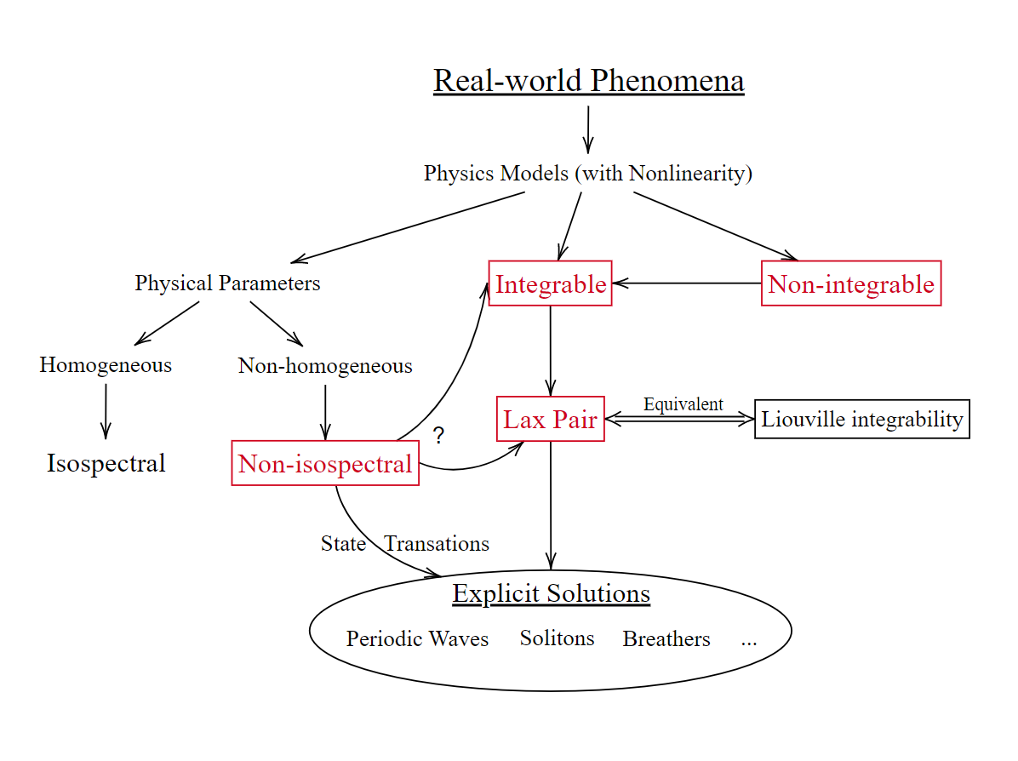
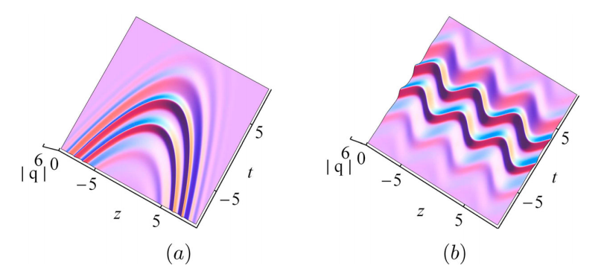
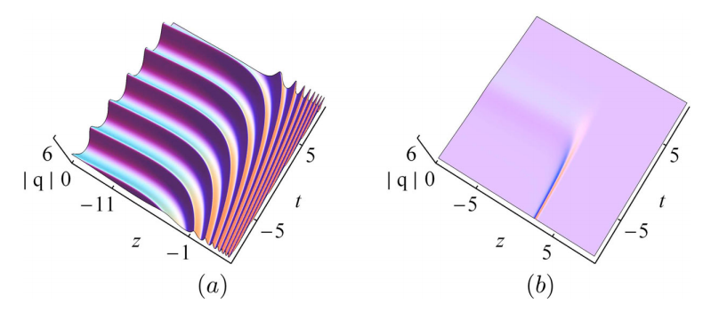
Non-isospectral modelling in probing nonlinear water waves Longyuan Zhang, Wenyang Duan, Jiazhi Li
State transitions in a non-isospectral modified Hirota system (D.Yang et al., 2021)

Slide 3
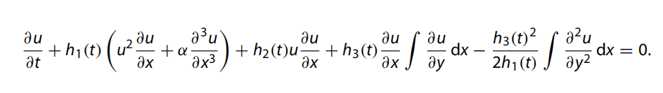
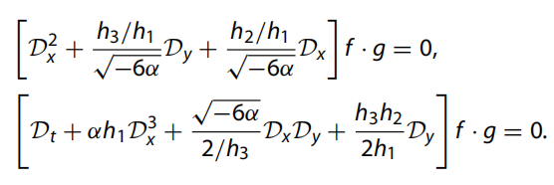
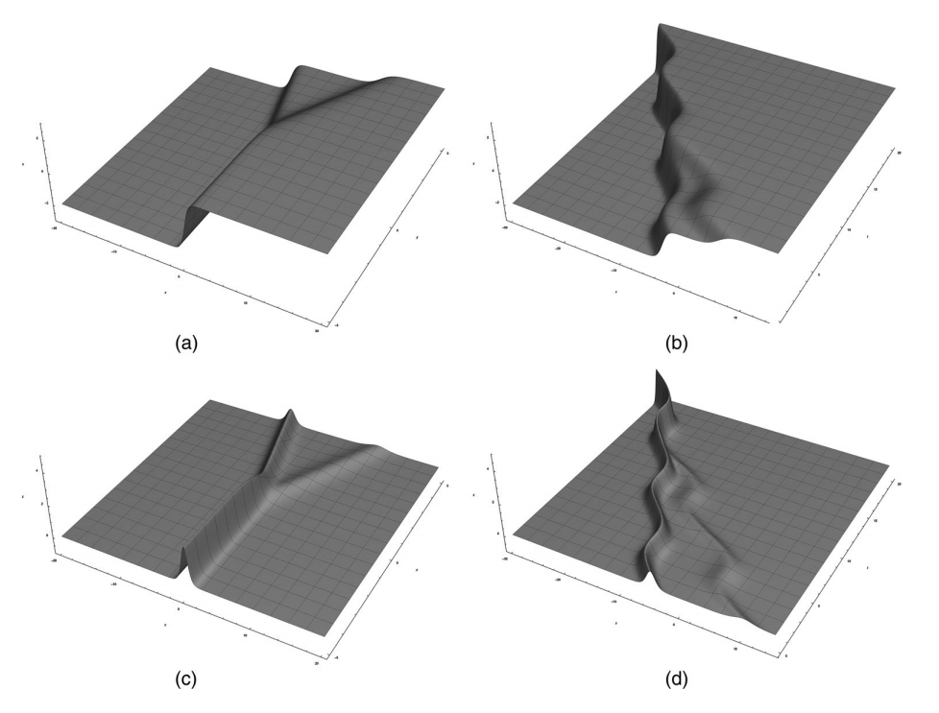
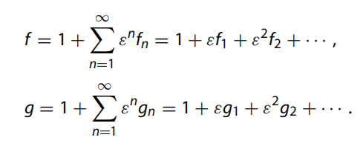

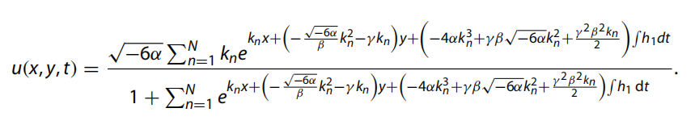
Non-isospectral modelling in probing nonlinear water waves Longyuan Zhang, Wenyang Duan, Jiazhi Li
Hirota's bilinear formalism
Non-isospectral (2+1)-dimensional Gardner equation
Lax pair
Non-isospectral interactions of kink-type solitons (L.Zhang, W.Duan, 2022)
N-kink non-isospectral interactions

Slide 4
Thank you
References
[1] Yang, D. Y., Tian, B., Hu, C. C., Liu, S. H., Shan, W. R., & Jiang, Y. (2021). Conservation laws and breather-to-soliton transition for a variable-coefficient modified Hirota equation in an inhomogeneous optical fiber. Waves in Random and Complex Media, 1-17.
[2] Zhang, L. Y., & Duan, W. Y. (2022). Integrability, Lax pair and solitary interactions of the non-isospectral (2+ 1)-dimensional Gardner system on directional surface waves with large spreading angles. Waves in Random and Complex Media, 1-15.

