Slide 1


NORTHWEST UNIVERSITY
Quantitative Assessment and Mapping of soil water and wind erosion in Pakistan
Supervisor: Yang Qinke Professor
Reporter: Yang Xuyan

Slide 2
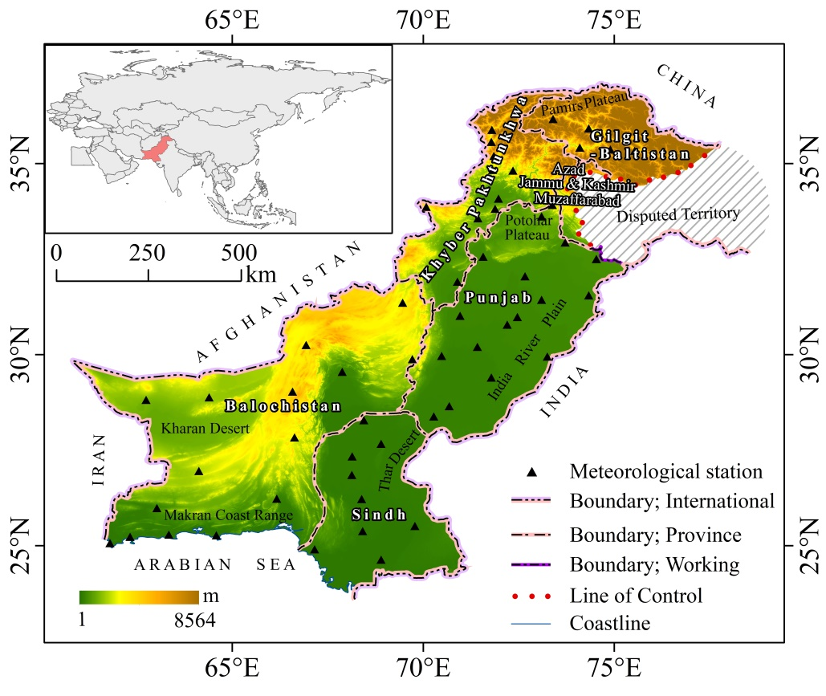
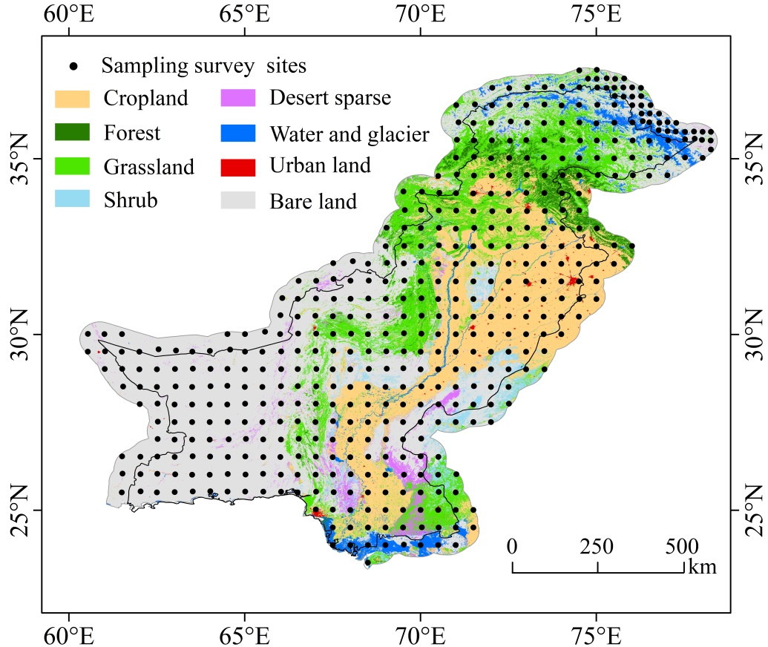
1 Study area

Slide 3

2 Research Methods
Literature data
Overlay
Covariates
Sampling survey(totally 475 units)
R、K、LS、BET…
Machin Learning
Regression
Matrix
Soil water erosion rate
Model evaluation
Random forest
Prediction model(train)
Model parameters
Visualization
Predict values at all locations
Compare and evaluate
Soil water erosion rate in Pakistan
Reasonableness analysis
Notes:
E:\2022YQK\Exchange\Reg_Ero-Mapping\Pic_Bakistan

Slide 4
Data
Climate data
Soil data
DEM
NDVI
Literature data
Wind speed
Precipitation
Temperature
Solar radiation
Snow depth
Sand(%)
Silt(%)
Clay(%)
CaCO3(%)
TOC(%)
SRTM DEM
MODIS NDVI
Soil erosion rate
Wf
SW
SD
Factor
WF
SCF
EF
K′
C
RWEQ
Reasonableness analysis
Result
Soil wind erosion rate in Pakistan

Slide 5
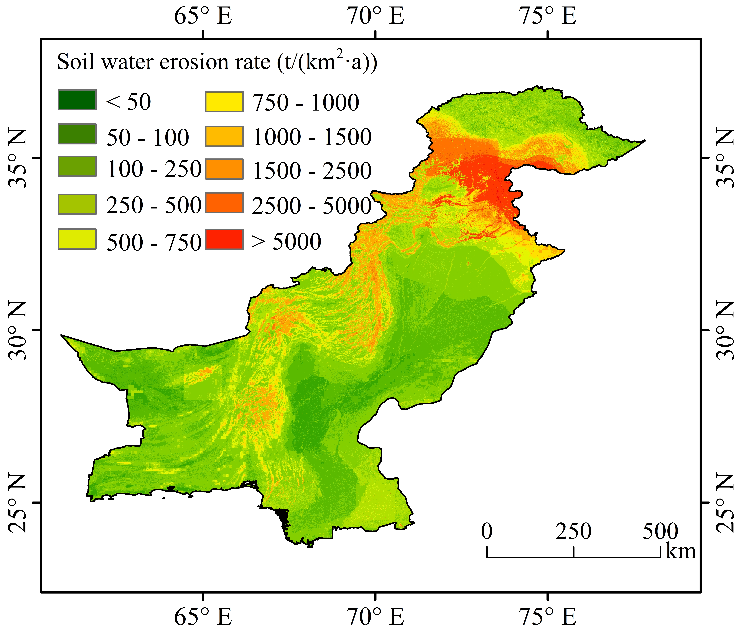
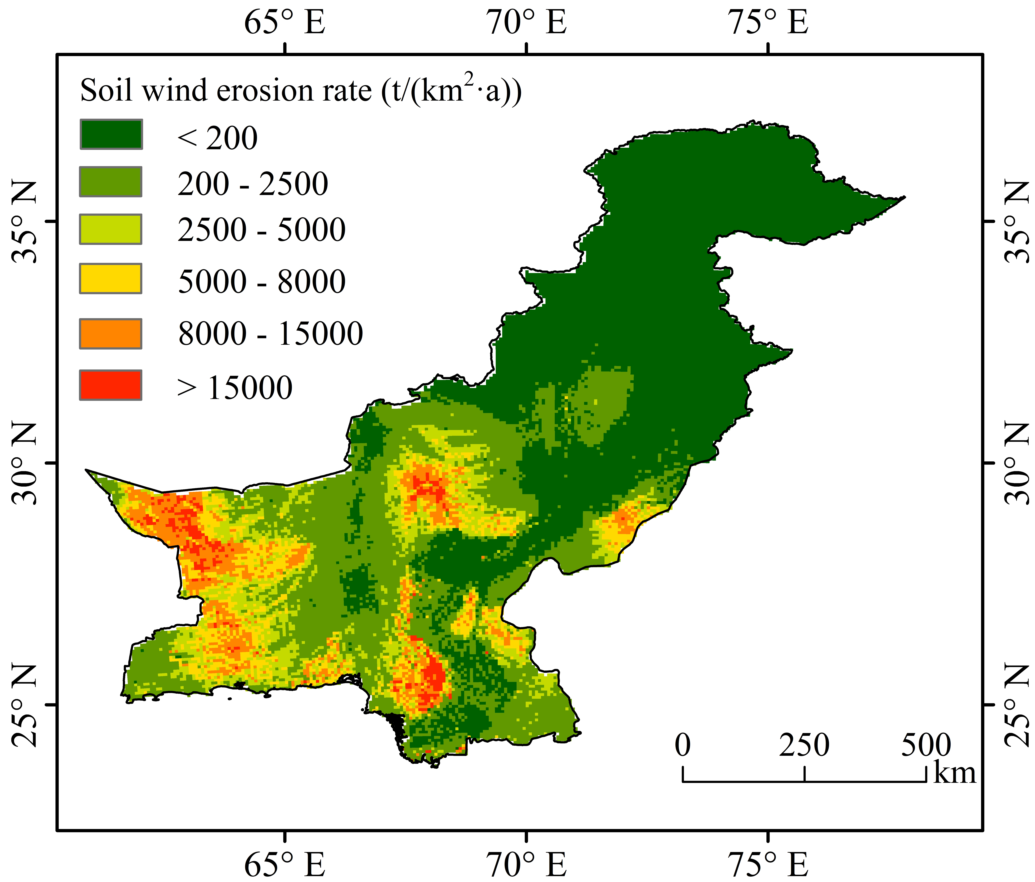
3 Results
The average soil water erosion rate is 451.76 t/(km²·a).
The average wind erosion soil rate was 2,063 t/(km²·a)
The high values were mainly concentrated in the Potohar
Plateau to the south of the northern high mountains.
The high values were mainly concentrated in the Kharan
Desert and Thar Desert.

Slide 6
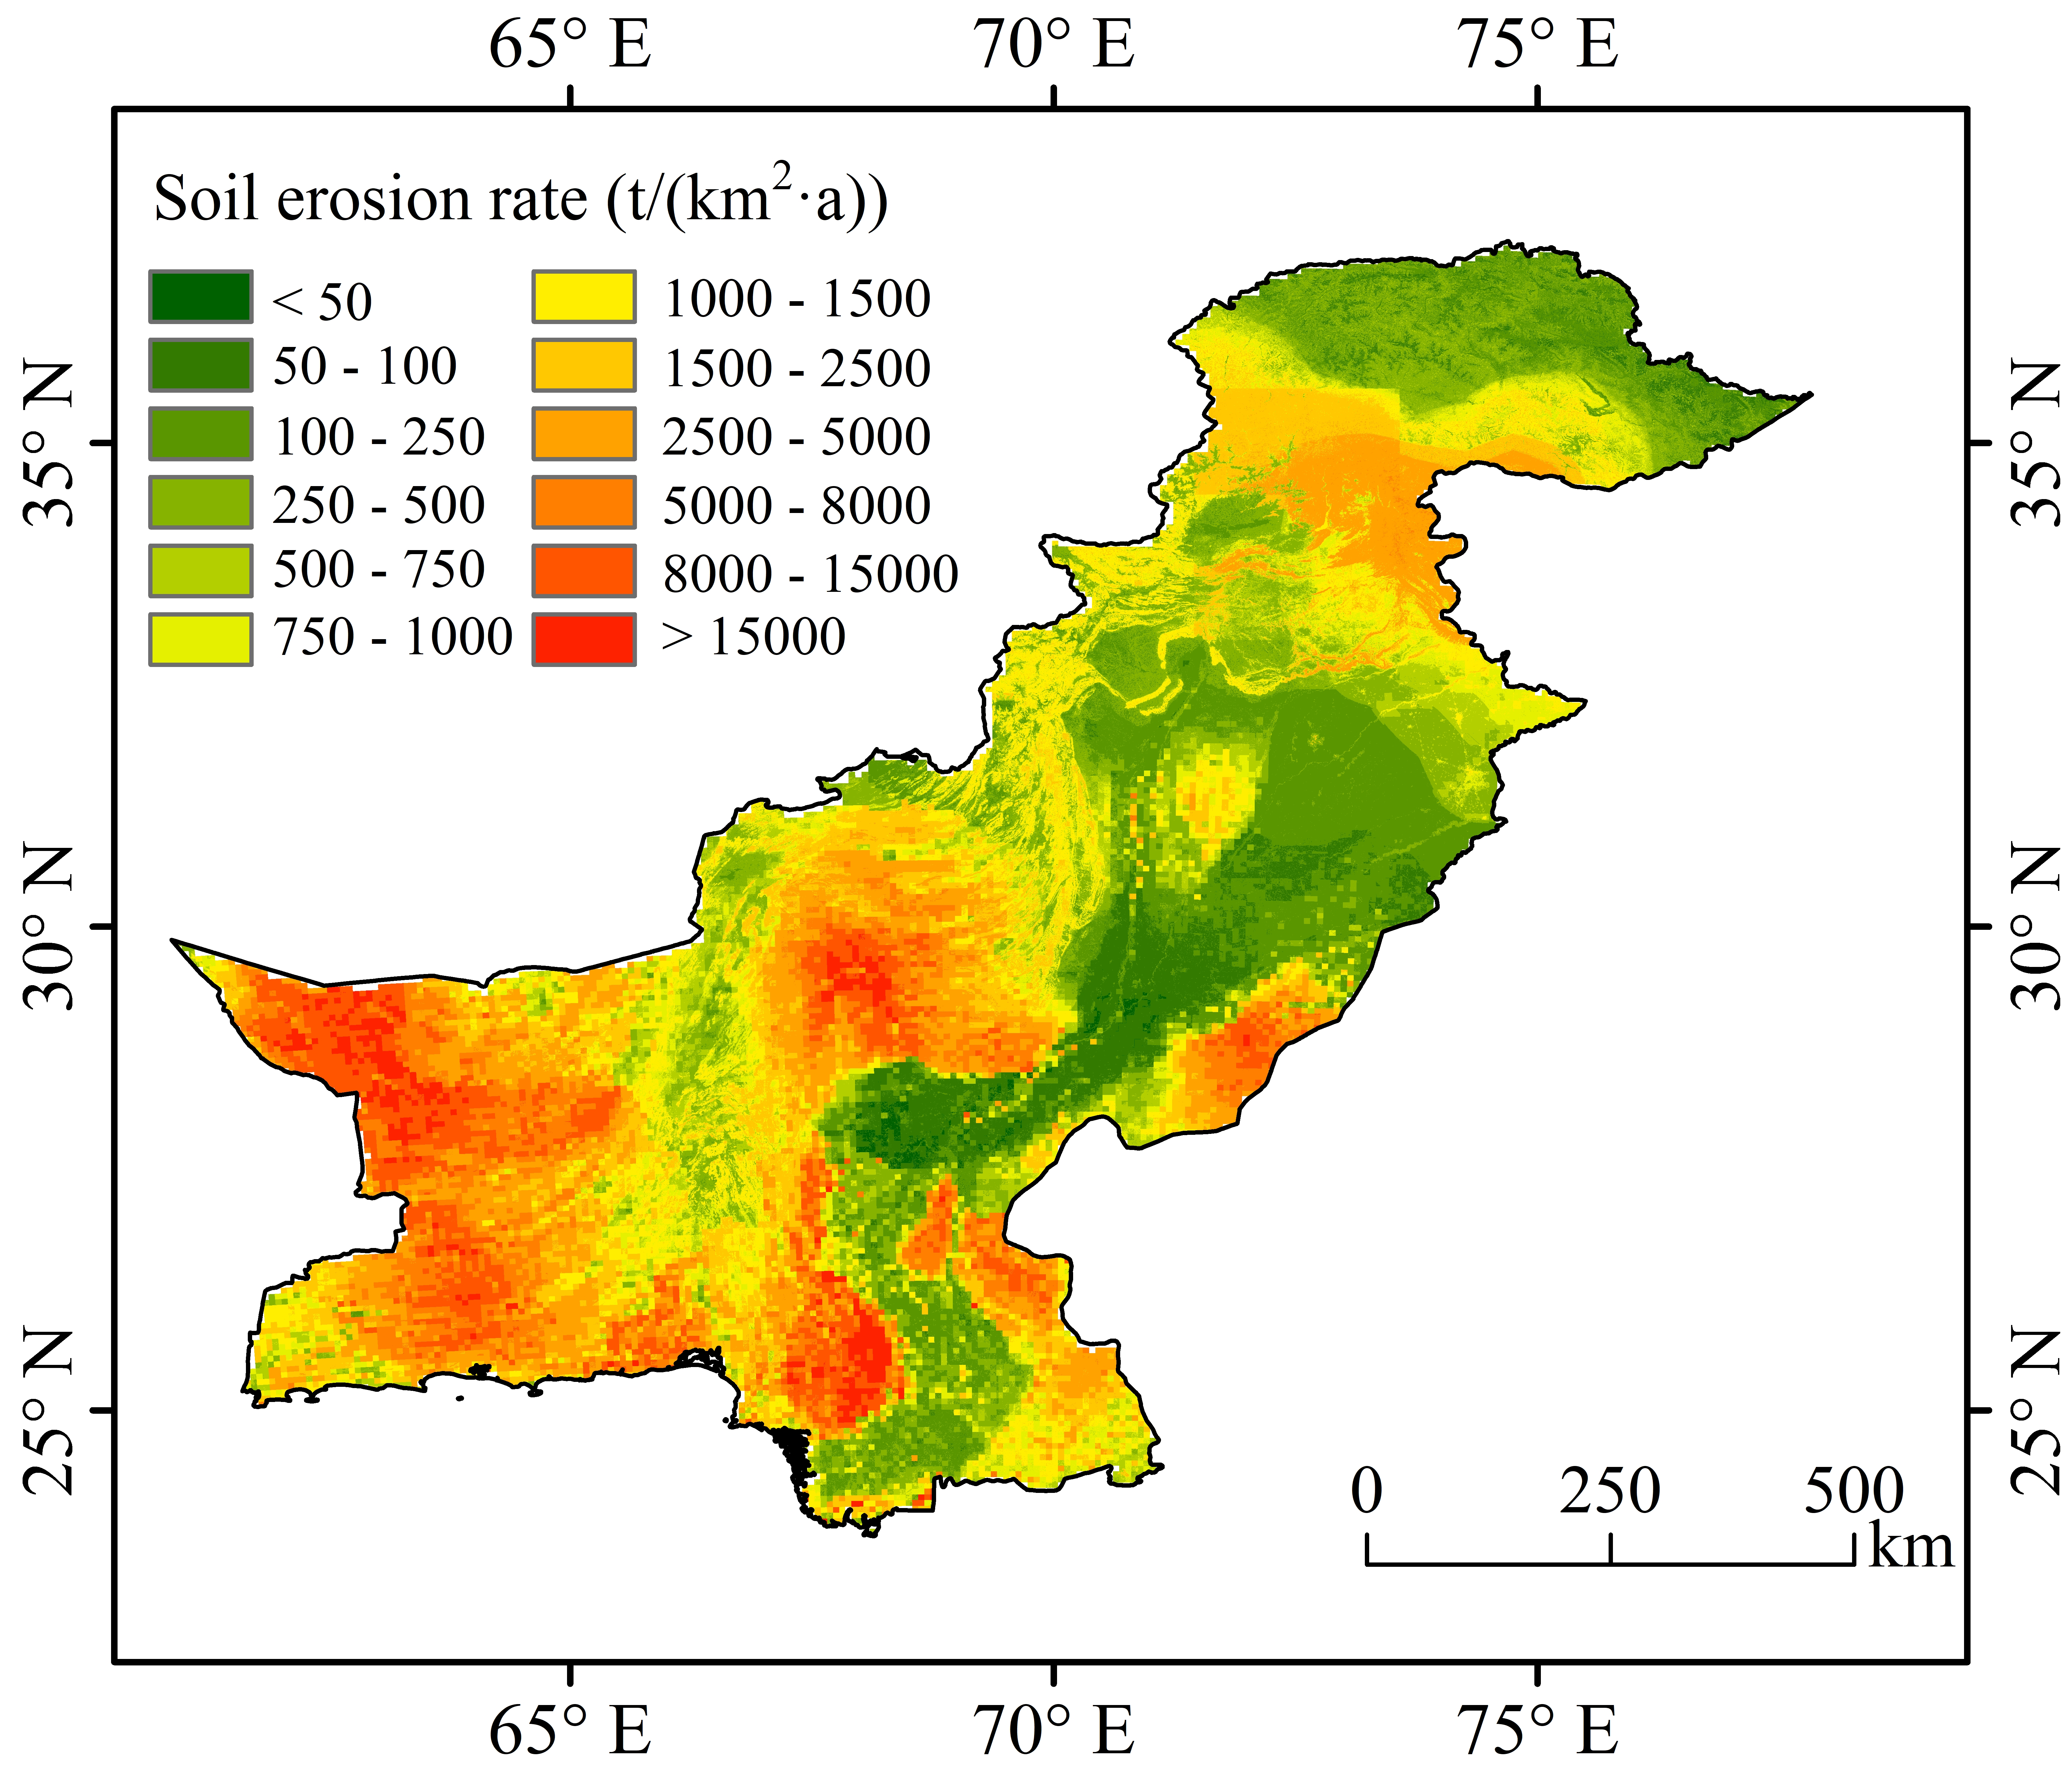
3 Results
The results showed that : the average soil erosion rate in Pakistan is 2,514.98 t/(km²·a).
(1) The Potohar Plateau and nearby mountainous areas are the main cultivated areas, with soil erosion rates of up to 5,000 t/(km²·a) or more.
(2) The Kharan Desert in the southwest and the Thar Desert in the southeast, where vegetation cover is lower, high evapotranspiration and low rainfall are its distinctive features. and the soil erosion rates are basically greater than 15,000 t/(km²·a).
Machin Learning
RWEQ
+

Slide 7



