Slide 1
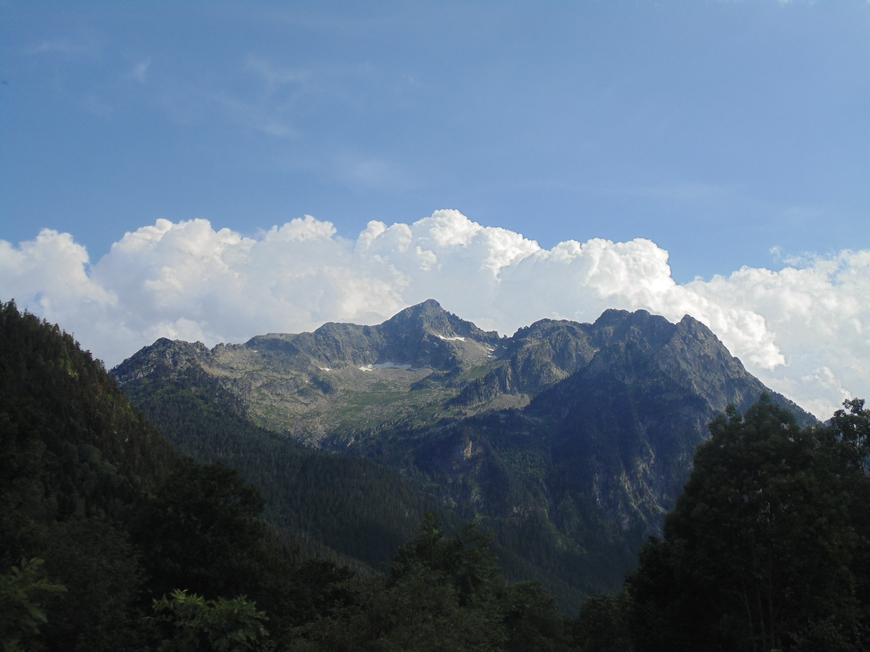








Maximum glacier extent of the Penultimate Glacial Cycle in the Upper Garonne Basin (Pyrenees): new chronological evidence
M. Fernandes, M. Oliva, G. Vieira, D. Palacios, J.M. Fernández-Fernández, M. Delmas,
J. Garcia-Oteyza, I. Schimmelpfennig, J. Ventura, ASTER Team
Supervisors:
Prof. Dr. Marc Oliva
Prof. Dr. Gonçalo Vieira
PhD degree in Geography
Specialization in Physical Geography
Wienna, May 23rd 2022
Notes:
1

Slide 2
Maximum glacier extent of the Penultimate Glacial Cycle in the Upper Garonne Basin (Pyrenees): new chronological evidence
Goals
Main objective:
Study area
Chronological reconstruction of the maximum glacial extent in the Central Pyrenees
State of the Art
Specific objectives:
Methodology
  Geomorphological mapping of the moraine systems at the terminal basin of the Upper Garonne Valley (Loures-Barousse-Barbazan basin; LBBb)
Results
Reconstruction of the deglaciation chronology by using absolute dating of the glacial evidence based on Cosmic Ray Exposure (CRE)
  When were the moraines deposit and when did the glaciers start retreating and abandoned the LBBb?
Discussion
Reconstruction of the paleoglaciers and paleoELA’s from the study area
Conclusions
Marcelo Fernandes
Vienna 23/05/22

Slide 3
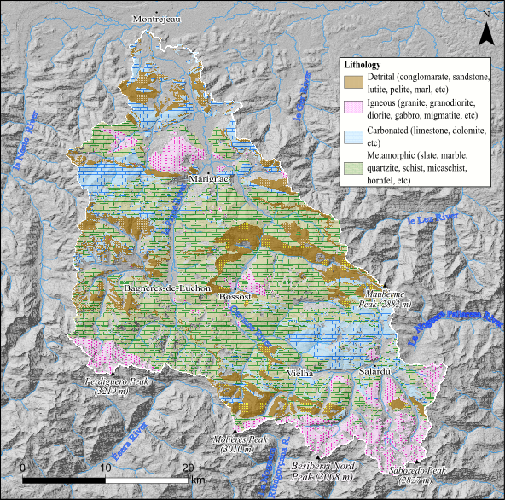
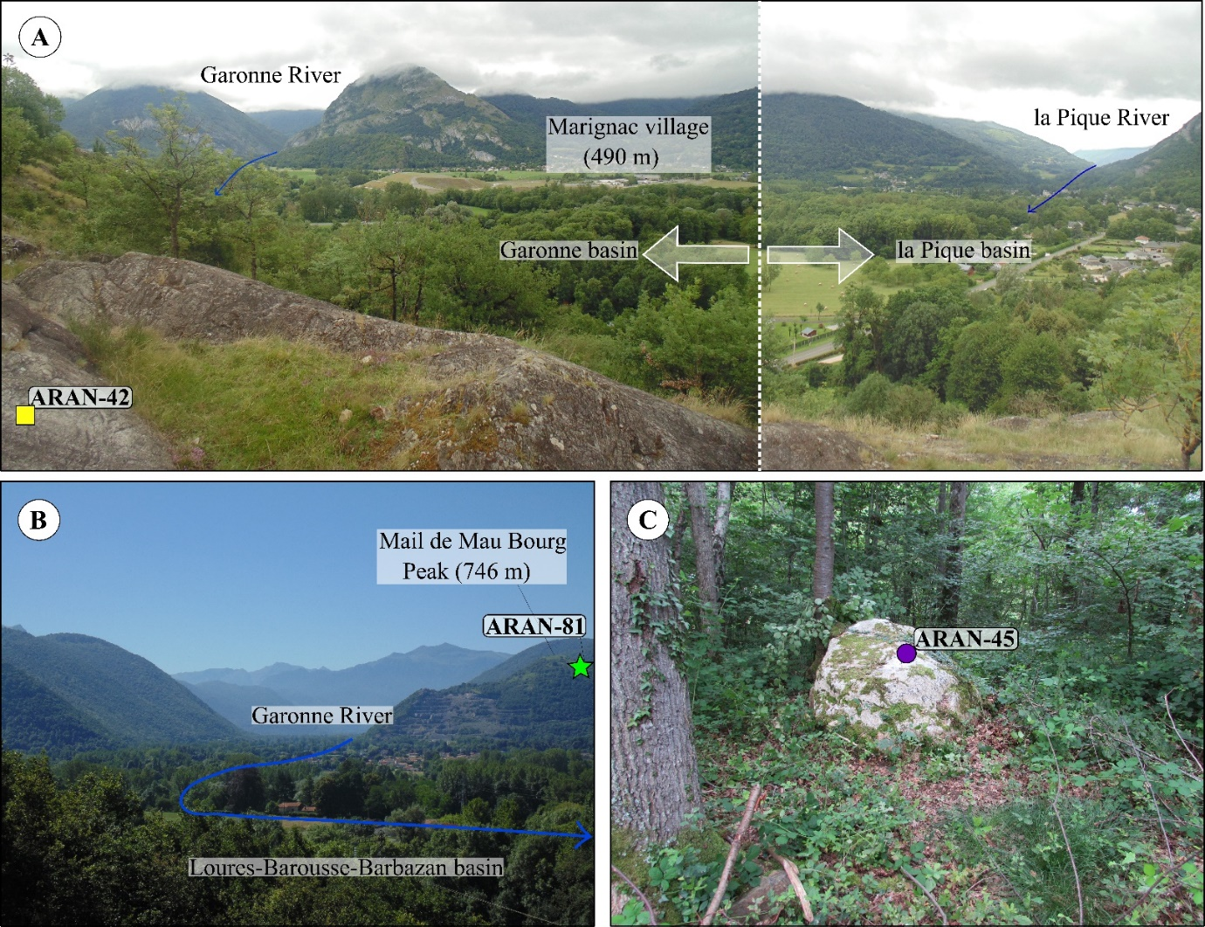
Maximum glacier extent of the Penultimate Glacial Cycle in the Upper Garonne Basin (Pyrenees): new chronological evidence
Goals
2. Upper Garonne Basin
Sedimentary rocks
Jurassic - Cretaceous
Pyrenean range; SE- NW
Terminal basin 500-400 m
Headwaters >3000 m
Garonne River
Study area
State of the Art
Methodology
- Metasediments
Cambrian - Devonian
Results
- Plutonic rocks
Carboniferous
Discussion
Geographical setting of the LBBb. (A) Location in Europe. (B) Location in the Pyrenees. (C) Limits and topography of the valley.
Conclusions
Marcelo Fernandes
Vienna 23/05/22
Notes:
3

Slide 4
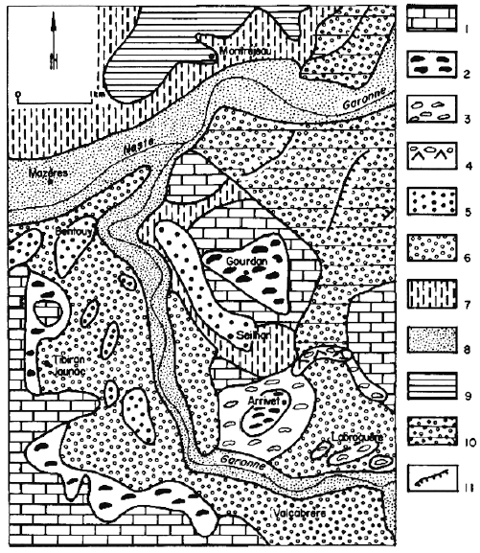
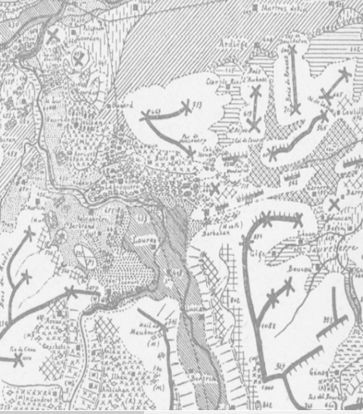
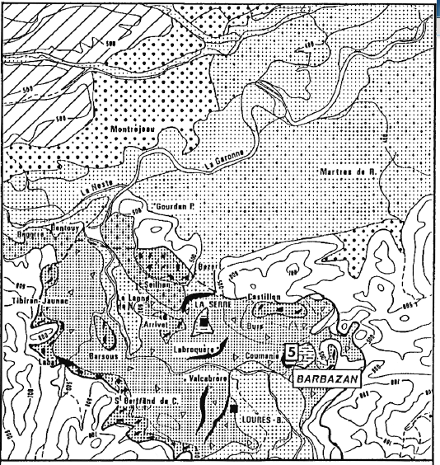
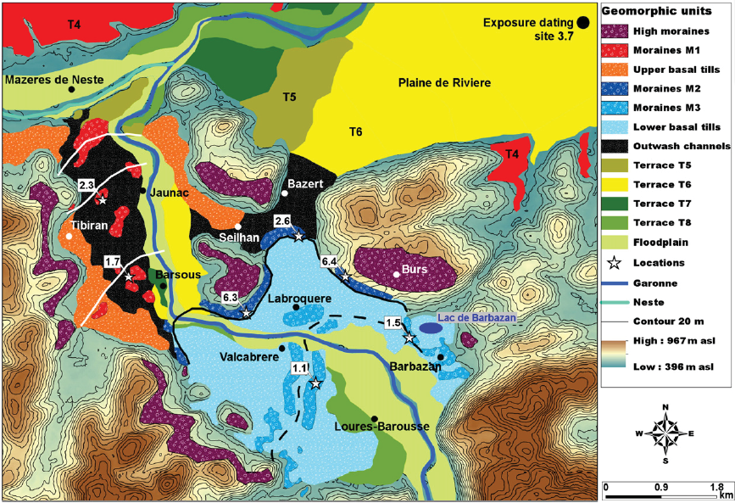
Maximum glacier extent of the Penultimate Glacial Cycle in the Upper Garonne Basin (Pyrenees): new chronological evidence
Goals
3.2. State of the Art
Barbazan Lake
9.5 m: 31.6-30.1 ka cal BP
12.3 m: 29.9-27.2 ka cal BP
22.6 m: 40.7-32.3 ka cal BP
(Andrieu et al., 1988)
Piette, 1874;
Leymerie, 1881;
Penck, 1885
Boule, 1895
Study area
State of the Art
Obermaier, 1906
Denizot, 1922, 1925;
Depéret, 1923;
Chaput, 1924, 1927;
Pic, 1933
Goron, 1941
Methodology
Taillefer, 1953, 1957, 1976
Hubschman, 1975, 1982
Hérail and Jalut, 1986
Andrieu 1988, 1991a, 1991b
Jalut et al., 1992
Results
Discussion
Stange et al., 2014
Conclusions
1850
1900
1950
2000
2021
Marcelo Fernandes
Vienna 23/05/22
Notes:
4
4

Slide 5
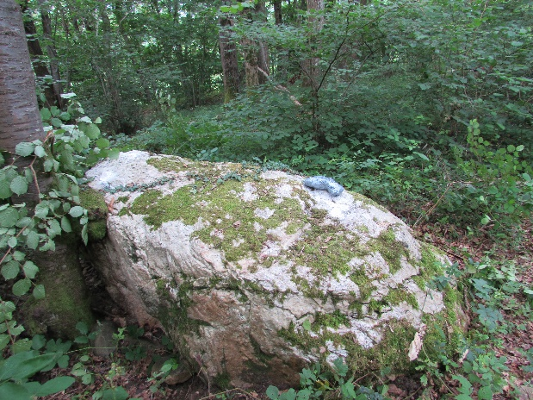
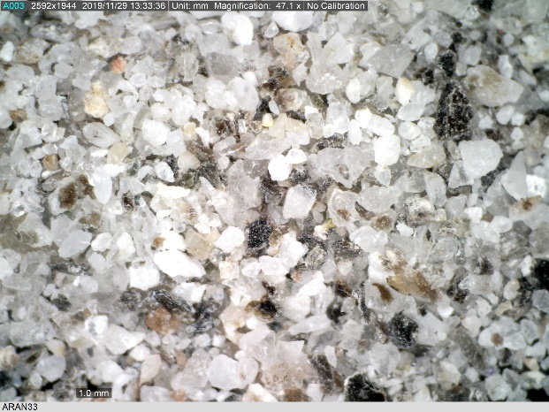
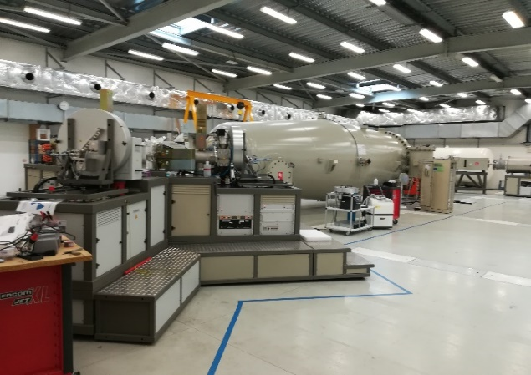
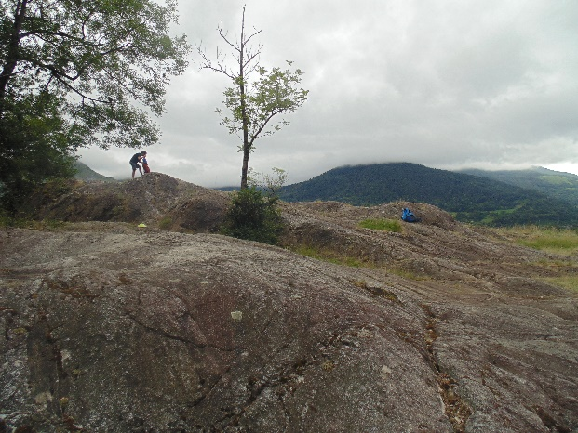
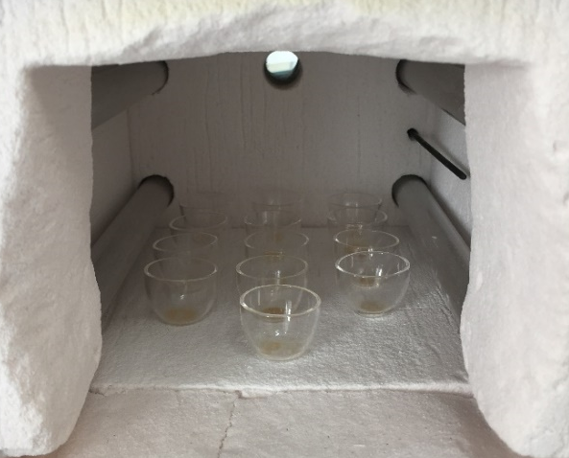
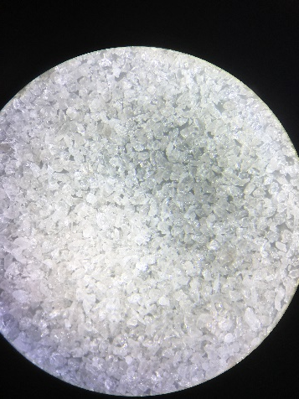
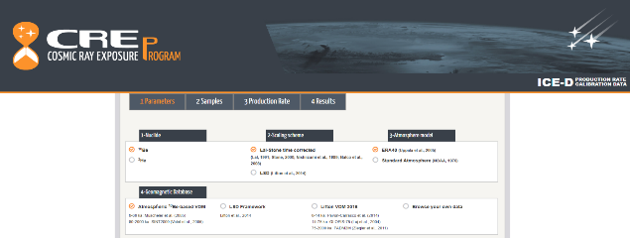
4. Methodology – Sampling strategy, laboratory procedures and exposure age calculation
Goals
Sampled landforms
From crushing to Beryllium oxidation
From ion exchange to exposure ages claculation
Study area
State of the Art
Quartzo – Be¹⁰
Methodology
Terminal basin
University Complutense of Madrid
ASTER (CEREGE, France)
Results
Discussion
Martin et al. 2017
Marinhac basin
ASTER (CEREGE, France)
Conclusions
Note: Glacier reconstruction and Equilibrium-Line Altitude (ELA) calculation
Marcelo Fernandes
Vienna 23/05/22

Slide 6
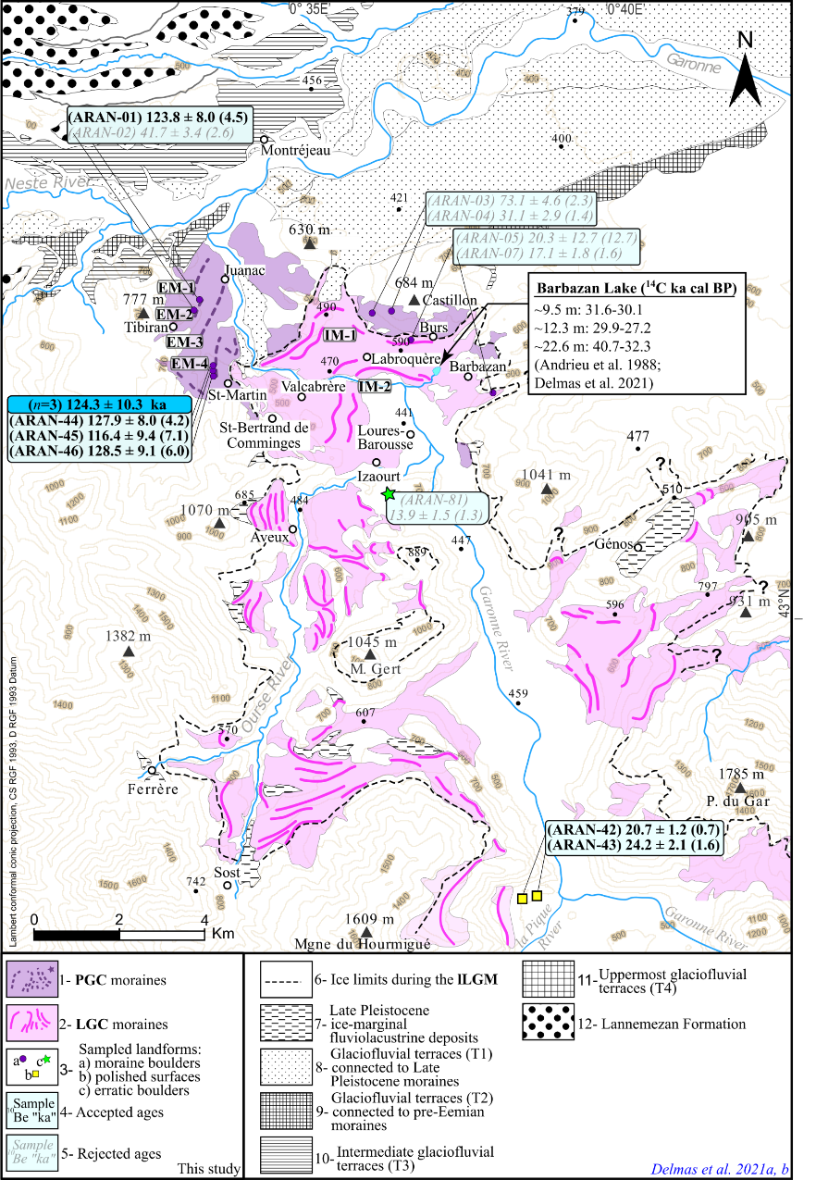
Maximum glacier extent of the Penultimate Glacial Cycle in the Upper Garonne Basin (Pyrenees): new chronological evidence
Goals
5.1. Results
Sample name |  | Quartz weight (g) | mass of carrier (⁹Be mg) | ASTER AMS cathode number |  | ¹⁰Be/⁹Be (10⁻¹⁴) |  | Blank correction (%) | [¹⁰Be] (10⁴ atoms g⁻¹) | Age (ka)
External frontal moraines (EM)
ARAN-01 | EM-2 | 11.41 | 0.459 | CHAU | 25.54 ± 0.96 | 25.54 ± 0.96 |  | 0.77 | 68.17 ± 2.57 | 123.8 ± 7.8 (4.5)
ARAN-02 |  | 11.66 | 0.464 | CHAV | 8.96 ± 0.59 | 8.96 ± 0.59 |  | 2.20 | 23.32 ± 1.57 | 41.6 ± 3.4 (2.6)ª
ARAN-44 | EM-4 (n=3) 124.1 ± 9.6 (5.5) ka | 18.70 | 0.443 | IGNJ | 43.71 ± 1.46 | 43.71 ± 1.46 |  | 0.44 | 68.85 ± 2.30 | 127.9 ± 8.0 (4.2)
ARAN-45 |  | 20.45 | 0.441 | IGNK | 44.37 ± 2.80 | 44.37 ± 2.80 |  | 0.43 | 63.63 ± 4.04 | 116.4 ± 9.4 (7.1)
ARAN-46 |  | 20.76 | 0.440 | IGNL | 48.89 ± 2.29 | 48.89 ± 2.29 |  | 0.39 | 68.95 ± 3.24 | 128.5 ± 9.1 (6.0)
Highest erratic boulder (EM)
ARAN-81 |  | 19.23 | 0.438 | IGNU | 5.97 ± 0.57 | 5.97 ± 0.57 |  | 3.34 | 8.79 ± 0.86 | 13.9 ± 1.5 (1.3)
Highest moraines of the EM
ARAN-03 |  | 11.19 | 0.455 | CHAW | 17.9 ± 0.55 | 17.9 ± 0.55 |  | 1.93 | 47.65 ± 1.49 | 73.1 ± 4.6 (2.3)
ARAN-04 |  | 11.61 | 0.454 | CHAX | 7.90 ± 0.34 | 7.90 ± 0.34 |  | 4.49 | 19.77 ± 0.91 | 31.1 ± 2.1 (1.4)
Internal moraines
ARAN-05 | IM-1 | 10.88 | 0.457 | CHAY | 4.54 ± 2.62 | 4.54 ± 2.62 |  | 8.04 | 11.78 ± 7.35 | 20.3 ± 12.7 (12.7)
ARAN-07 |  | 11.44 | 0.460 | CHAZ | 4.01 ± 0.36 | 4.01 ± 0.36 |  | 9.10 | 9.89 ± 0.96 | 17.1 ± 1.8 (1.6)
Polished surfaces
ARAN-42 |  | 21.36 | 0.432 | IGNH | 8.58 ± 0.29 | 8.58 ± 0.29 |  | 2.33 | 11.34 ± 0.39 | 20.7 ± 1.2 (0.7)
ARAN-43 |  | 18.38 | 0.436 | IGNI | 8.67 ± 0.60 | 8.67 ± 0.60 |  | 2.29 | 13.42 ± 0.95 | 24.2 ± 2.1 (1.6)
Chemistry blank details
Blank name |  | Processed with | mass of carrier (⁹Be mg) | ASTER AMS cathode number | ¹⁰Be/⁹Be (10⁻¹⁴) | ¹⁰Be/⁹Be (10⁻¹⁴) |  | [¹⁰Be] (10⁴ atoms)
BK-1 |  | ARAN-3, 4, 5, 7 | 0.46 | CHAT | 0.34 ± 0.04 | 0.34 ± 0.04 |  | 10.30 ± 1.24 | - | -
BK-3 |  | ARAN-1, 2 | 0.46 | IGHI | 0.20 ± 0.03 | 0.20 ± 0.03 |  | 5.98 ± 0.93 | - | -
ARAN-BK |  | ARAN-42, 43, 44, 45, 46, 81 | 0.43 | IGNV | 0.20 ± 0.03 | 0.20 ± 0.03 |  | 5.65 ± 0.84 | - | -
Study area
State of the Art
Methodology
Results
Discussion
Conclusions
Marcelo Fernandes
Vienna 23/05/22
Notes:
6
6

Slide 7
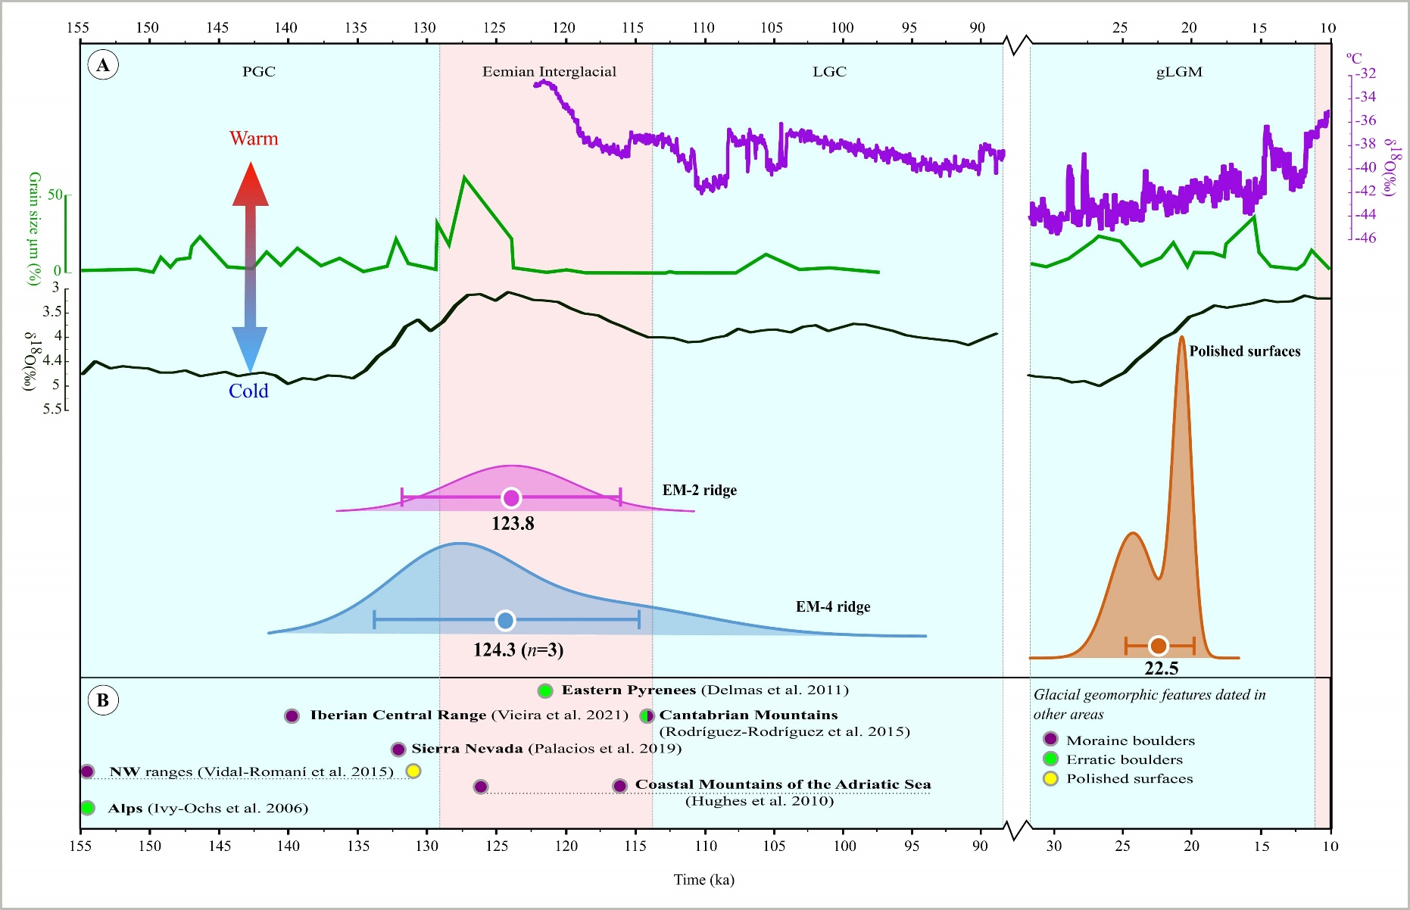
Maximum glacier extent of the Penultimate Glacial Cycle in the Upper Garonne Basin (Pyrenees): new chronological evidence
Goals
6.1. Discussion
Study area
ELA = 1711 m
- 9.3 °C
State of the Art
Methodology
Results
Discussion
Conclusions
Marcelo Fernandes
Vienna 23/05/22
Notes:
7
7

Slide 8
Maximum glacier extent of the Penultimate Glacial Cycle in the Upper Garonne Basin (Pyrenees): new chronological evidence
Goals
7.1. Conclusions
Study area
Four boulders from the external moraine ridges confirm that the largest palaeoglacier in the Upper Garonne Valley developed before the LGC, at ~129 ka.
The first CRE ages reporting a period of glacial expansion in the Pyrenees during the PGC, as also observed in other Iberian mountain ranges (e.g. Sierra Nevada, Central Range, NW Ranges)
However, boulders from the internal moraine system of the glacial terminal basin did not yield consistent geochronological results. Thus, we do not have any data of glacial advance or retreat during the LGC in LBBb.
Exposure ages from glacially polished bedrock surfaces located at the confluence Garonne-la Pique valleys - 18 km to the south of the external moraines - reported ages of 24-21 ka, confirming that the terminal basin was already ice-free during the gLGM.
State of the Art
Methodology
Results
Discussion
Conclusions
Marcelo Fernandes
Vienna 23/05/22
Notes:
8
8

Slide 9
Vielen Dank!
Marcelo Vieira Fernandes

