Slide 1


Characteristic Ion Length Scales For Four Types Of Interplanetary Shocks
Byeongseon Park, Alexander Pitňa, Jana Šafránková and Zdeněk Němeček
Charles University, Faculty of Mathematics and Physics, V Holešovičkách 2, 180 00 Prague 8, Czech Republic
byeongseon.park@matfyz.cuni.cz
EGU General Assembly 2022, Vienna, Austria
23-27 May 2022

Slide 2


Introduction
Park et al.
Motivation of the study
At present, large attention is focused on how turbulence interacts with collisionless shocks in solar wind
Downstream spectral amplitude is typically increased by a factor of 10 or more
Upstream spectral index (slope) of the inertial range is unchanged for the downstream magnetic variance, kinetic energy and density variance
However, less attention is directed to different shock types and the kinetic range of plasma turbulence
Preliminary results for the investigation of these topics will be elucidated

Slide 3
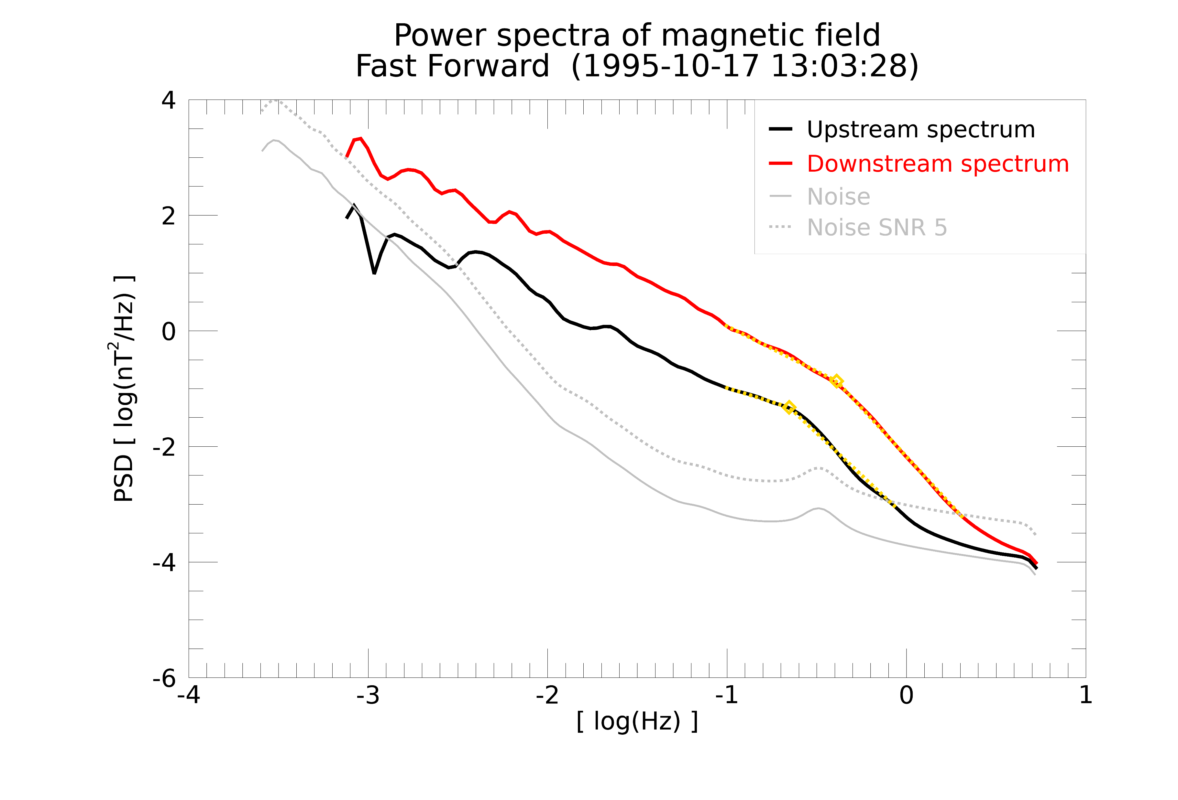
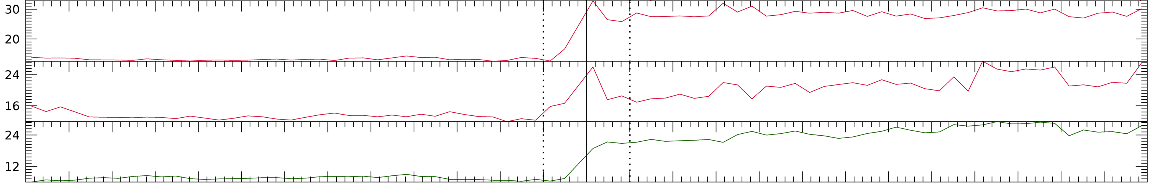
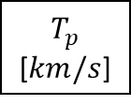
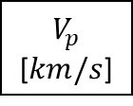
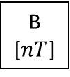
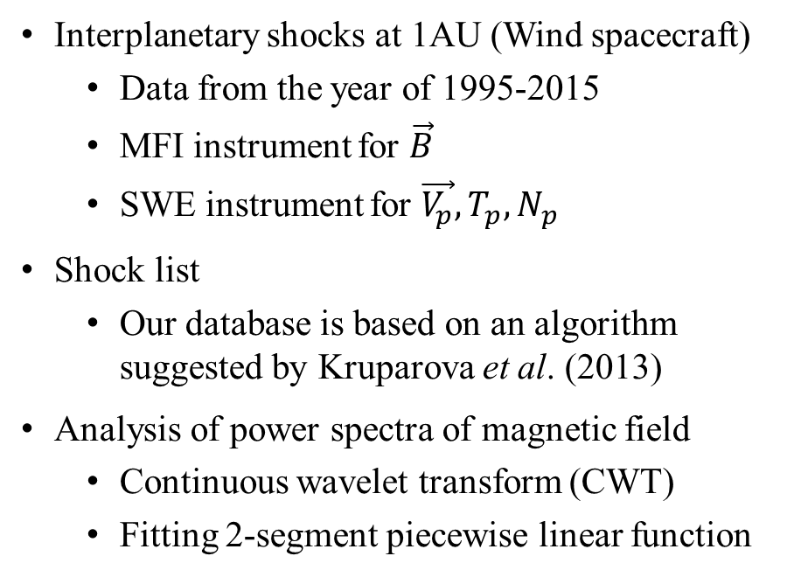
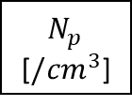
Data set
Park et al.
Interplanetary shocks at 1AU (Wind spacecraft)
Data from the year of 1995-2015
MFI instrument for $\vec{B}$
SWE instrument for $\vec{V_{p}},T_{p},N_{p}$
Shock list
Our database is based on an algorithm suggested by Kruparova et al. (2013)
Analysis of power spectra of magnetic field
Continuous wavelet transform (CWT)
Fitting 2-segment piecewise linear function
1 hour
1 hour
B [$nT$]
$V_{p}$ [$km/s$]
$T_{p}$ [$km/s$]
$N_{p}$ [$/{cm}^{3}$]
Time (min)
(unit: number) | Fast | Slow
Forward | FF (541) | SF (230)
Reverse | FR (110) | SR (189)

Slide 4
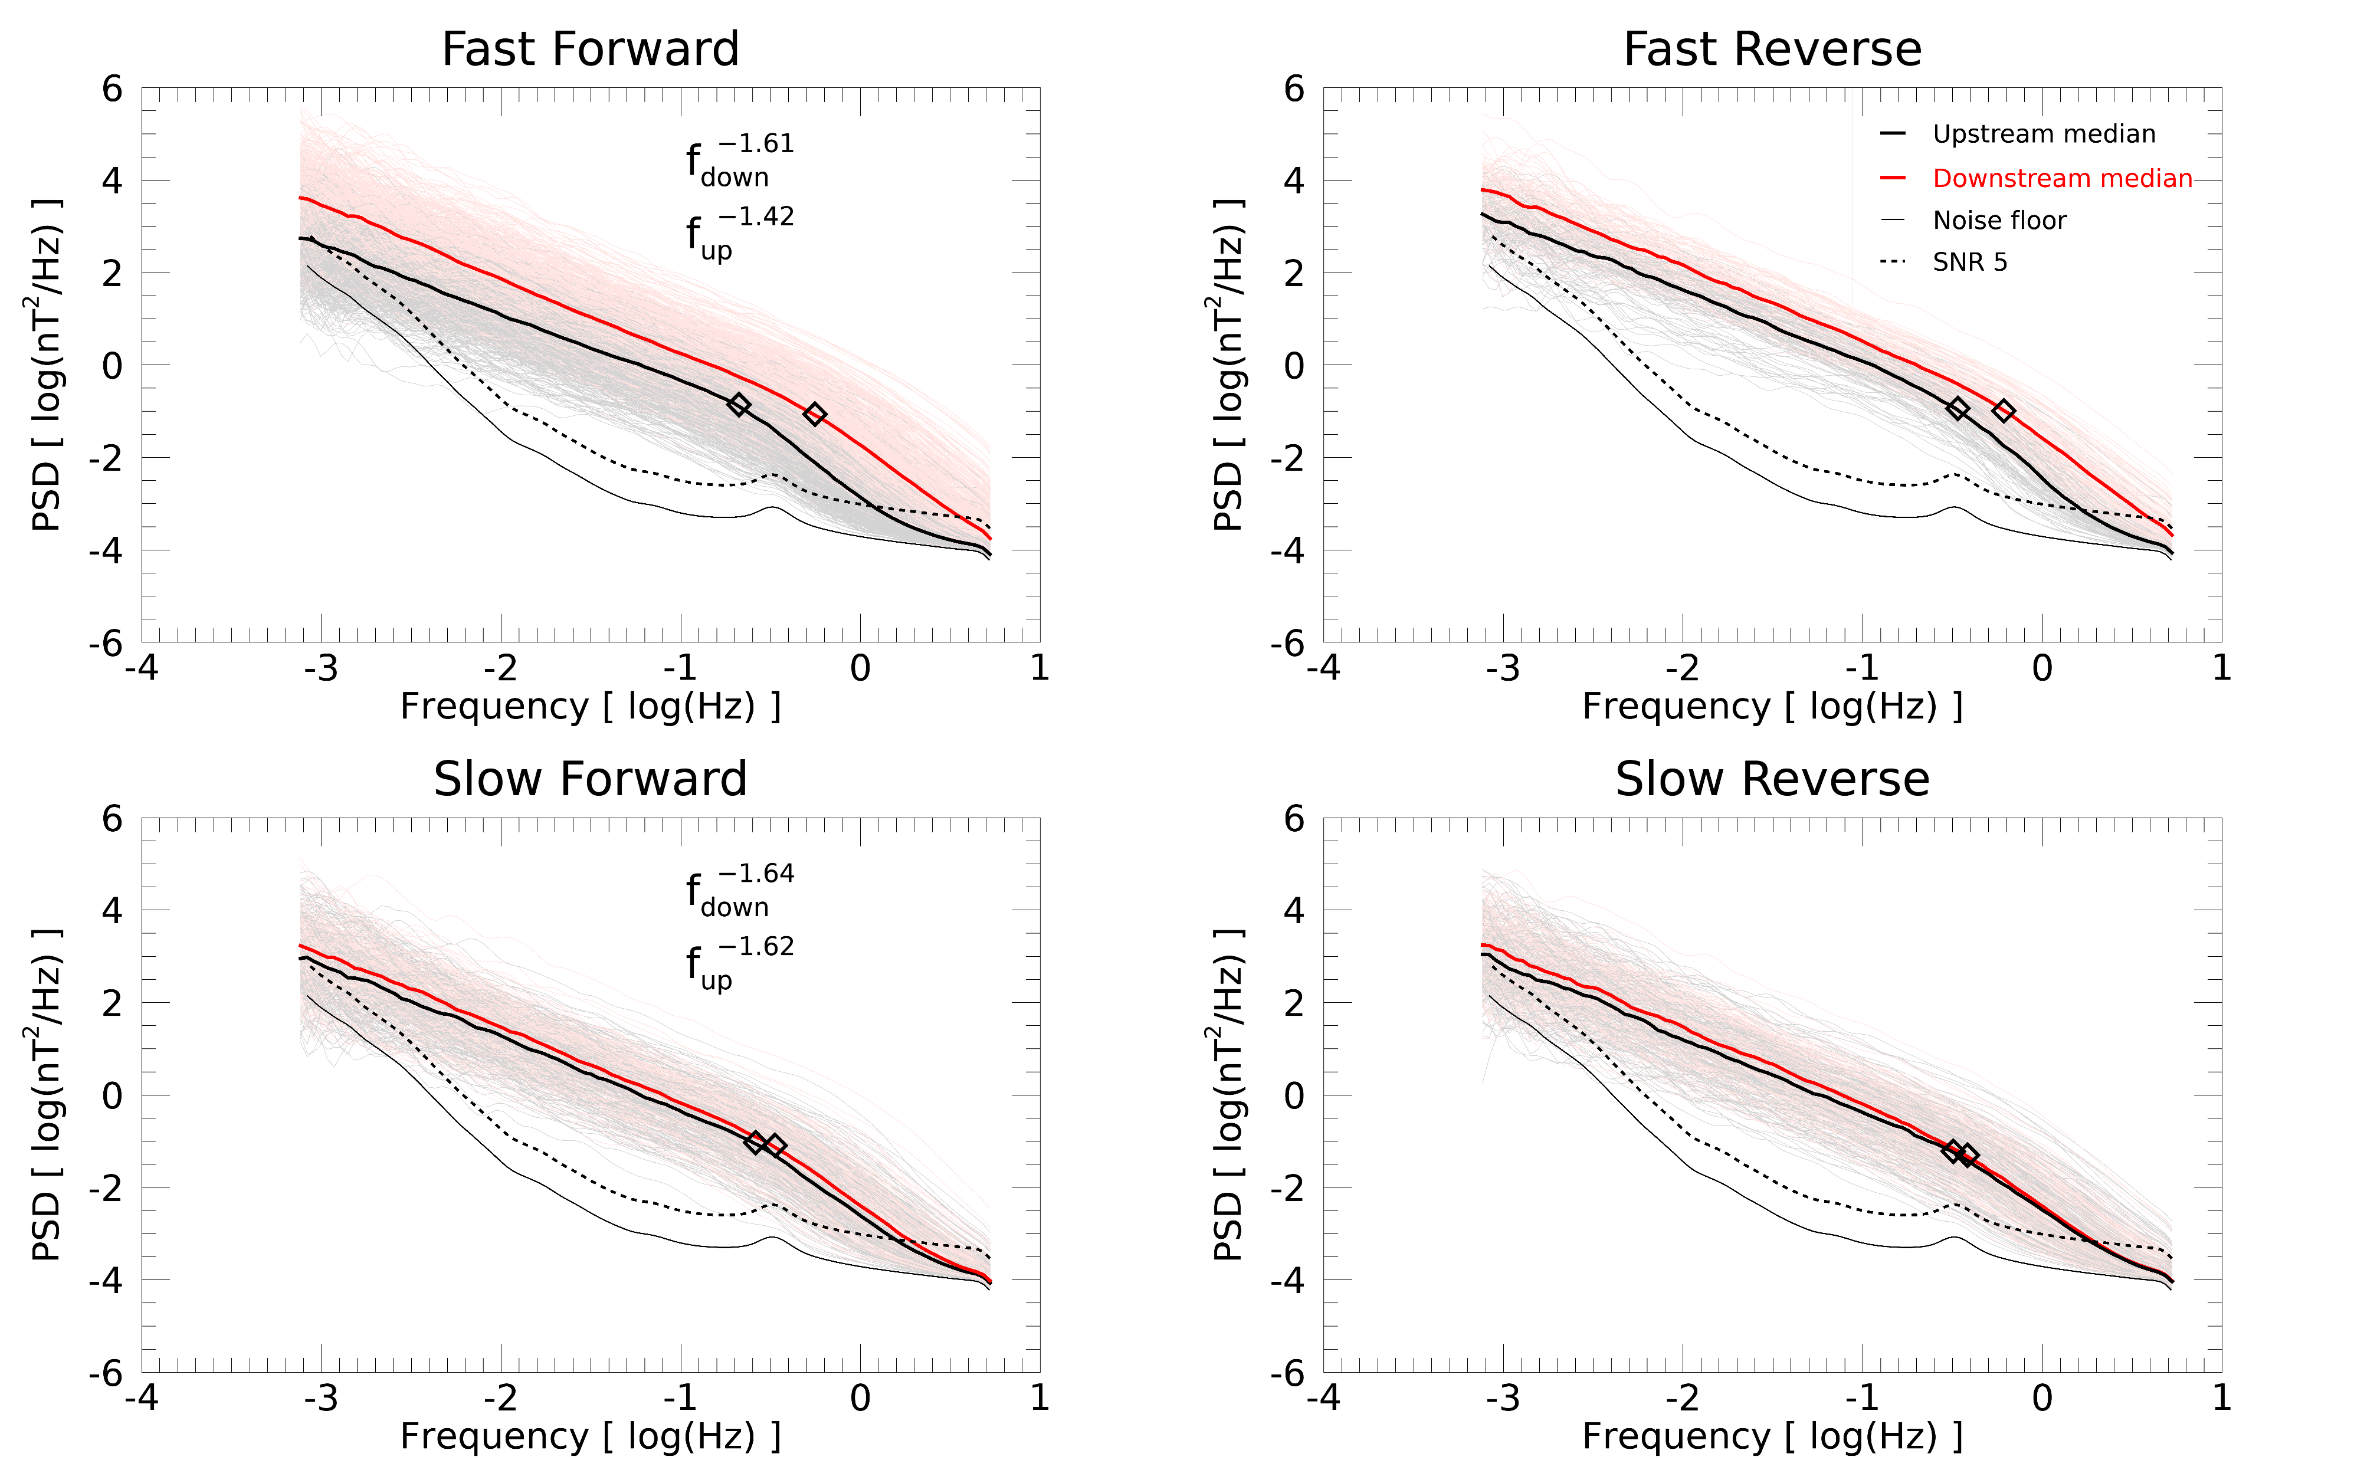
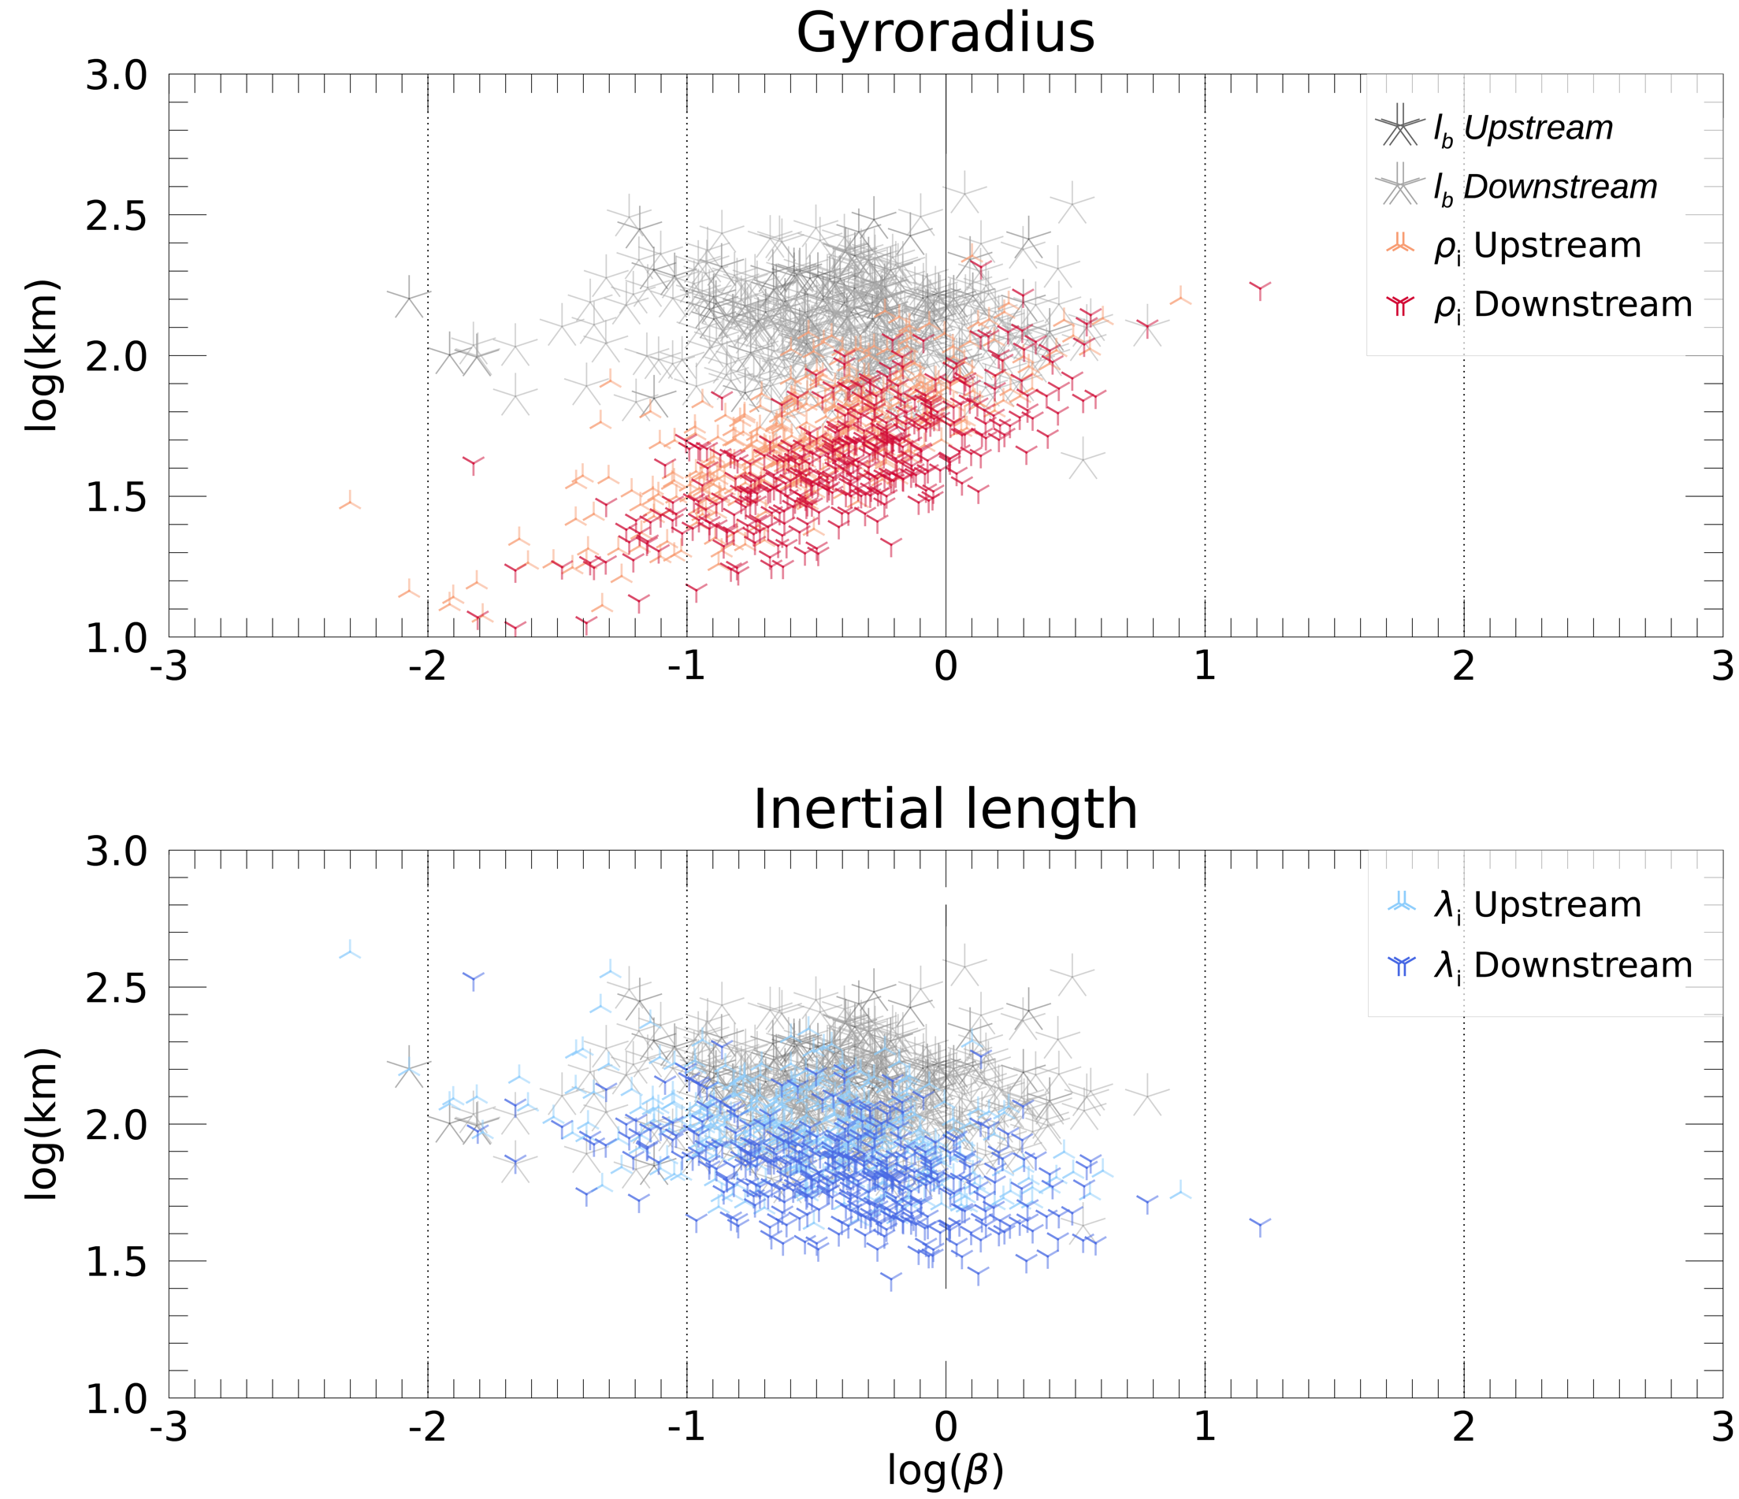
Preliminary Result
Park et al.
e.g. Fast Forward case
Taylor’s Hypothesis

Slide 5
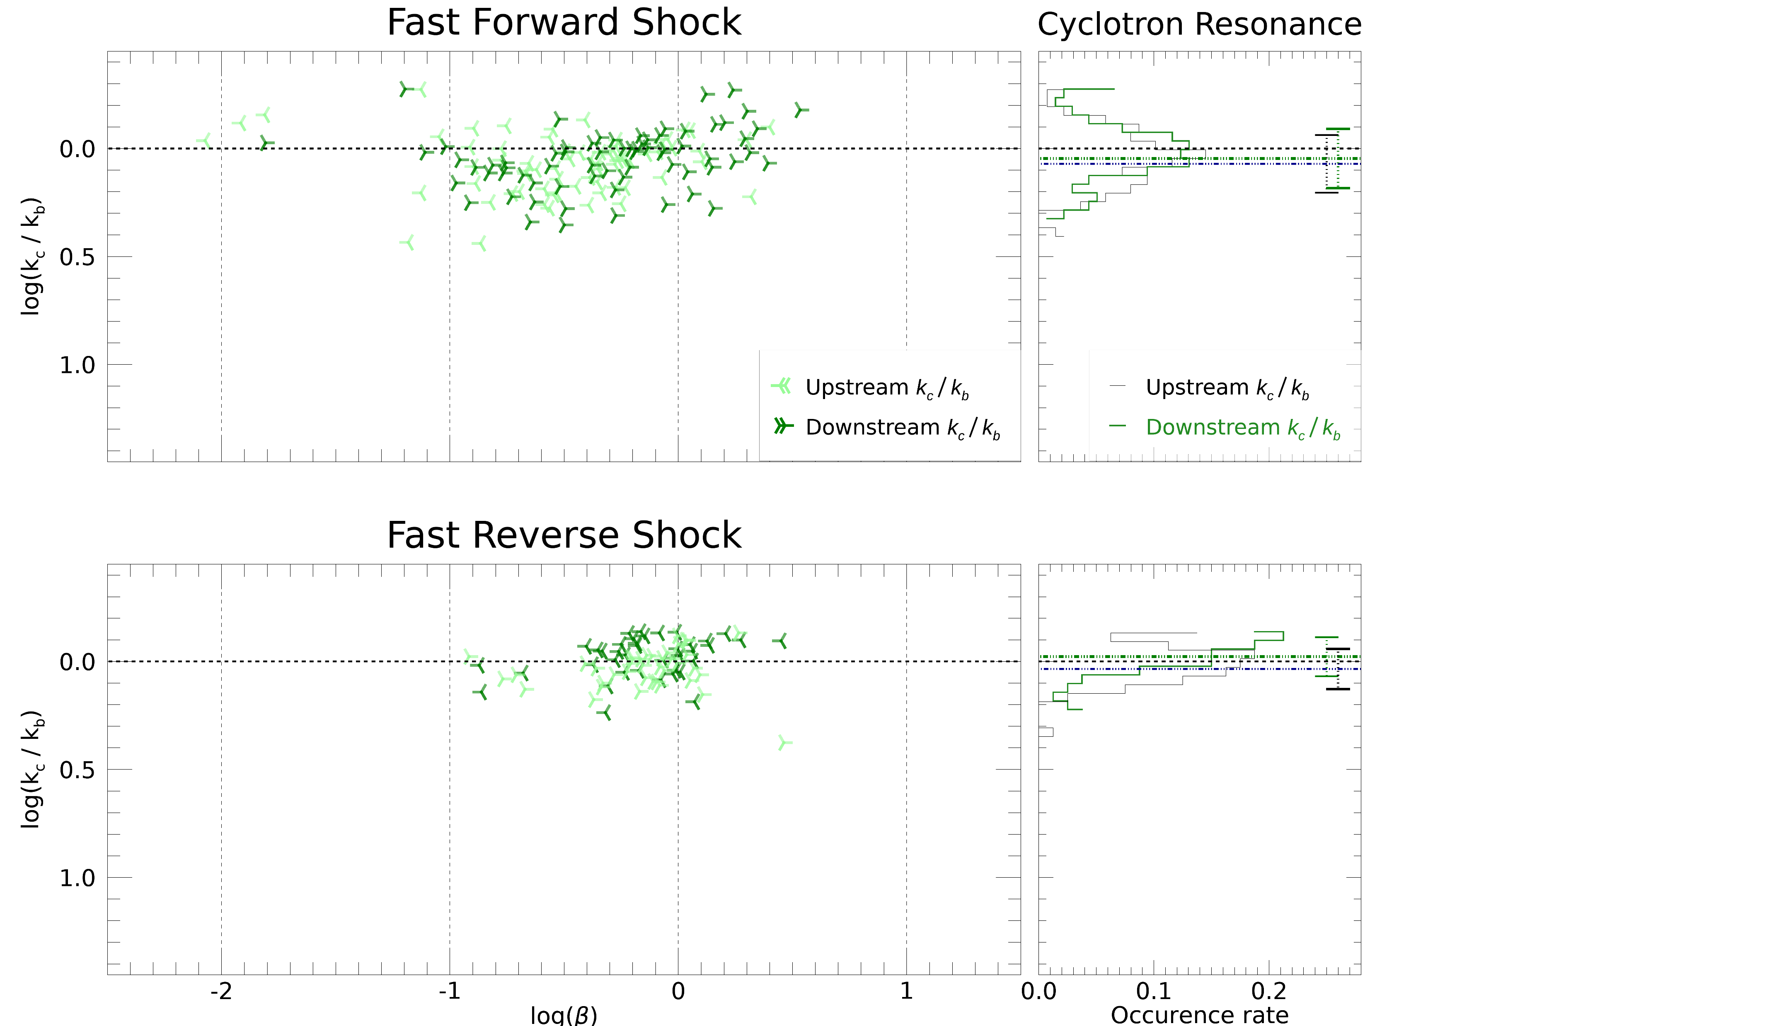
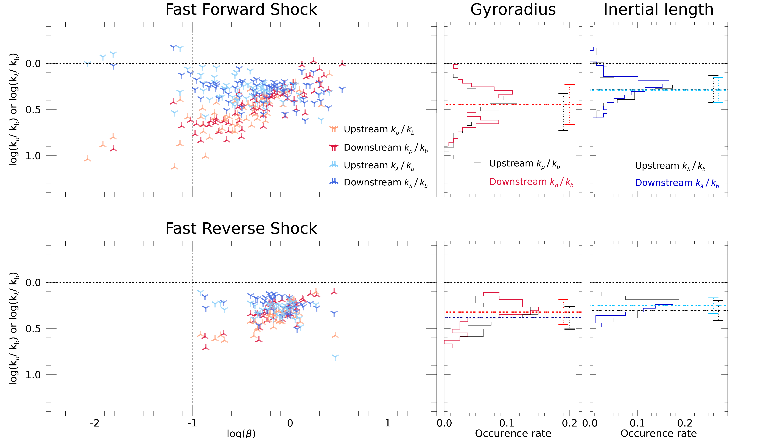
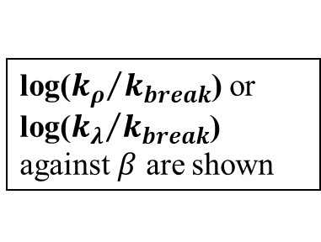
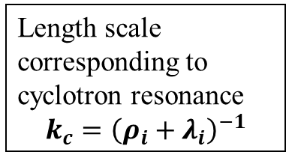
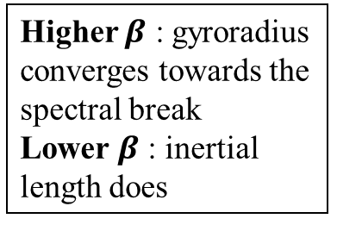
Preliminary Result
Park et al.
log(${k_{ρ}}/{k_{break}}$) or log(${k_{λ}}/{k_{break}}$) against $β$ are shown
Higher $β$ : gyroradius converges towards the spectral break
Lower $β$ : inertial length does
Consistent with the result from
Chen et al. (2014) Šafránková et al. (2016)
Woodham et al. (2018)
Length scale corresponding to cyclotron resonance
$$k_{c}={\left(ρ_{i}+λ_{i}\right)}^{−1}$$

Slide 6
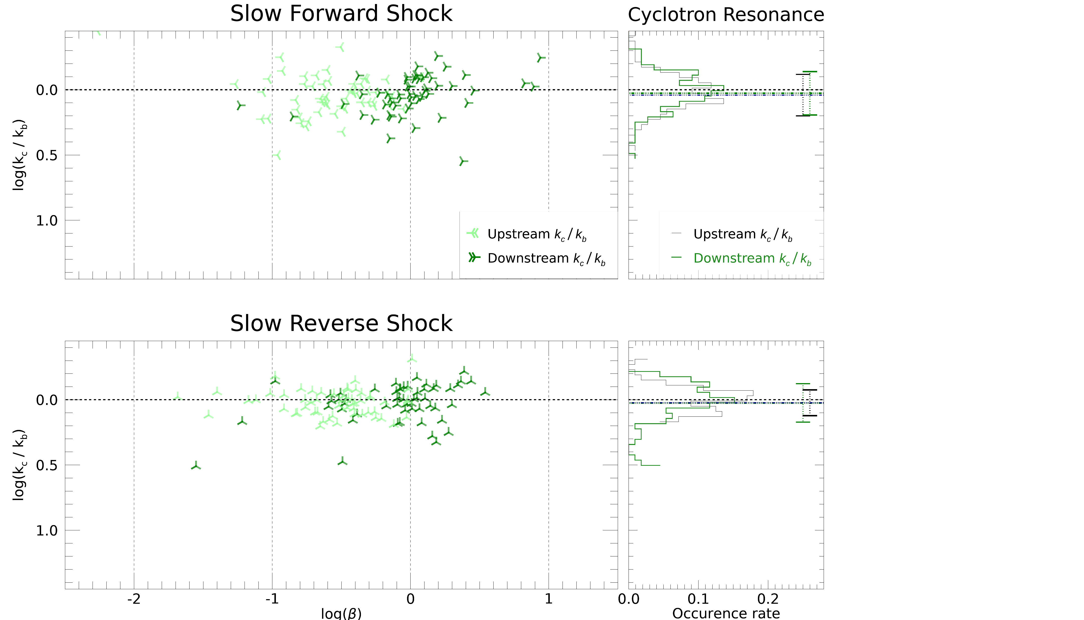
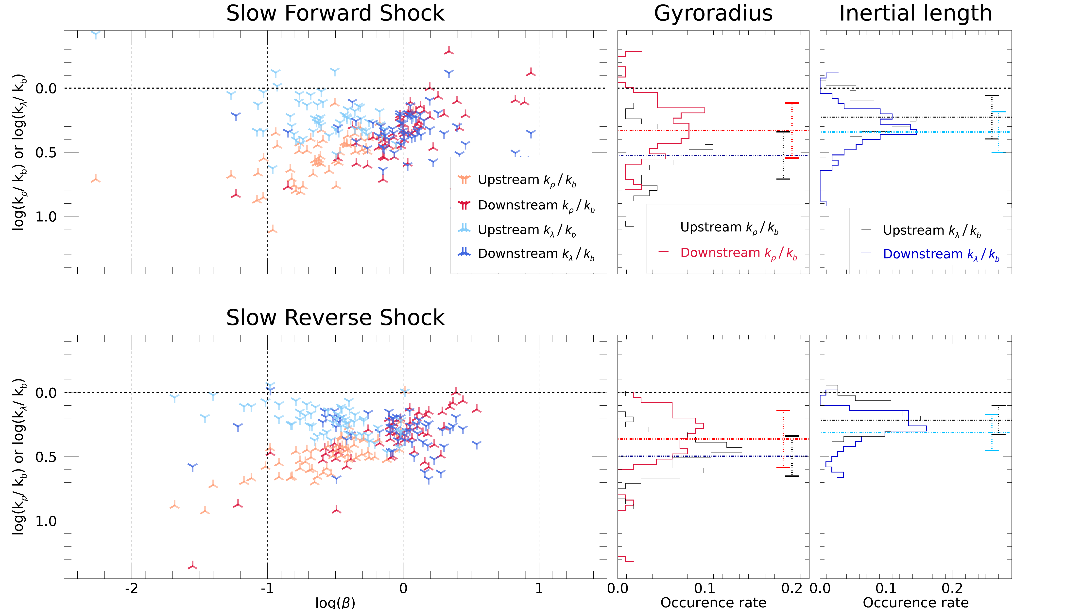
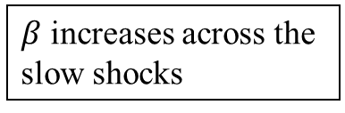
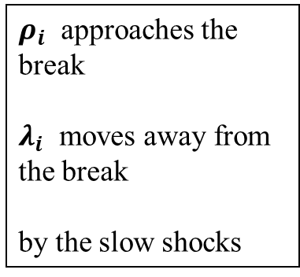
Preliminary Result
Park et al.
$β$ increases across the slow shocks
The trend of length scales’ convergence towards the spectral break can be seen remaining in downstream
$ρ_{i}$ approaches the break
$λ_{i}$ moves away from the break
by the slow shocks

Slide 7
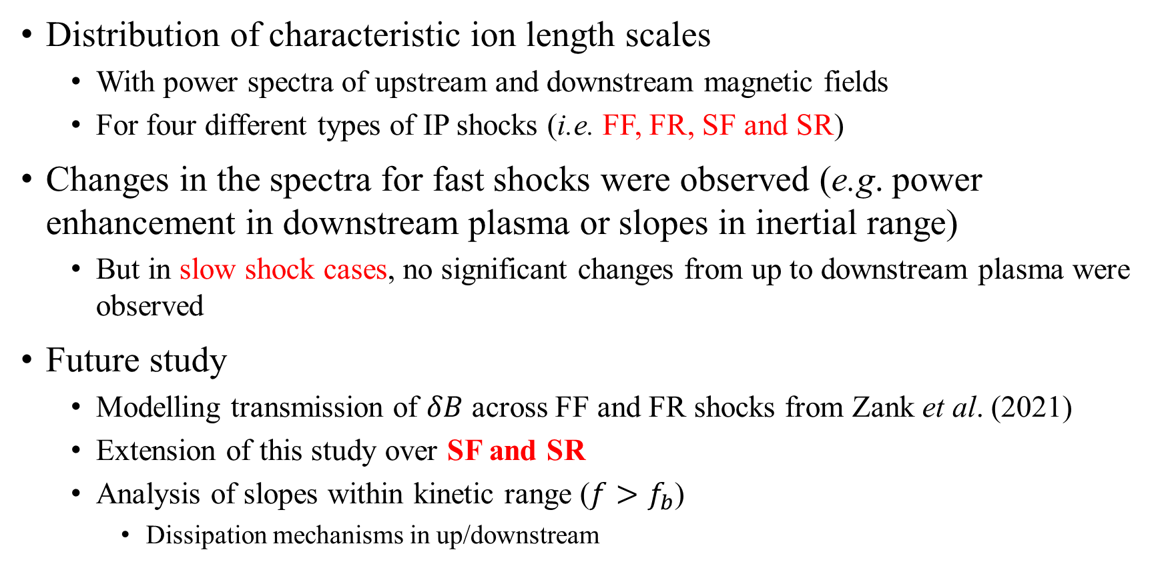
Summary
Park et al.
Distribution of characteristic ion length scales
With power spectra of upstream and downstream magnetic fields
For four different types of IP shocks (i.e. FF, FR, SF and SR)
Changes in the spectra for fast shocks were observed (e.g. power enhancement in downstream plasma or slopes in inertial range)
But in slow shock cases, no significant changes from up to downstream plasma were observed
Future study
Modelling transmission of $δB$ across FF and FR shocks from Zank et al. (2021)
Extension of this study over SF and SR
Analysis of slopes within kinetic range ($f>f_{b}$)
Dissipation mechanisms in up/downstream

