Slide 1
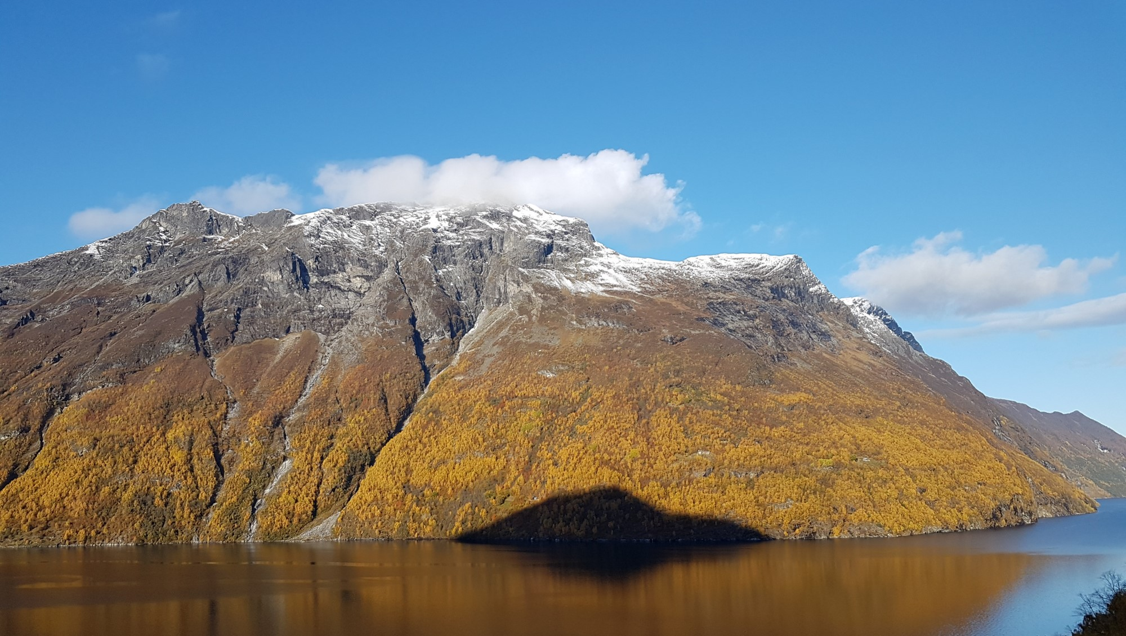




What causes creep bursts in the Åknes landslide, Norway?
Andreas Aspaas^{1,3}, Pascal Lacroix^{1,2}, Lene Kristensen³, Bernd Etzelmüller¹ and François Renard^{1,2}
¹Department of Geosciences, Njord Centre, University of Oslo (email: a.g.aspaas@geo.uio.no)
²ISTerre, Univ. Grenoble Alpes, Grenoble INP, Univ. Savoie Mont Blanc, CNRS, IRD, Univ. Gustave Eiffel
³Section for Landslides and Avalanches, Norwegian Water Resources and Energy Directorate
Notes:
Hi, my name Andreas Aspaas, phd student at UiO and geologist NVE. Today I am going to talk about landslides, in particular the Åknes landslide in Norway.

Slide 2
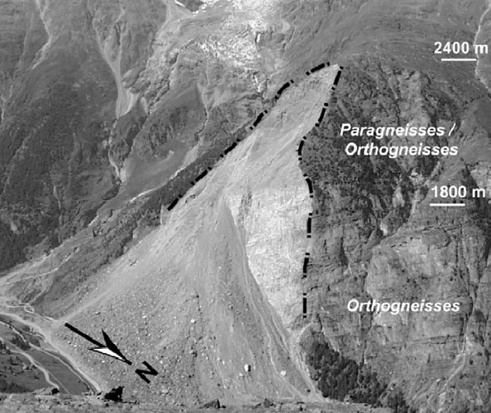
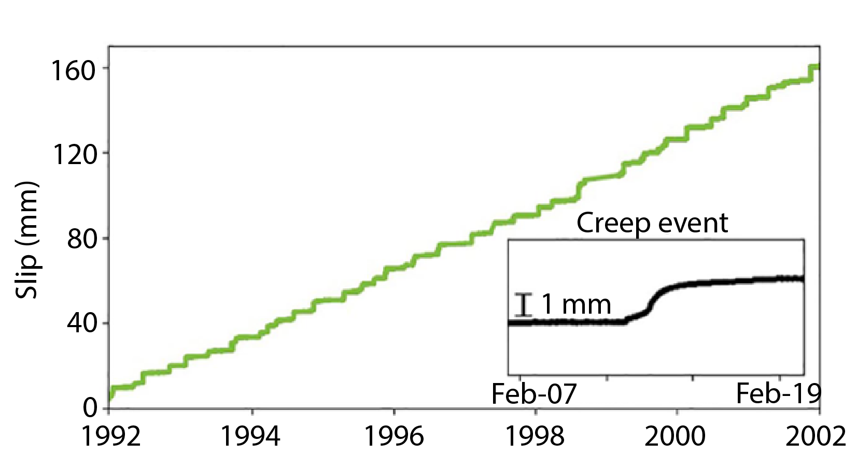
What are landslides ?
The Randa rockslide
Active landslides are mass wasting events of rock or soil that can either creep or creep and accelerate to failure
Landslide hazard costs approximately 4.500 lives each year (2004-2018)
Brideau et.al, 2009
What is a creep burst?
Creep bursts at the San Andreas Fault
Creep bursts are transient accelerations of slip
They play a dominant role in surface slip
Mechanics and dynamics of creep bursts are still unknown
Gittins & Hawthorne, 2022
Notes:
mm to m/yr, accelerate m/s
Accelrations on landslides and earthquake faults
These accelerations defined as creep bursts
Repetative cause slips
Unknown mechanisms and dynamics

Slide 3
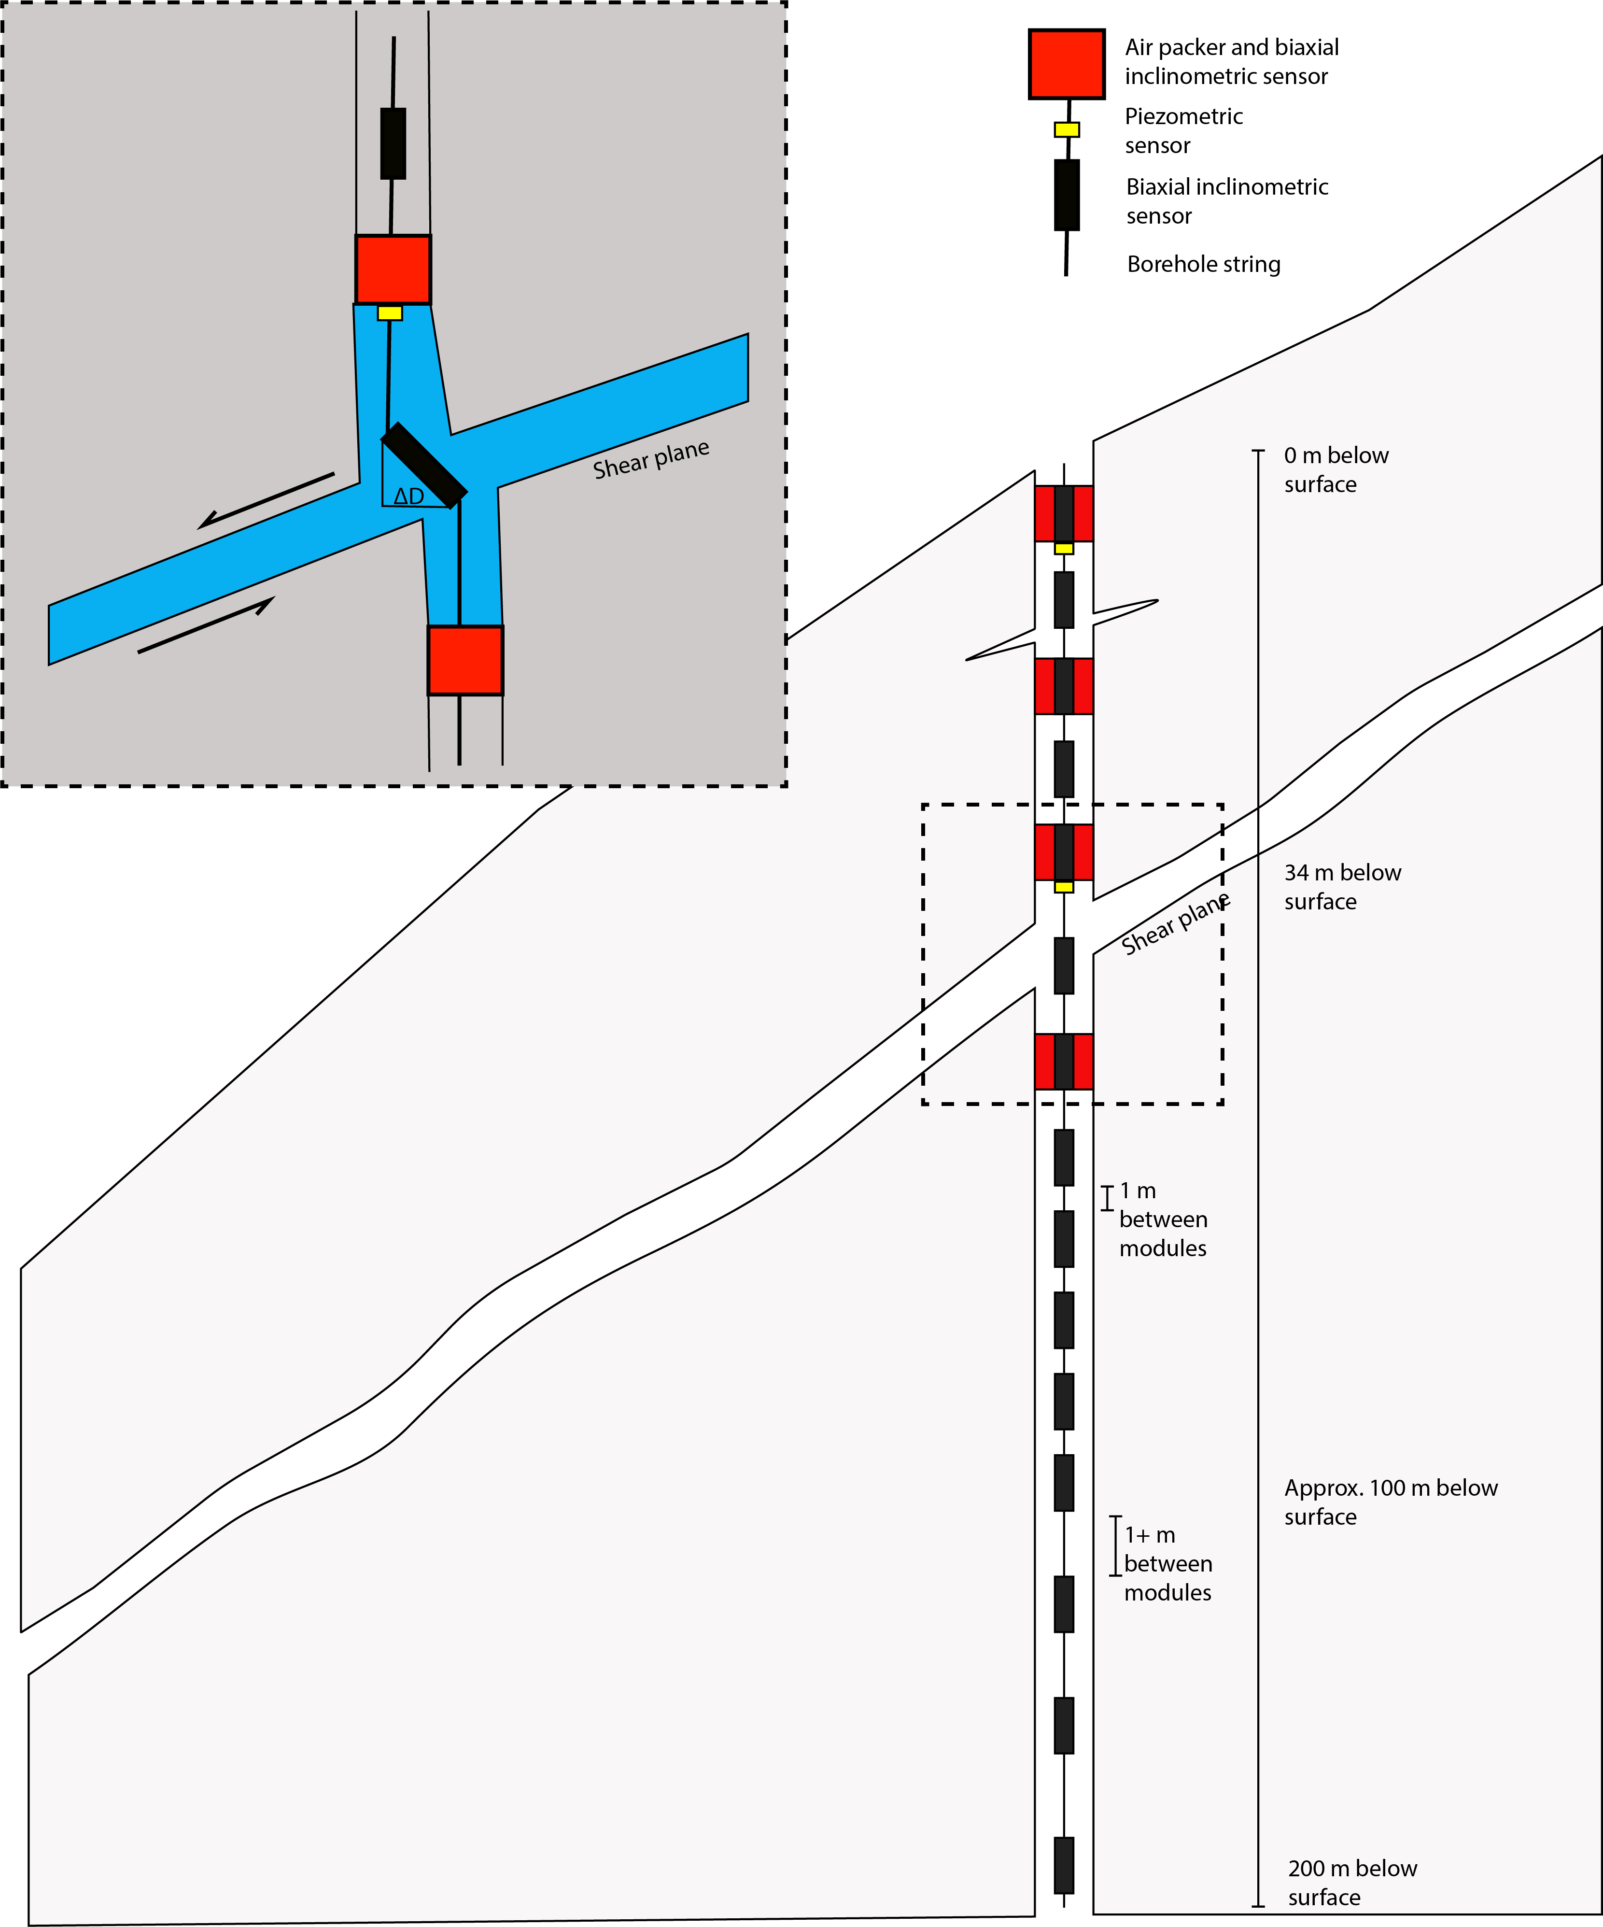
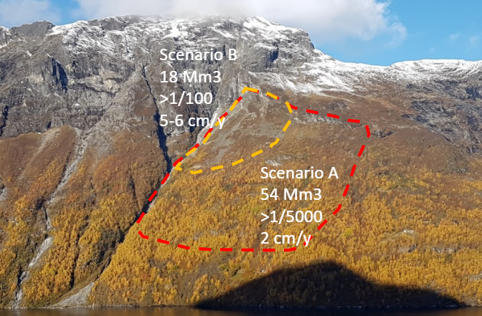
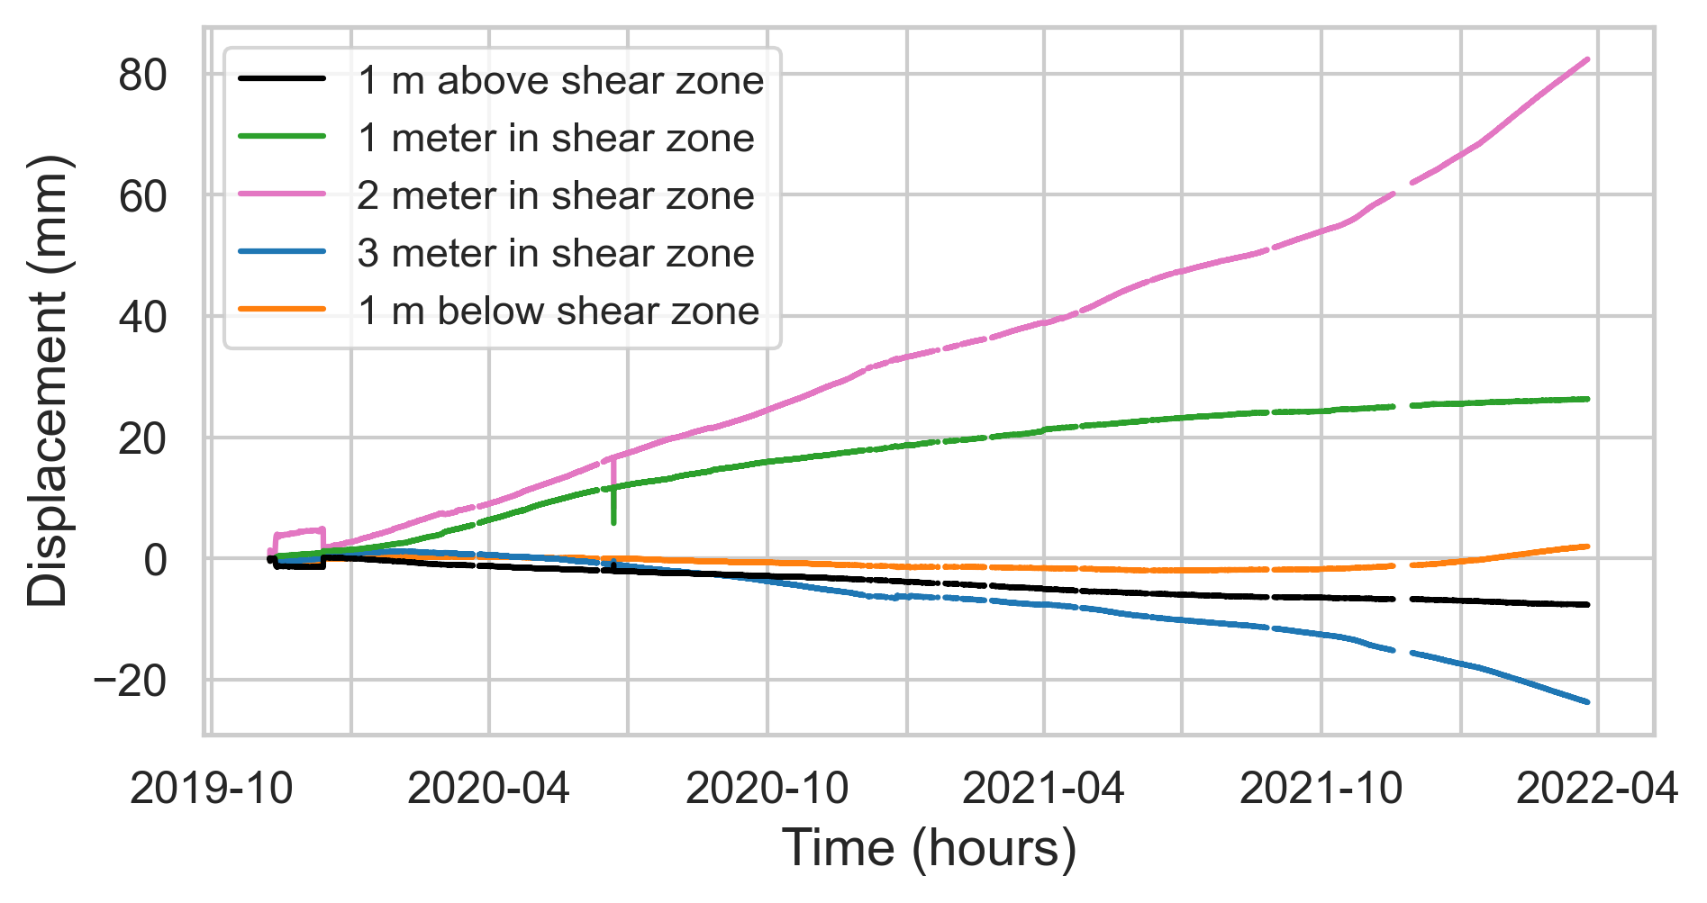
The Åknes landslide
700 meter long backscarp at 700-1000 masl
Average slip rate of 55 mm/yr
Very well instrumented over ~20 year
(boreholes, GPS, seismometers)
Can we detect creep bursts in Åknes?
Main shear zone
Notes:
Why Åknes??
Large landslide that is well instrumented over 20 yrs due to high risk, , (boreholes, crack meters, GPSs, total station, lasers, seismic array, meteorological station)
Geology, foliation parallell sliding plane
Focus on boreholes in this presentation
Borehole include:
Biaxial inclinometers
1 meter spacing from 0-100 m
Sporadic from 100-200 m
Packers isolating fracture zones
Piezometer in each zone
Displacement from modules, in following plots, from module in shear zone only

Slide 4
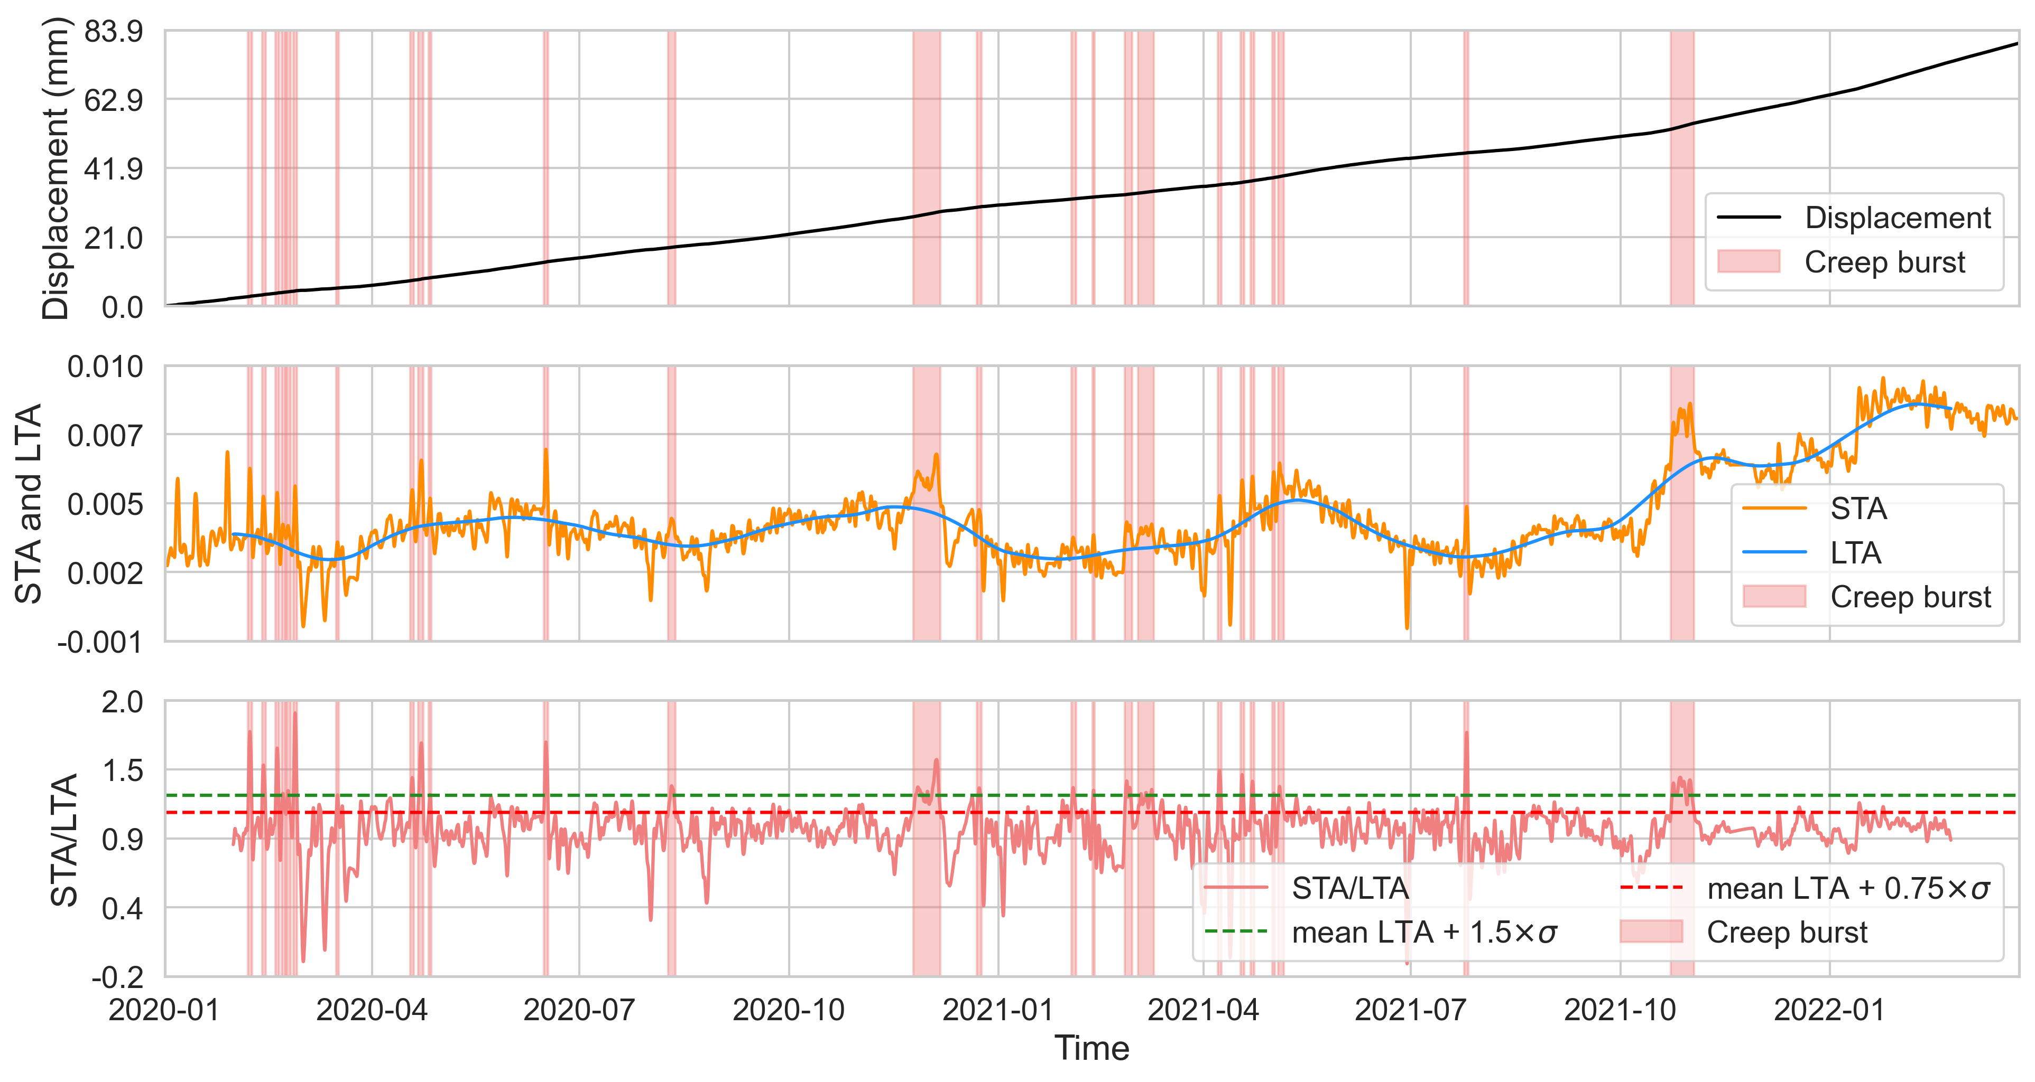
Creating a creep burst database
data from one borehole
Notes:
removing noise Butterworth filter (1 day cut off)
calculated velocity by a linear fit over a period of time.
Long term average is 30 times short term average.
Defining creep bursts above green line, and length of burst by red line

Slide 5
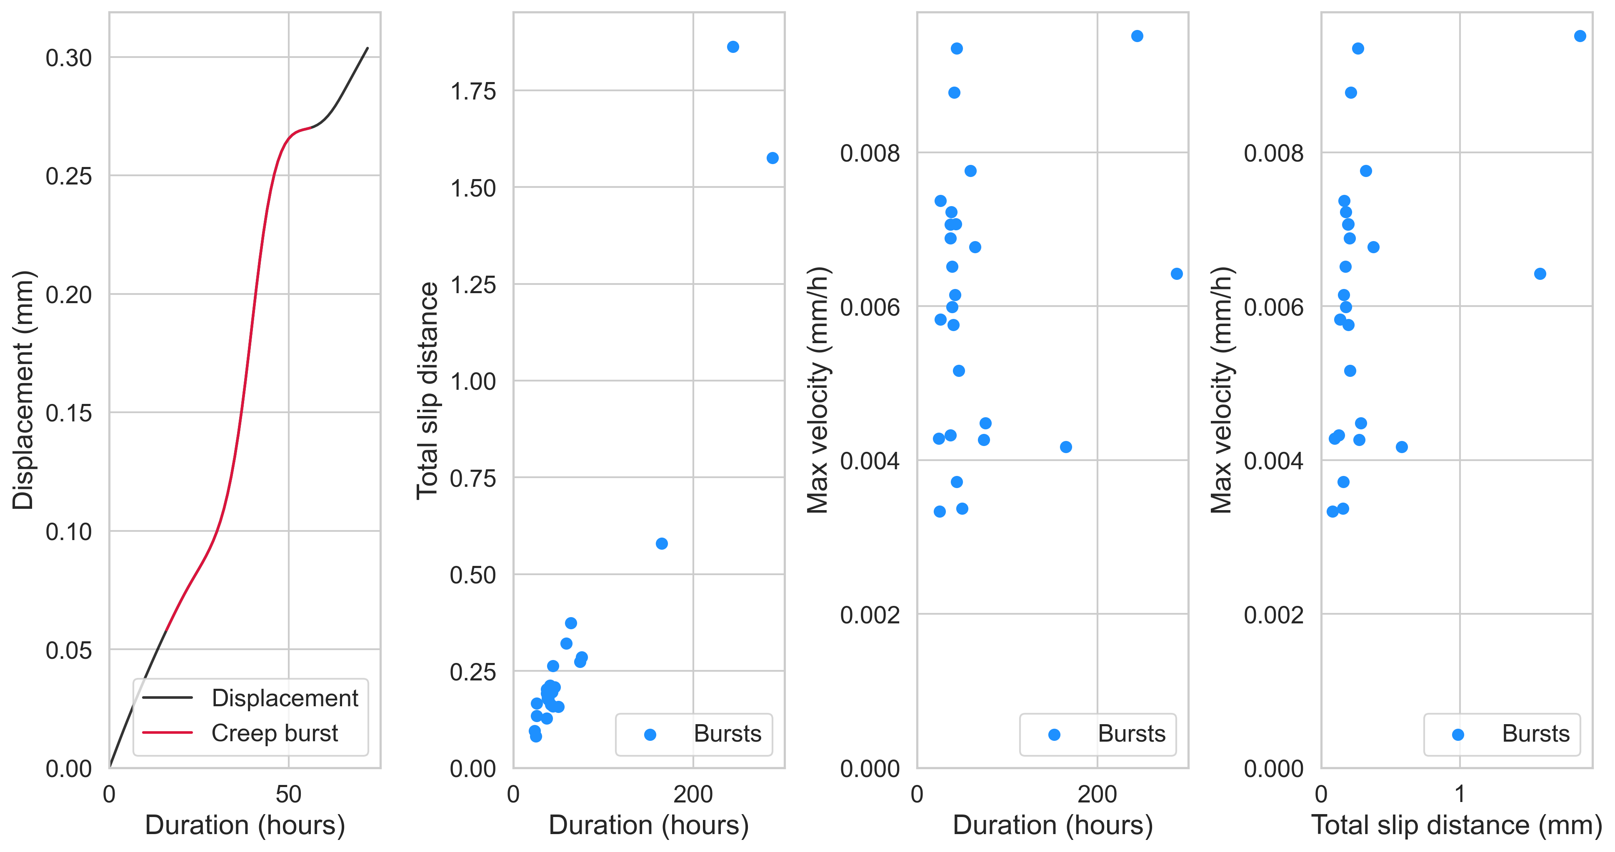
The creep burst database
data from one borehole
Notes:
Typical creep burst with s-shape.
increased duration correlates increasing distance.
no correlation between velocity and duration and slip distance

Slide 6
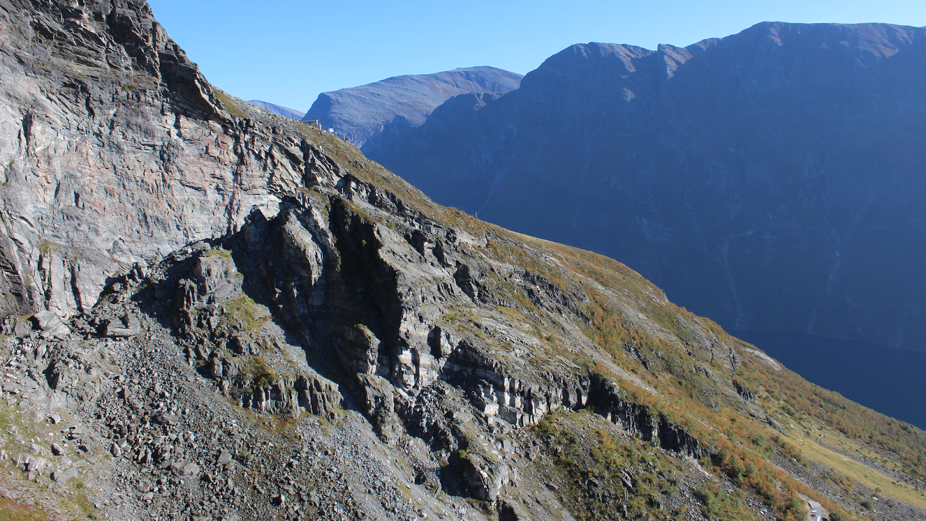
Conclusions and further work
Boreholes at the Åknes landslide have recorded numerous creep bursts
The mechanism of creep bursts is unknown in this landslide
On-going analysis:
Cross correlation between borehole data, local seismicity, and meteorological parameters
Notes:
On-going analysis:
Water pressure causing creep bursts ? Borehole correlate indicating sliding on the same sliding plane?
Seismic events from the seismic catalog related to cracking or sliding.
Meteorological parameters as climatic forcing by temperature, snow, and rain

Slide 7
References
Brideau, M.-A., Yan, M., & Stead, D. (2009). The role of tectonic damage and brittle rock fracture in the development of large rock slope failures. Geomorphology, 103(1), 30-49.
Ganerød, G. V., Grøneng, G., Rønning, J. S., Dalsegg, E., Elvebakk, H., Tønnesen, J. F., . . . Braathen, A. (2008). Geological model of the Åknes rockslide, western Norway. Engineering Geology, 102(1-2), 1-18.
Gittins, D. B., & Hawthorne, J. C. (2022). Are Creep Events Big? Estimations of Along‐strike Rupture Lengths. Journal of Geophysical Research: Solid Earth, e2021JB023001.

Slide 8
Research questions
How to detect creep bursts in Åknes?
analysis of different time series
correlation between time series in space and time
What is controlling the dynamics of creep bursts?
Do creep events differ in amplitude and frequency annually?
Do creep events depend on the spatial location in regards to the landslide fall-line and are creep behaviour differing with depth along the borehole columns?
Do creep events correlate with meteorological parameters or seismic events?
What is the origin of these creep bursts?
Under which conditions do creep event evolve into catastrophic failure?
Notes:
Understand mechanics and dynamics of creep bursts at Åknes
Detect them in time series and correlate in space and time
Characterize creep bursts by their signal, spatial location and correlation with meteorological parameters and seismic events

Slide 9
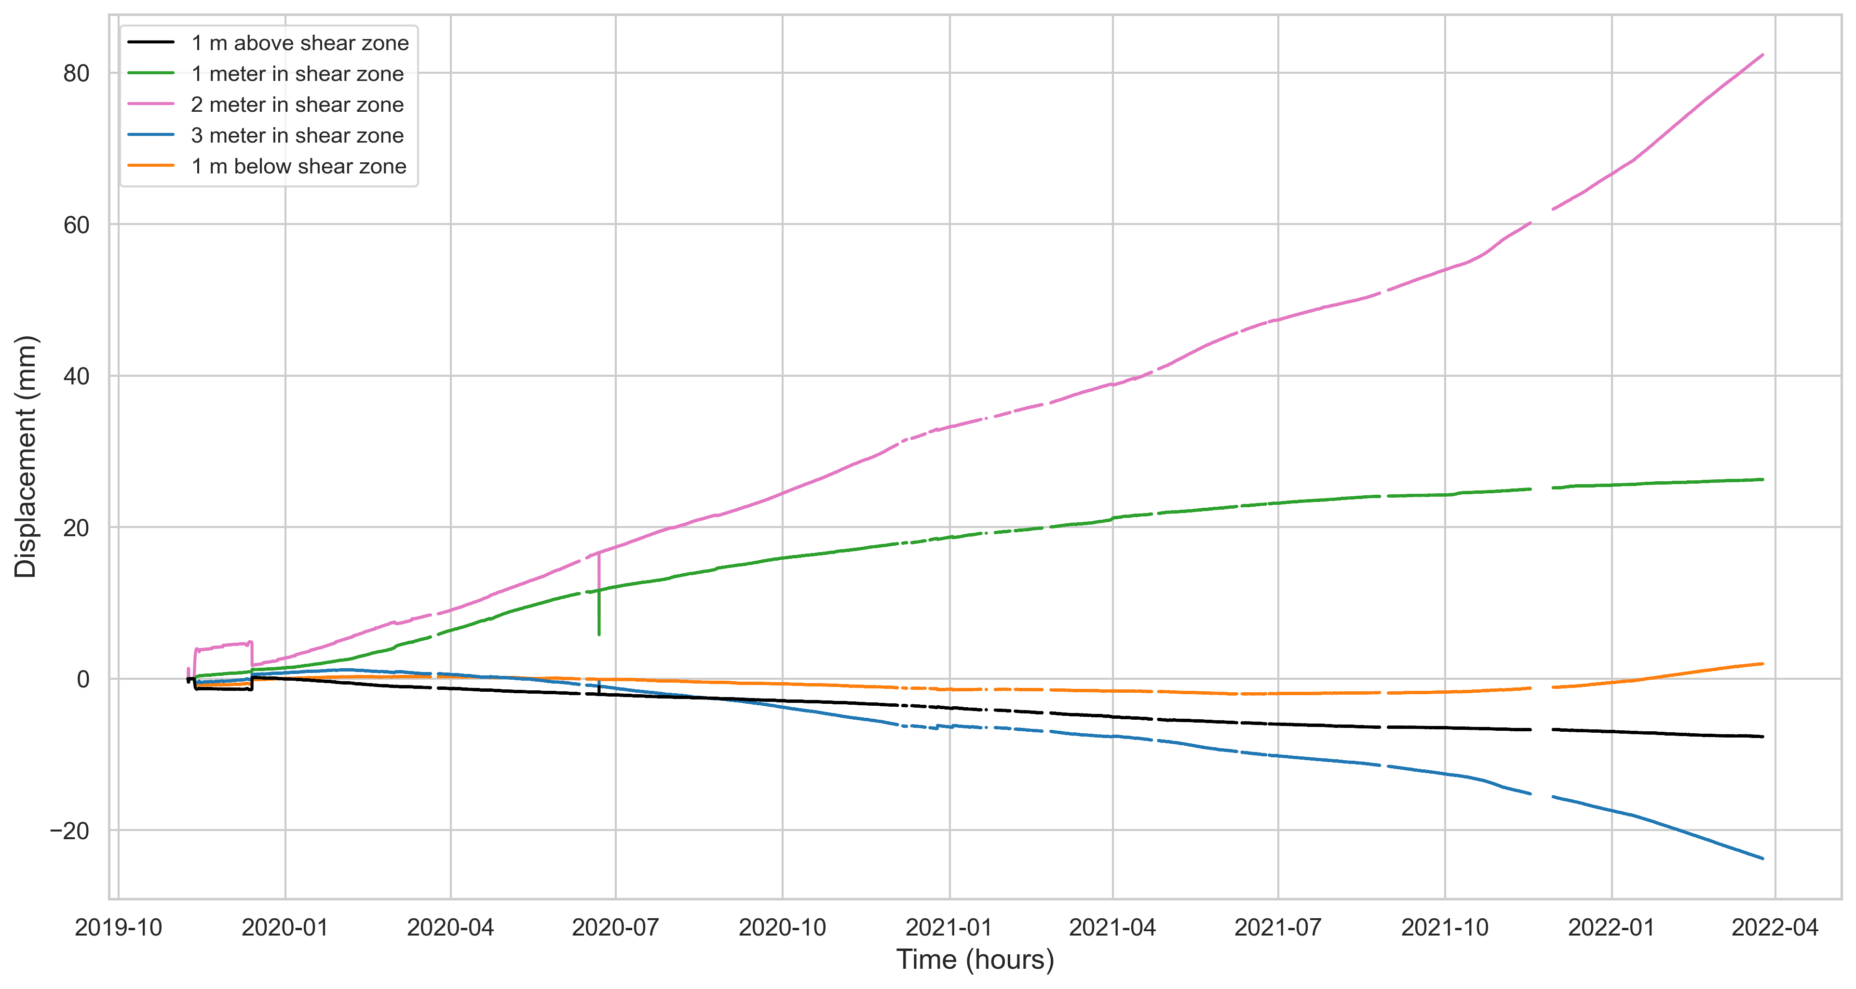
KH-01-18 displacement in inclinometers
Main shear zone
In shear zone
Out of shear zone
In shear zone

Slide 10
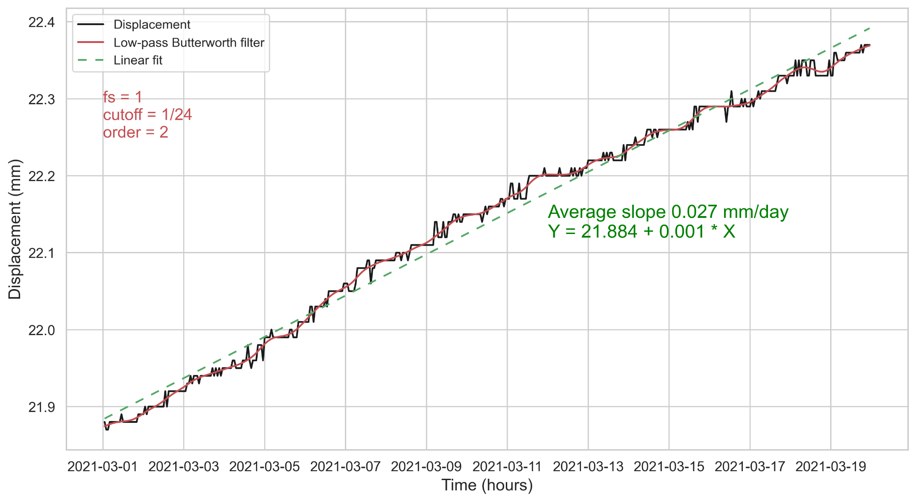
Filtering displacement series of KH-02-18
Notes:
To detect transients, filtering noise
1 day cut off best fit to remove noise
Avg velocity on 20 days

