Slide 1



Interannual variability in Monsoon LOW Level Jet and Indian Summer Monsoon Rainfall (ISMR)
Smrati Purwar, Rakesh V, GN Mohapatra
CSIR Fourth Paradigm Institute, Bangalore, Karnataka, India
Academy of Scientific and Innovation Research (AcSIR), Ghaziabad, India
EGU- General Assembly-2022
23-27 May 2022

Slide 2
Content
Introduction
Objectives
Methodology
Result
Conclusion

Slide 3
Introduction
ISM brings about 80% of annual precipitation over Indian subcontinent during June-September
ISM circulation is maintained by the land-atmosphere-ocean interaction
The main conduit for transfer of moisture from the ocean to the land mass is Monsoon Low Level Jet (MLLJ)
Any changes in the characteristics of LLJ can substantially affect the monsoon water cycle.
Many studies show the intensification of monsoon rainfall and increase in heavy to very heavy rainfall.

Slide 4
Objectives
The temporal changes in MLLJ strength and Level (Height) during recent decades
How the variations in MLLJ strength and height affect the intra-seasonal precipitation characteristics of Indian subcontinent

Slide 5
Methodology
The monthly mean wind profile during 1979-2018 (40 years) from ERA-Intrim, IMDAA, and MERRA.
MLLJ strength is calculated by taking average of wind speed and then maximum over vertical pressure level.
MLLJ level is the pressure level in which the wind speed is maximum.
Datasets | Horizontal resolution | Vertical resolution | References
ERA-Intrim | 0.75˚×0.75˚ | 60 vertical pressure levels from surface to 0.1hpa | Dee et al.2011
IMDAA | 0.12˚×0.12˚ | 63 vertical pressure levels from surface to 40km above sea level | Rani et al. 2021
MERRA | 0.5˚×0.625˚ | 72 vertical pressure levels from surface to 0.01hpa | Rienecker et al. 2011

Slide 6
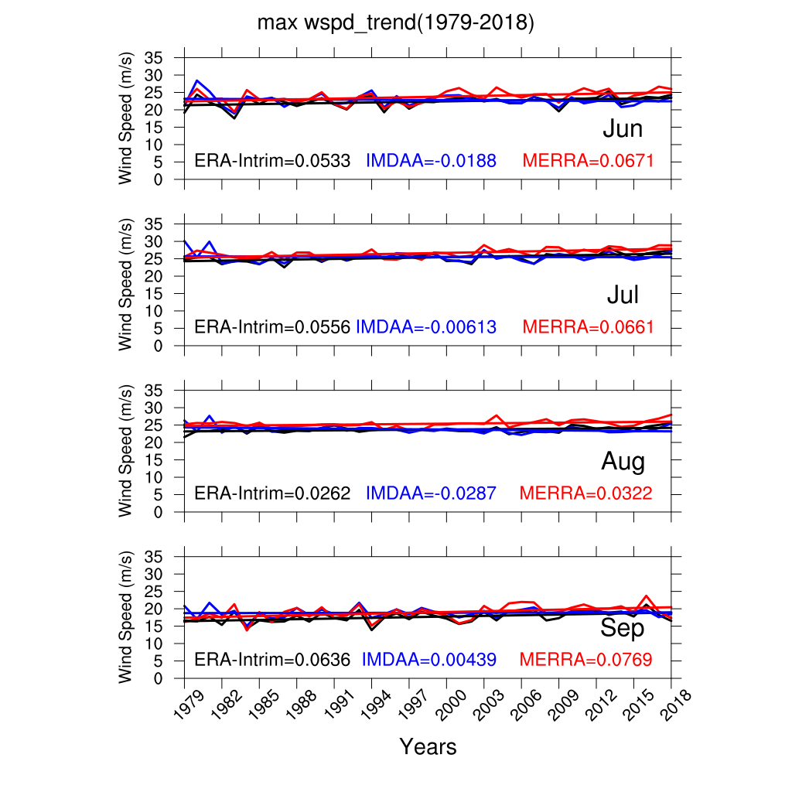
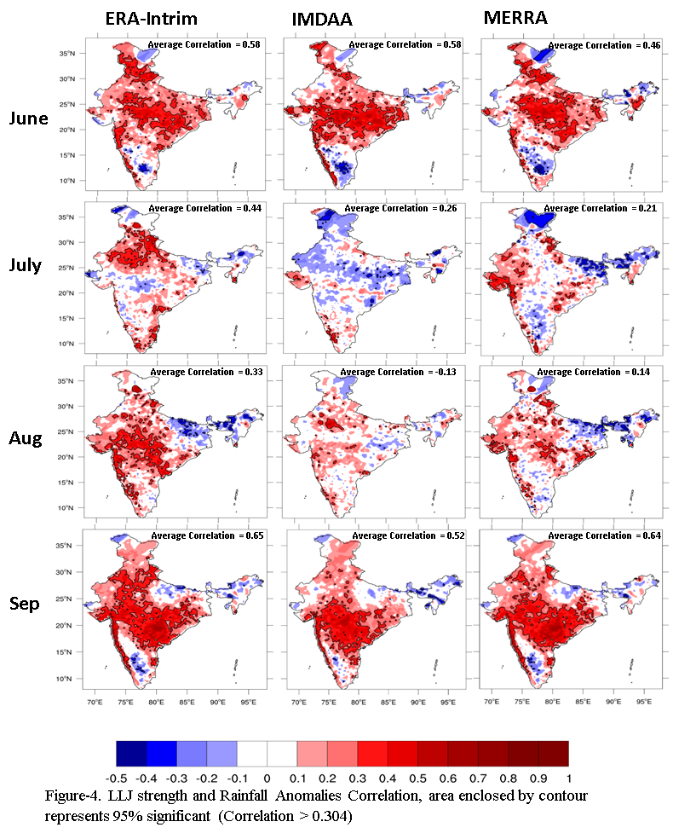
Result
The temporal variation in MLLJ strength
Anomalies Correlation between MLLJ strength and ISMR

Slide 7
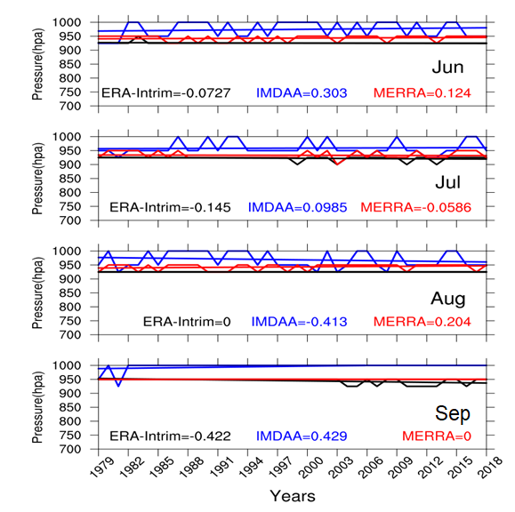
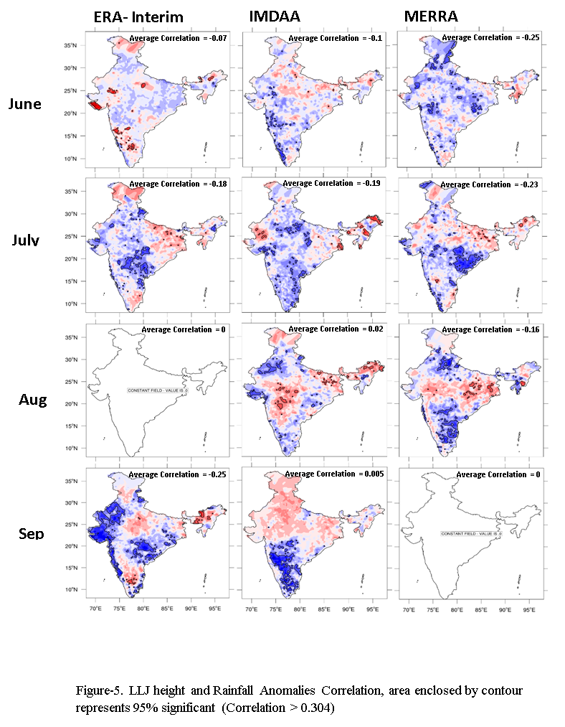
Cont…
The temporal variation in MLLJ Level
Anomalies Correlation between MLLJ height and ISMR

Slide 8
Conclusion
The MLLJ strength is showing positive trend in every summer months (JJAS).
The variation in MLLJ strength is positively correlated to the mostly regions of India except the south and north-east India
The MLLJ strength impacts upper portion of India, which may be caused of northward propagation of MLLJ.
The MLLJ strength affects the Indian Summer monsoon rainfall more in the onset and withdrawal month, compared to other months.
The variation in MLLJ level is showing negative trend from ERA-Intrim dataset (95% significant)
The correlation between MLLJ level and ISMR is negative, but the spatial anomalies correlation is not consistent from these reanalysis datasets.

Slide 9
THANK YOU

