Slide 1

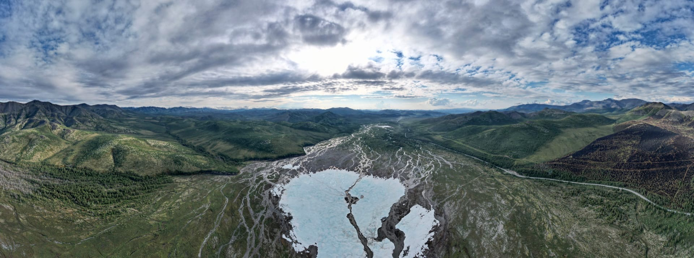





Aufeis impact on hydrological cycle in the North-Eastern Russia
Anastasiya ZEMLYANSKOVA^{1,2}, Nataliia NESTEROVA^{1,2}, Olga MAKARIEVA^{1,2}, Andrey SHIKHOV³, Andrey OSTASHOV^{1,2}, Vladimir ALEXEEV²
¹St. Petersburg State University, Russian Federation,
²Melnikov Permafrost Institute, Russian Federation,
³Perm State University, Russian Federation

Slide 2
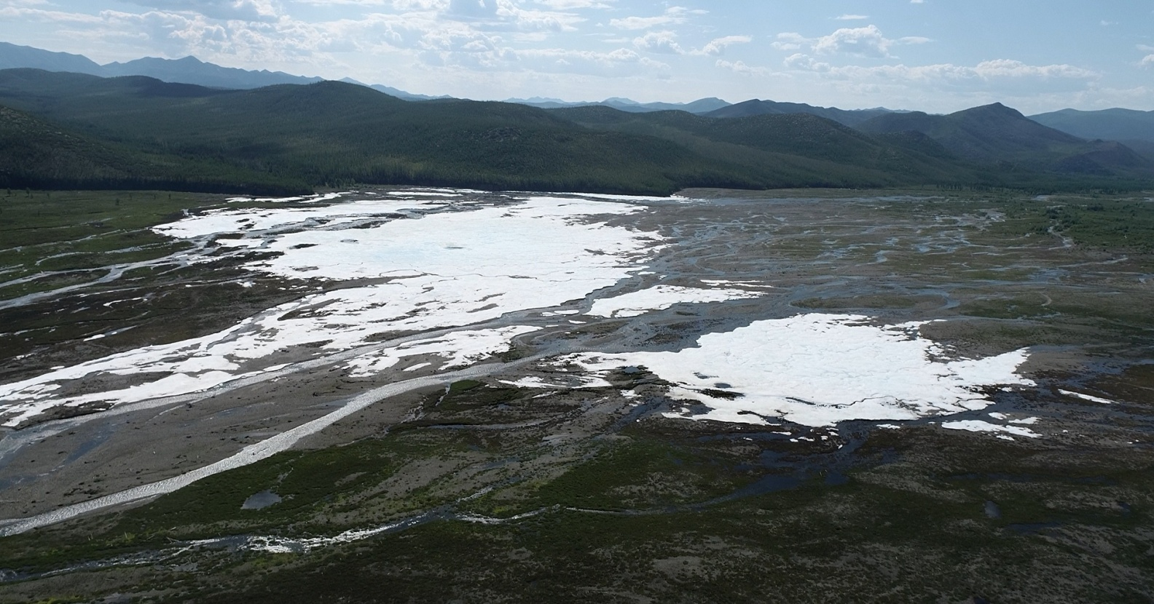
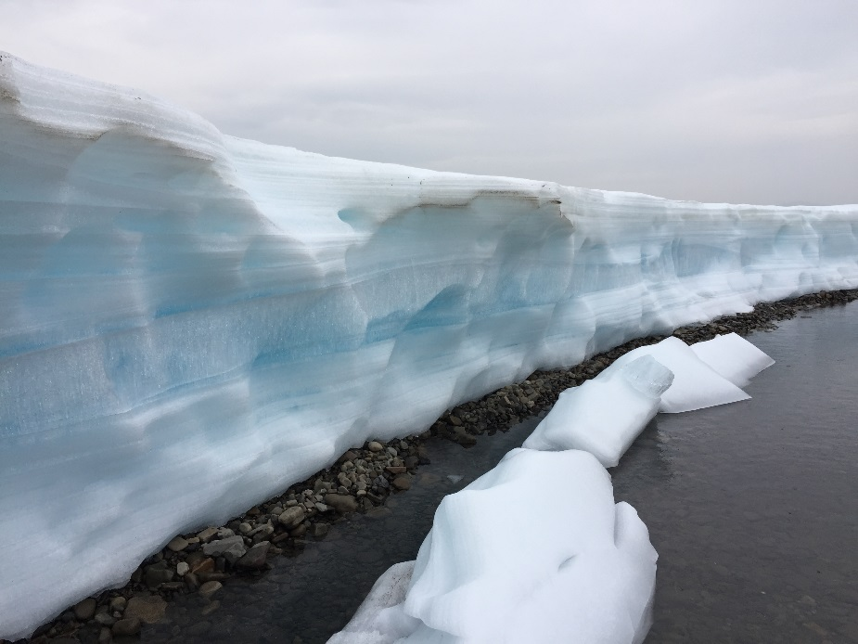
Relevance
- Aufeis (or icings, or naled) are the ice fields produced annually due to layer-by-layer freezing of ground water on the surface.
The indicator of the complex relationship between permafrost, river streamflow and groundwater.
Play a significant role in hydrological cycle.
The important water resource.
2
The Anmangynda aufeis, the Kolyma River basin

Slide 3
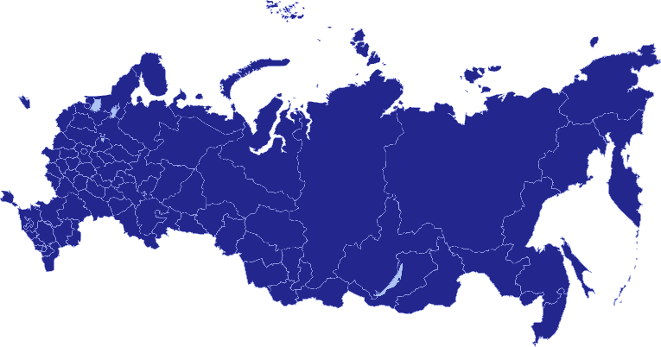
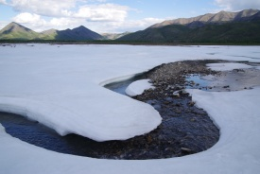

Study area
Aufeis are widespread at the North-East of Russia (Yana, Indigirka, Kolyma, Anadyr, Penzhina Rivers and rivers of the Chukchi Peninsula). Total study area is about 2 000 000 km².
By historical data assessed from aerial images (1940-1950)
there are more than 7000 spring aufeis with the total area about 4700 km².
Climate and natural conditions
mostly continental climate;
mountainous terrain (maximum elevation 3147 m);
continuous permafrost zone;
average annual air temperature ranges from -15.7˚C in Oymyakon (726 m) to -2.8˚C in Magadan (118 m);
River regime is characterized by spring-summer high water, high summer-autumn rain floods and winter low water.

Slide 4
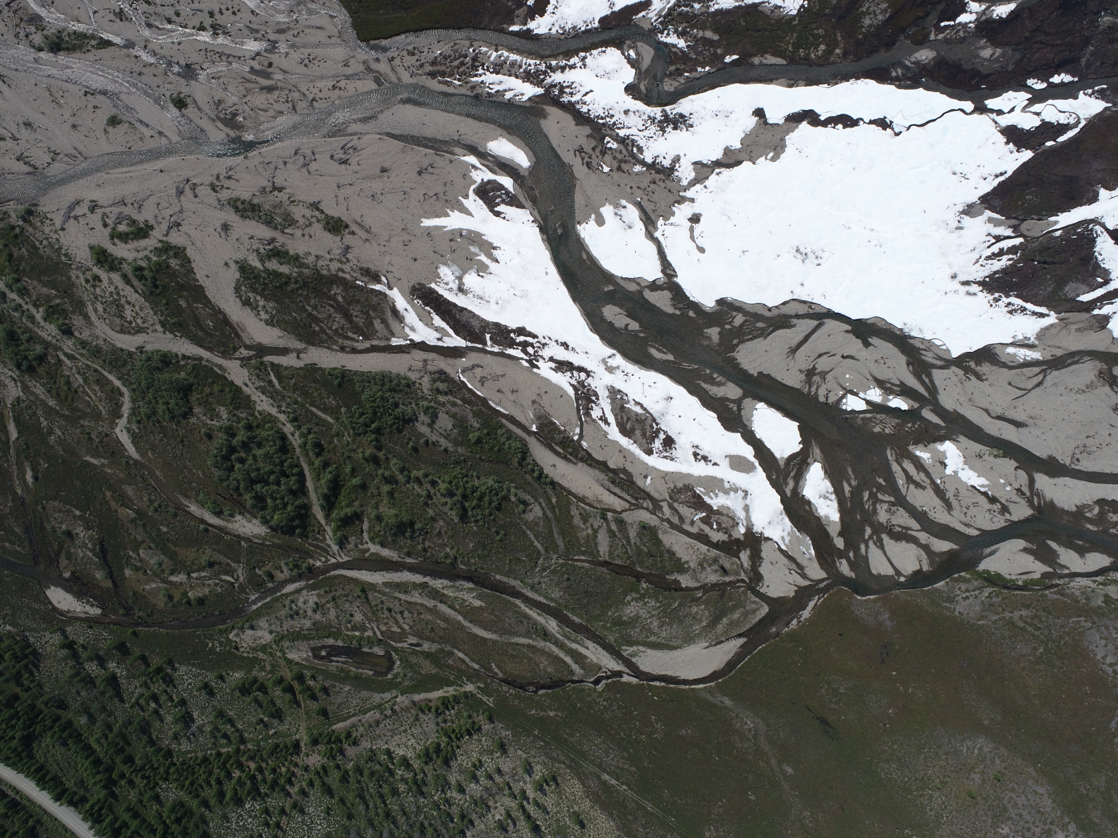
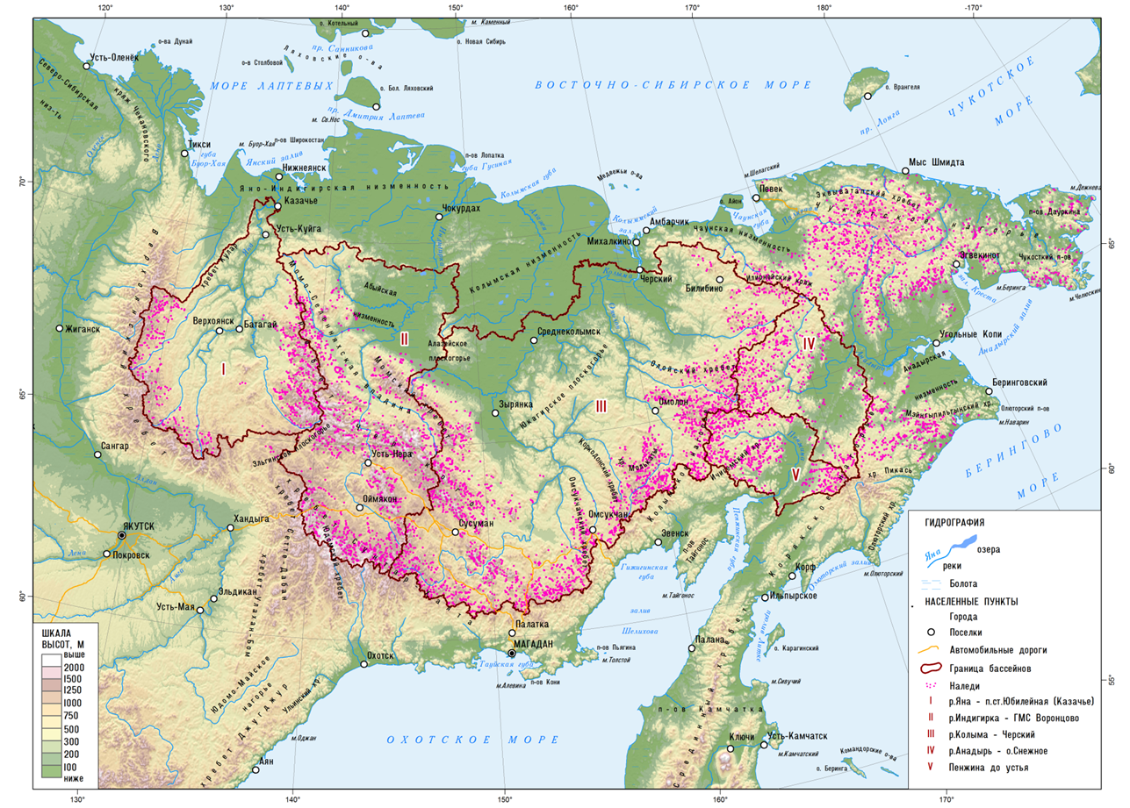
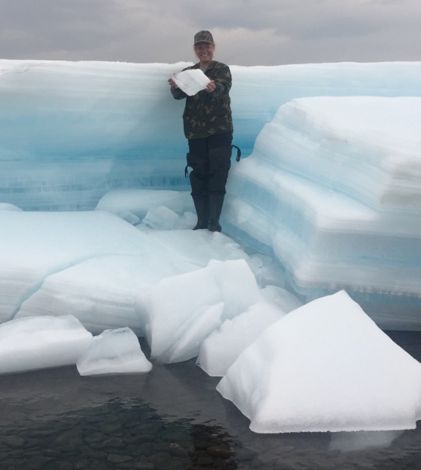
Aim
The aim is the general assessment of water resources stored by groundwater aufeis and their role in the structure of water balance and the runoff formation of the rivers in permafrost zone of North-East of Russia.
>7000 giant aufeis

Slide 5
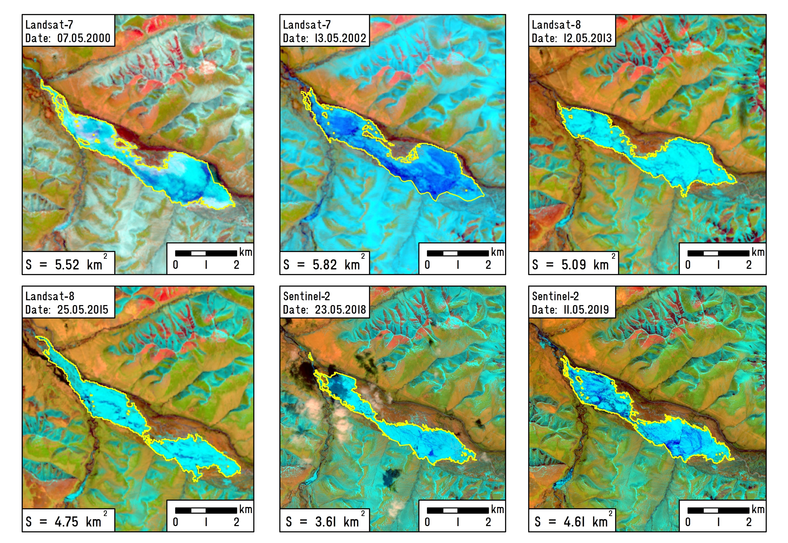
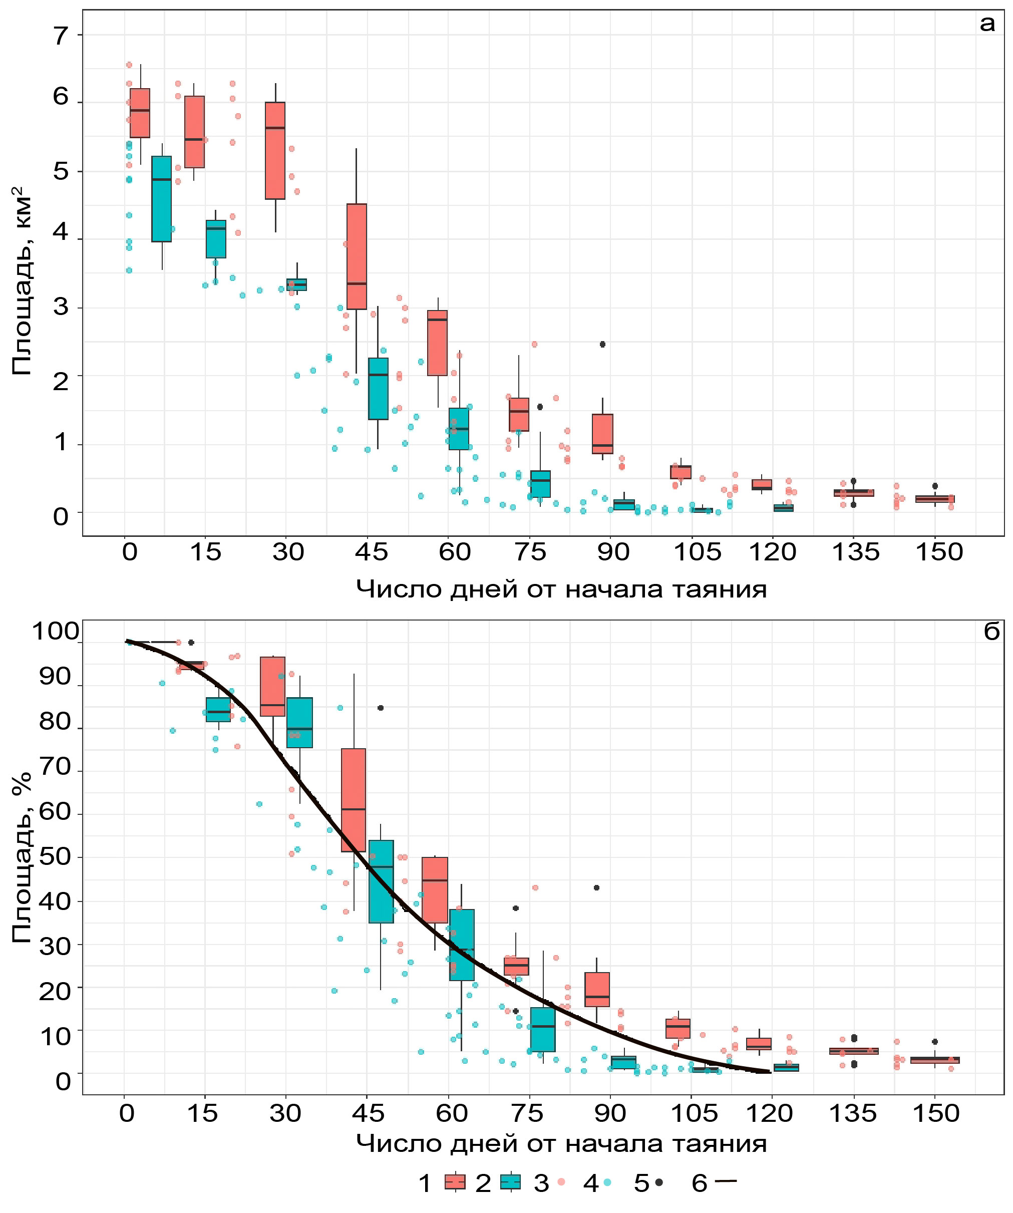
Aufeis in current climate – data of Landsat and Sentinel images (2013-2019)
Empirical dependence of area depletion with time for aufeis with area 0,6-23 km²
(Sokolov, 1975)
Aufeis area, %
The number of days from the beginning of ablation
Some images were obtained in a late spring when aufeis area could loose up to 70%.
The method by Sokolov (1975) was applied to “recover” maximum area of aufeis.
Aufeis Volume W = αF^{n}, F – area, α=0,75, n=1,12
Winter runoff – October-April period, spring freshet – May-June period and with the assumption that 70% of the aufeis volume melts during the period May-June (Sokolov, 1975)
The calculations were made for 58 gauges with basin area from 523 to 526 000 km²

Slide 6
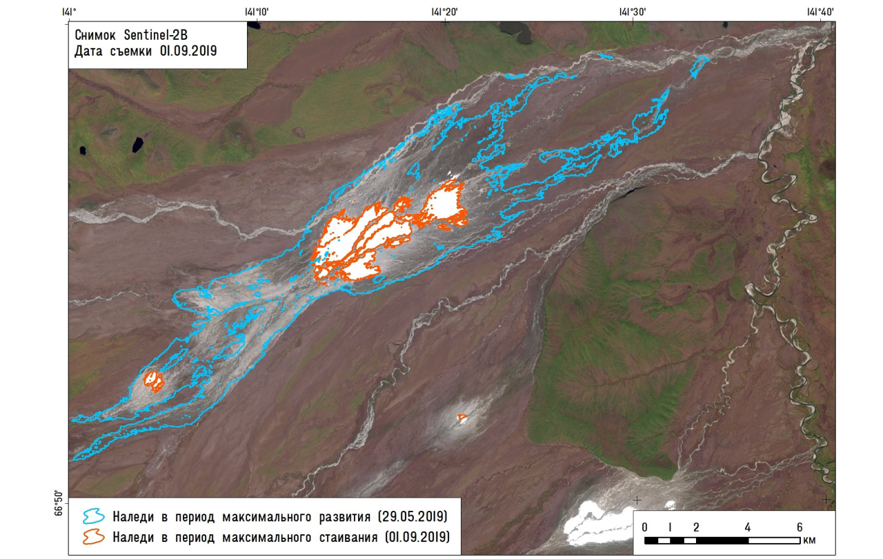
Aufeis resource
The total aufeis resource of the North-East are at least 10.6 km³ or 5 mm of water depth.
River basin | Basin area, km² | Aufeis coverage, % | Aufeis area, km² | Aufeis volume, km³ | Aufeis runoff, mm
Yana | 224000 | 0.23 | 506 | 1.1 | 4.5
Indigirka | 305000 | 0.55 | 1663 | 4.25 | 11
Kolyma | 643000 | 0.19 | 1085 | 2.2 | 3.7
Penzhina | 73500 | 0.26 | 189 | 0.4 | 5.1
Anadyr | 156000 | 0.26 | 398 | 0.85 | 5.1
Amguama | 26400 | 0.39 | 102 | 0.20 | 7.7
Total (North-East of Russia) | 1 950 000 | 0.23 | 4529 | 10.6 | 5
Sentinel-2B, 2019
Giant aufeis (>1 km²) make the main contribution to the formation of aufeis resources.
Amount of water stored in a single aufeis field may reach up to 0.5 km³ (the giant aufeis at the Syuryuktyakh River, area 80 km², the Indigirka River basin)
Aufeis area: 29 May, 3 September

Slide 7
Aufeis resource
Yana River
1.1 km³
4.5 mm
Anadyr River
2.6 km³
5.1 mm
Kolyma River
2.2 km³
3.7 mm
Indigirka River
4.3 km³
11 mm
Penzhina River
0.4 km³
5.2 mm

Slide 8
Annual aufeis flow
0.3 to 29 mm (0.1 – 22% with average value 3.8%)
Agayakan River (28.7 mm or 14.1% of annual value)
Moma River (28.7 mm or 21.6% of annual value)
The champions!

Slide 9
Winter aufeis flow
6 to 712 % (average value 112%)
The largest aufeis contribution to the winter runoff observed at the Moma River (712%).

Slide 10
Spring freshet aufeis flow
0.2 to 43 % (average value 7.1%)
The largest aufeis contribution to the spring freshet runoff at the Agayakan River (43%)

Slide 11
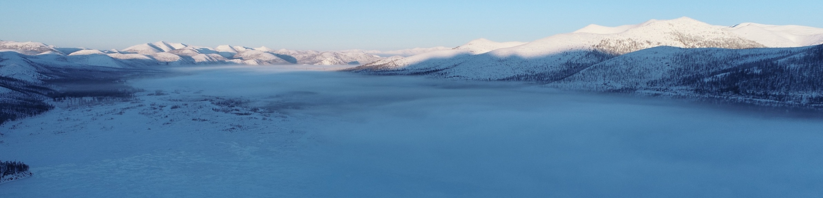
Conclusion
Aufeis are important water resources that strongly impact the runoff formation in mountainous permafrost zone.
The dynamics of aufeis formation is directly related to the winter runoff, which changes are observed in different permafrost environment.
In the North-East the aufeis runoff exceeds the glacial runoff and aufeis water resources exceed the same of glaciers. The role of aufeis is largely underestimated in the studies and modelling results.
Under the warming climate conditions, the changes in the aufeis processes will play a significant role in the amount of river flow discharging to the Arctic Ocean. This will eventually lead to changes in the natural the ocean–climate system and its various components.
The study was carried out with the support of Russian Foundation for Basic Research (19-55-80028, 20-05-00666)
and St. Petersburg State University (project 75295776)

Slide 12
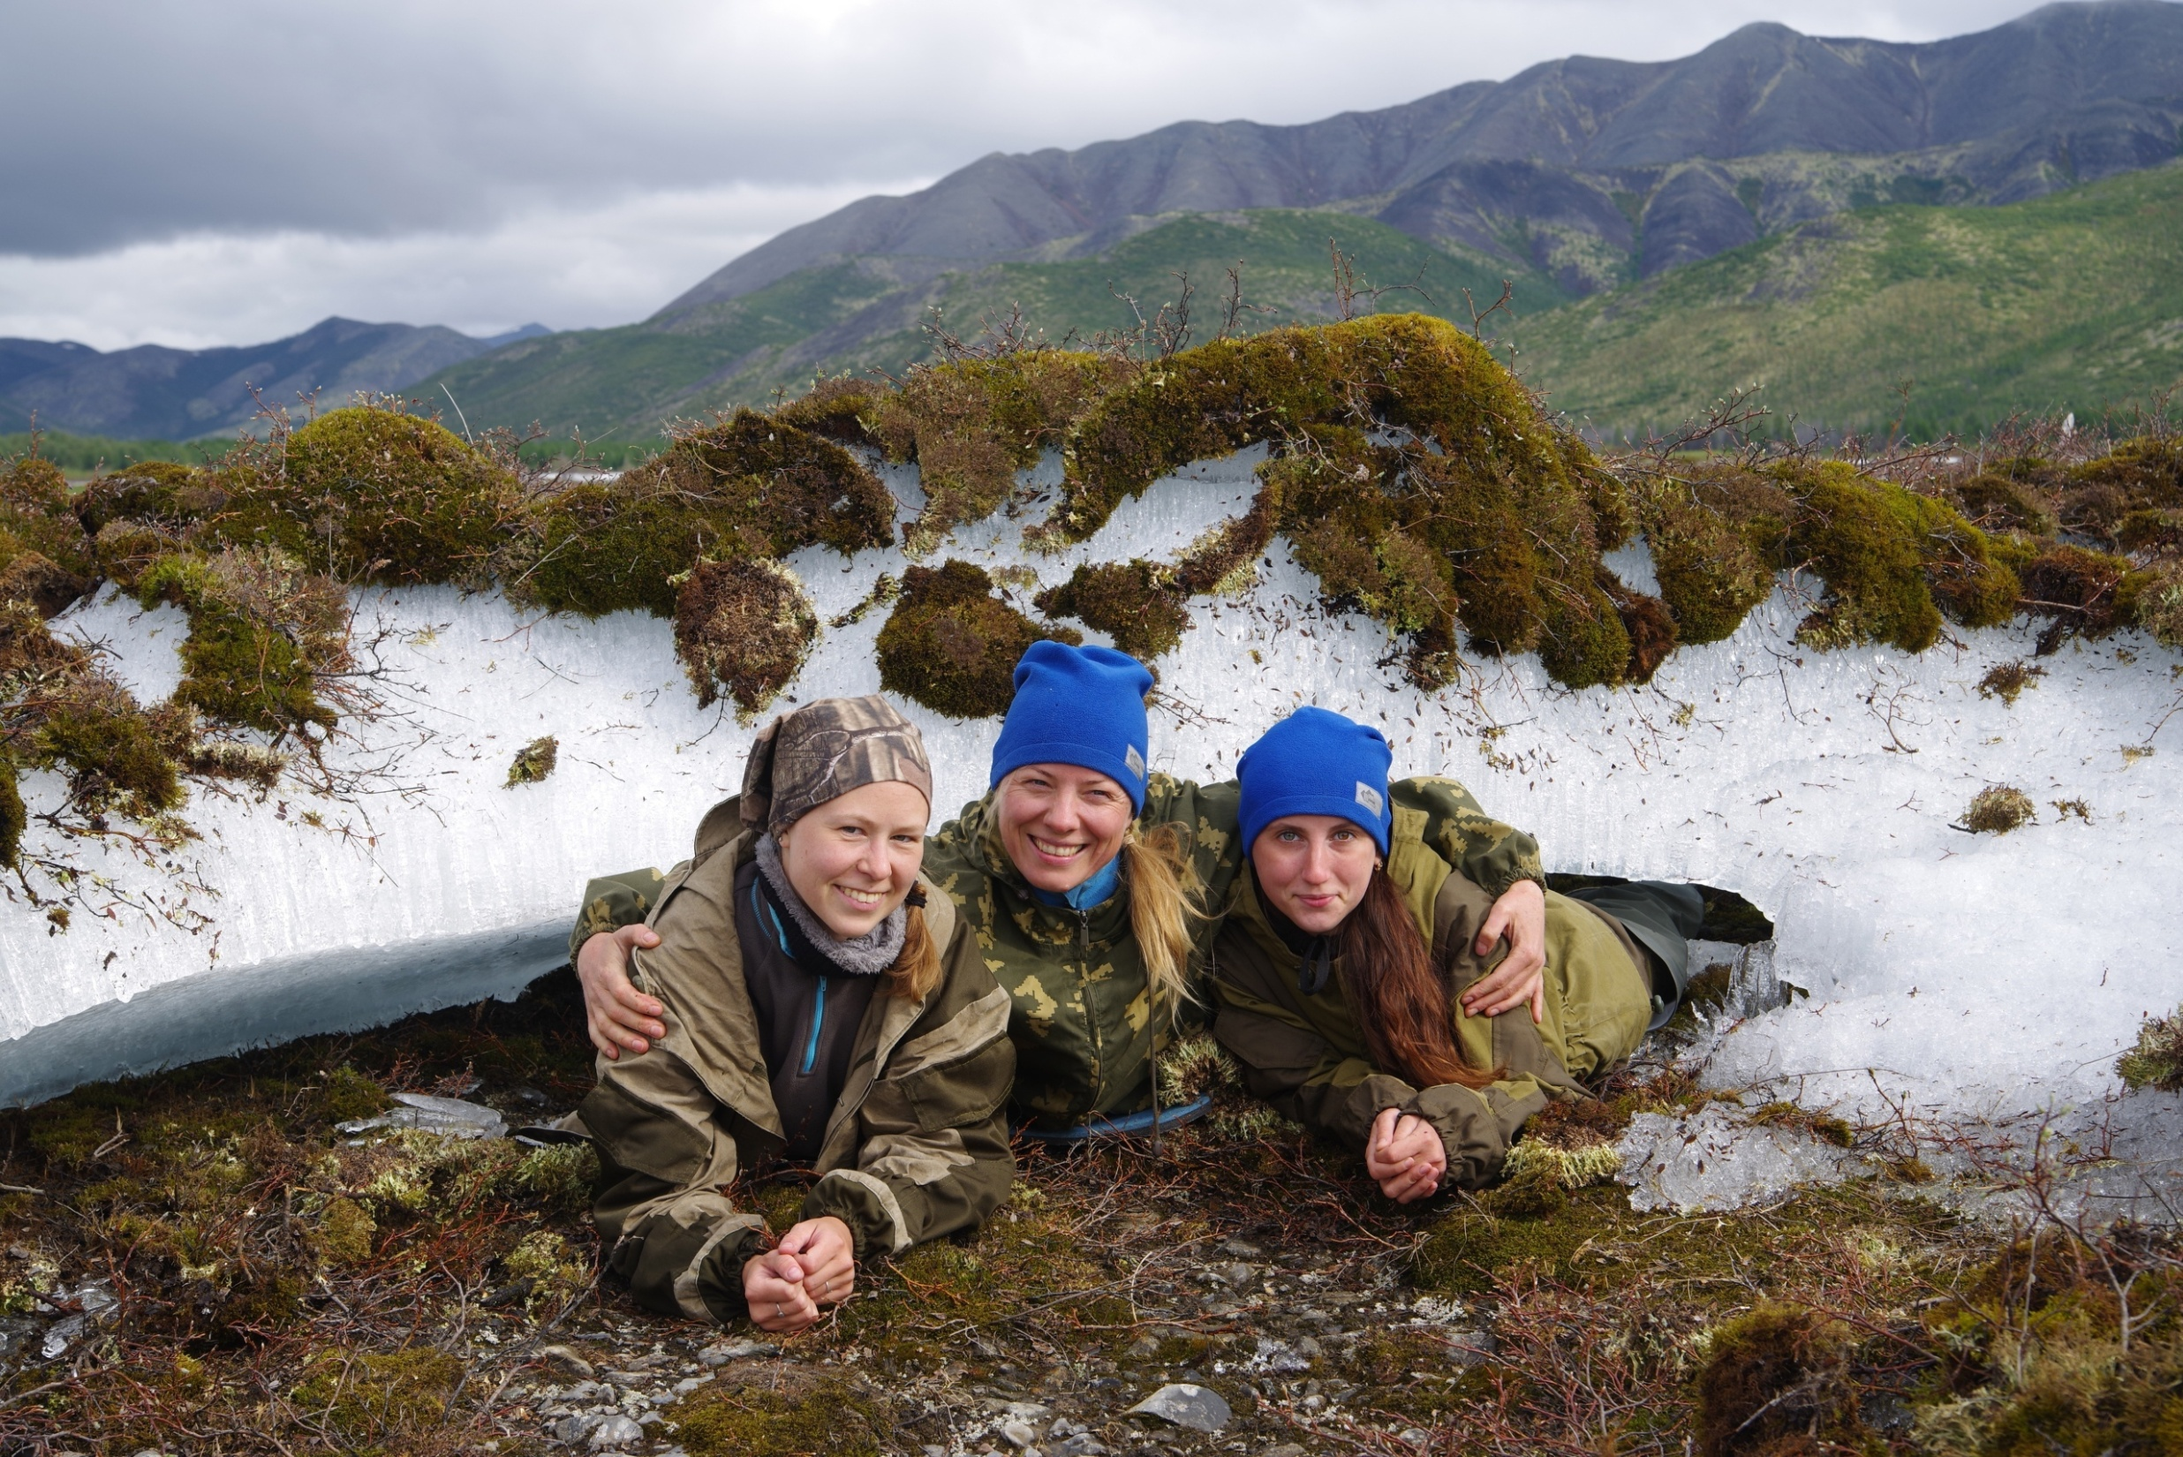

https://www.youtube.com/watch?v=MAUa6aKRxyQ https://www.youtube.com/watch?v=mehBEb2JFcA&t=2s
Thank you for attention!
Visit us in the Kolyma!

