Slide 1

Pressure balance at the subsolar magnetopause: Statistical study
Kostiantyn Grygorov, Zdenek Nemecek, Jana Safrankova
Charles University, Faculty of Mathematics and Physics, Prague, Czech Republic
Jiri Simunek
Institute of Atmospheric Physics CAS, Prague, Czech Republic
EGU General Assembly, May 2022
Moscow, February 16–20, 2015

Slide 2
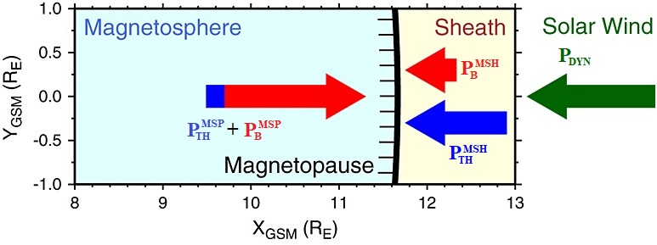
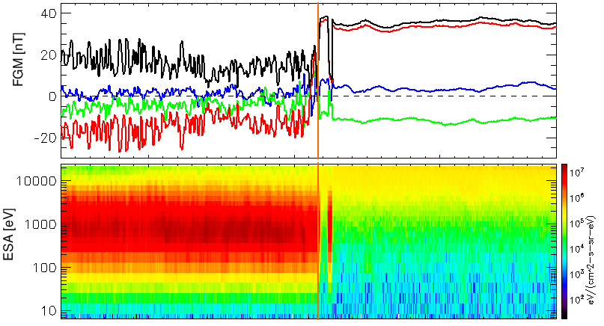
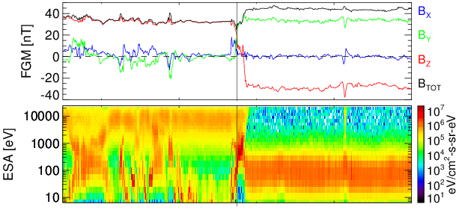
Typical situation:
B_{MSH}/B_{MSP}<1
Under study:
B_{MSH}/B_{MSP}>1 (inverse gradient)
MSH
MSP
MSP
MSH
How is pressure balance at subsolar magnetopause (MP) keeping for inverse gradient?

Slide 3

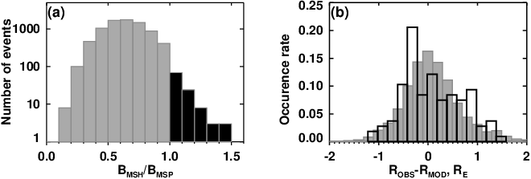
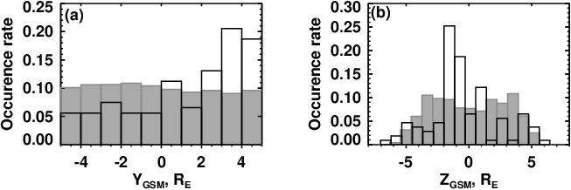
Data set and selection criteria
Themis spacecraft crossings in span of 2007-2020
Subsolar region |Y_{GSM}|<5 R_{E} (flanks were studied by Němeček et al. 2021)
ESA, FGM and EFI instruments were used
5 min averages just inbound (B_{MSP}) and outbound (B_{MSH}) of the MP
Omni dataset as a proxy for SW conditions
Crossings under southward IMF B_{Z}
Median: 0.64
Distributions of ratios B_{MSH}/B_{MSP} around a particular MP crossing.
Differences between the observed, R_{OBS} and predicted, R_{MOD} MP locations for both datasets (Lin 2010 model)
7856
107
Smooth profile of B_{MSH}/B_{MSP}
MP location is well predicted by the Lin 2010 model regardless of the B_{MSH}/B_{MSP} ratio
Occurrence rates of MP observations as a function of (a) Y_{GSM} and (b) Z_{GSM} coordinates
Inverse magnetic gradient across the MP is observed more frequently on the dusk side of the subsolar MP at lowest latitudes

Slide 4
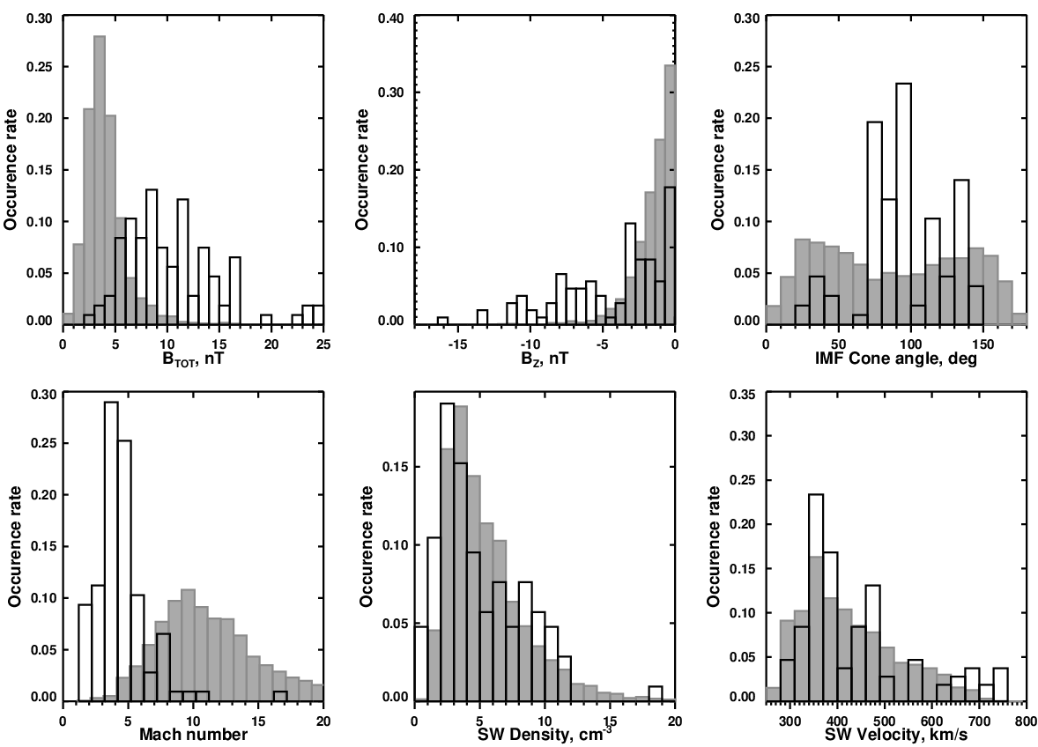
Upstream conditions favorable for the inverse gradient
B_{MSH} /B_{MSP}<1
B_{MSH} /B_{MSP}>1
Events with B_{MSH}/B_{MSP}>1 exhibit significantly larger (median 10 nT) than average (median 4.5 nT) IMF strength
Large IMF strength is caused by large B_{Y} and B_{Z} components resulting in the cone angle around 90º.
The Alfvenic Mach number with the most probable value of 4

Slide 5
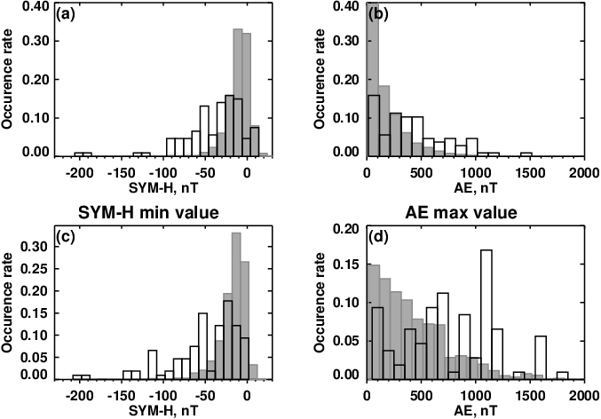
Relation of inverse gradient to storm/substorm activity
B_{MSH} /B_{MSP}<1
B_{MSH} /B_{MSP}>1
SYM-H (a) and AE (b) indices at the moment of the MP crossing
(c) minimum of SYM-H within 6 hours prior to the crossing
(d) maximum of AE within 6 hours prior to the crossing
The distribution of SYM-H values is wide and shifted to negative values with median of -32 nT for crossings with the inverse magnetic gradient, while the rest of the crossings exhibits only slightly negative values (median -11 nT)
Enhanced AE index associated with inverse magnetic gradient, but its effect is probably not important

Slide 6
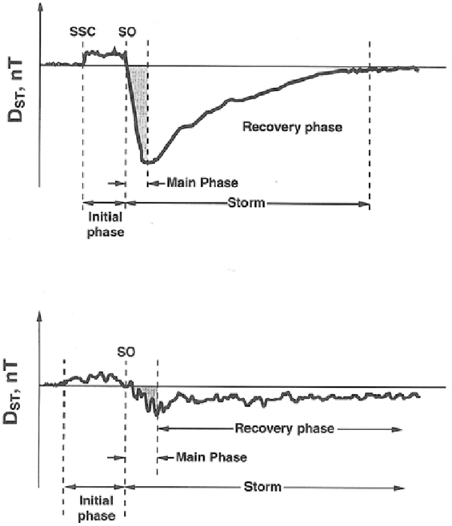
Relation of inverse gradient to storm/substorm activity
CME magnetic storm:
Geomagnetic storms can last for several hours to days and usually consist of three stages: initial, main and recovery phases.
Detailed analysis reveals that 2/48/37 MP crossings appear during initial/main/ recovery phases, respectively, while no storm was detected around the rest of crossings (20 crossings)
The careful analysis of the solar wind type indicates that a majority of the MP crossings with inverse magnetic gradient (70) were connected with the CME passing the Earth. The rest of them were associated with CIRs (17 events) and non-disturbed solar wind (20)
CIR magnetic storm:

Slide 7
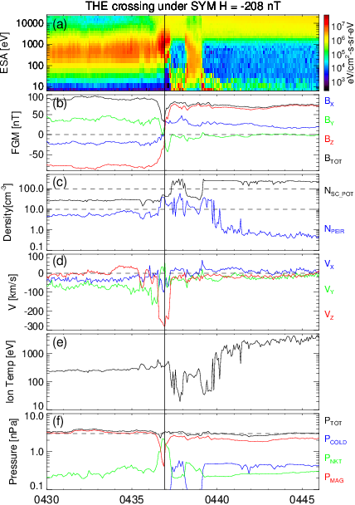
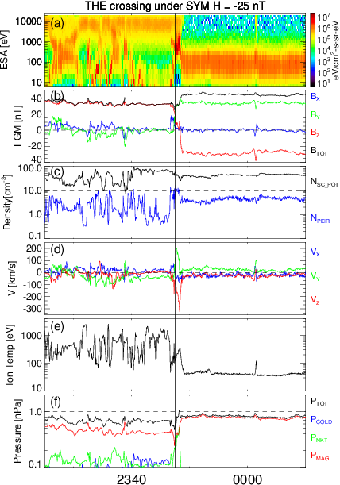


Case studies
(7.5, -0.8, -2.2)_{GSM}
(12, 1, -1.6)_{GSM}
The existence of a boundary layer at both sides of the MP
strong inverse magnetic field gradient
B_{MSH}/B_{MSP}≈1.3
B_{MSH}/B_{MSP}≈1.2
ESA density (≥10 cm⁻³)
Plasma density inferred from the s/c potential (≥100 cm⁻³)
strong reconnection jet
Upstream and downstream pressures are roughly equal after adding the estimated contribution of cold ions to the total magnetospheric pressure computed as k(N_{sc_pot} –N_{ESA})T_{cold}
T_{cold}$≈2 eV$
T_{cold}$≈40 eV$
Case studies have identified the low-energy ions of the plasmaspheric origin as a possible ion component keeping the pressure balance at the MP
IMF B_{Z} turns to large negative values few hours before the MP crossings

Slide 8
Conclusions
The inverse magnetic gradient at the MP is created when
IMF is twice larger than average
IMF cone angle is close to 90º
Magnetospheric activity is enhanced due to ongoing magnetic storm
A large magnetic field in the magnetosheath leads to apparent pressure imbalance at the MP that was already reported (e.g., Shue and Chao, 2013) but our study shows that the pressure balance is kept by the low-energy plasma of a plasmaspheric origin that penetrates toward the MP even in the cases when the SYM-H index is small. A presence of the low-energy plasma at the MP decreases the reconnection rate and results in a creation of the boundary layer in front of the MP (like under northward IMF). Nevertheless, questions of how is the magnetosheath flow influenced by geomagnetic storms or what is the role of plasmaspheric plume at the MP remain open (e.g., Walsh and Zou, 2021)
Thank you for attention!

