Slide 1

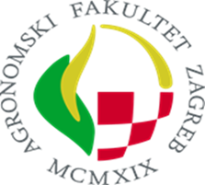




Modelling of pedogenic carbonates formation in karst soils – a case from Dalmatia (Croatia)
Josip Šušnjar¹, David Domínguez-Villar², Aleksandra Bensa¹, Mirna Švob¹, Kristina Krklec¹
jsusnjar@agr.hr
¹University of Zagreb, Faculty of Agriculture, Zagreb, Croatia
²University of Salamanca, Faculty of Sciences, Salamanca, Spain

Slide 2
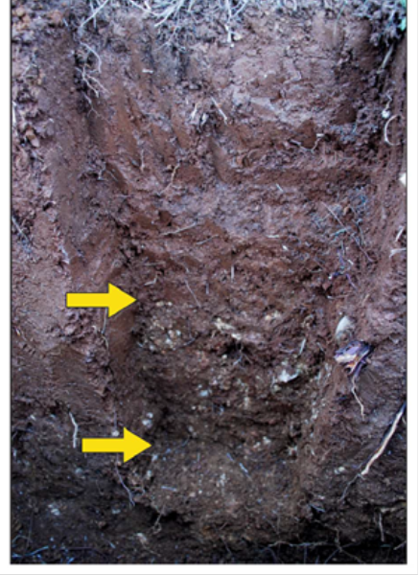
Pedogenic carbonates (PC)
Secondary carbonates, often found in soils of Mediterranean region
Dissolution and re-precipitation of existing carbonates
Aim of the study: to better understand factors controlling PC formation processes and their seasonality
Soil profile at Stara Jametina, Croatia.
Arrows indicate calcite nodules in the calcic horizon

Slide 3
Methods
Continuous monitoring of soil:
temperature
water content
bulk electrical conductivity
soil air CO₂
Sketch of the equipment used to monitor

Slide 4
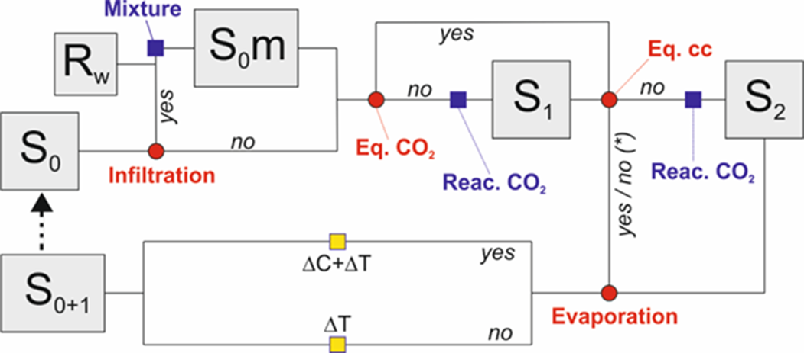
Thermodynamic model
Mixing of soil solution due to infiltration
Equilibration with soil air CO₂
Equilibration with respect to calcite
The chemistry of the final solution is recalculated according to water losses

Slide 5
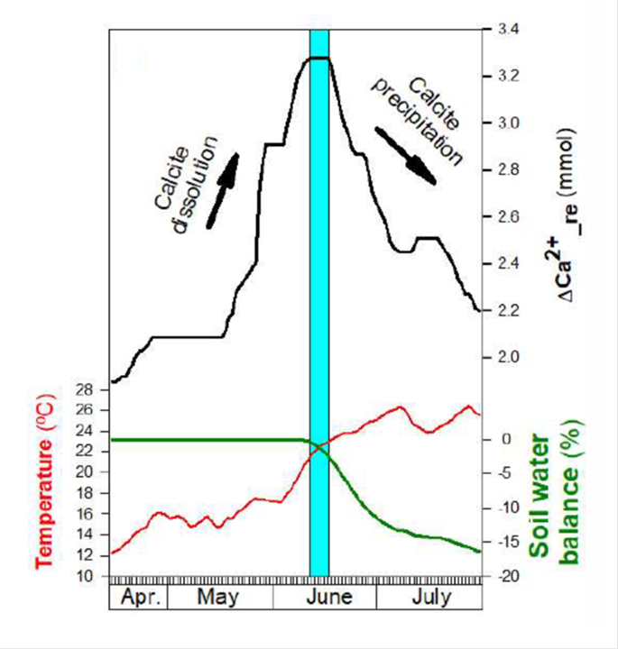
Preliminary results
83% of the calcite dissolved was re-precipitated as pedogenic carbonate

Slide 6
Conclusions
Dissolution and precipitation events of pedogenic carbonates are related to specific stages within the year at the studied site
Preliminary monitoring results indicate presence of 2 cycles of precipitation (summer and winter) and dissolution (spring and autumn)
Soil air CO₂ is dominant factor controlling calcite reactions in soil

Slide 7

Thank you for attention!
Acknowledgement:
This work is part of the research project “Inter-comparison of karst denudation measurement methods” (KADEME, IP-2018-01-7080) and “Young Researchers’ Career Development Project – Training New Doctoral Students” (DOK-2021-02) financed by Croatian Science Foundation.

Slide 8


References
Domínguez-Villar D.; Bensa A.; Švob M.; Krklec K. 2022. Causes and implications of the seasonal dissolution and precipitation of pedogenic carbonates in soils of karst regions ― A thermodynamic model approach. Geoderma. (Under review).

