Slide 1


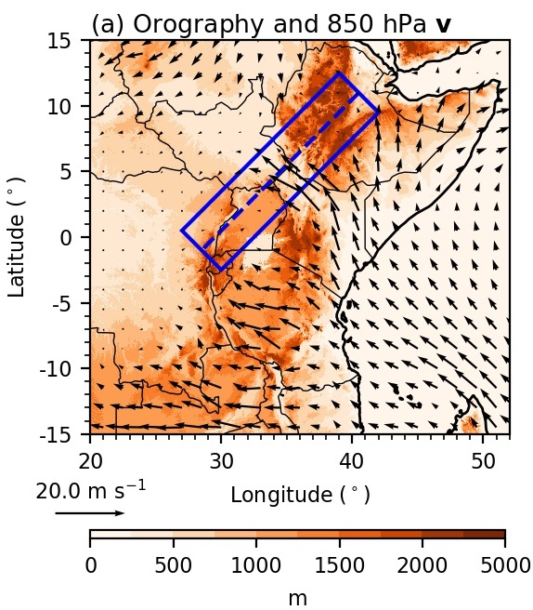

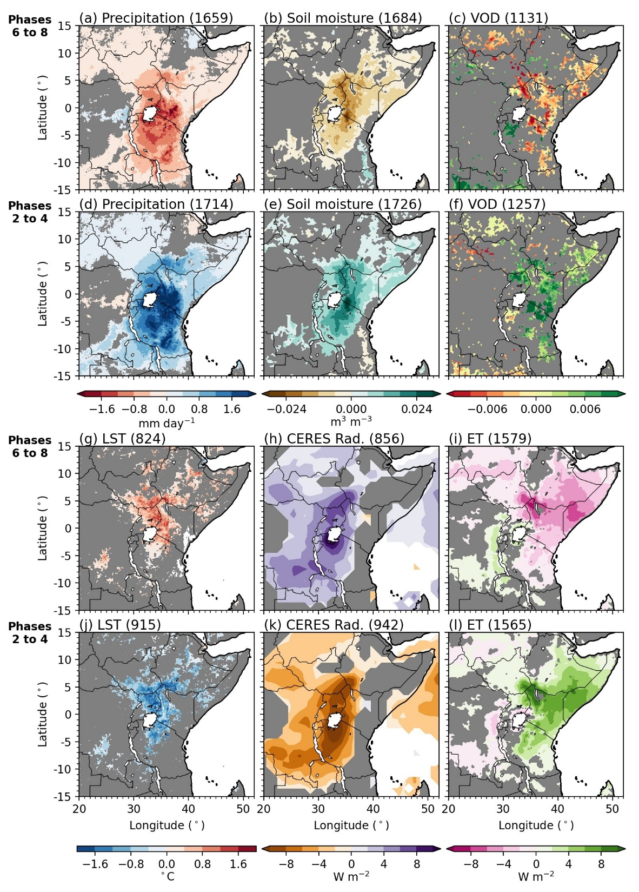
MJO-induced land-atmosphere feedbacks across East Africa Talib et al. UKCEH
Using satellite observations and ERA5, we show that the MJO promotes a soil moisture-atmosphere feedback which impacts the intensity of the Turkana jet and East African precipitation.
About me: Climate scientist researching intraseasonal land-atmosphere feedbacks.
We identify a coherent surface soil moisture and turbulent flux response to periods of intraseasonal variability driven by the MJO.
ERA5
Satellite-derived variables
Orography and climatological 0 UTC 850 hPa horizontal wind.
CHIRPS precipitation, ESA CCI soil moisture, and MODIS LST anomalies during dry MJO days (phases 6 to 8).

Slide 2
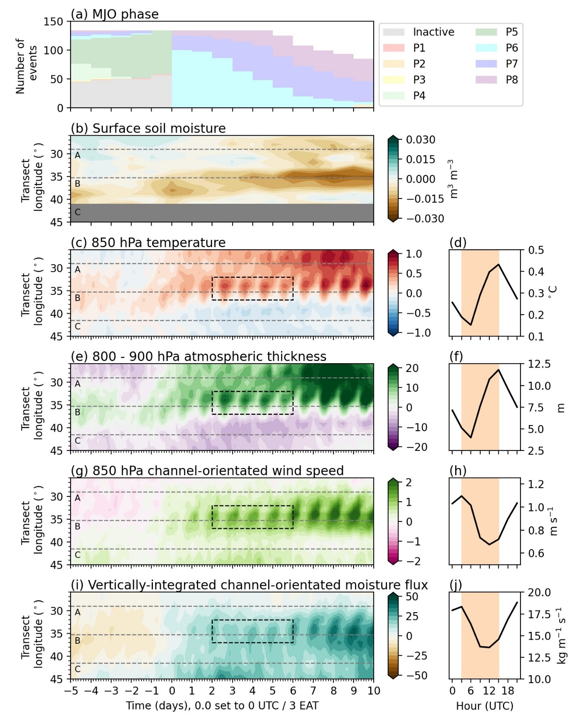
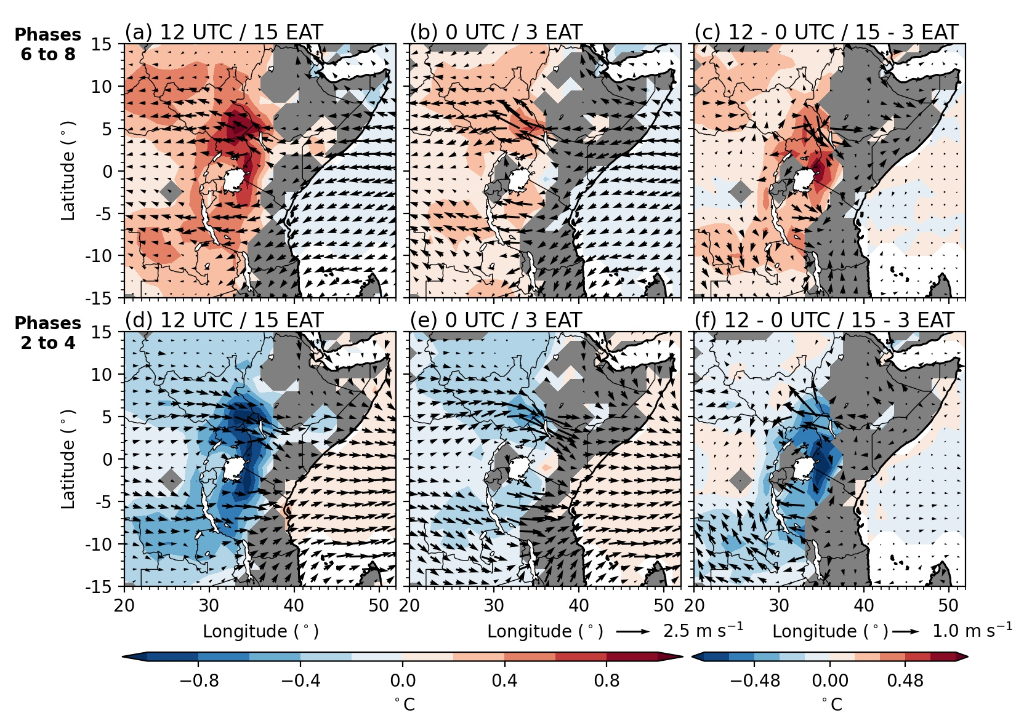

MJO-induced land-atmosphere feedbacks across East Africa Talib et al. UKCEH
Using satellite observations and ERA5, we show that the MJO promotes a soil moisture-atmosphere feedback which impacts the intensity of the Turkana jet and East African precipitation.
About me: Climate scientist researching intraseasonal land-atmosphere feedbacks.
We identify a strong near-surface atmospheric response across the exit region of the Turkana jet.
ERA5
ERA5
Low-level temperature changes influence the intensity of the Turkana jet and moisture flux out of East Africa.
Anomalous near-surface temperature and 850 hPa horizontal wind at 850 hPa.
Hövmullers of 850 hPa temperature, 850 hPa channel-orientated wind speed, and vertically-integrated moisture flux during dry MJO events.

Slide 3
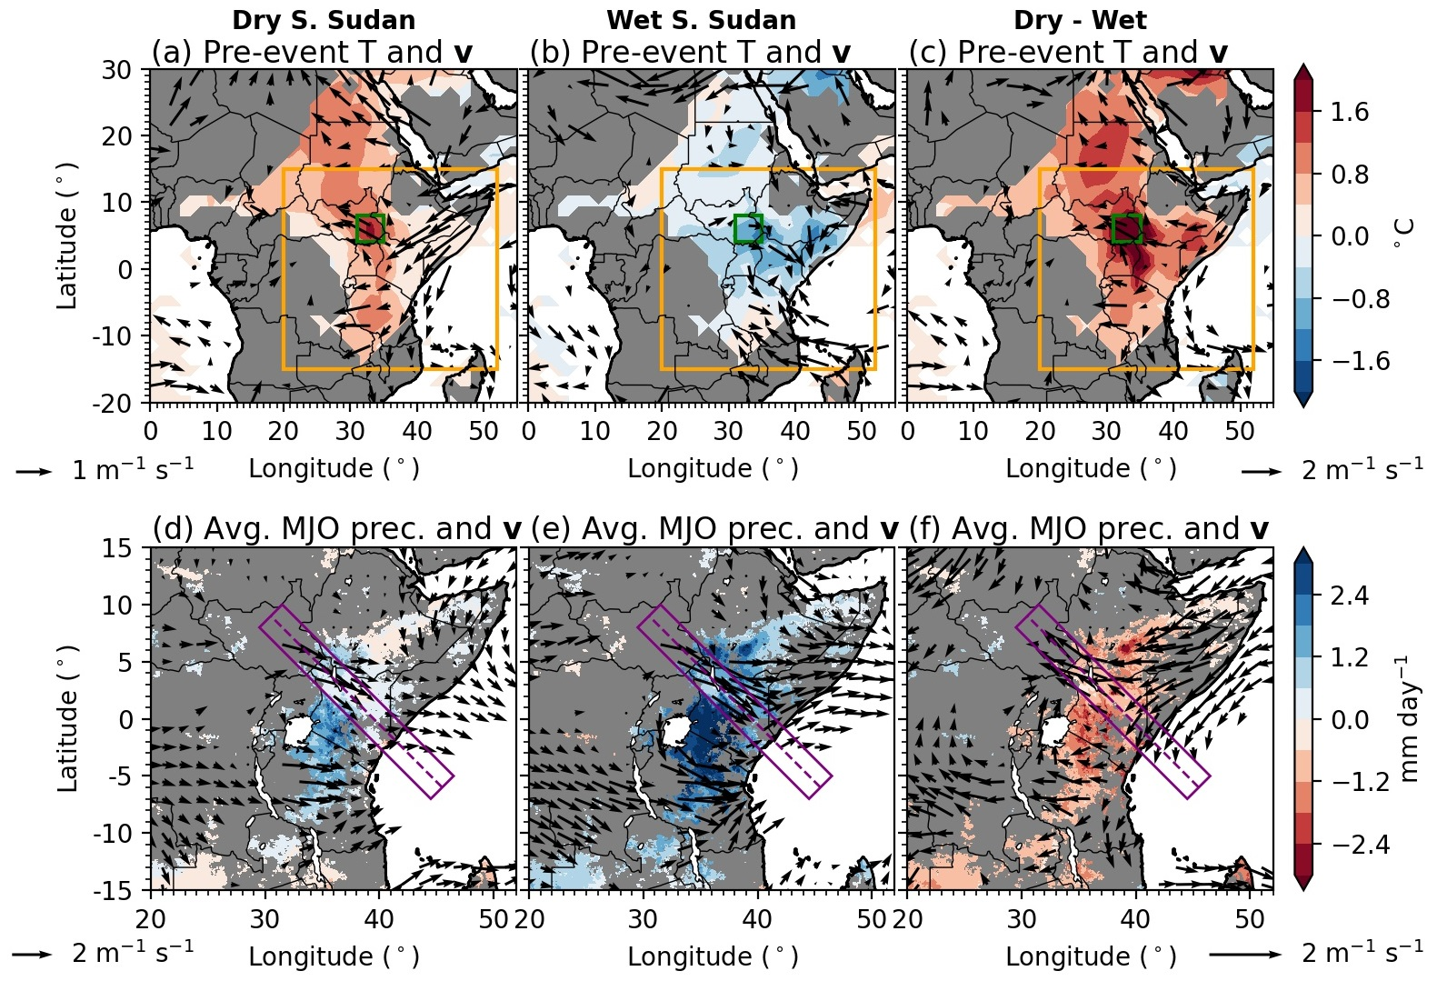

MJO-induced land-atmosphere feedbacks across East Africa Talib et al. UKCEH
Using satellite observations and ERA5, we show that the MJO promotes a soil moisture-atmosphere feedback which impacts the intensity of the Turkana jet and East African precipitation.
About me: Climate scientist researching intraseasonal land-atmosphere feedbacks.
The control of surface soil moisture on jet intensity influences precipitation characteristics across East Africa.
We conclude that we can we improve our predictions of the impact of an MJO event across East Africa by observing soil moisture across south-east South Sudan.
ERA5 and satellite-derived precipitation.
Average CHIRPS precipitation and 850 hPa horizontal wind during dry MJO events when soils in exit region of Turkana jet are (left) dry and (mid.) wet. Right panel shows dry-wet.

