Slide 1






The role of external forcing in seasonal forecasts of European summer temperature
Matt Patterson¹, Antje Weisheimer^{1,2,3}, Dan Befort^{1,3} and Chris O’Reilly⁴
1. Atmospheric, Oceanic and Planetary Physics, University of Oxford 2. National Centre for Atmospheric Science (NCAS), 3. European Centre for Medium-Range Weather Forecasts (ECMWF) 4. Dept. of Meteorology, University of Reading
@MattPattClimate

Slide 2
How warm will this summer be in Europe?

Slide 3
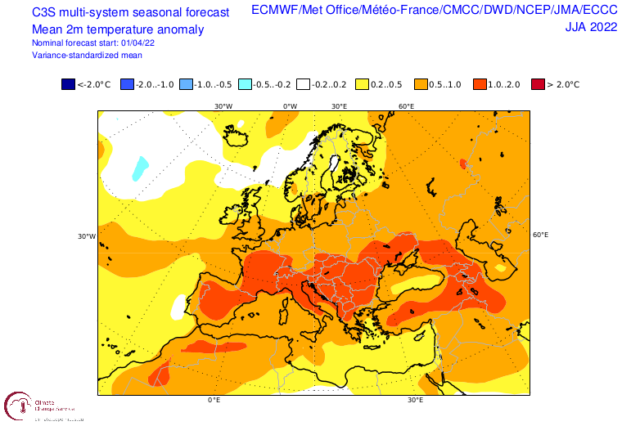
How warm will this summer be?
Can we trust this prediction for JJA 2022 T2m? How have these systems performed in the past?
How much of a role is the forced trend playing in this prediction?
https://climate.copernicus.eu/charts/c3s_seasonal

Slide 4
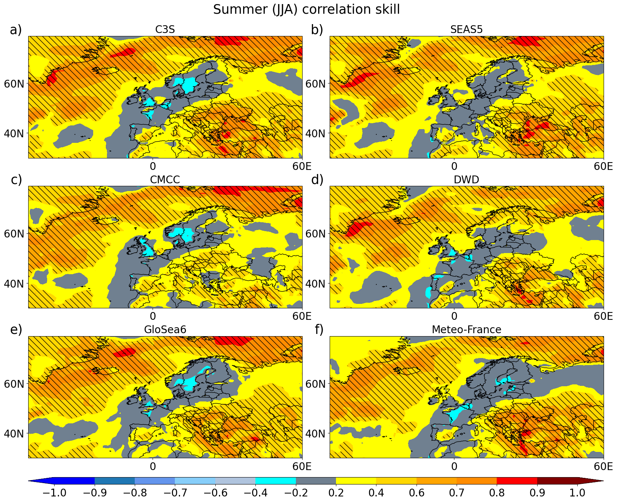
Operational seasonal forecasts show relatively low skill in European summer T2m
Particularly low skill for North-West Europe, but higher skill for Southern Europe.
Anomaly correlation skill for T2m in operational seasonal forecasting systems for hindcasts 1993-2016 relative to ERA5

Slide 5
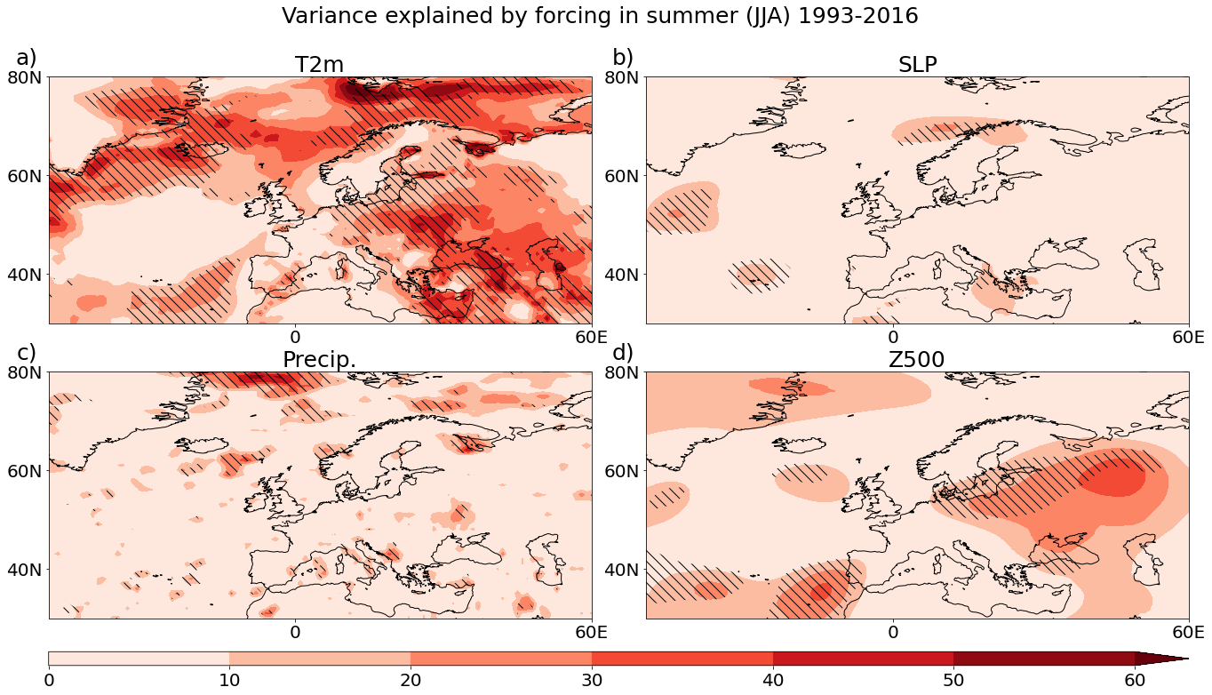
Forcing explains 20-40% of summer T2m variance for central to eastern Europe 1993-2016
Forced time series = CMIP6 ensemble mean
Correlated with ERA5 T2m, SLP, Z500 and GPCP precip.
Variance explained by forcing (%)

Slide 6
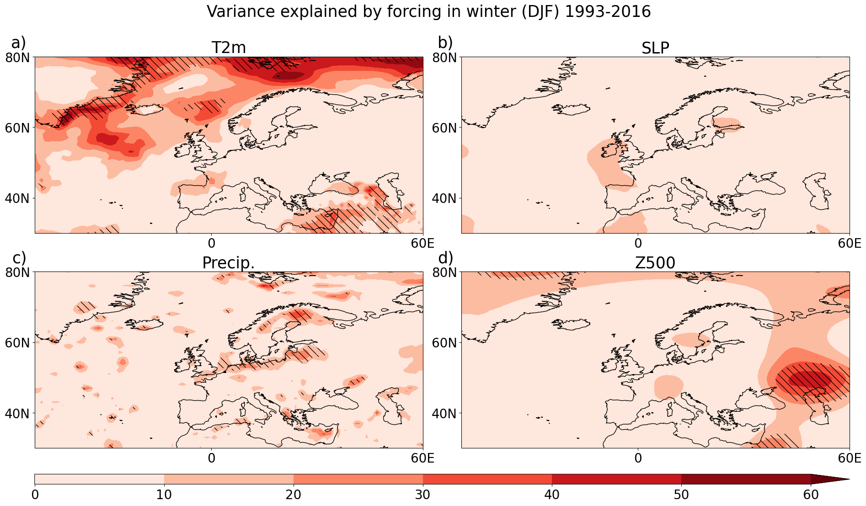
… but forcing explains little winter T2m variability
Variance explained by forcing (%)

Slide 7
How important is the forced trend for seasonal prediction skill?

Slide 8
Let’s determine this by comparing the skill in initialised seasonal forecasts systems to the skill obtained from using free-running climate simulations
Both sets of seasonal predictions and climate projections have information on the forcing, the difference is that the predictions know about the recent state of the atmosphere and ocean

Slide 9
Data
60 member hindcast ensemble from 5 seasonal forecast models for the period 1993-2016 (Initialized on 1st May, look at JJA i.e. months 2-4)
  CMCC SPS3
  DWD CFSV2.0
  ECMWF System 5 (SEAS5)
  Met Office GloSea6
  Meteo-France system 7
60 uninitialized CMIP6 ensemble members (historical forcings +ssp585)
SEAS5 13-month hindcasts (15 members) and atmosphere-only (25 members)
ERA5 reanalysis

Slide 10
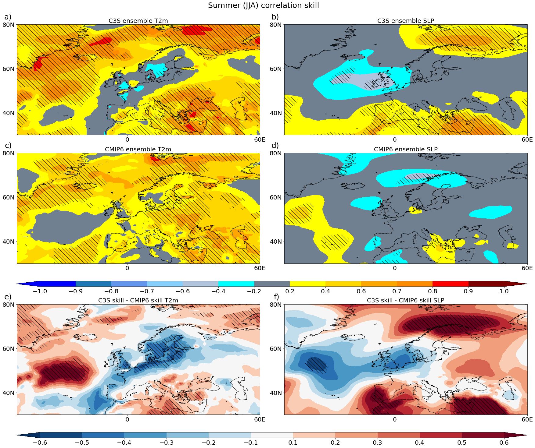
Low skill in the C3S ensemble

Slide 11
Compare to CMIP6 ensemble to show skill due to forcing
Bizarrely, CMIP6 ‘skill’ is higher in T2m for NW Europe than C3S for JJA 1993-2016

Slide 12
This is quite an unexpected result – the uninitialized projections show higher skill over northern Europe than the projections!
Perhaps the initialization poses a problem? In which case we expect that with increasing lead-time, information from the initial state will be lost, and hence the forecast will tend towards that of a free-running model. In which case, skill might go up with lead-time…

Slide 13
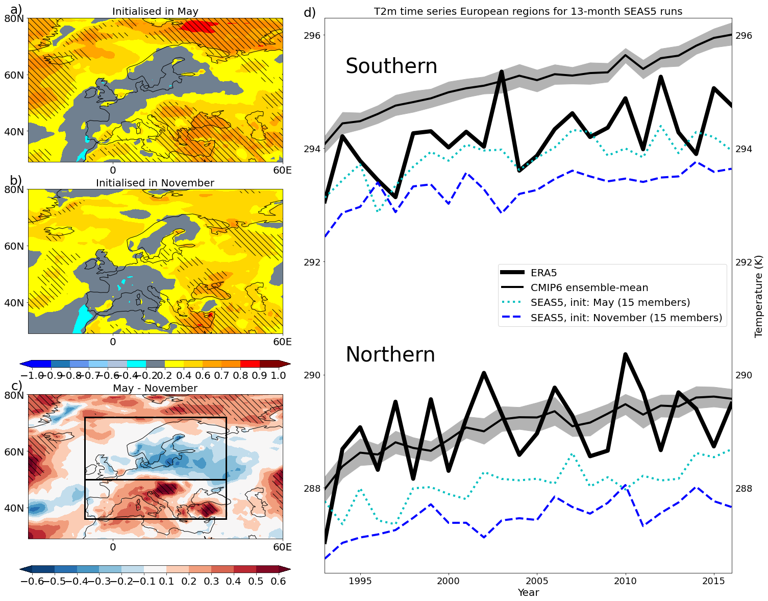
Skill increases with lead-time in SEAS5
Correlation skill for ECWMF system 5 for summer at (top) 2-4 month lead-time, (middle) 5-7 month lead-time and (bottom) the difference. Right hand panel shows time series for T2m average over Northern and Southern Europe.

Slide 14
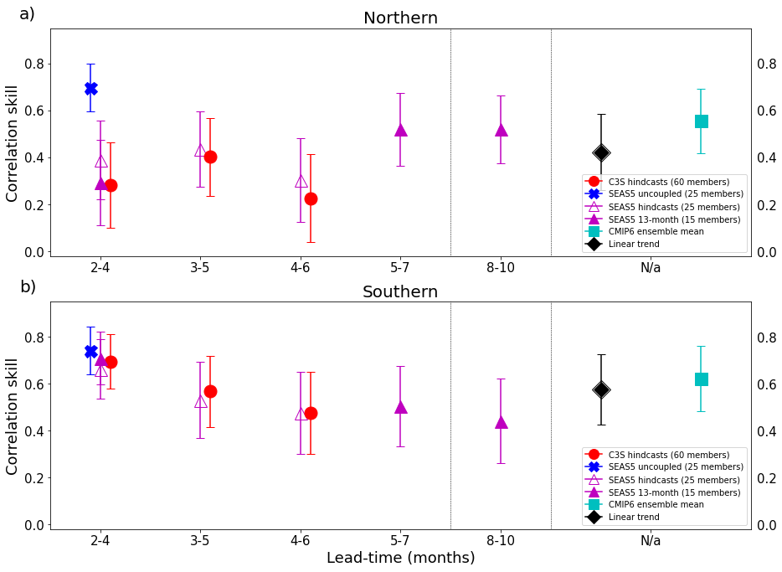
Southern Europe: Skill decreases with lead-time
Northern Europe: Skill increases with lead-time

Slide 15
Implications
The low skill for Northern European summer T2m means we should be cautious when using current summer seasonal predictions for this region.
Uninitialized CMIP6 projections show some skill in T2m, even on seasonal timescales. Projections may provide useful information on this timescale for some users.
Southern Europe T2m is skilfully predicted at 2-4 month lead-time (R=0.7) due to a strong trend and some skill in atmospheric circulation.

Slide 16
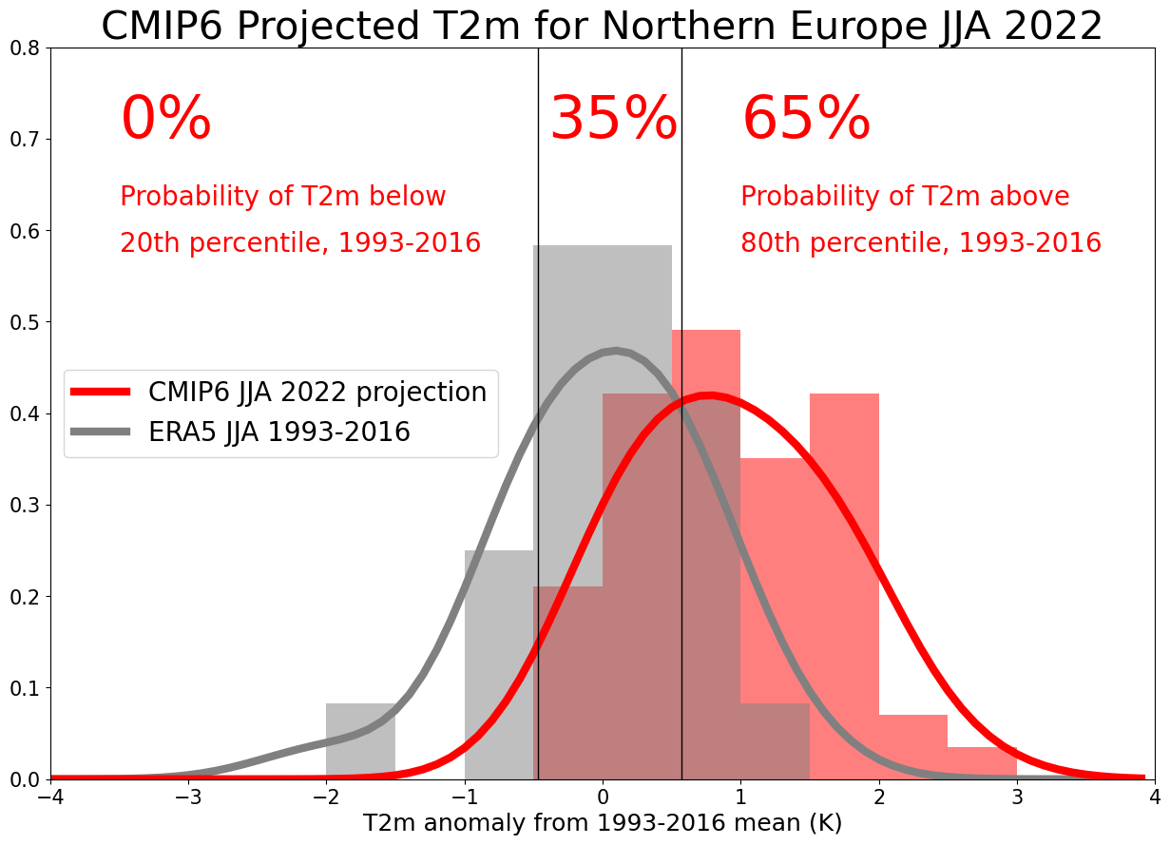
My (probabilistic) forecast for Northern Europe JJA 2022 based on CMIP6…
Calculated from the 60-member CMIP6 ensemble by bias-correcting and calibrating (following Doblas-Reyes et al 2005) based on ERA5 1993-2016.

Slide 17
Patterson et al – “The strong role of external forcing in seasonal forecasts of European summer temperature” in revision for resubmission to Environmental Research Letters

Slide 18
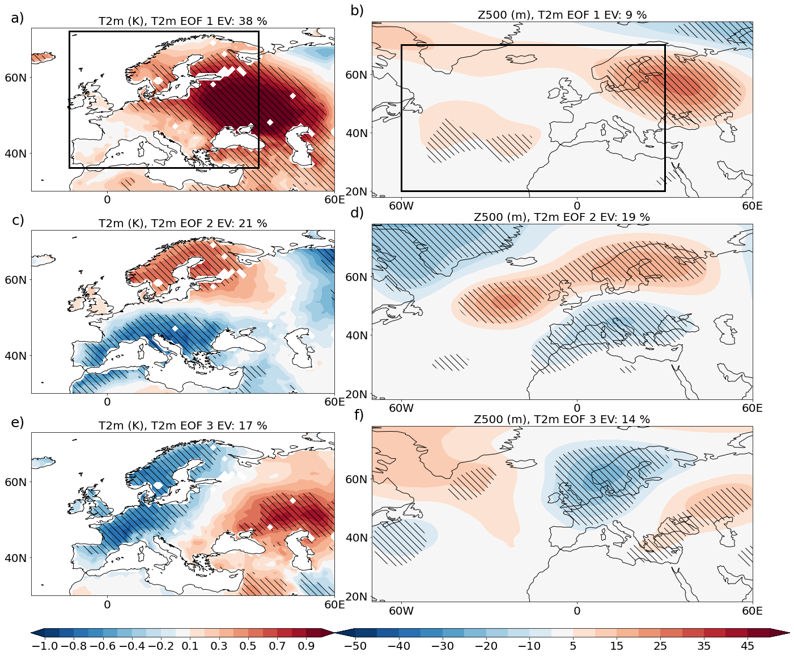
EOF analysis of T2m variations 1993-2016
Left hand side shows first three EOFs from T2m variations in the boxed region in ERA5. Right hand side shows the principal components regressed onto Z500.

