Slide 1
Using Deep Learning for a High-Precision Analysis of Atmospheric Rivers in a High-Resolution Large Ensemble Climate Dataset
Tim Higgins¹, Aneesh Subramanian¹, Peter Watson², Andre Graubner³, Lukas Kapp-Schwoerer³, Karthik Kashinath⁴, Sol Kim⁵, Luca Delle Monache⁶, Will Chapman⁷
University of Colorado – Boulder¹
University of Bristol²
ETH Zurich³
Lawrence Berkeley National Laboratory⁴
University of California, Berkeley⁵
Scripps Institution of Oceanography, University of California, San Diego⁶
National Center for Atmospheric Research⁷
April 7th, 2022

Slide 2
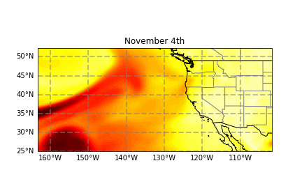
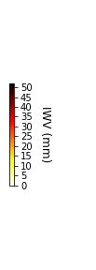

Problem
Atmospheric rivers can be difficult to identify in large datasets given the computational expense of traditional detection algorithms
Semantic segmentation is a good alternative to empirical heuristics, but only global domains have been used to train ML models so far
Large climate datasets often use smaller domains in order to save computing power
Weather@Home
Used computing power from thousands of volunteers’ computers to generate a unique large ensemble high resolution dataset representing several future climates
ARs needed to be identified in 2 TB of data

Slide 3

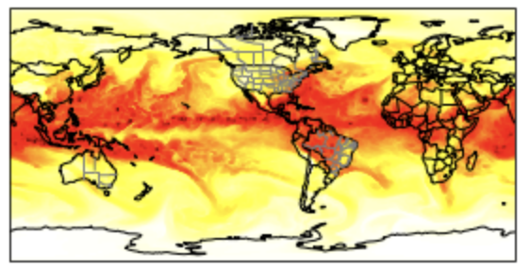
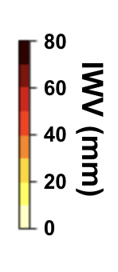
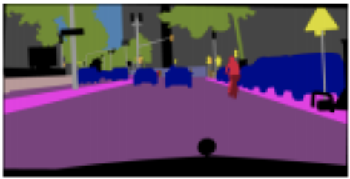
Applying Semantic Segmentation to Atmospheric Rivers
Training set contains ~ 500 feature-label pairs
Source: Wu et al. 2019
CGNet and DeepLabv3+ have previously been applied to identifying objects in cityscapes

Slide 4
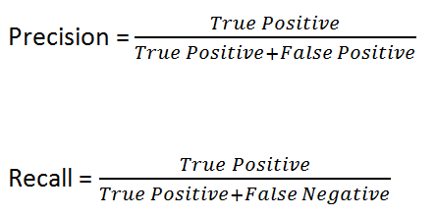
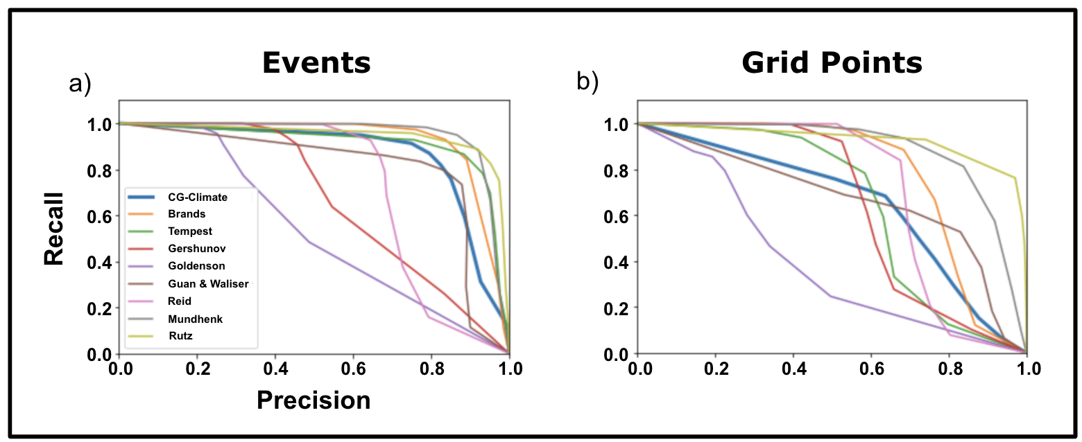
Event Precision and Recall

Slide 5
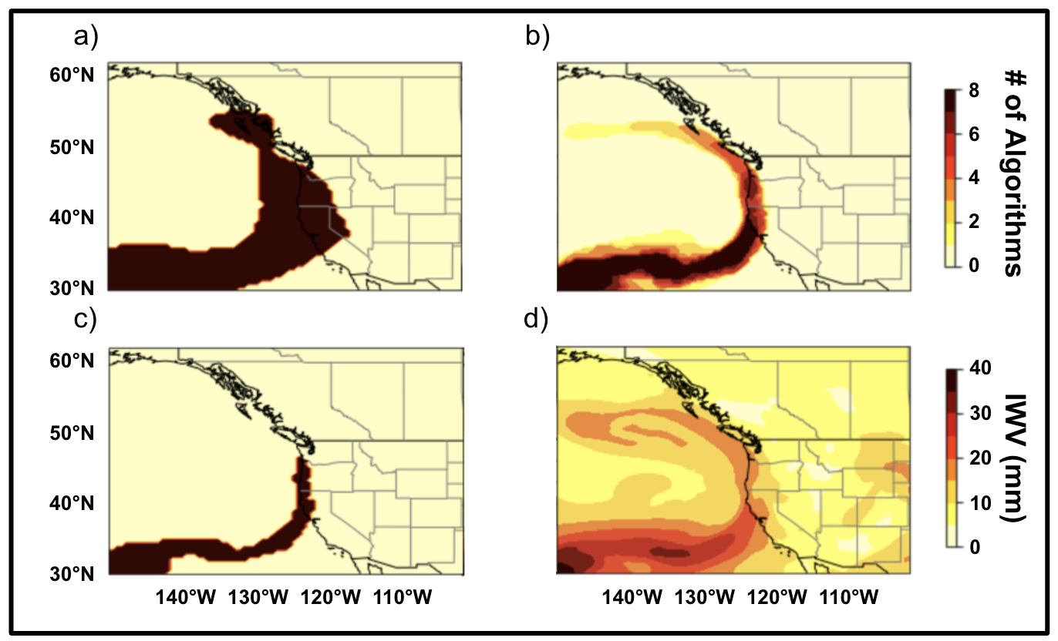
Limitation of Mean IoU
AR IoU between CGNet (a) and Mundhenk (c) in this timestep: .307
Mean AR IoU between CGNet and Mundhenk over 20 winter months of data: .384

Slide 6
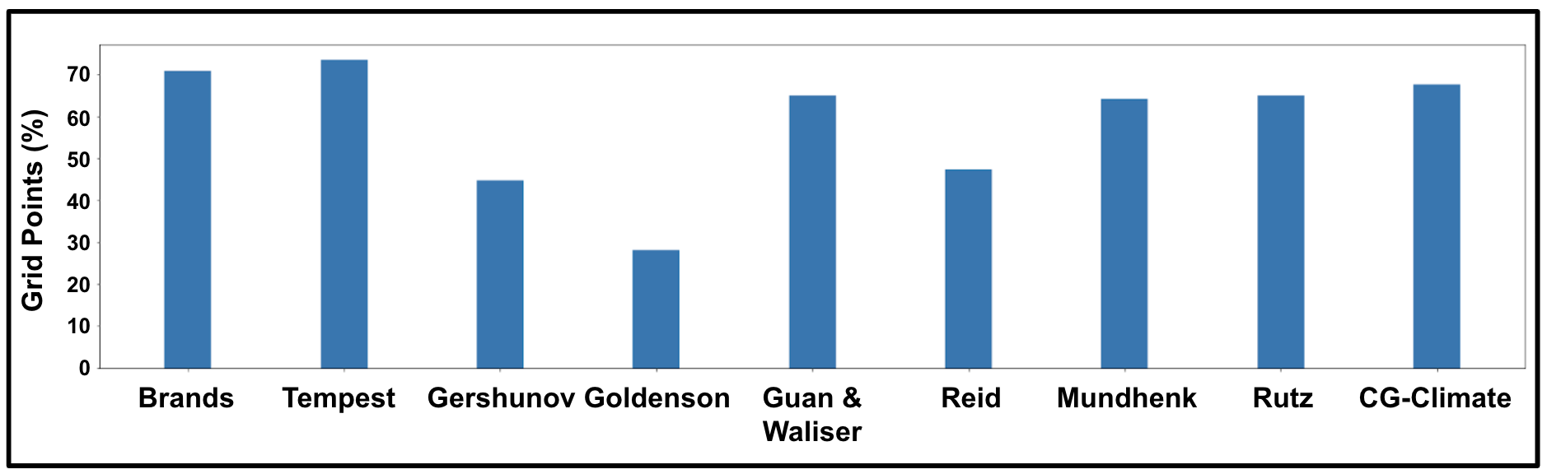
Percentage of Non-Overlapping Grid Points Associated with the same Event
Takeaway: Spatial area bias drives deficiencies in IoU rather than CGNet detecting different events

Slide 7
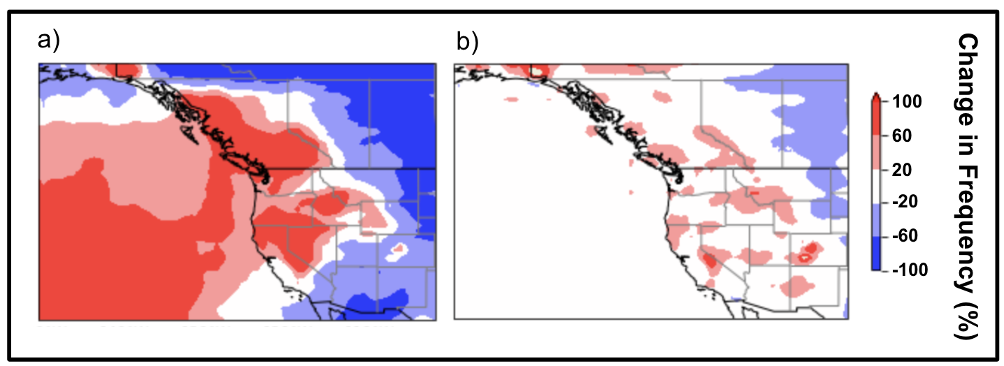
Change in AR grid point Frequency
a: Change from ARTMIP mean to CGNet when trained on human hand labeled contours
b: Change from ARTMIP mean to CGNet when trained on ARTMIP labels

