Slide 1


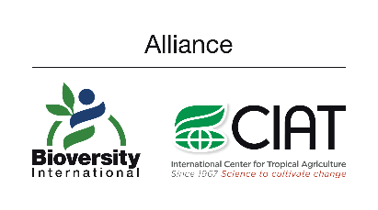


Modeling the spatial distribution of soil organic carbon and carbon stocks for the Casanare flooded Savannas, Colombia
Javier M. Martín-López¹·³, Louis Verchot¹, Christopher Martius², and Mayesse da Silva¹
¹ Alliance Bioversity-CIAT, Multifunctional landscapes, Colombia
² Center for International Forestry Research (CIFOR), Indonesia
³ University of Münster, Germany
j.m.martin@cgiar.org
Vienna, Austria
May 23-27, 2022

Slide 2
Context
Objectives
Methodology
Results & conclusions
Questions & discussion
References
CONTENT

Slide 3
1
Context

Slide 4
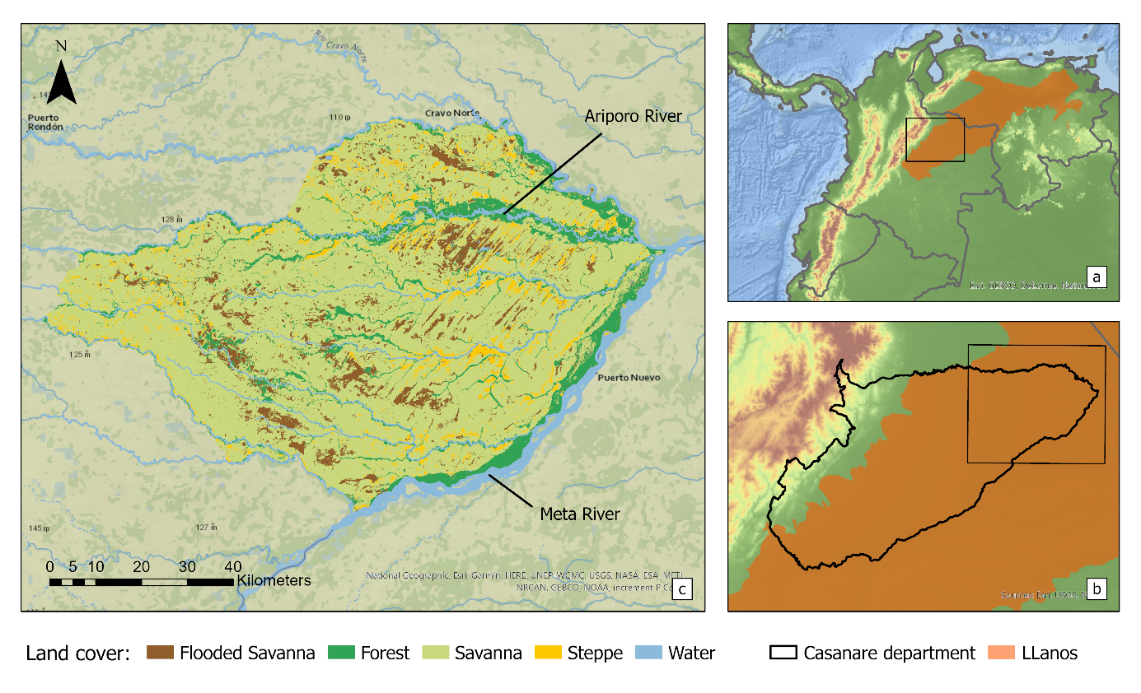
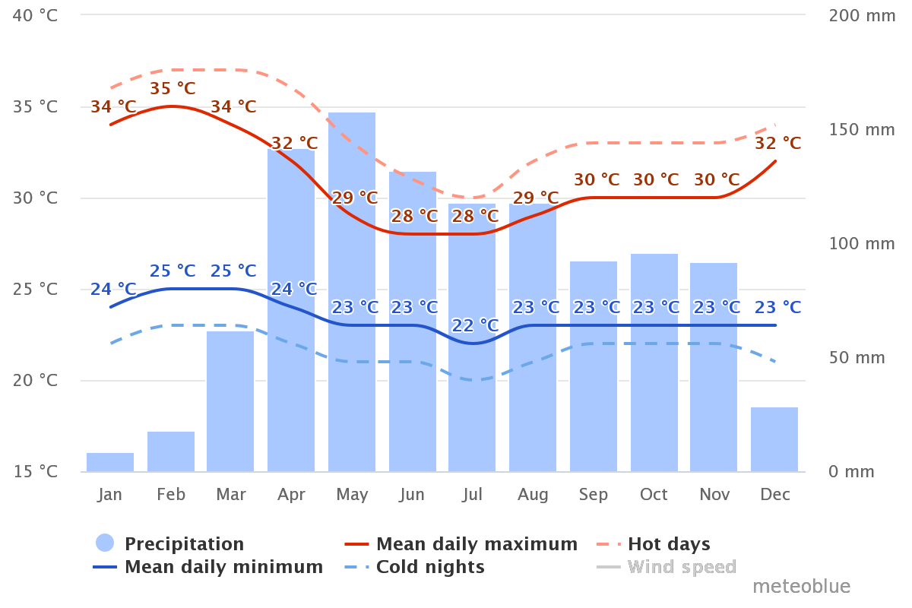
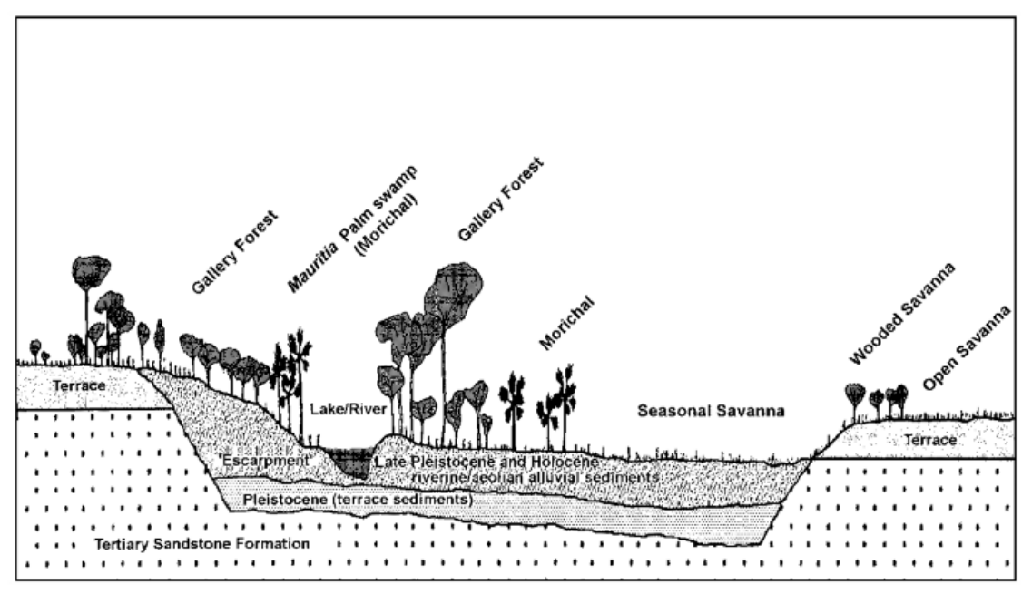
Location
Weather
Relief
(Meteoblue, 2022)
Soils
(own contribution)
Inceptisols and Entisols formed from alluvial, fluvio-torrential sediments from the upper Pleistocene to the lower Holocene, upon which Aeolian materials subsequently accumulated (IGAC, 2014)
(Mejia, 2016)
Flooded savannas of Casanare

Slide 5
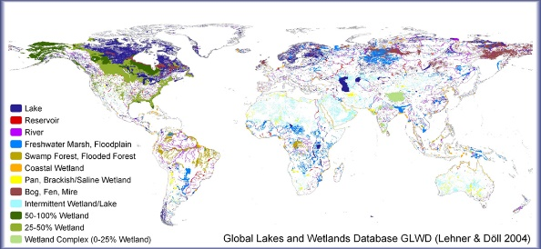
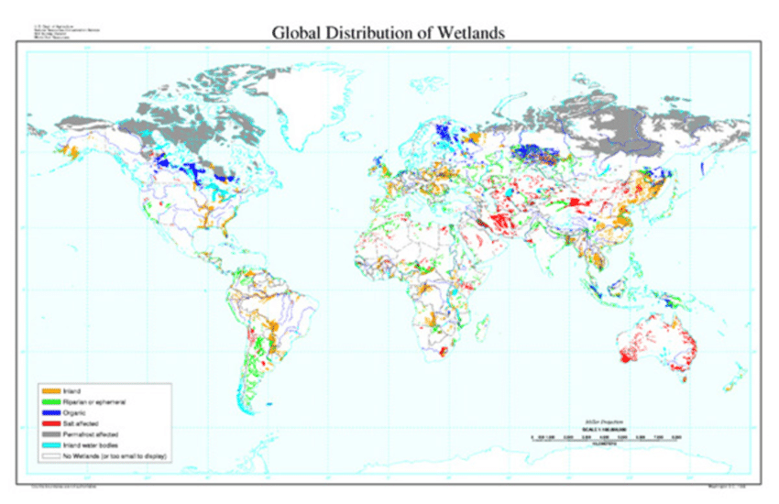
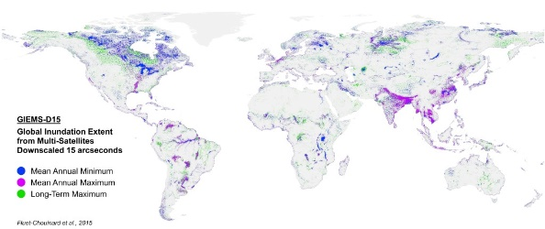
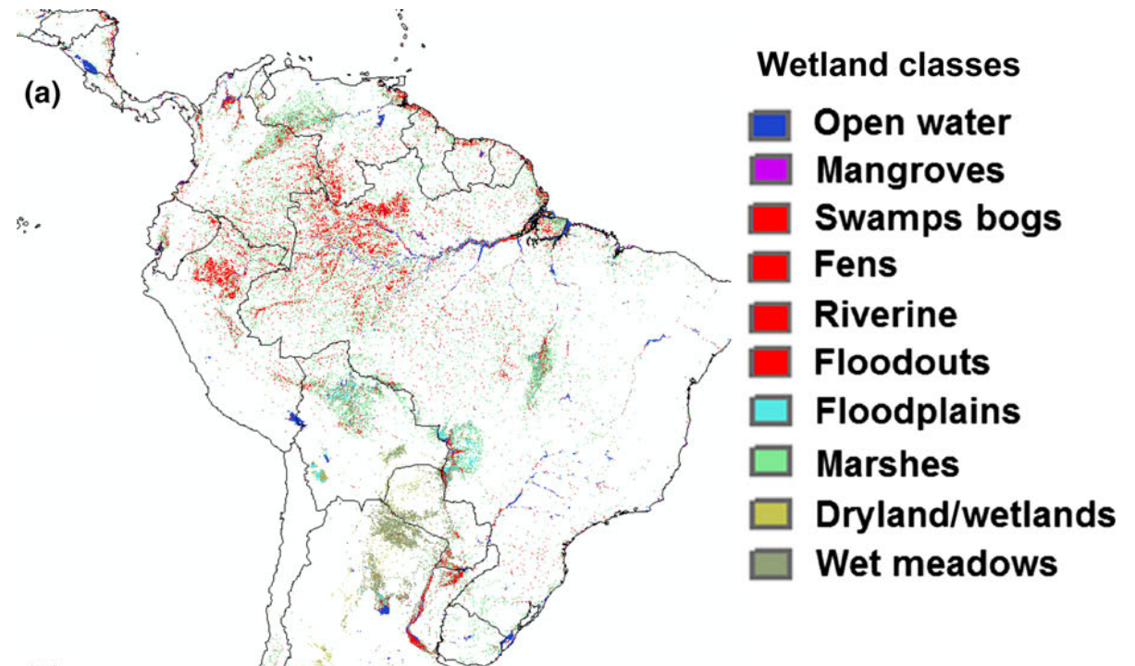
Multiple ecosystem services: Carbon sink, supports biodiversity, water quality …
Several global prediction models.
South America is the largest contributor of wetlands worldwide.
Prediction of peatlands in the Llanos ecoregion.
(Lehner et al., 2004)
(Köchy, et al., 2009)
(Fluet, et al., 2015)
(Gumbricht et al., 2017)
Extent and state of wetlands

Slide 6
2
Objectives

Slide 7
Objectives
Map the spatial distribution of soil organic carbon (SOC) content and stocks using two digital soil mapping (DSM) approaches in the Llanos ecoregion of Colombia.
Determine the factors that influence their variability.
Estimate the potential contribution of this region to the greenhouse gas emissions (GHG) if the ecosystem is heavily altered.
Data & Analysis

Slide 8
2
Methodology

Slide 9
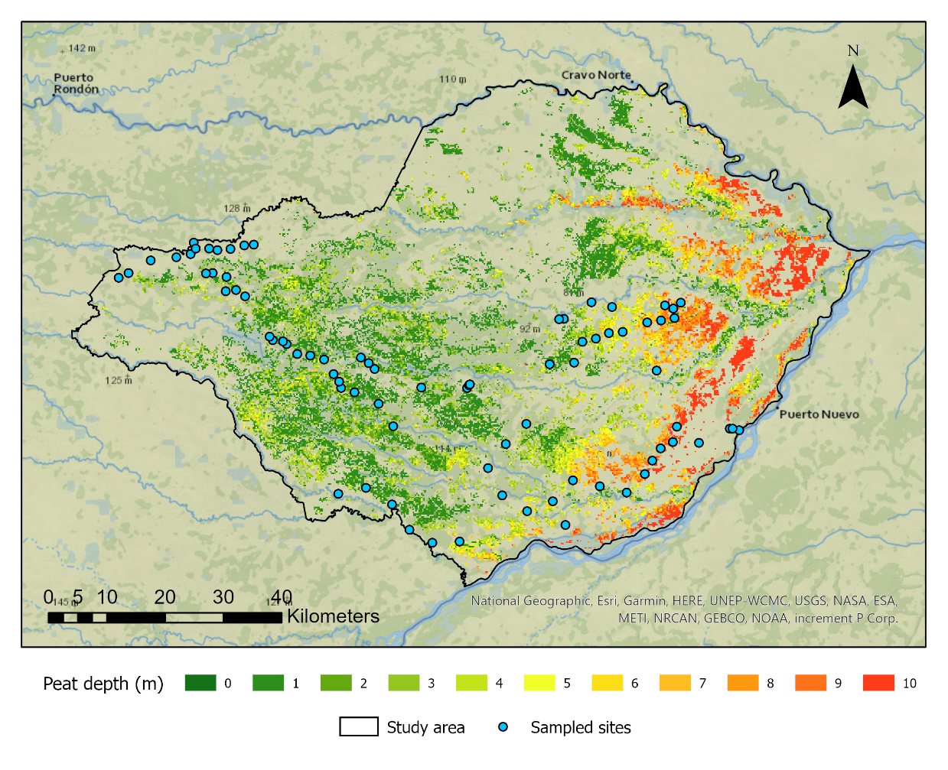
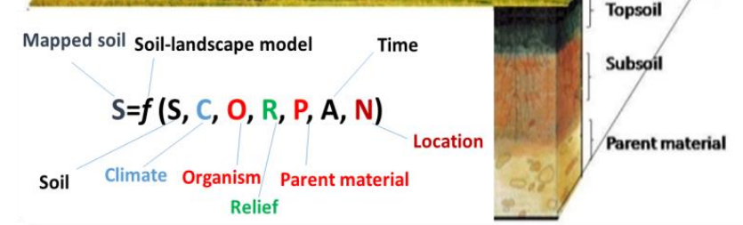
80 sites (0-10 cm and 10-30 cm).
Bulk density (BD), soil texture, Soil organic carbon (SOC).
Descriptive statistics across:
land cover, geomorphic feature, generalized soil texture.
Mean comparison:
Kruskal-Wallis non-parametric >> Dunn post-hoc test.
Considering the SCORPAN model (spatial resolution = 12 m).
SOC-landscape relationships
Soil sampling
Statistical analysis
Covariate selection
(Zeraatpisheh, 2017)
Data & Analysis

Slide 10
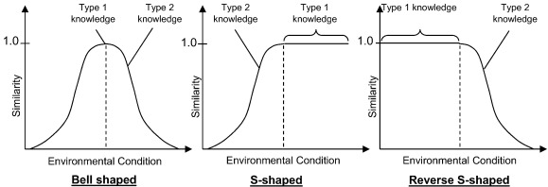
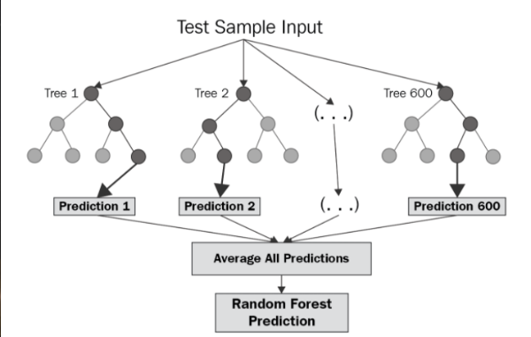
SOC spatial prediction
Digital Soil Mapping (DSM) approaches
Expert knowledge (Soil Inference model).
Random Forest (Machine learning).
SOC stock quantification (0-30 cm)
Theoretical scenario of soil carbon loss (Deng et al., 2016).
EK
(Bui et al., 2017)
SOC Stocks & CO2 emissions
RF
(Chen et al., 2020)
$$SOC Stock (ton/ha) = SOC∙BD∙Depth∙(1−G/100)∙10$$
Data & Analysis

Slide 11
3
Results & conclusions

Slide 12
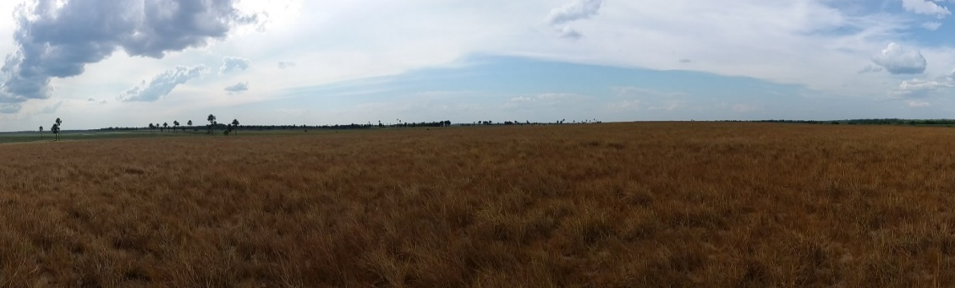
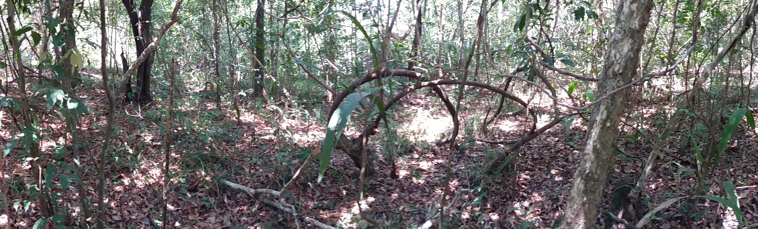
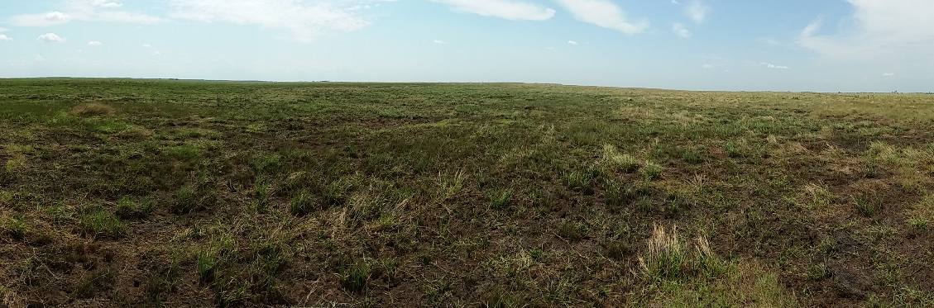
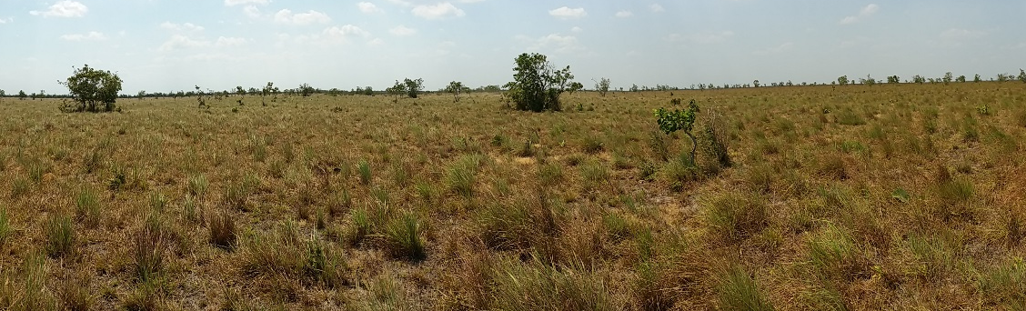


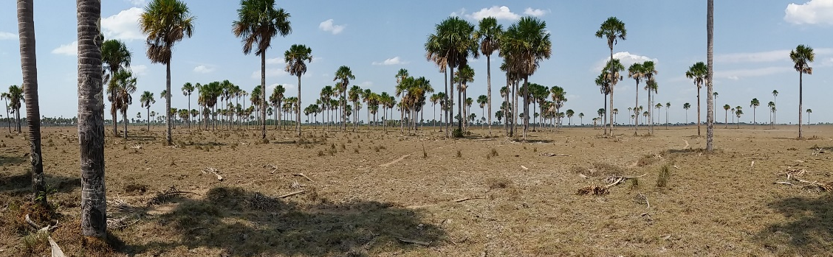

Native_Grass
Savanna
Carbon levels lower than expected, but high relative to other South American flooded savannas.
Native_Forest
Forest
Nat_Grass-Marsh
Flooded savannas
No Peats
Steppe
SOC characterization
Moriche palm

Slide 13



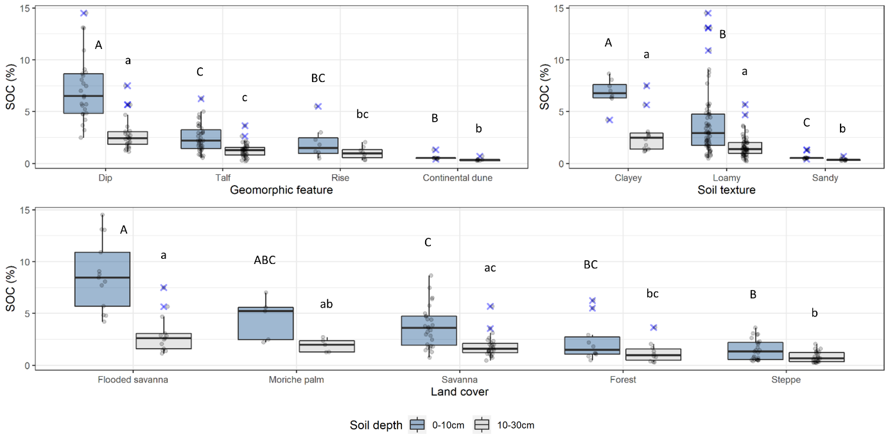
Vegetation coverage, topography and soil texture were the most relevant factors in explaining variability of SOC.
SOC characterisation

Slide 14
Vegetation coverage, topography and soil texture were the most relevant factors in explaining variability of SOC.
SOC characterisation

Slide 15
Vegetation coverage, topography and soil texture were the most relevant factors in explaining variability of SOC.
SOC characterisation

Slide 16
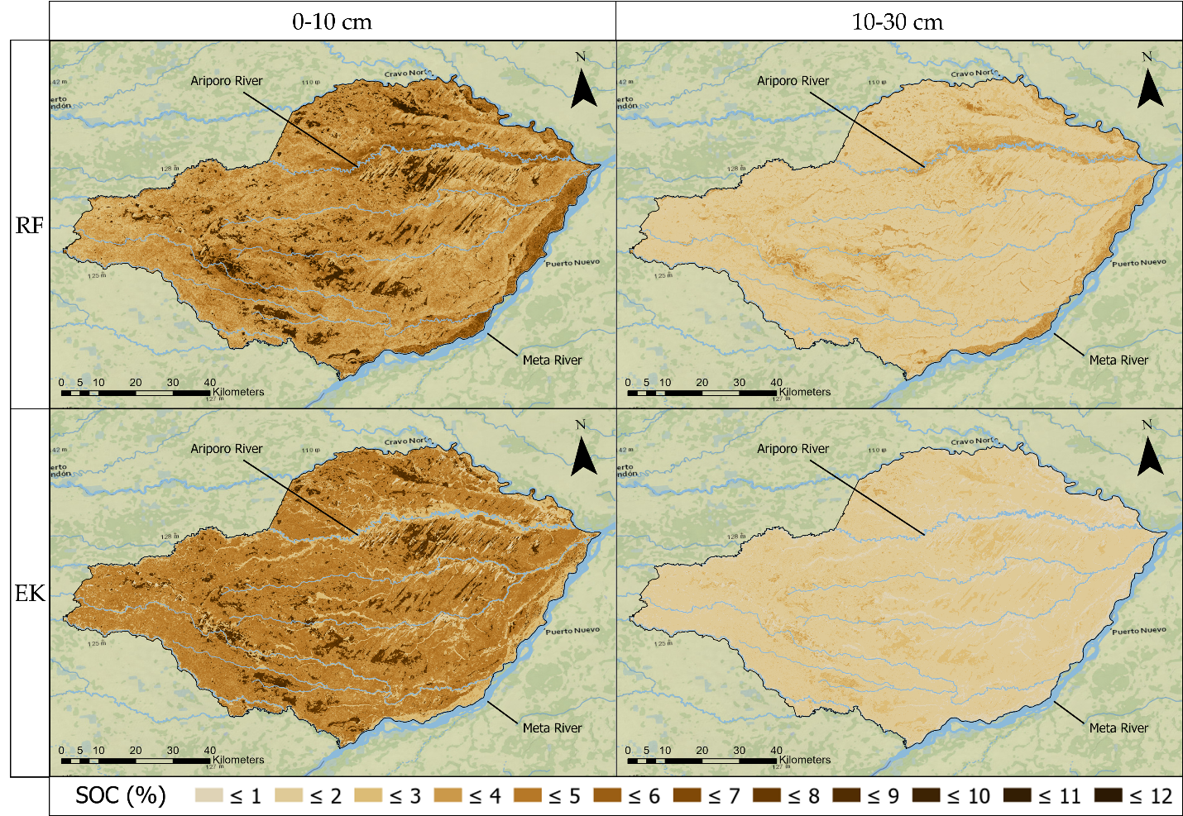


Although DSM approaches (Expert Knowledge and Random Forest) performed very well, EK was considered slightly superior to predict SOC
Soil depth | Method | RMSE | MAE | R²
0–10 cm | RF | 1.76 | 1.48 | 0.49
 | EK | 1.81 | 1.45 | 0.42
10–30 cm | RF | 0.74 | 0.59 | 0.32
 | EK | 0.70 | 0.53 | 0.36
SOC spatial predictions

Slide 17



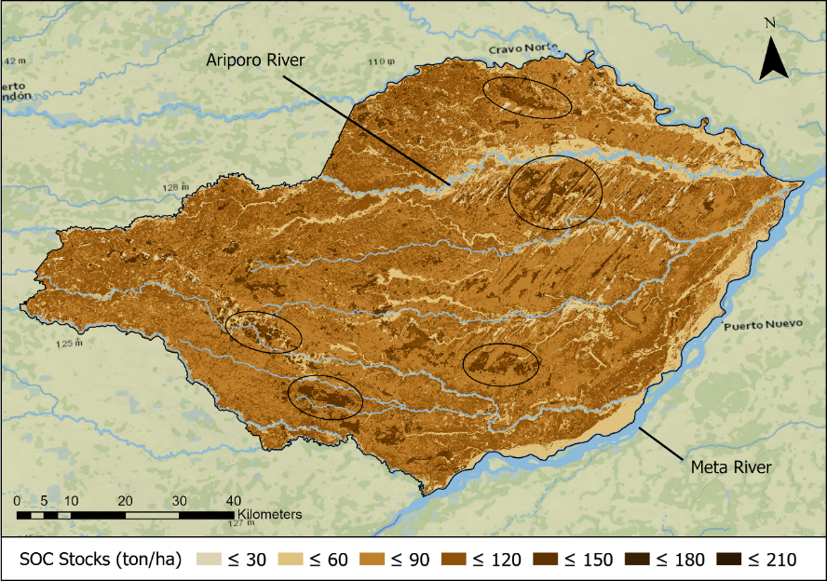
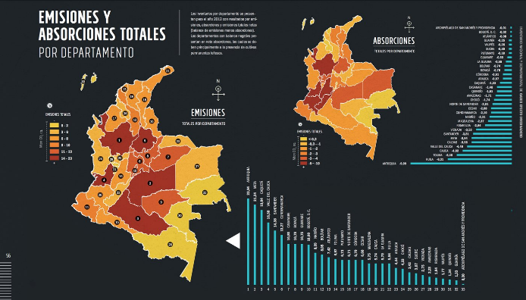
High carbon stocks and high potential of CO2 emissions associated with intensive agricultural development in the region
Potential CO2 emissions
2.83% of Colombia’s annual net “AFOLU” GHG emissions
Total SOC stock: 55.07 Mt
Area: 0.6 % Colombian territory
SOC Stock & CO2 emissions
AFOLU: Agriculture, Forestry and Other Land Use

Slide 18
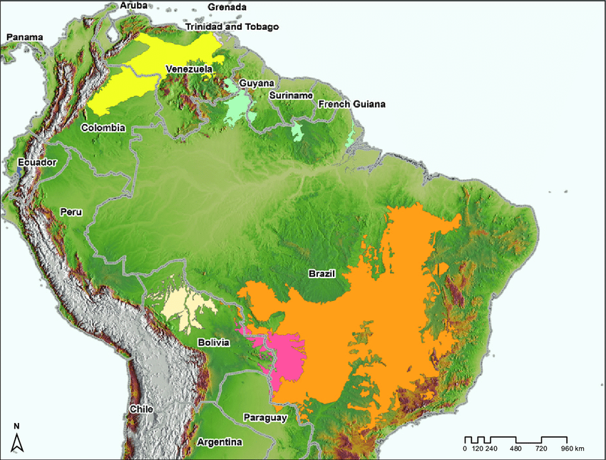
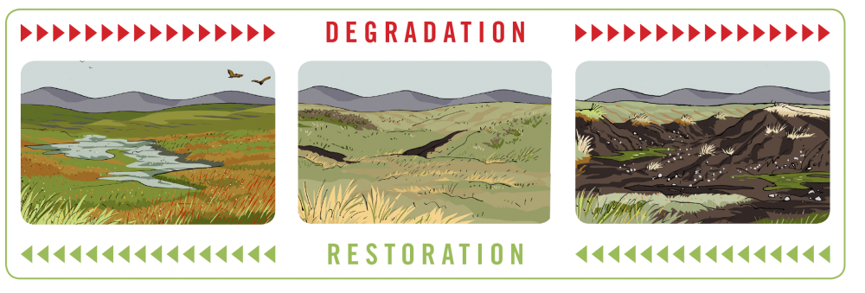
1/3 of Colombian AFOLU CO₂ emissions (85.4 Mt of CO₂)
15 Mha
(Rincón et al, 2014)
Flooded savannas and similar areas in South America are relevant carbon storage ecosystems that must be protected.
SOC Stock & CO2 emissions

Slide 19
5
Questions & discussion

Slide 20
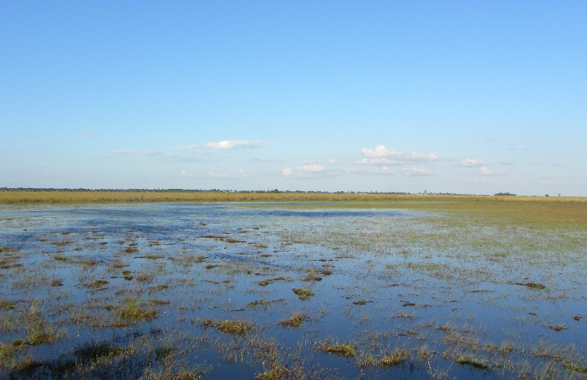
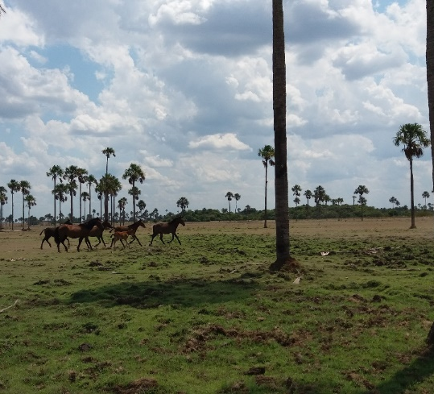
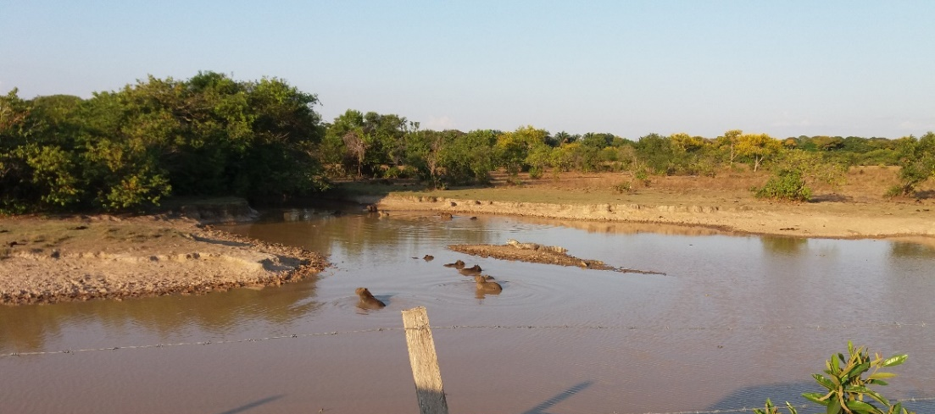
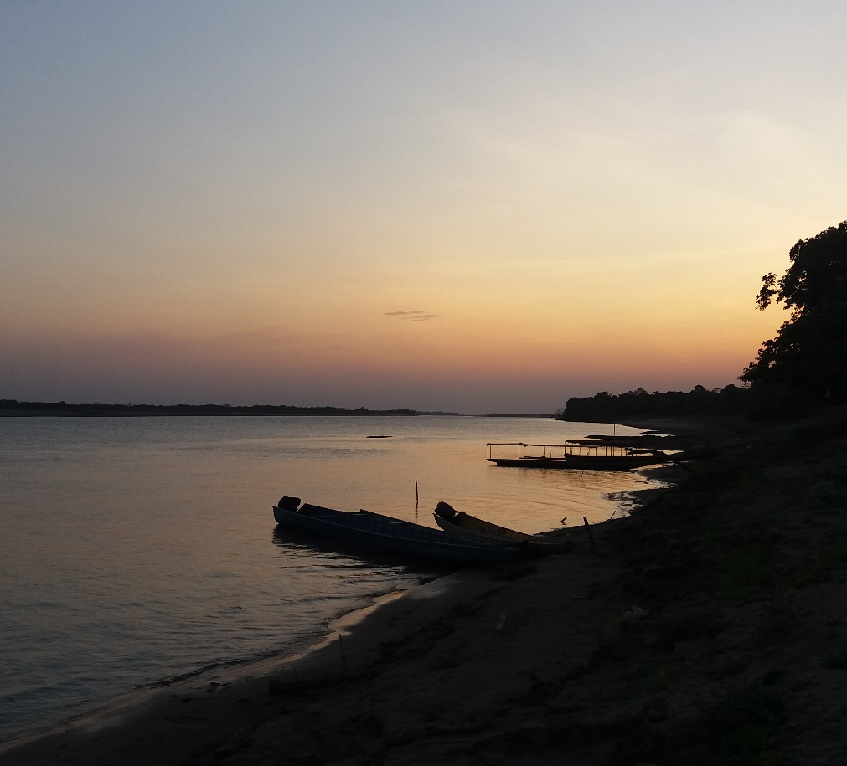
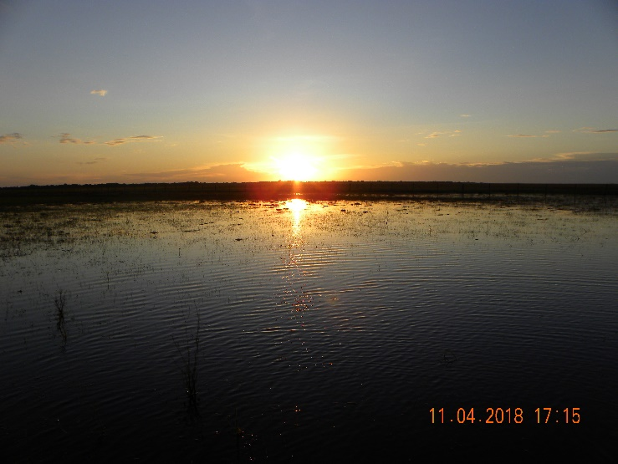
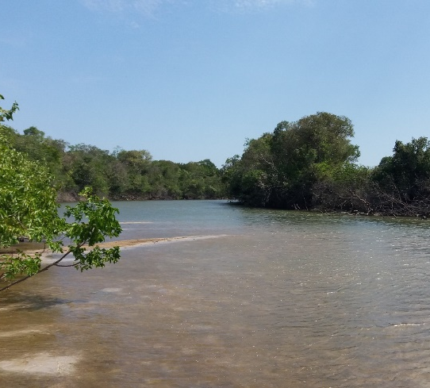
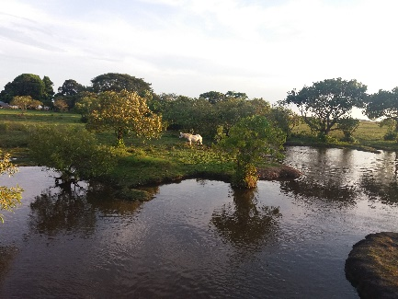
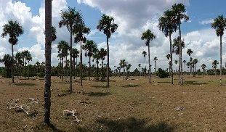
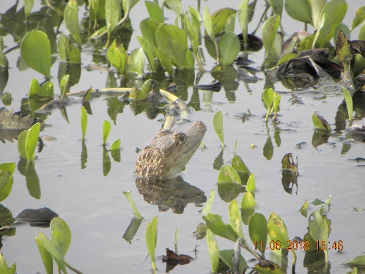
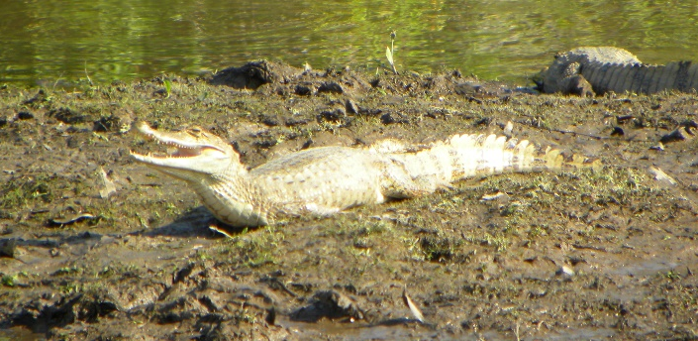
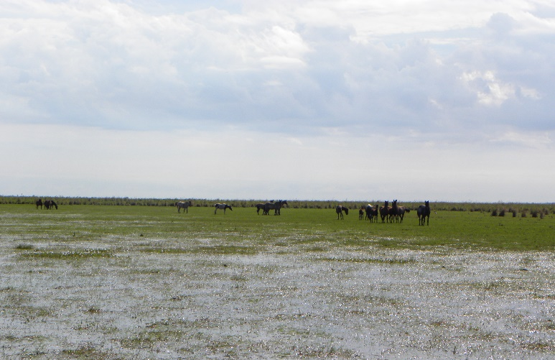
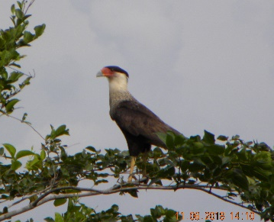
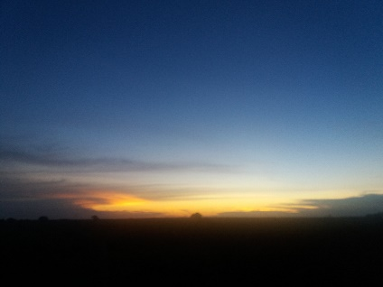
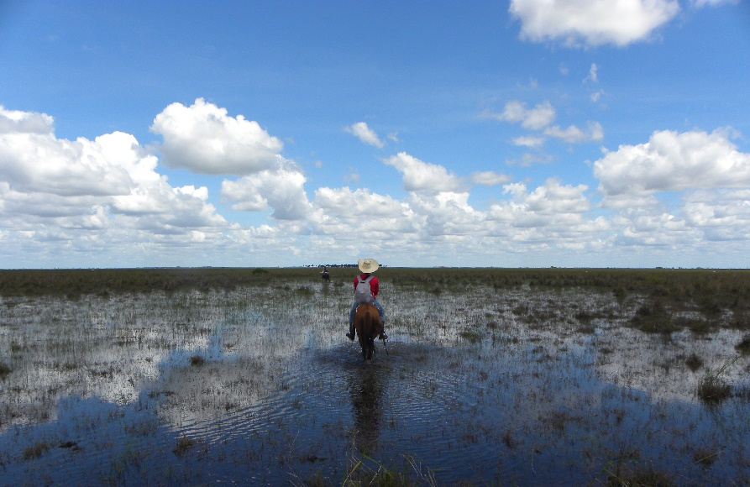
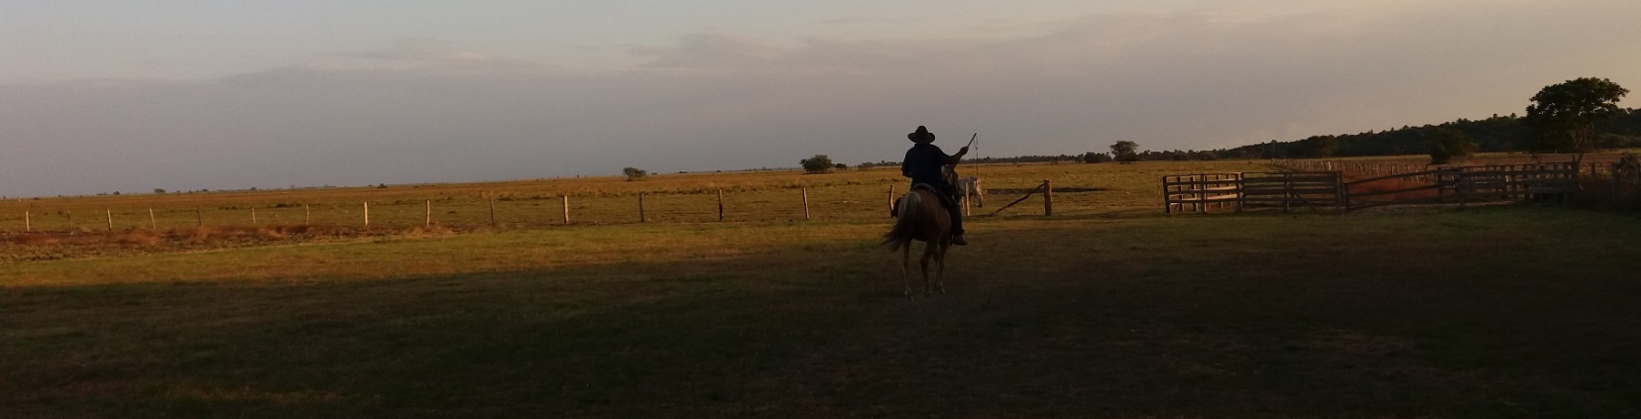
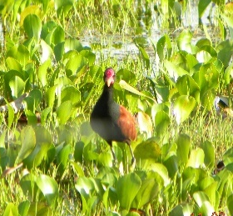
5. Questions & Discussions

Slide 21
Thank you !!
Javier M. Martín-López
j.m.martin@cgiar.org

Slide 22
6
References

Slide 23
Buriticá Mejia, N., 2016. Sabanas inundables de la orinoquía colombiana -documento resumen-. Humboldt 1–19.
Deng, L., Zhu, G., Tang, Z., Shangguan, Z., 2016. Global patterns of the effects of land-use changes on soil carbon stocks. Global Ecology and Conservation 5, 127–138. doi:10.1016/j.gecco.2015.12.004
Gumbricht, T., Roman‐Cuesta, R.M., Verchot, L., Herold, M., Wittmann, F., Householder, E., Herold, N., Murdiyarso, D., 2017. An expert system model for mapping tropical wetlands and peatlands reveals South America as the largest contributor. Global Change Biology 23, 3581–3599. doi:10.1111/gcb.13689
Fluet-Chouinard E., Lehner B., Rebelo L.M., Papa F., Hamilton S.K. (2015): Development of a global inundation map at high spatial resolution from topographic downscaling of coarse-scale remote sensing data, Remote Sensing of Environment. 158: 348-361
IGAC, 2014. Estudio general de suelos zonificación de tierras: Departamento de Casanare
Köchy, Martin & Freibauer, Annette. (2009). Global spatial distribution of wetlands. 10.13140/RG.2.2.20114.40644.
Lehner, B., Döll, P.: Development and validation of a global database of lakes, reservoirs and wetlands, Journal of Hydrology, Volume 296, Issues 1–4, 20 August 2004, Pages 1-22, http://dx.doi.org/10.1016/j.jhydrol.2004.03.028.
McBratney, A.B., Mendonça Santos, M.L., Minasny, B., 2003. On digital soil mapping, Geoderma. doi:10.1016/S0016-7061(03)00223-4
Mejia, N., 2016. Sabanas inundables de la orinoquía colombiana -documento resumen-. Humboldt 1–19
Meteoblue, www.meteoblue.com
Rincón, Sofia & Suarez, Cesar & Romero-Ruiz, Milton & Flantua, Suzette & Sarmiento, Adriana & Hernández, Natalia & Lozano, Maria & Naranjo, Luis & Usma Oviedo, José. (2014). Identifying Highly Biodiverse Savanans based on the European Union Renewable Energy Directive (SuLu Map): Conceptual background and technical guidance.
Zeraatpisheh, 2017, Digital soil mapping, downscaling and updating conventional soil maps using GIS, RS, Statistics and auxiliary data

