Slide 1

What drives increased evaporation at cloud top in polluted stratocumulus clouds?
Adele L Igel
University of California, Davis
Abigail Williams
University of California, San Diego

Slide 2
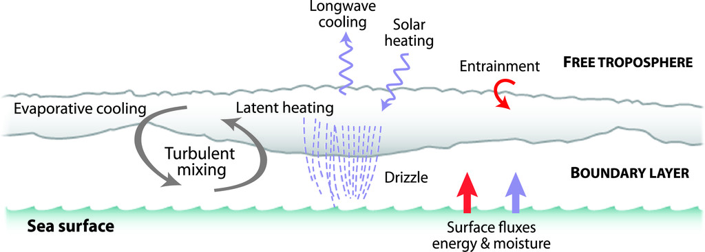
Stratocumulus Clouds
v
Wood 2012

Slide 3
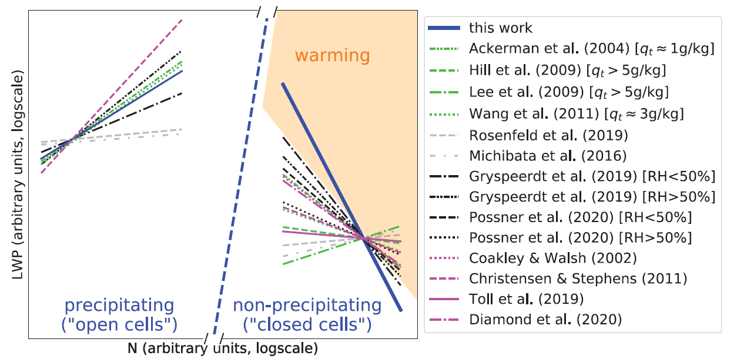

Stratocumulus Clouds
f
The sign of the LWP change with N is important for understanding the change in albedo with N:
Glassmeier et al. 2021

Slide 4
Stratocumulus Clouds
The decrease in LWP is due to
Stronger evaporation of cloud liquid in higher aerosol conditions at cloud top because …
Smaller droplets evaporate more efficiently because they have more surface area for a given total amount of liquid
Smaller droplets reside closer to the entrainment interface than larger droplets owing to reduced gravitational settling, which increases the potential for evaporation.
f
The sign of the LWP change with N is important for understanding the change in albedo with N:
Glassmeier et al. 2021

Slide 5
Is this explanation correct?
The decrease in LWP is due to
Stronger evaporation of cloud liquid in higher aerosol conditions at cloud top
Smaller droplets evaporate more efficiently because they provide a larger surface for a given total amount of liquid
Smaller droplets reside closer to the entrainment interface than larger droplets owing to reduced gravitational settling, which increases the potential for evaporation.
We ran large eddy simulations of decoupled stratocumulus clouds to investigate this mechanism
One precipitating case, one non-precipitating case
RAMS
dx = 50 m; dz = 10 m
Bulk microphysics
NO DROPLET SEDIMENTATION
Updated Harrington radiation scheme
Testing this part
Not testing this part
Williams and Igel 2021

Slide 6
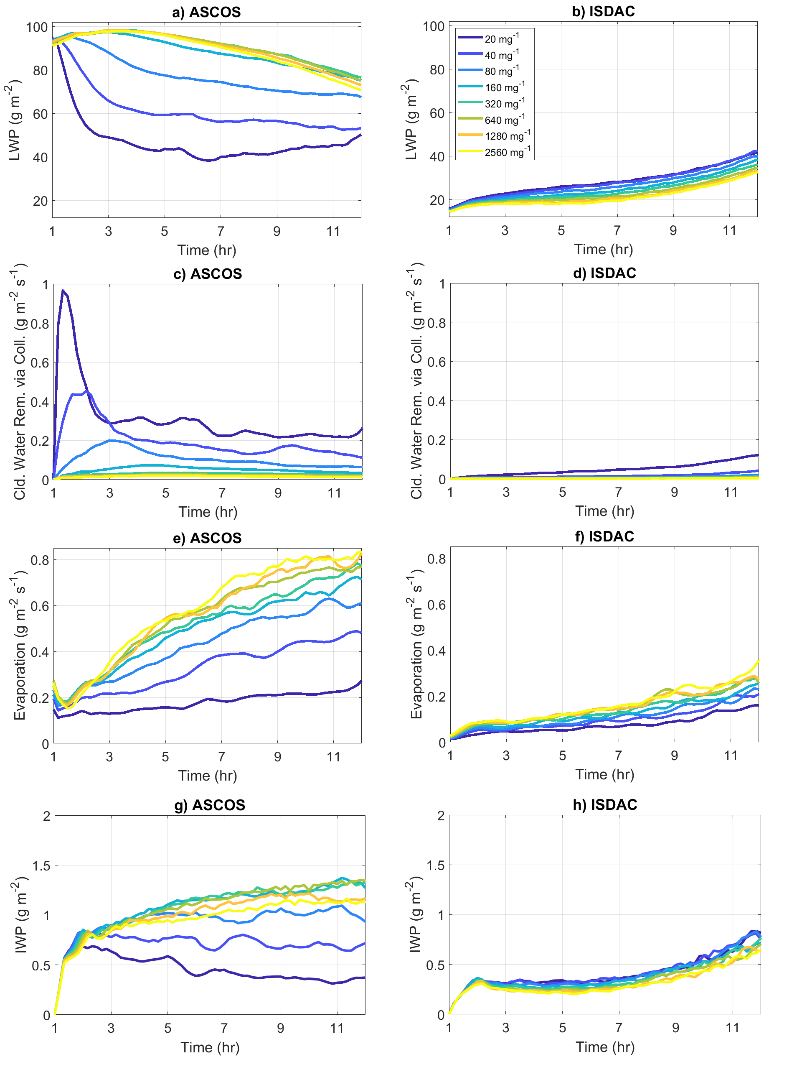
LWP Response
Precipitating Case
Non-Precipitating Case
g
Nonmonotonic response: increase then decrease with aerosol
Monotonic decrease with aerosol
Williams and Igel 2021

Slide 7
Cloud Top Evaporation
Precipitating Case
Non-Precipitating Case
f
Consistent with the idea that there is enhanced evaporation at cloud top with higher droplet concentrations and that this enhancement drives more entrainment.
Williams and Igel 2021

Slide 8
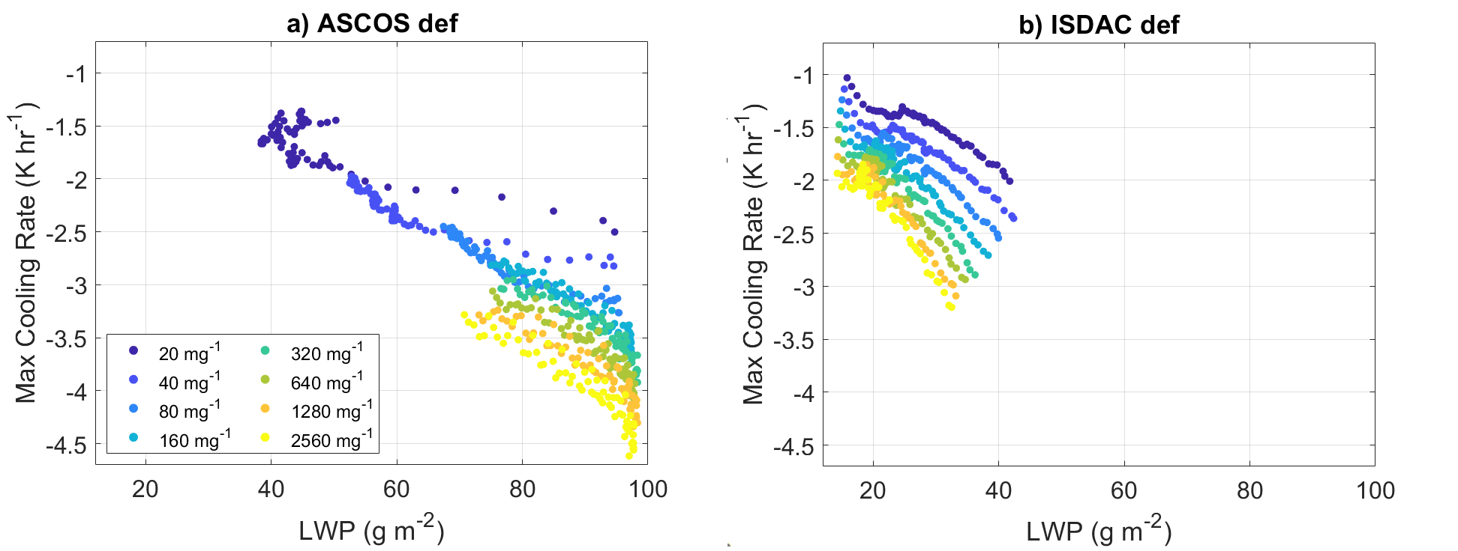
Cloud Top Radiative Cooling
Precipitating Case
Non-Precipitating Case
f
LWP > 50 g m⁻²!
LWP slightly less than 50 g m⁻²
Local cloud top radiative cooling is also increased with higher droplet concentrations. And even if LWP is high.
Williams and Igel 2021

Slide 9
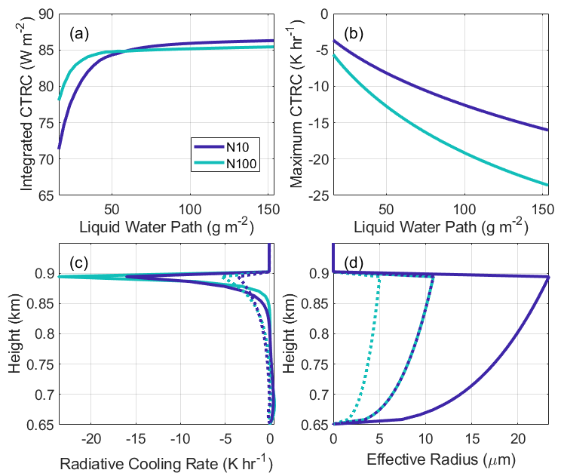
Cloud Top Radiative Cooling
BUGSrad radiation calculations
LWP=157 g m⁻²
LWP=16 g m⁻²
Maximum cloud top radiative cooling is strongly dependent on LWP and droplet properties!
Williams and Igel 2021

Slide 10
Cloud Top Radiative Cooling
Precipitating Case
Non-Precipitating Case
f
LWP > 50 g m⁻²!
LWP slightly less than 50 g m⁻²
Does the longwave radiative cooling rate impact the cloud top evaporation rate?
Williams and Igel 2021

Slide 11
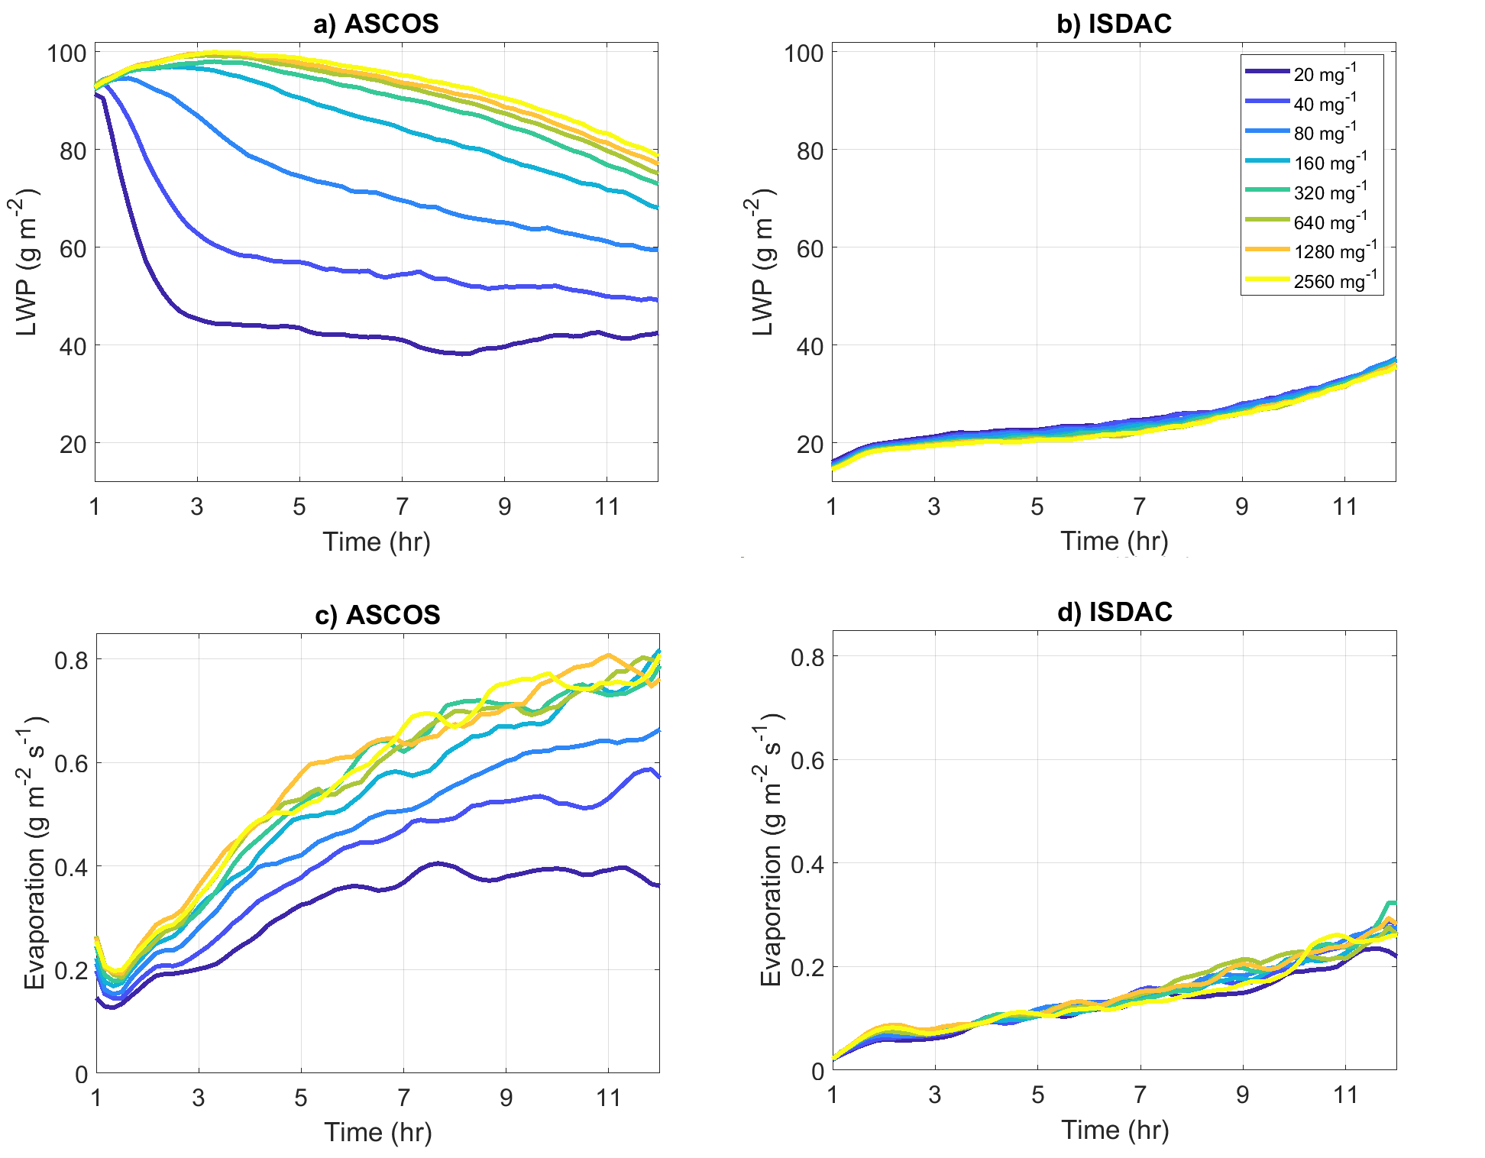
What Happens If We Make Longwave Radiation Insensitive to Droplet Size?
Precipitating Case
Non-Precipitating Case
f
Now almost no sensitivity to aerosol concentration
Original range of LWP
Now a monotonic increase driven by precipitation suppression
Williams and Igel 2021

Slide 12
Cloud Top Evaporation
Precipitating Case
Non-Precipitating Case
No trend among most polluted simulations
No trend in evaporation rates with aerosol concentration
Williams and Igel 2021

Slide 13

What the Simulations Suggest
LWP decreases in non-precipitating clouds are indeed a result of increased evaporation
BUT, the increased evaporation is NOT being driven by more efficient evaporation of small, numerous cloud droplets
INSTEAD, the increased evaporation is a result of changes in maximum cloud top radiative cooling rates which increase the rate of dry air entrainment.
Williams and Igel 2021

Slide 14
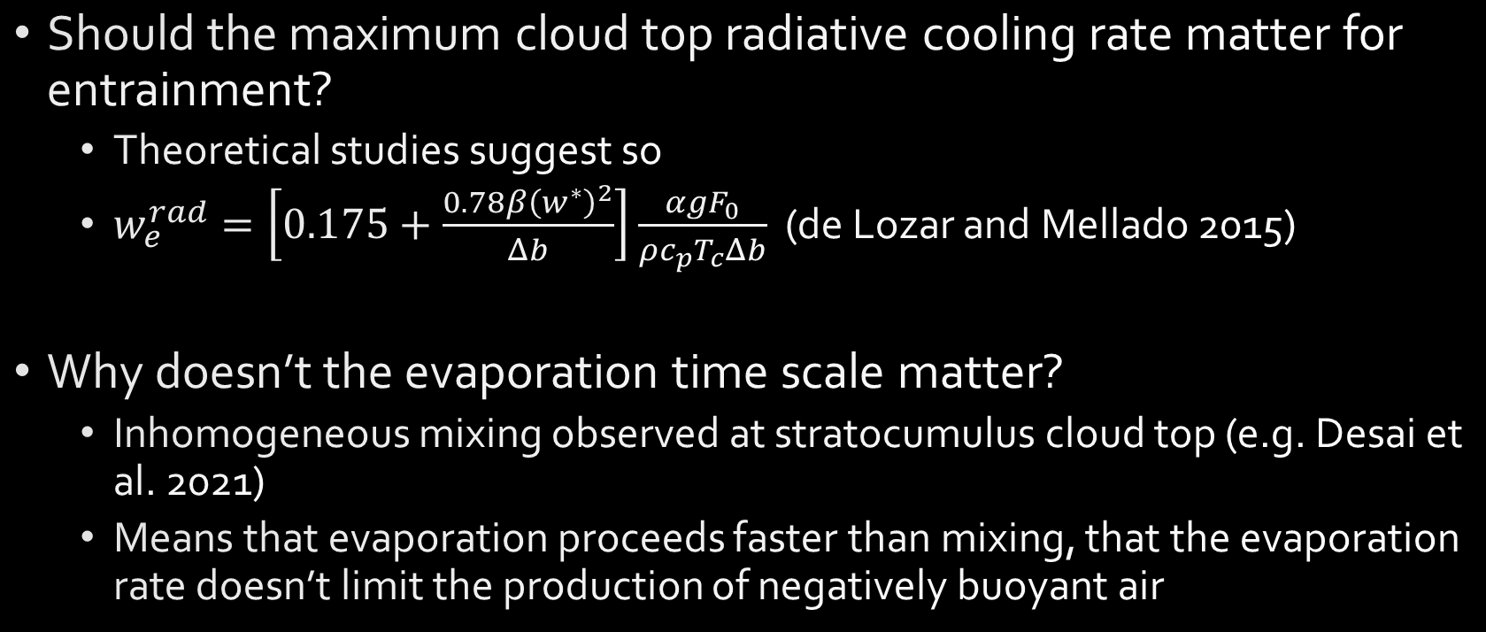
Two Questions
Should the maximum cloud top radiative cooling rate matter for entrainment?
Theoretical studies suggest so
$w_{e}^{rad}=\left[0.175+\frac{0.78β{\left(w^{∗}\right)}^{2}}{Δb}\right]\frac{αgF_{0}}{ρc_{p}T_{c}Δb}$ (de Lozar and Mellado 2015)
Why doesn’t the evaporation time scale matter?
Inhomogeneous mixing observed at stratocumulus cloud top (e.g. Desai et al. 2021)
Means that evaporation proceeds faster than mixing, that the evaporation rate doesn’t limit the production of negatively buoyant air
Williams and Igel 2021

Slide 15

Take-Home Points
Cloud top radiative cooling can be quantified in terms of a cloud depth integral or as the maximum local rate at cloud top
The maximum local cloud top radiative cooling rate always depends on LWP and droplet size
Aerosol-induced changes to cloud droplet properties and maximum cloud top radiative cooling rates may drive increased entrainment and evaporation, decreased LWP in non-precipitating stratocumulus clouds
Williams and Igel 2021, doi: 10.1029/2021GL094740

Slide 16
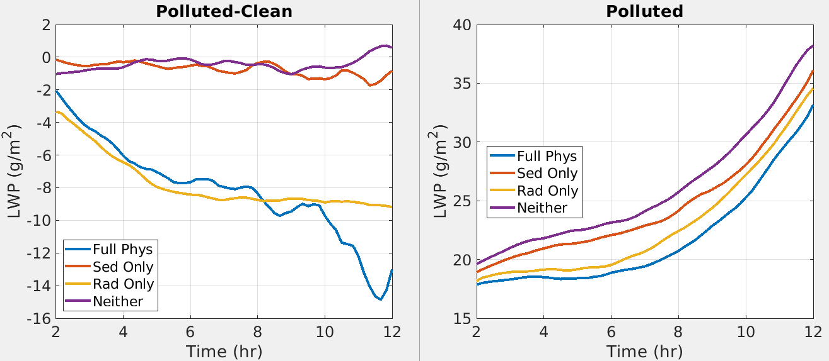
What About Droplet Sedimentation?

