Slide 1


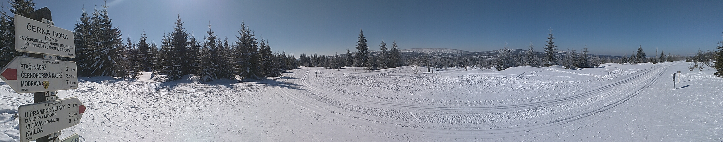
EGU General Assembly 2022, Vienna, Austria & Online | 23–27 May 2022, CR3.1 Changes in the frequency and extremity of rain-on-snow events in the warming climate
Ondrej Hotovy and Michal Jenicek
Charles University, Department of Physical Geography and Geoecology, Prague, Czechia ondrej.hotovy@natur.cuni.cz, https://www.natur.cuni.cz/geography/physgeo
Research was supported by the Charles University Grant Agency, project No: GAUK 272119

Slide 2
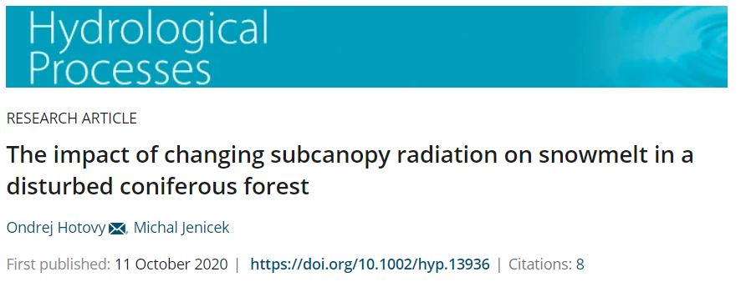
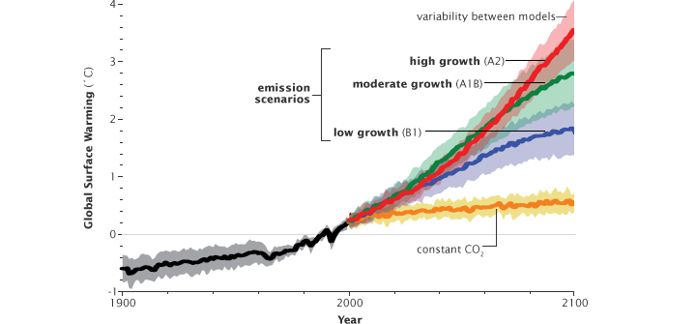
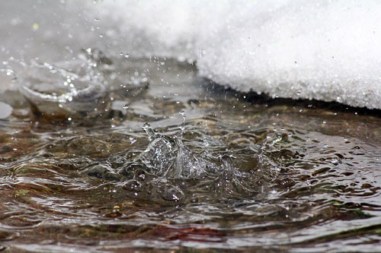
Changes in the frequency and extremity of rain-on-snow events in the warming climate
MOTIVATION AND RESEARCH OBJECTIVES
Heat from rain in the context of snowpack energy balance
→ flood risk
Limited knowledge of rain-on-snow (ROS) change in the warming climate, especially for non-Alpine mountainous rain-snow transition catchments in Central Europe
More frequent ROS?
Monthly and elevation distibution of ROS trends?
Higher ROS extremity?
Increasing flood risk?
?

Slide 3
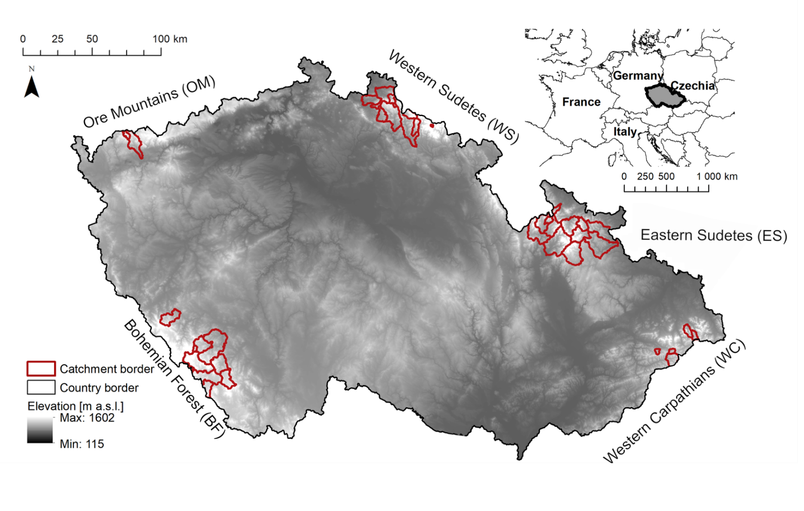
Changes in the frequency and extremity of rain-on-snow events in the warming climate
STUDY AREA
40 near-natural mountainous catchments in Czechia
Snow influence on runoff, no major human influence
Long-term time series of meteorological and hydrological data:
- T and P: 1965 – 2019
- Q and SWE: 1980 – 2014
Fig. 1 Location of study catchments located in five different mountain ranges in Czechia.

Slide 4
Changes in the frequency and extremity of rain-on-snow events in the warming climate
METHODS
PRECIPITATION
HBV model to simulate individual components of the rainfall-runoff process (100 m elevation zones distribution)
Model testing:
- several objective criteria
- SWE simulations
- ROS occurrence simulations
- ROS class simulations
ROS days definition → trend analyses (Mann-Kendall tests)
ROS events definition → runoff classes and trends in hydrological response
SNOW ROUTINE
SOIL ROUTINE
GROUNDWATER ROUTINE
Daily mean air temperature > 0 °C
Snow water equivalent ≥ 10 mm
Total daily precipitation ≥ 5 mm
SIMULATED RUNOFF
ROUTING ROUTINE
Fig. 2 Schematic structure of HBV model (Seibert et Vis, 2012).

Slide 5
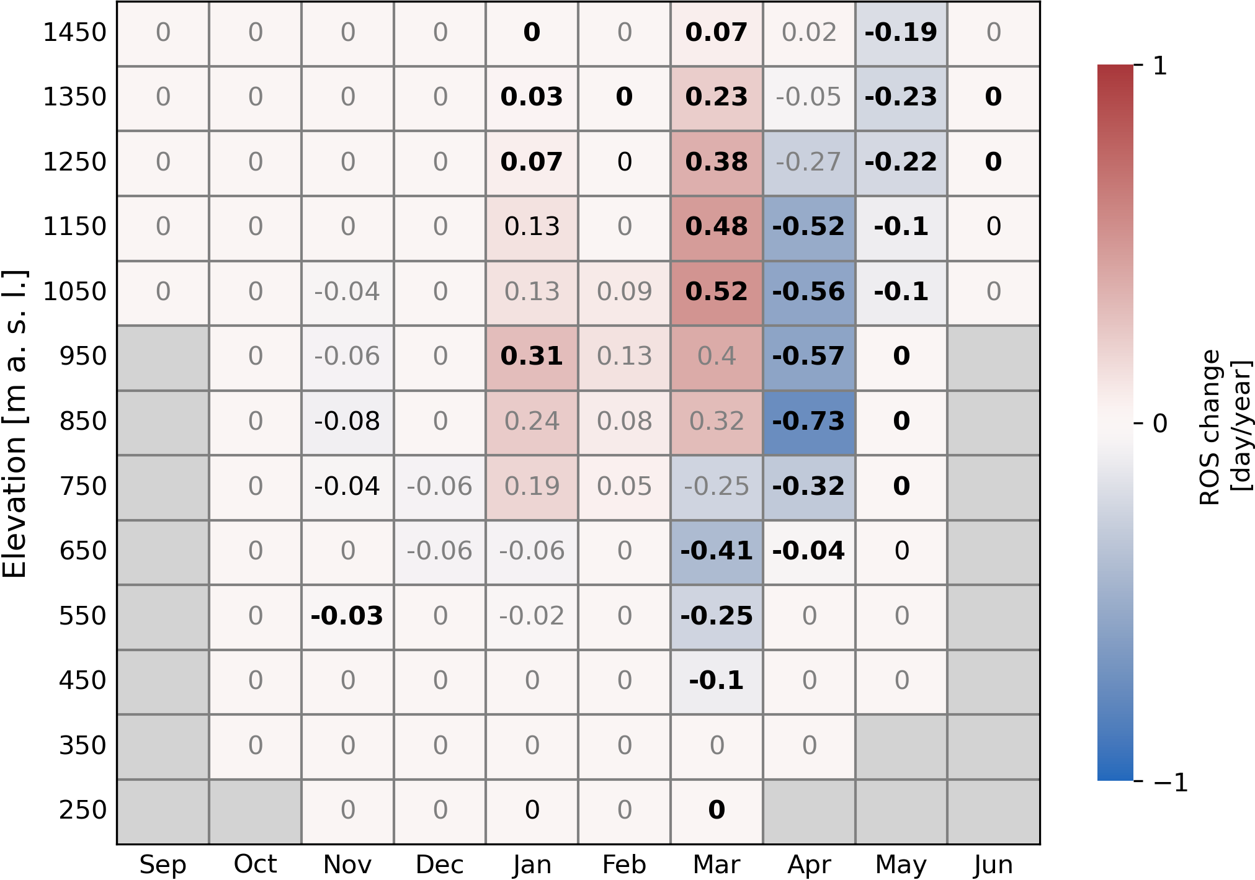
Changes in the frequency and extremity of rain-on-snow events in the warming climate
RESULTS – Monthly and elevation distribution of ROS trends
More rain during winter period
→ more ROS days (especially at higher elevations)
Shorter periods with snowcover
→ less ROS days in the end of winter season
Fig. 3 Trends in ROS days at different elevations during the period 1965-2019. The values represent Theil-Sen’s slopes of the regression line. Significant Mann-Kendall trends are highlighted in black bold (p < 0.05) and in black (p < 0.1), decreasing trends in shades of blue and increasing trends in shades of red.

Slide 6
Changes in the frequency and extremity of rain-on-snow events in the warming climate
RESULTS – Hydrological response on ROS, changes in ROS extremity
Runoff class | Hydrological response | Definition
1 | Negligible runoff | Q_{last} ≤ 125% Q₀
2 | Low runoff | 125% Q₀ < Q_{last} ≤ 250% Q₀
3 | Medium runoff | 250% Q₀ < Q_{last} ≤ 500% Q₀
4 | High runoff | Q_{last} > 500% Q₀
Tab. 1 Classification of ROS events runoff response. Q₀ represents a simulated daily runoff in the day zero (the day before the first ROS day of the specific ROS event) and Q_{last} represents a simulated daily runoff in the last day of the specific ROS event.
Fig. 4 Total number of ROS events in October to June in the period 1965-2019, classified into four different runoff classes.

Slide 7
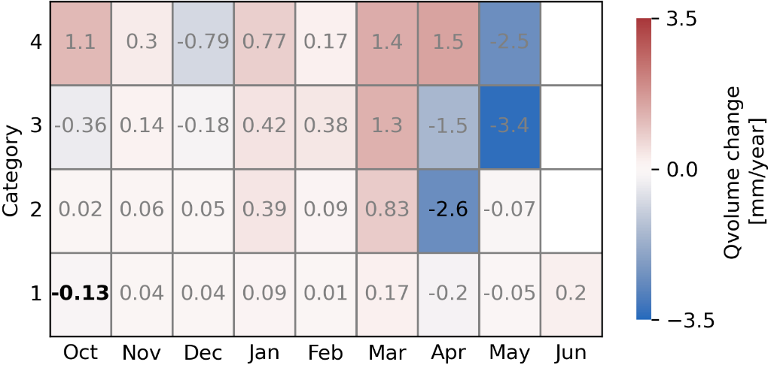
Changes in the frequency and extremity of rain-on-snow events in the warming climate
RESULTS – Hydrological response on ROS, changes in ROS extremity
Runoff class | Hydrological response | Definition
1 | Negligible runoff | Q_{last} ≤ 125% Q₀
2 | Low runoff | 125% Q₀ < Q_{last} ≤ 250% Q₀
3 | Medium runoff | 250% Q₀ < Q_{last} ≤ 500% Q₀
4 | High runoff | Q_{last} > 500% Q₀
Tab. 1 Classification of ROS events runoff response. Q₀ represents a simulated daily runoff in the day zero (the day before the first ROS day of the specific ROS event) and Q_{last} represents a simulated daily runoff in the last day of the specific ROS event.
Runoff class
Fig. 5 Volume trend in ROS events during the period 1965-2019 according to ROS runoff type classification. The values represent Theil-Sen’s slopes of the regression line. Significant Mann-Kendall trends are highlighted in black bold (p < 0.05) and in black (p < 0.1), decreasing trends in shades of blue and increasing trends in shades of red.

Slide 8
Changes in the frequency and extremity of rain-on-snow events in the warming climate
OUTLOOK
Rather weak and not consistent trends at catchment scale
Significant trends at temporal and spatial scale:
Increase in number of ROS days during winter season (higher elevations)
Decrease in the late winter (all elevations, different timing)
Monthly distribution of runoff response ROS classes
Significant changes in runoff volumes/ROS extremity cannot be proved, although certain changes were visible

Slide 9
EGU General Assembly 2022, Vienna, Austria & Online | 23–27 May 2022, CR3.1 Changes in the frequency and extremity of rain-on-snow events in the warming climate
THANK YOU FOR YOUR ATTENTION.
Ondrej Hotovy and Michal Jenicek
Charles University, Department of Physical Geography and Geoecology, Prague, Czechia ondrej.hotovy@natur.cuni.cz, https://www.natur.cuni.cz/geography/physgeo
Research is supported by the Charles University Grant Agency, project No: GAUK 272119

