Slide 1

Application of Remote Sensing and GIS to Assess Snow Cover and its Dynamics: A Case Study of Uttarakhand Himalaya, India
Author(s): Arvind Pandey, Deepanshu Parashar, Sarita Palni, and Ajit Partap Singh
Presenting Author- Arvind Pandey (pandeyarvind02@gmail.com)

Slide 2
General Introduction
Transition between the snow-covered area and non-snow-covered area is known as the snow line.
Himalayan glaciers face various non-reversible troubles, such as a downturn in snow lines year by year, resulting in a decrease in snow cover areas.
In the Indian Himalaya, around 9575 glaciers cover 37,466 km² of land cover
The Himalayan mountain range have one of the highest consolidation of glaciers and permanent snow cover fields in the world

Slide 3
Study area
The study deals with the Pinder watershed (Uttarakhand Himalaya) extending between 30°6'15.429"N 30°19'15.45"N latitudes and 79°47'57.434"E to 80°5'41.672"E longitudes and encompasses an area of 391.05 km².
The study site experienced various climatic conditions that ranged from heavy to sunny snowfall and needed a 70-kilometer hike from village ‘Song’
The region's average temperature ranges from -10°C to -15°C in the summer and from -20°C to -40°C in the winter.

Slide 4
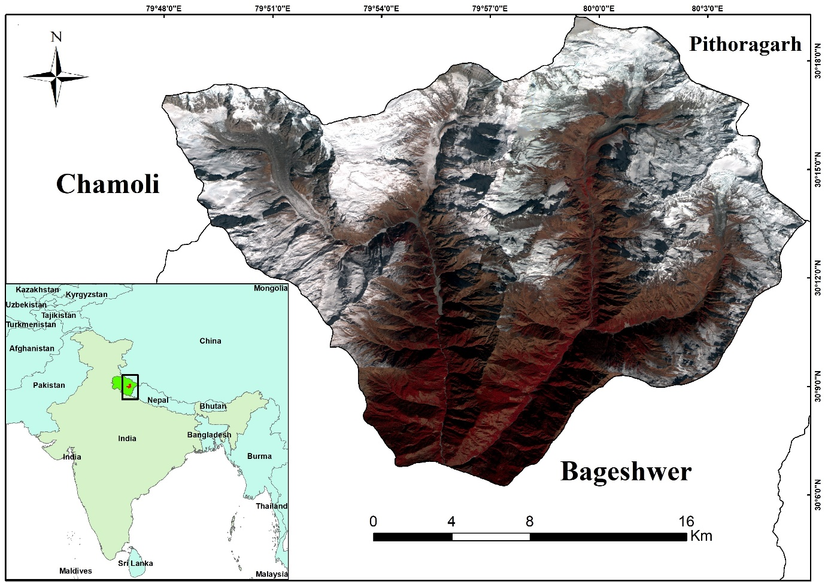

Slide 5
Aim and objectives
This research aims to assess snow cover trends and snow lines over the Pindari glacier Himalayan region from 1972 to 2018.
Extraction of Snow cover land over the study area.
Monitor the shifting pattern of show line in Himalayan region.

Slide 6
Methodology
This study uses Snow- Altitude Curve and NDSI for extracting the snow-covered area.
Time period of the study was 1972, 1999, 2011, 2018
The study includes the Landsat and Sentinel satellite imageries of the last 46 years for assessing the spatiotemporal coverage of the study area.
On screen digitization for better extraction of snow line
Analysis of power data access viewer meteorological dataset.

Slide 7
Outcomes and findings
Time Period | Minimum Elevation change (m) | Maximum Elevation change (m)
Change from 1972 - 1999 | 92 | 114
Change from 1999 - 2011 | 134 | 127
Change from 2011 - 2018 | 110 | 91
Change from 1972 - 2018 | 336 | 332
The net change of snow line in Pindari valley of Uttarakhand from 1972 – 2018.
Time Period | Net change in Snow cover
Change from 1972 - 1999 | -6.49
Change from 1999 - 2011 | -4.44
Change from 2011 - 2018 | 8.67
Change from 1972 - 2018 | -2.26
The net change in snow cover area in Pindari valley of Uttarakhand from 1972 – 2018.

Slide 8
Snow line dynamics of the Pindari valley of Uttarakhand from 1972 - 2018.

Slide 10
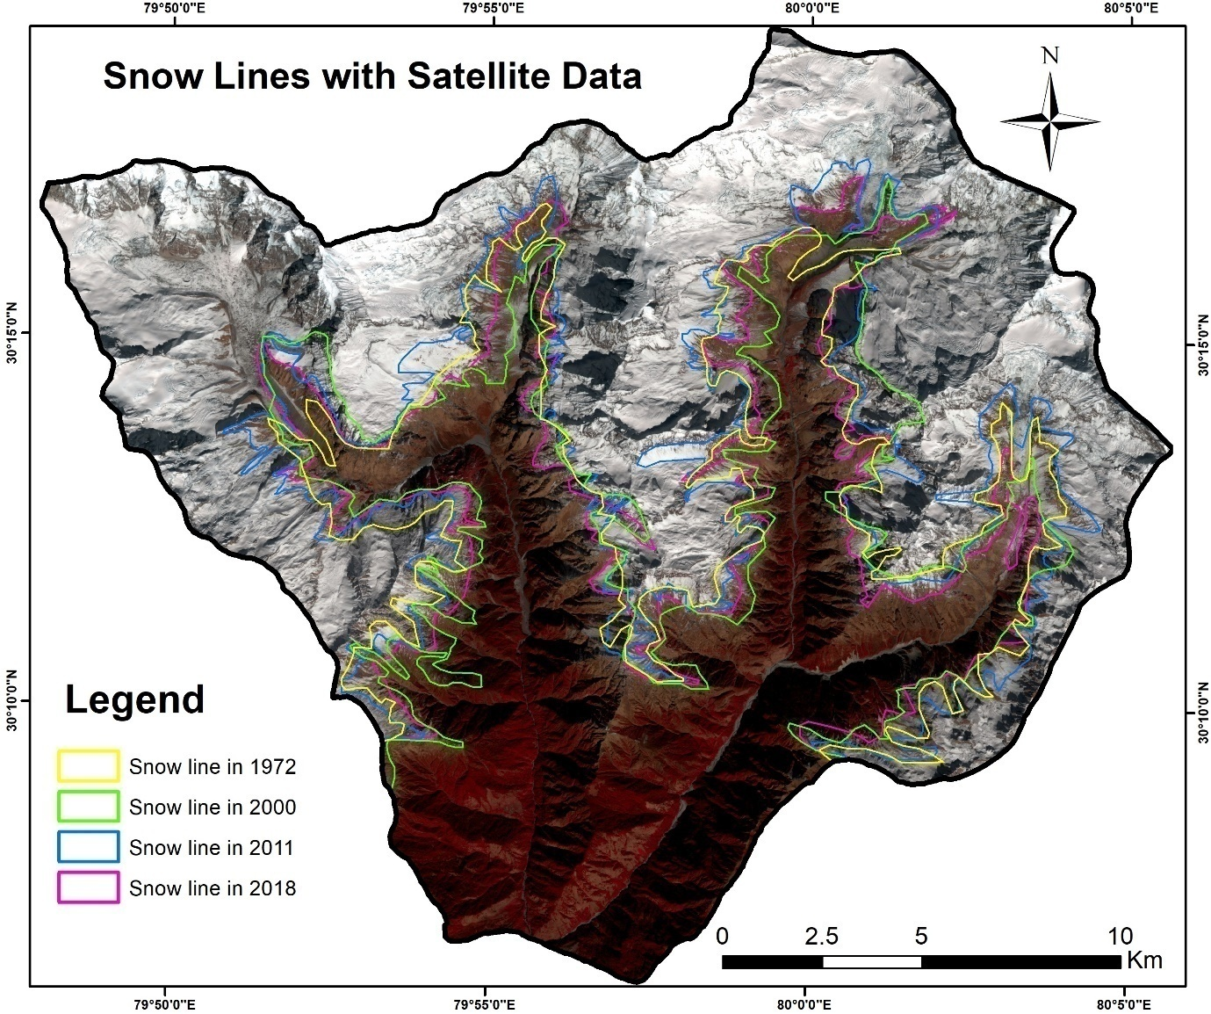

Slide 11
Annual maximum (A) and minimum (B) temperature trend of Pindari valley from 1981 to 2018

Slide 12
Conclusion
This study shows that in the years 1972, 1999, 2011, and 2018 snow line lie at an altitude of 2560m, 2652m, 2786m, and 2896m a.s.l. in the western side of the study location.
snow line lie at an altitude of 2571m, 2685m, 2812 and 2903m a.s.l. in the eastern side of the study location part of the study area
snow-covered areas had been decreased by 2.24 km² in 46 years from 1972 – 2018
The main cause of this snow line shift and decreasing in the field of snow cover snow cover area in the region is an increase in temperature
These changes would have a dramatic impact on ecology and the environment.

