Slide 1


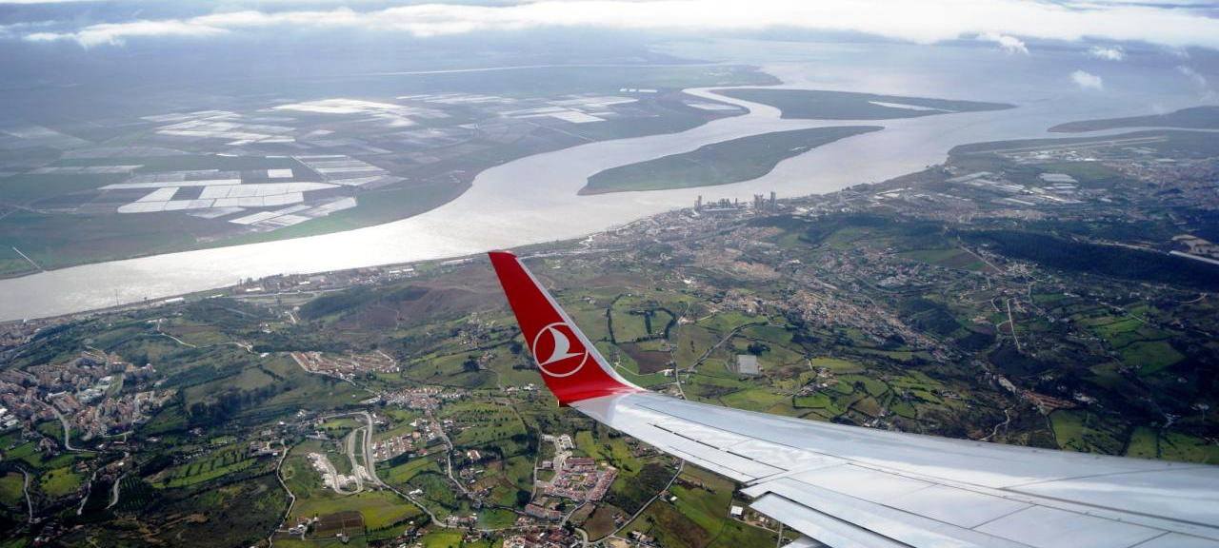

Mohammad Foroutan
Surface-rupturing paleoearthquakes in a context
of slow deforming continental interiors:
the Lower Tagus Valley fault, Central Portugal
S. Vilanova, S. Heleno, A. Murray, L. Pinto, A. Sajedi Far, A. Falcão,
M. Torkamani, C. Canora, P. Pina, G. Vieira, J. Fonseca
EGU General Assembly-23 May 2022 (Vienna, Austria)

Slide 2
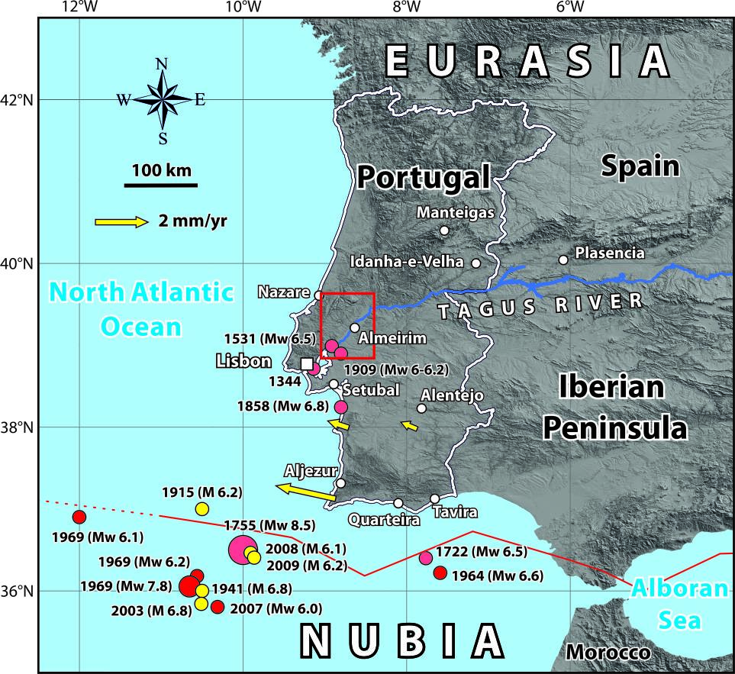
Research question
2
How active are the prominent strike-slip faults slicing
Central Portugal?
Convergence of Nubia-Eurasia plates amounts to 5±1 mm yr⁻¹
Central Portugal is characterized by slow deformation rate of ~1 mm yr⁻¹
Northward decrease in geodetic slip rates is consistent with the overall pattern of seismicity

Slide 3
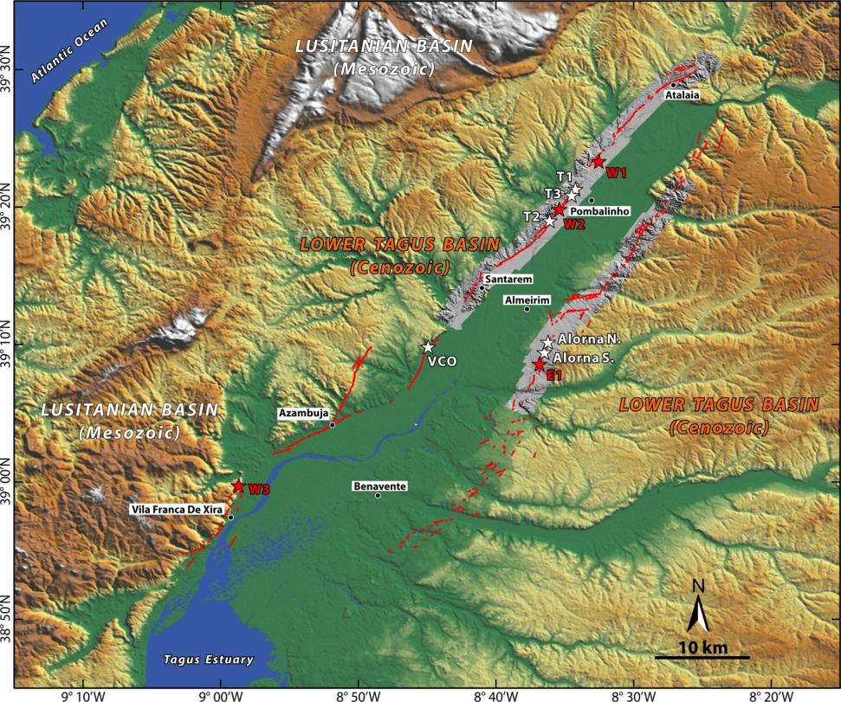
Eastern Lower Tagus Valley Fault Zone
3

Slide 4
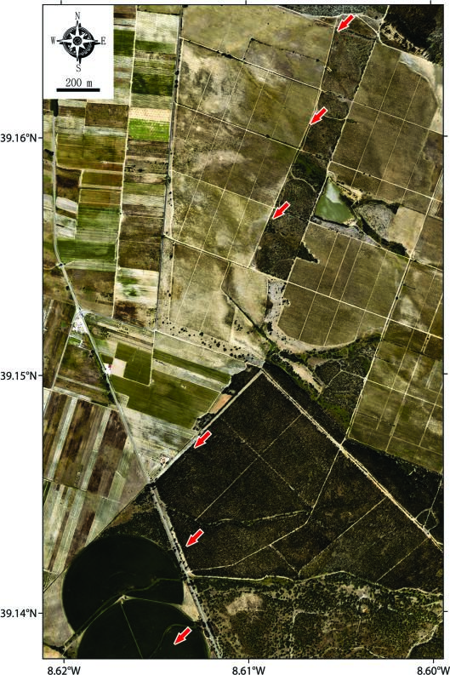
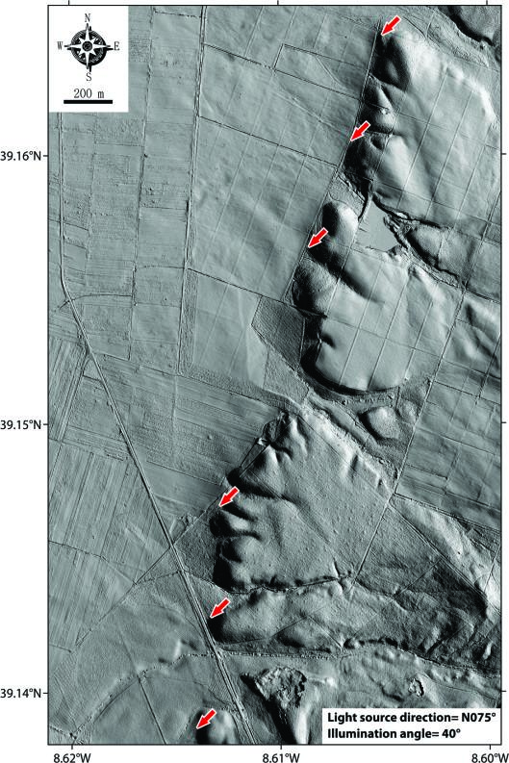
Orthophoto (Pixel Res. 10 cm) Vs. LiDAR DEM (Pixel Res. 50 cm)
4
Potential to acquire ground points through dense vegetation canopies

Slide 5
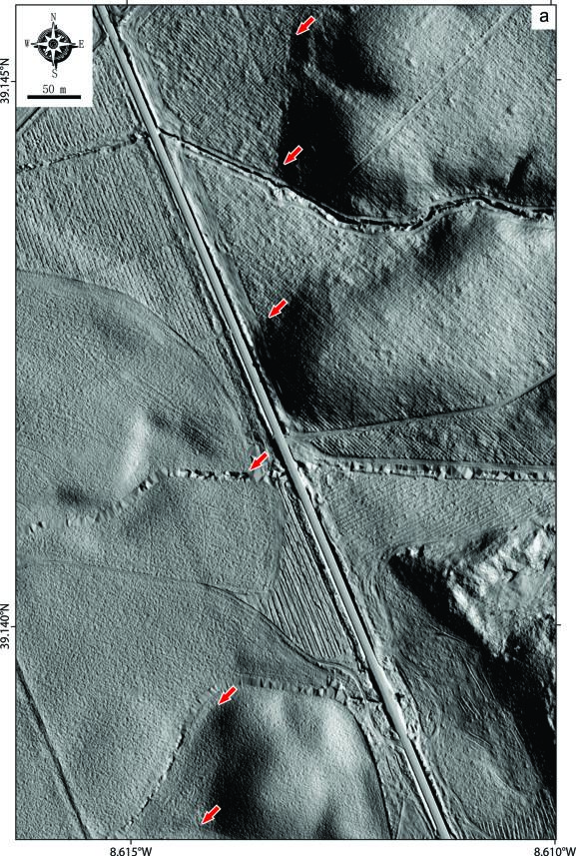
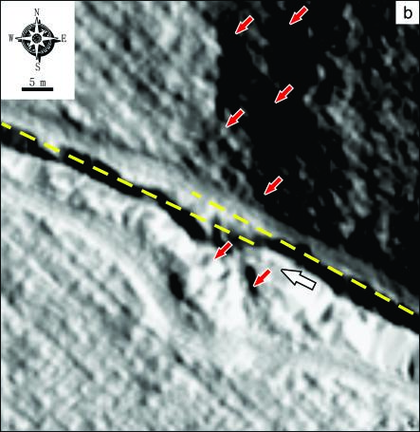
Smallest Left-Lateral Offset
5

Slide 6
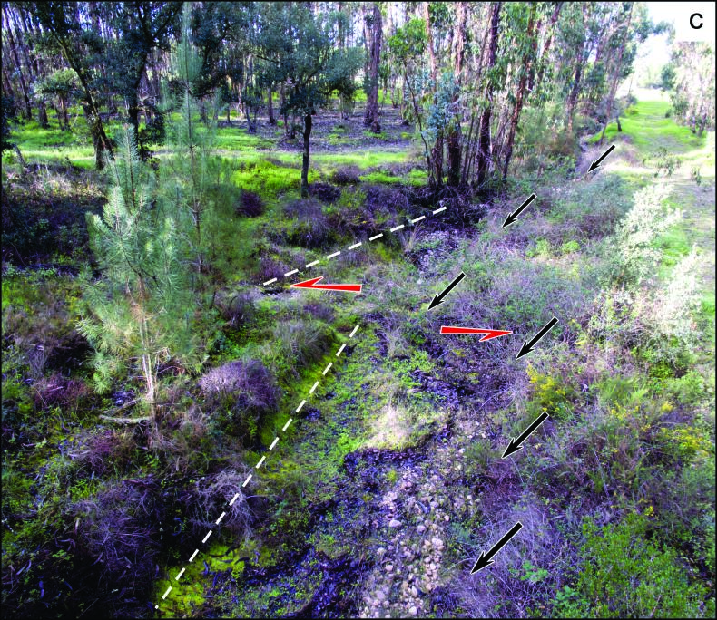
Smallest Left-Lateral Offset
6
Left-lateral offset of 2.5 ± 0.5 m

Slide 7
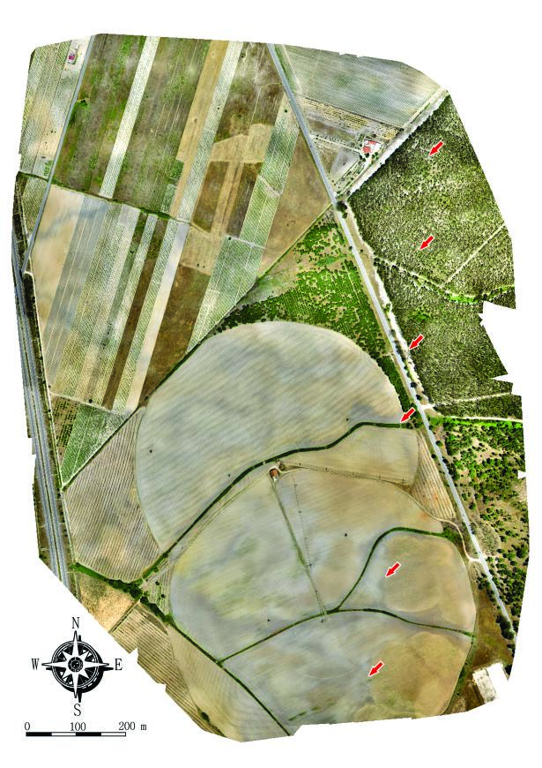
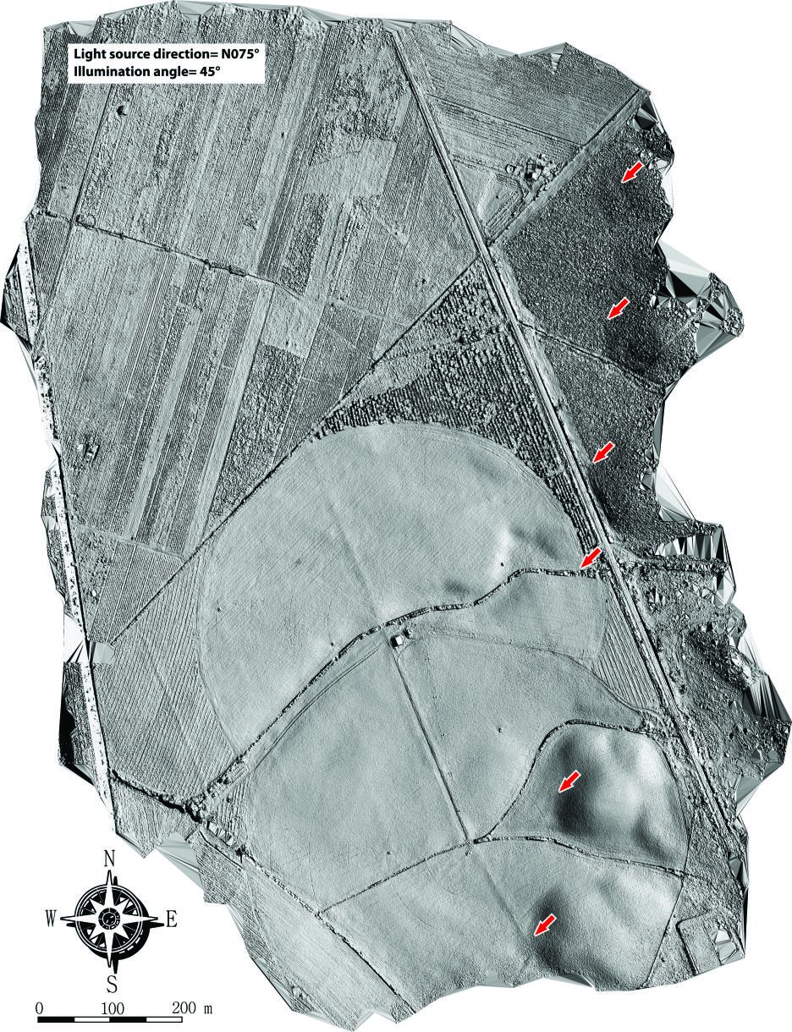
Small unoccupied aerial system
7
Orthophoto (Pix. Res. 4 cm)
Digital Surface Model (Pix. Res. 20 cm)
Light source direction = N075°
Illumination angle = 45°
Offset channel
2.5 ± 0.5 m
Offset channel
2.5 ± 0.5 m
~1.4 km² (662 images)

Slide 8
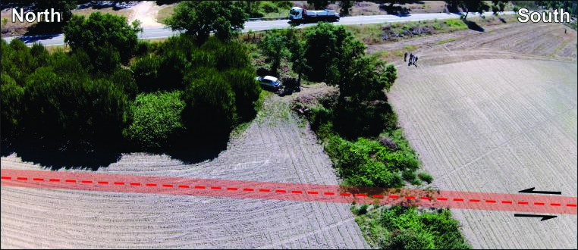
Small unoccupied aerial system
8
Light source direction = N075°
Illumination angle = 45°
~1.4 km² (662 images)

Slide 9
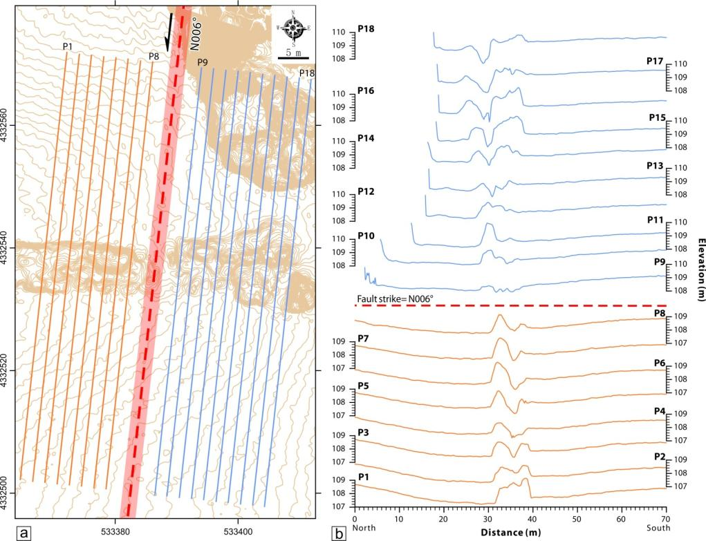

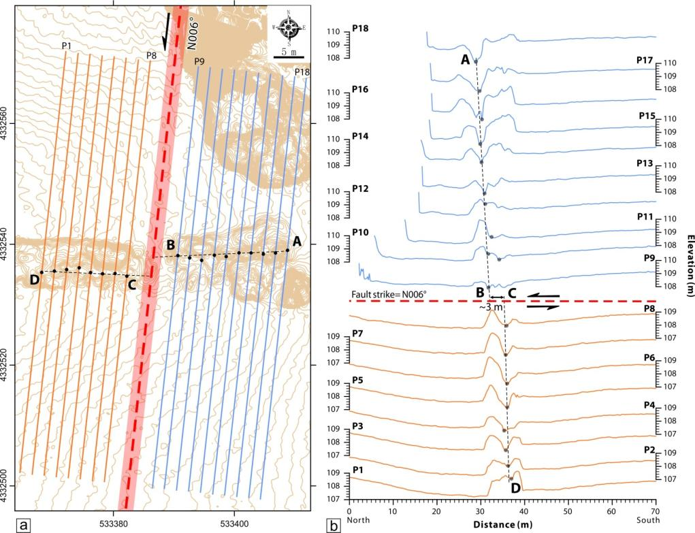
Smallest Left-Lateral Offset
9
Left-lateral offset of ~3 m

Slide 10
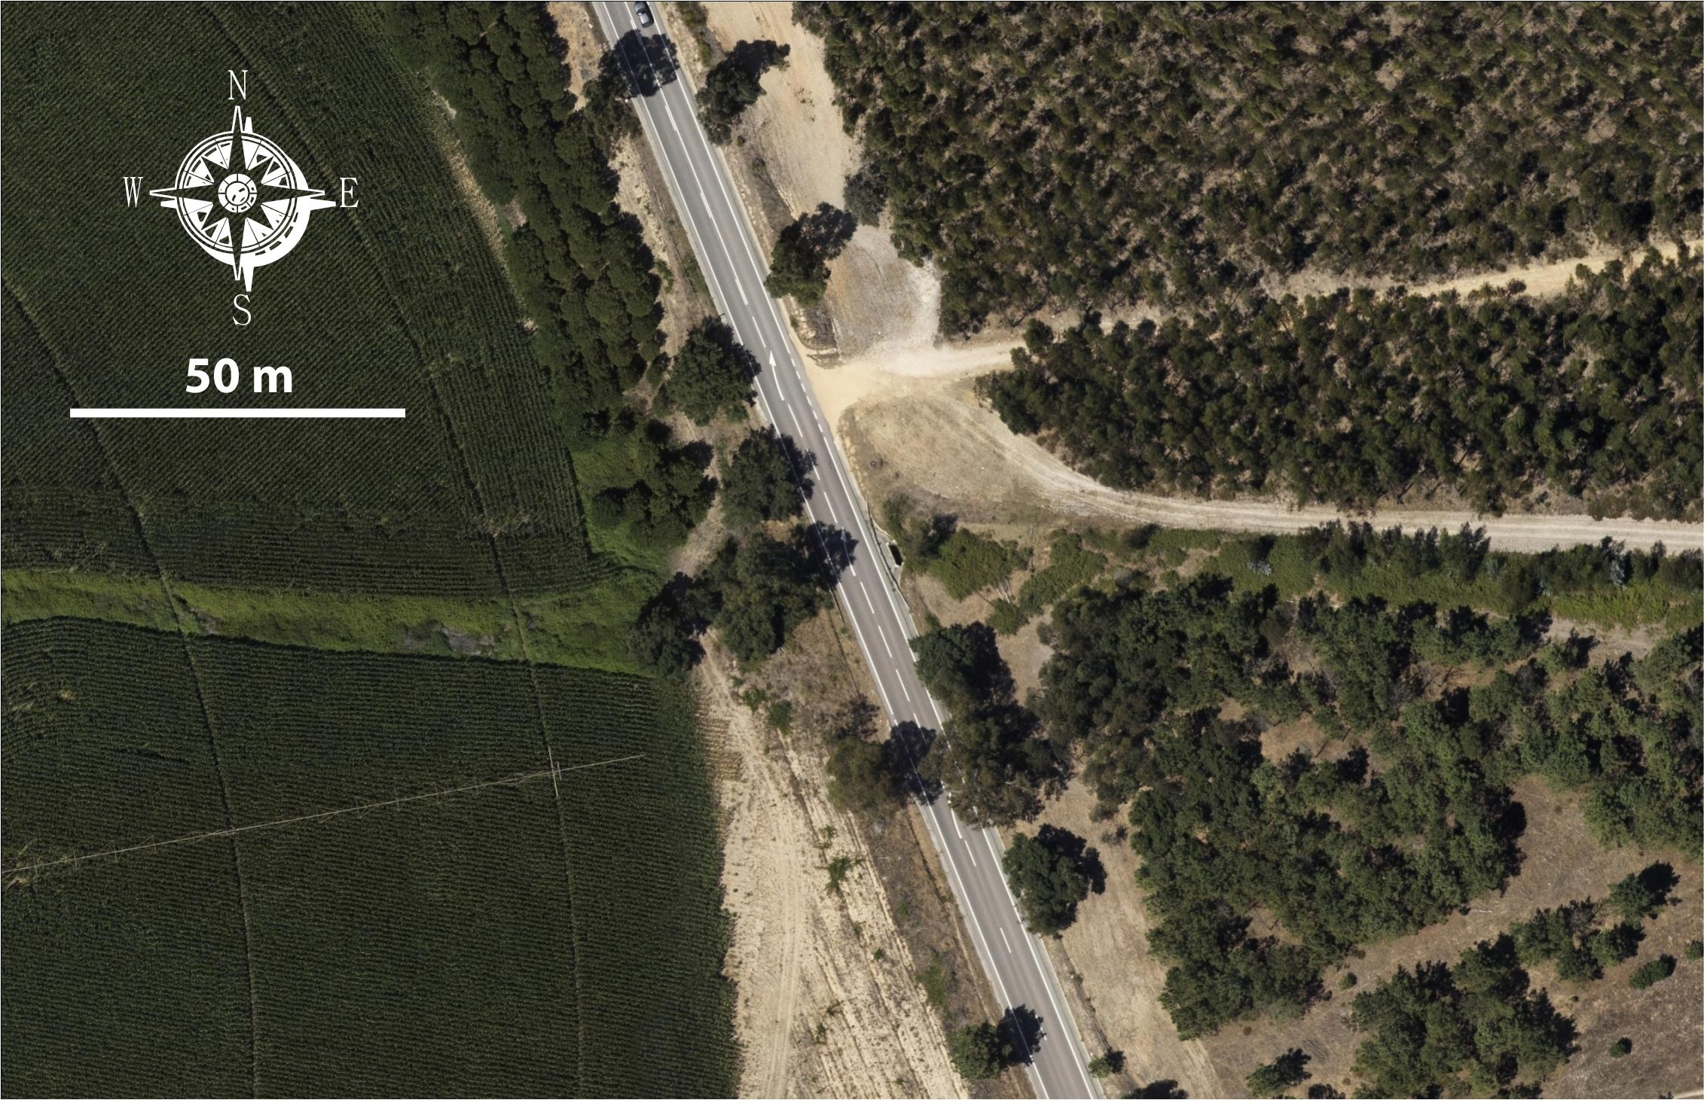
Cumulative left-lateral displacement
10

Slide 11
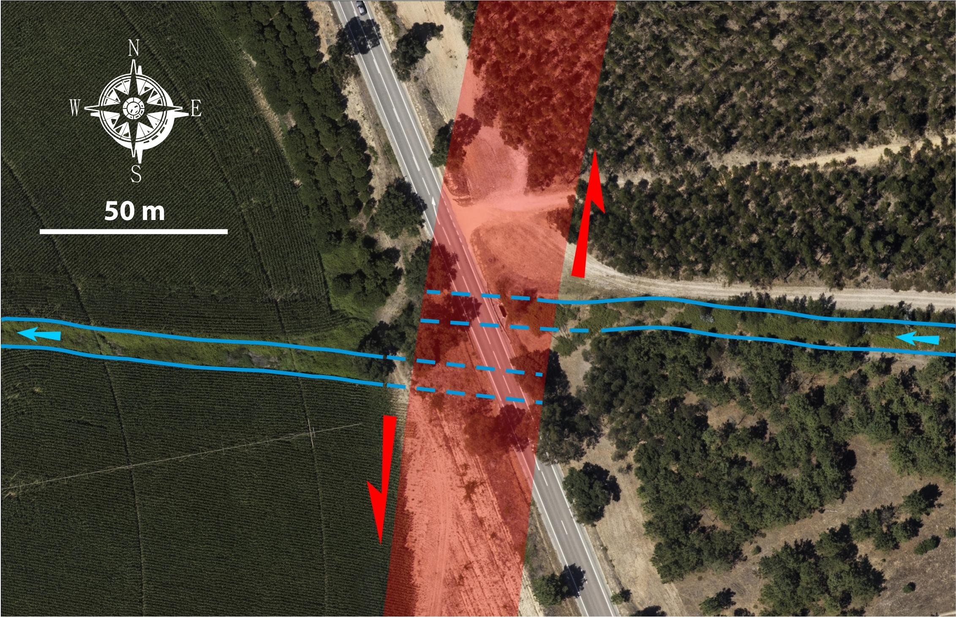
Cumulative left-lateral displacement
11
Left-lateral offset of 16.5 ± 4.5 m

Slide 12
Abandoned Alluvial Surface
12
Surface abandonment age of 41 ± 3.0 ka
Cumulative 19.0±5.0 m offset is likely to postdate the abandonment of alluvial surface (41±3.0 ka)
minimum slip rate of ~0.32 mm yr⁻¹
Capable to generate large-magnitude earthquakes with long recurrence interval

Slide 13
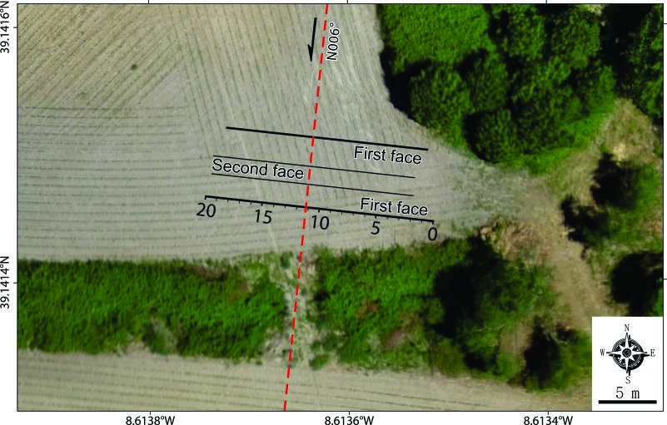
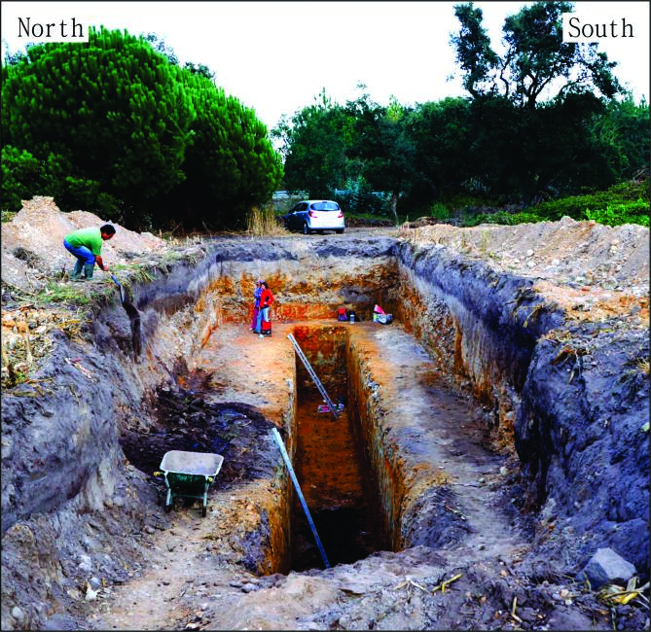
Paleoseismic investigations
13
20-m long, 6-m wide
benched trench exposes
stratigraphic strata down to a depth of ~6 m

Slide 14
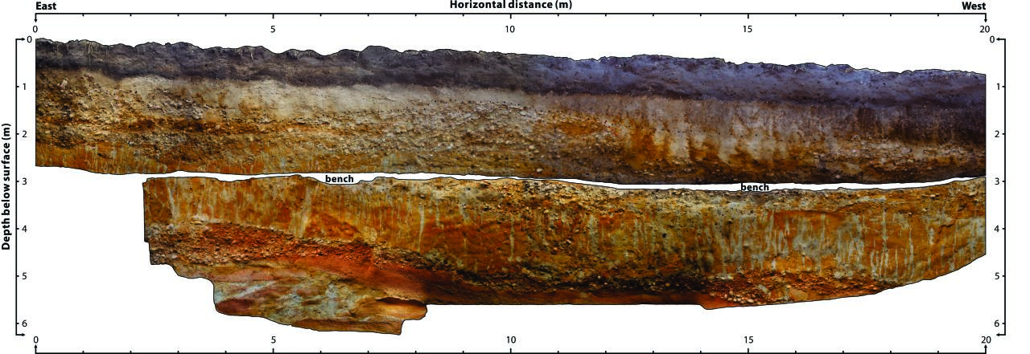

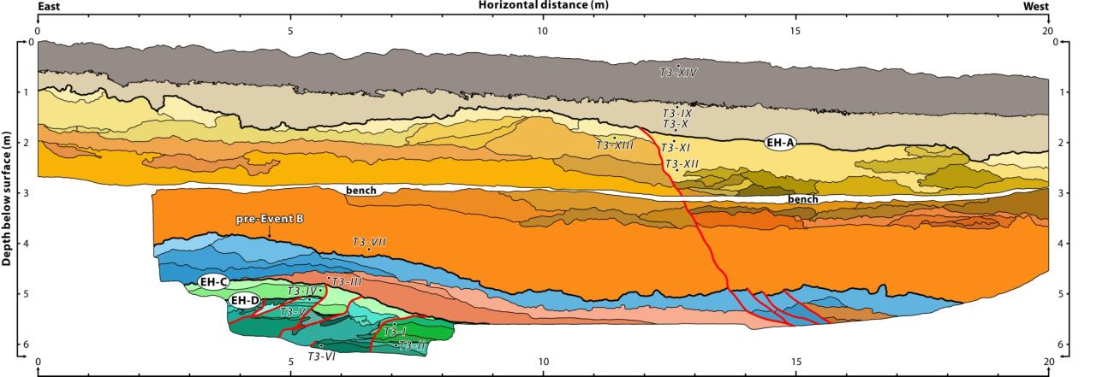
Paleoseismic investigations using IBM photomosaic technique
14
High-resolution, seamless photomosaic is created using Image-based modeling (IBM) technique incorporating 1,325 images and 89 control points

Slide 15
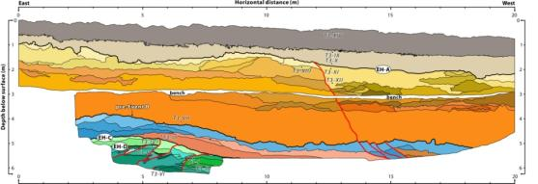
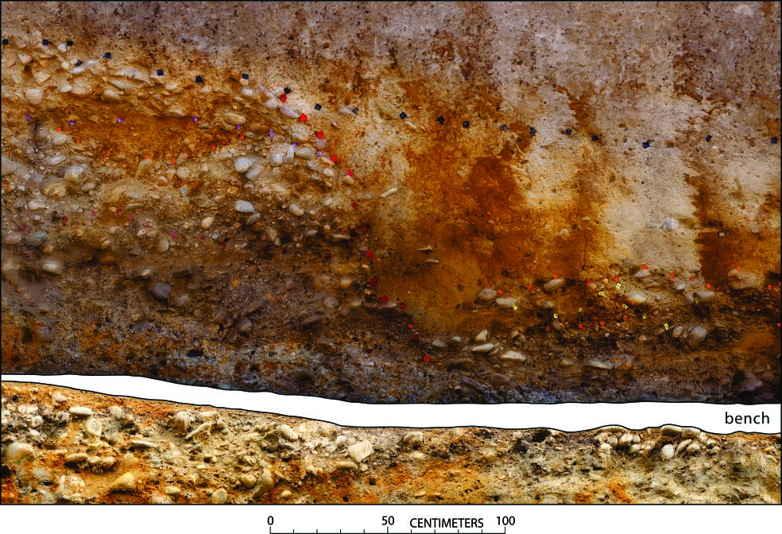
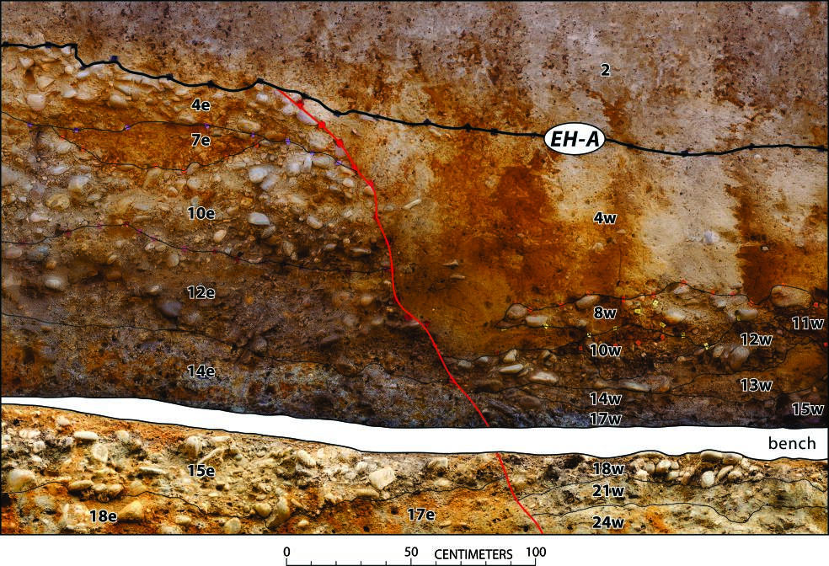
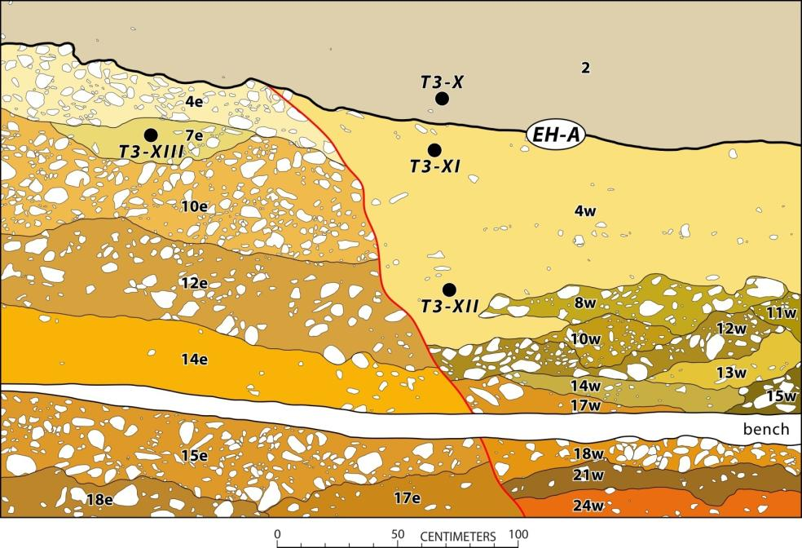
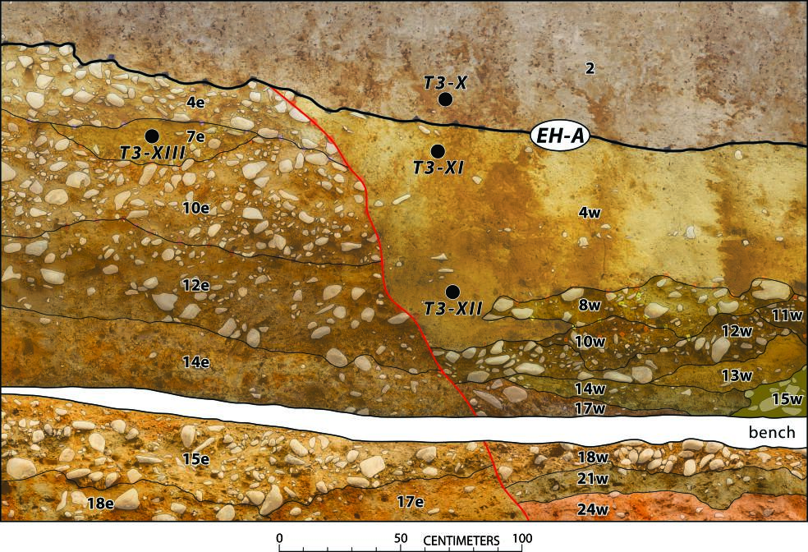
Identification of past earthquakes (Event A)
15
Ground surface at the time of
the Most Recent Earthquake
(6.45±1.45 ka)
4.8±0.2 ka
14.6±0.9 ka
7.7±0.6 ka
11.6±0.6 ka

Slide 16
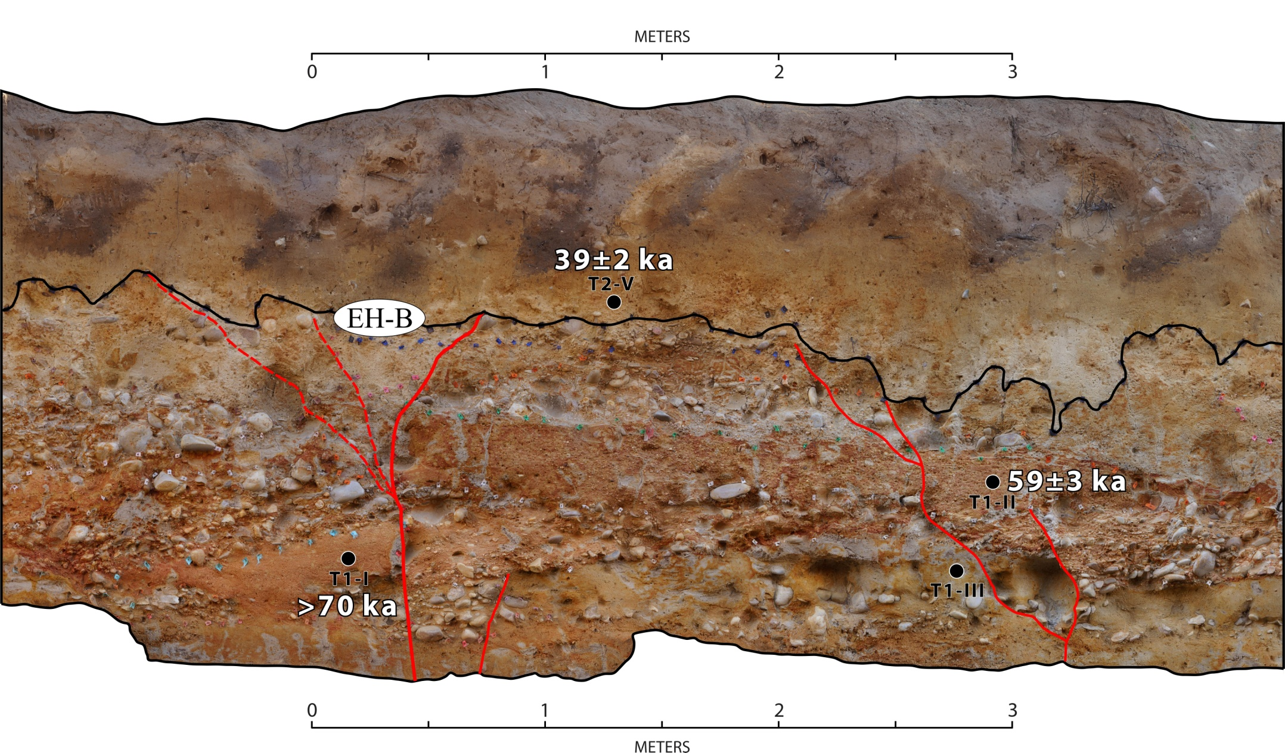
Identification of past earthquakes (Event B)
16
Surface faulting postdates the abandonment of alluvial surface (41±3.0 ka) and predates 39±2.0 ka
between 44 ka and 37 ka (40.5±3.5 ka)

Slide 17
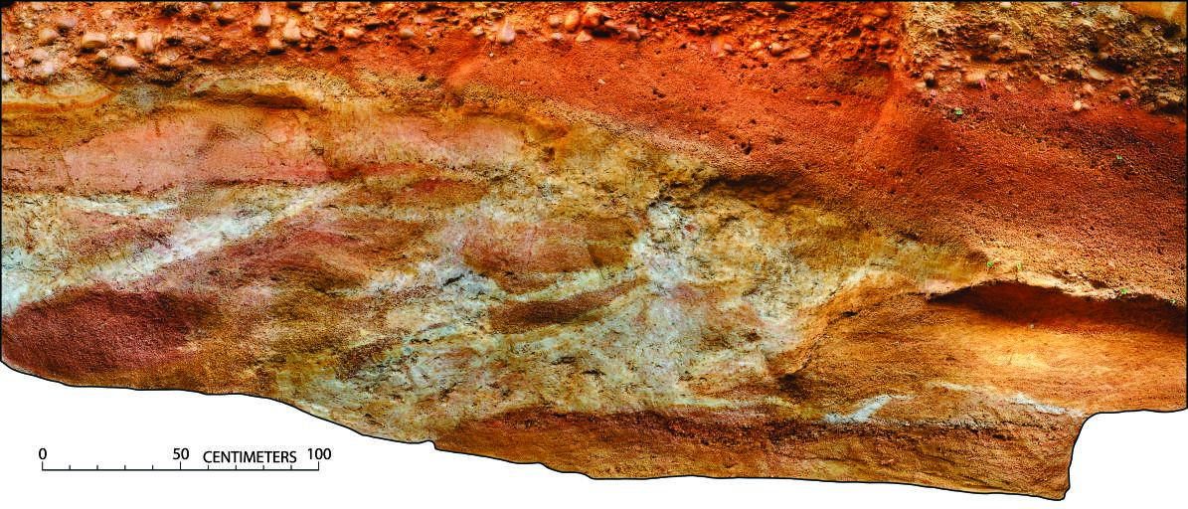
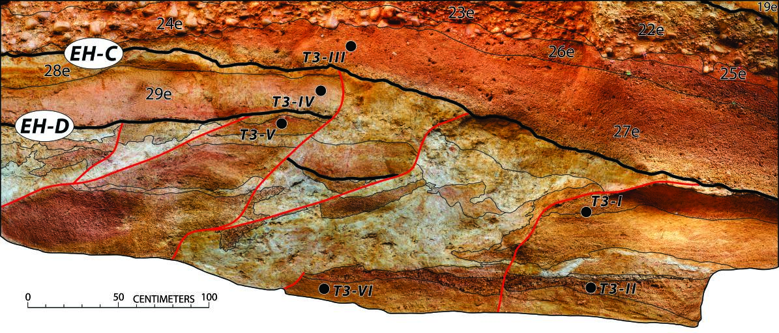
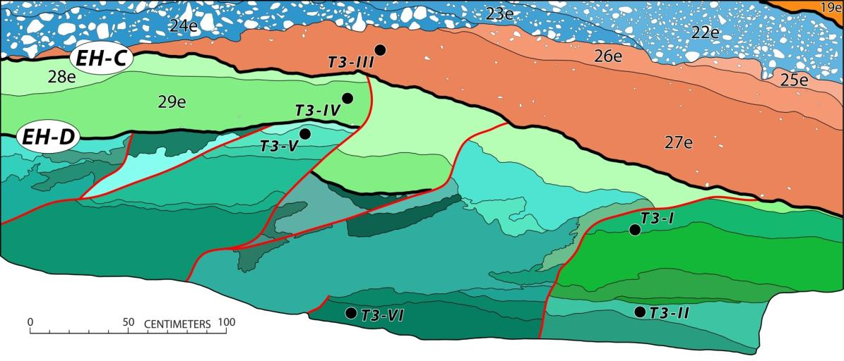
Identification of past earthquakes (Events C & D)
17
older paleoearthquakes predating MIS 4
>79 ka
>81 ka

Slide 18
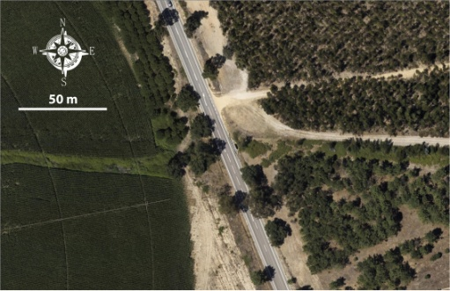
Take home messages
Minimum geologic slip rate along the Eastern LTVFZ is about
0.32 mm yr⁻¹ over the last 44 ka
The most recent sizeable earthquake occurred sometime in 6.45±1.45 ka
Eastern LTVFZ may be characterize by low slip rates and instrumentally a quiescent structure, it remains capable of generating morphogenic large-magnitude earthquakes
18

Slide 19


