Slide 1
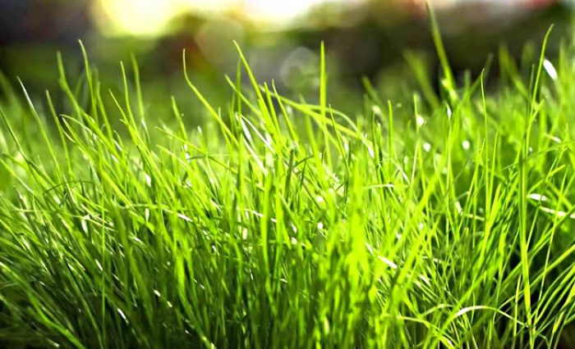





Enhancing the modelling of Gross Primary Productivity with Sentinel-2 data for the monitoring of ecosystem health.
Mario Alberto Fuentes Monjaraz, Anna Spinosa, Ghada El Serafy

Slide 2

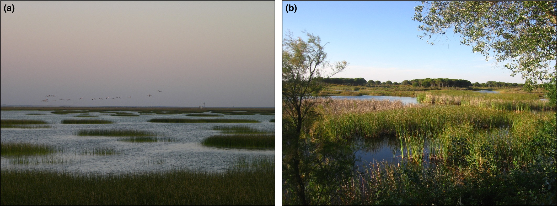
Introduction
Primary productivity
Underpins most of the ecosystem functions
Used to understand and assess the status of the ecosystems health
Essential Biodiversity Variable (EBV)
Key parameter for biodiversity assessment
Frontiers in Ecol & Environ, Volume: 15, Issue: 2, Pages: 99-107, First published: 09 February 2017, DOI: (10.1002/fee.1459)
Notes:
Gross Primary Productivity (GPP), the total amount of carbon captured by plants, and Net Primary Productivity (NPP), the GPP after accounting for the costs of autotrophic respiration.
Wetlands are highly valuable ecosystems for biodiversity and human beings. The natural wetland extension has drastically declined in the past decades thus several international agreements have emphasized the importance of monitoring and conserving practices.
Wetlands, being essential habitat for several plants, animals and ecosystem services providers, are highly valuable ecosystems for biodiversity and human beings. Wetlands not only support all water-related ecosystems and are vital in maintaining the water cycle, but also regulate the impact of natural hazard providing flood alleviation, and coastal protection during extreme weather events, playing a key role in mitigating climate changes effects. Regardless of the importance of wetlands for biodiversity and the benefits to human beings, the natural wetland extension has drastically declined in the past decades.
Given the status and trend in the wetland ecosystems degradations, several international agreements have emphasized the importance of monitoring and conserving these areas. Satellite imageries, providing information in a systematic and timely way can serve as a monitoring tool to describe the dynamics of the ecosystem in time and space, and better understand processes and drivers of ecosystem changes leading to better conservation and restoration practices.
Wetlands are vital in maintaining the water cycle, but also in regulating the impact of natural hazard, playing a key role in mitigating climate changes effects.
Primary productivity, understood as the rate at which energy is transformed into organic matter primarily through photosynthesis (GEO BON, n.d.), is a biodiversity variable that can be directly monitored through in-situ and remote sensing techniques (Pettorelli et al., 2018). In terrestrial ecosystems, primary productivity can be categorized in gross primary production (GPP) when considering the total amount of carbon captured by plants and net primary production (NPP) when considering the carbon allocated to plant tissue equal to the total amount of carbon captured minus the costs of respiration processes, also known as autotrophic respiration (Ruimy et al., 1994). In this sense, GPP and NPP represent the carbon removed from the atmosphere and the carbon fixed in vegetation available for secondary production or other trophic levels, respectively (Field et al., 1995). Primary productivity components can be used to understand and assess the capacity of the ecosystems to directly or indirectly bring benefits (e.g., food provision or barrier effect) to a range of species, including human beings, within or outside the ecosystem's boundaries. The degradation of primary productivity could be linked to the degradation of the overall function of the ecosystems.
Relevance:
Indicator of carbon sequestration (Debburman, 2021)
Indicator of health (Running et al., 2004): Use to evaluate enviromental degradation
Desertification
Impacts of pollution
Climate change
Deforestation
Essential Biodiversity Variable (GEO BON; Pereira et al. 2013)
Important to apply sustainable grazing practices

Slide 3
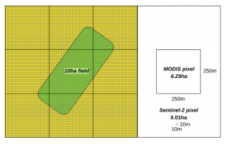
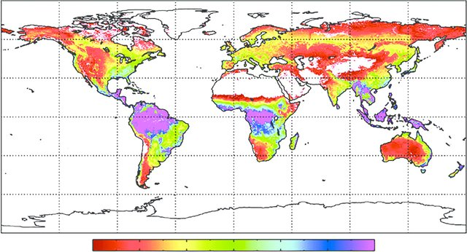
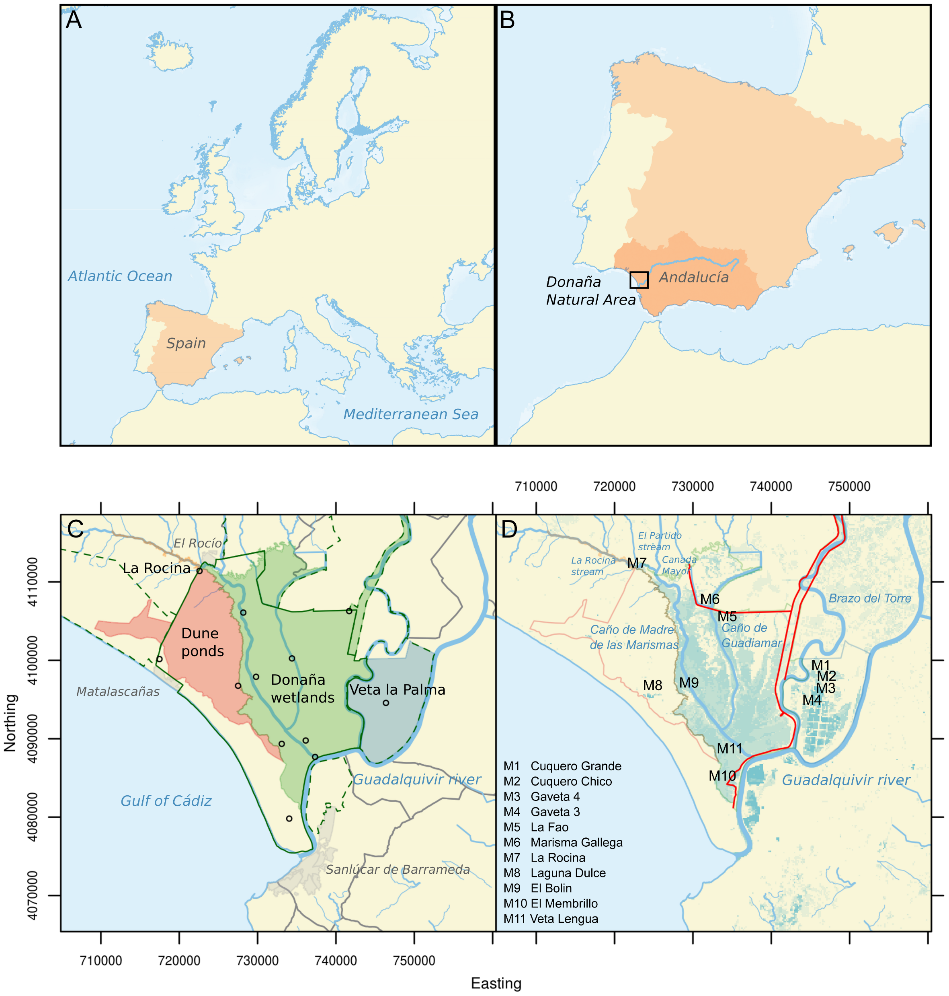
Introduction
Doñana National Park
Remote sensing allows for the monitoring of PP
MODIS pixel
250m
Limitations of MODIS products:
Coarse data (500-1000m)
Calibration
250m
Sentinel-2 pixel
10m
10m
Cervest. (2020). Remote Sensing Of Planet Eart. Part 3: Modis vs Sentinel-2.
Sentinel-2 data (10-60m)
MODIS gross primary production satellite product (MOD17)
Empirical model
Notes:
Shelters the largest wetland in Western Europe, composed of a complex environment of marshlands, phreatic lagoons, and a dune ecosystem.

Slide 4
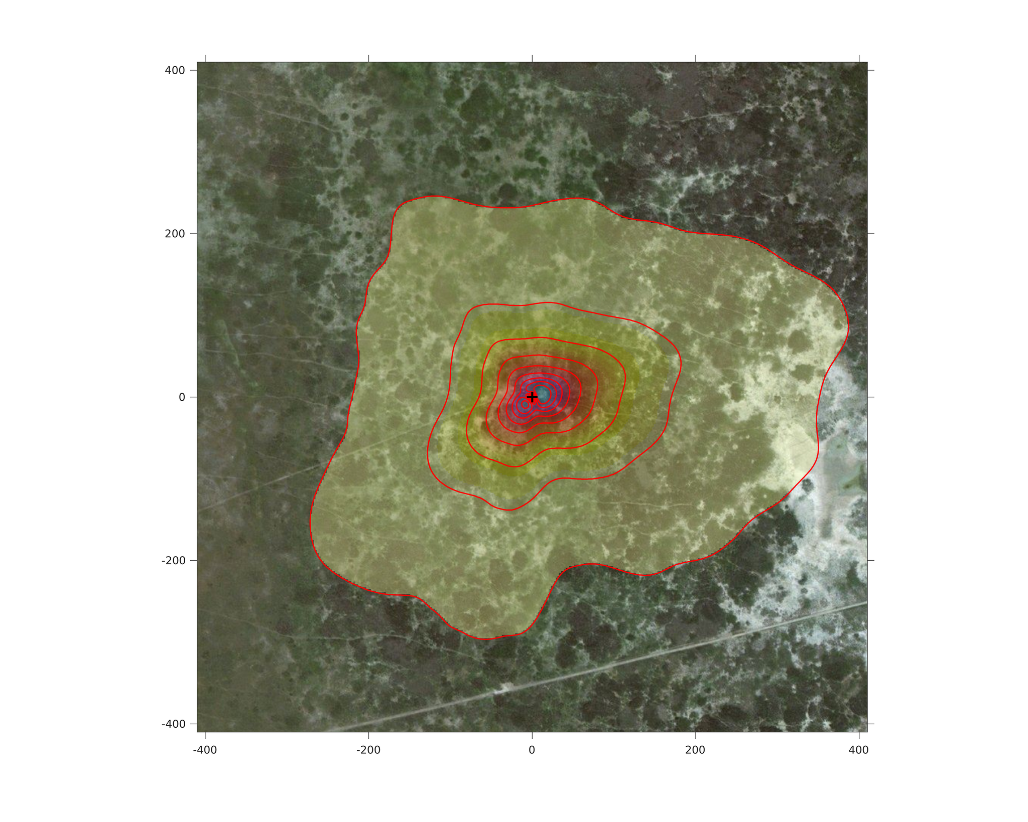
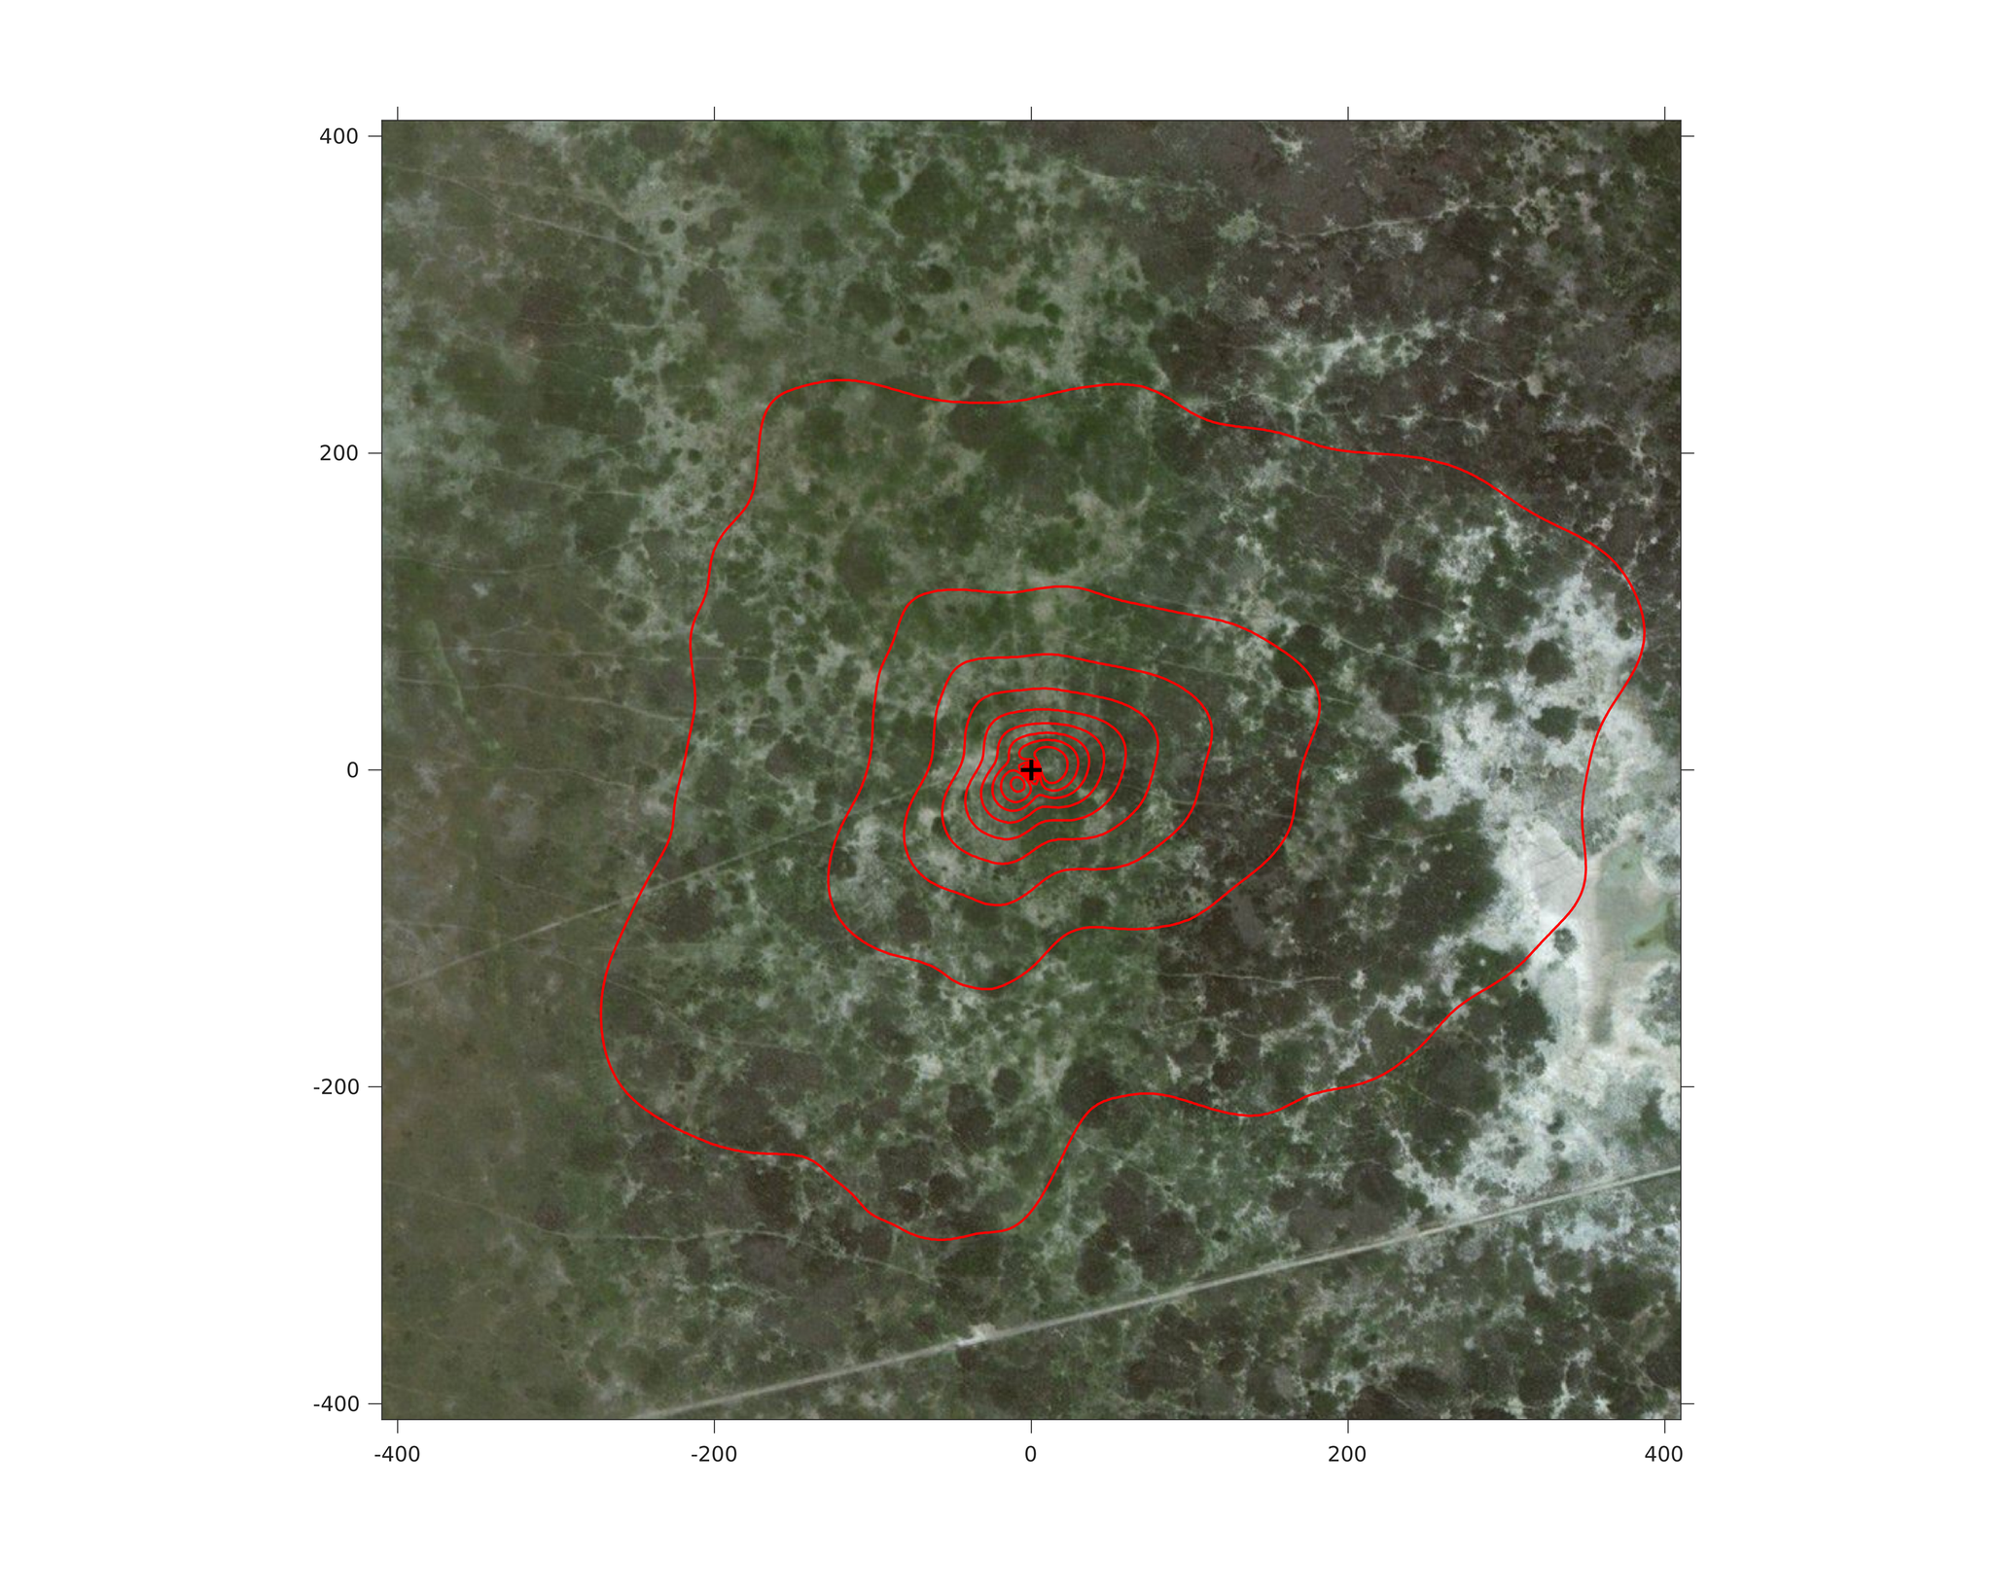
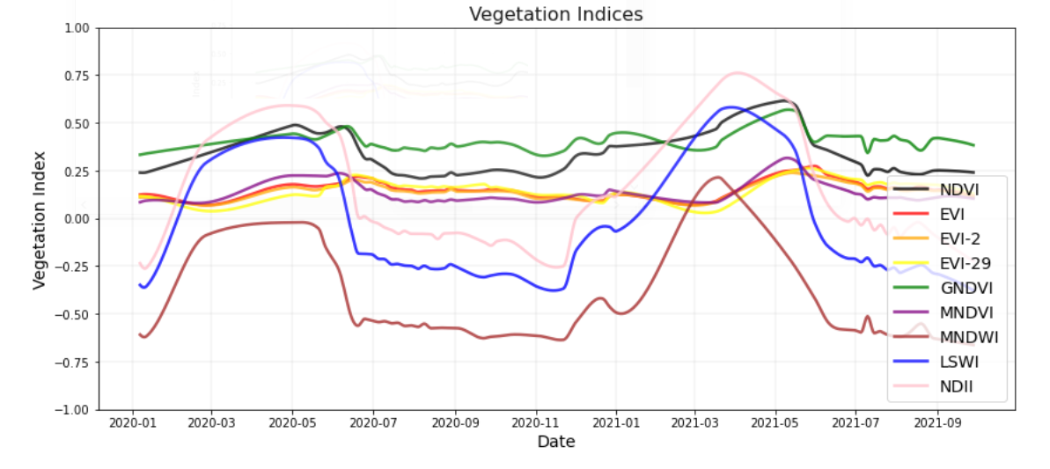
Vegetation Indices (VI)
Climatological footprint
Vegetation Index
Date
Eddy covariance tower
Notes:
Description: Processing the in-situ meteorological data to derive daily values of:
Vapour pressure deficit
Global radiation
Atmosferic temperature
Rainfall* (rolling averages with windows of 7, 15, 30, 60 and 90 days and delays of 7, 15, 30, 60, 90, 120, 150 and 180 days)

Slide 5
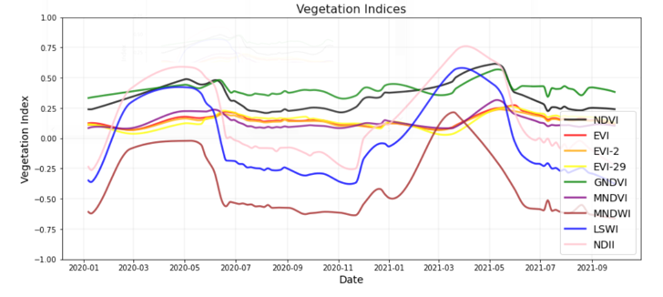
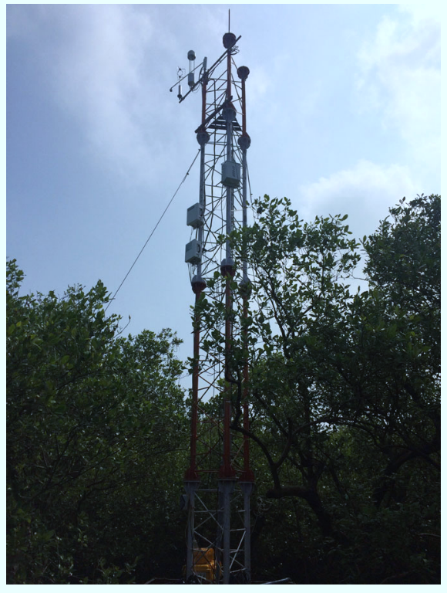

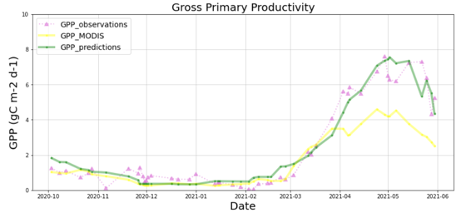
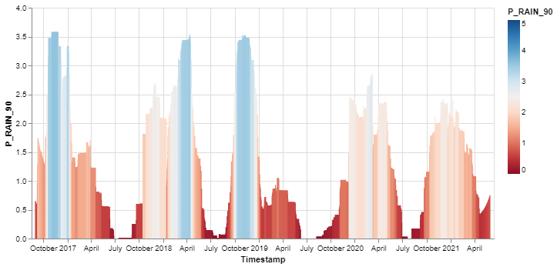
GPP
Vegetation Index
Carbon fluxes
MNDVI: modified normalized difference vegetation index (MNDVI)
Date
Gross Primary Productivity
Gross Primary Productivity
10
8
6
4
2
0
Precipitation
Precipitation
GPP (gC m-2 d-1)
Time
Time
Oct Nov Dec Jan Feb Mar Apr May Jun
Date
2020 2021
Date
Notes:
MNDVI is a normalized difference between the narrow red-edge bands with a central wavelength of 705 nm (Re1) and 783 nm (Re3) (Kordelas et al., 2018):

Slide 6
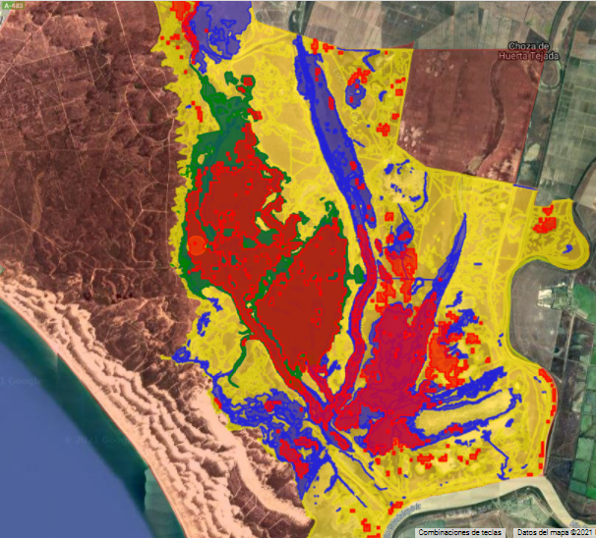
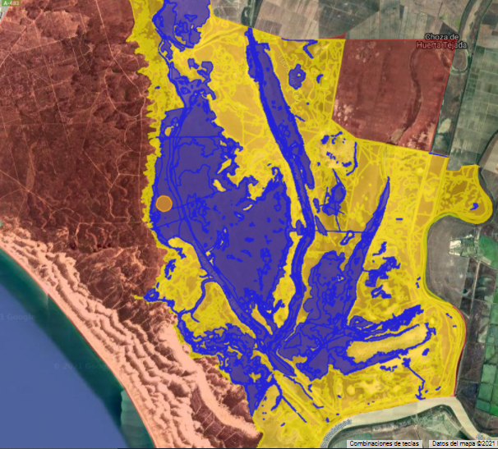
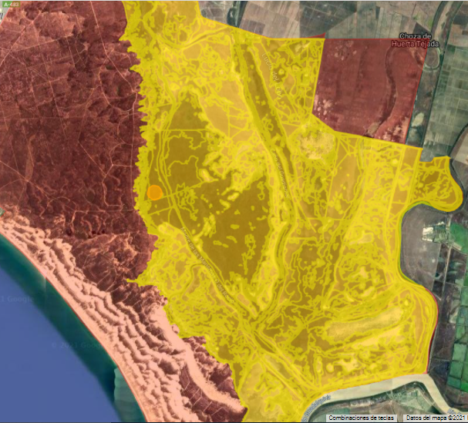
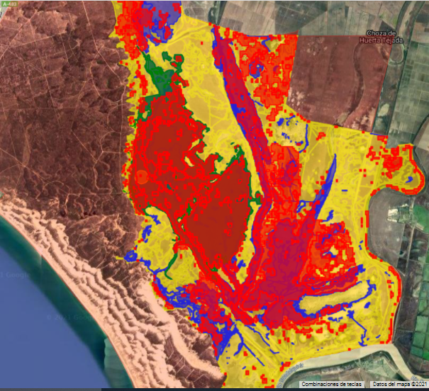
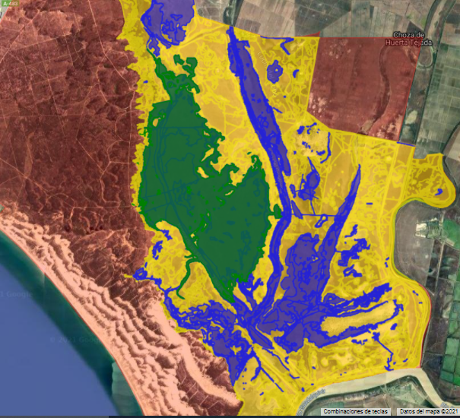
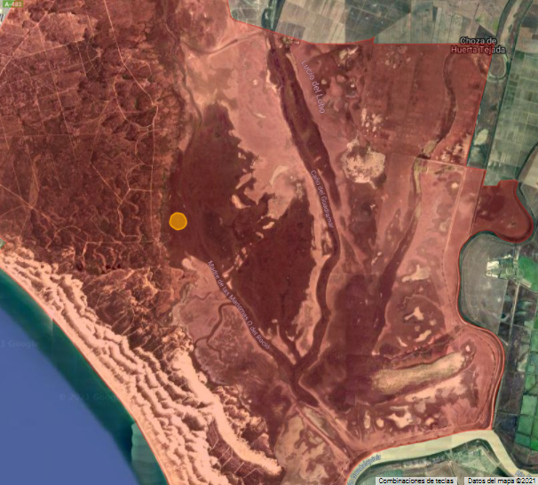
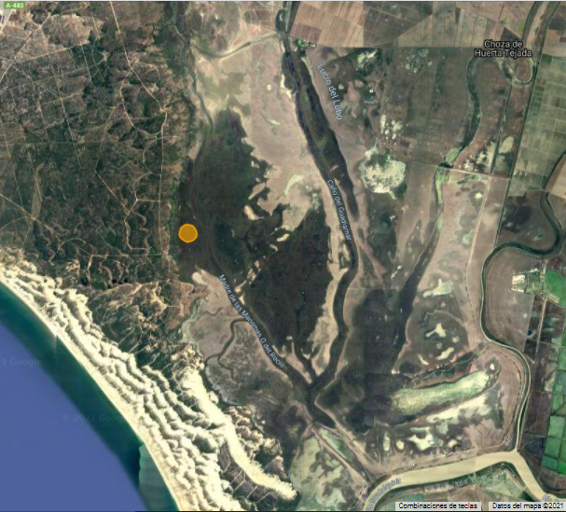

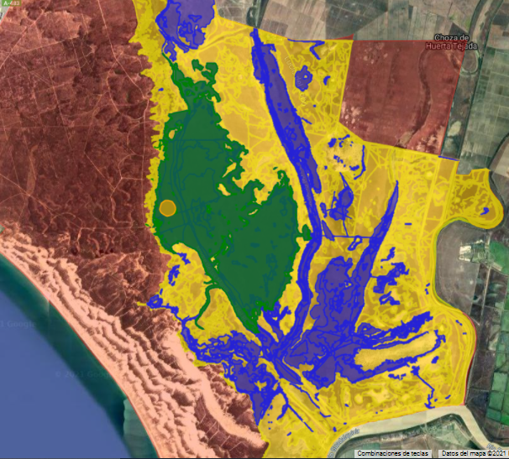
Upscaling model: Vegetation Classification Maps
Unsupervised classification (clustering) with the K-means method. This method minimizes the average squared distance between points in the same cluster
Software: Weka software implemented in ee. python package.
7 classes; 5000 training pixels and 25 variables of classification including the VI selected for the model formulation.

Slide 7
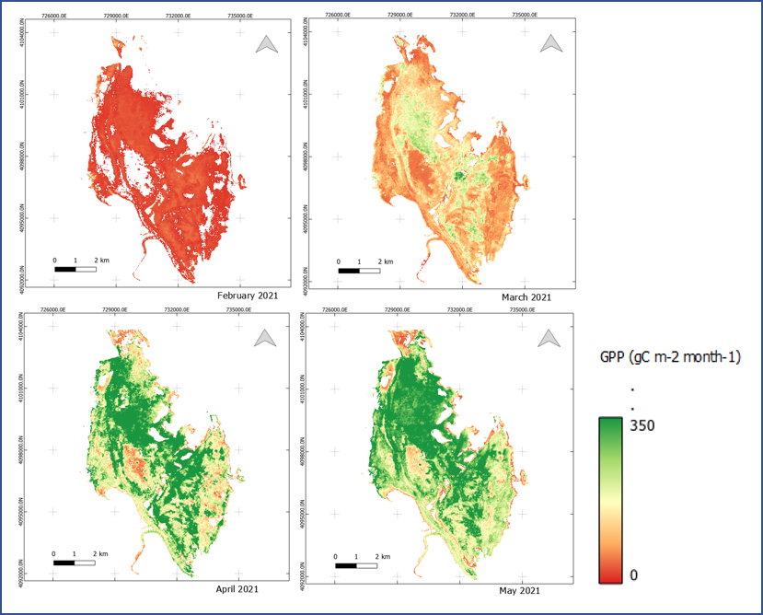
Monthly GPP Maps
Feb 2021
Mar 2021
Apr 2021
May 2021

Slide 8
Conclusions & Outlook
Continues estimations of GPP and NPP
Workflow easily reproducible and applicable to different ecosystems
Eddy covariance (European Fluxes Database Cluster) data are required to derive GPP models. Biomass estimations are required for CUE and NPP estimations.
Recalibrate the model for other ecosystems

Slide 9






Acknowledgment
For more information:
Mario Alberto Fuentes Monjaraz
Ghada El Serafy
anna.spinosa@deltares.nl
linkedin.com/AnnaSpinosa
Thanks for your attention
The work has been conducted within the framework of the e-shape project. e-shape has received funding from the European Union’s Horizon 2020 research and innovation programme under grant agreement 820852.

