Slide 1


A tale of two methods: Uncertainties in data-driven versus model-based leakage detection and localization methods in water distribution systems
Prasanna Mohan Doss*, David Bernhard Steffelbauer, Marius Møller Rokstad, and Franz Tscheikner-Gratl
Department of Civil and Environmental Engineering
Norwegian University of Science and Technology
prasanna.m.doss@ntnu.no

Slide 2
What is a Water Distribution Network (WDN)?
Introduction
Network of interconnected pipes, valves, pumps, reservoirs and tanks
Main objective: Deliver potable water to consumers 24x7reliably
Challenges: Leakages, Scheduling of network operations (monitoring & control)
Leakage detection and Localization (LDL)
Detection vs Localization vs Pinpointing
Finding that leak(s) has occured
Approximating the location
Exact position of leak (difficult for low flow leaks!)
Notes:
Be quick in this slide!

Slide 3
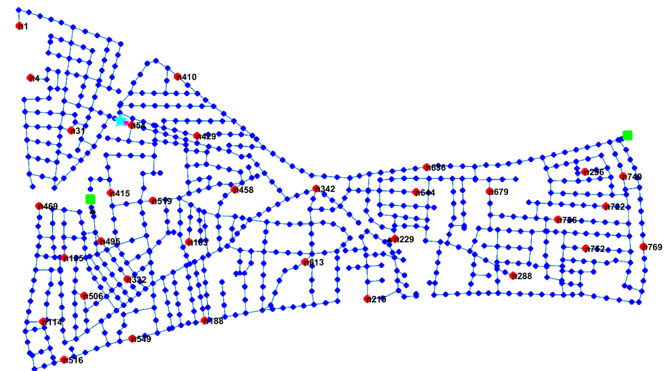
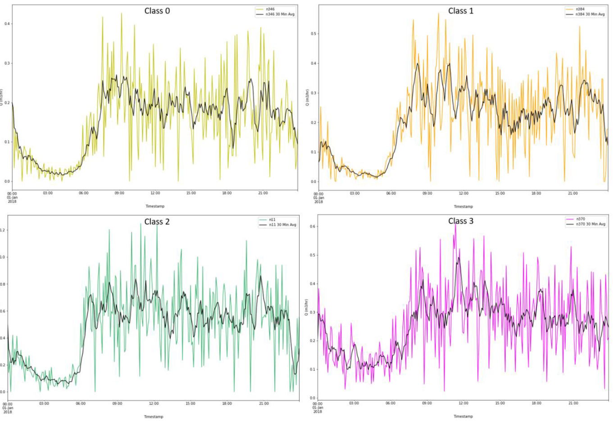
Challenges in LDL
Pipelines are burried underground
Complex interconnections
Ageing, unreliable pipe rehabilitation history data
Stochastic demands
LDL in Practice
Model-based
Steady-state models
Transient models
Mismatch between model prediction & measurements used to detect and isolate leak
Steady state or transient model
Inaccuracy in hydraulic models leads to more error
Requires more no. of intermediate flow/pressure measurements
Data-driven
Uses flow, pressure and level measurements and NO hydrualic model
ML/DL (Black box model)
Eg) SVM & Clustering
Requires labeled data for leaky and non-leak situations (majority of existing literature)
Hybrid methods
+
Data comprises combinations of both direct measurements and simulations
Surrogate models are developed using measurements
Notes:
Ageing – Scaling or corrosion, change in roughness parameter
Stochastic demands difficult to model and calibrate
LDL in practice:
1. Model based uses mismatch – inaccuracy leads to more error, needs more # m/ts
2. DD methods uses labeled data mostly superviosry approach
3. Hybrid complements these limitations of these methods

Slide 4
Timeline of LDL Reviews
2017
Data-driven burst methods
2010
2016
2019
2021
Leak management review
Pipeline fault detection review
Pressure based Methods
Survey of mathematical models for WDNs
Model vs Data-driven methods
Transient Review
Burst-Leak detection review
Internal vs External Methods
Pressure management for Leakage monitoring
Issue of Dataset collection for Burst detection
2009
2015
2017, 2018
2018
Review of steady-state leak detection strategies
Key Observations
Research trend shifted from Transient models to Steady-state to Data-driven and Hybrid models in last two decades.
Uncertainty is often overlooked even after the shift has happened towards data-driven methods.
Most of the research in model-based methods (specifically in steady-state methods) has not been implemented in real-world.
2020
Notes:
O1 – shift in trend
O2 – Uncertianty is overlooked efter after DD methods
O3 – Limited in field observations

Slide 5
Interplay between methods and associated uncertainties
Hydraulic Solver (H)
Hydraulic Solver (H)
Measurements(M)
Measurements(M)
Measurements(M)
LDL
LDL
Model-based methods
M
Calibration
Calibration
Model-based (eg., FSM)
d, L, D
Data-driven (SVM / VAE with acoustics)
Xi
H
C
LDL
Hybrid (eg., K-means with montecarlo & SVM)
Model Structural Uncertainty
Degree of skeletonization
Tank models
N/w topology
Headloss relationship
Model I/p Uncertainty
Stochastic demands
Pipe diameters, tank diameter and others
3. Parameter Uncertainty
Pipe roughness
Minor loss coeffs
Pump parameters
Uncertainty in Calibration data
Uncertainty in Calibration methods
Model-based
Data-driven
Hybrid-models
1. Is calibration data sufficient? (Qualitative and Quantitative)
2. Algorithmic (Effect of initial values, obj fns, constraints)
Xi, M → Input Uncertainty
H, C, L → Model Uncertatinty
Notes:
P1 – 4 blocks and interplays
P2 – quick description of uncertainty in blocks

Slide 6
Calibration process – Hydraulic model & Demand Calibration
Optimisation techniques (LS problem, search bounds, gradient-based, GA) all aim to reduce parameter uncertainty without quantifying them.
They are in essence, a multi-objective optmisation problem aimed to find a pareto optimal without considering the dependency of measurement errors and their underlying distributions.
FOSM based methods assumes weak-linearity of models, which in practical is not the case.
Uncertainty propagation from different sources (model, inputs, and choice of optimization) is missing.
Other influencing factors
State estimation and observalibity plays a critical role in reducing uncertainty
Optimal sensor placement problem considering state unceratinty results in equifinality (Steffelbauer and Fuchs-Hanusch 2016)
Many optimisation methods perform equally better – No free lunch theorem!
The fitness landscape is dependent on leakage scenarios and number of sensors
Notes:
P1 – no quantification, dependency of measurement error is not usually considered, propagation is missing
P2 – State estimation and observability plays a critical role – uncertainty leads to equifinalty
P3 – No free lunch, fitness depends on leak scenarios

Slide 7
Understanding uncertainties in data-driven methods
Measurement
Leak detection and localization using ML/DL
Black-box model
Model-based methods is inhibited by unrealistic assumptions. Data-driven method on other hand needs more measurements
Most data-driven methods are limited to leak or burst detection rather than localization
Missing data, noisy data and sensor cost vs observability are main factors in data-driven methods
Data imputation (e.g., MLPCA multivariate methods, kriging interpolation) and probabilistic methods (e.g., Bayesian analysis, parametric estimation of underlying distribution) provide some improvements.
Generative models incorporating probabilistic framework (e.g., GANs, VAE) provide incremental advantage

Slide 8
Hybrid methods
Xc
Measurement
Validation & Testing
Hydraulic Solver
Leak detection and localization
Xi
d, L, D
These methods combine data and models (hydraulic and/or models from data) For eg., Time series models used in combination with steady-state models
They complement each other in the combined approach to reduce LDL uncertainty
Graph based interpolation in combination with model-based method (Romero et al., 2022) and Pressure-leak duality analysis (Steffelbauer et al., 2021) are some interesting examples
The methods however are still reliant on sensor placement and model accuracy
Notes:
P1 – complement each other (model based in high concertrated demand meter zone and data-driven in pressure measured zones)
P2 – However these methods are still reliant on model accuracy and data accuracy

Slide 9
Summary
LDL methods saw a shift in research trends with combination of different algorithms in last decade
Uncertainty quantification and propagation through different blocks, especially for localization process is missing
Model-based methods require accurate models which impacts real-world applications
Generalizability is difficult in data-driven methods and suffer from supervisory approach and high FP rates
There is still a long way to go for hydraulically decoupled data-driven methods to achieve accurate leak localization
Sensorization and hybrid methods in combination with statistical analysis will provide possible improvements in near future
Notes:
P1 – shift, propagation is missing
P2 – Model based (accuracy), data-driven (supervisory and high FP)
P3 – long way to decoupling and hybrid methods with statistical analysis for improvements

Slide 10
Thank you! If you have any questions, you can reach me at prasanna.m.doss@ntnu.no

