Slide 1




Enhancing the modeling of dissolved oxygen concentration using machine learning. A case study in the Greek Mediterranean Sea.
Anna Spinosa^{1,2}, Ghada El Serafy^{1,2}
¹ Stitching Deltares, Boussinesqweg 1, 2629 HV Delft, The Netherlands
² Delft Institute of Applied Mathematics, Delft University of Technology, Mekelweg 5, 2628 CD Delft, The Netherlands

Slide 2
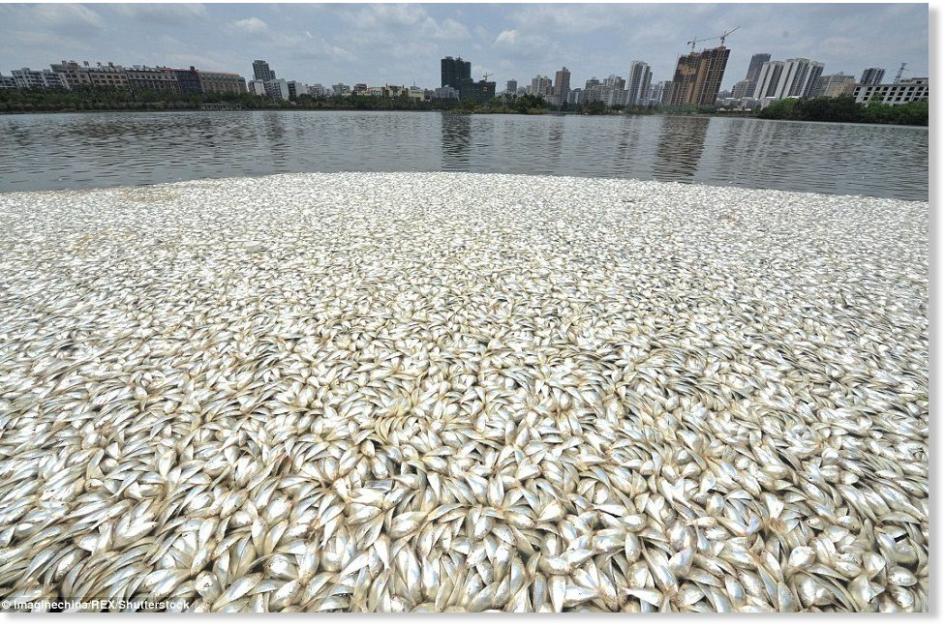

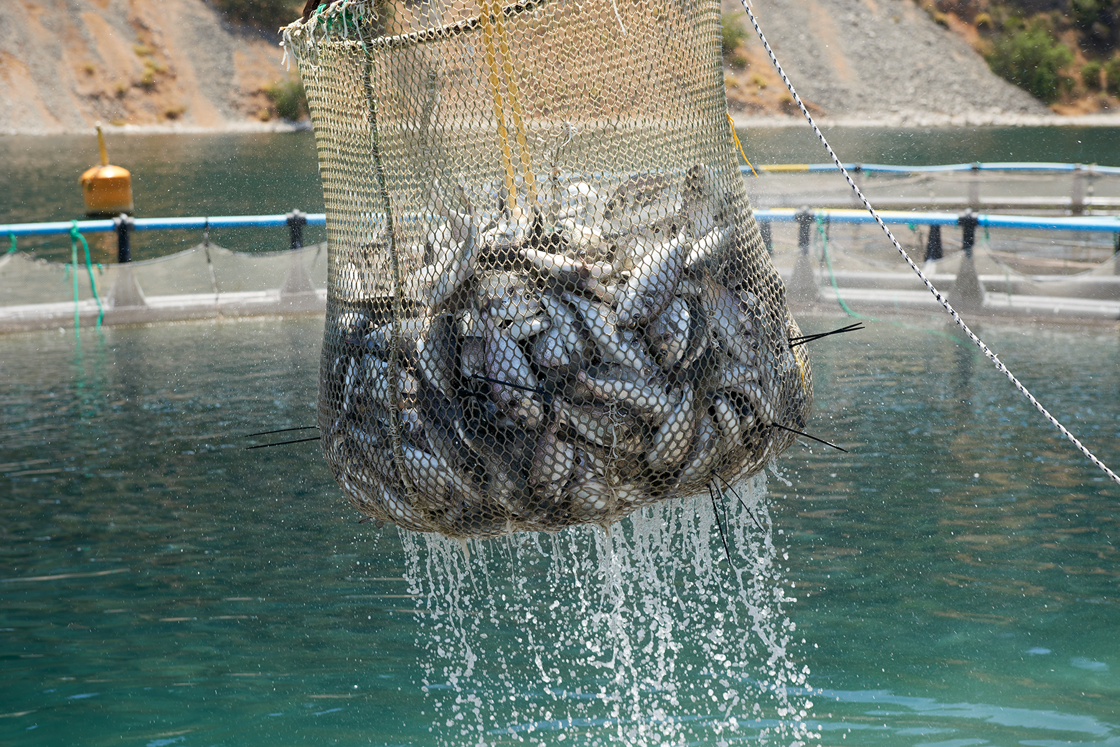
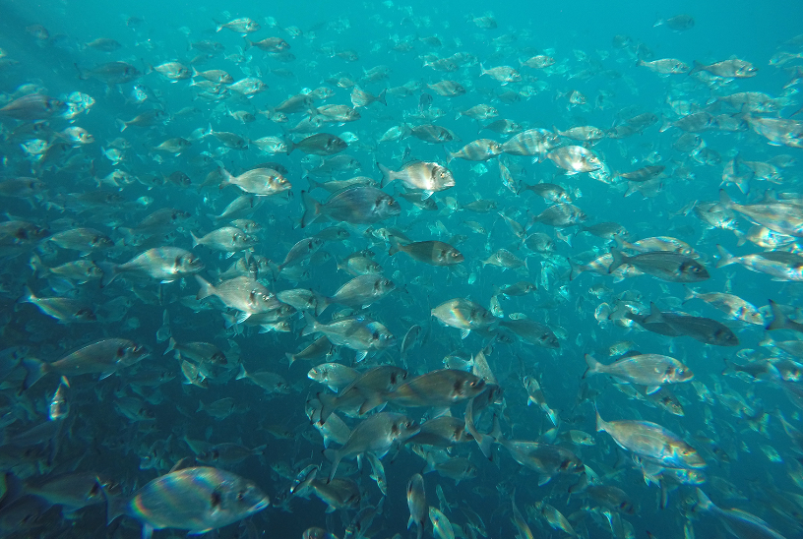

The Dissolved Oxygen
Essential to the health of the environment and life species
Forecast DO levels for the sustainability of the aquaculture activity
Key element of water quality
Affects fish health, robustness, growth rate and feeding
Lethal level over a matter of hours
Notes:
DO concentration is of extreme importance for the health of the envinroment and key ingredient of water quality.
Among others, DO concentration is an environmental variable of concern for the aquaculture industry since DO levels affect the fish health, robustness, growth rate and feeding in aquaculture cages. Over a matter of hours, DO levels can change from optimum to lethal levels, therefore is of extreme importance for the aquaculture industry to have a forecasting system in place. Still squaculture industry mainly rely on in situ measurements.
In this research we attempt at modelling the hourly variation of DO concentration looking at his correlation with currents and temperature.

Slide 3
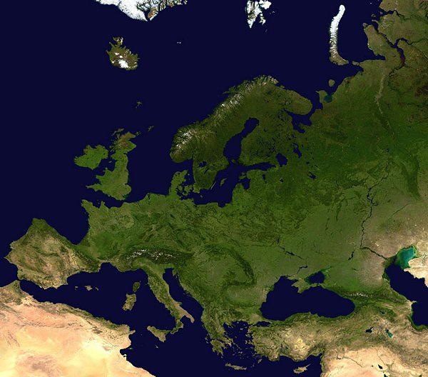
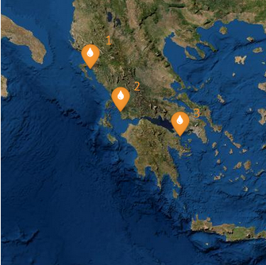
Data driven model
Station | Time Span | Temporal resolution
Thesprotia (1) | 28 Jul - 25 Oct 2019 | 2÷10’
Astakos (2) | 11 Jul – 08 Oct 2019 | 2÷10’
Ovrios (3) | 20 Jul – 23 Oct 2019 | 2÷10’
DO(t) ∼ SWT(t) + u(t) + v(t)
Measured at 7 m depth below the sea water surface
Resampled every 5 minutes -> ~26000 entries
Notes:
DO ranges between 5.5 and 7.3 mg/L
T ranges between 22°C and 28°C
Currents 15 cm/s

Slide 4
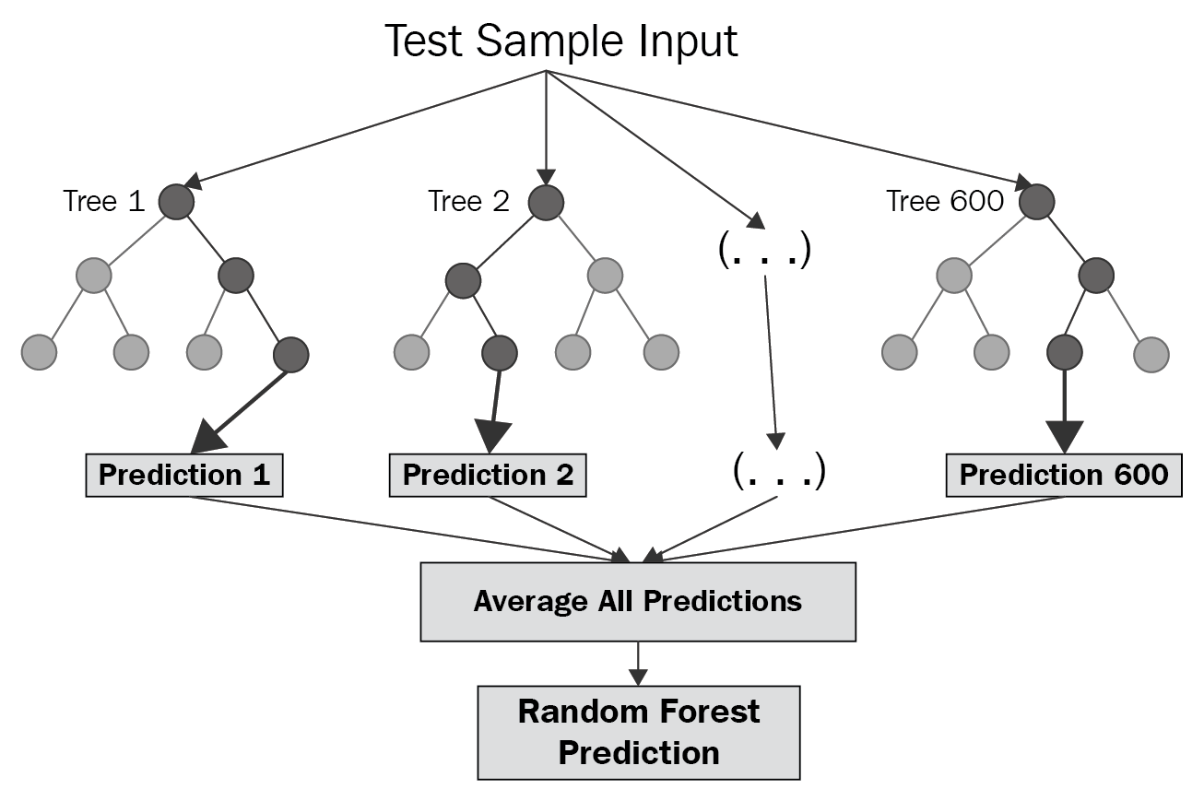
Methods
Random Forest (RF)
Ensemble learning method
Creates multiple decision trees implemented on a subset of the featured space
Returns the average prediction of each individual trees
Contributes in increasing the confidence interval and the choice of the model.
Notes:
We decided to explore the RF and GRNN performances. RF is an ensemble learning method composed of a large number of simple decision trees implemented to random subsets of the feature space. For regression tasks, the average prediction of the individual trees is returned.
The random forest being an ensemble method is usually favored over single models when a limited target is available since by sub-setting and averaging the different predictions, it contributes in increasing the confidence interval and the choice of the model.

Slide 5
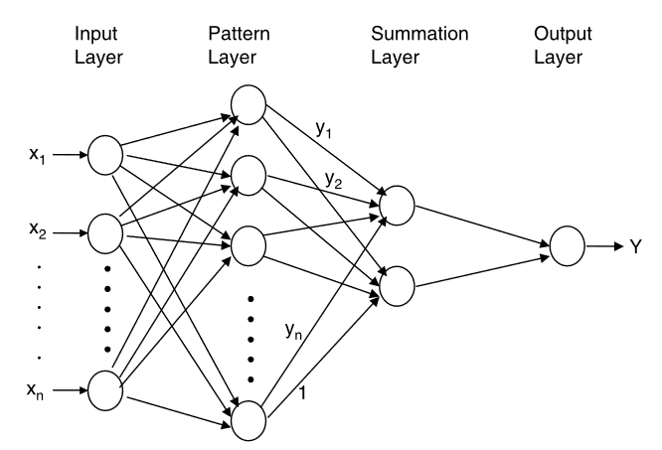


Methods
Generalized Regression Neural Network (GRNN)
Radial basis neural networks based on a single-pass learning
Notes:
The GRNN is a radial basis neural networks based on a single-pass learning so no backpropagation is required, and the target variable is estimated as a nonlinear weighted average of all the training target values yi given the training explanatory variables xi .
Each observed value yi is weighted exponentially according to its Euclidean distance (Di) from xi

Slide 6
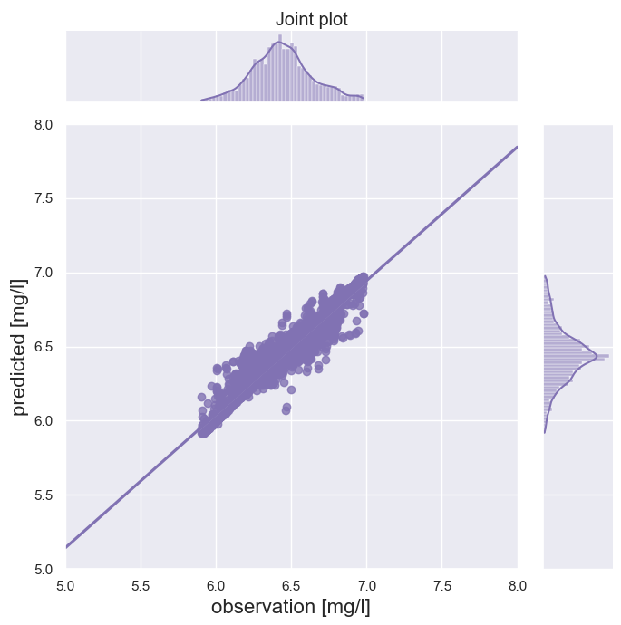
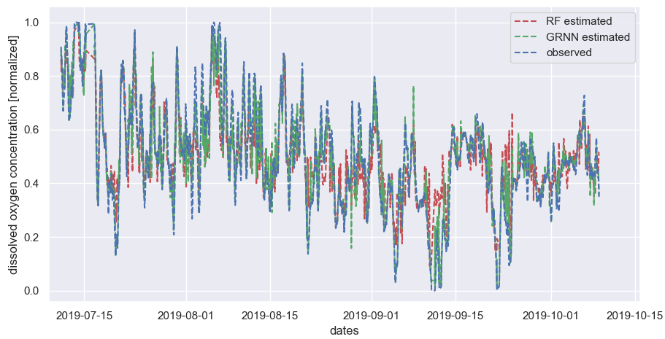
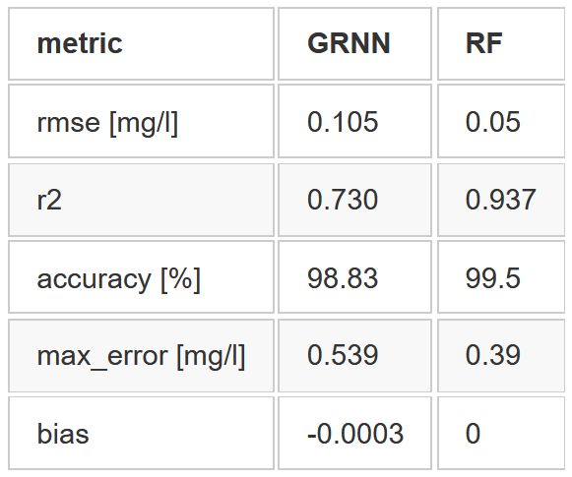
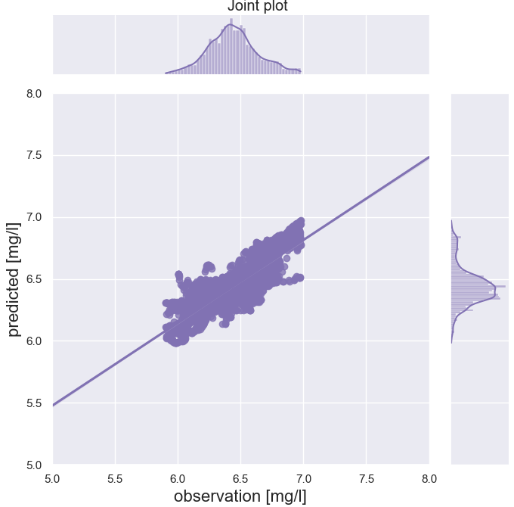
Results
RF
Astakos (2)
R2 = 0.94
GRNN
R2 = 0.73

Slide 7
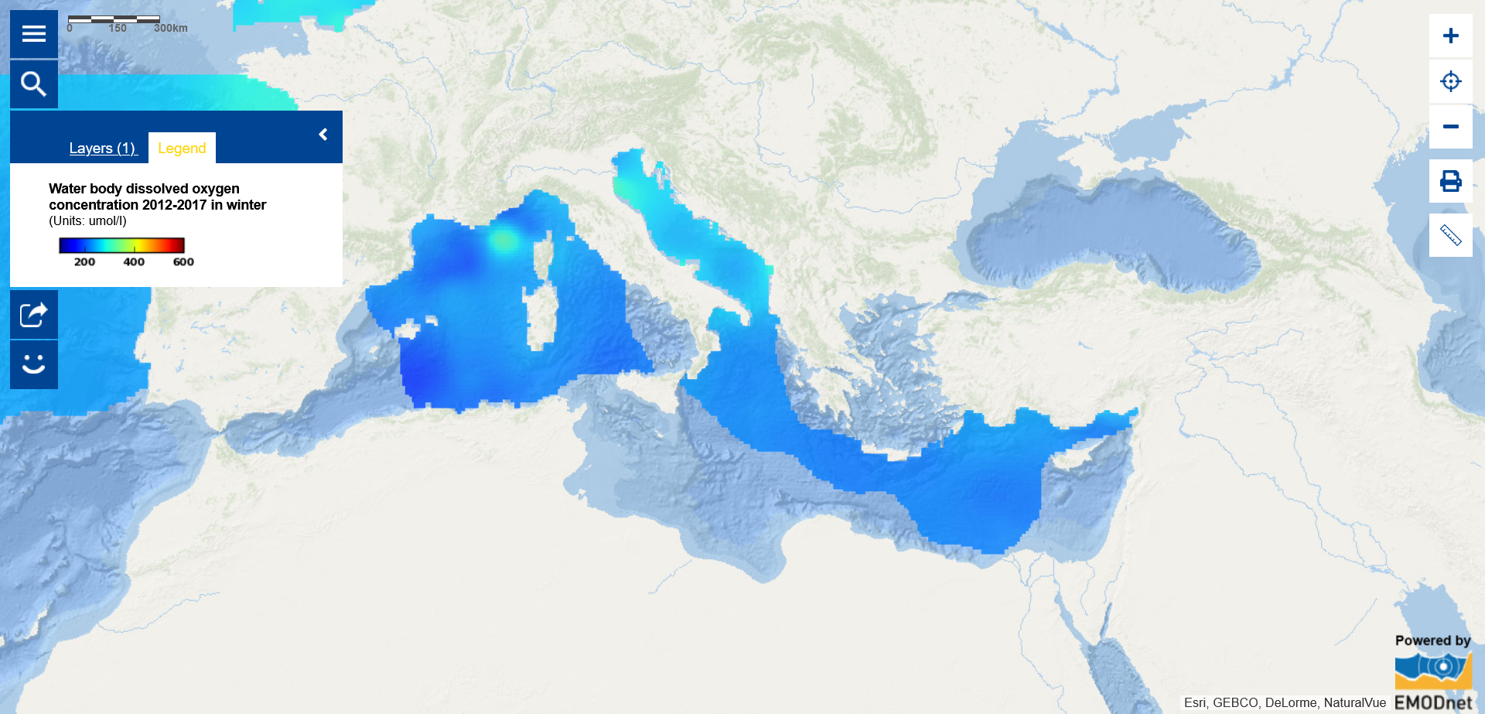


Outlook
GRNN and RF results are very promising with accuracy >95% at the three different stations
Real time forecasting
Include other forcing variables, as the wind
Extend to different areas
Trade-off between temporal and spatial resolution
This project has received funding from the European Union's Horizon 2020 research and innovation programme under grant agreement No 821934

Slide 8



Thanks for your attention
Contacts
anna.spinosa@deltares.nl
linkedin.com/AnnaSpinosa

