Slide 1
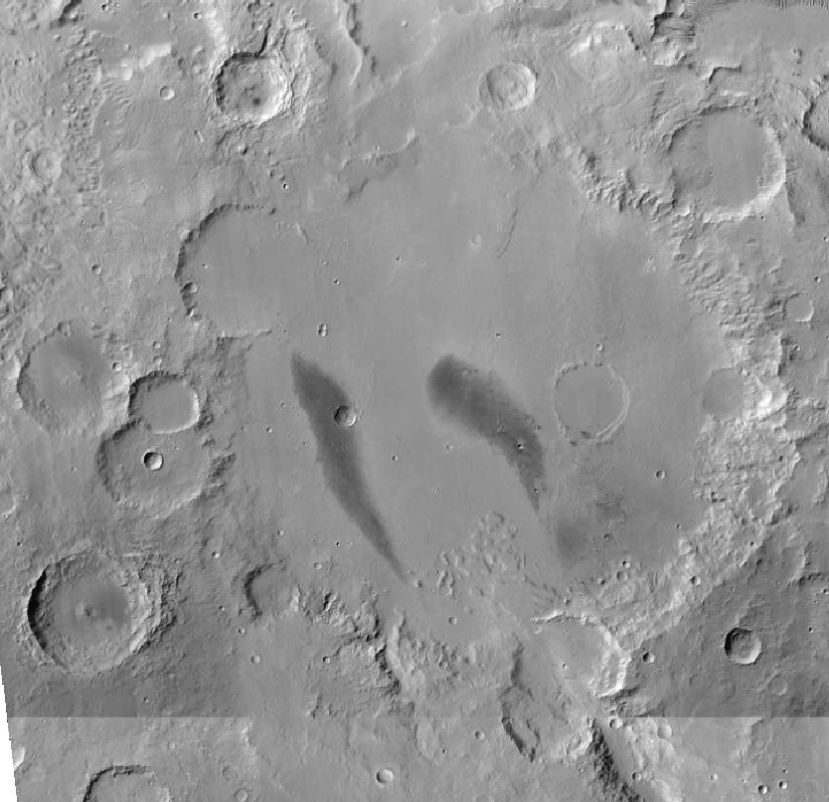
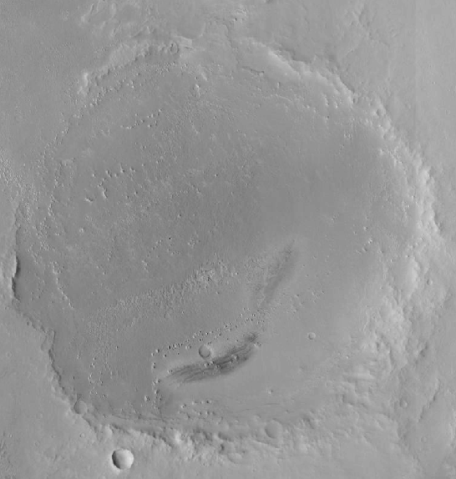
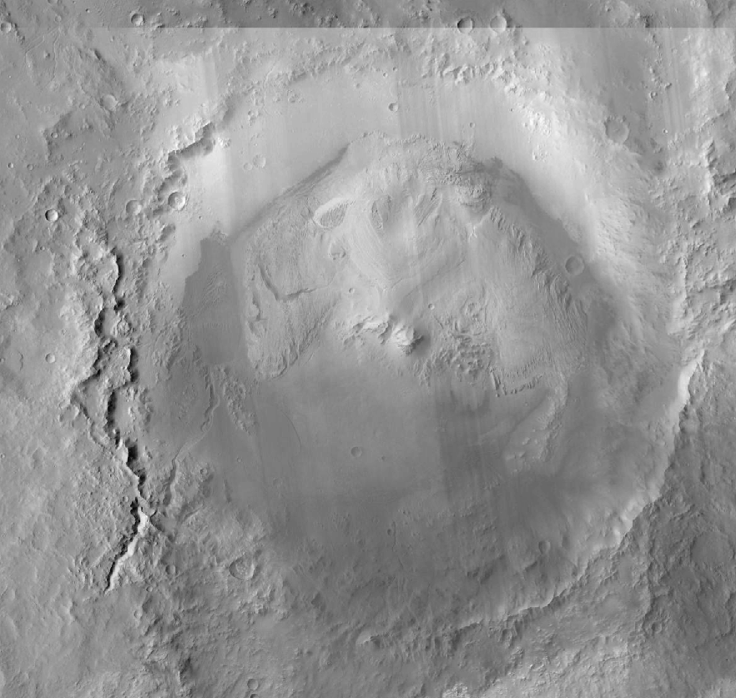





Possible geomorphic indicators of methane emission in three Martian impact craters
Elettra Mariani (International Research School of Planetary Sciences (IRSPS), Italy) and Pascal Allemand (Université Claude Bernard Lyon 1, LGL-TPE, France)

Slide 2
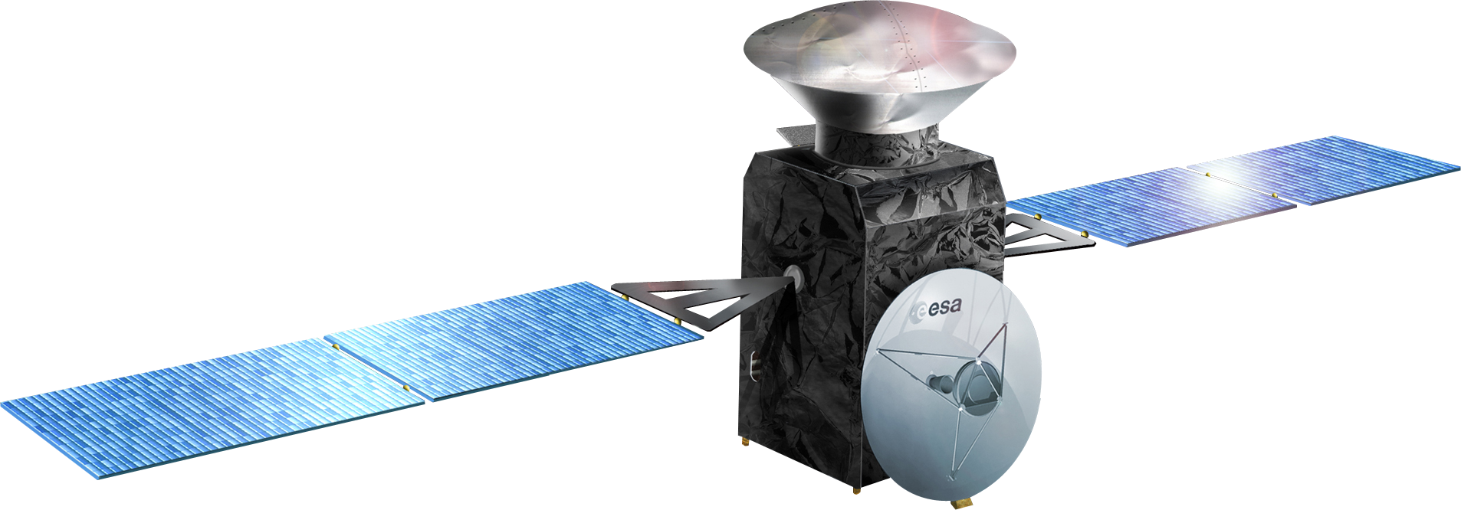
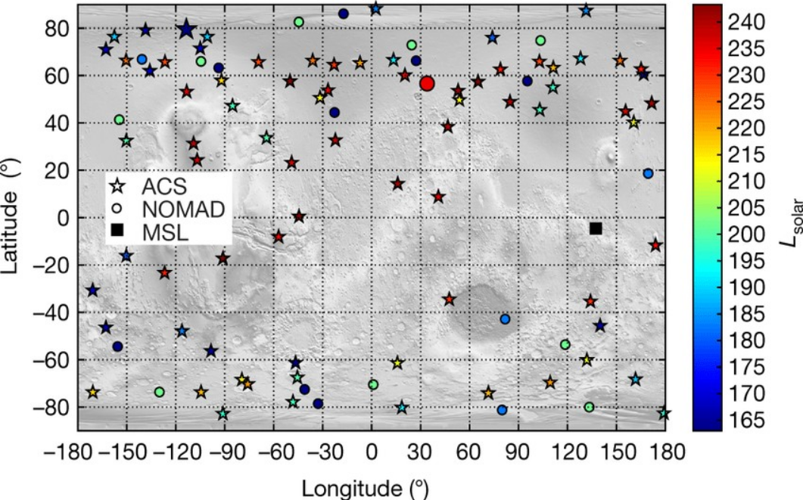
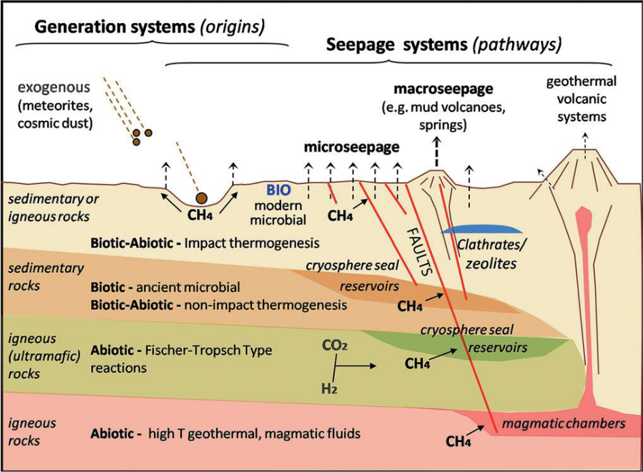
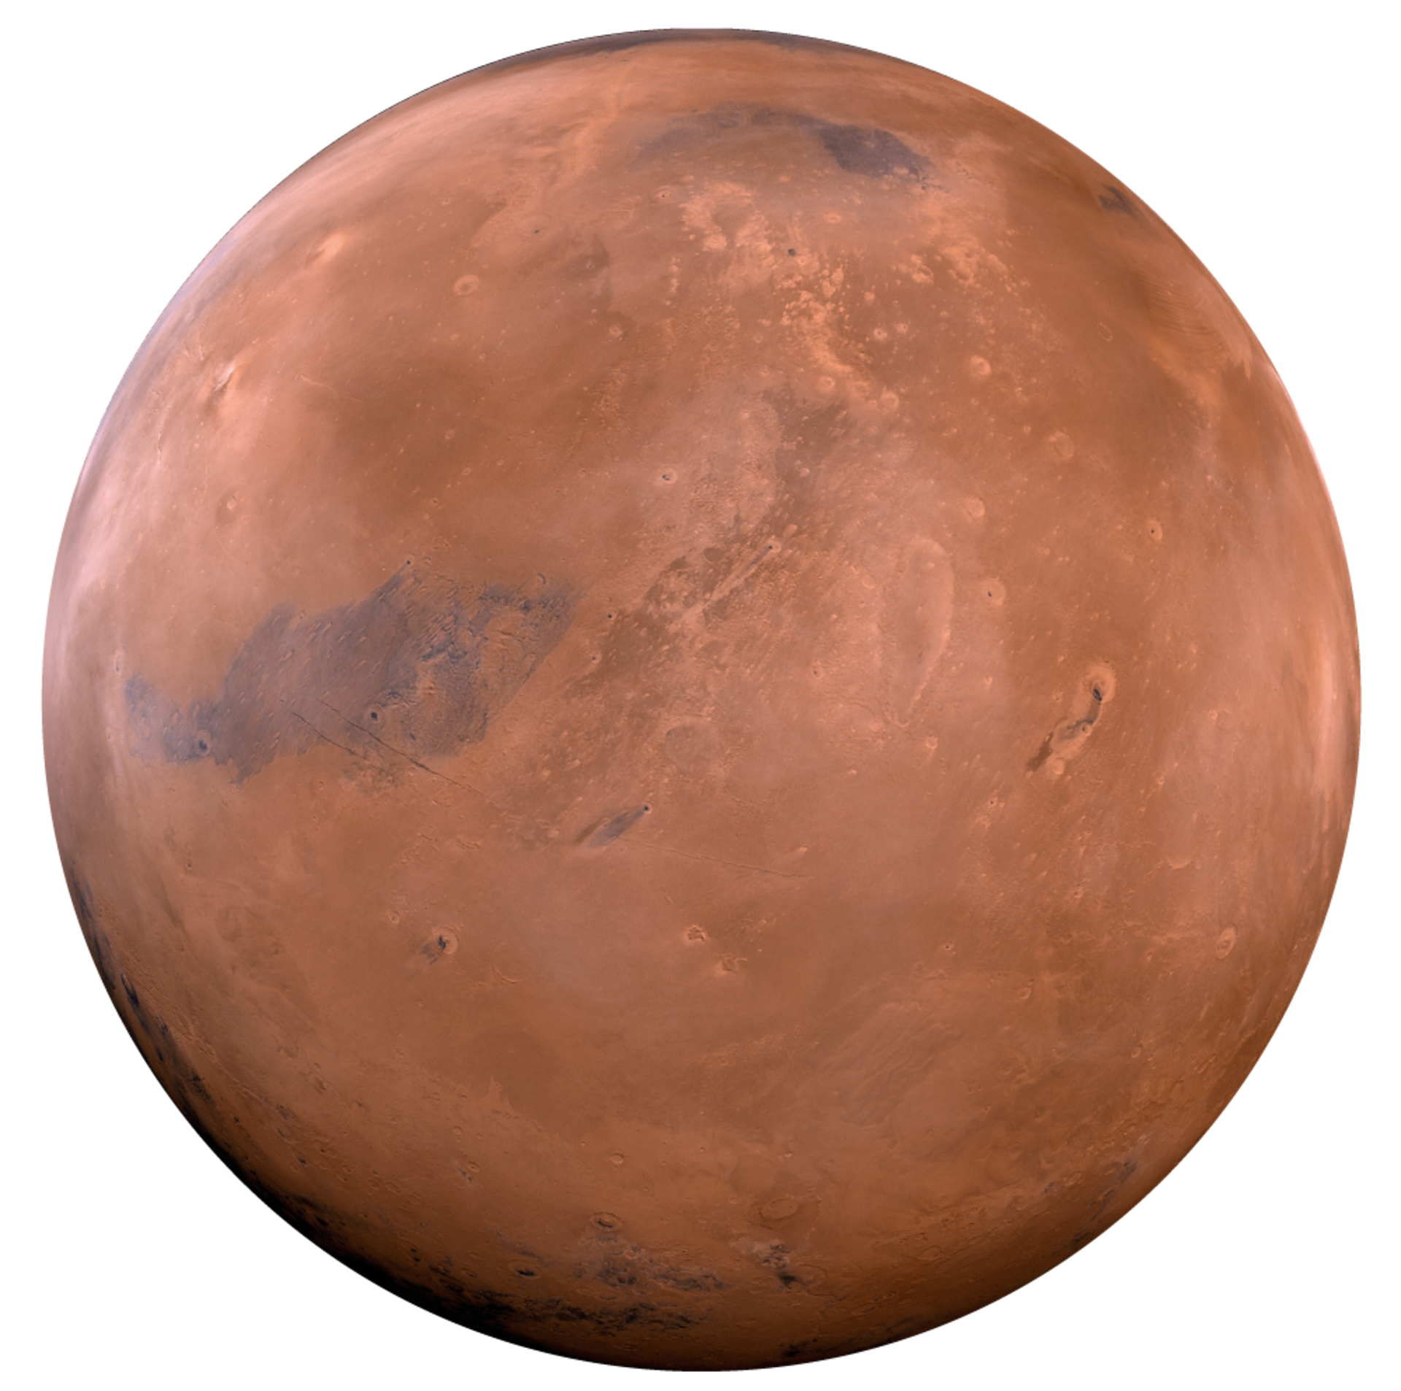
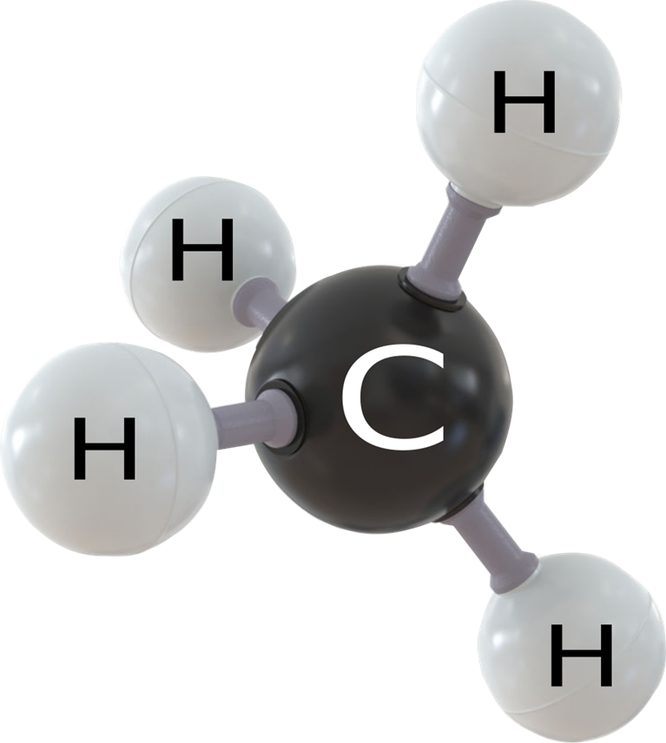

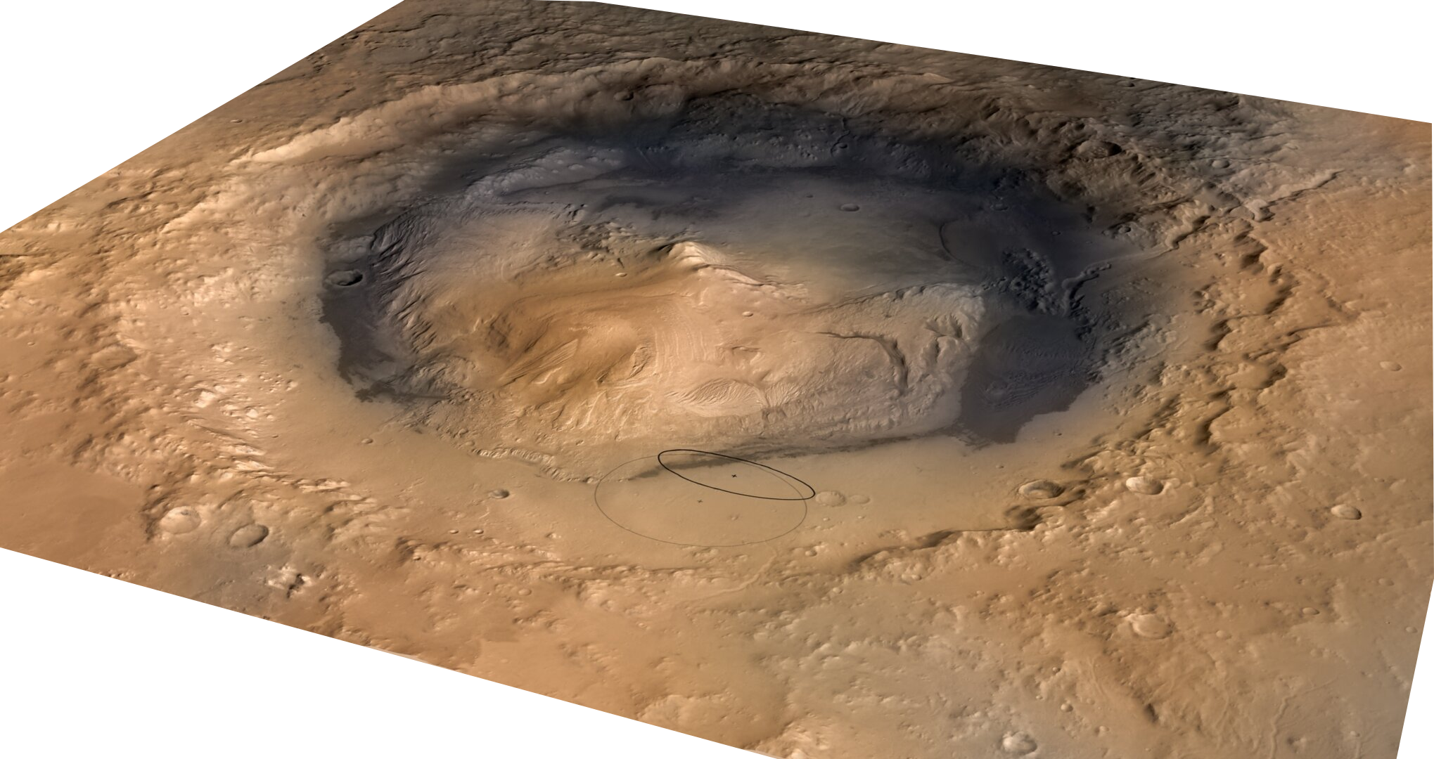
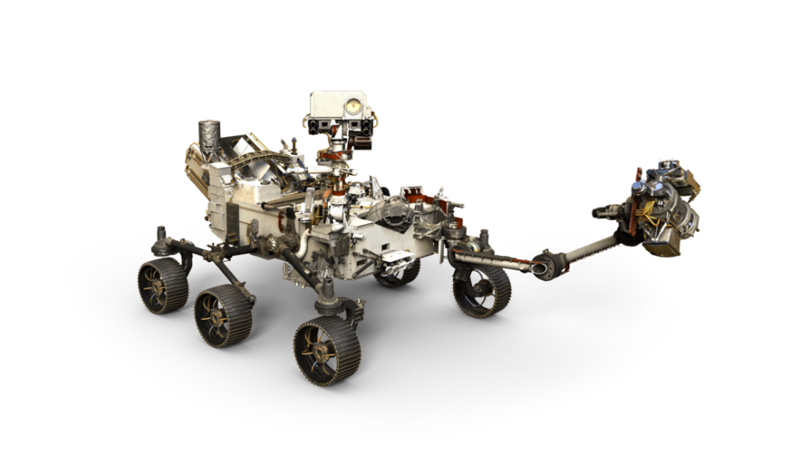
Scientific Problem
Research Goals
Methods
Discussion
Conclusions
Possible origin mechanism
TGO Global map methane measurements in Mars’ atm
METHANE ON MARS?
O. Korablev et al. (2019)
But it’s tricky… it does’t always detect it (most of the time there are no-detections in the atmosphere)
But Curiosity confirmed its presence on the surface with TLS measurements and seasonal variations
Oheler et al., (2017)

Slide 3
Scientific Problem
Research Goals
Methods
Discussion
Conclusions
1
Create a geological map of all of these craters
2
From this maps find possible geomorphic indicators of methane emission in Gusev, Vernal and Gale crater

Slide 4
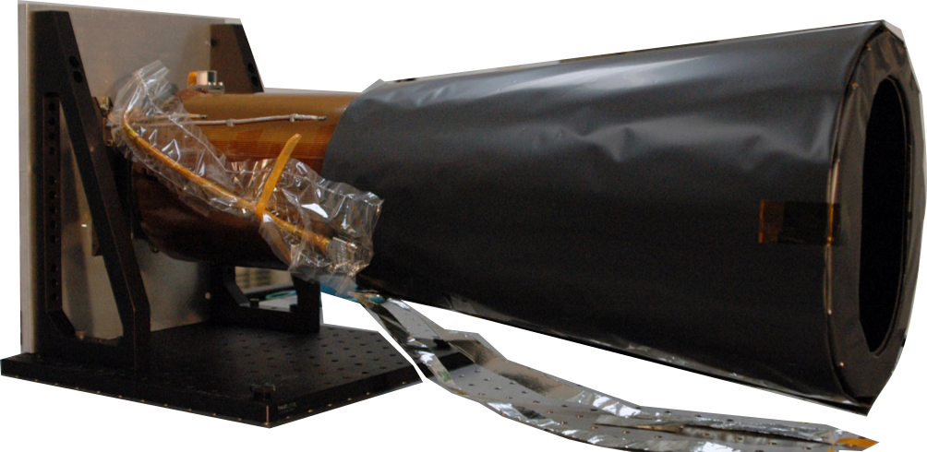
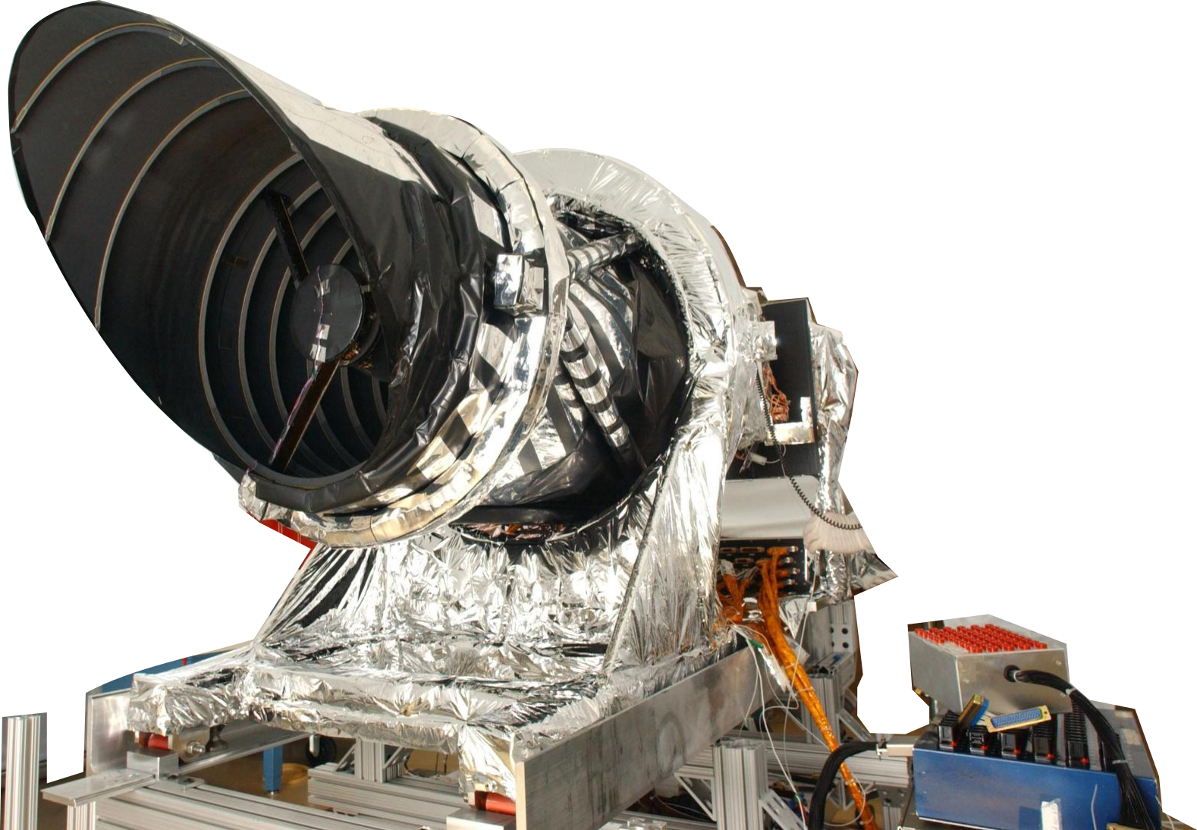
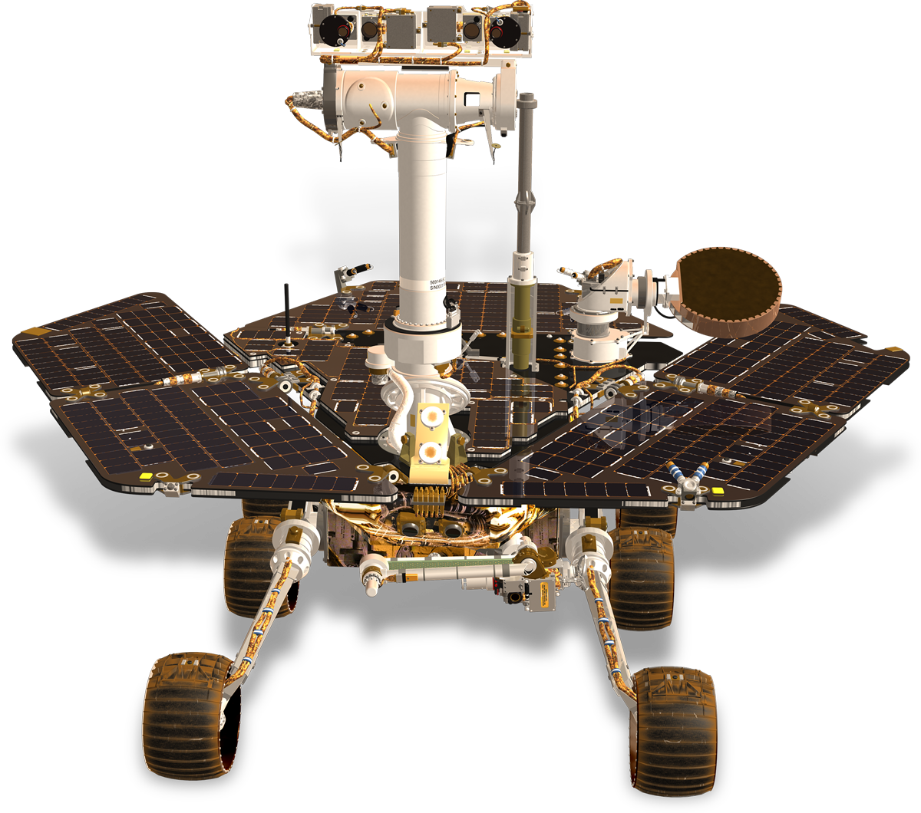




Scientific Problem
Research Goal
Methods
Discussion
Conclusions
Satellite dataset for basemap:
Contect Camera (CTX – MRO mission)
High Resolution Imaging Science Experiment (HiRISE – MRO mission)
In situ hyperspectral dataset form:
Spirit rover (MER mission in Gusev crater)
Mars Science Laboratory rover (MSL rover Mission)
Mapping of Gusev, Vernal and Gale crater using
Crater counting method to have absolute age of the units in order to create a stratigraphic column
Methods:
Define possible methane springs in all different craters using CRISM images and in situ spectrometer dataset (Gusev and Gale crater with Spirt and Curiosity)
Define the different indicators as ancient or recent possible methane springs
Find common indicators that can support the research theory for methane spring

Slide 5
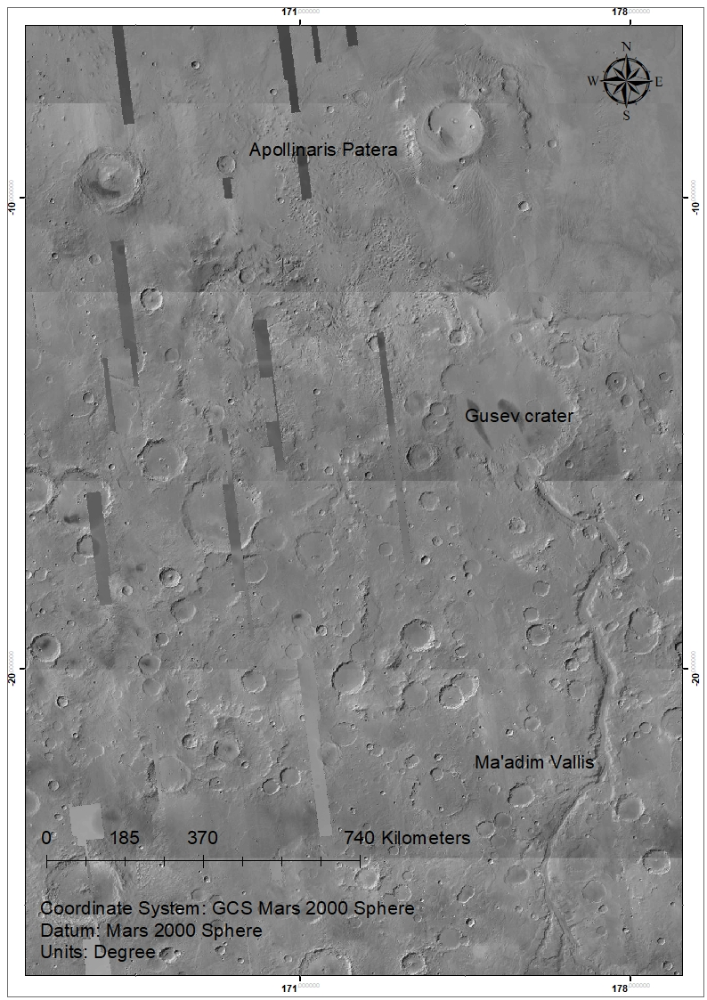
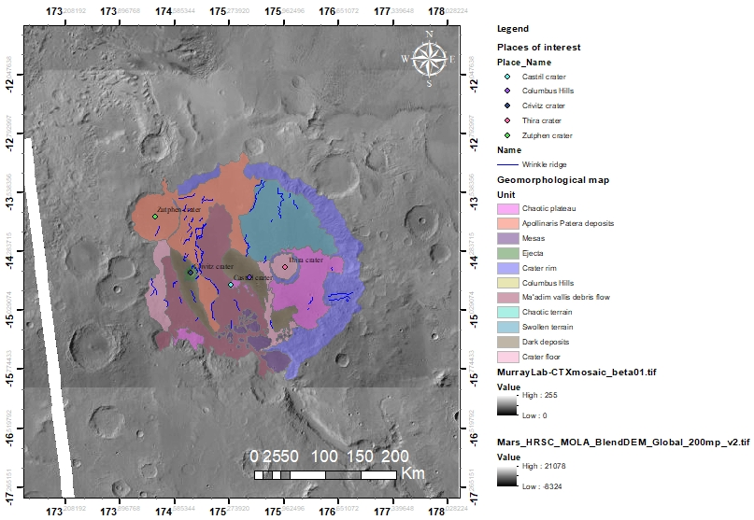
Scientific Problem
Research Goals
Methods
Discussion
Conclusions
Gusev crater

Slide 6
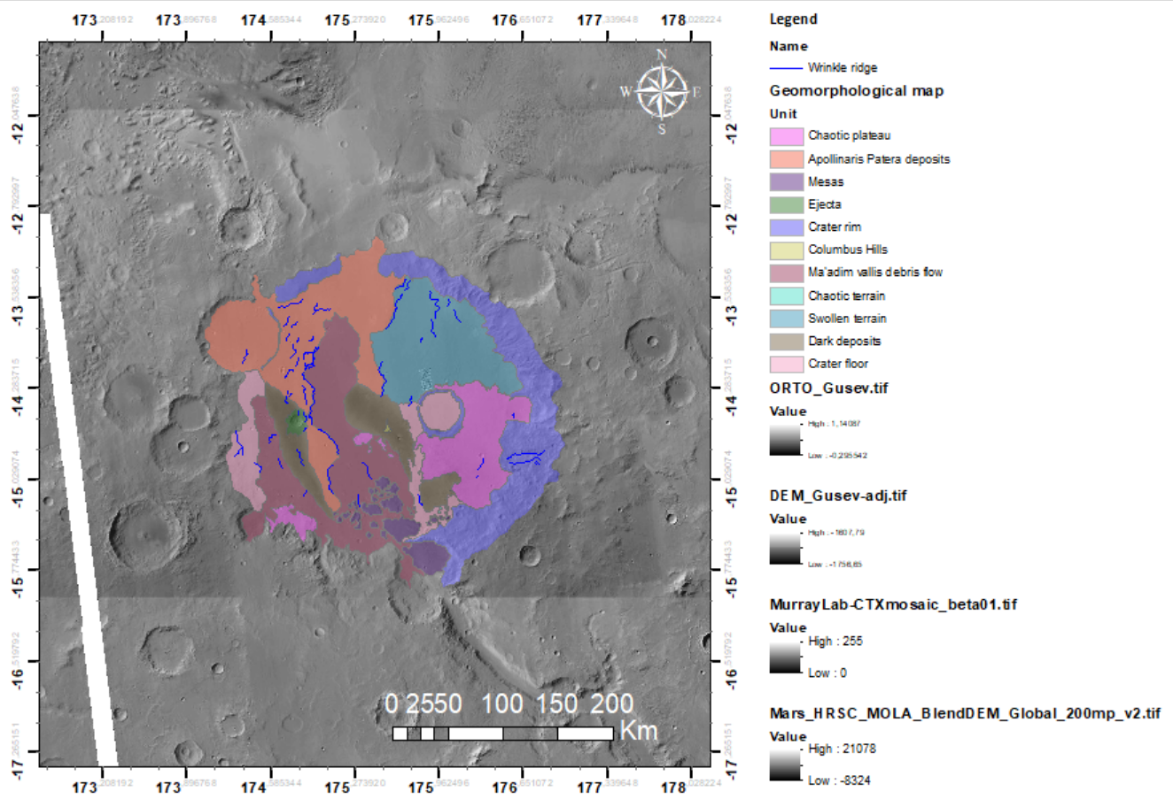
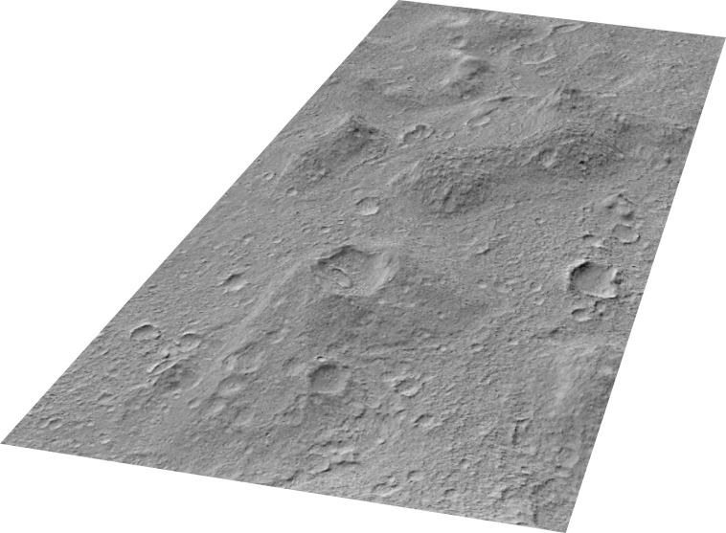
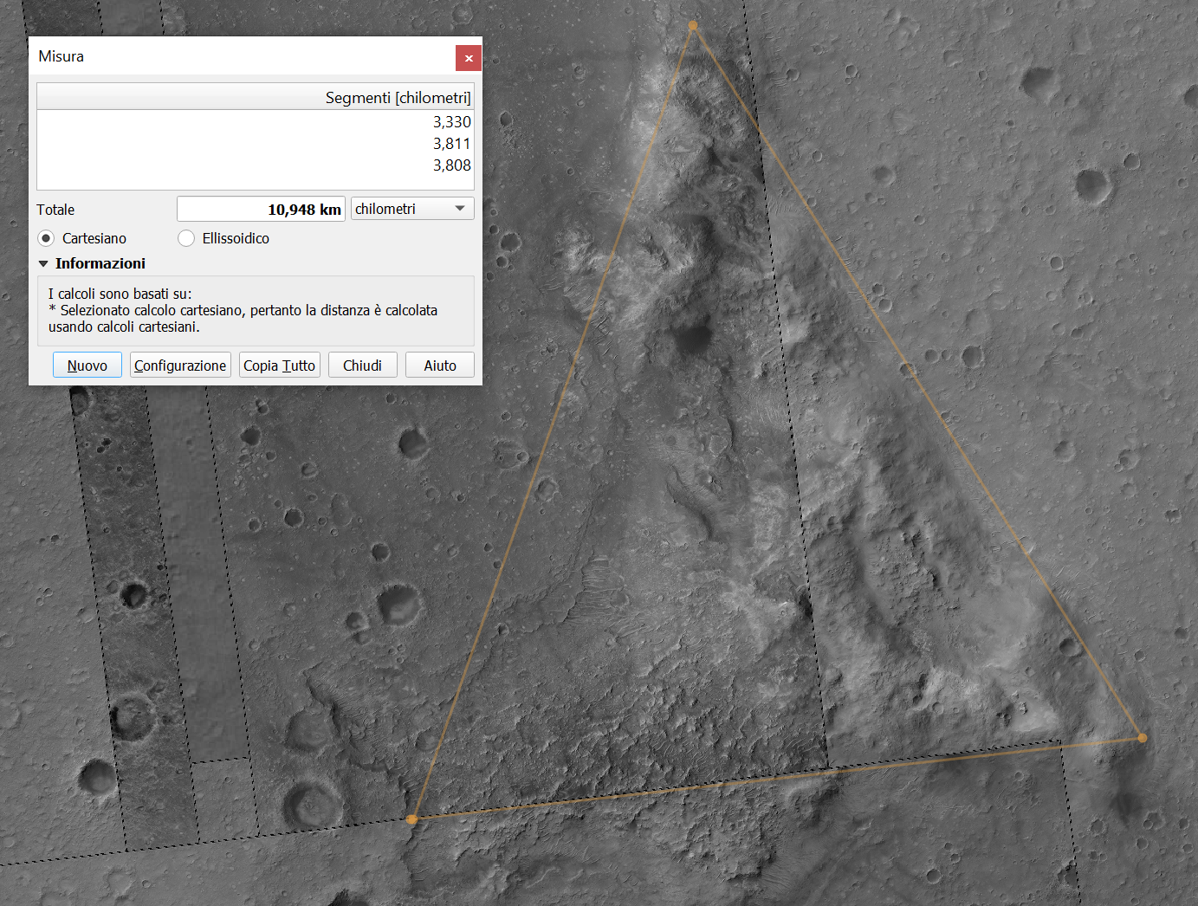

Scientific Problem
Research Goals
Methods
Discussion
Conclusions
Gusev crater’s indicators
Structure Measures
Lenght: 2.3 Km
Wide: 0.6 Km
Height: 100 mt
Vertical Exageration: 10x
1
2
3
2
3
1
PSP_009385_1655_PSP_009886_1655

Slide 7
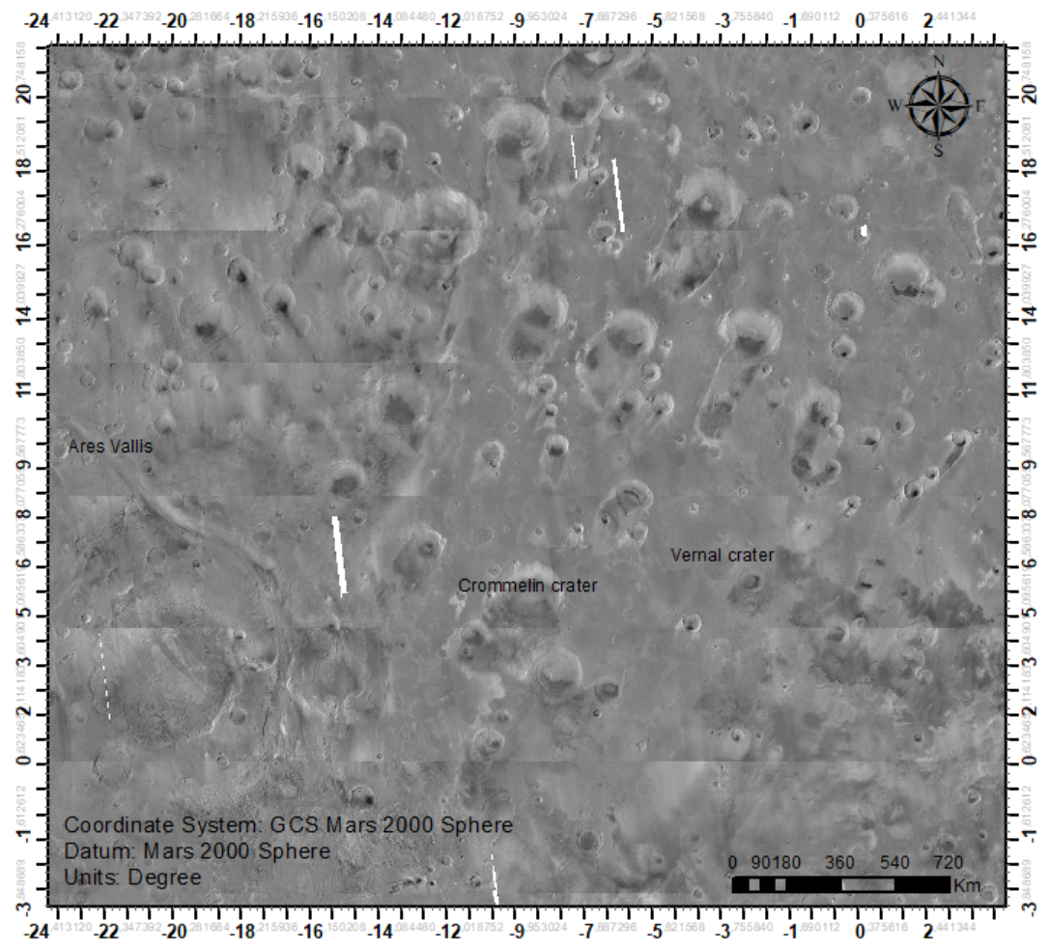
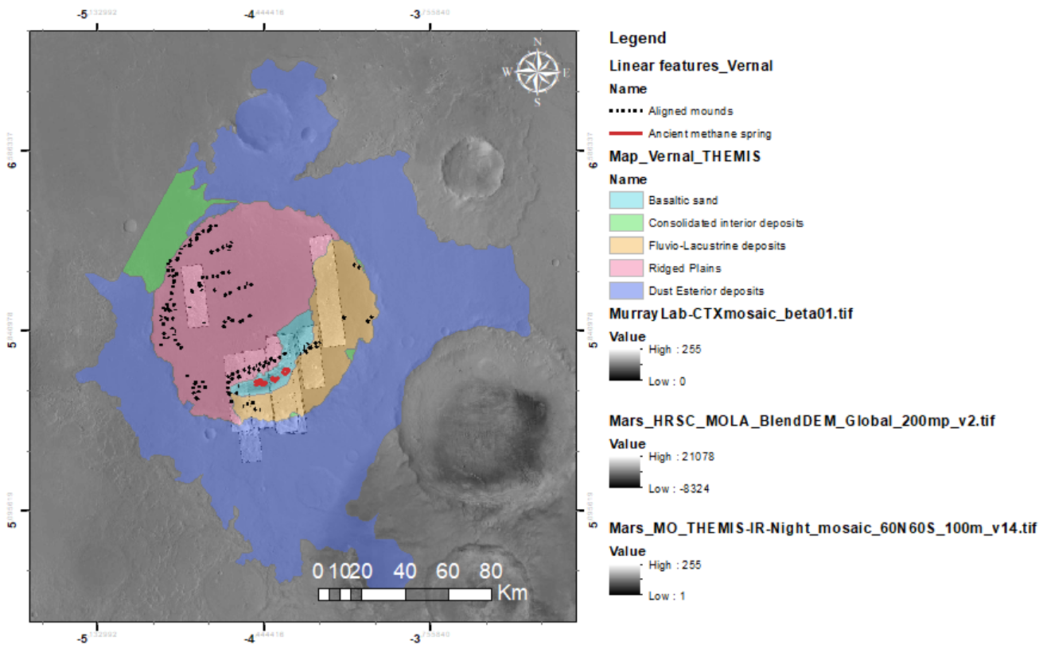
Scientific Problem
Research Goals
Methods
Discussion
Conclusions
Vernal crater

Slide 8
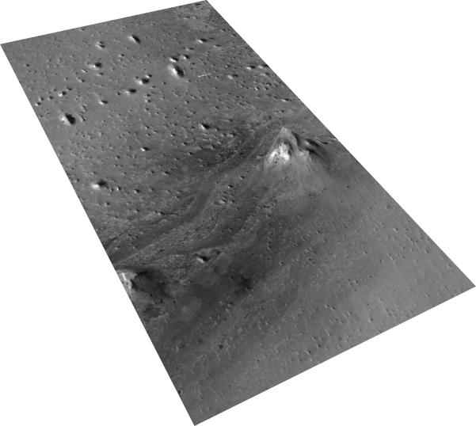
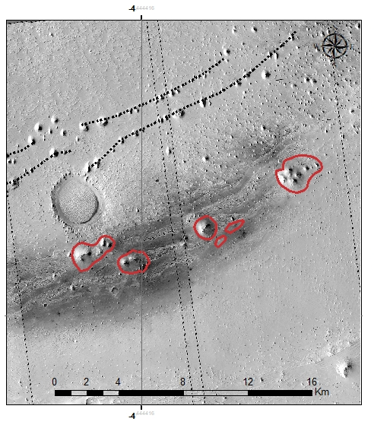
Scientific Problem
Research Goals
Methods
Discussion
Conclusions
Vernal crater’s indicators
A
Structure Measures
A - Mound
Diameter: 1.2 Km
B - Ancient methane spring 1
Diameter: 0.434 Km
C - Ancient methane spring 2
Diameter: 0.6 Km
Vertical Exageration: 10x
C
B
ESP_011844_1855_PSP_002812_1855

Slide 9
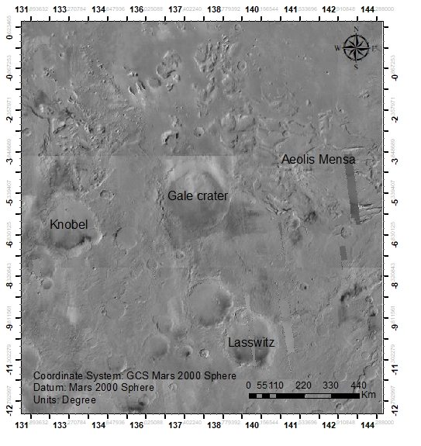
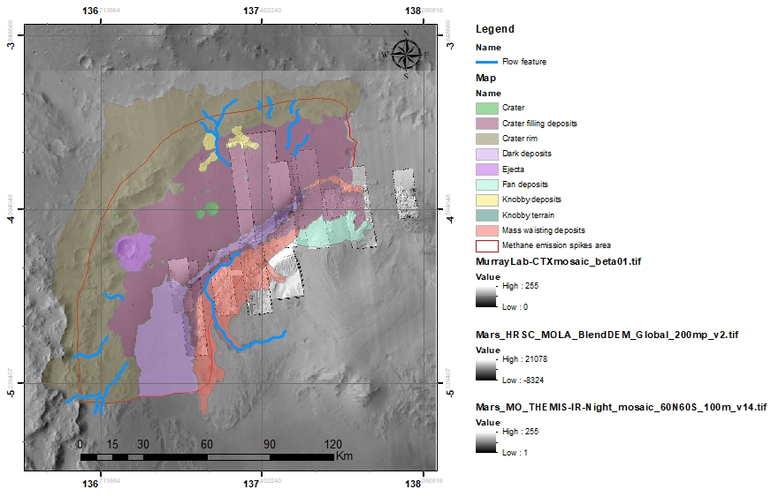
Scientific Problem
Research Goals
Methods
Discussion
Conclusions
Gale crater

Slide 10
Scientific Problem
Research Goals
Methods
Discussion
Conclusions
The preliminary results of this research are promising from a morphological and mineralogical point of view
The seemingly contradictory observations used as constraints and combined with a rigorous scientific logic lead to infer that only very small CH₄ emissions coming from a source located in the northwestern rim of Gale Crater (from very close to the rover, can lead to a detection by Curiosity and non-detection by TGO).
In both cases, Curiosity measurements provide the ground truth, and the upper limits of TGO measurements provide the boundary condition for the maximum global average CH₄ concentration.
So, we can start hypothesize some alternative scenarios:
Curiosity has landed on or right next to the only CH₄ source on the planet, which is extremely unlikely.
There is something wrong with the measurements, but this possibility has been investigated in detail and ruled out, a theory sustained also by Webster et al. 2018, 2021.
CH₄ lifetime in the Martian atmosphere is for some unknown reason much shorter than predicted by known chemistry.
Further works
Already planned since this research is a work in progress as part of the European FlyRadar project that will end in 2025, for info: Home - (flyradarproject.eu)
THANK YOU FOR YOUR ATTENTION

