Slide 1

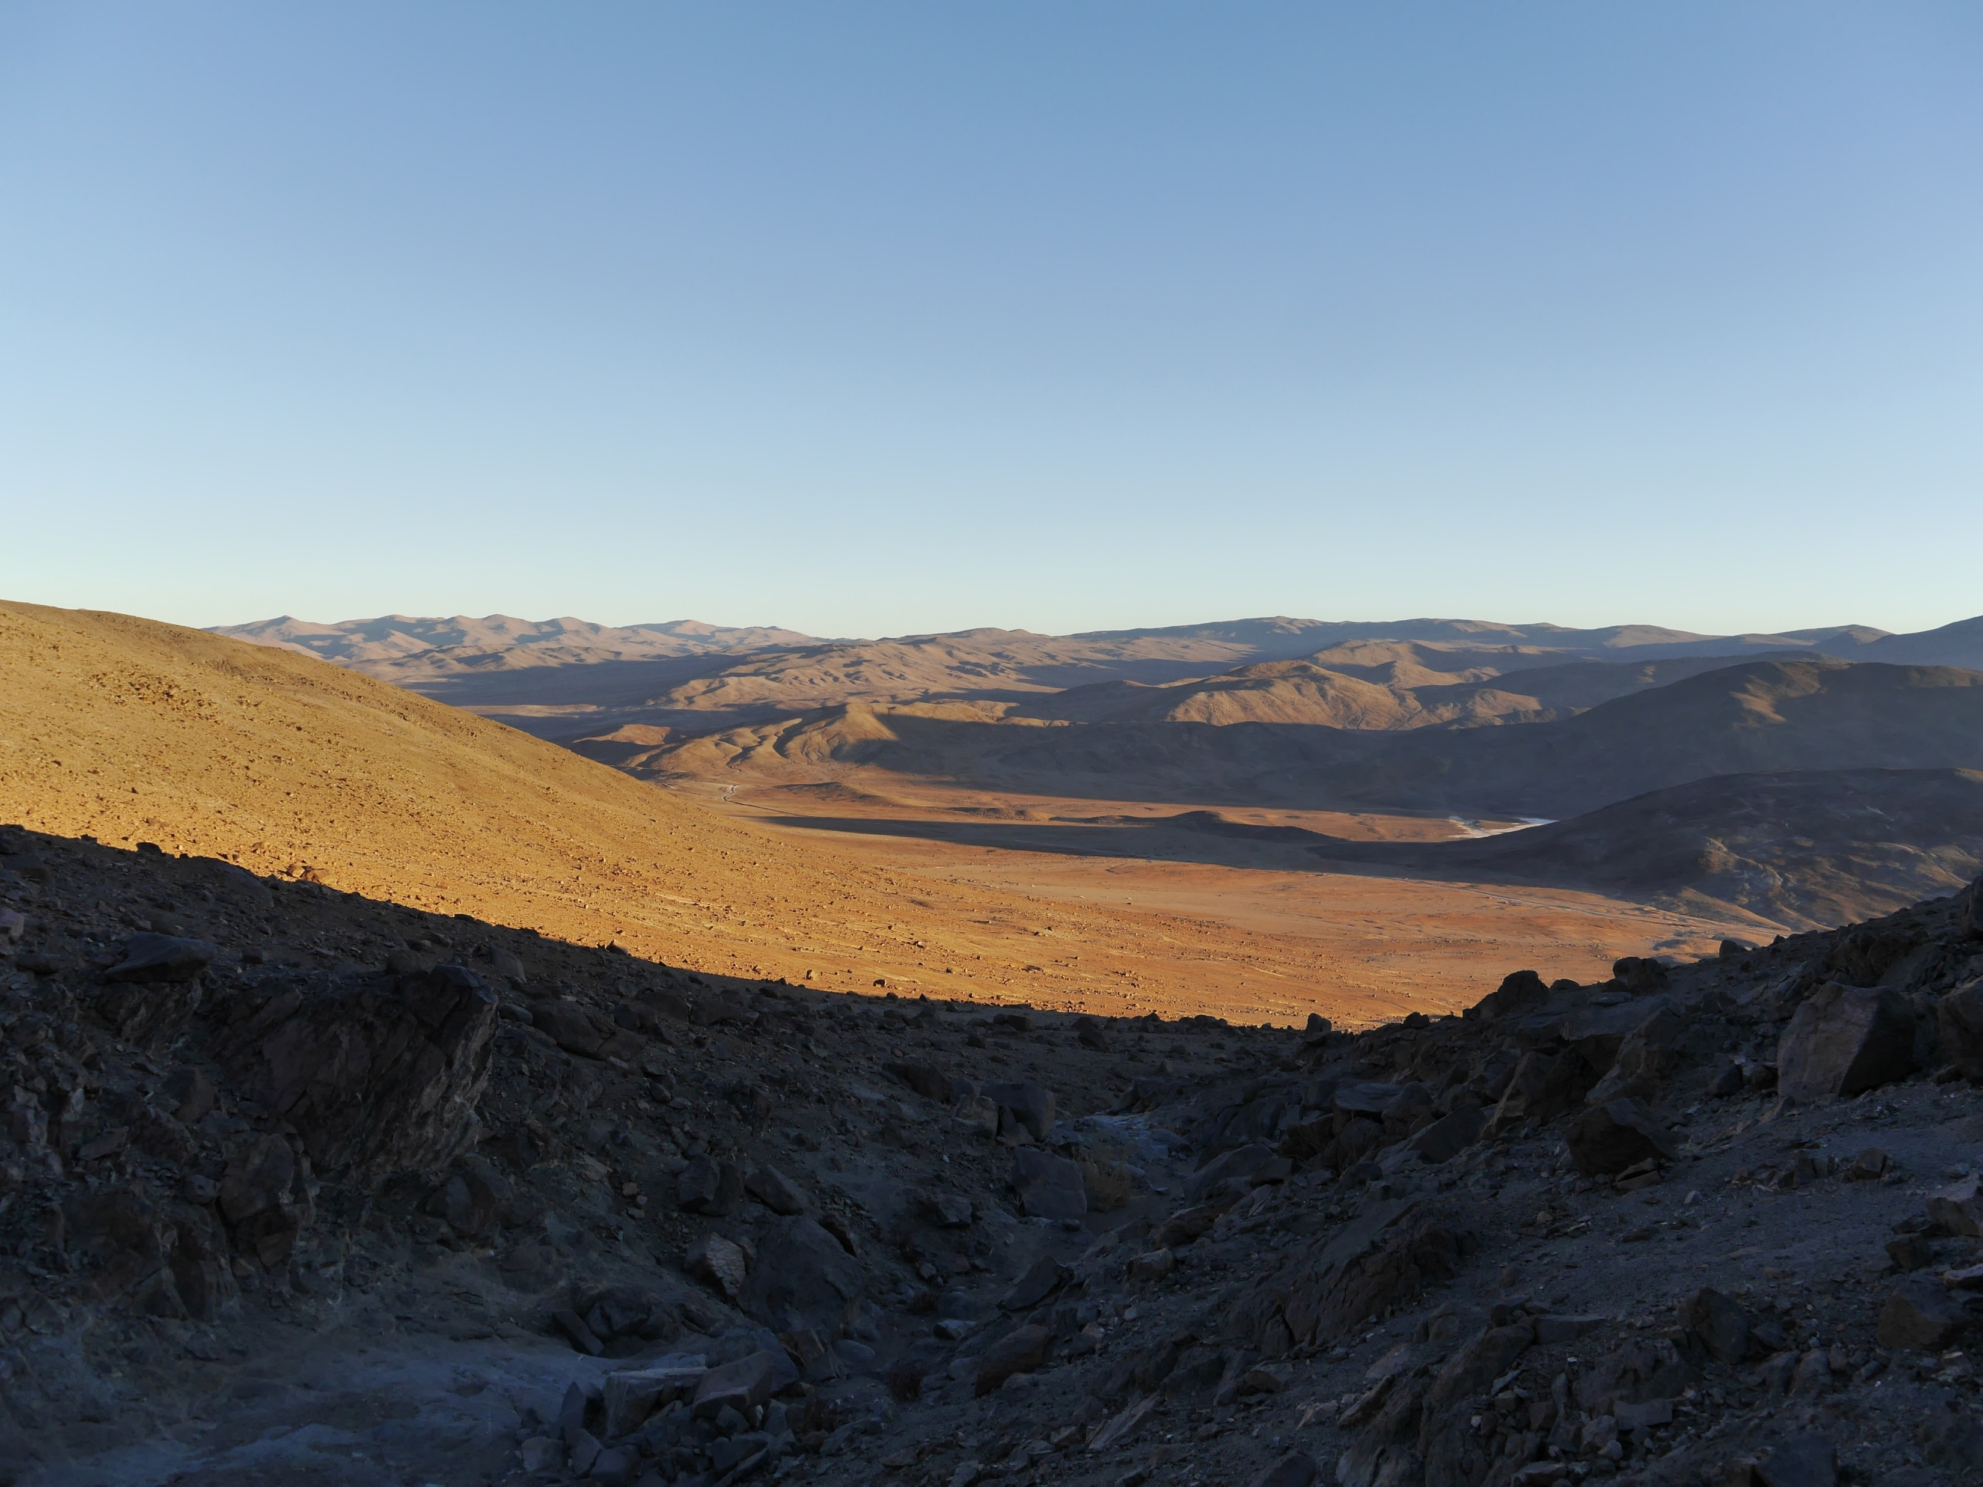

European Geoscience Union - General Assembly 2022
Session TS3.1 ‘Seismic imaging and characterization of crustal faults’ | EGU22-1926
May 25, 2022 | Wien
Geological imaging of a crustal-scale seismogenic source in the continental crust (Bolfin Fault Zone, Atacama Fault System, Chile)
Simone Masoch^{1*}, Michele Fondriest², Rodrigo Gomila¹, Erik Jensen³, Giulia Magnarini⁴, Javier Espinosa⁵, Karin Hofer⁵, Thomas Mitchell⁴, José Cembrano^{5,6}, Giorgio Pennacchioni¹, Giulio Di Toro^{1,7}
* simone.masoch@phd.unipd.it
Dipartimento di Geoscienze, Università degli Studi di Padova, Padua, Italy.
Institute de Sciences de la Terre (ISTerre), Grenoble, France.
CIGIDEN, Santiago, Chile.
Department of Earth Sciences, University College London, London, United Kingdom.
Departamento de Ingenieria Estructural y Geotécnica, Pontificia Universidad Católica de Chile, Santiago, Chile.
Andean Geothermal Center of Excellence, Santiago, Chile.
Sezione di Tettonofisica e Sismologia, Istituto Nazionale di Geofisica e Vulcanologia, Rome, Italy.

Slide 2
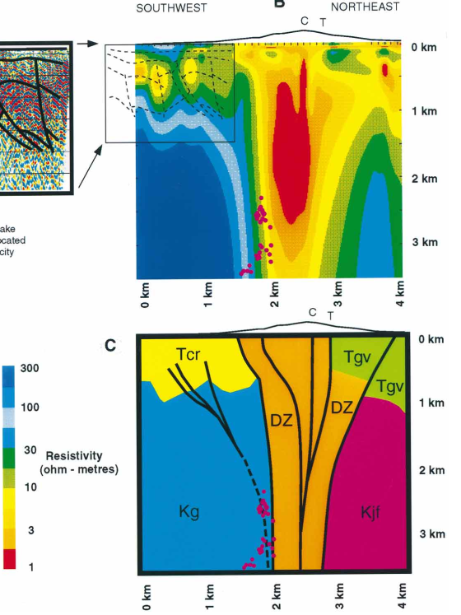
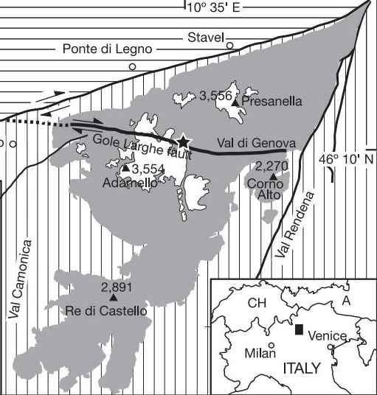
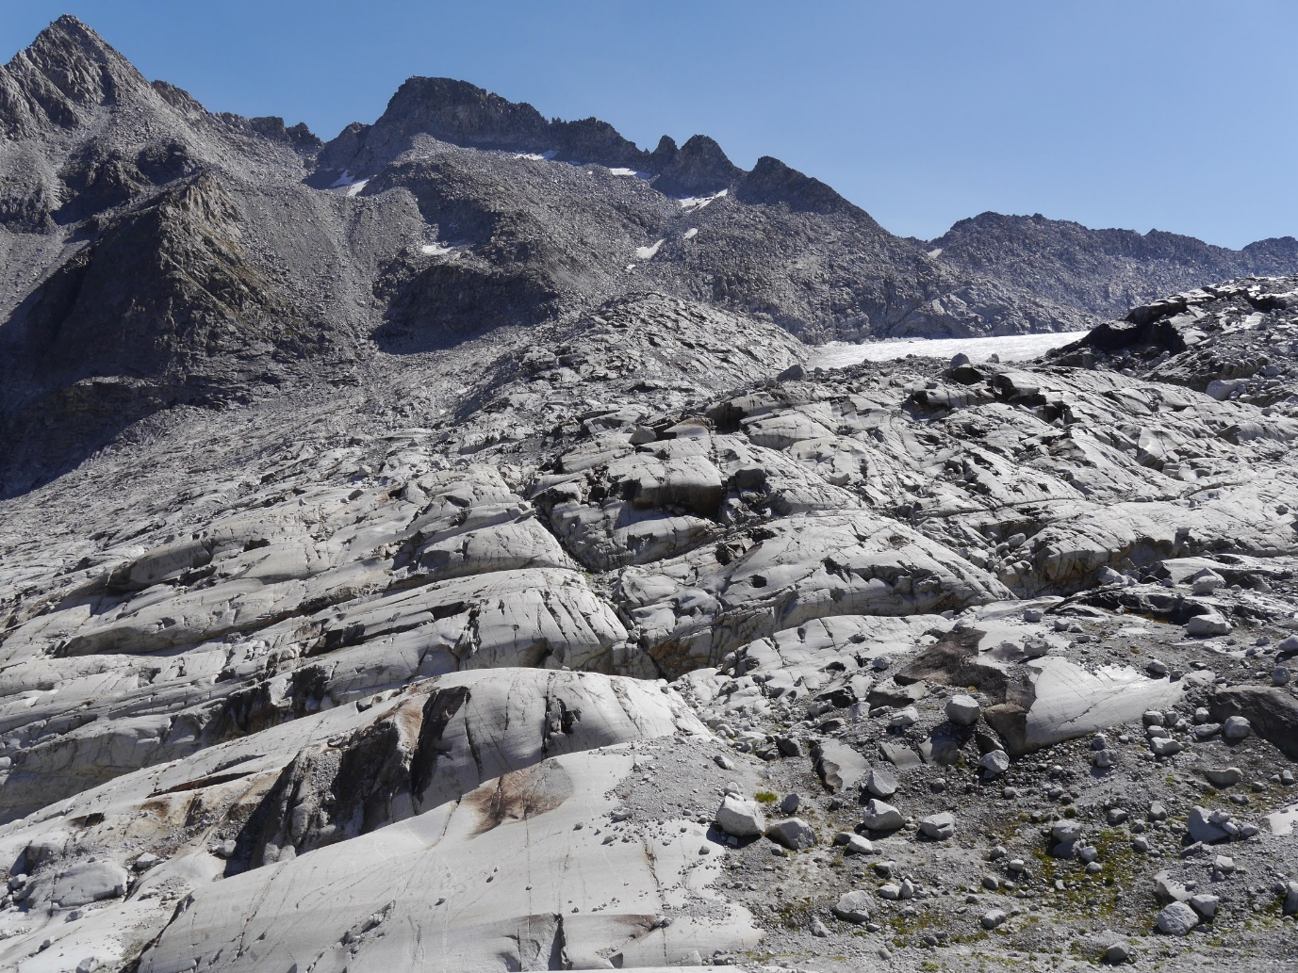
Imaging of fault zone architecture
Geophysical techniques have low resolution at depth
Resistivity (ohm)
1 km
Modified from Unsworth et al. (1997)
N
S
Limited exposure of natural fault zones
Modified from Di Toro and Pennacchioni (2005); Smith et al. (2013)
10 km
10 m
Notes:
MAGNETOTELLURIC survey
FAULT EASILY ERODED
Even though the exposure QUALITY is OUTSTANDING
Luckly, there are very few areas on the earth where crustral scale fautl are well exposed

Slide 3
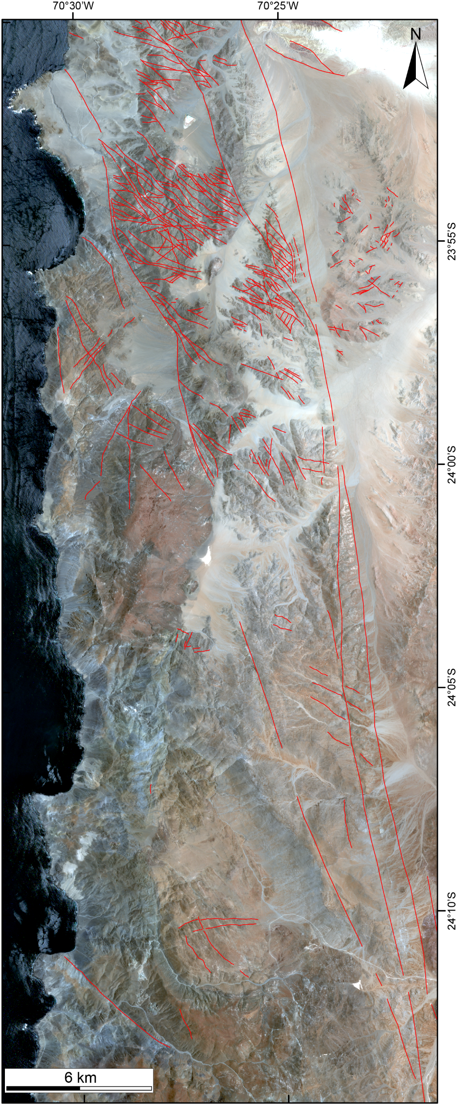
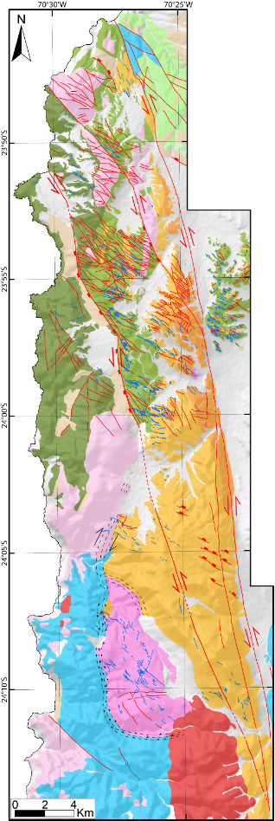
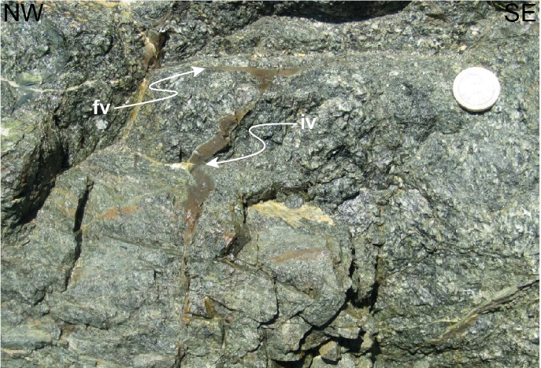
Bolfin Fault Zone (Atacama Fault System)
Ancient seismicity attested by pseudotachylytes
Seismic (125-118 Ma) faulting occurred at 5-7 km depth and ≤ 300 °C in a fluid-rich environment
Bolfin Fault Zone
Bolfin Fault Zone
Atacama
Desert
Modified from Scheuber and Gonzalez (1999); Cembrano et al. (2005); Gomila et al. (2021); Masoch et al. (2021)

Slide 4
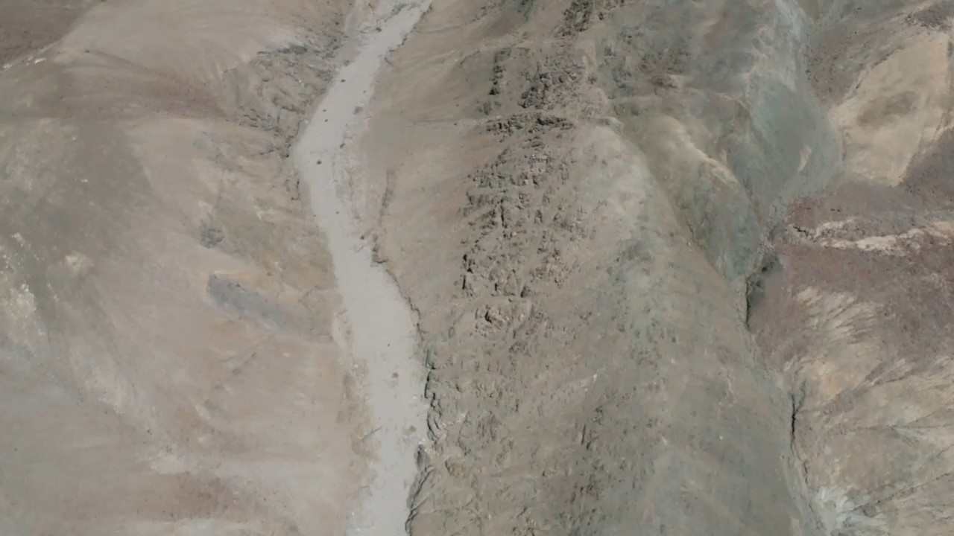
Bolfin Fault Zone (Atacama desert, Chile): Intense fluid-rock interaction + mineral precipitation (Chl + Ep)

Slide 5
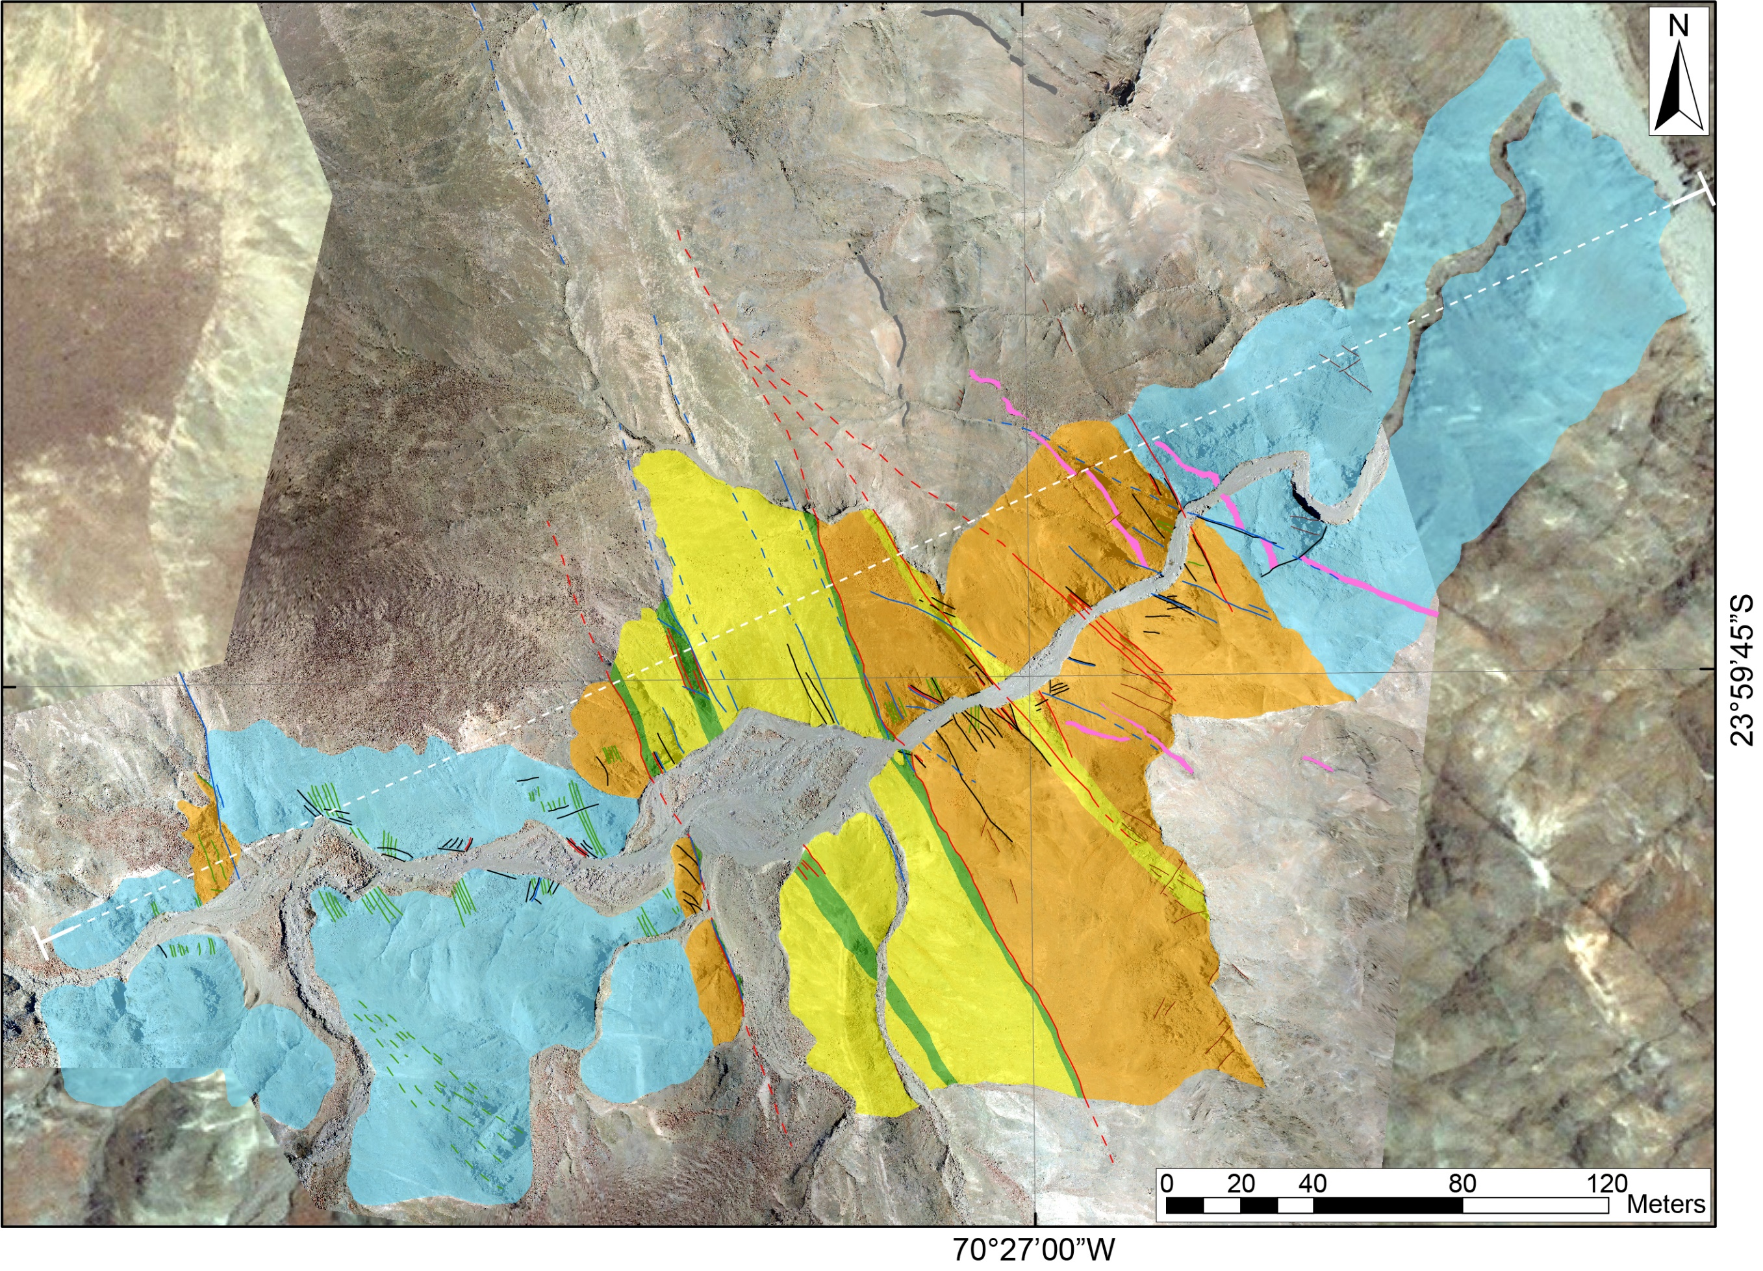
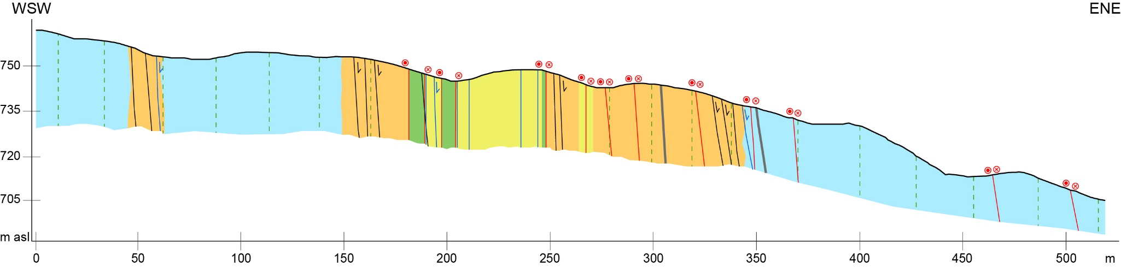
Fault core widening = mineral precipitation strengthening
Strongly
altered DZ
50 m
Low strain DZ
Low strain DZ
Fault Core
Low strain DZ
Strongly
altered DZ
Fault Core
Low strain DZ
Notes:
Max width 60 m. WIDE FAULT CORE

Slide 6
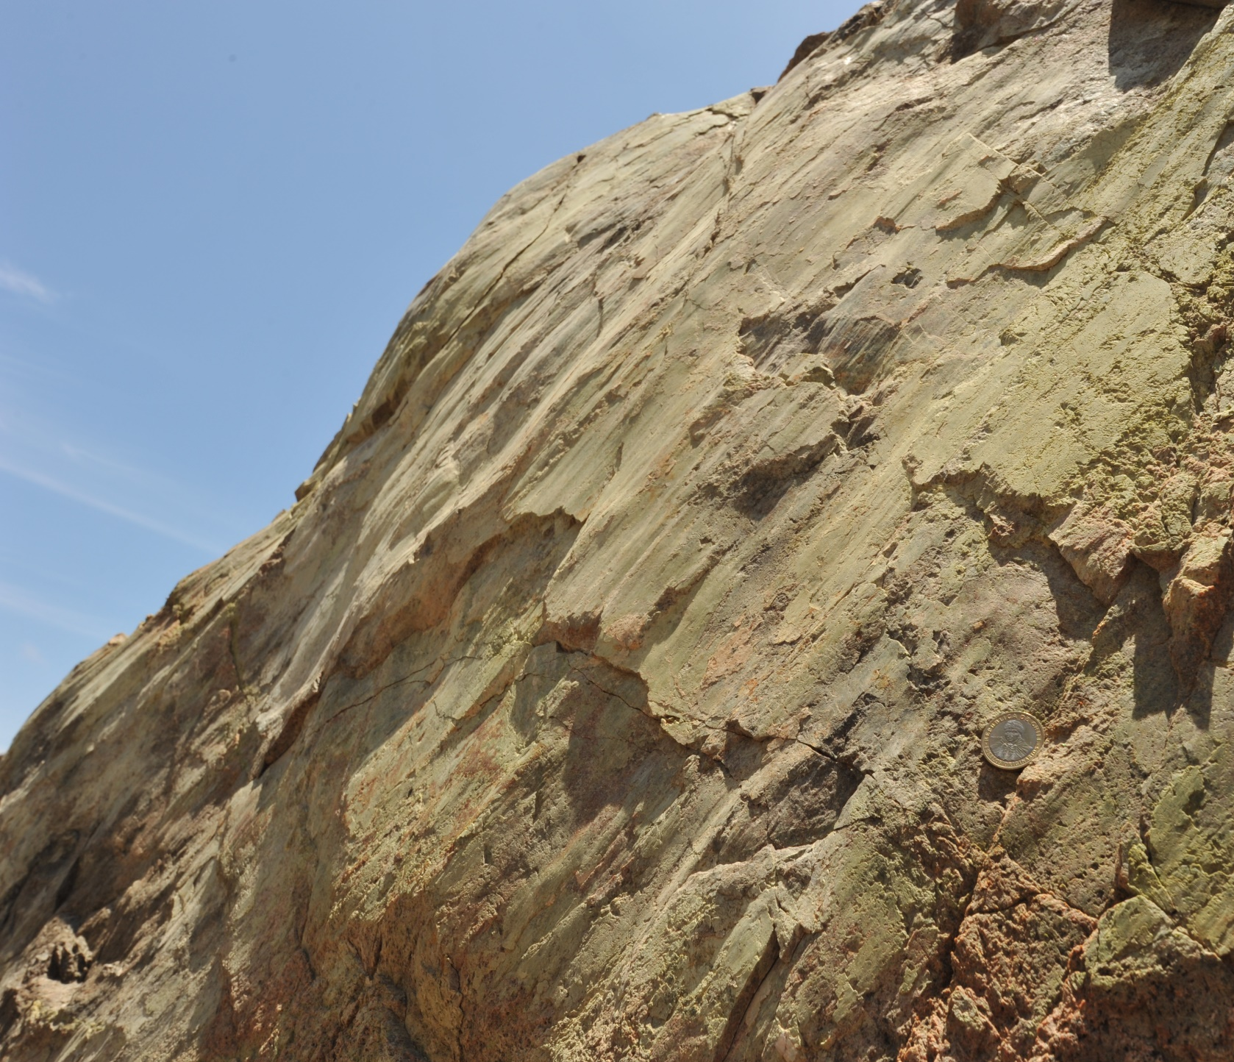
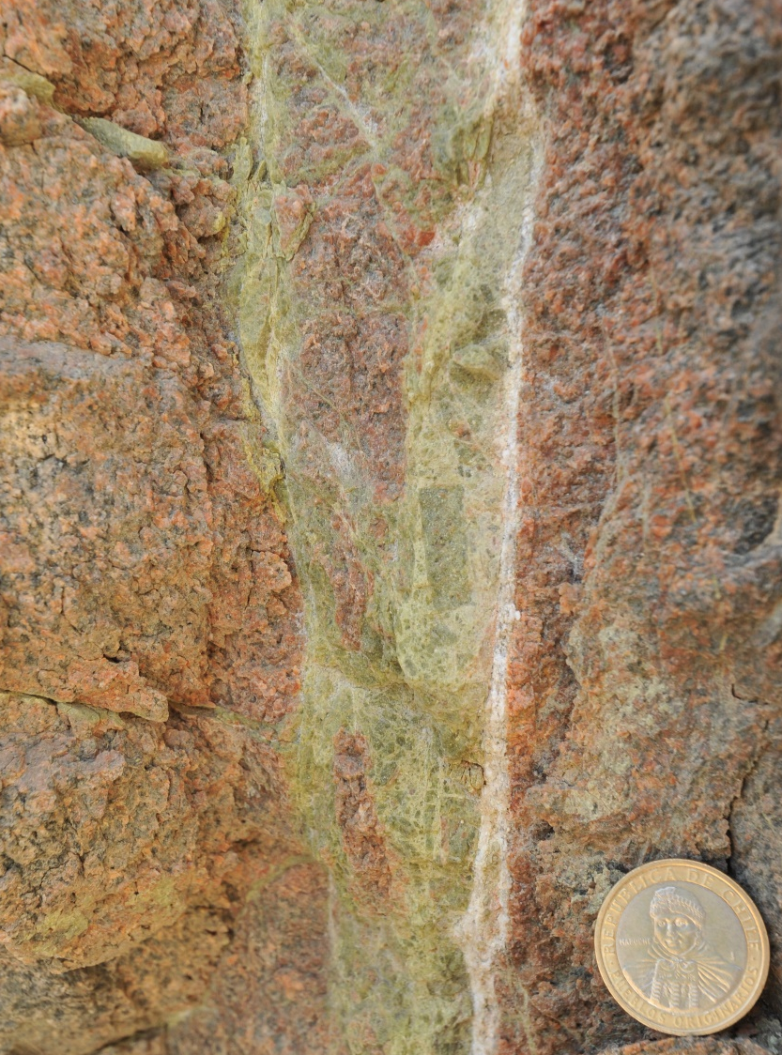
Damage zone associated with clusters of epidote-rich fault & vein networks
5 cm
Small-displacement (<1-1.5 m) normal dip-slip to strike-slip fault veins
Hybrid fractures & dilatant breccias
Notes:
CLUSTER assocciated with fault intersections
FLUID-ROCK INTERACTION

Slide 7
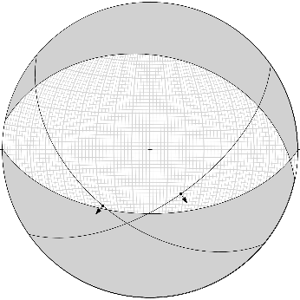
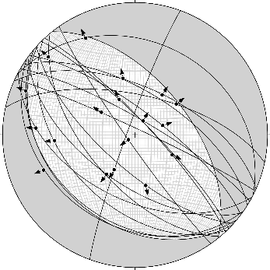
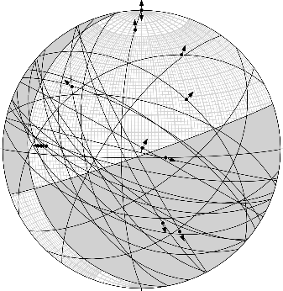
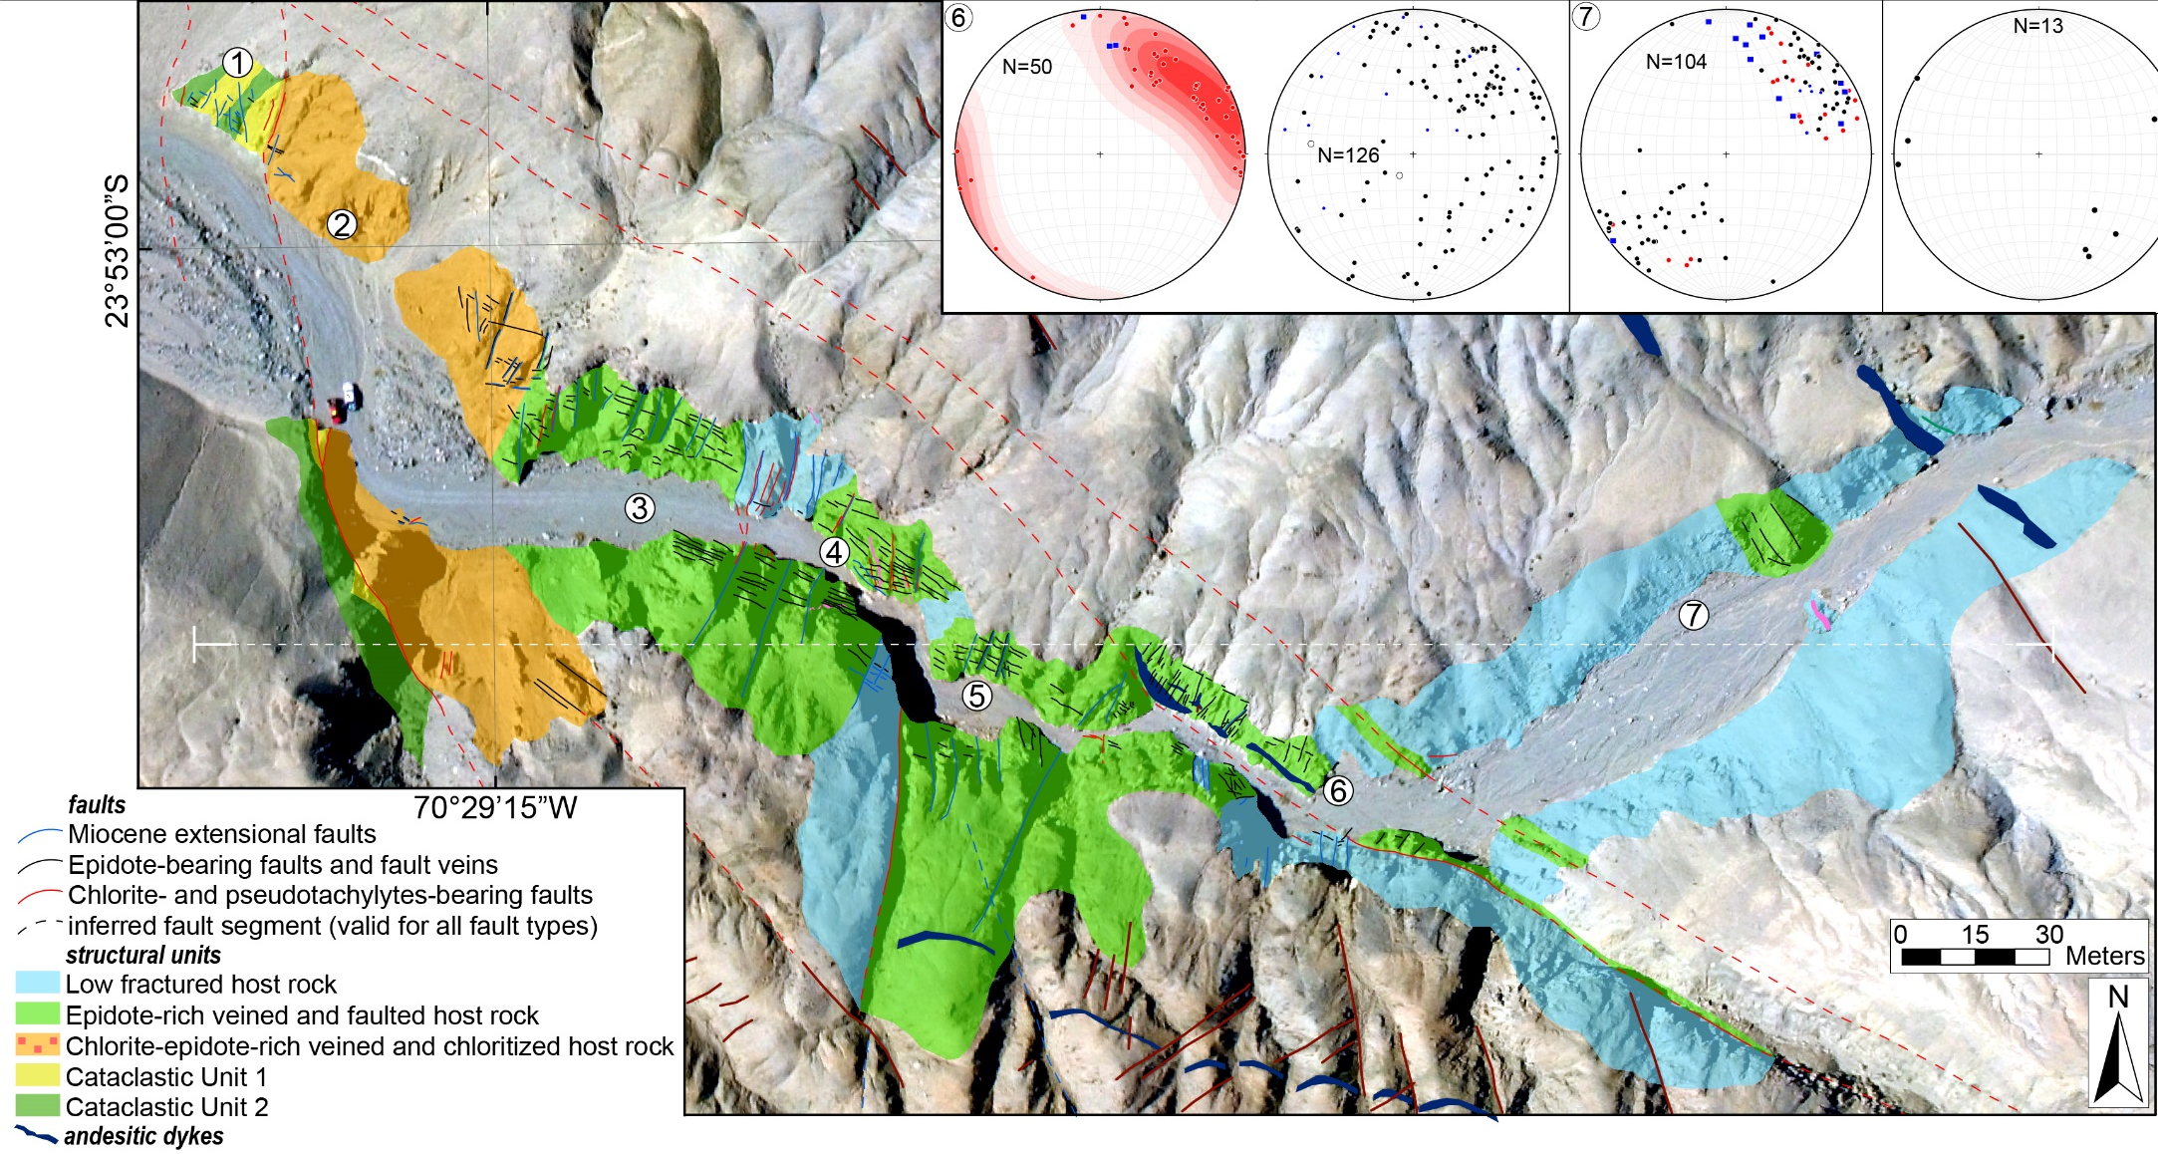
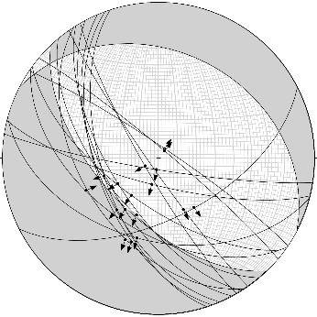
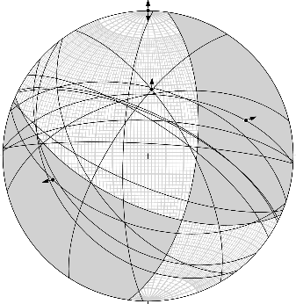
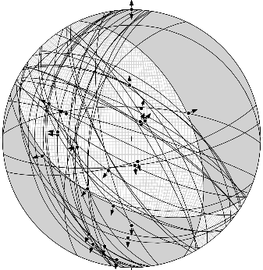
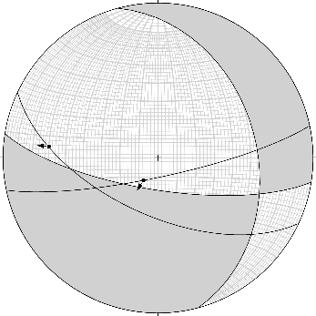
Damage zone associated with clusters of epidote-rich fault & vein networks
Fault slip analysis
Normal dip-slip kinematics
Oblique-slip kinematics

Slide 8
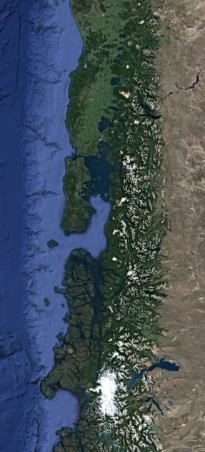
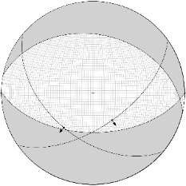

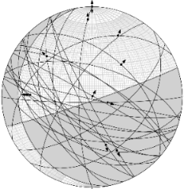
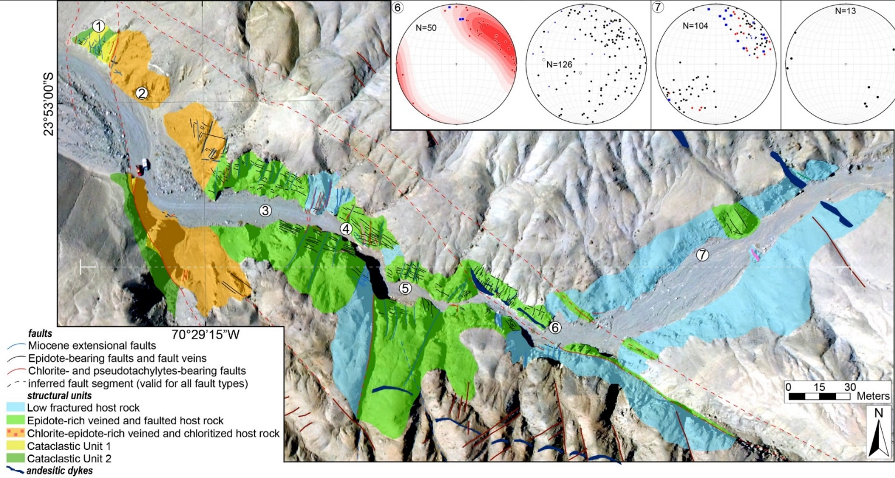
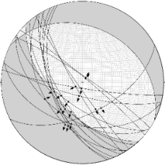
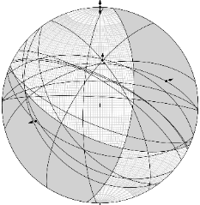
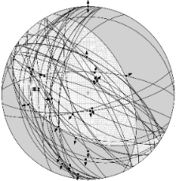
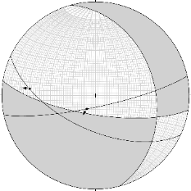
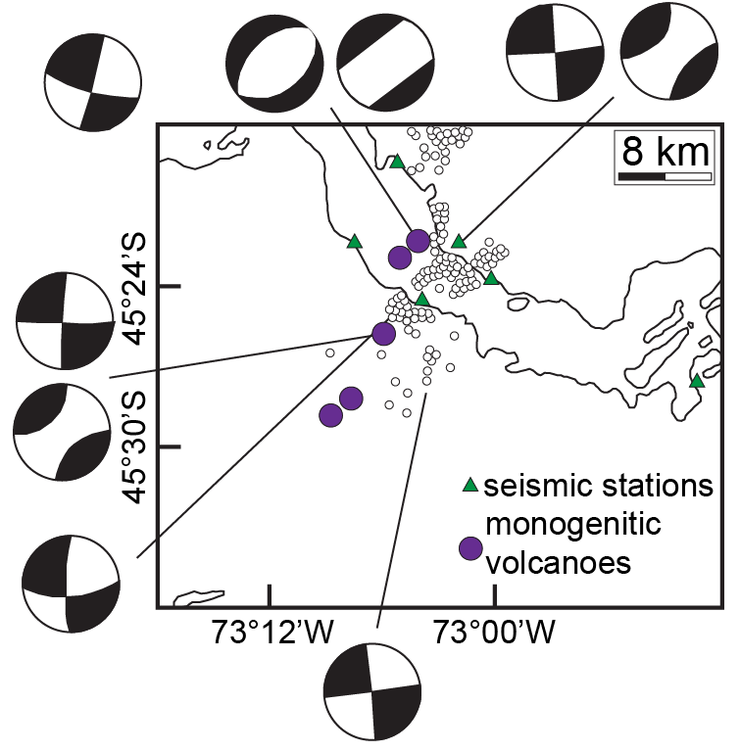
Epidote-rich fault-vein network = exhumed analogue of swarm sequence
Toltén
Pucón
Puerto
Montt
Liquiñe-Ofqui Fault System
100 km
2007 Aysén Fyord swarm sequence
Modified from Legrand et al. (2011)
Notes:
HAVE VARIABLE KINEMATICS
CLUSTERING
CYCLING FRACTURING AND SEALING
EXTENSIVE FLUID-ROCK INTERACTION
THESE FEATURES ARE OBSERVED IN FLUID-DRIVEN SWARM SEQUENCE. AS A RESULT, WE CAN INTERPRETED ….

Slide 9
Conclusions
The Bolfin Fault Zone is an example of a crustal-scale seismogenic fault hosted in crystalline basement rocks.
The Bolfin Fault Zone consists of multiple fault core strands associated with strongly altered and damaged rocks.
Clusters of epidote-rich fault-vein networks are interpreted as exhumed seismic sources of fluid-driven swarm sequences.
Fell free to contact me at
simone.masoch@phd.unipd.it

