Slide 1

Measuring Height Difference Using Two-Way Satellite Time and Frequency Transfer
Peng Cheng¹, WenBin Shen^{1,2}, Xiao Sun¹,
Chenghui Cai¹, Kuangchao Wu¹ and Ziyu Shen³
1. School of Geodesy and Geomatics, Wuhan University, China.
2. State Key Laboratory of Information Engineering in Surveying,
Mapping and Remote Sensing, Wuhan University, China.
3. School of Resource, Environmental Science and Engineering,
Hubei University of Science and Technology, China.
EGU General Assembly 2022, (23-27 May 2022)

Slide 2
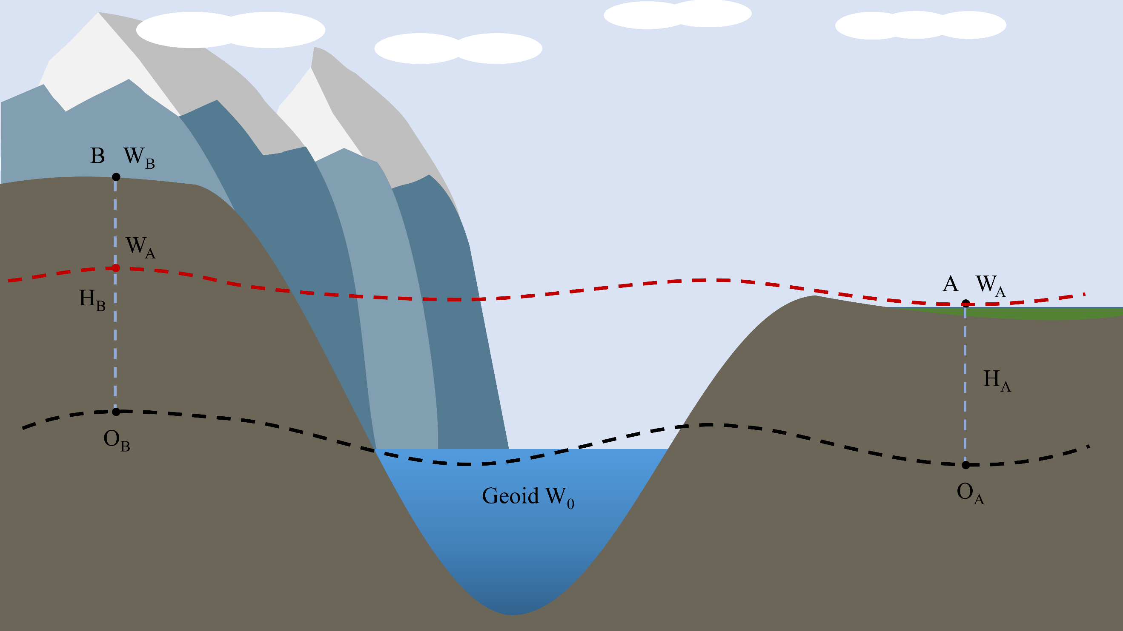
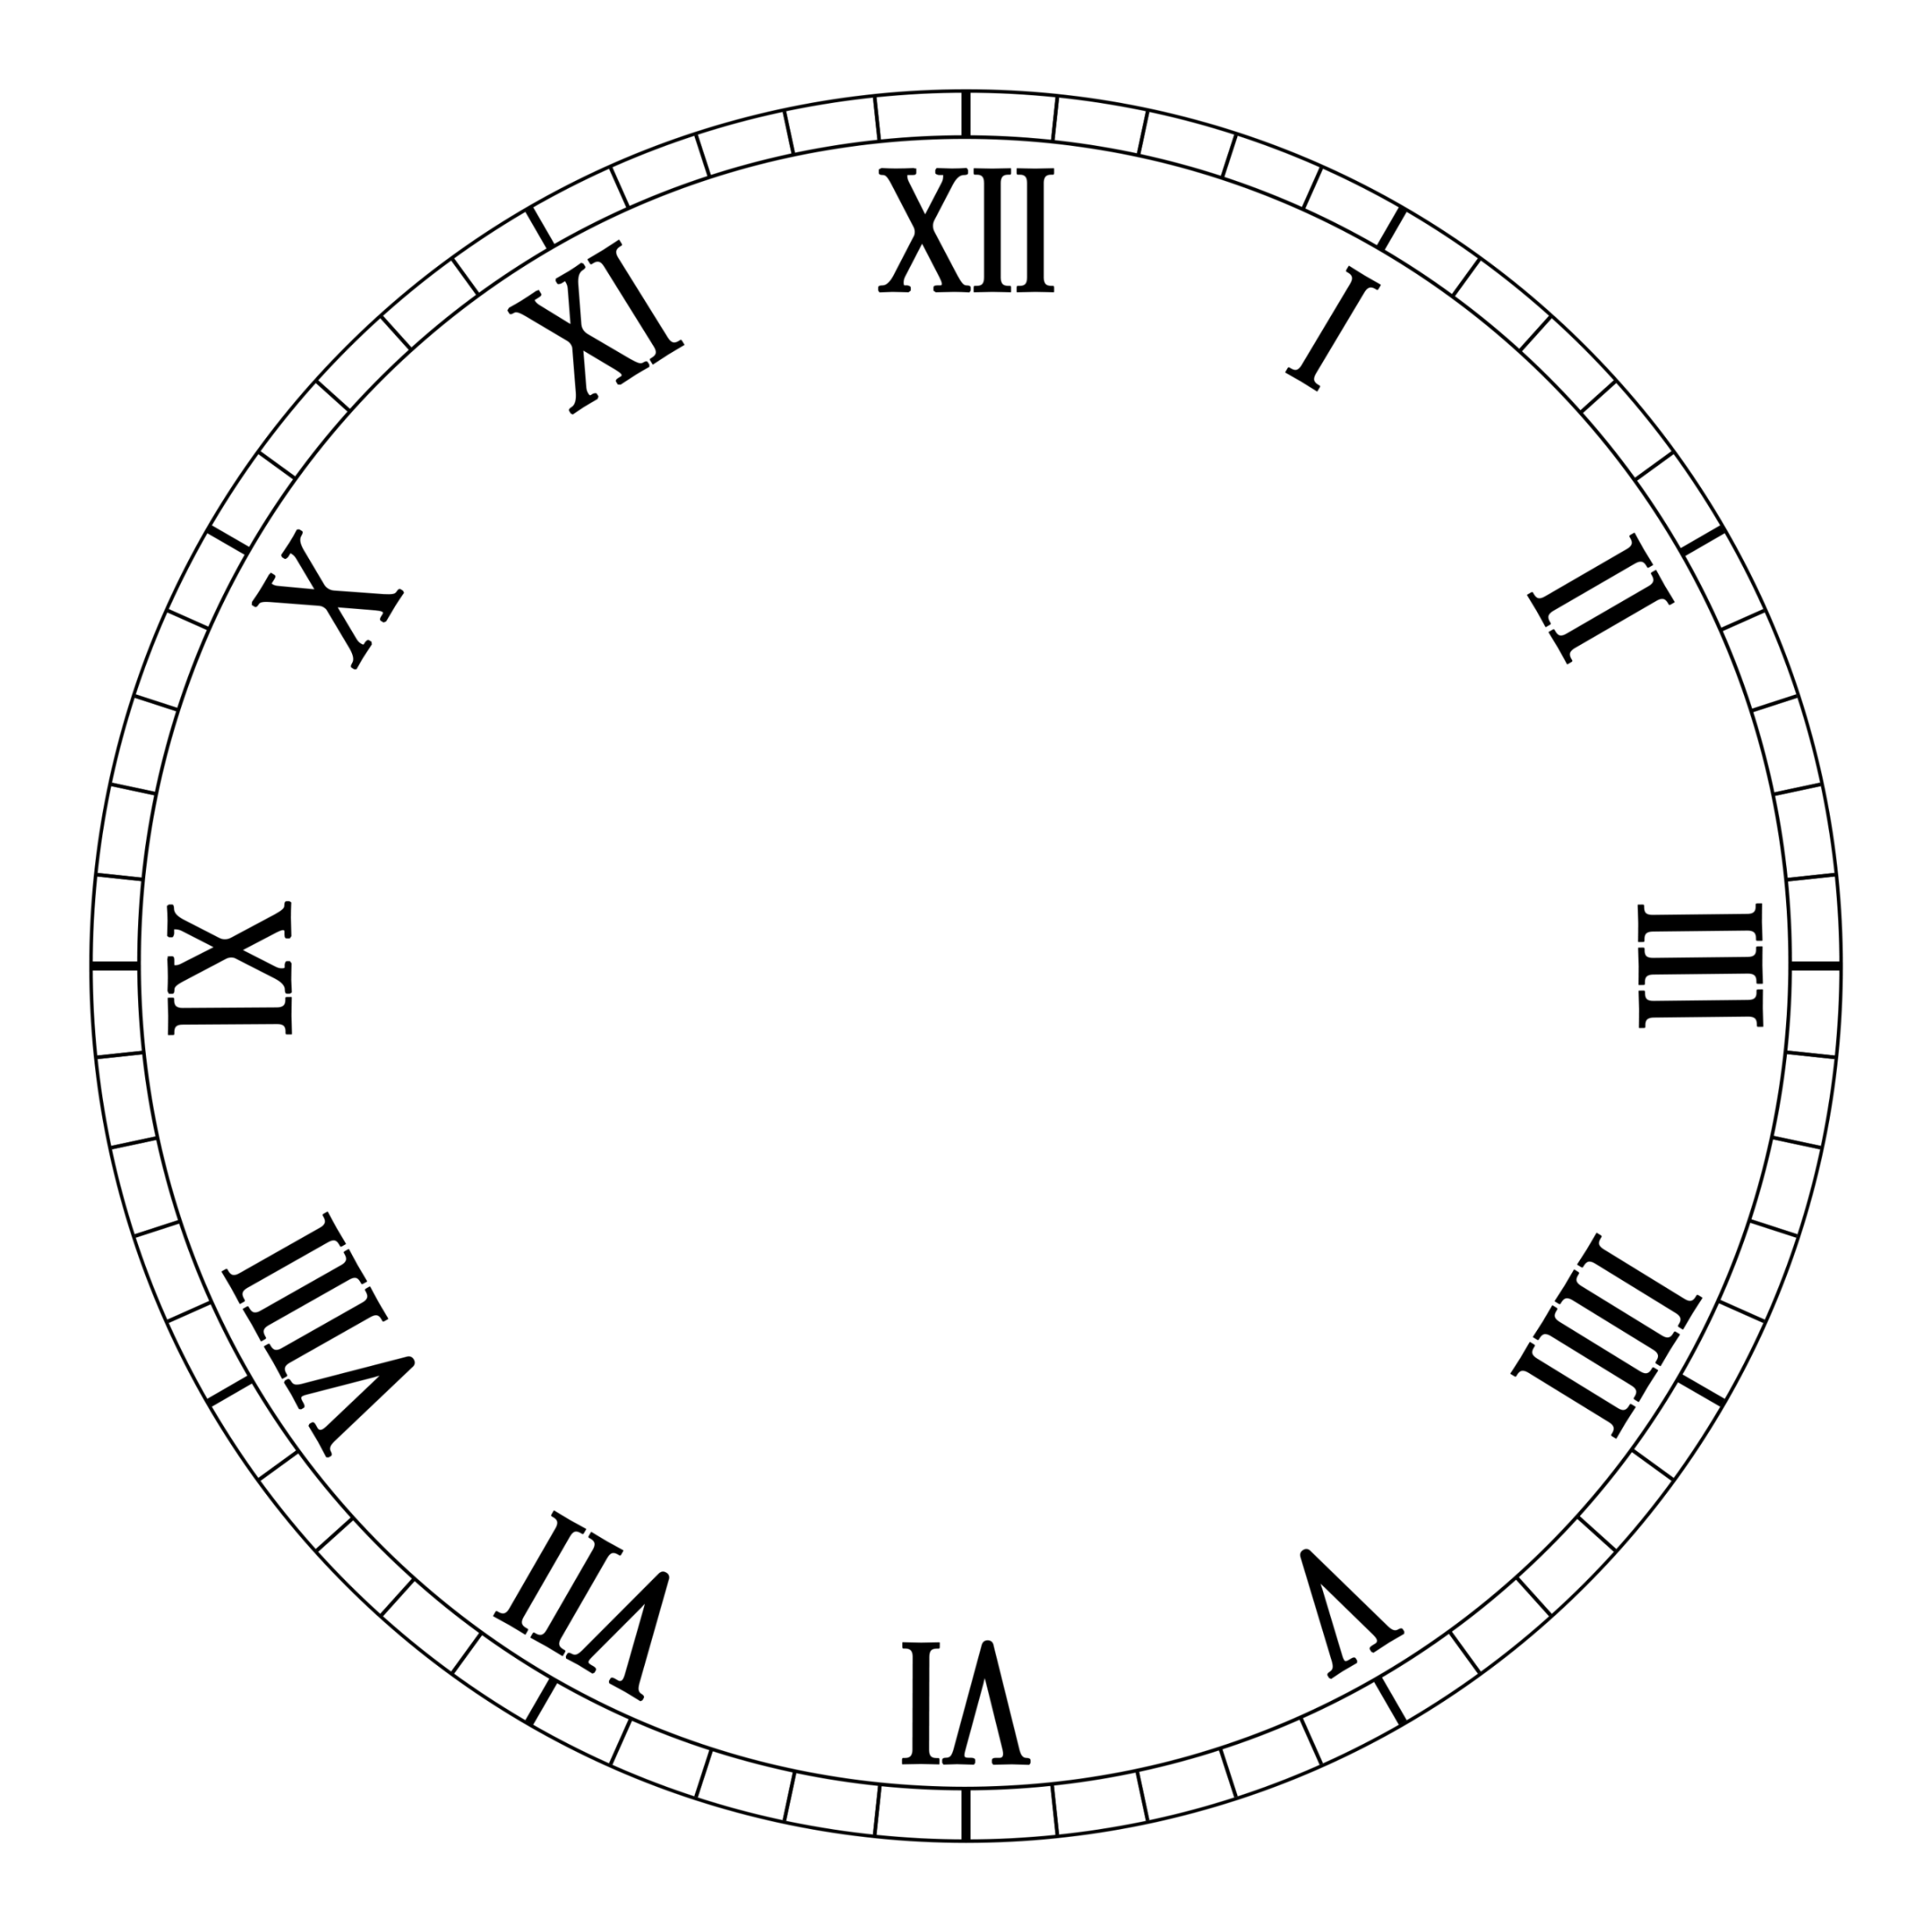

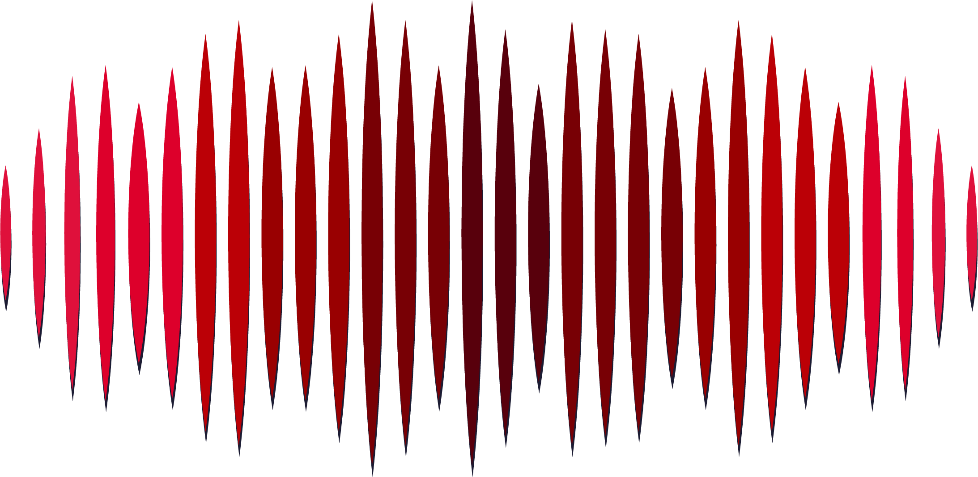

Theory
According to general relativity theory (GRT), the clock at a position with lower geopotential ticks slower than an identical one at a position with higher geopotential (Figure 1). Here, we provide a geopotential comparison using a non-transportable hydrogen clock and a transportable hydrogen clock for altitude transmission based on the two-way satellite time and frequency transfer (TWSTFT) technique.
(1)
(2)
Figure 1 relativistic gravity measurement(Cheng et al. 2022)

Slide 3
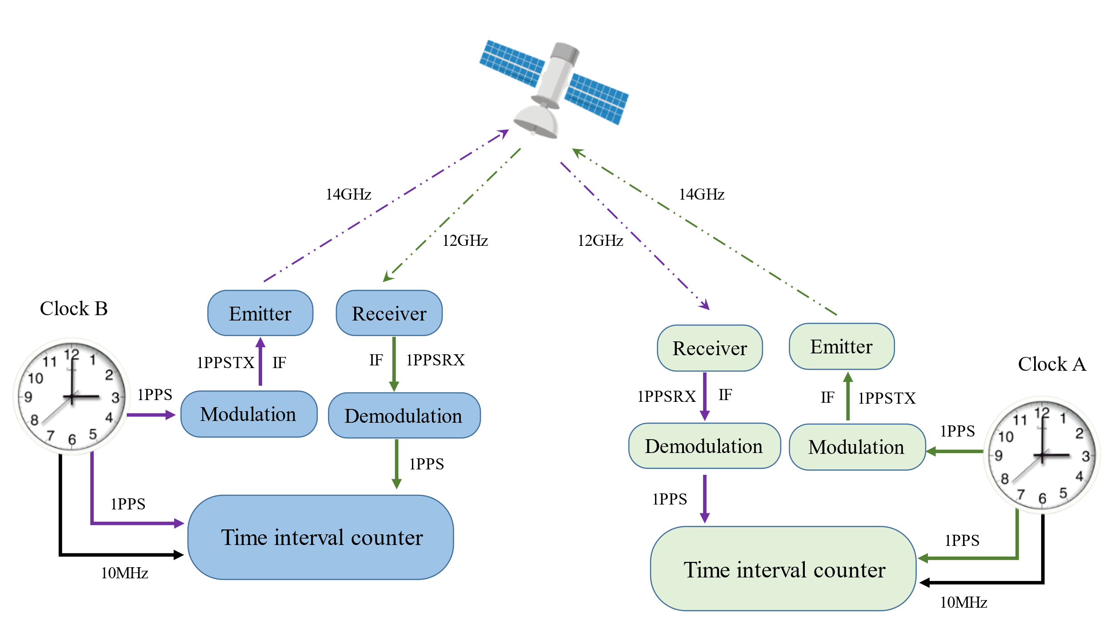
Method
Figure 2 shows the transmission process of 1 PPS signal in the TWSTFT. When the 1 PPS signal is generated by a clock, a part of the 1 PPS signal enters time interval counter (TIC) as trigger gate open pulse. Another part of the 1 PPS signal is transmitted to a satellite, through the modulation and emitter. The satellite uses a transparent transponder to transmit it to another ground station. After the signal from the satellite is received, the receiver and demodulation recover the 1 PPS signal from the received signal. The recovered 1 PPS signal enters the TIC as a pulse to trigger the gate close. The above processes are conducted between each of the two stations.
Figure 2 TWSTFT transmission process (Cheng et al. 2022)

Slide 4
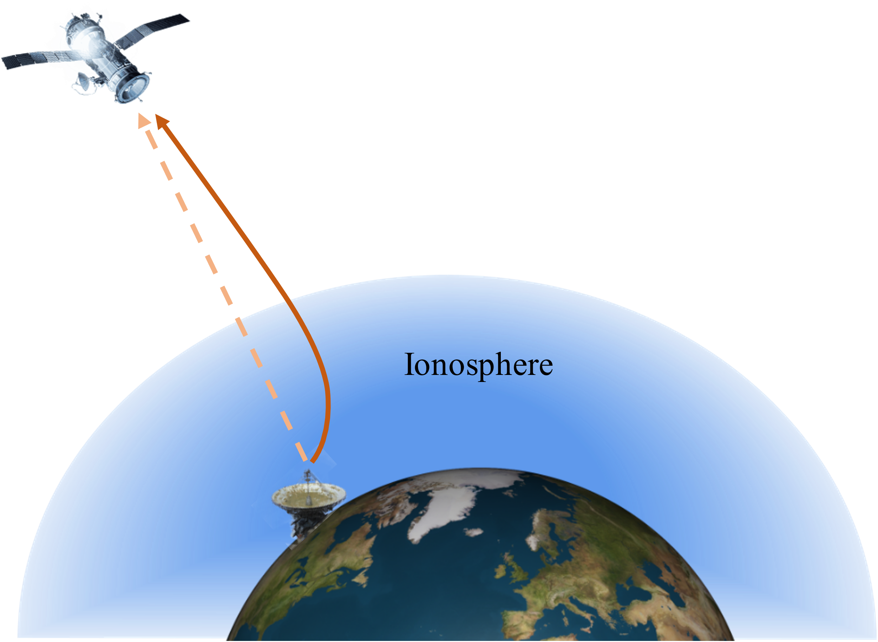
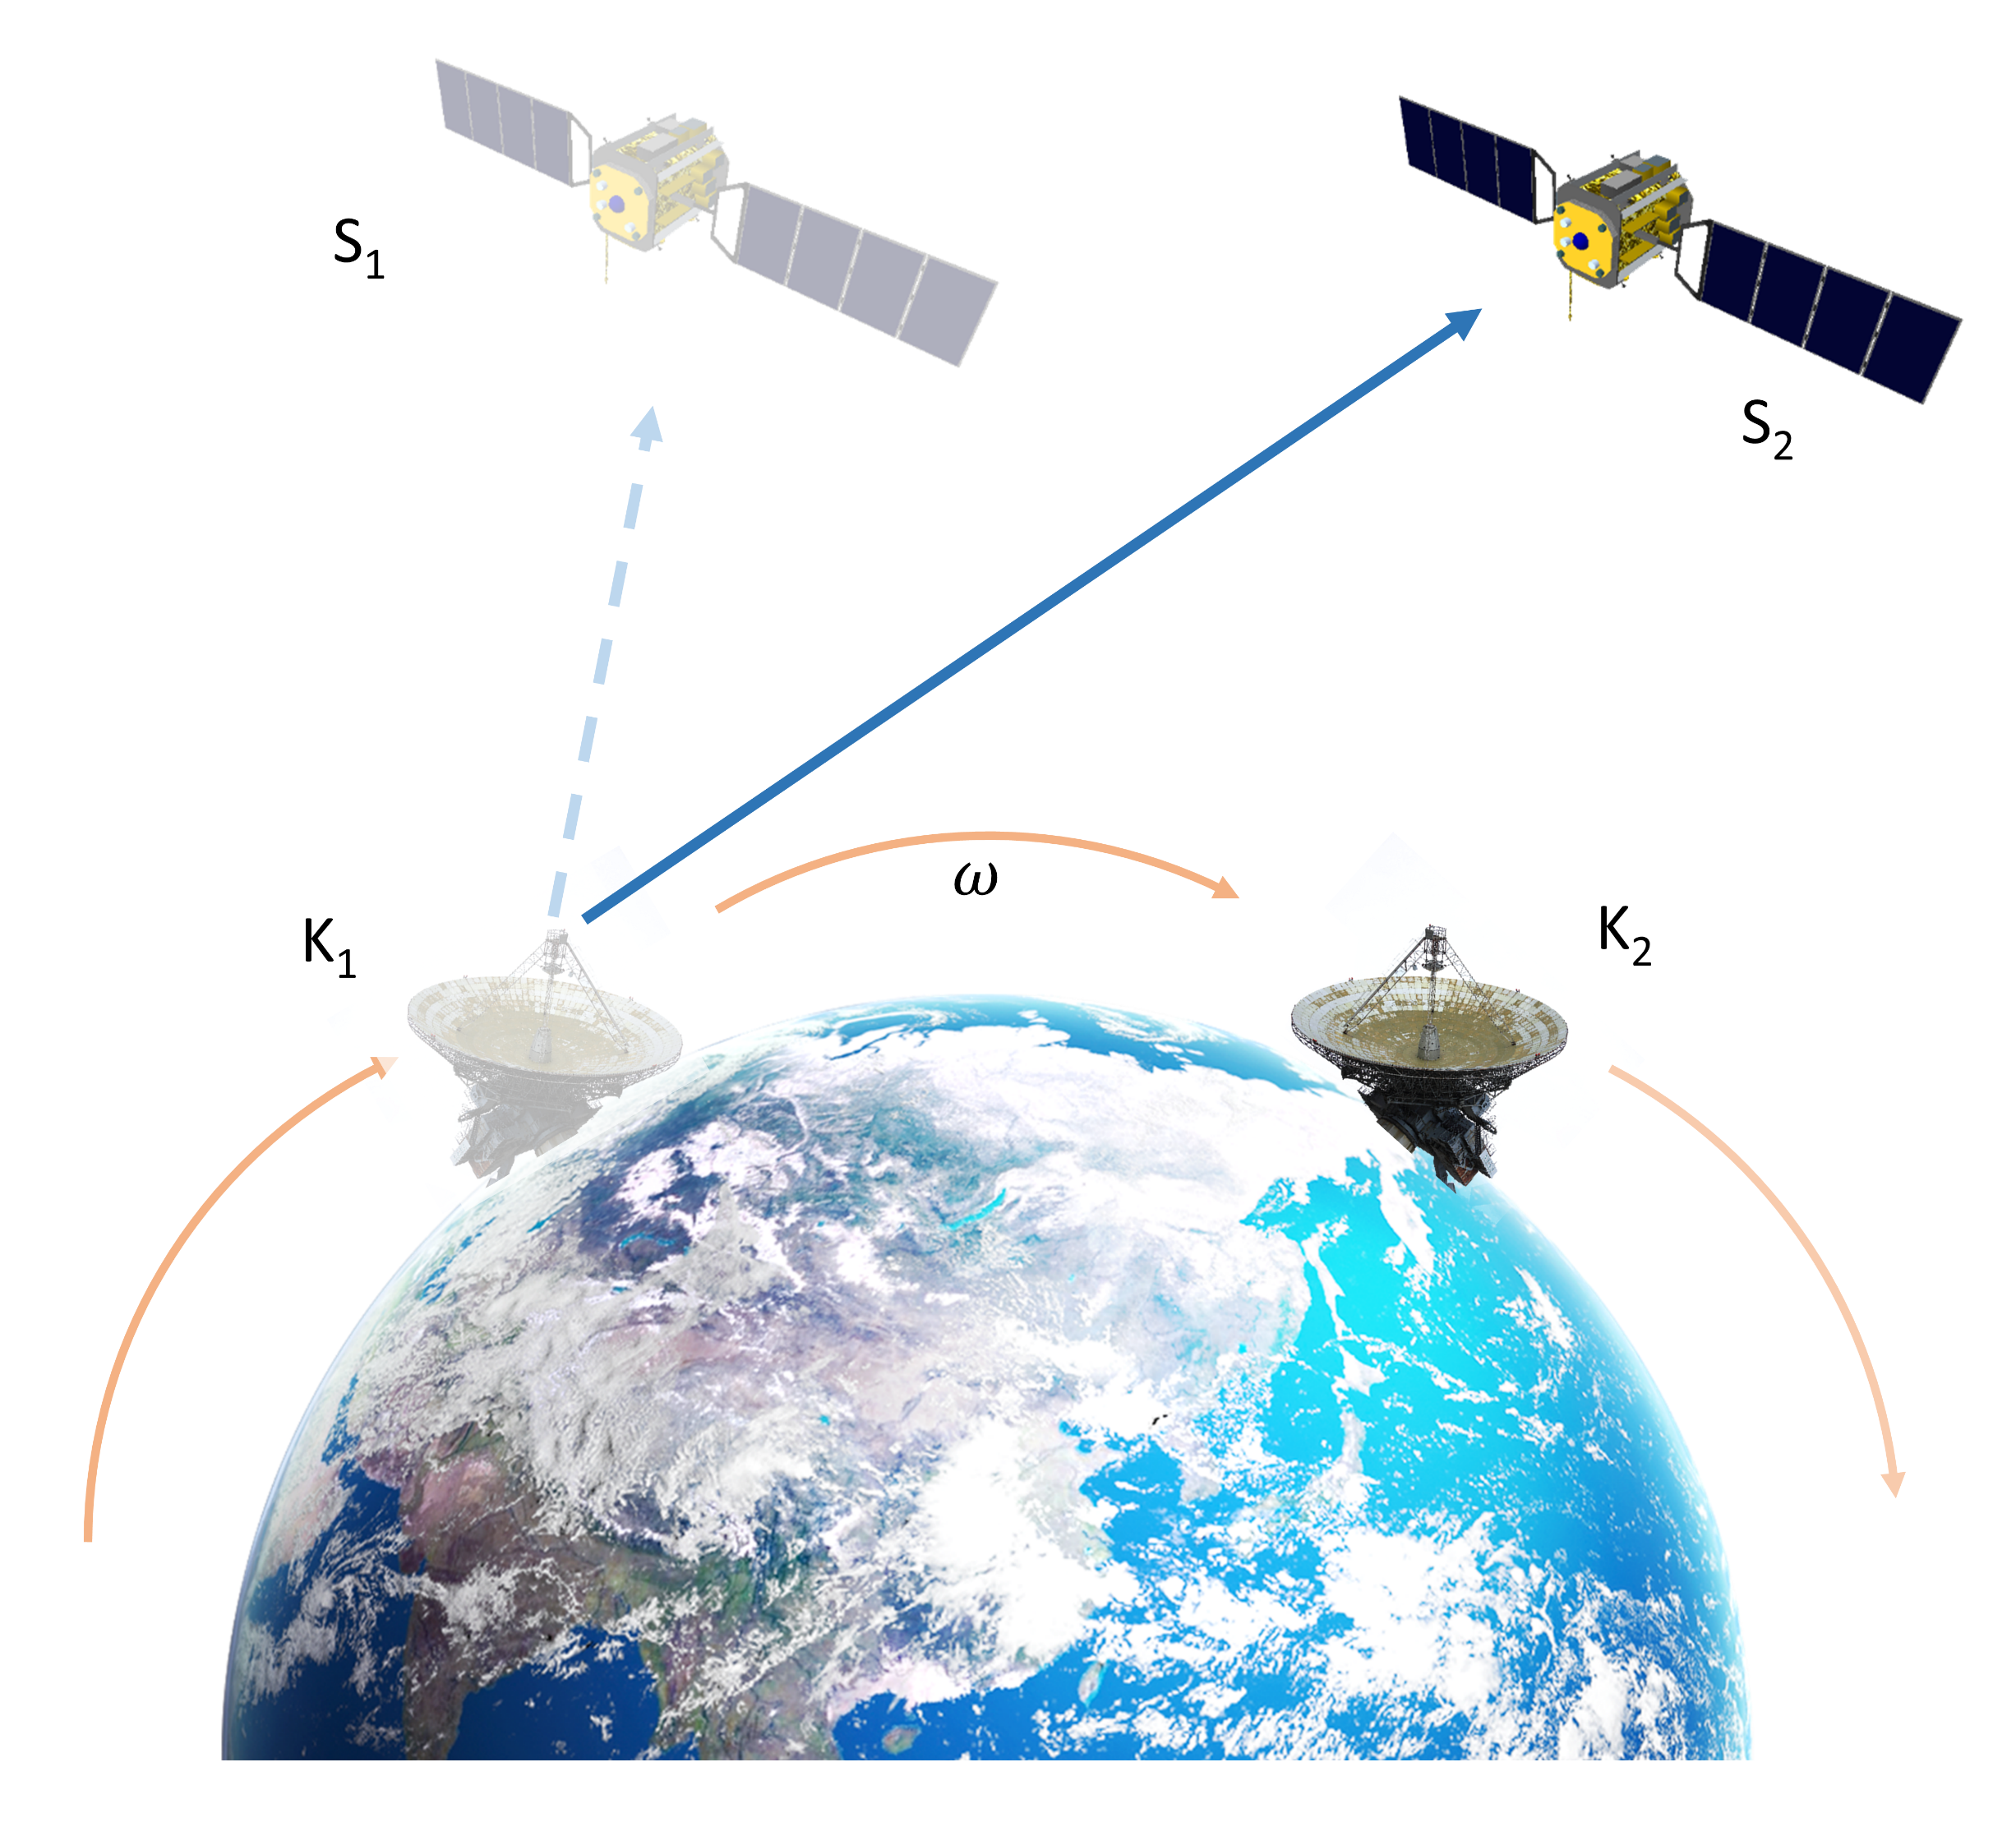
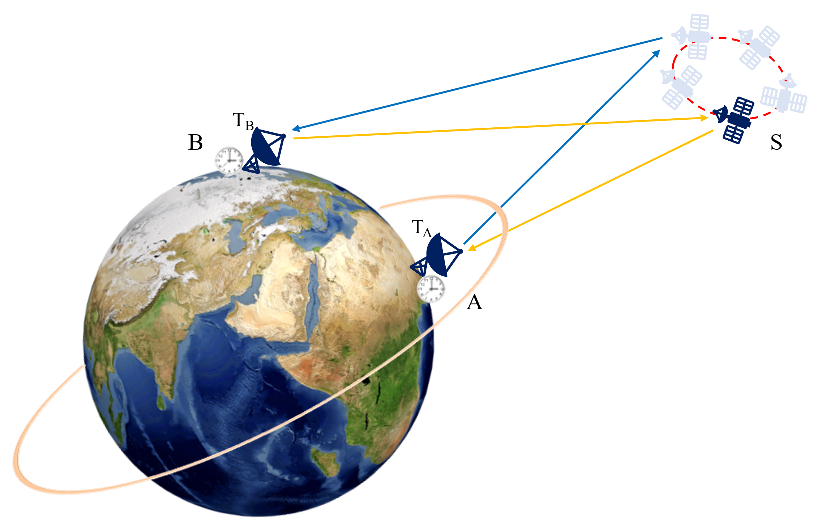
Error correction
Figure 3 Ionospheric delay
Figure 4 Sagnac effect
Figure 5 Movement of satellite
The ionospheric delay error is mainly caused by charged particles in the ionosphere. The charged particles can change the speed and path of the signal.
Since the satellite and ground stations are moving, this motion causes the signal-propagation change; the corresponding influence is referred to as the Sagnac
effect.
In terrestrial reference frame, the position of satellite relative to station changes over time. This will bring some errors caused by asymmetry.

Slide 5
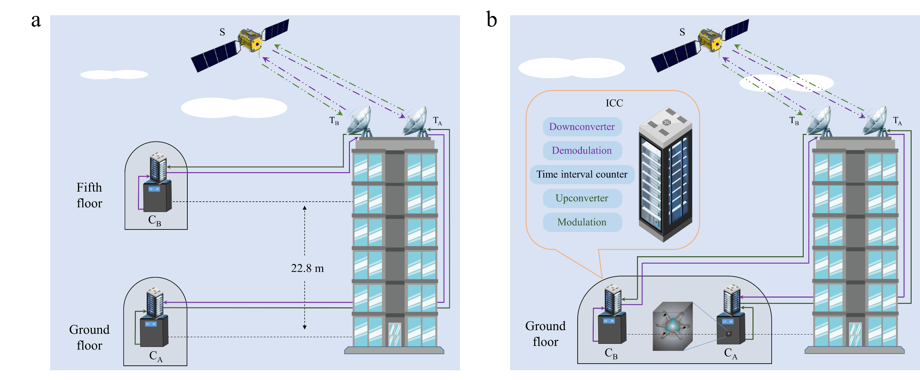
Experiments
To verify the feasibility of this method, we conducted the experiment in a building at the BIRMM, Beijing.
Figure 6 Time difference measurement. (a) Geopotential difference measurement. (b) Zero-baseline measurement (Cheng et al. 2022)

Slide 6
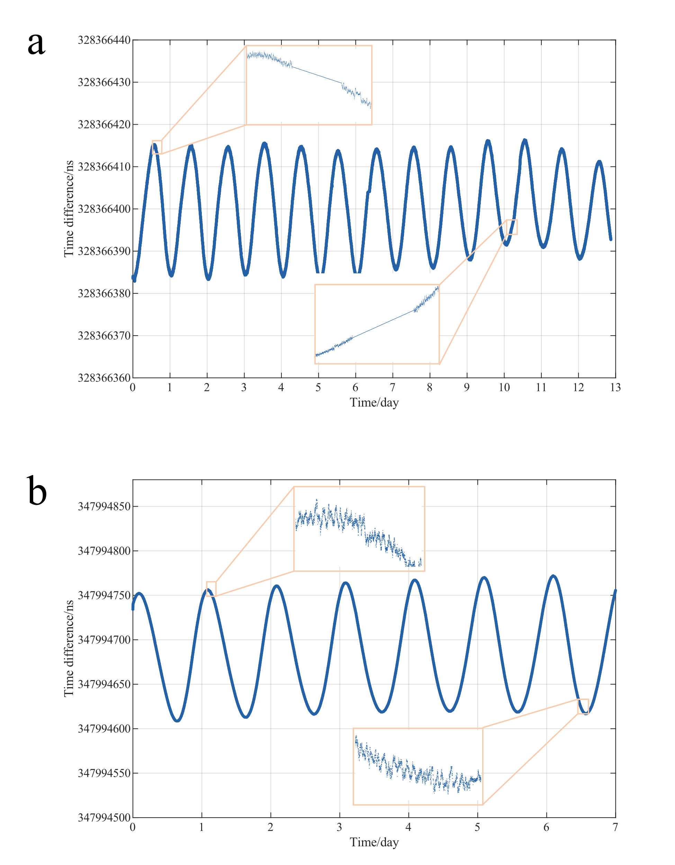
Data processing
There are some defects in row data. To improve the quality of the data, the following procedures are adopted
Outliers
Missing data
Jumps
Elimination
linear interpolation
Up and down shift
Figure 7 Time difference data. (a) Geopotential difference measurement. (b) Zero-baseline measurement (Cheng et al. 2022)

Slide 7
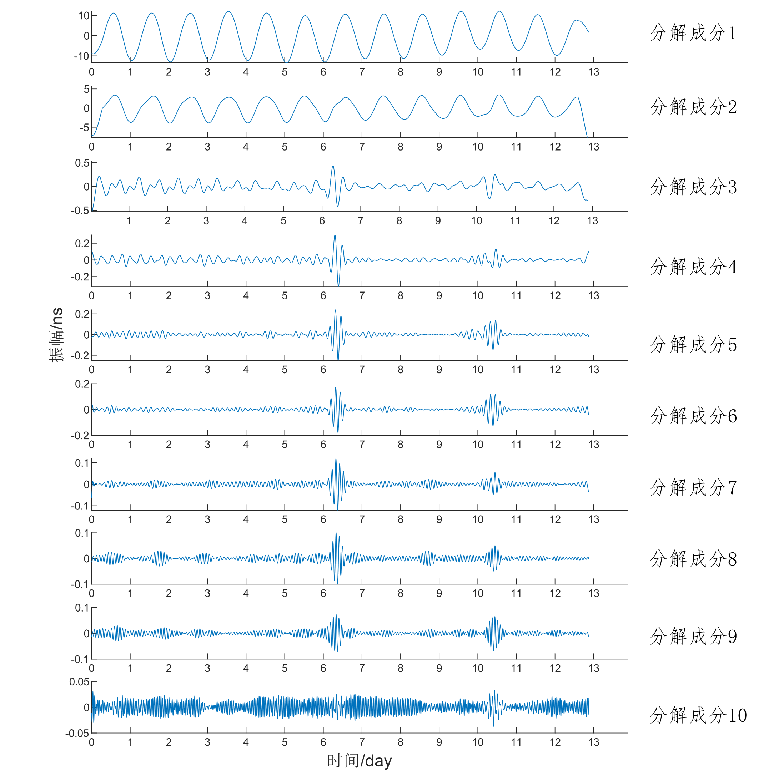
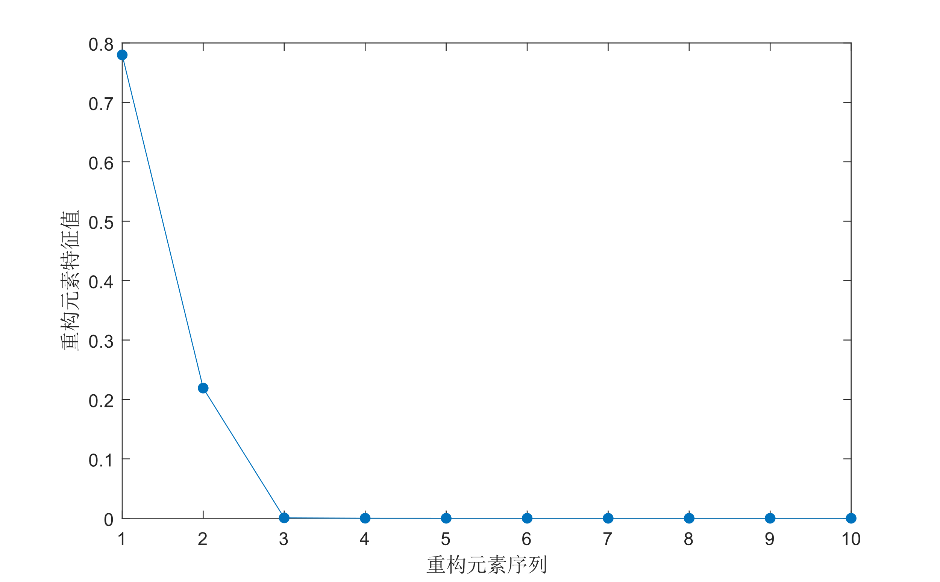
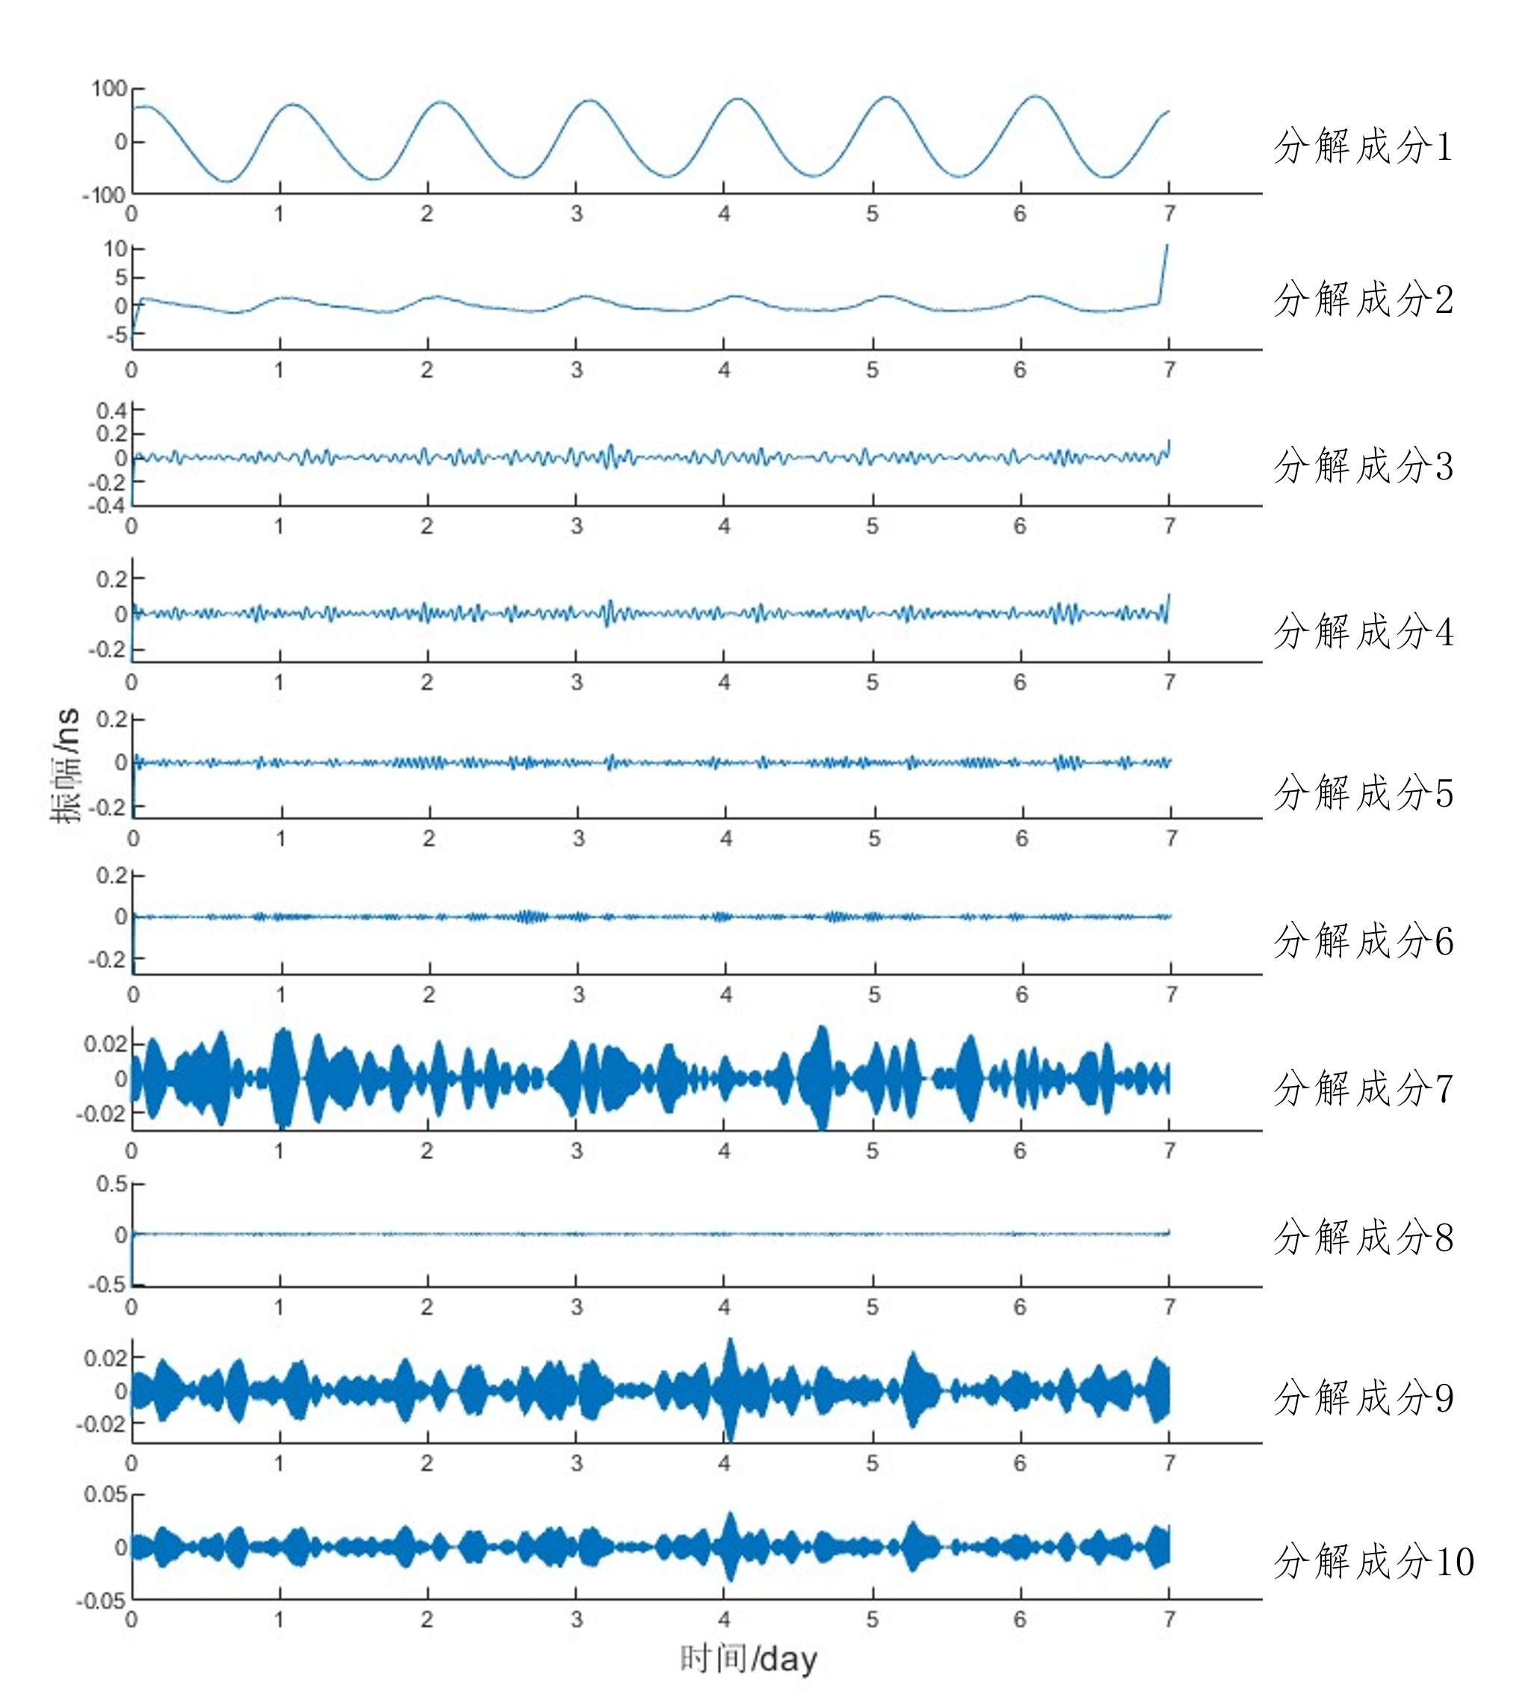
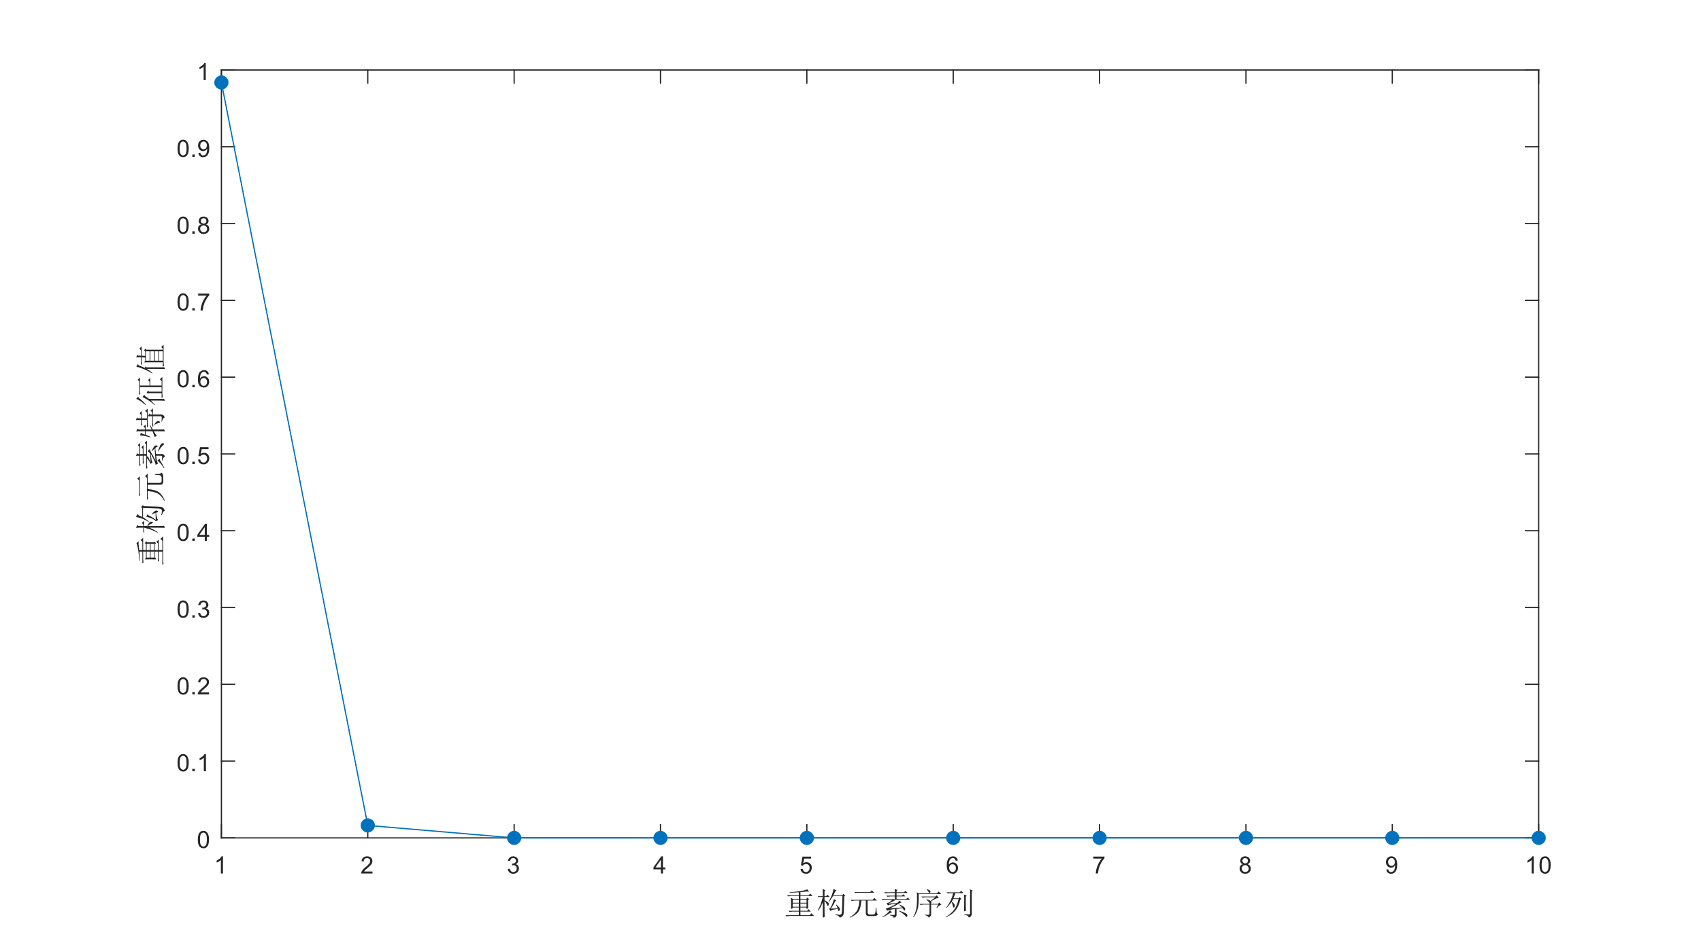
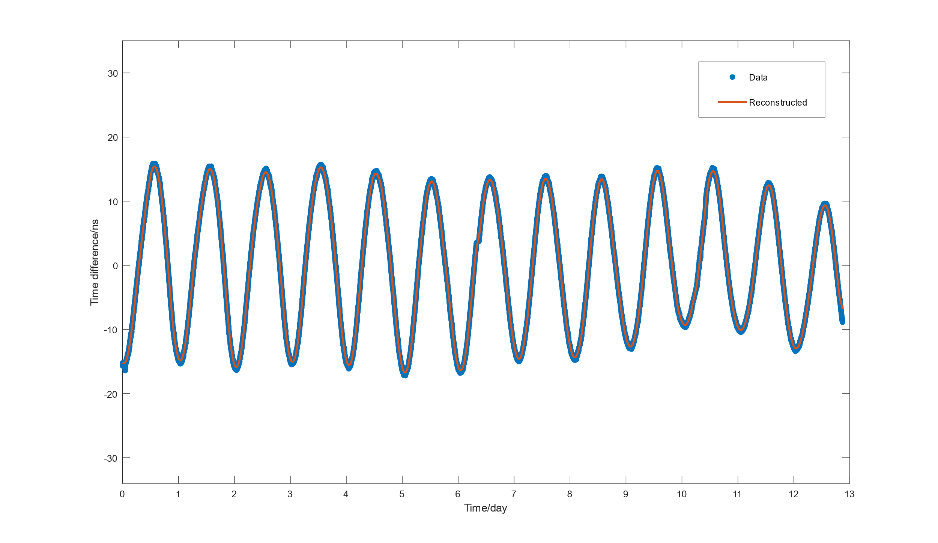
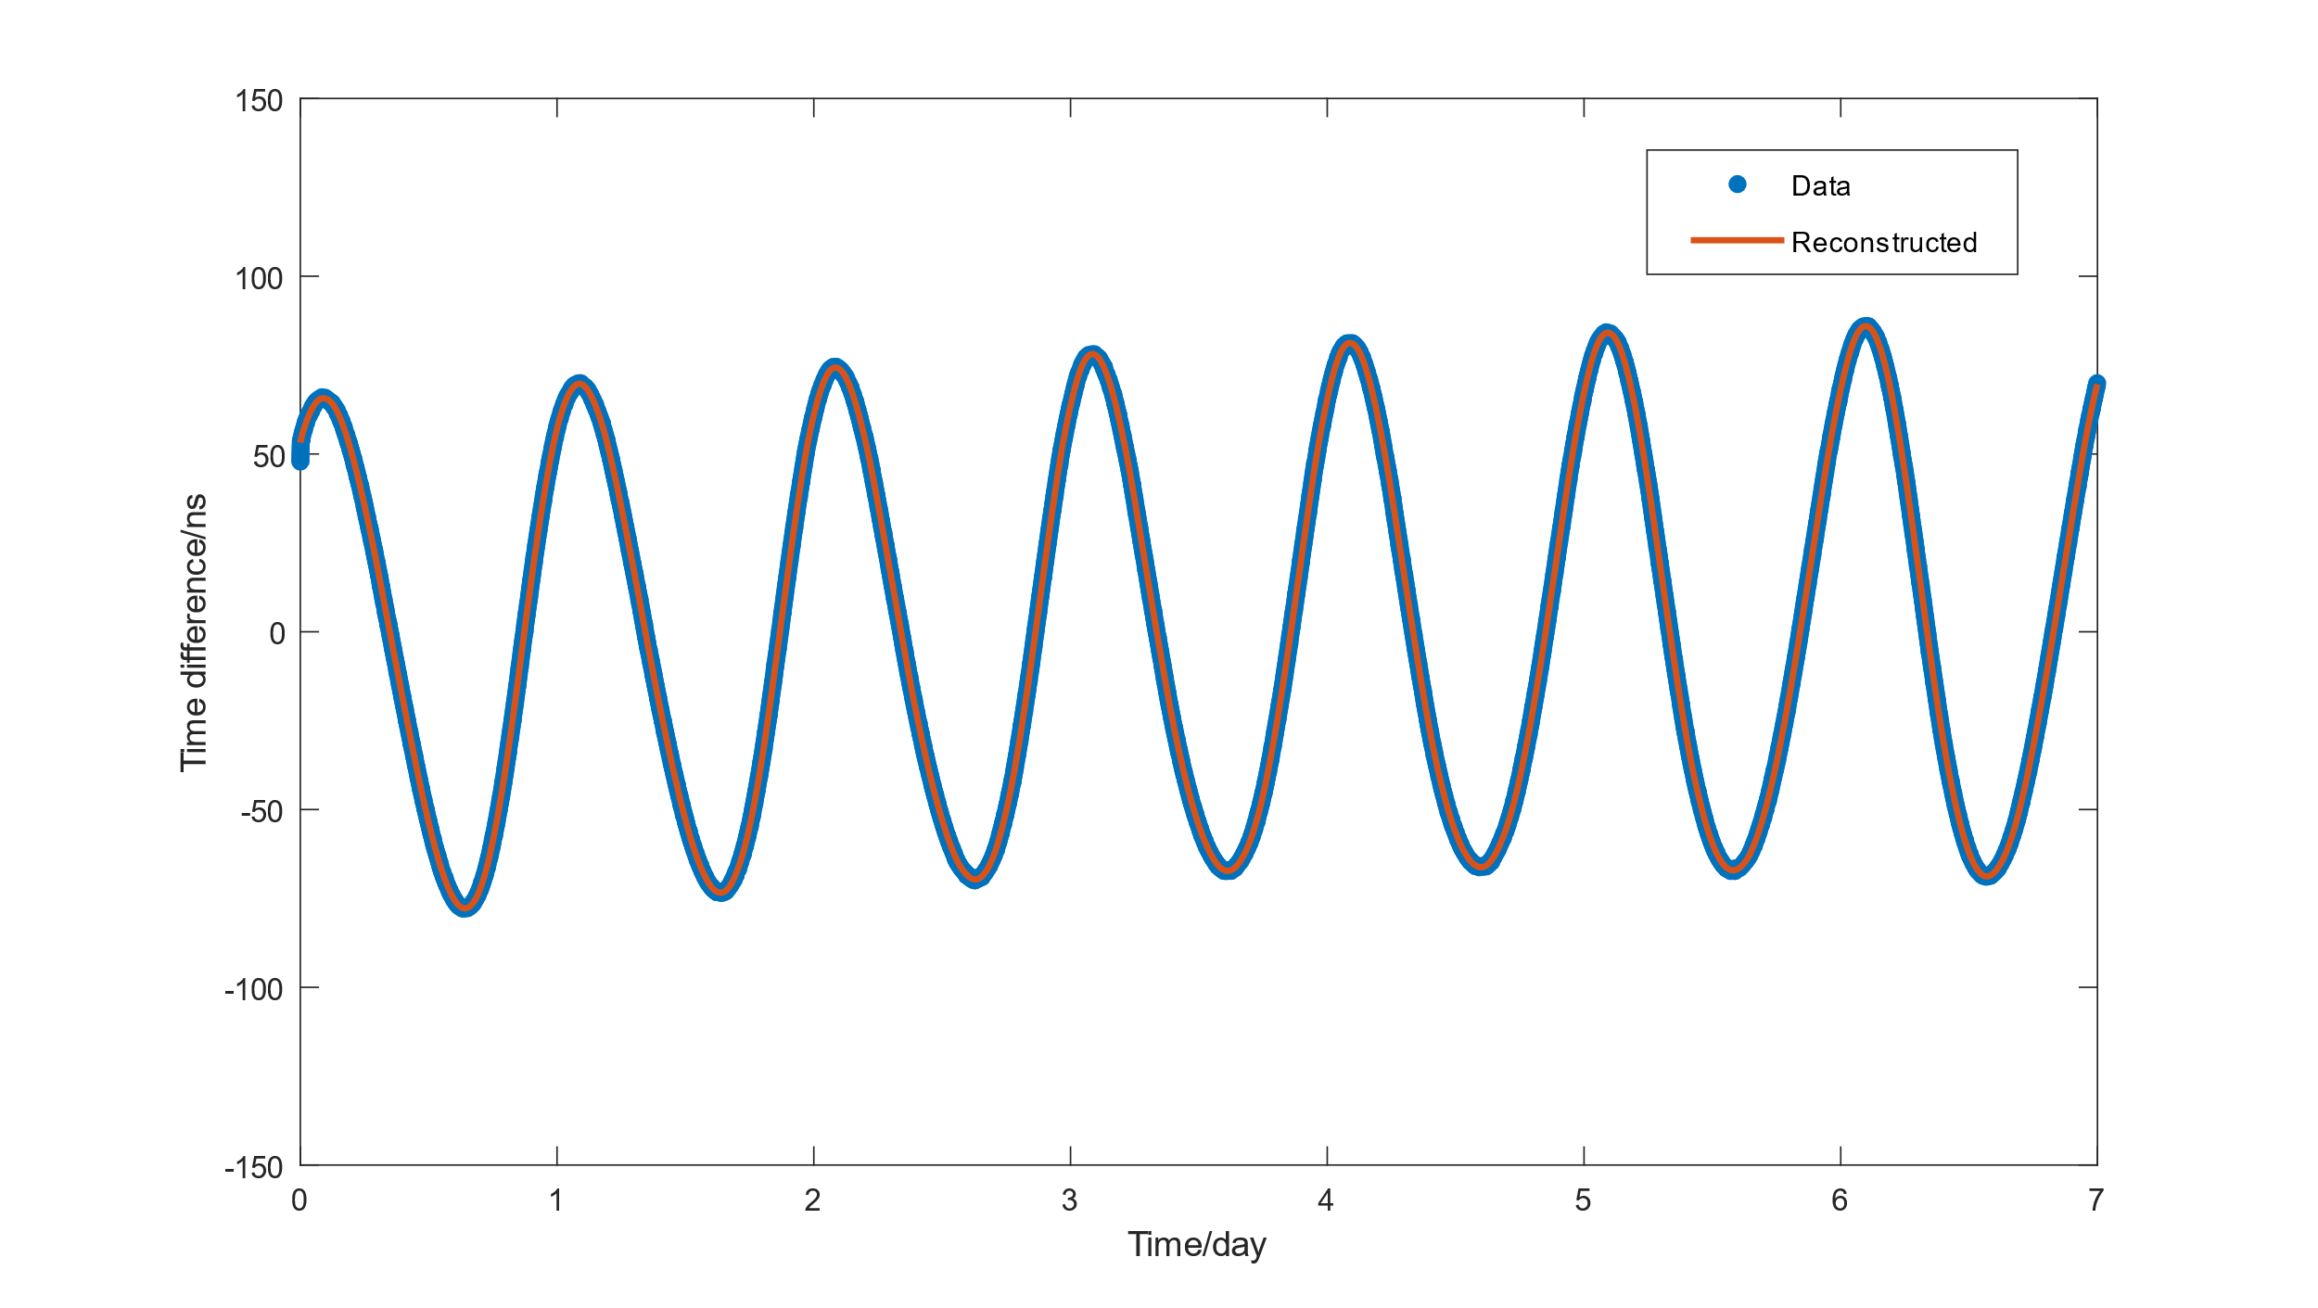
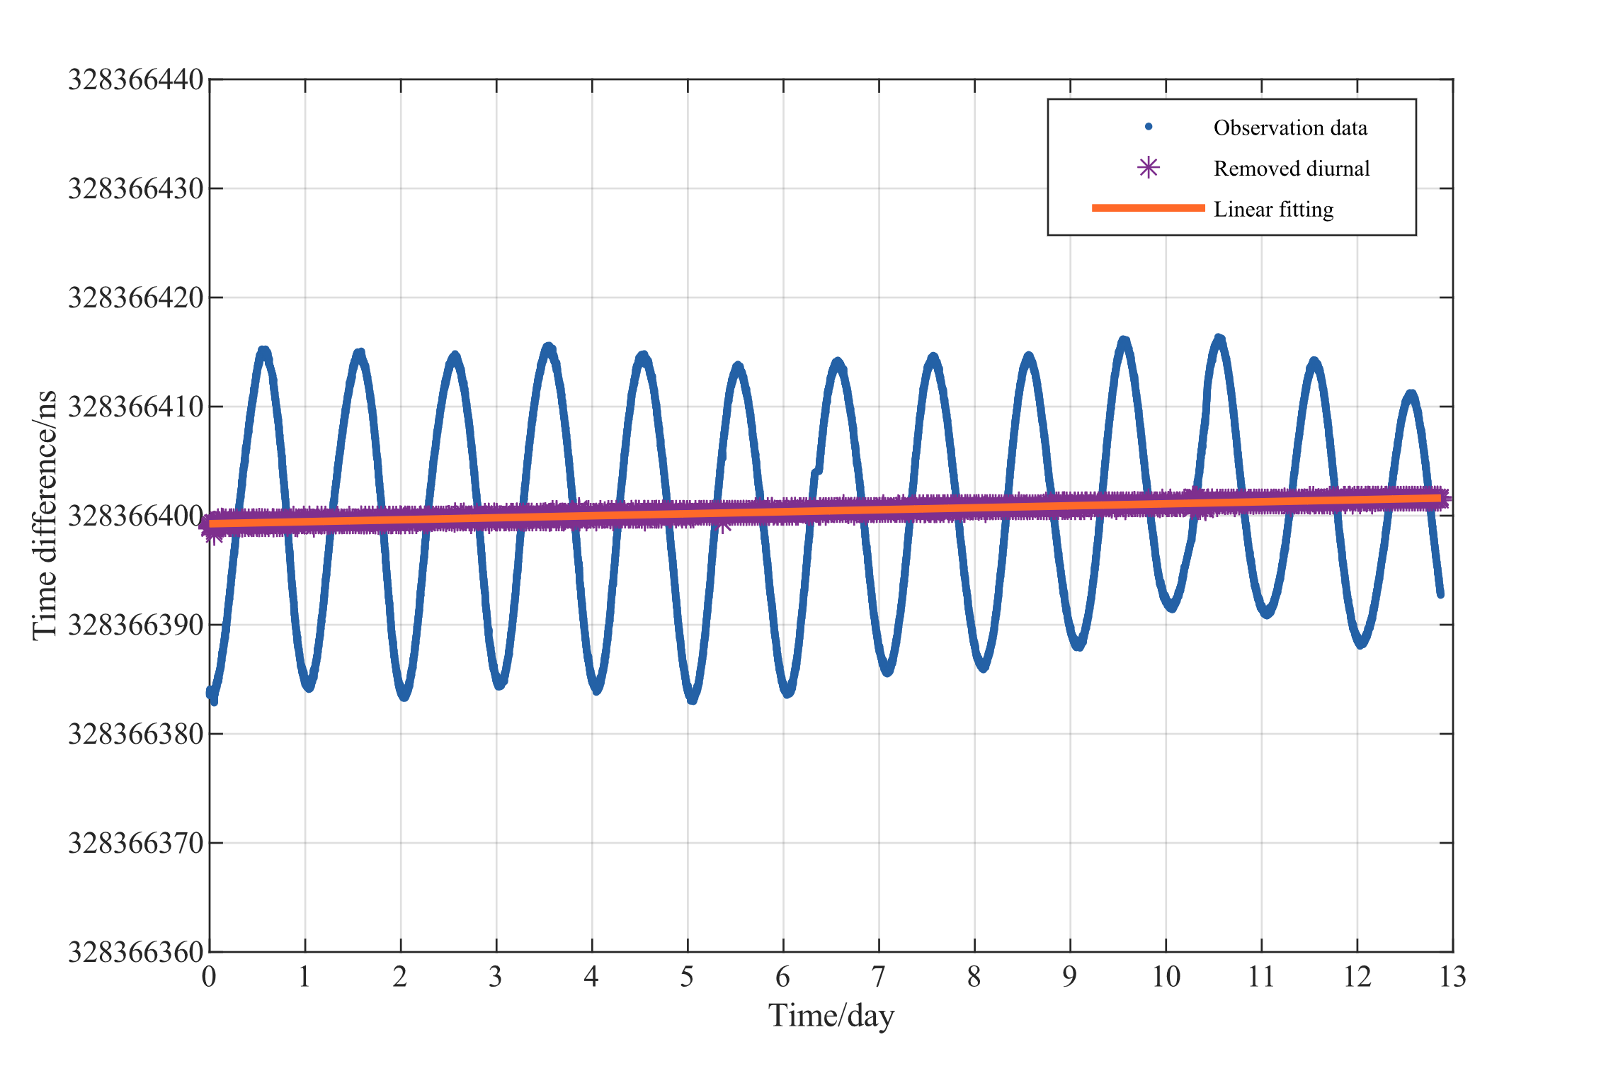
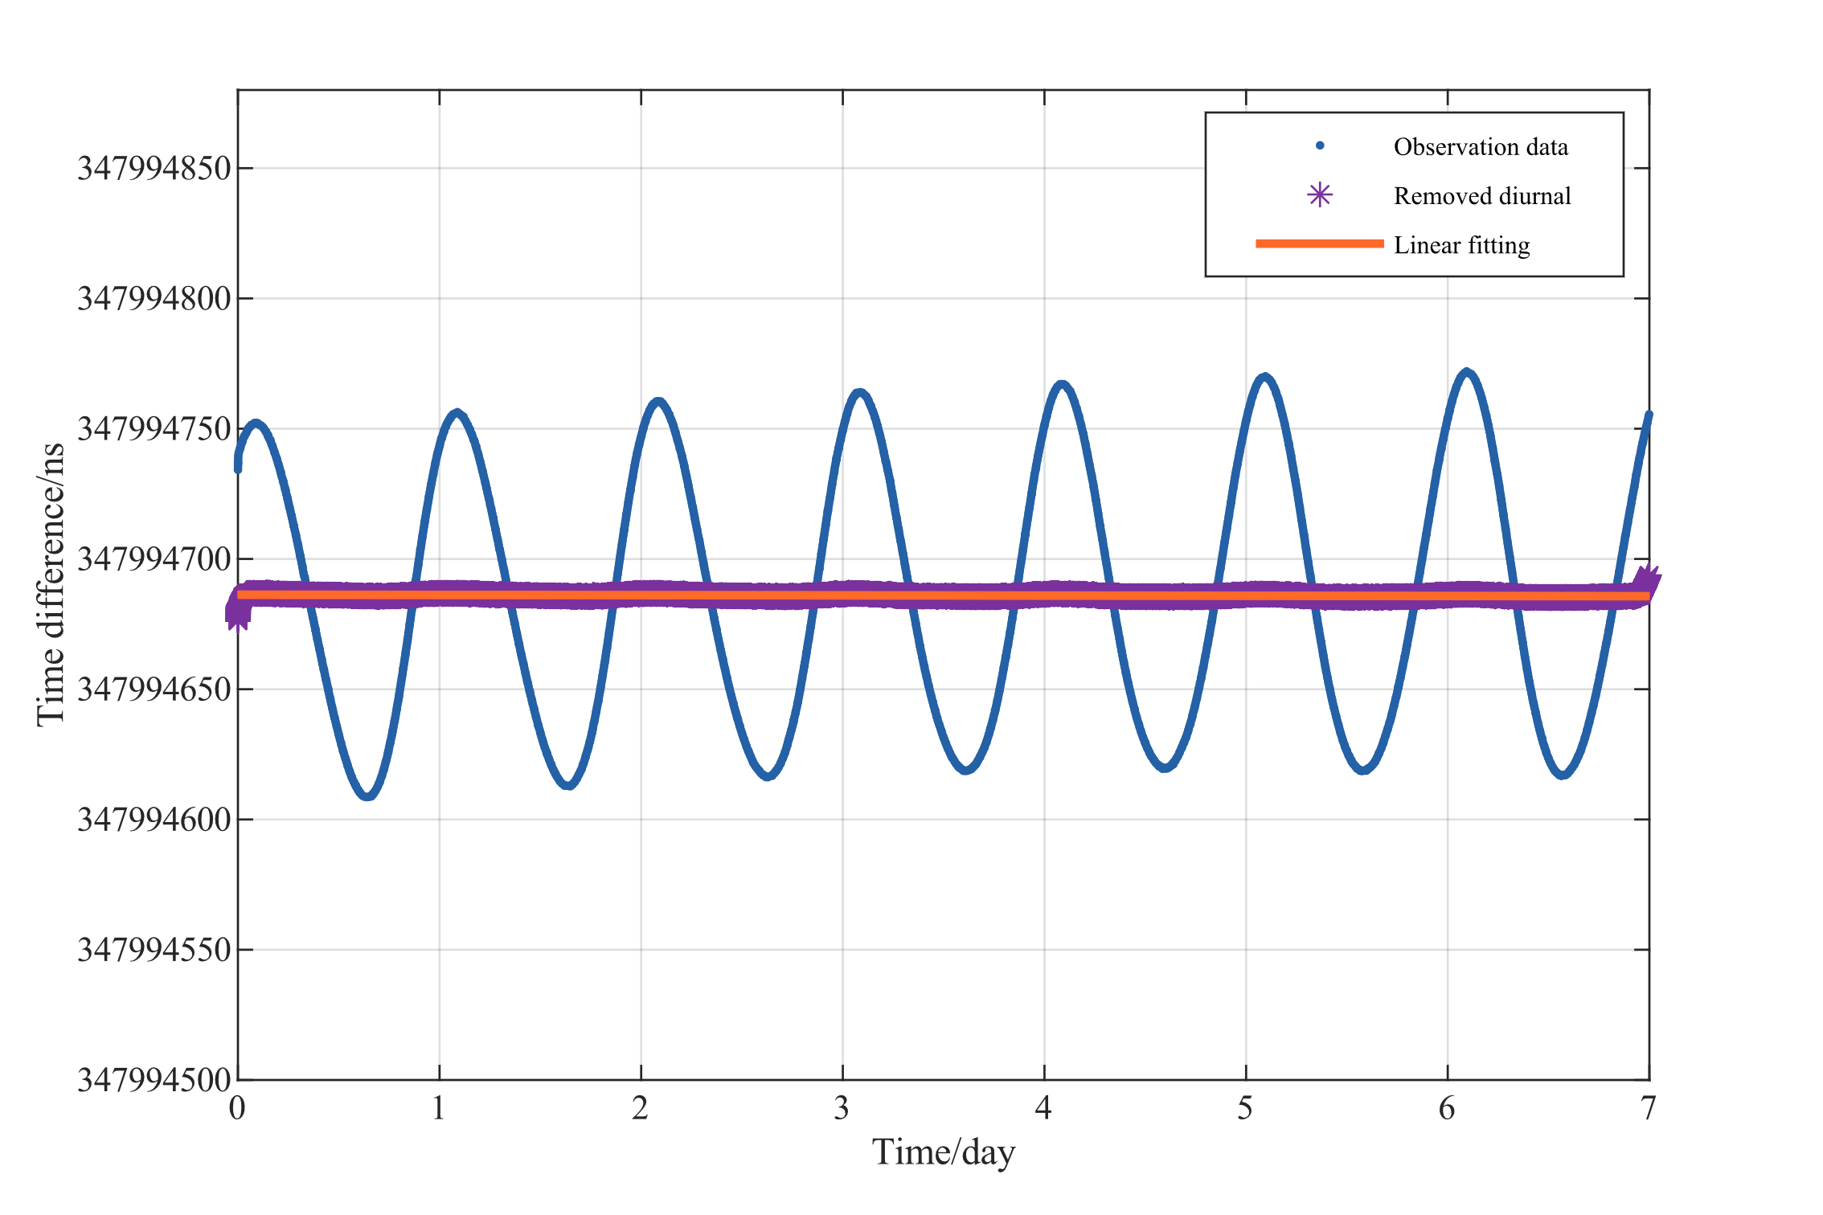
Singular spectrum analysis
Geopotential difference measurement Zero-baseline measurement
Figure 8 The first ten components
Figure 10 The first ten components
Figure 9 Extracted signal (Cheng et al. 2022)
Figure 11 Extracted signal (Cheng et al. 2022)

Slide 8
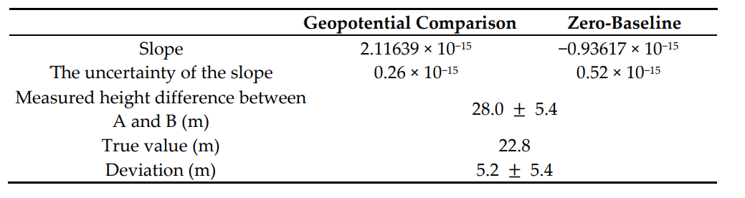
Results and conclusions
Table1 Results of geopotential comparison and zero-baseline comparison.
Conclusions
The accuracy of the measurement is slightly better than the clocks
The experimental results proved the feasibility of the method

Slide 9
Thank you for your attention!

