Slide 1


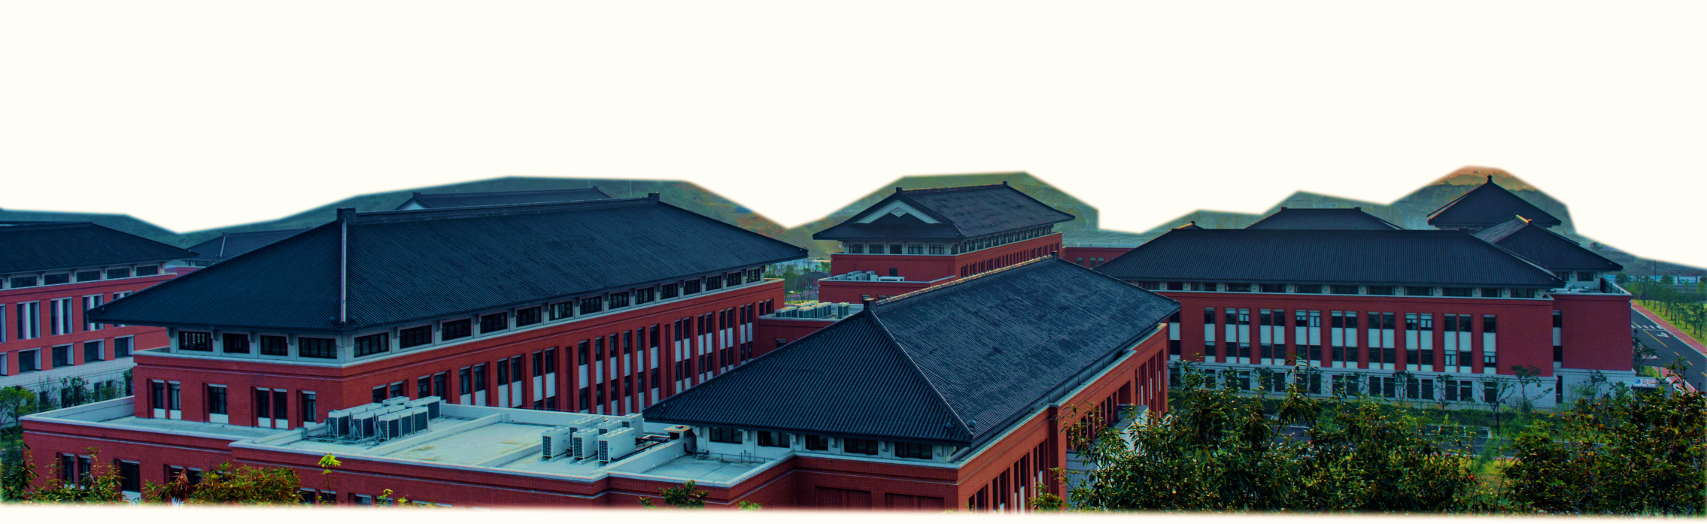
Development and field applications of shallow-water hydro-sediment-morphodynamic models
A new two-phase version and its applications to Yangtze river
Peng Hu, Binghan Lyu, Ji Li, Qifeng Liu, Youwei Li, Zhixian Cao

Slide 2
Content
What is shallow water hydro-sediment-morphodynamic model?
What is the new progress in this talk?
Results of the new progress

Slide 3
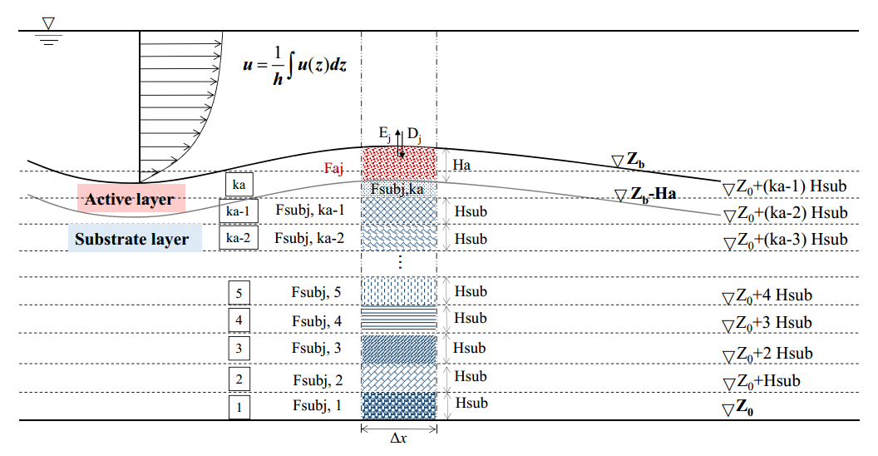
1. What is shallow water hydro-sediment-morphodynamic modelling (SWHSM)?
We use: the depth-averaged RANS equations (shallow water equations)
Physical coupling between hydro-sediment-morphodynamics
We do not ignore: the feedback of bed deformation on flow evolution
We appreciate the fact that: sediment are not necessarily in the capacity regime

Slide 4
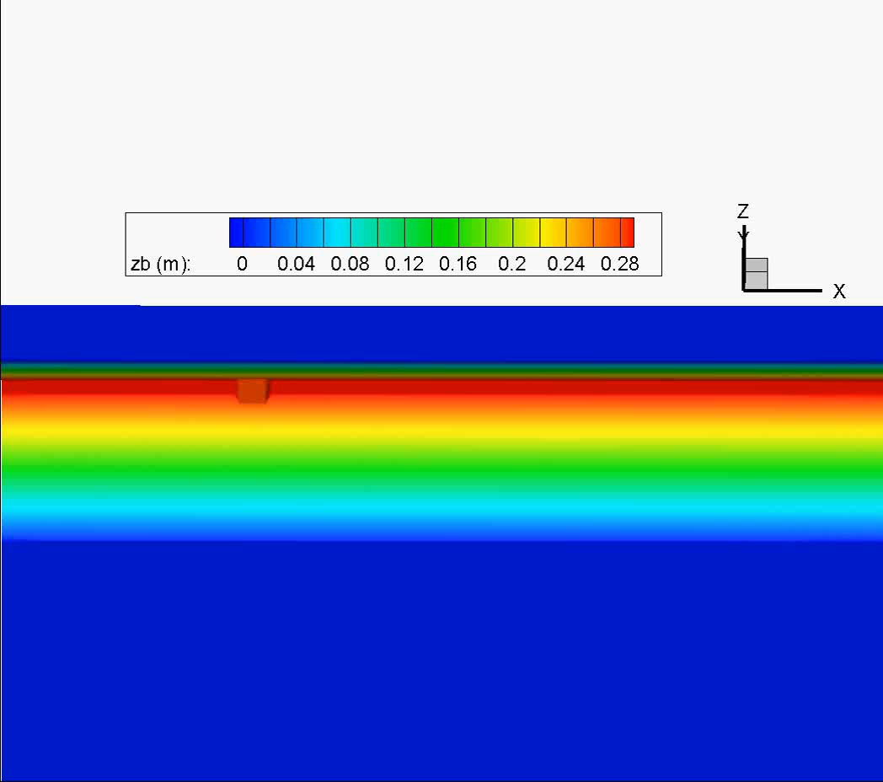
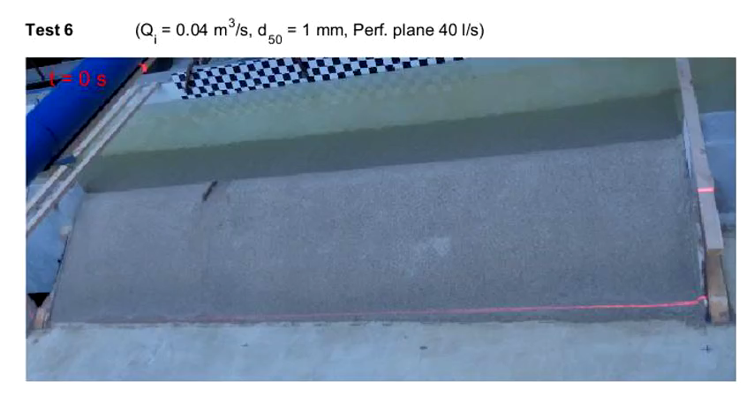
An application example
Flume Experiment (Rifai et al.，2016)
Our Simulations

Slide 5
An application example
（a）采用传统方法时，底床接收崩塌泥沙量的分布
（b）采用改进方法时，水体接收崩塌泥沙量的分布

Slide 6
Content
What is shallow water hydro-sediment-morphodynamic model?
What is the new progress in this talk?
Results of the new progress

Slide 7
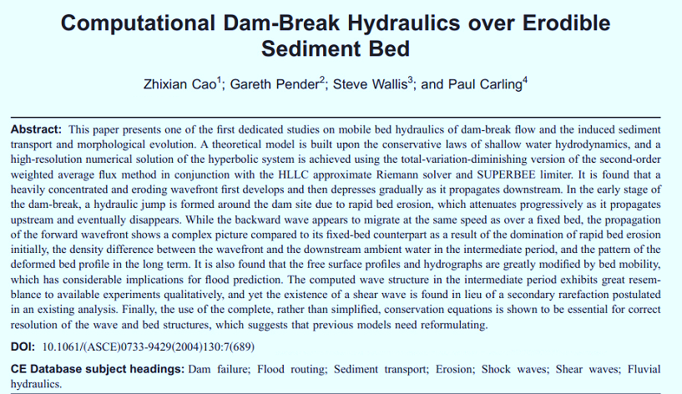
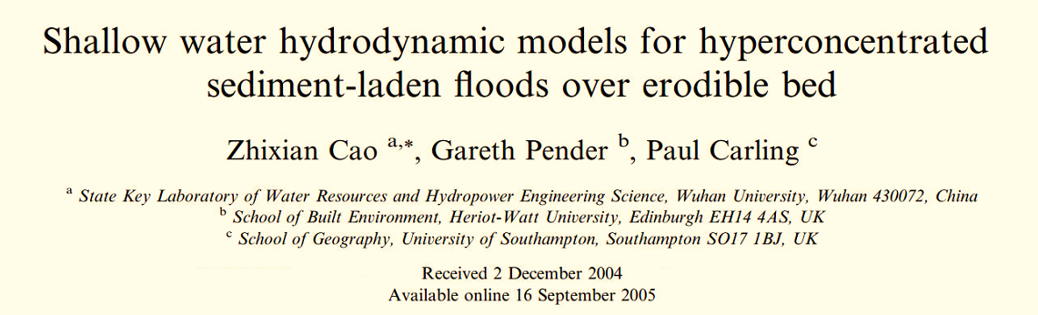
The very beginning
Cao et al. (2004, JHE): Computational dam-break hydraulic over erodible sediment bed
Cao et al. (2006, ADWR): Shallow water hydrodynamic models for hyperconcentrated sediment-laden floods over erodible bed
Cao et al. (2007, ADWR): Multiple time scales of alluvial rivers carrying suspended sediment and their implications for mathematical modelling

Slide 8
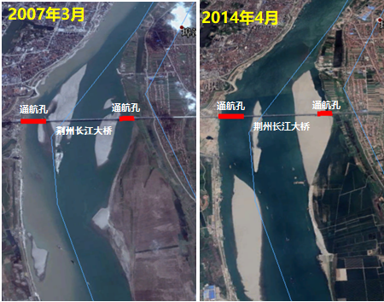
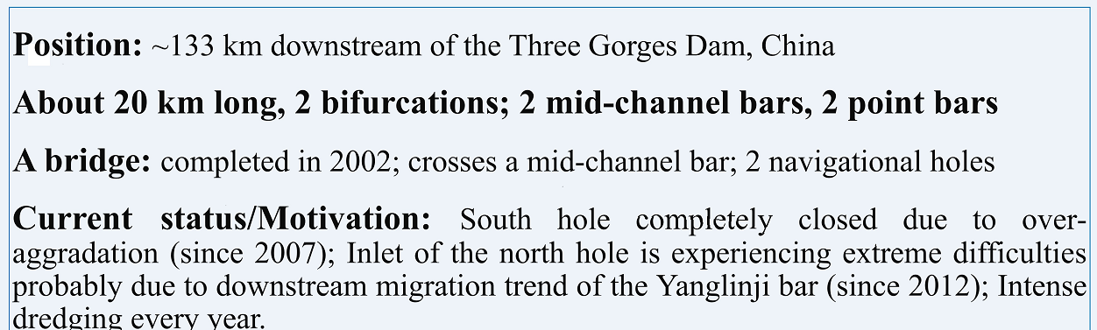
The motivation: intensive sediment transport and rapid bed deformation in the field
Navigation hole
A bifurcation in Yangtze river
Sediment-laden open channel flow
Bar evolution affects navigation
We need high-resolution and relative long term (~ years ) prediction of bar evolution for well-informed river regulation and training.
Note that we cannot simply narrow the Yangtze river

Slide 9
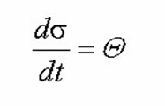

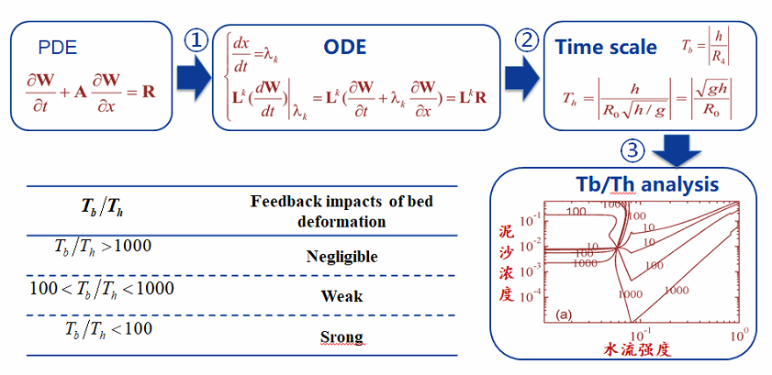
Therefore, we need to consider the feedback-impacts of bed deformation
For ordinary equation, we can define the time scale naturally
Shallow water equations are hyperbolic. Theory of characteristics can transform PDE form of SWE to ODE along characteristics

Slide 10
Improvement in computational efficiency
Local time stepping (2016-2018)
GPU-acceleration or MPI parallel computing (2018-2021)

Slide 11
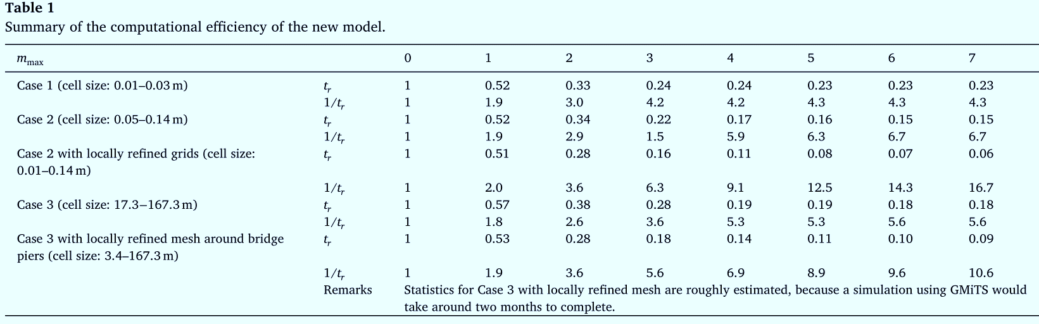
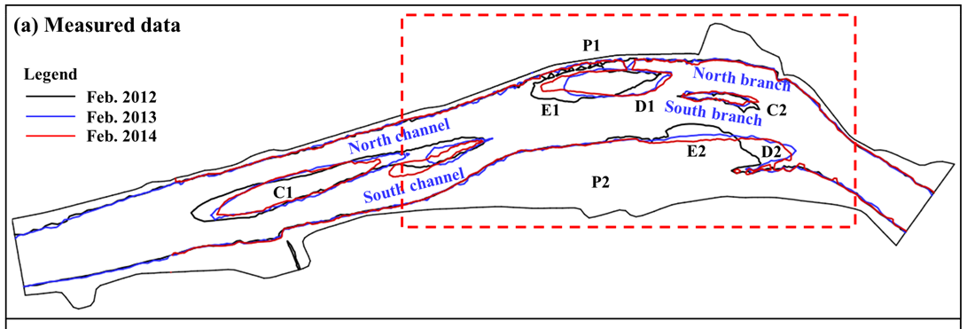

Computational cost for modeling 2-year bar evolution
Without Hybrid LTS/GMaTs: About 60 days
Using Hybrid LTS/GMaTs： Five days；90% reduction
Measured bar evolution
Computed bar evolution
11
Notes:
补充每篇论文被引用多少次！
科学价值：理论先进，最大程度提升可靠性
实际可行，确保计算效率

Slide 12
However,

Slide 13
Relatively coarse sediment in the Yantze River may lag behind the flow

Slide 14
Relatively coarse sediment in the Yantze River may lag behind the flow
The above-mentioned model applications ignore the lag between the sediment and the flow

Slide 15
The new progress (2020-2022)
Development of a new SWHSMM, which is two-phase
Application of the two-phase model to the Yangtze river

Slide 16
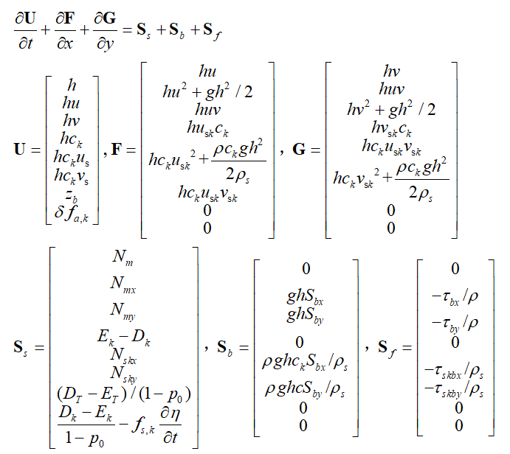
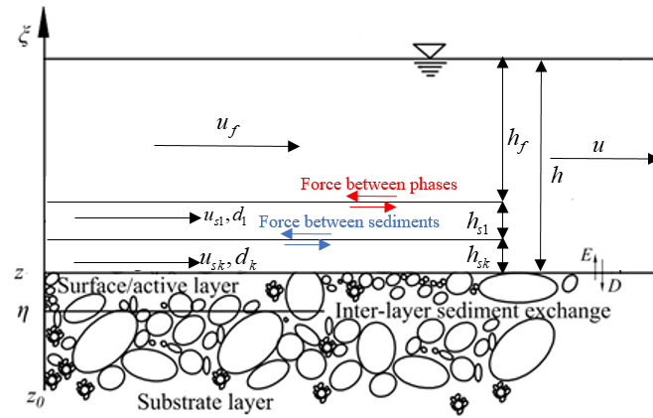
Dr Ji Li is an expert in two-phase hydro-sediment-morphodynamic model for debris flow.
Instead of setting u_{s}=u, we now solve momentum equations for sediment phase to get u_{s}.
16
Notes:
补充每篇论文被引用多少次！
科学价值：理论先进，最大程度提升可靠性
实际可行，确保计算效率

Slide 17
Content
What is shallow water hydro-sediment-morphodynamic model?
What is the new progress in this talk?
Results of the new progress

Slide 18
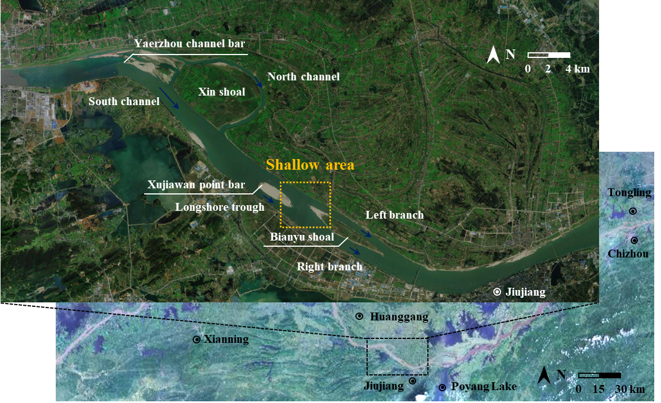
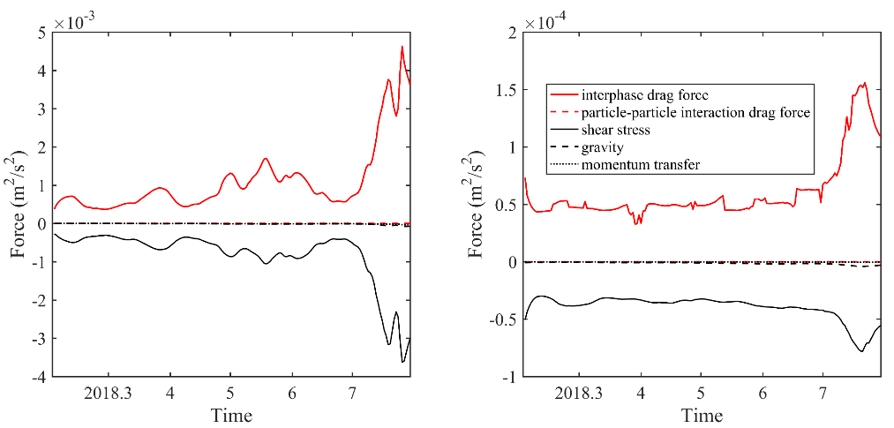
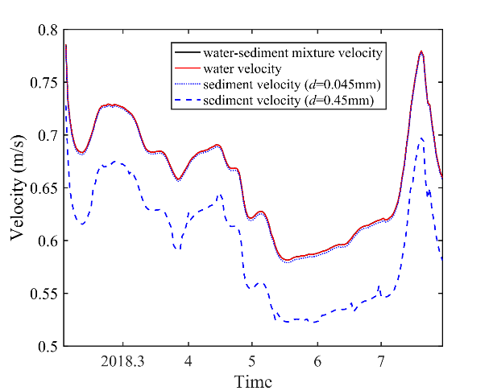
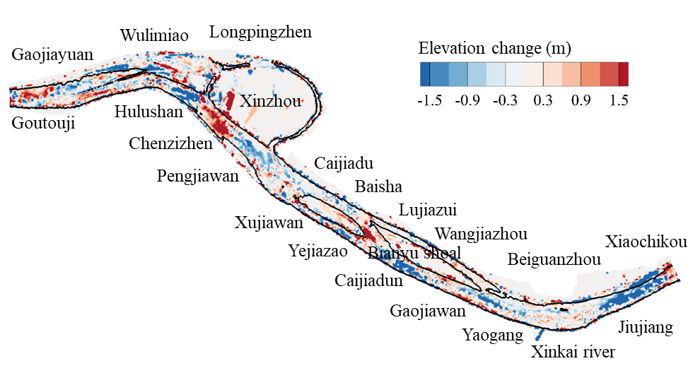
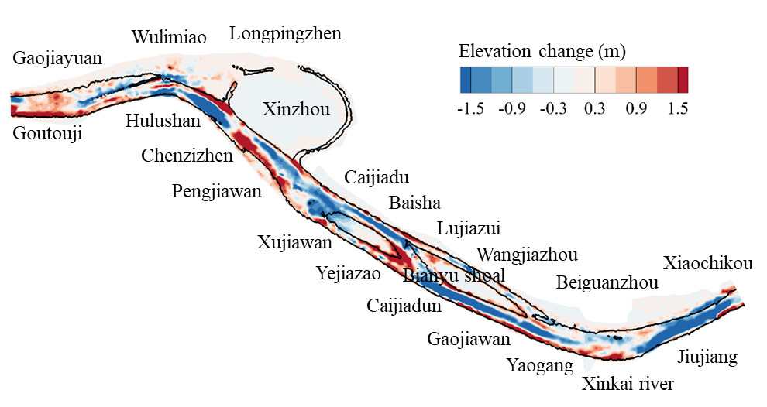
Model filed application
Xinzhou-Jiujiang waterway in the middle Yangtze river
Analysis on water-sediment movement process
(a) d=0.045mm
(b) d=0.45mm
dry seasom
flood seasom
Fig.1 Location of the Xinzhou-Jiujiang waterway
Fig.2 Interaction force and velocity during flow and sediment transport
Simulation of morphological evolution
(a) Measured data
(b) Simulation results
The present model accurately reproduces the morphological evolution of Xinzhou-Jiujiang waterway
The sediment velocity decreases with the increase of grain size in alluvial river
Fig.3 Comparison between simulation results and measured data
Notes:
实际应用（孙）

Slide 19
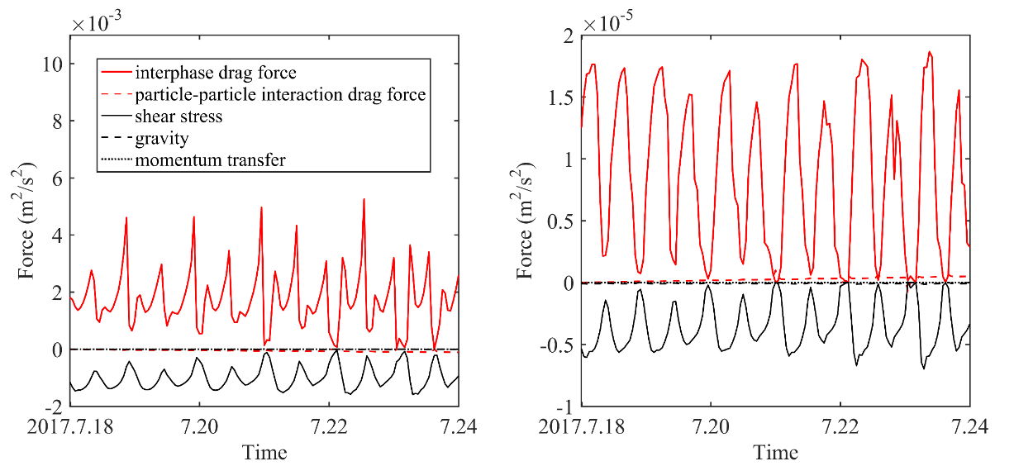
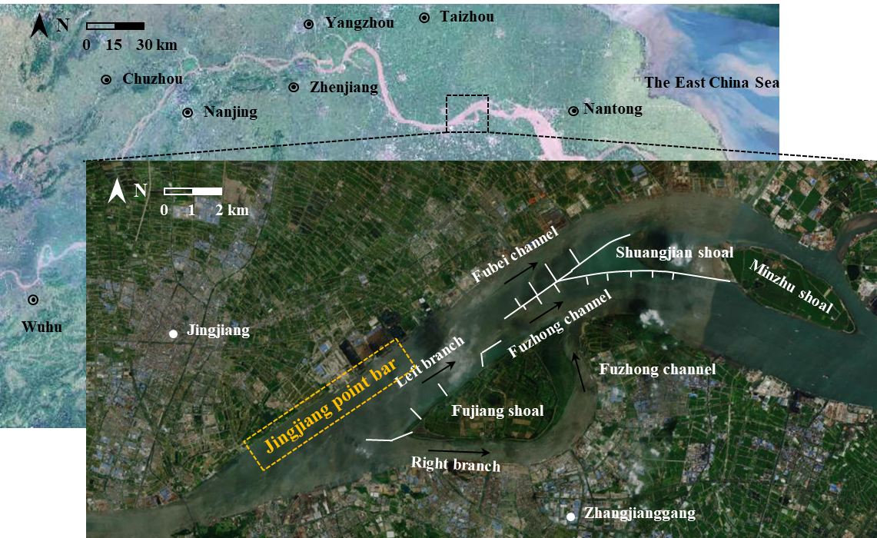
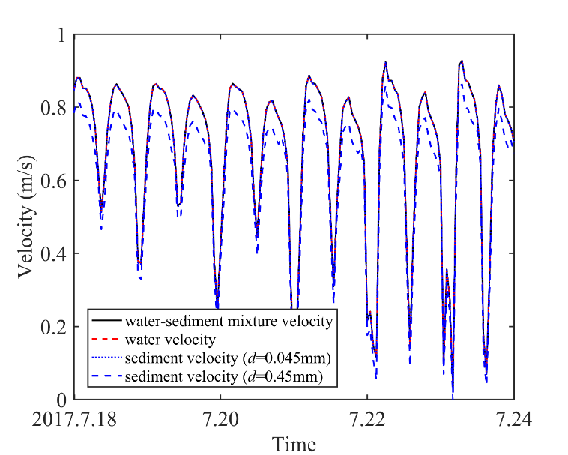
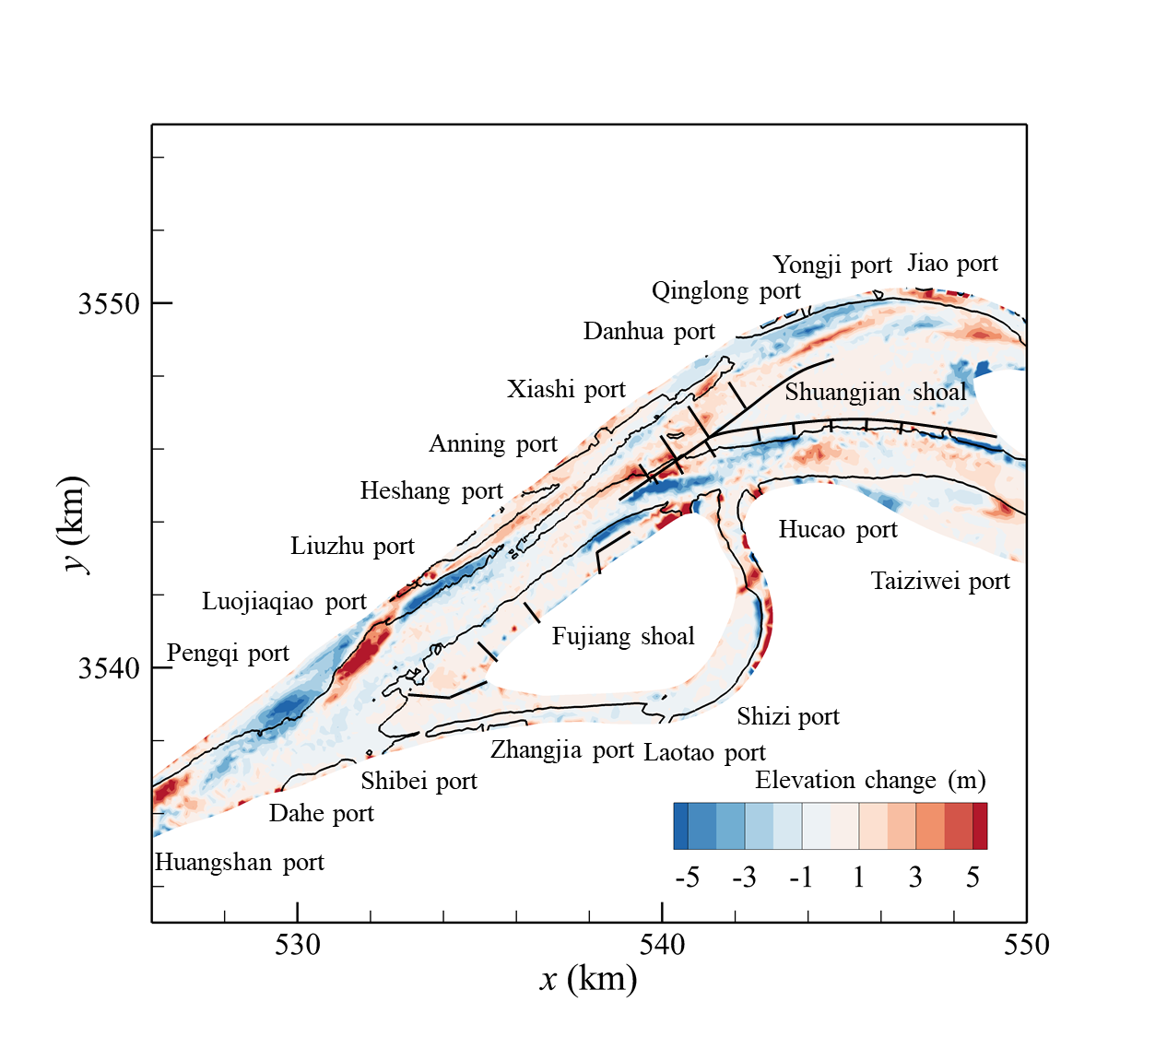
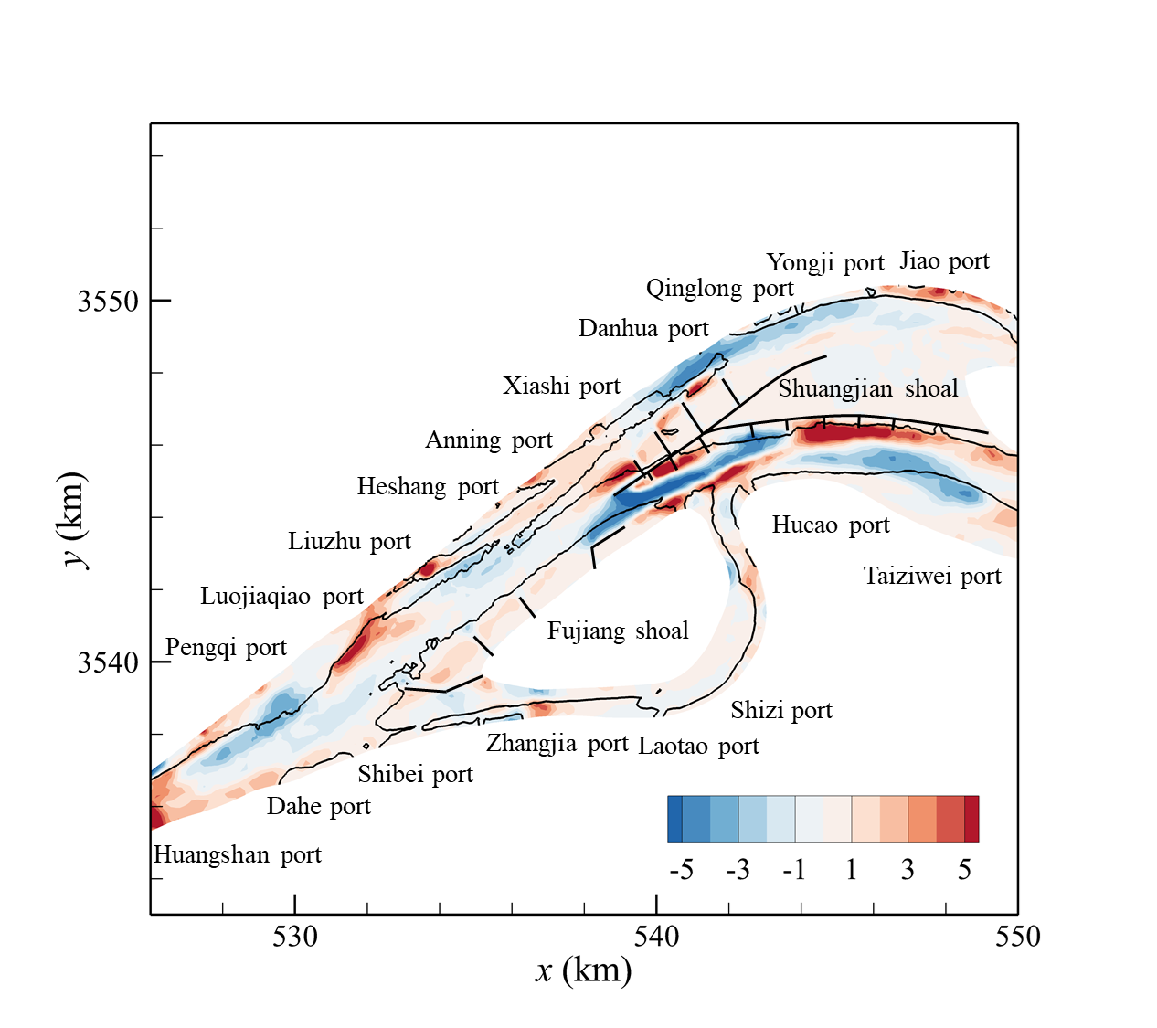
Fujiangsha waterway in the tidal reach of the Yangtze river
Analysis on water-sediment movement process
Fig.1 Location of the Fujiangsha waterway
Fig.3 Interaction during flow and sediment transport
Flood slack tide:
The sediment velocity is about 89% of the flow velocity
Ebb slack tide :
The sediment velocity is about 58% of the flow velocity
Simulation of morphological evolution
(b) Simulation results
(a) Measured data
Although the grain size in the tidal reach is fine, the transport characteristics of bedload are gradually significant in the process of the rising tide
Fig.2 Comparison between simulation results and measured data
Fig.4 Velocity of flow and sediment versus time
Notes:
实际应用（孙）

Slide 20
Thanks for listening !
A new two-phase shallow water hydro-sedi-morphodynamic model
with the HLLC solver for inter-grid numerical flux estimation
Peng Hu, Binghan Lyu, Ji Li, Qifeng Liu, Youwei Li, Zhixian Cao

