Slide 1





Estimation of organic positive artefacts on Quartz filters and volatilization loss from Teflon filters at a COALESCE network site – Bhopal, India
Ankur Bhardwaj
Department of Earth and Environmental Sciences
Indian Institute of Science Education and Research Bhopal

Slide 2
INTRODUCTION
Samples of fine particulate matter (PM_{2.5}) were used to measure carbonaceous components, water-soluble inorganic ions, and trace elements.
Particulate nitrate volatilization and/or organics volatilization cause lower gravimetric PM_{2.5} mass than the reconstructed mass.^{[1]}

Slide 3
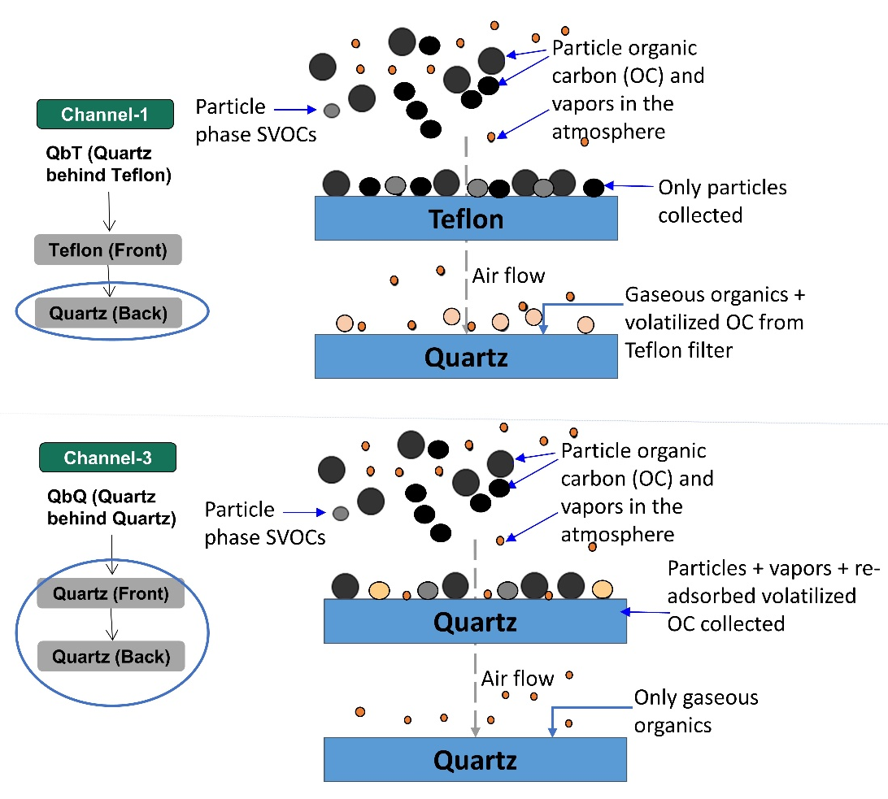
Contd….

Slide 4
OBJECTIVES
Assessment of organic artefacts to quantify their role in PM_{2.5} mass closure.
Study the implications of the temporally varying organics adsorption and volatilization artefacts on measured organic carbon (OC).

Slide 5
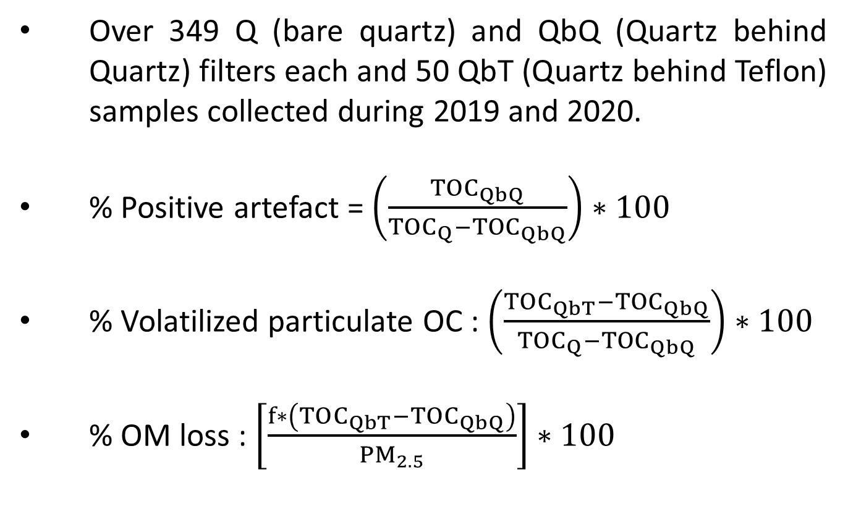
METHDOLOGY
Over 349 Q (bare quartz) and QbQ (Quartz behind Quartz) filters each and 50 QbT (Quartz behind Teflon) samples collected during 2019 and 2020.
% Positive artefact = $\left(\frac{{TOC}_{QbQ}}{{TOC}_{Q}−{TOC}_{QbQ}}\right)∗100$
% Volatilized particulate OC : $\left(\frac{{TOC}_{QbT}−{TOC}_{QbQ}}{{TOC}_{Q}−{TOC}_{QbQ}}\right)∗100$
% OM loss : $\left[\frac{f∗\left(TOC_{QbT}−TOC_{QbQ}\right)}{{PM}_{2.5}}\right]∗100$

Slide 6
RESULTS
Comparable values of TOC Q-FB and TOC_{QbQ} showed that QbQ filters only adsorb gaseous organics, no volatilized OC was captured by QbQ.

Slide 7
Contd….
Fraction-wise % OC loss and % TOC loss increased with ambient temperature.
(a)
(b)

Slide 8
Contd….
On accounting for volatilized OM lost from Teflon filters, 24 h PM_{2.5} violations increased by 5 days during 2019.

Slide 9
Contd….
On accounting for volatilized OM lost from Teflon filters, 24 h PM_{2.5} violations increased by 5 days during 2020.

Slide 10
CONCLUSION
Volatilization artefacts should be accounted in mass closure as temperatures exceed 30 °C for most locations in India for most of the year.
The results from this study provide the first systematic long term (two annual cycles) evaluation of fraction-wise OC sampling artefacts and estimates of OM volatilization losses from Teflon filters, together with its implications to PM_{2.5} mass closure, over Bhopal, Central India

Slide 11
ACKNOWLEDGEMENT
This work was supported by the MoEF&CC under the NCAP-COALESCE project (14/10/2014-CC)
Reference
Kumar, S., & Raman, R. S. (2020). Source apportionment of fine particulate matter over a National Park in Central India. Science of the Total Environment, 720, 137511.

