Slide 1





Shallow aquifers as an element of methane biogeochemical cycle in West Siberia
Aleksandr Sabrekov, Anatoly Prokushkin, Yuriy Litti, Mikhail Glagolev, Ekaterina Parkhomchuk, Alexey Petrozhitskii, Peter Kalinkin, Dmitry Kuleshov, and Irina Terentieva
A.N. Severtsov Institute of Ecology and Evolution RAS, Moscow, Russian Federation
Yugra State University, Khanty-Mansyisk, Russian Federation
Sukachev Institute of Forest, Siberian Branch of RAS, Krasnoyarsk, Russian Federation
Novosibirsk State University, Novosibirsk, Russian Federation
sabrekovaf@gmail.com

Slide 2
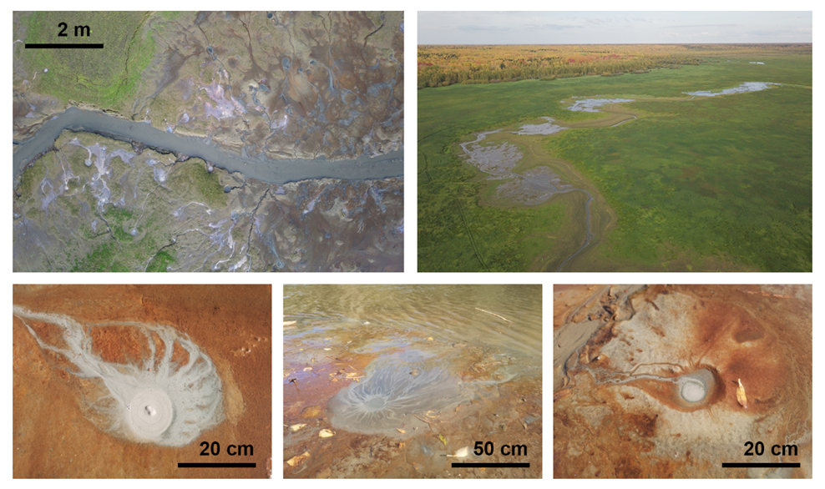
West Siberian middle taiga seeps

Slide 3
Motivation, questions and methods
Motivation: seeps recently found in West Siberian middle taiga floodplains emit a lot of methane, transported from raised bogs by groundwater. So, what’s about groundwater by itself?
- How much methane is in the groundwater of West Siberia on a regional scale?
What are the processes, driving methane concentration in groundwater?
Methods:
Gas: δ¹³С in СО₂, δ¹³С and δD in СН₄
Water: δD, δ¹⁸О, ³H, major ions, DOC, DIC, СН₄, СО₂ concentrations, optical properties (SUVA, SR, etc.)

Slide 4
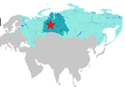
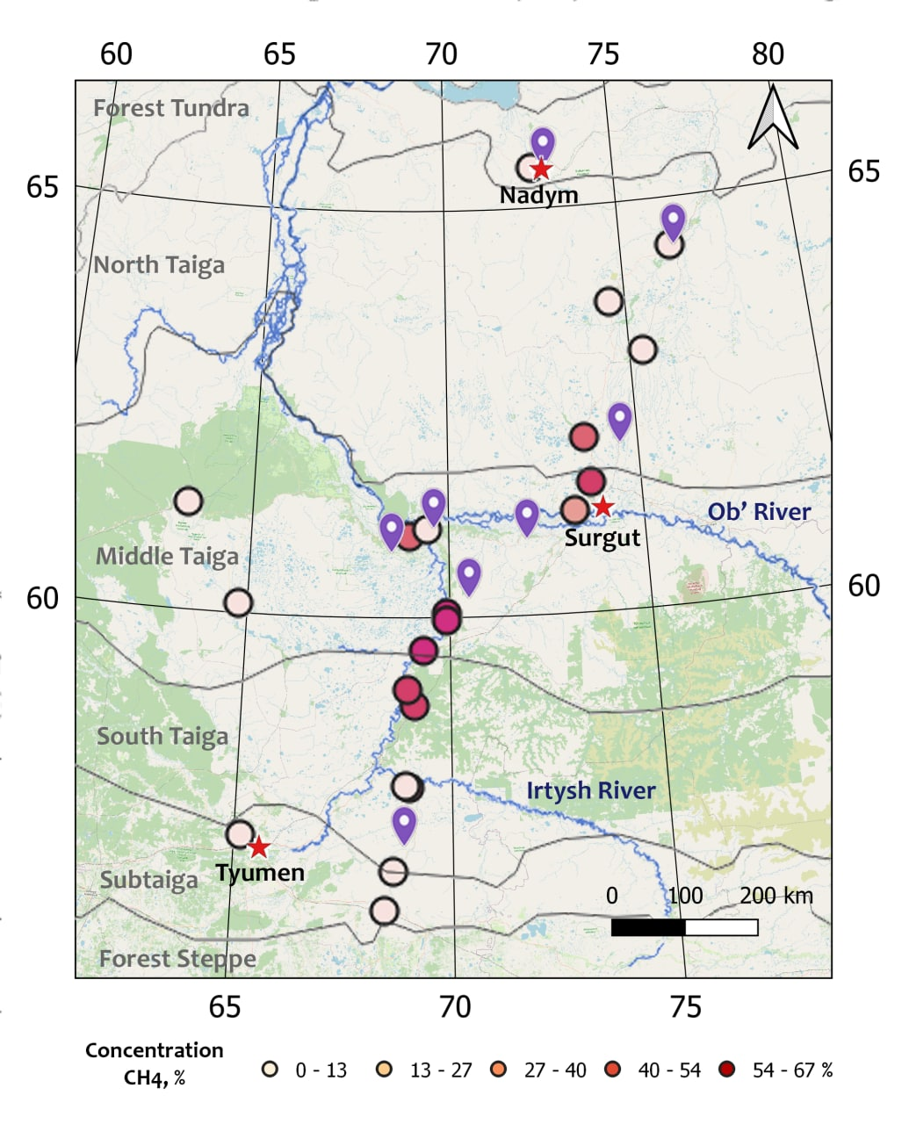
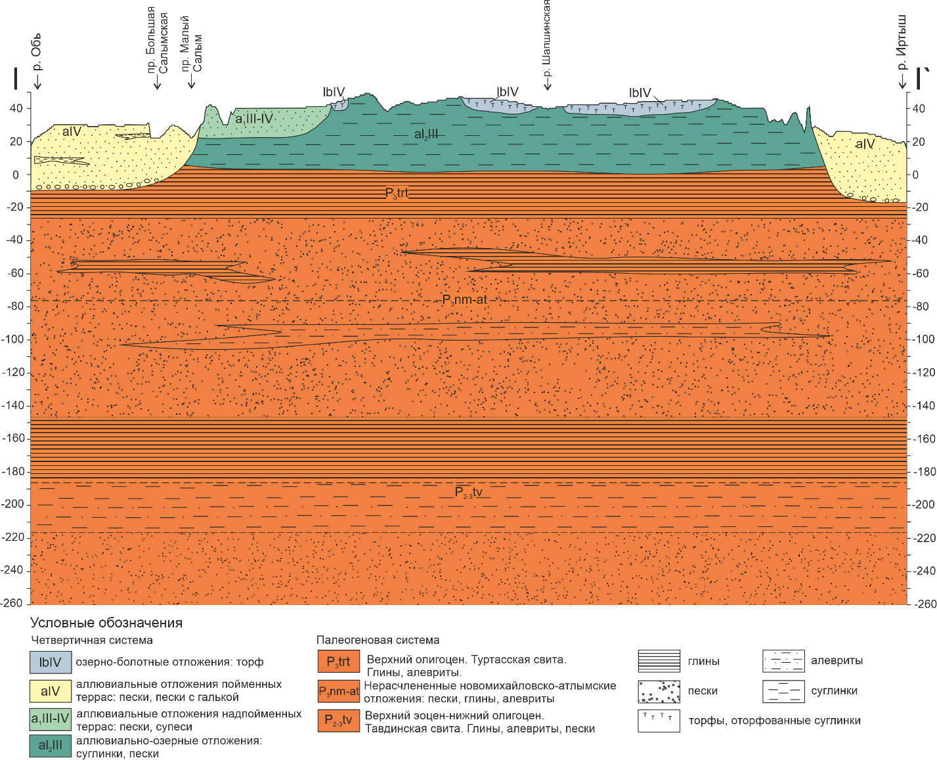
Study region
P₃¹
P₃¹
P₂₋₃
P₂₋₃
P₂³ – K₂ thick clay cap

Slide 5
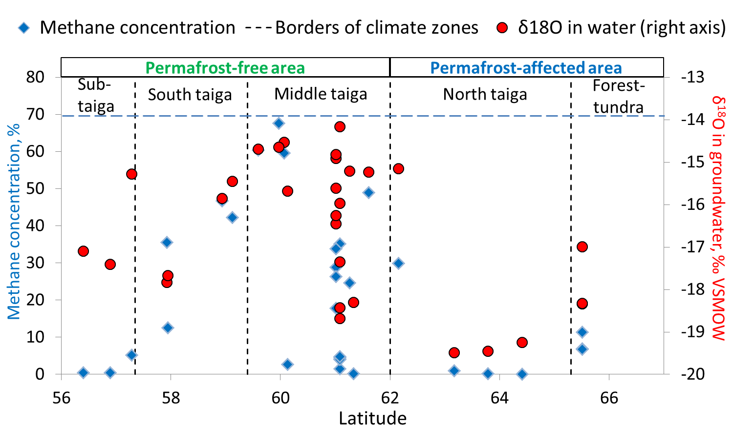
Groundwater of surface aquifers is saturated by methane in different parts of the region

Slide 6
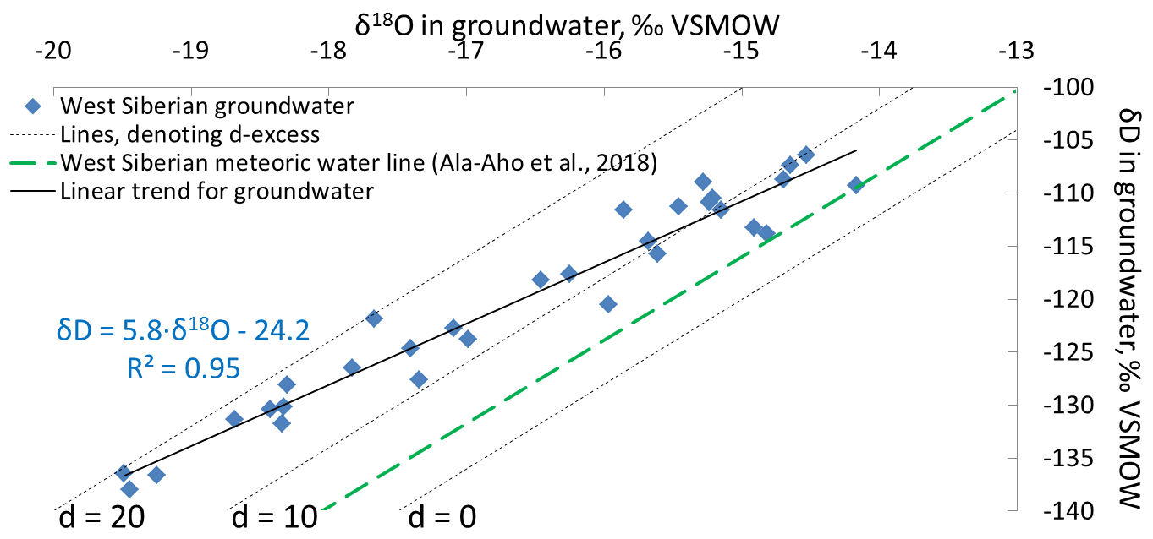
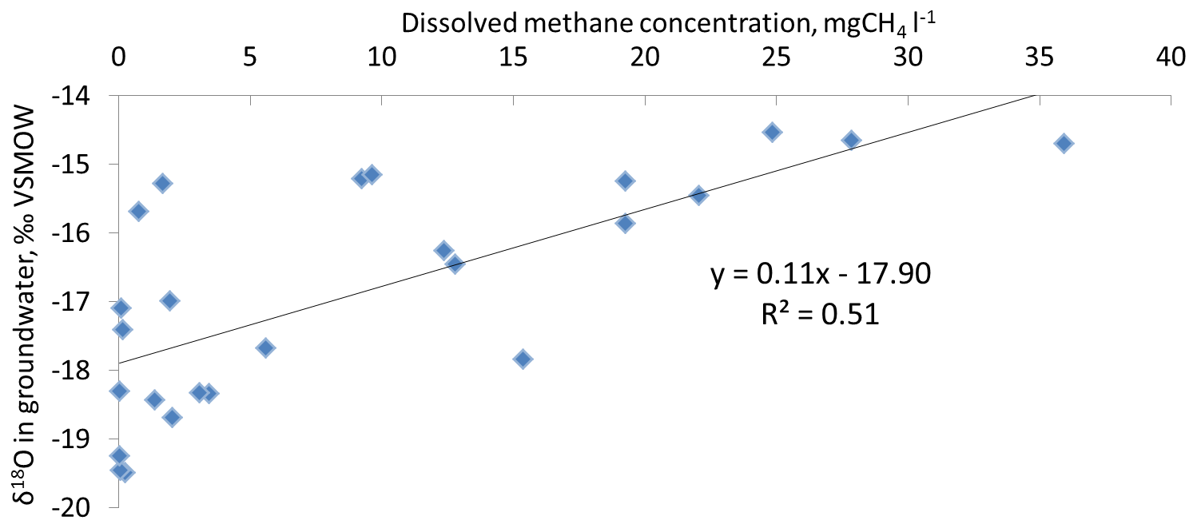
What are the sources of surface groundwater?
The “colder” water, the higher d-excess
The “colder” water, the lower methane concentration
Sabrekov et al., submitted

Slide 7
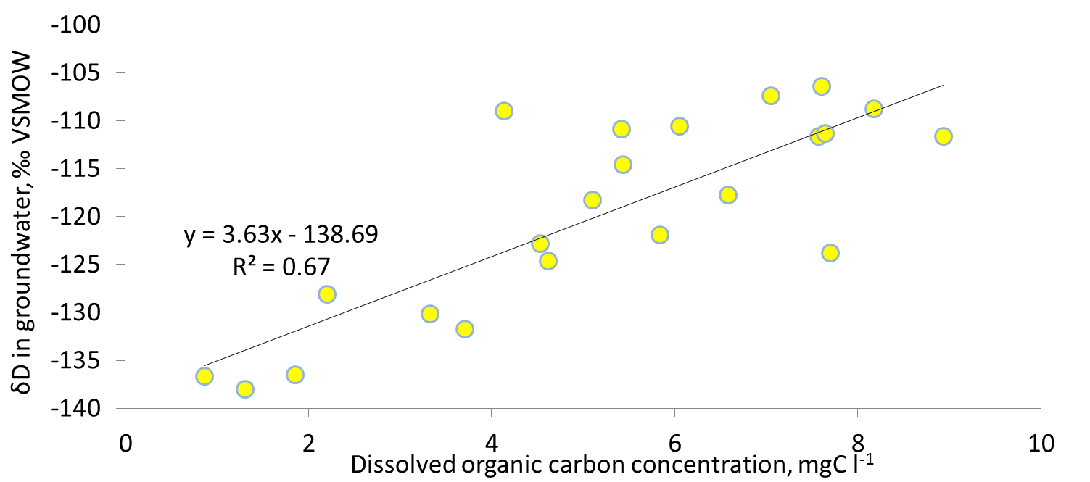
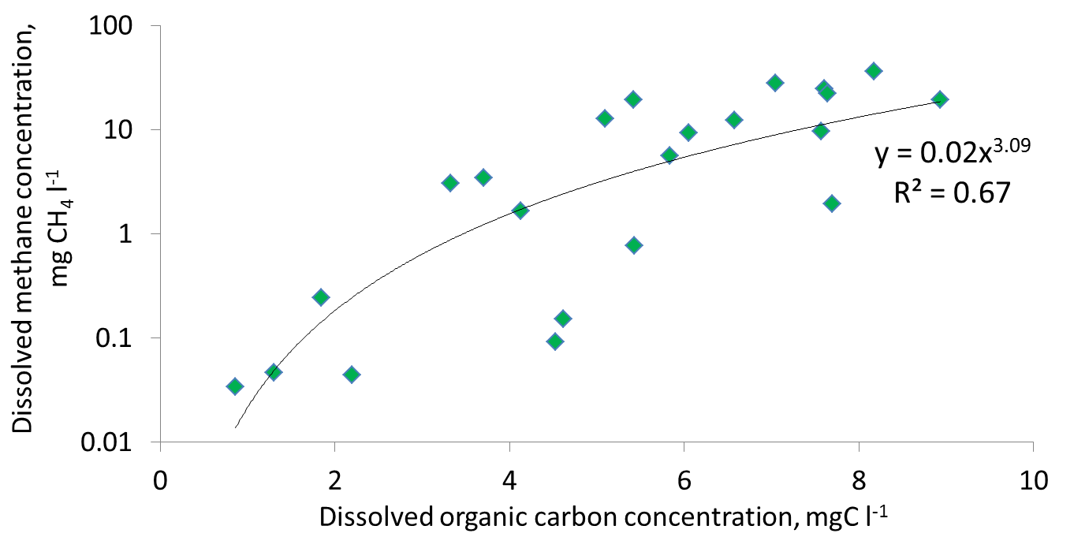
Not only methane but also a DOC
The “colder” water is, the less DOC it contains
The more DOC, the more methane

Slide 8
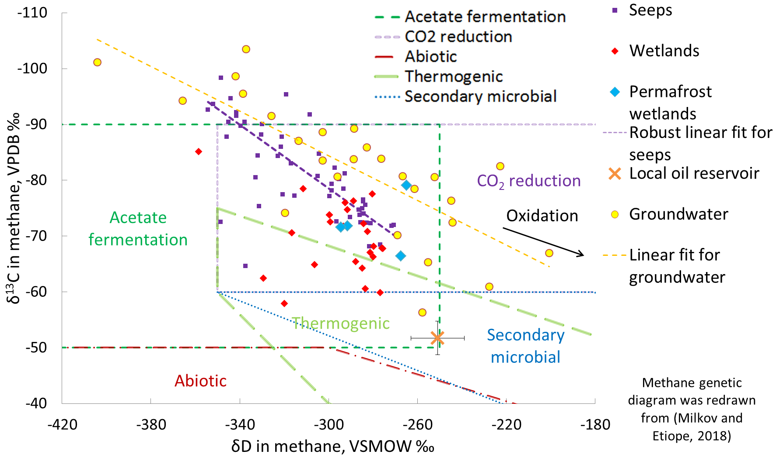
Oxidation, mixing or paleomethane?
Sabrekov et al., submitted

Slide 9
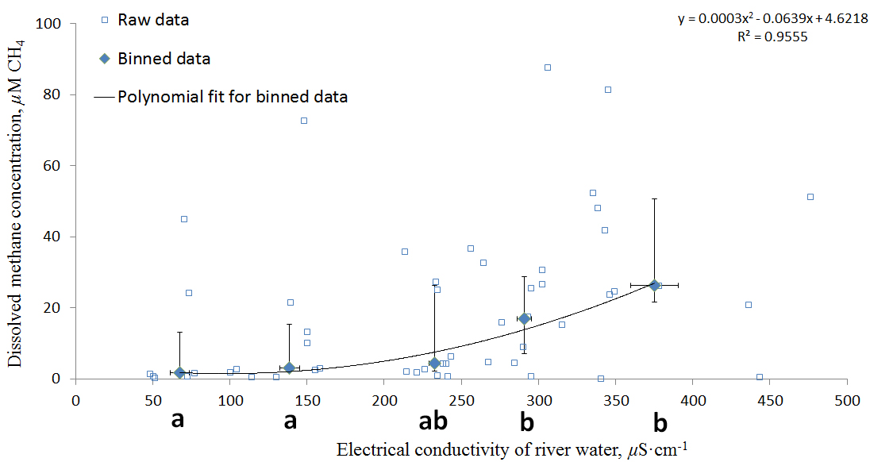
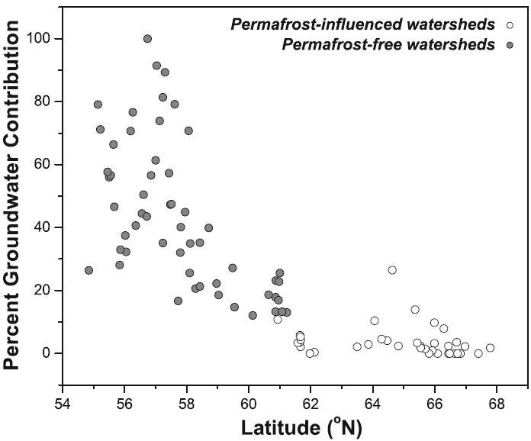
Groundwater contribute to streamflow of rivers throughout the permafrost-free regions of Western Siberia
The higher groundwater contribution, the higher methane concentration
According to (Frey et al., 2007), groundwater contribute to streamflow substantially, thereby transporting methane to rivers

Slide 10
Outlook
“Cold” recharge vs. “warm” recharge OR
paleowaters vs. modern waters?
2. Regional CH₄ emission from rivers
3. Transformation of DOC in groundwater
4. Contradiction between non-zero ³H content (age < 100 years) and ¹⁴CH₄ age > 1000 years
Thank you for your attention!
For data, questions and discussion get in touch with me at
sabrekovaf@gmail.com OR Research Gate (Alexander-Sabrekov)

