Slide 1







Extensional tectonics at oceanic transform plate boundaries: evidence from seafloor morphology
Yu Ren¹, Jacob Geersen², Ingo Grevemeyer¹
¹GEOMAR Helmholtz Centre for Ocean Research Kiel, Germany
²Institute of Geosciences, University of Kiel, Germany
Benefited
from
@renyu95

Slide 2
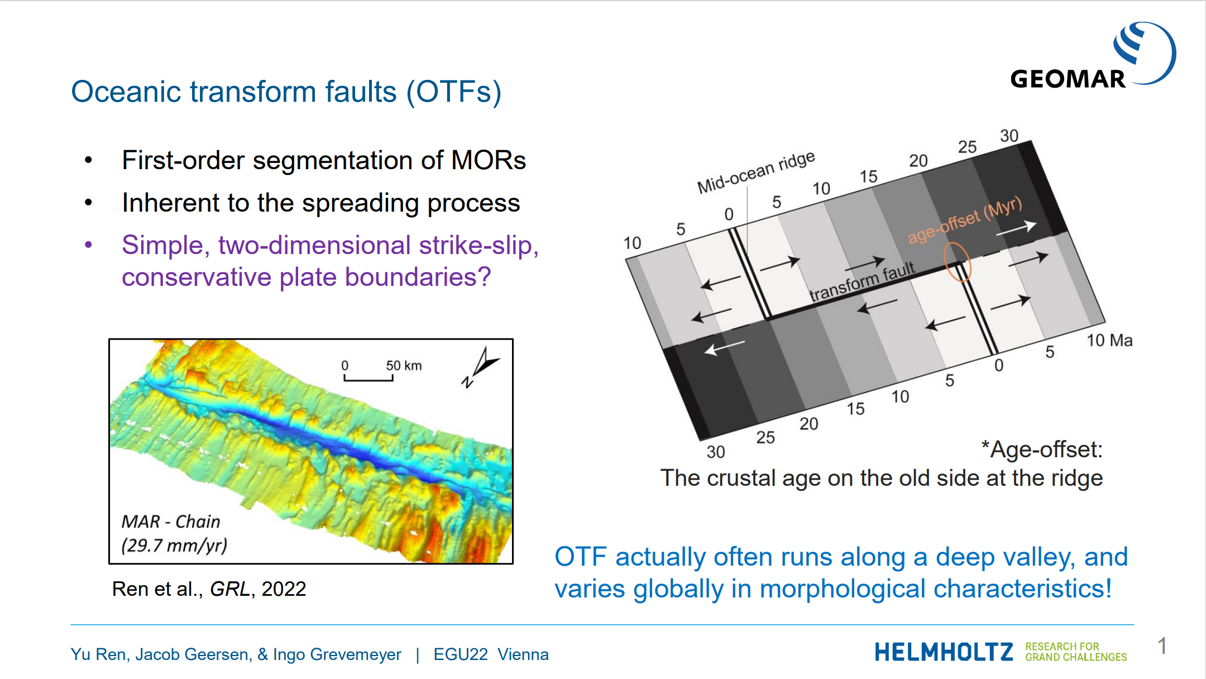

Slide 3
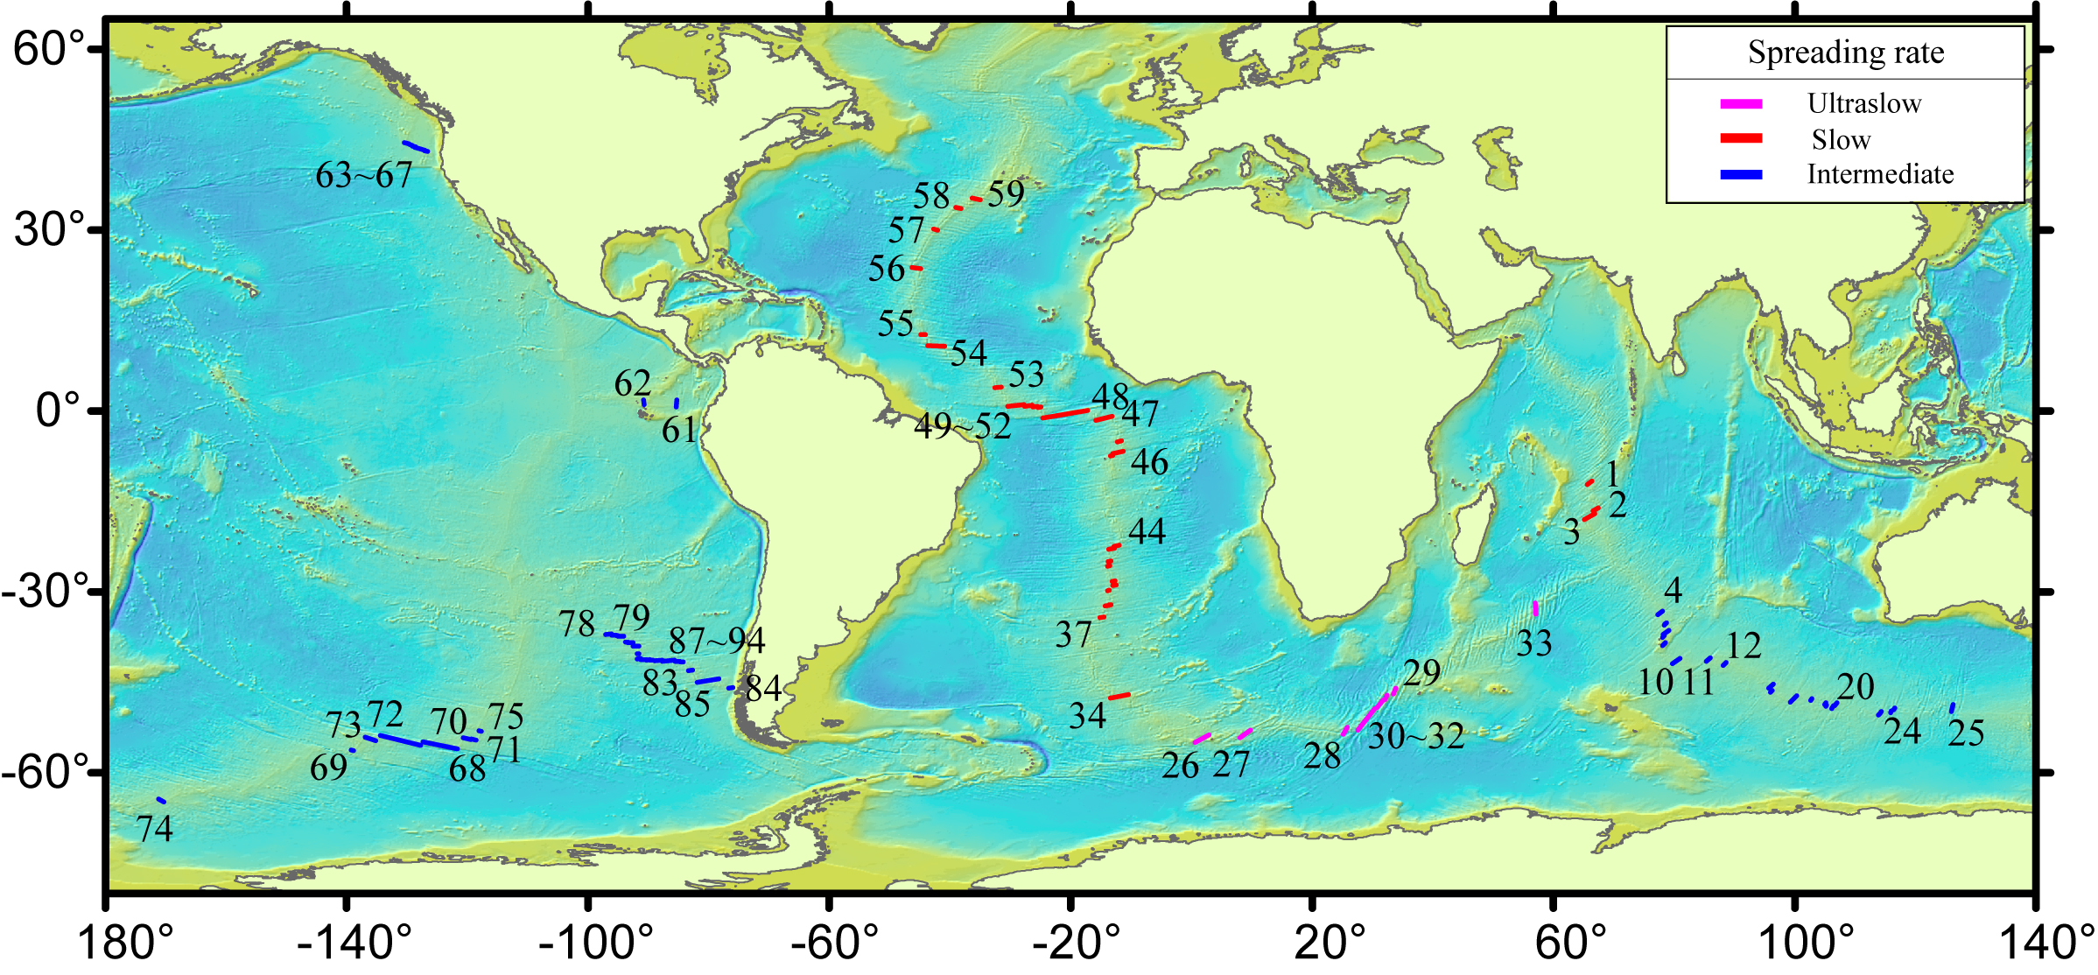
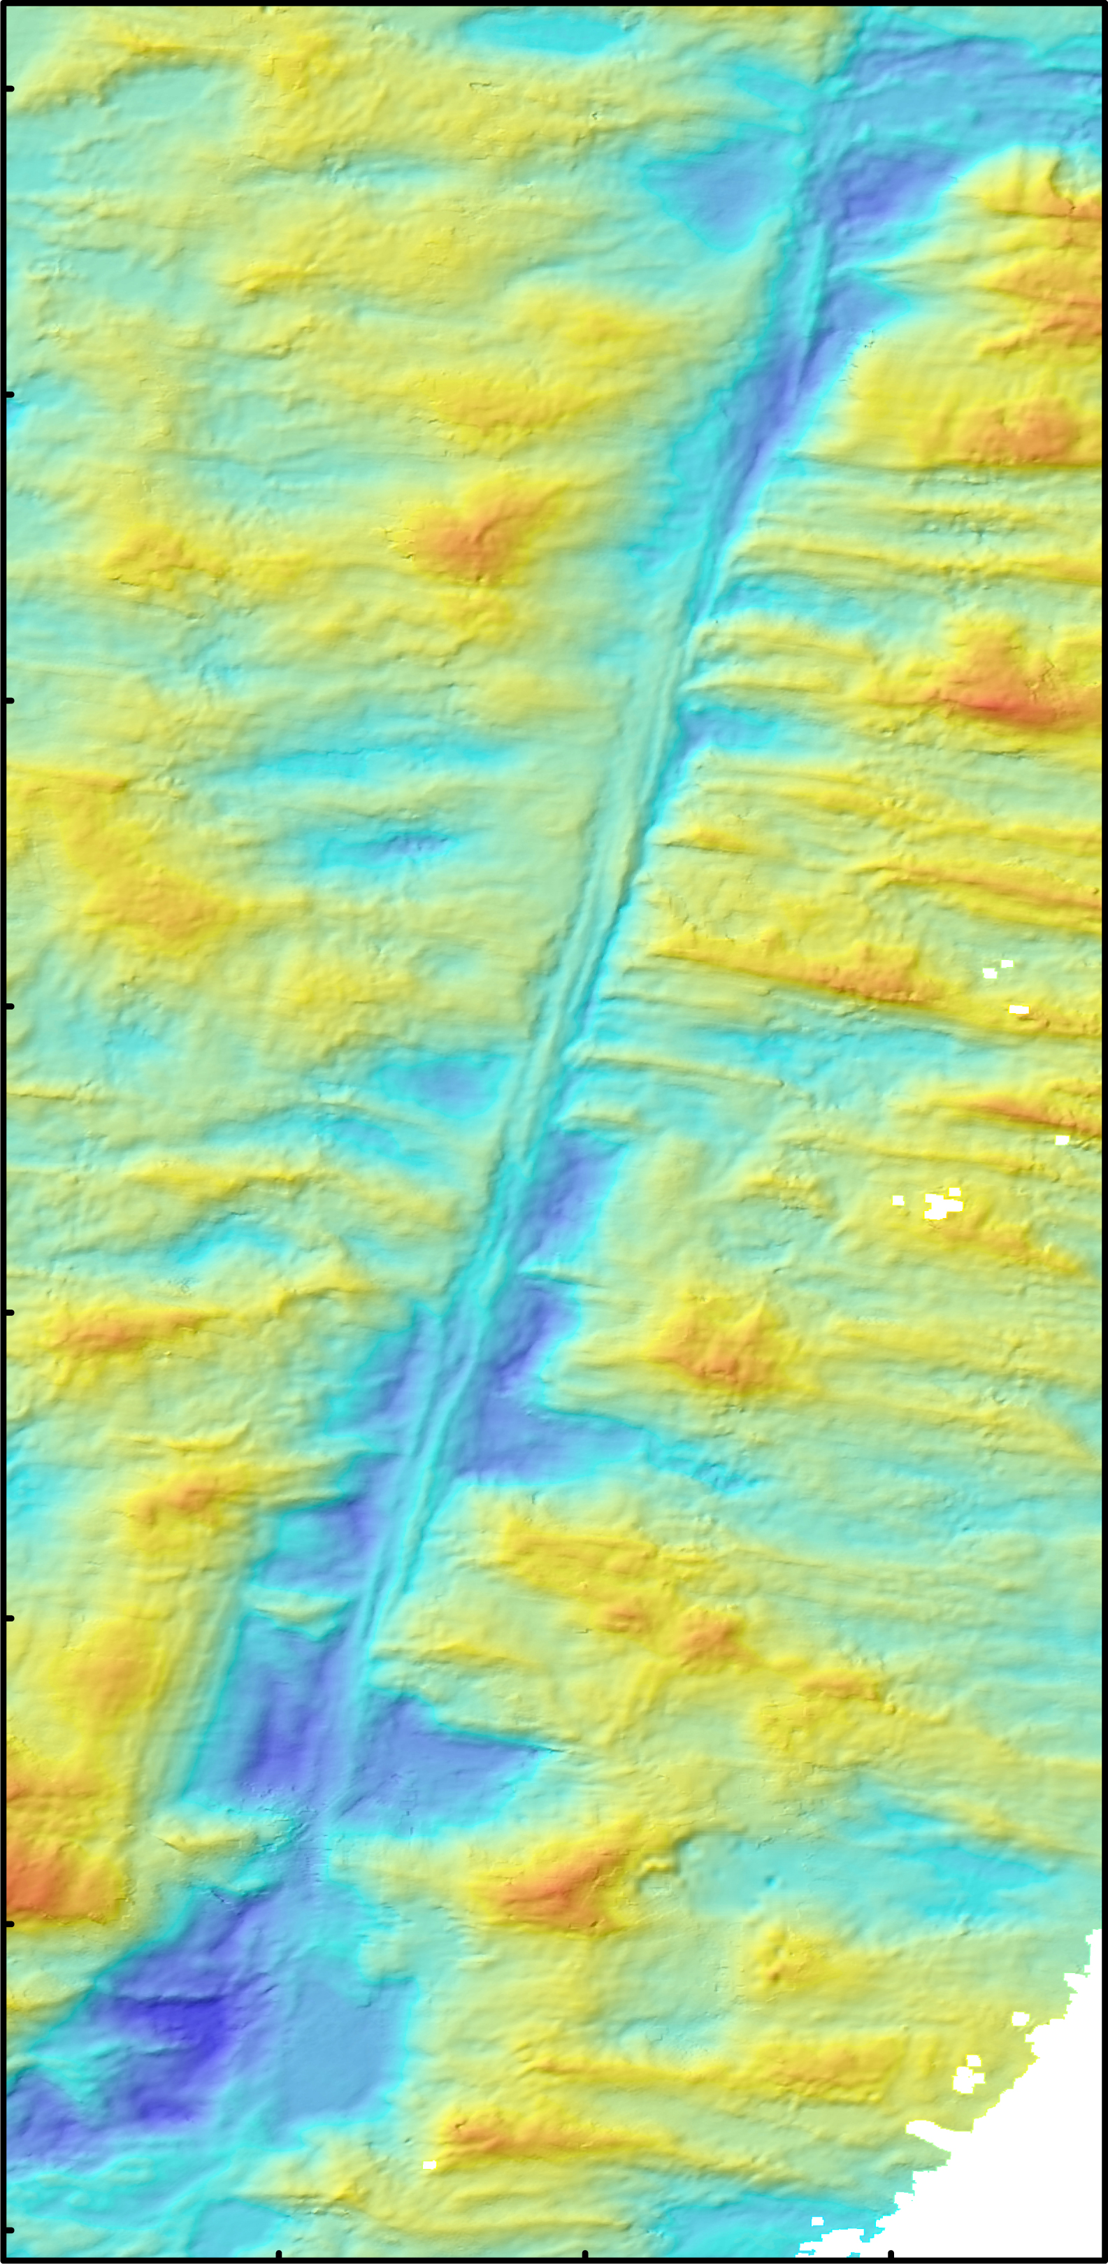
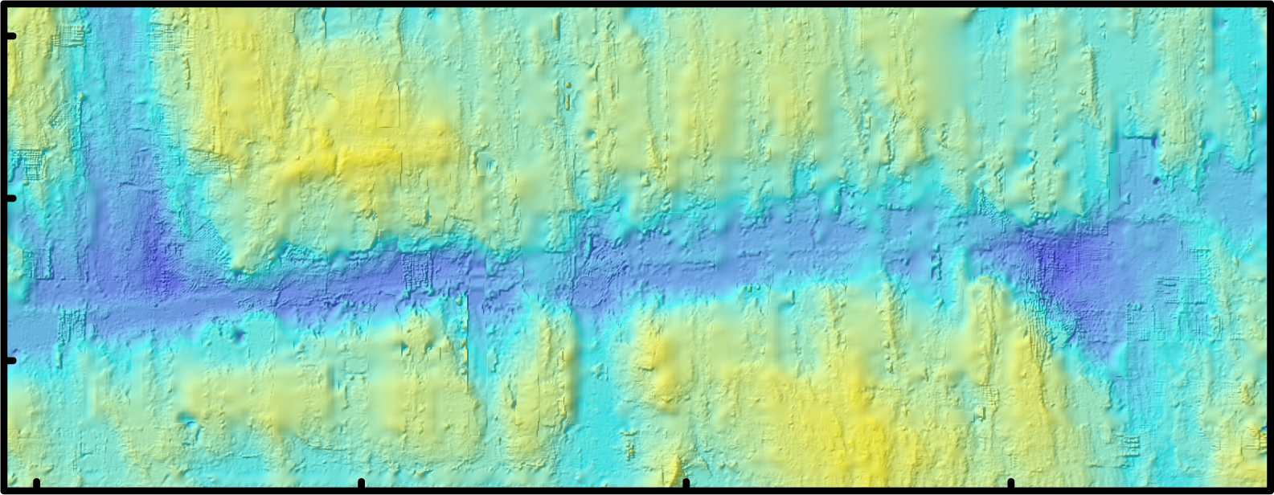
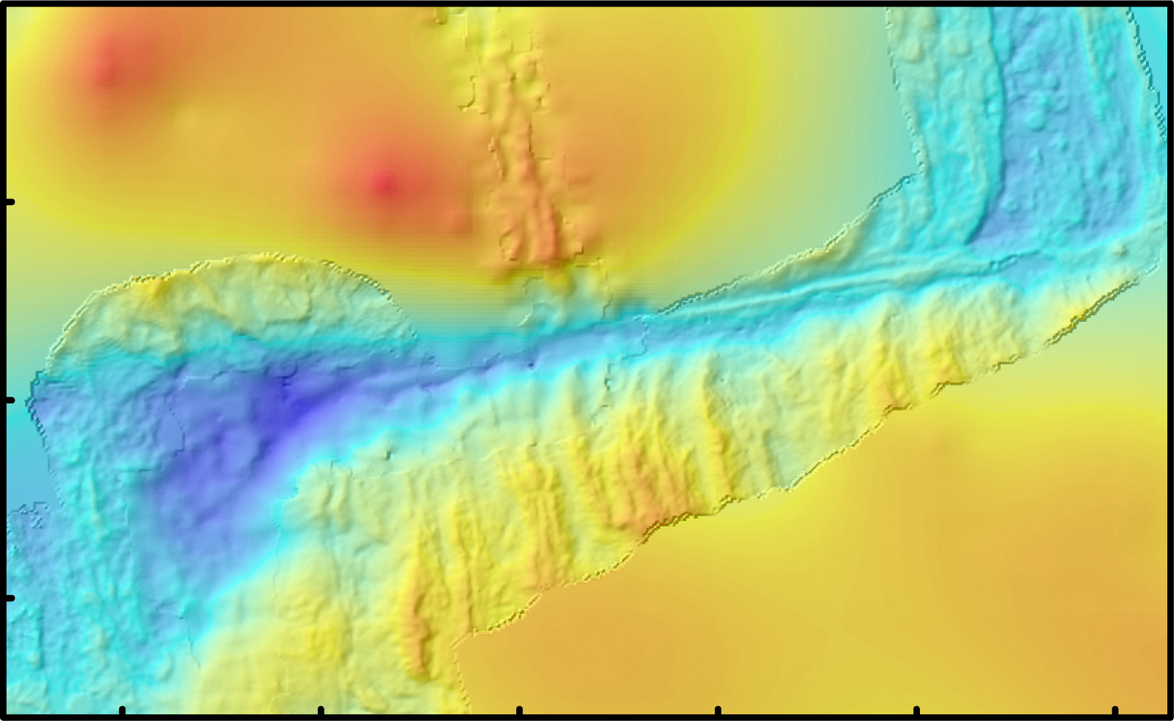
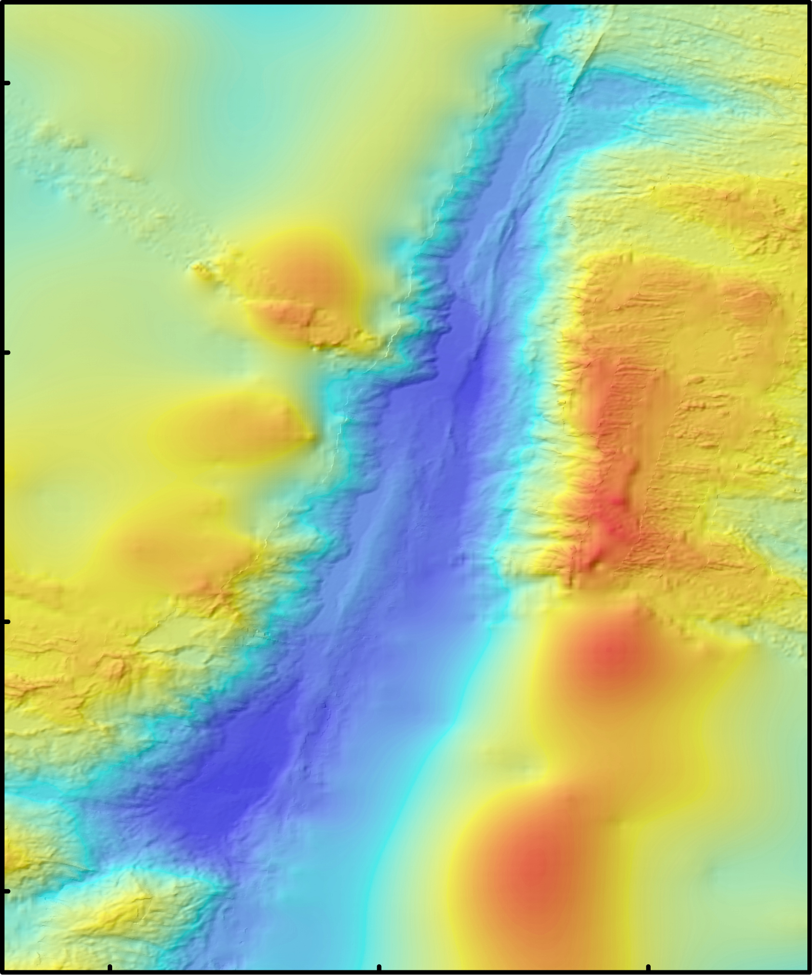
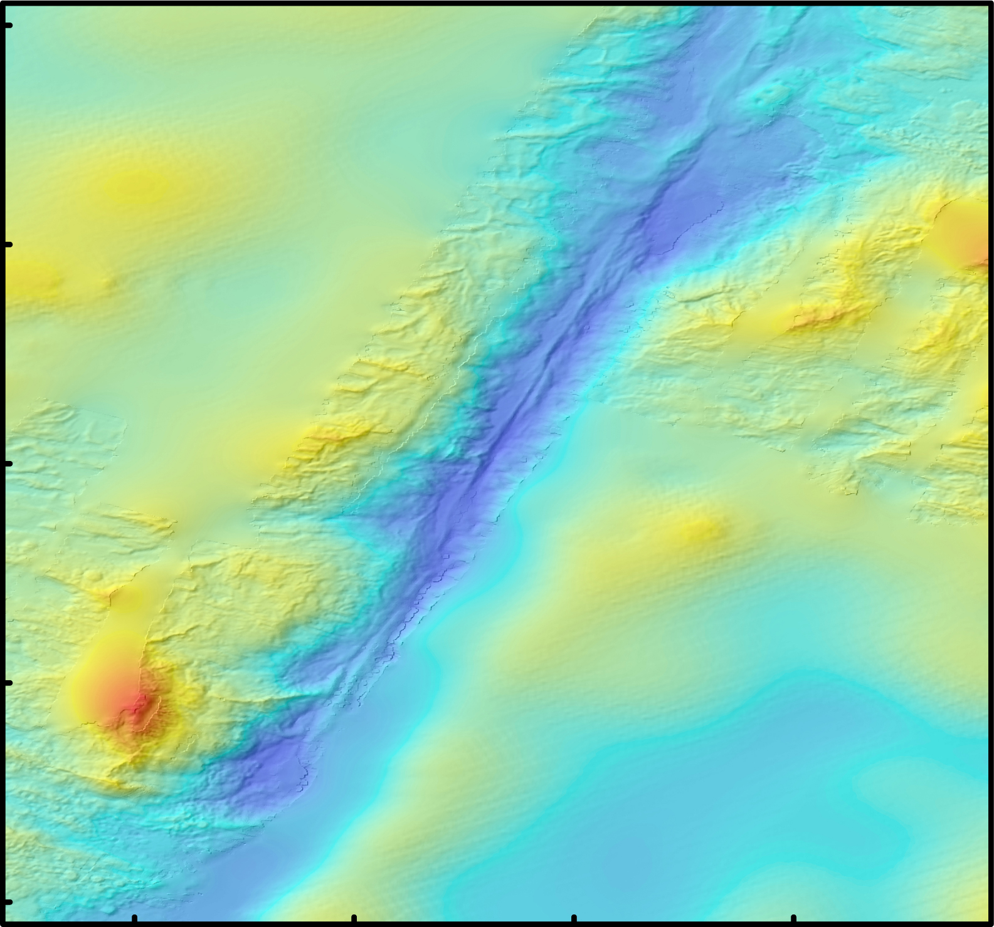
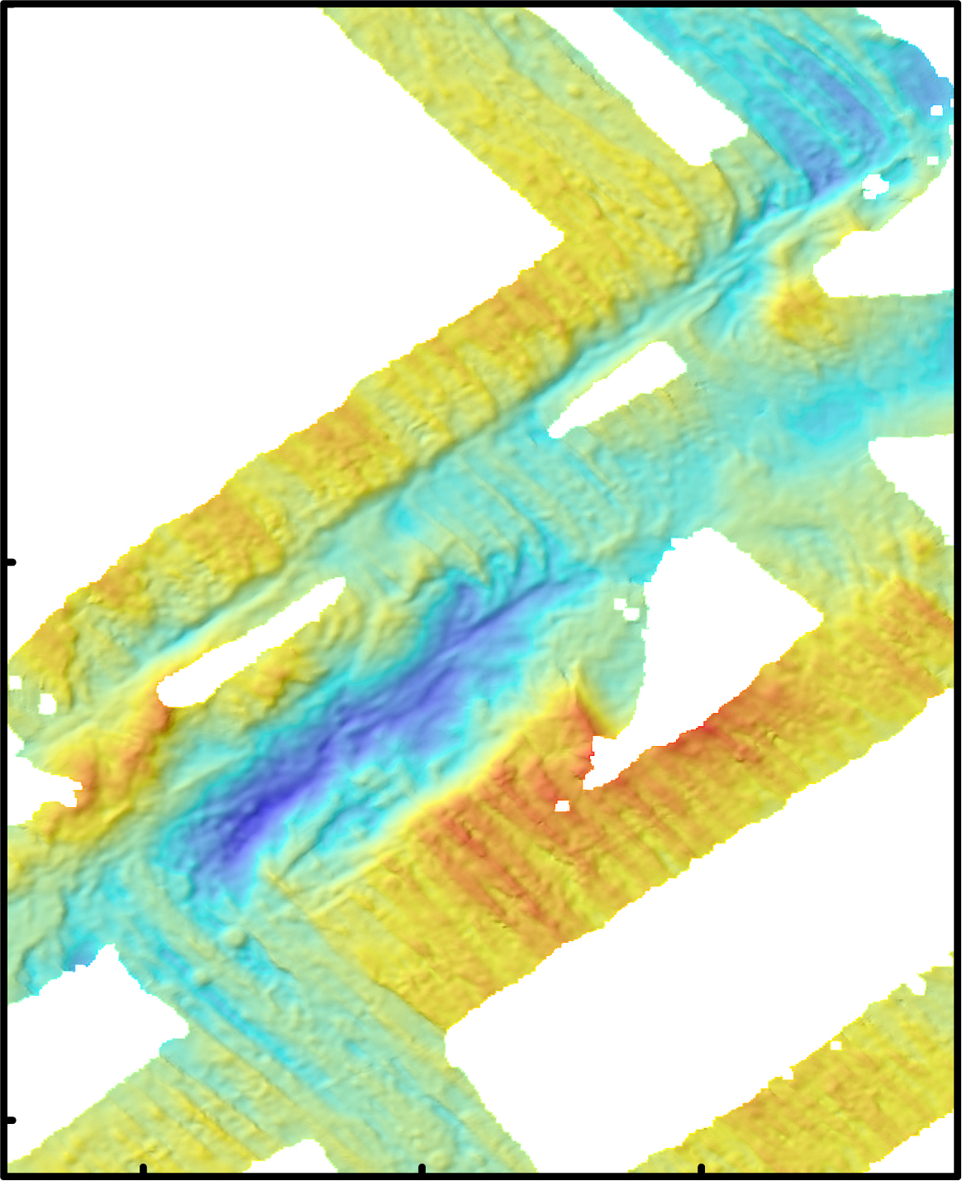
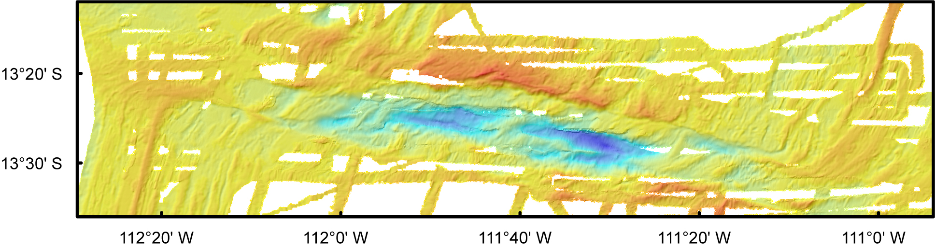
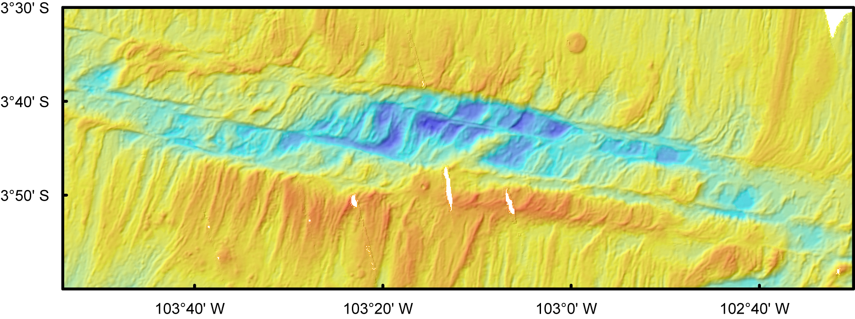
Data (GMRT + JAMSTEC + individual cruises)
Ren et al., GRL, 2022
From ultraslow- to intermediate-: 94 well mapped OTFs
(S.R., 14.1–83.1 mm/yr; A.O., 0.6–62.2 Myr)
Fast-slipping transform faults – too complex in geomorphology
Ultraslow: SWIR – 8 OTFs
Slow: CIR, MAR, Chile Rise – 49 OTFs
Intermediate: SEIR, PAR, JdFR, Cocos Ridge – 37 OTFs
2
Notes:
Data from open datasets (GMRT & JAMSTEC) and several individual research cruises…

Slide 4
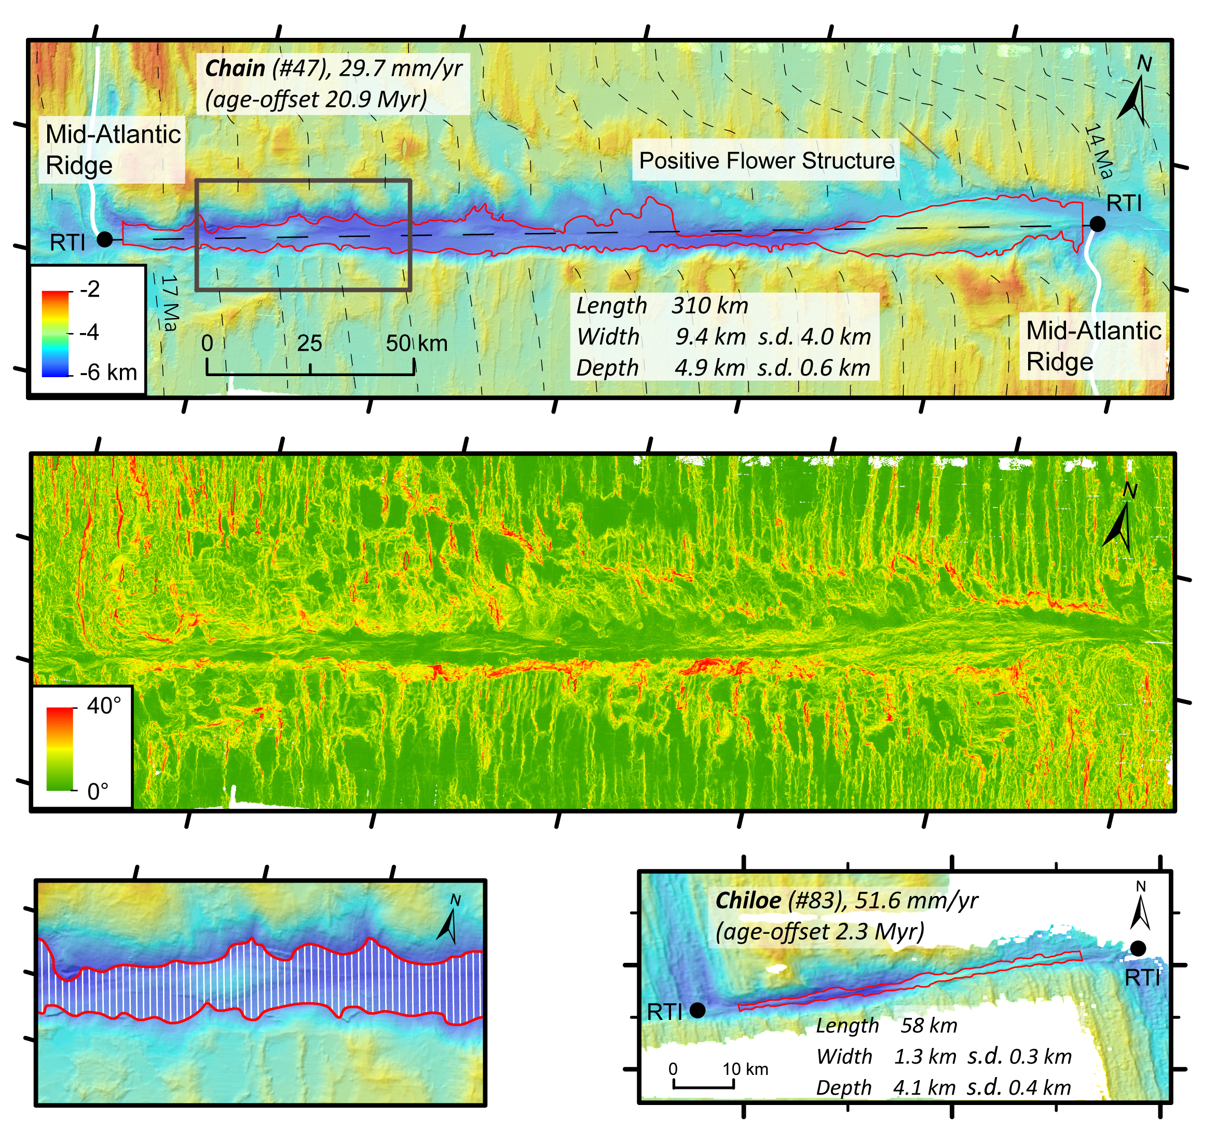
Methods
Length
the distance between the two ridge-transform intersections (RTIs)
Width
we generated vertical lines, equally spaced one kilometre apart, which are truncated by the outline of the transform valley floor. The width of the transform valley is defined as the mean length of these truncated lines
Depth
The polygon was further used to derive minimum, maximum and mean depth of the transform valley floor
Ren et al., GRL, 2022
3

Slide 5
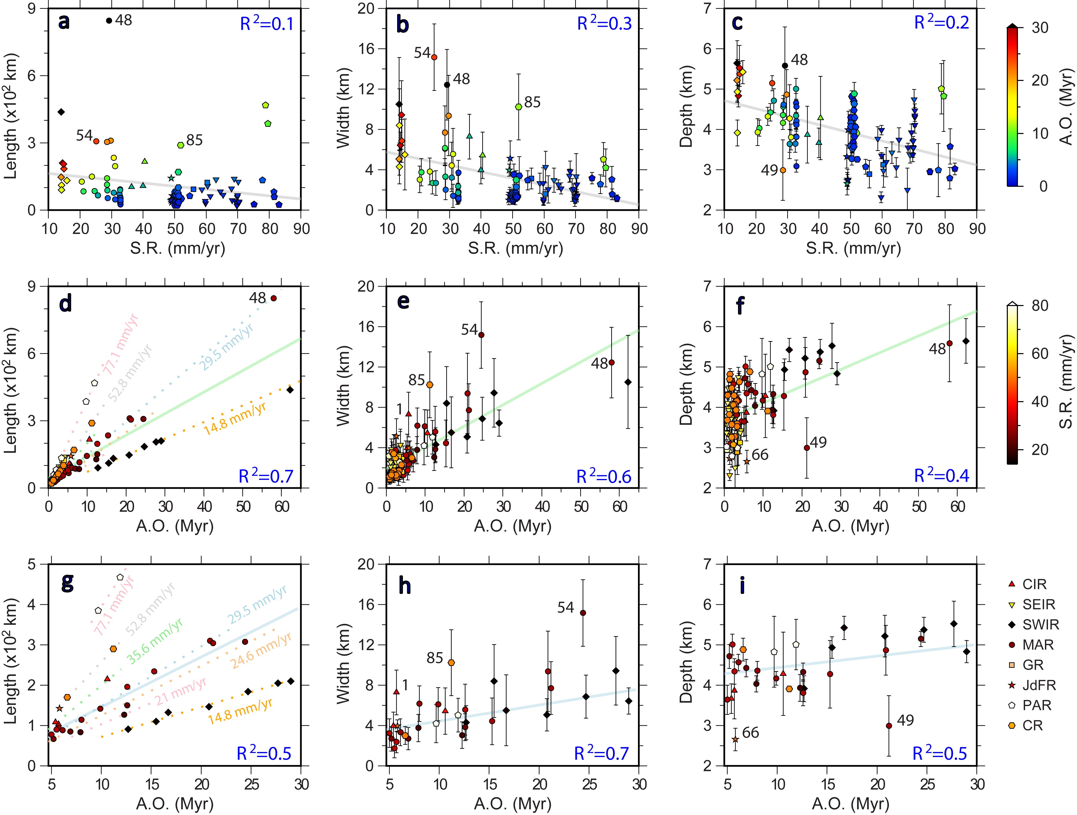
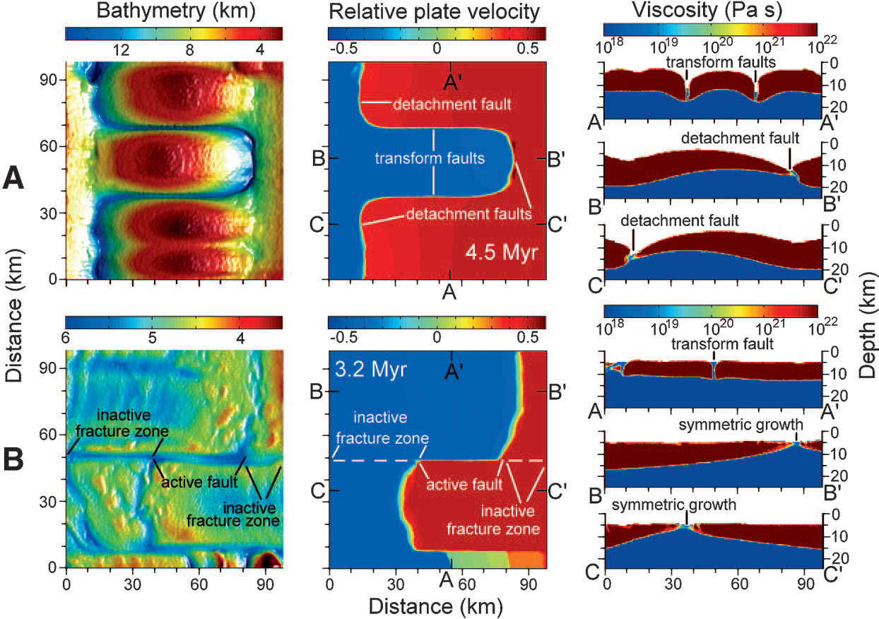
Morphological variablility of global OTFs
Correlation/impact:
Morphology v.s. S.R. – weak
Morphology v.s. A.O. – robust
Ren et al., GRL, 2022
Gerya, Science, 2010
4

Slide 6
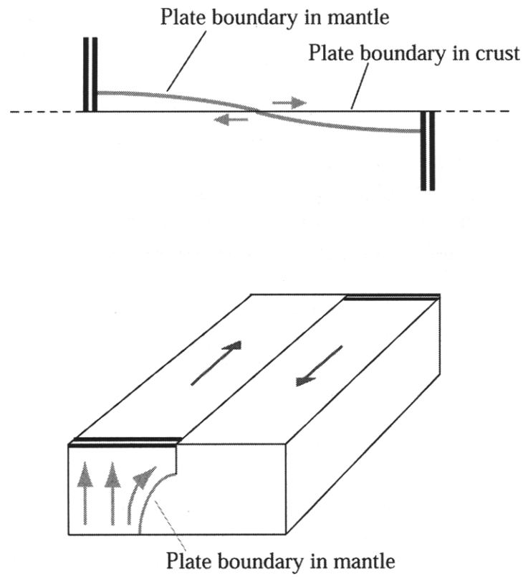
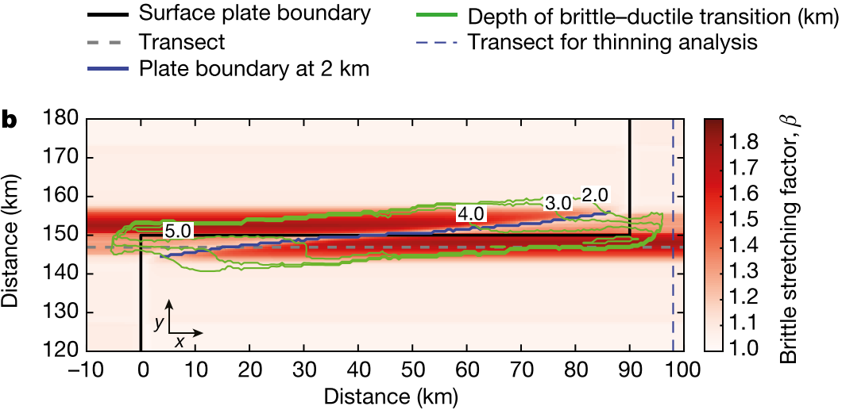
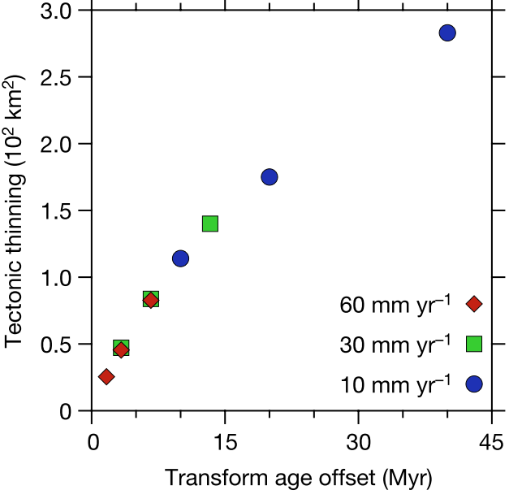
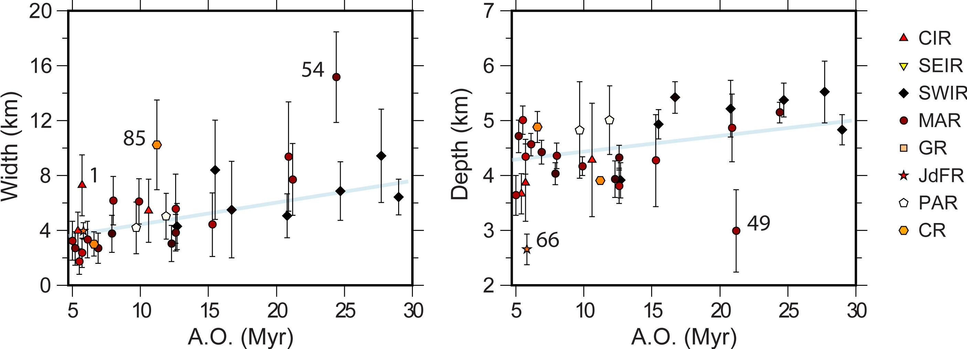
Implications
Furlong et al., GSL, 2001
oblique shear zone
Grevemeyer et al., Nature, 2021
Tectonic extension
Ren et al., GRL, 2022
Seafloor
morphology
Age-offset
5
Notes:
Our observation that morphological parameters of OTFs scales with age-offset links the predicted extensional tectonics to the surface deformation pattern, indicating that cross-transform extension is an important process acting on oceanic transform plate boundaries

Slide 7
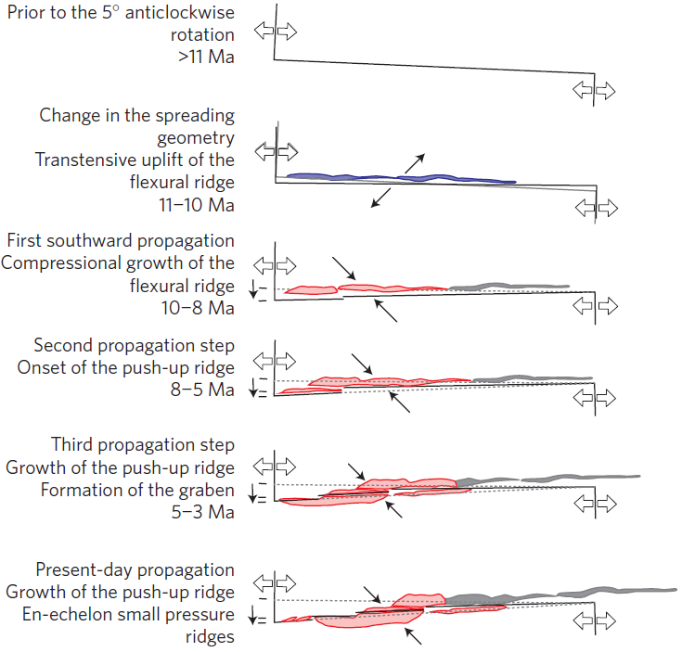
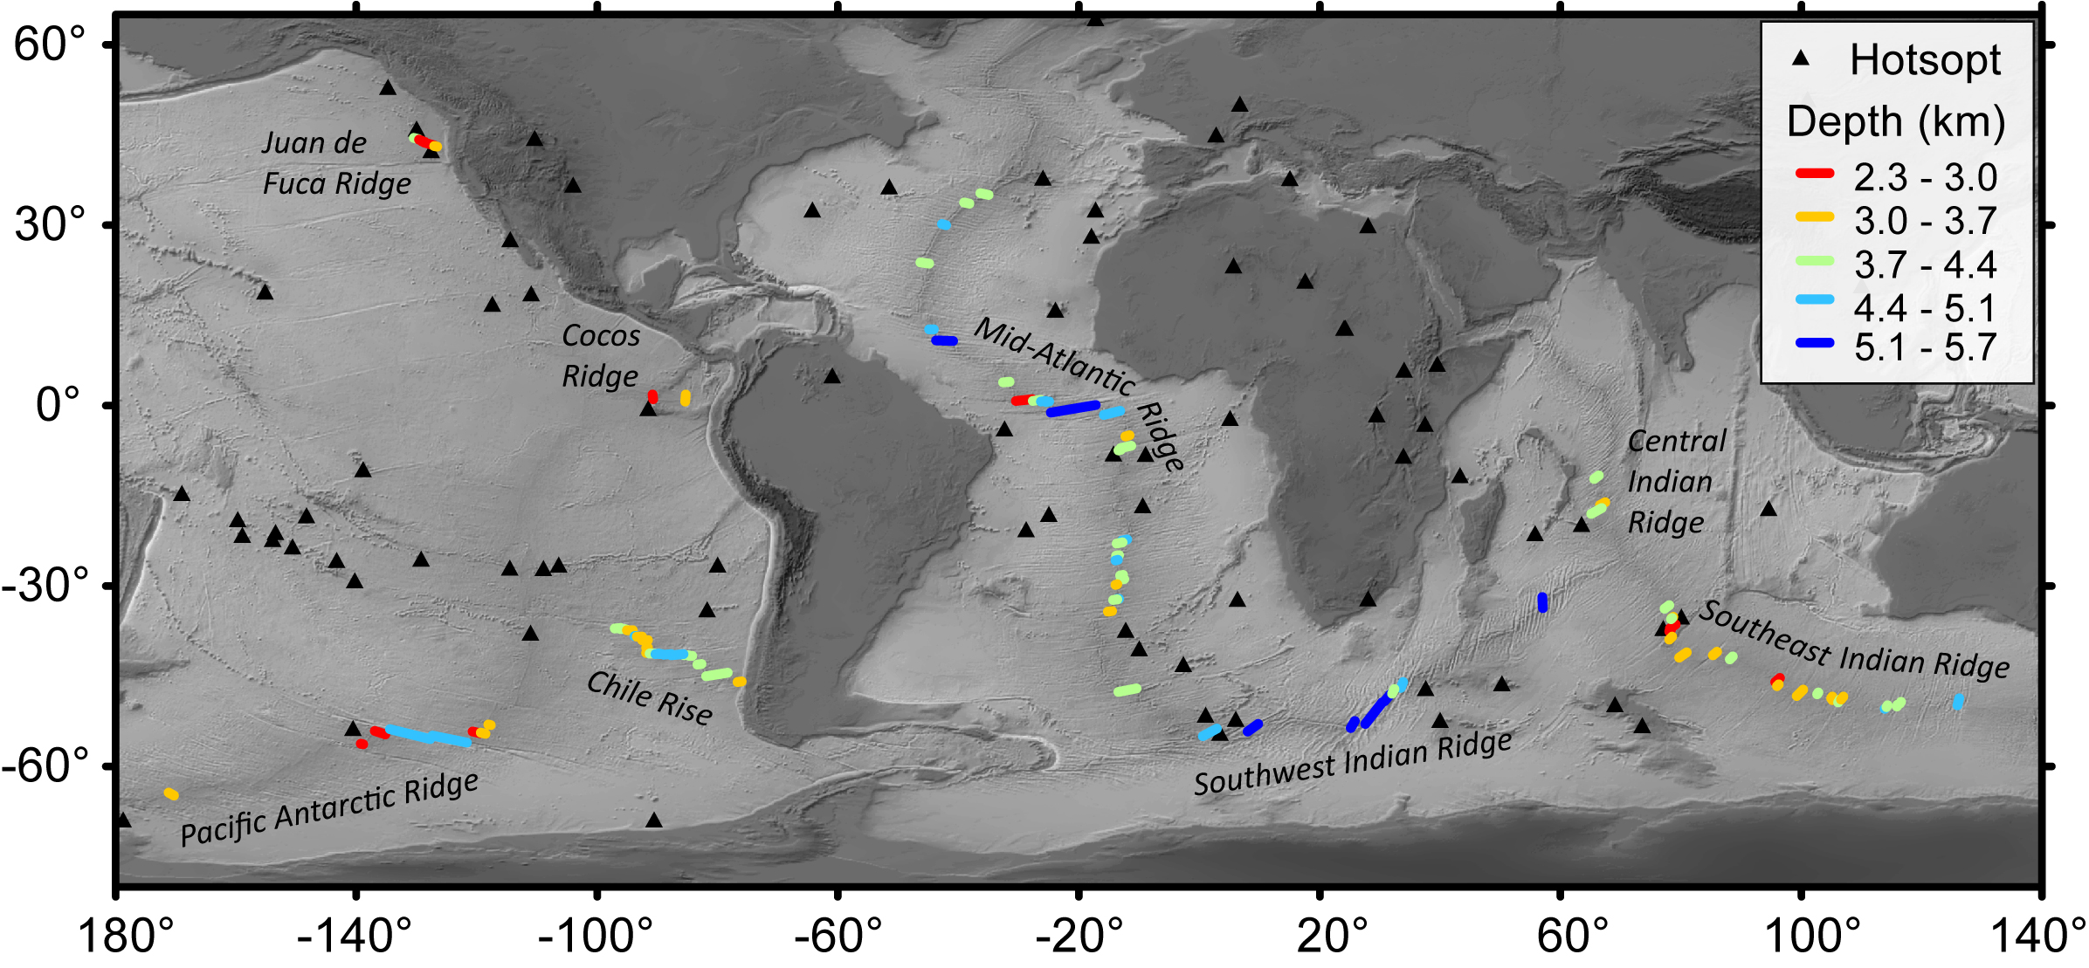
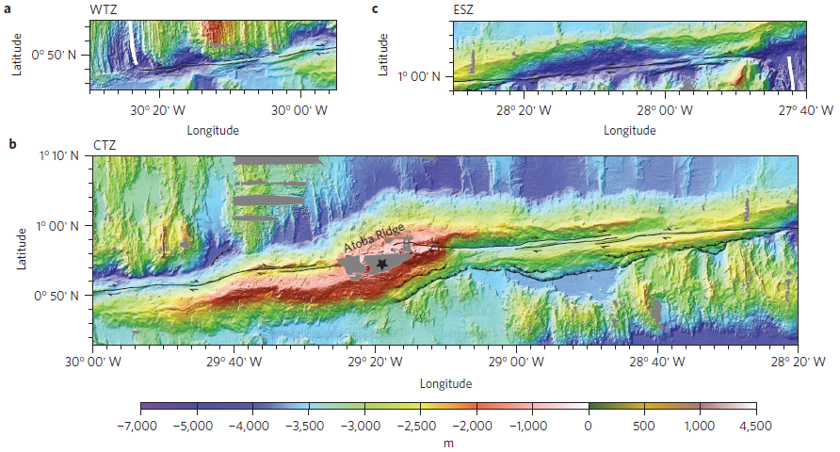
Conclusions
Transform morphology v.s. spreading rate ➔ weak
Transform morphology v.s. age-offset ➔ robust ➔ cross-transform extension is an important process acting on oceanic transform plate boundaries
Scatters ➔ in addition to the extension, there are also secondary processes affecting transform morphology, such as nearby hotspots and changes in plate motion
Ren et al., GRL, 2022
Maia et al., Nature Geoscience, 2016
6

Slide 8


Future prospective
High-resolution gravity, magnetic and seismic surveys within transform systems are needed to further explore the details of transform dynamics.
3D advanced geodynamic models will further our understanding of relationships between the key features of OTFs, e.g., thermal structure, tectonic extension, fault rheology, hydration, impact of secondary processes, etc.
…
For more details please see:
Ren, Y., Geersen, J., & Grevemeyer, I. (2022). Impact of spreading rate and age-offset on oceanic transform fault morphology. Geophysical Research Letters, 49, e2021GL096170. https://doi.org/10.1029/2021GL096170
@renyu95 yren@geomar.de
7

Slide 9
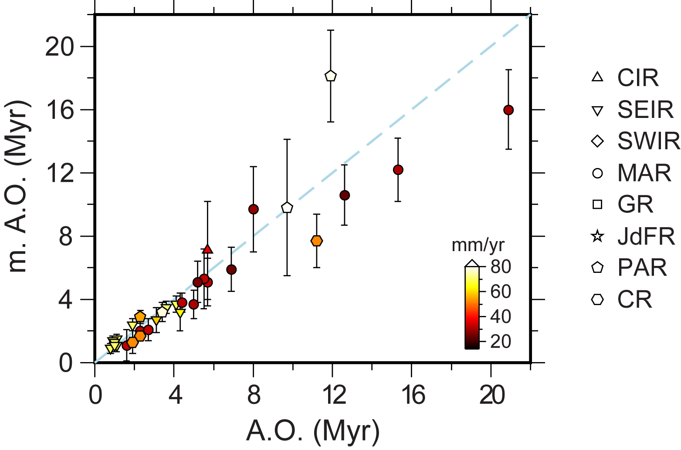
Appendix – measured age-offset v.s. calculated age-offset

Slide 10
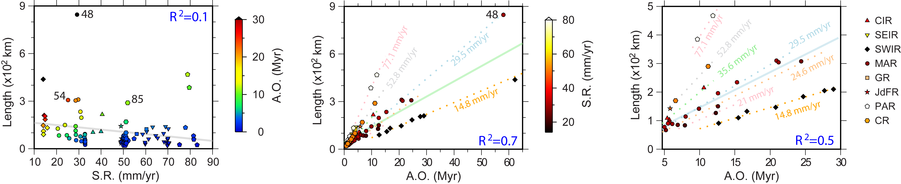
Appendix - length
Length = half-spreading rate * age-offset
21 – 847 km, average ~118 km
Slow spreading rate favors long RTF
L vs. SR – negative, scatter
L vs. AO – positive, near linear

Slide 11
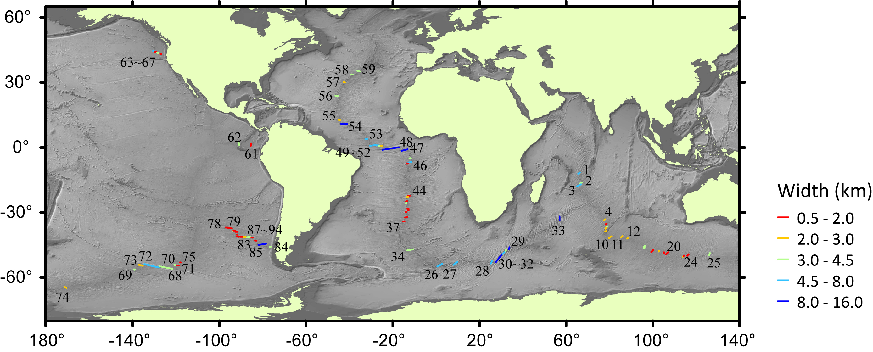
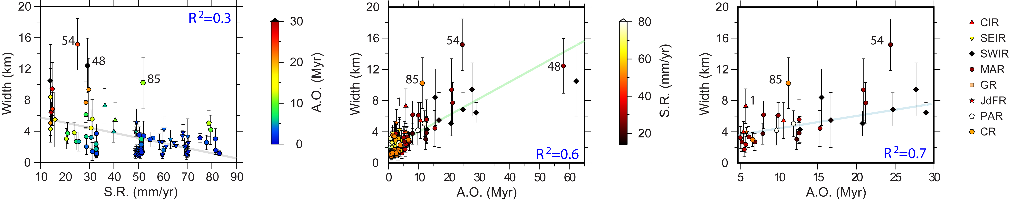
Appendix - width
Width
0.9 – 15.1 km, average ~3.7 km
Slow spreading rate favors wide RTF
W vs. SR – negative, scatter
W vs. AO – positive, near linear

Slide 12
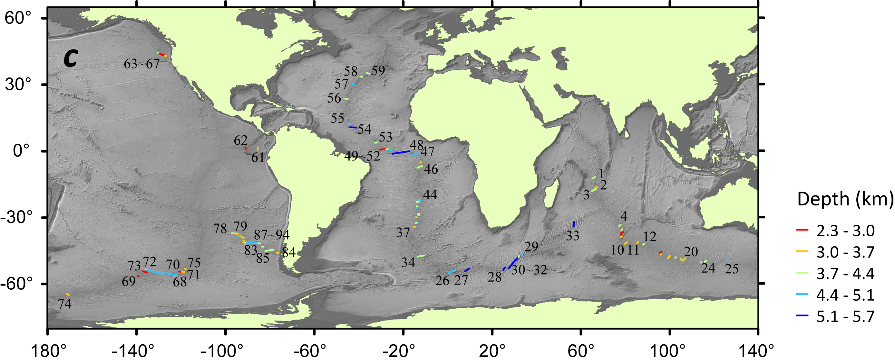
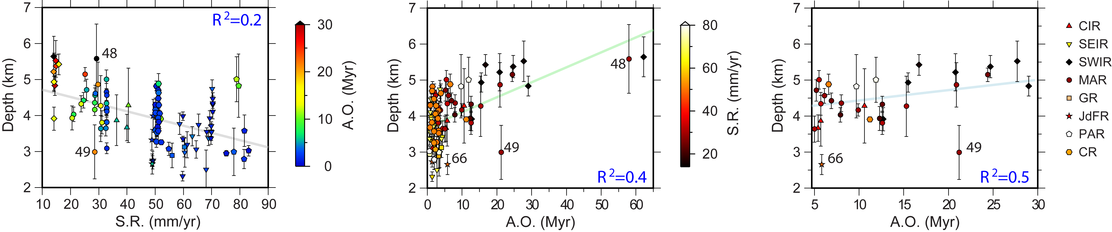
Appendix - depth
Depth
2.3 – 5.61 km, average ~3.8 km
Slow spreading rate favors deep RTF
D vs. SR – negative, scatter
D vs. AO – positive, near linear (>5 Myr)
scattering (0 – 5 Myr)

Slide 13
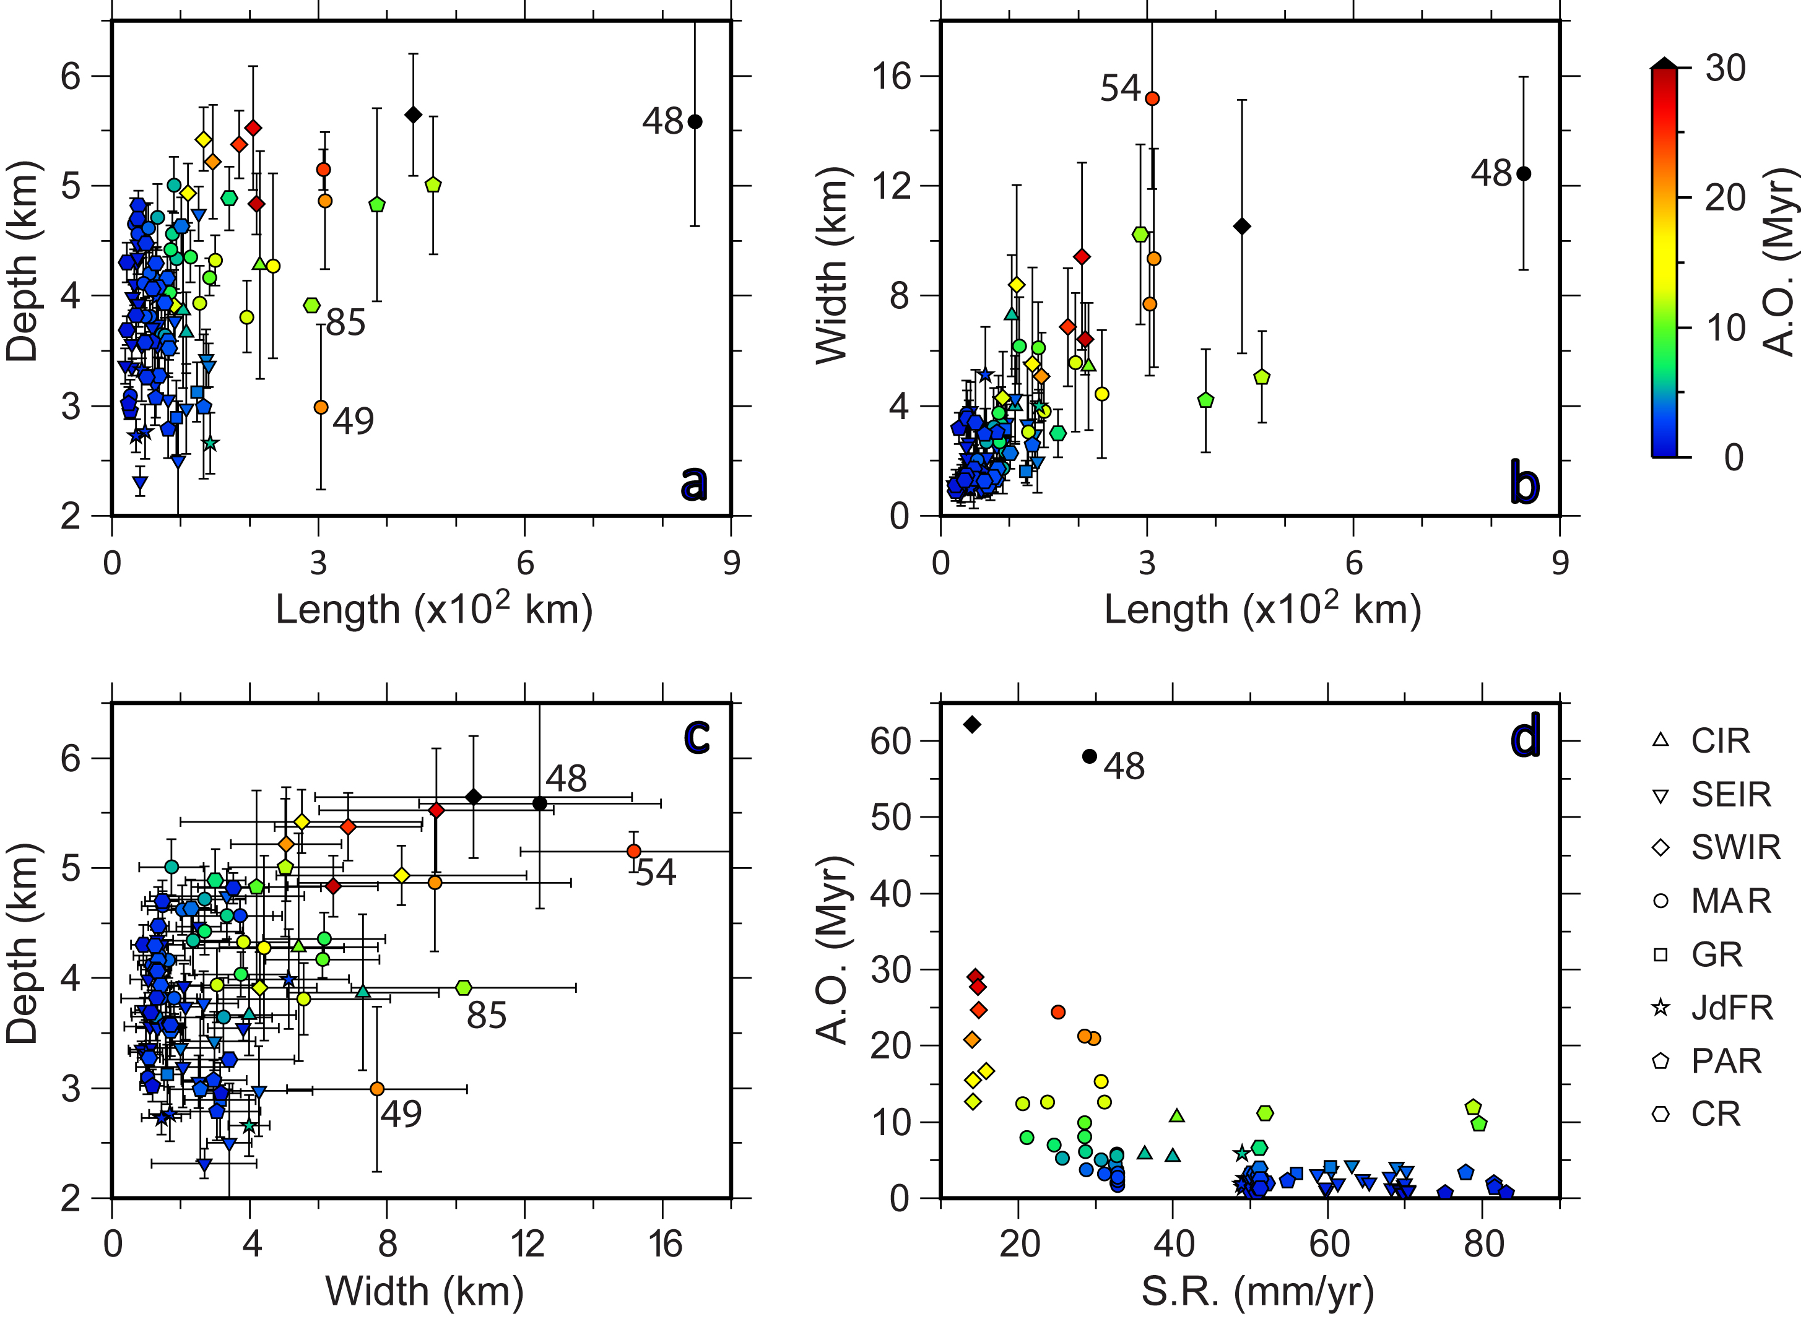
Appendix - crossplots

Slide 14
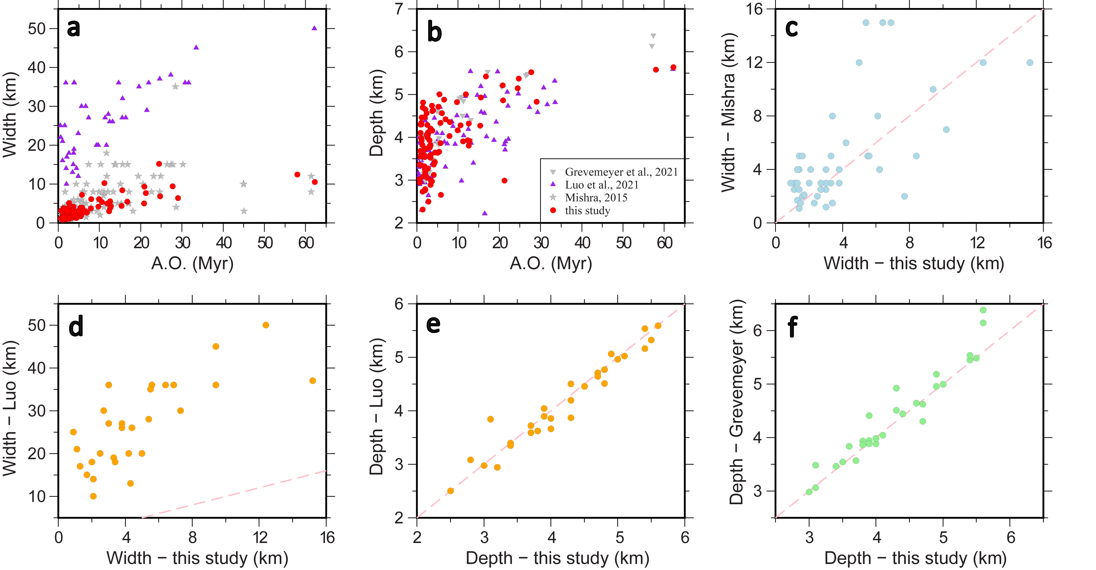
Appendix – comparsion with previous datasets

Slide 15
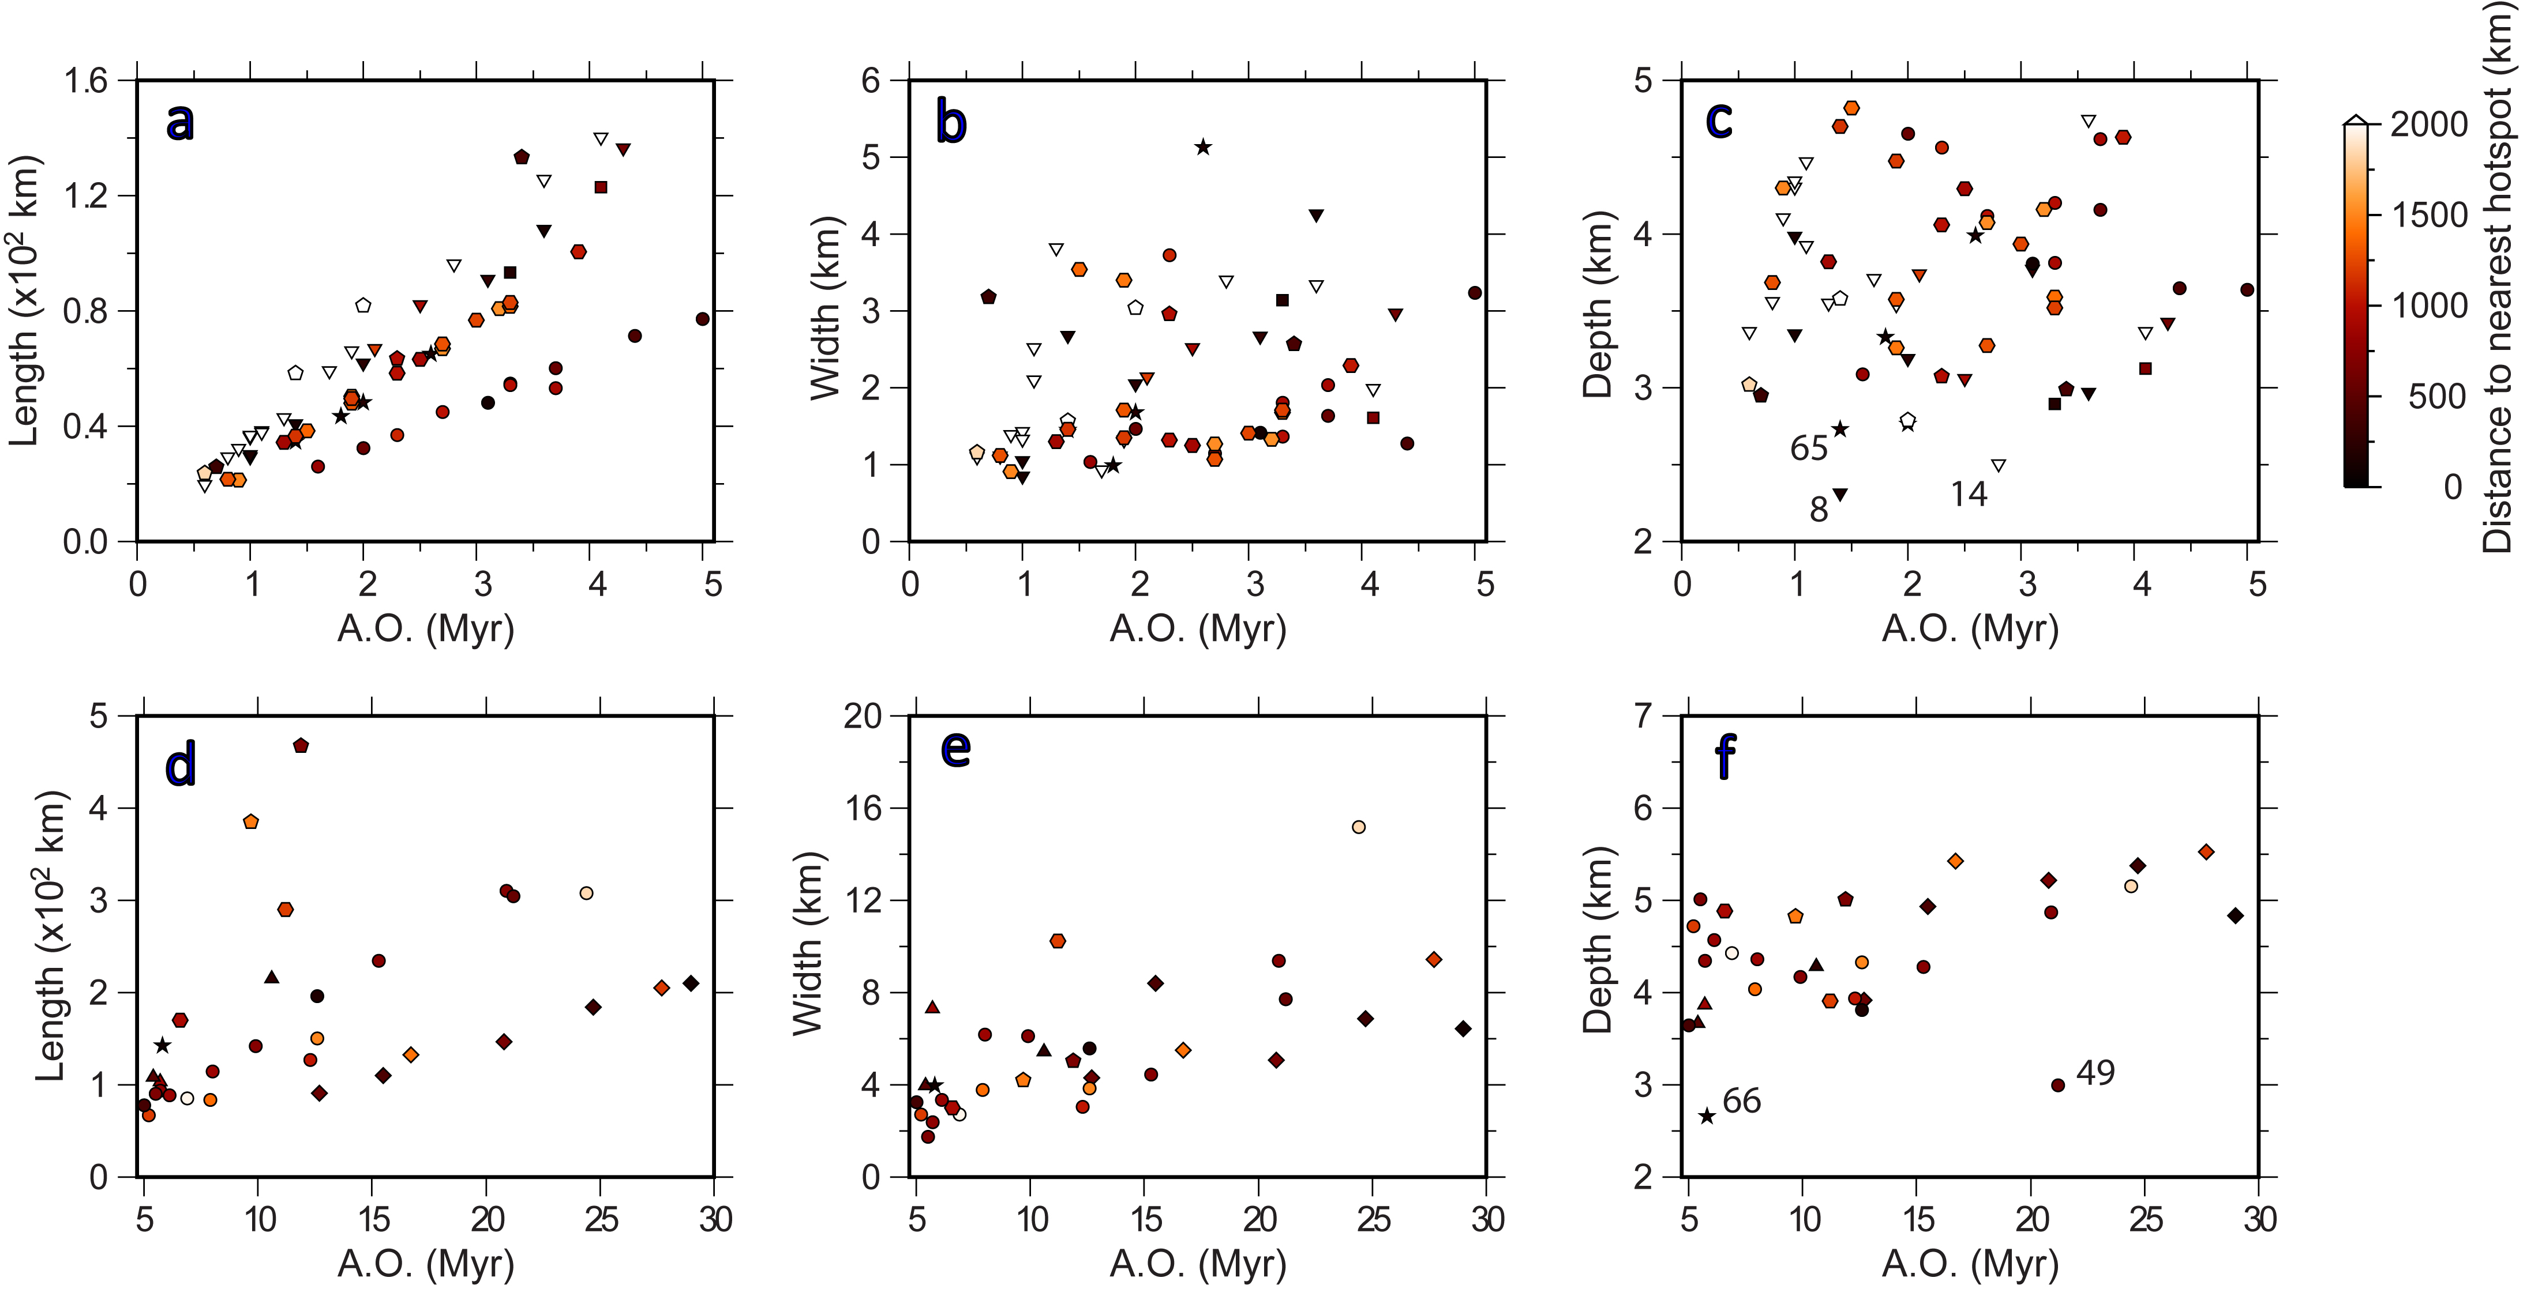
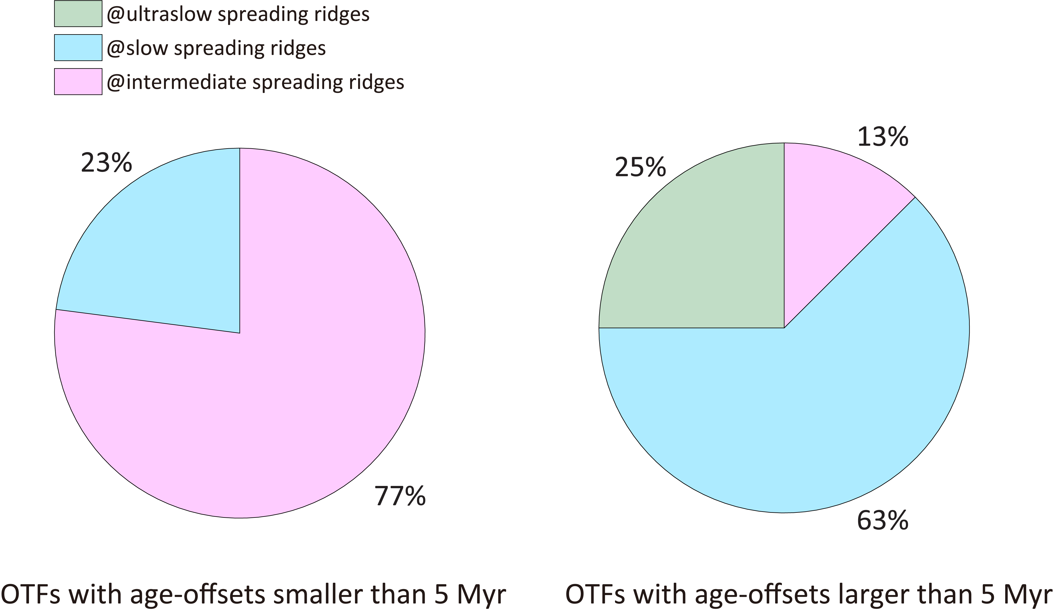
Impact of nearby hotspots
Appendix – outlier analysis
Ren et al., GRL, 2022
Gerya, Science, 2010

Slide 16
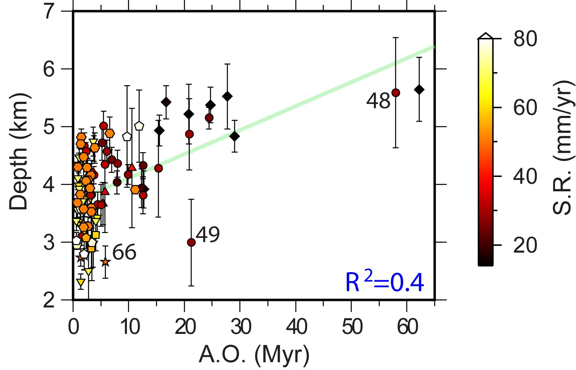
Impact of changes in plate motion
Appendix – outlier analysis
Maia et al., NG, 2016

