Slide 1
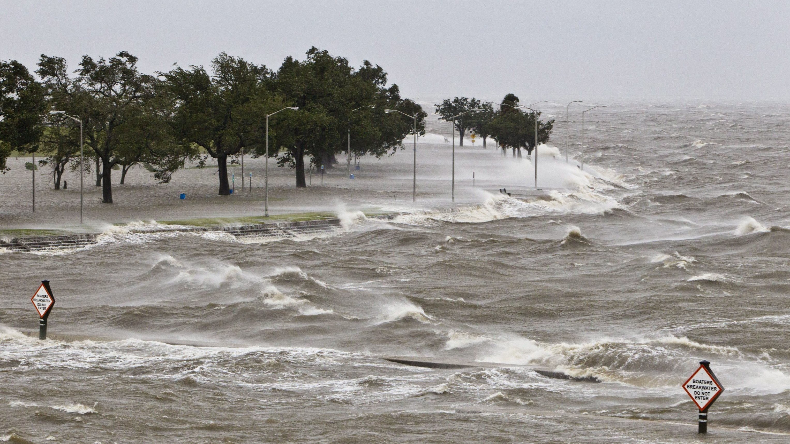






An efficient multiscale modelling framework for assessment of coastal flooding events
Irene Benito Lazaro, Sanne Muis, Dirk Eilander, Philip Ward, Jeroen Aerts

Slide 2
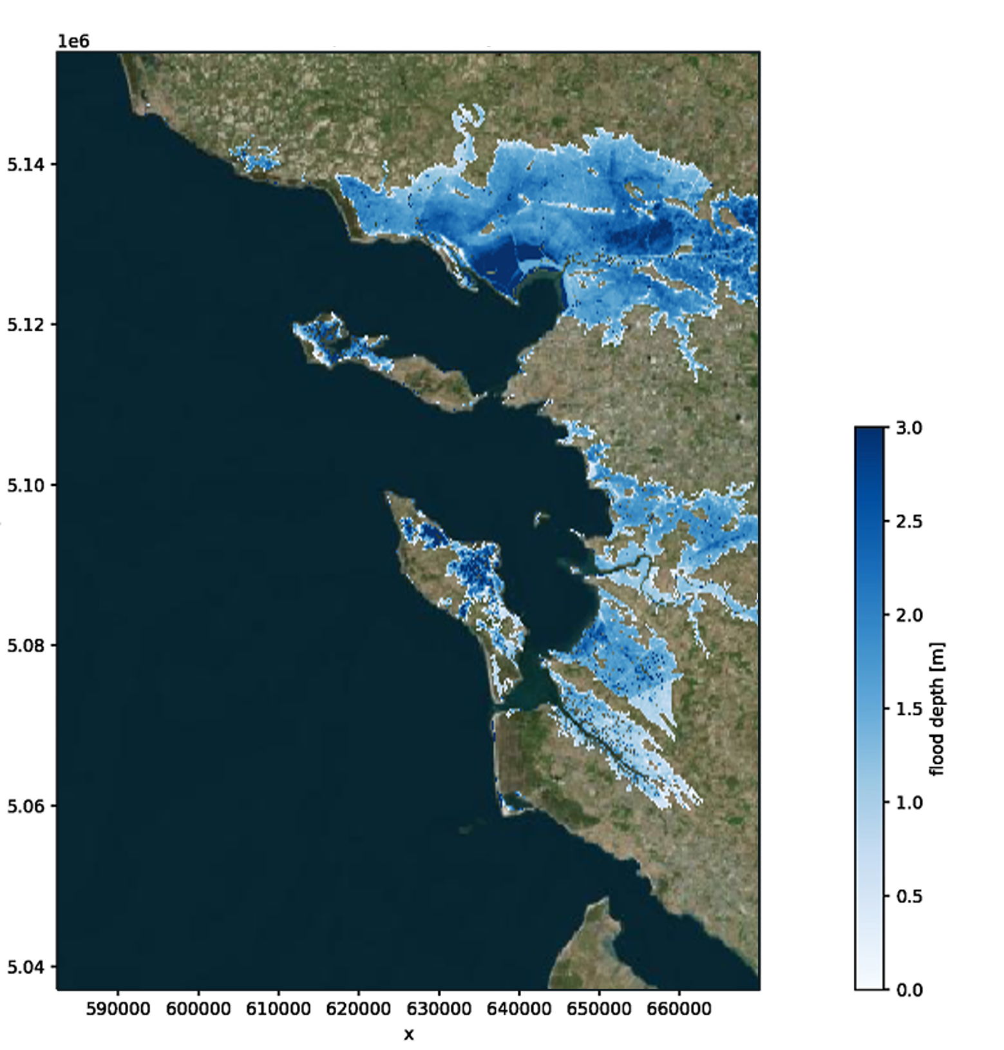
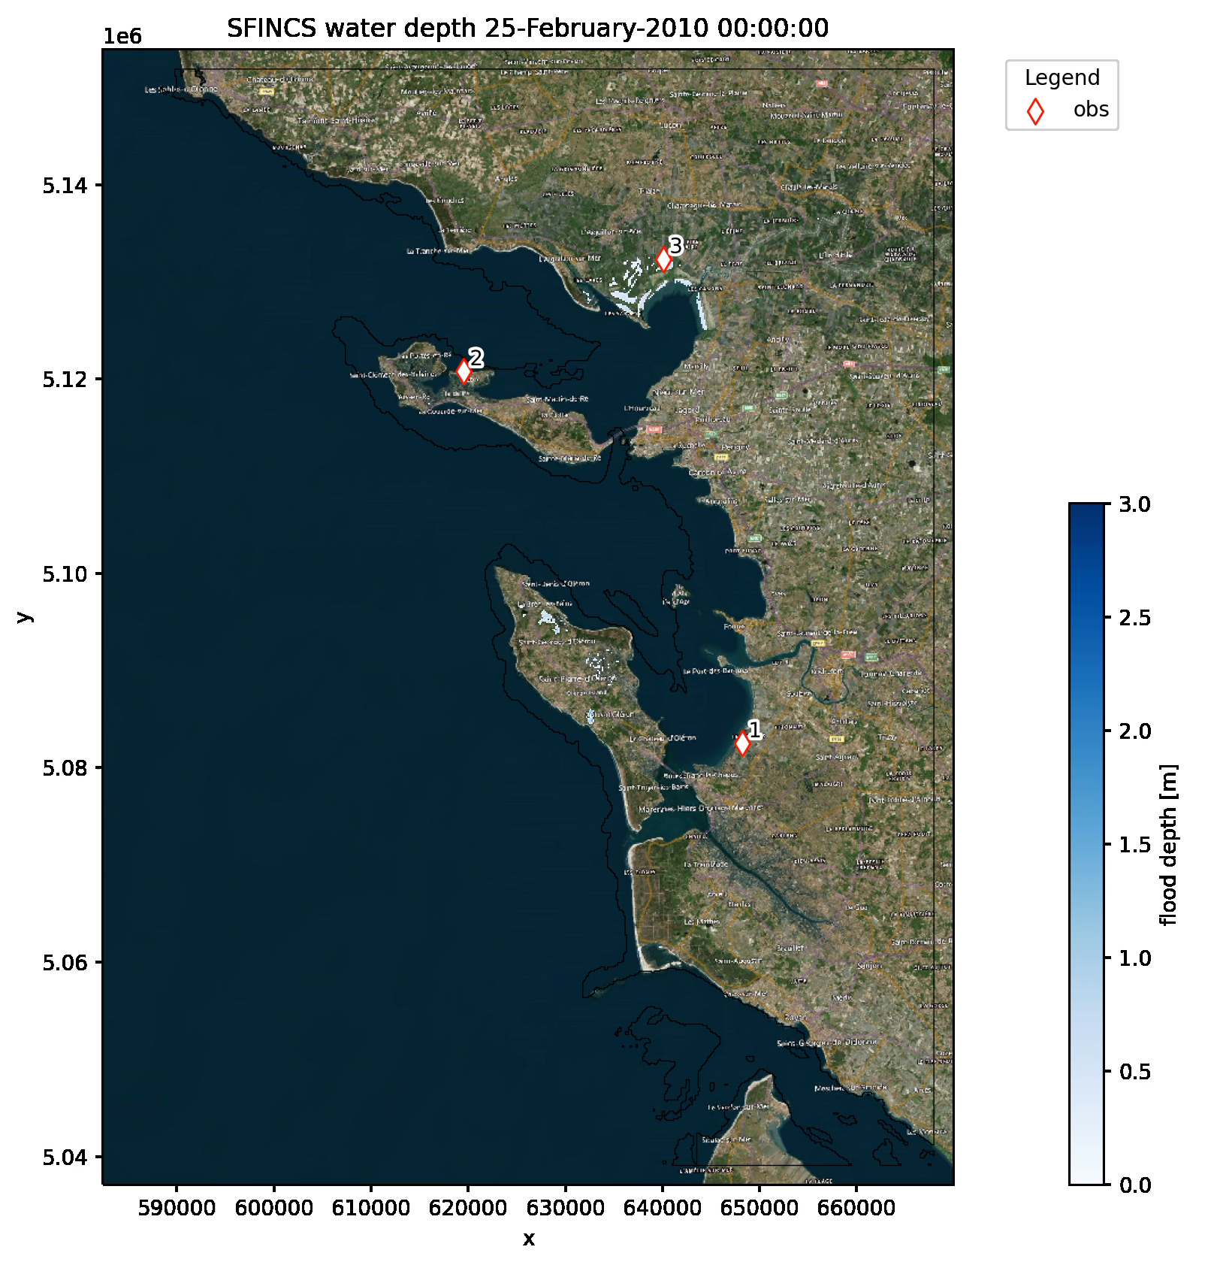
Why do we need a modelling framework?
Hazard:
Static
Dynamic
Risk:
Return-period based
Event-based
Notes:
Fast and accurate flood models are crucial to take adequate decisions regarding disaster risk reduction. In recent years, improvements have been made on global coastal flood risk assessments. However, uncertainties related to the estimation of extreme sea levels, hazard propagation, and flood risk calculations are still present, and challenges remain which make the event-based assessment of flood risk at global scale difficult.
Static → Dynamic: account for physics of flooding processes and flood duration. Static: lead to overestimation. Lately, simplified complexity models: SFINCS at large scales.
Return-p → Event-b: homogeneous return periods for large scales, misestimation. Neglection spatial patterns of flood events. Risk management decisions miss the information on return-p based approaches.

Slide 3
Modelling framework
Fast and reliable
Flexible:
Scale of the assessment
Input datasets
Flood hazard mapping methodology
Storm track
Meteorological forcing
Holland Model
Global Tide and Surge Model
Preprocess
Flood hazard modelling
Static
Dynamic

Slide 4
Modelling framework: Coastal boundary conditions
OMUSE
OMUSE allows to:
Coupling models.
Nesting local-high resolution models in global models.
Make models more interactive.
Storm track
Meteorological forcing
Holland Model
Global Tide and Surge Model
Preprocess
Flood hazard modelling
Static
Dynamic
Notes:
OMUSE: Oceanographic Multipurpose Software Environment

Slide 5
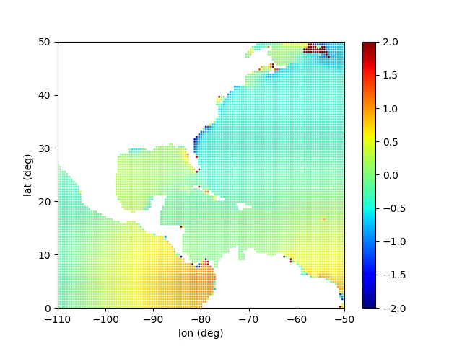
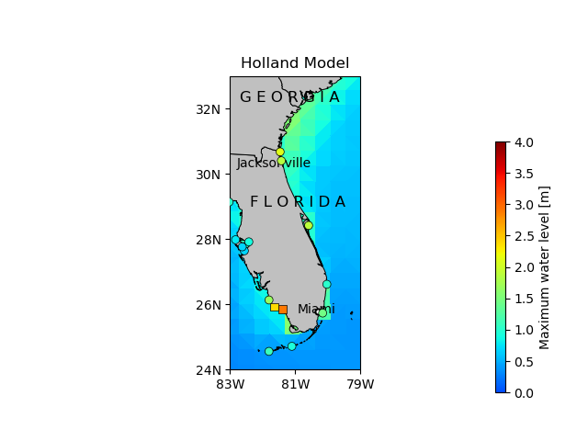
Modelling framework: Coastal boundary conditions
OMUSE
OMUSE allows to:
Coupling models.
Nesting local-high resolution models in global models.
Make models more interactive.
Storm track
Meteorological forcing
Holland Model
Global Tide and Surge Model
Preprocess
Flood hazard modelling
Bathtub
SFINCS
Delft3d FM

Slide 6
Modelling framework: Flood hazard
OMUSE
Storm track
Meteorological forcing
Holland Model
Global Tide and Surge Model
Preprocess
Flood hazard modelling
Static
Dynamic
Bathtub
SFINCS
Delft3d FM
Notes:
Simplify into static and dynamic approaches!

Slide 7
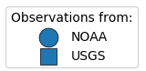
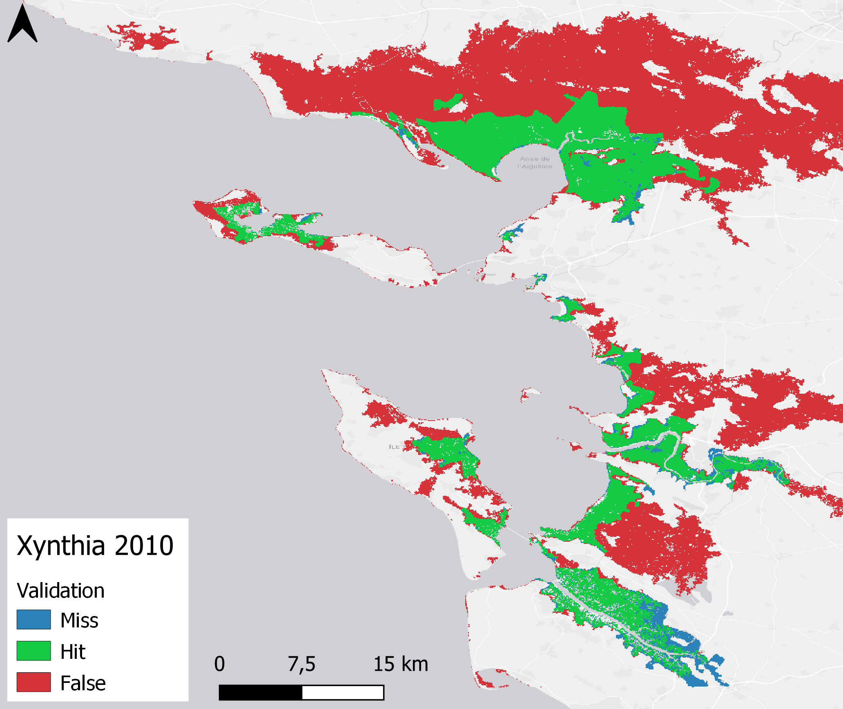
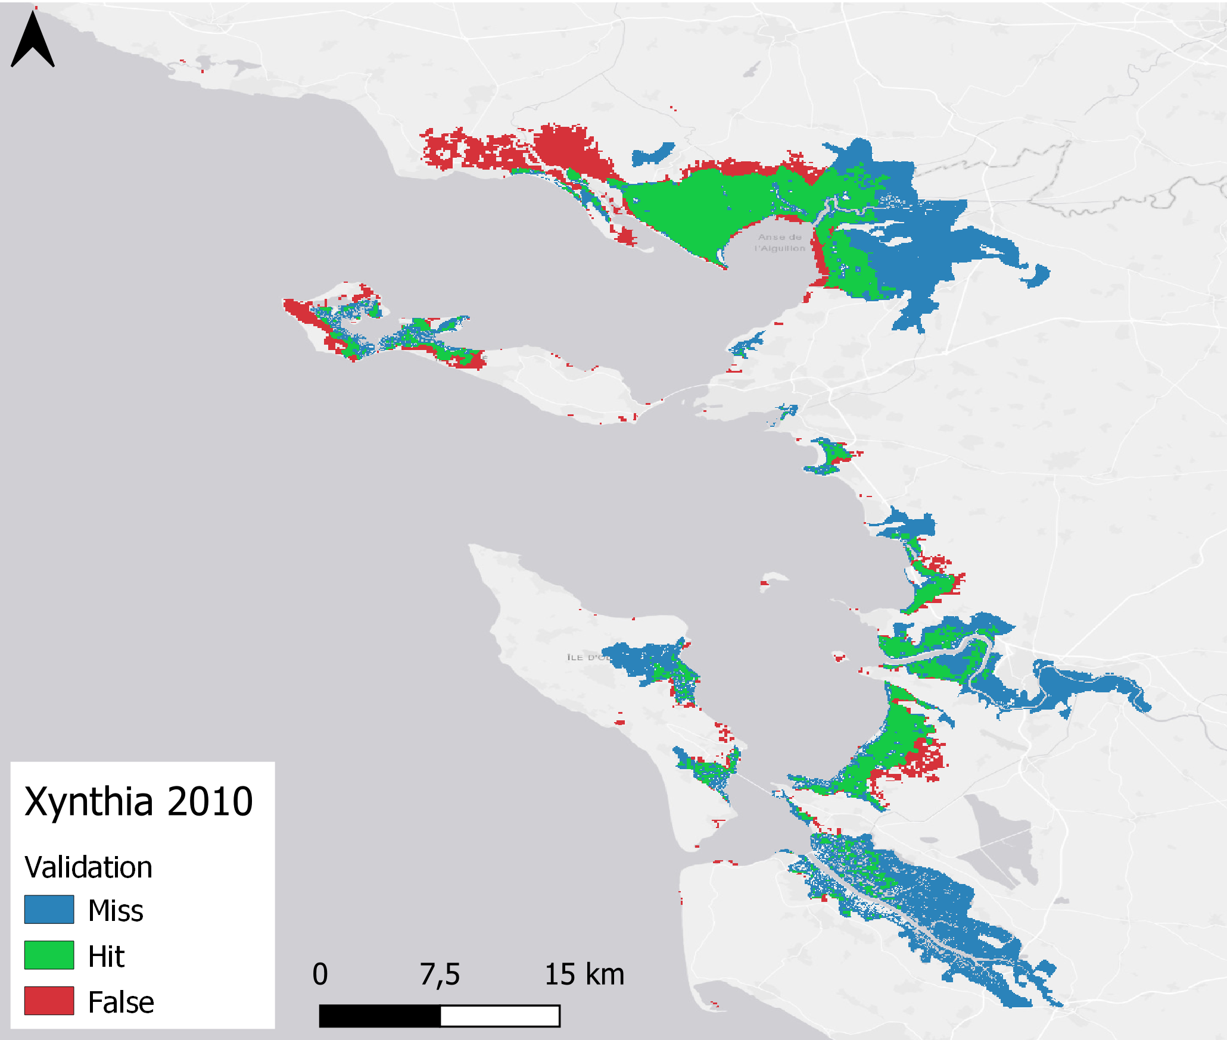
Framework validation
Global Tide and Surge Model
Flood hazard modelling
Static
Dynamic
Notes:
Talk a bit more about the figure. What are we actually seeing? Background, output GTSM. Points, validation data.

Slide 8

Moving towards a dynamic approach
to assess coastal flooding events at large scales
Questions? Please email me: i.benito.lazaro@vu.nl
More information:

