Slide 1

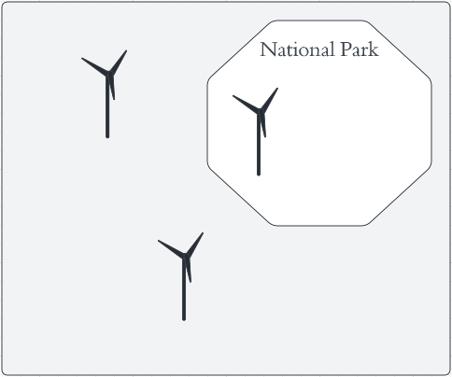
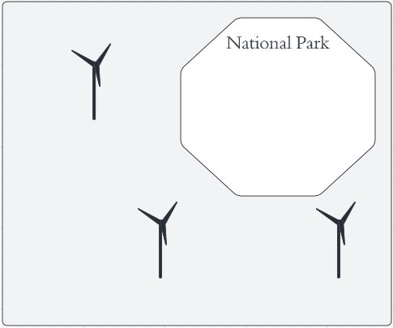
Restricting the deployment of renewable energy from highly valuable areas
A
B
How do these restrictions impact the cost, spatial footprint and ecosystem service value of the energy system?

