Slide 1
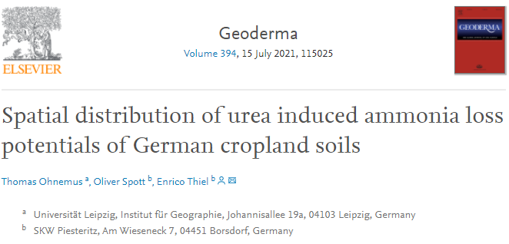


Thomas Ohnemus
25.05.2022
https://doi.org/10.1016/j.geoderma.2021.115025

Slide 2




Motivation
$${NH}_{3 }$$
$${NH}_{3 }$$
$${NH}_{3 }$$
Urea fertilizer
(Agrarheute.com)
Notes:
Strongest N loss from urea in form of NH3

Slide 3
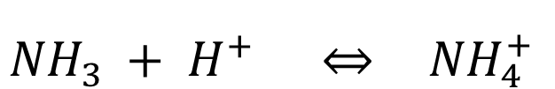
Ammonia/Ammonium equilibrium
Soil Matrix
Soil Solution
Uptake
$${NH}_{3 }+ H^{+} \underset{⇔}{} {NH}_{4}^{+}$$
Rising pH
Notes:
If NH4+ is taken up by the soil matrix, to maintain the equilibrium in soil solution more NH4+ will be produced. A rising pH shifts the equilibrium towards NH3 promoting NH3 loss.

Slide 4
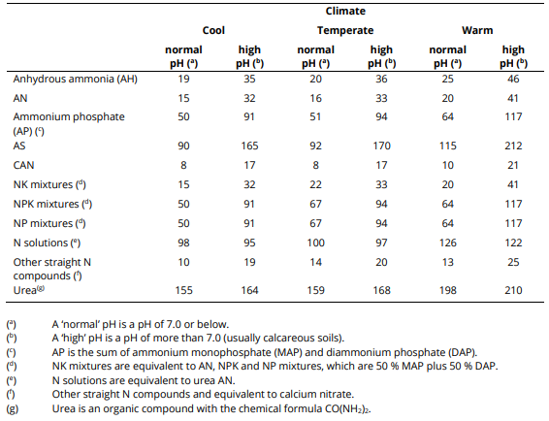
Motivation & Structure
1
Identify emission- relevant soil parameters
2
Model NH₃ loss potentials
3
Map spatial NH₃ loss potentials
(EMEP/EEA 2019)
Notes:
According to the EEA all of this work is unnecessary, because they solved this riddle already, according to this table. In this publication for urea three assumptions are made:
Urea emissions rise with rising temperature. This is the climatic factor determining NH3 emissions.
For soil parameters, pH is dominant. Higher soil pH leads to higher NH3 emissions.
A narrow value range appears to be realistic for NH3 emissions, from 15.5 to 21 % of applied Nitrogen
These assumptions will be challenged here.

Slide 5
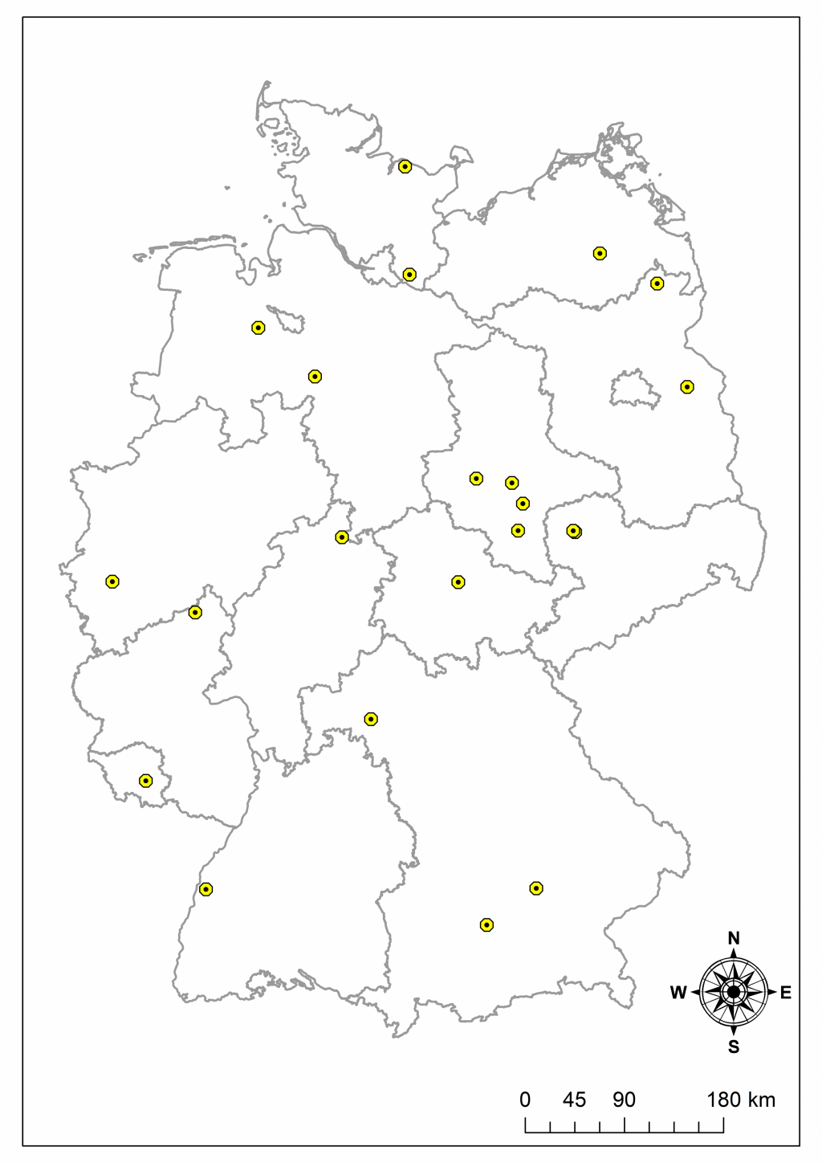
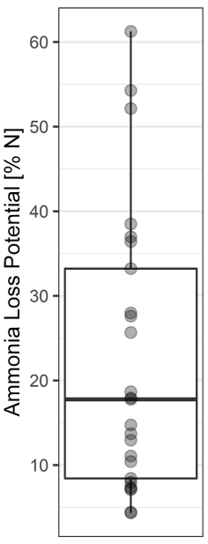
Soil Samples
Notes:
Soil samples from 27 locations of Germany were used and their physicochemical soil characteristics as well as their NH3 loss potential under extreme loss conditions (low soil volume, easy exchange with the atmosphere, high T of 20 °C) were determined.

Slide 6
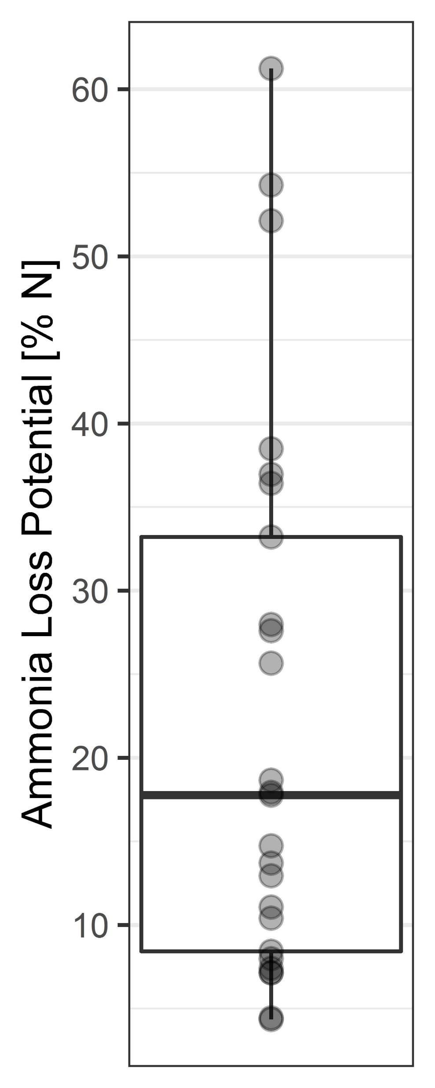
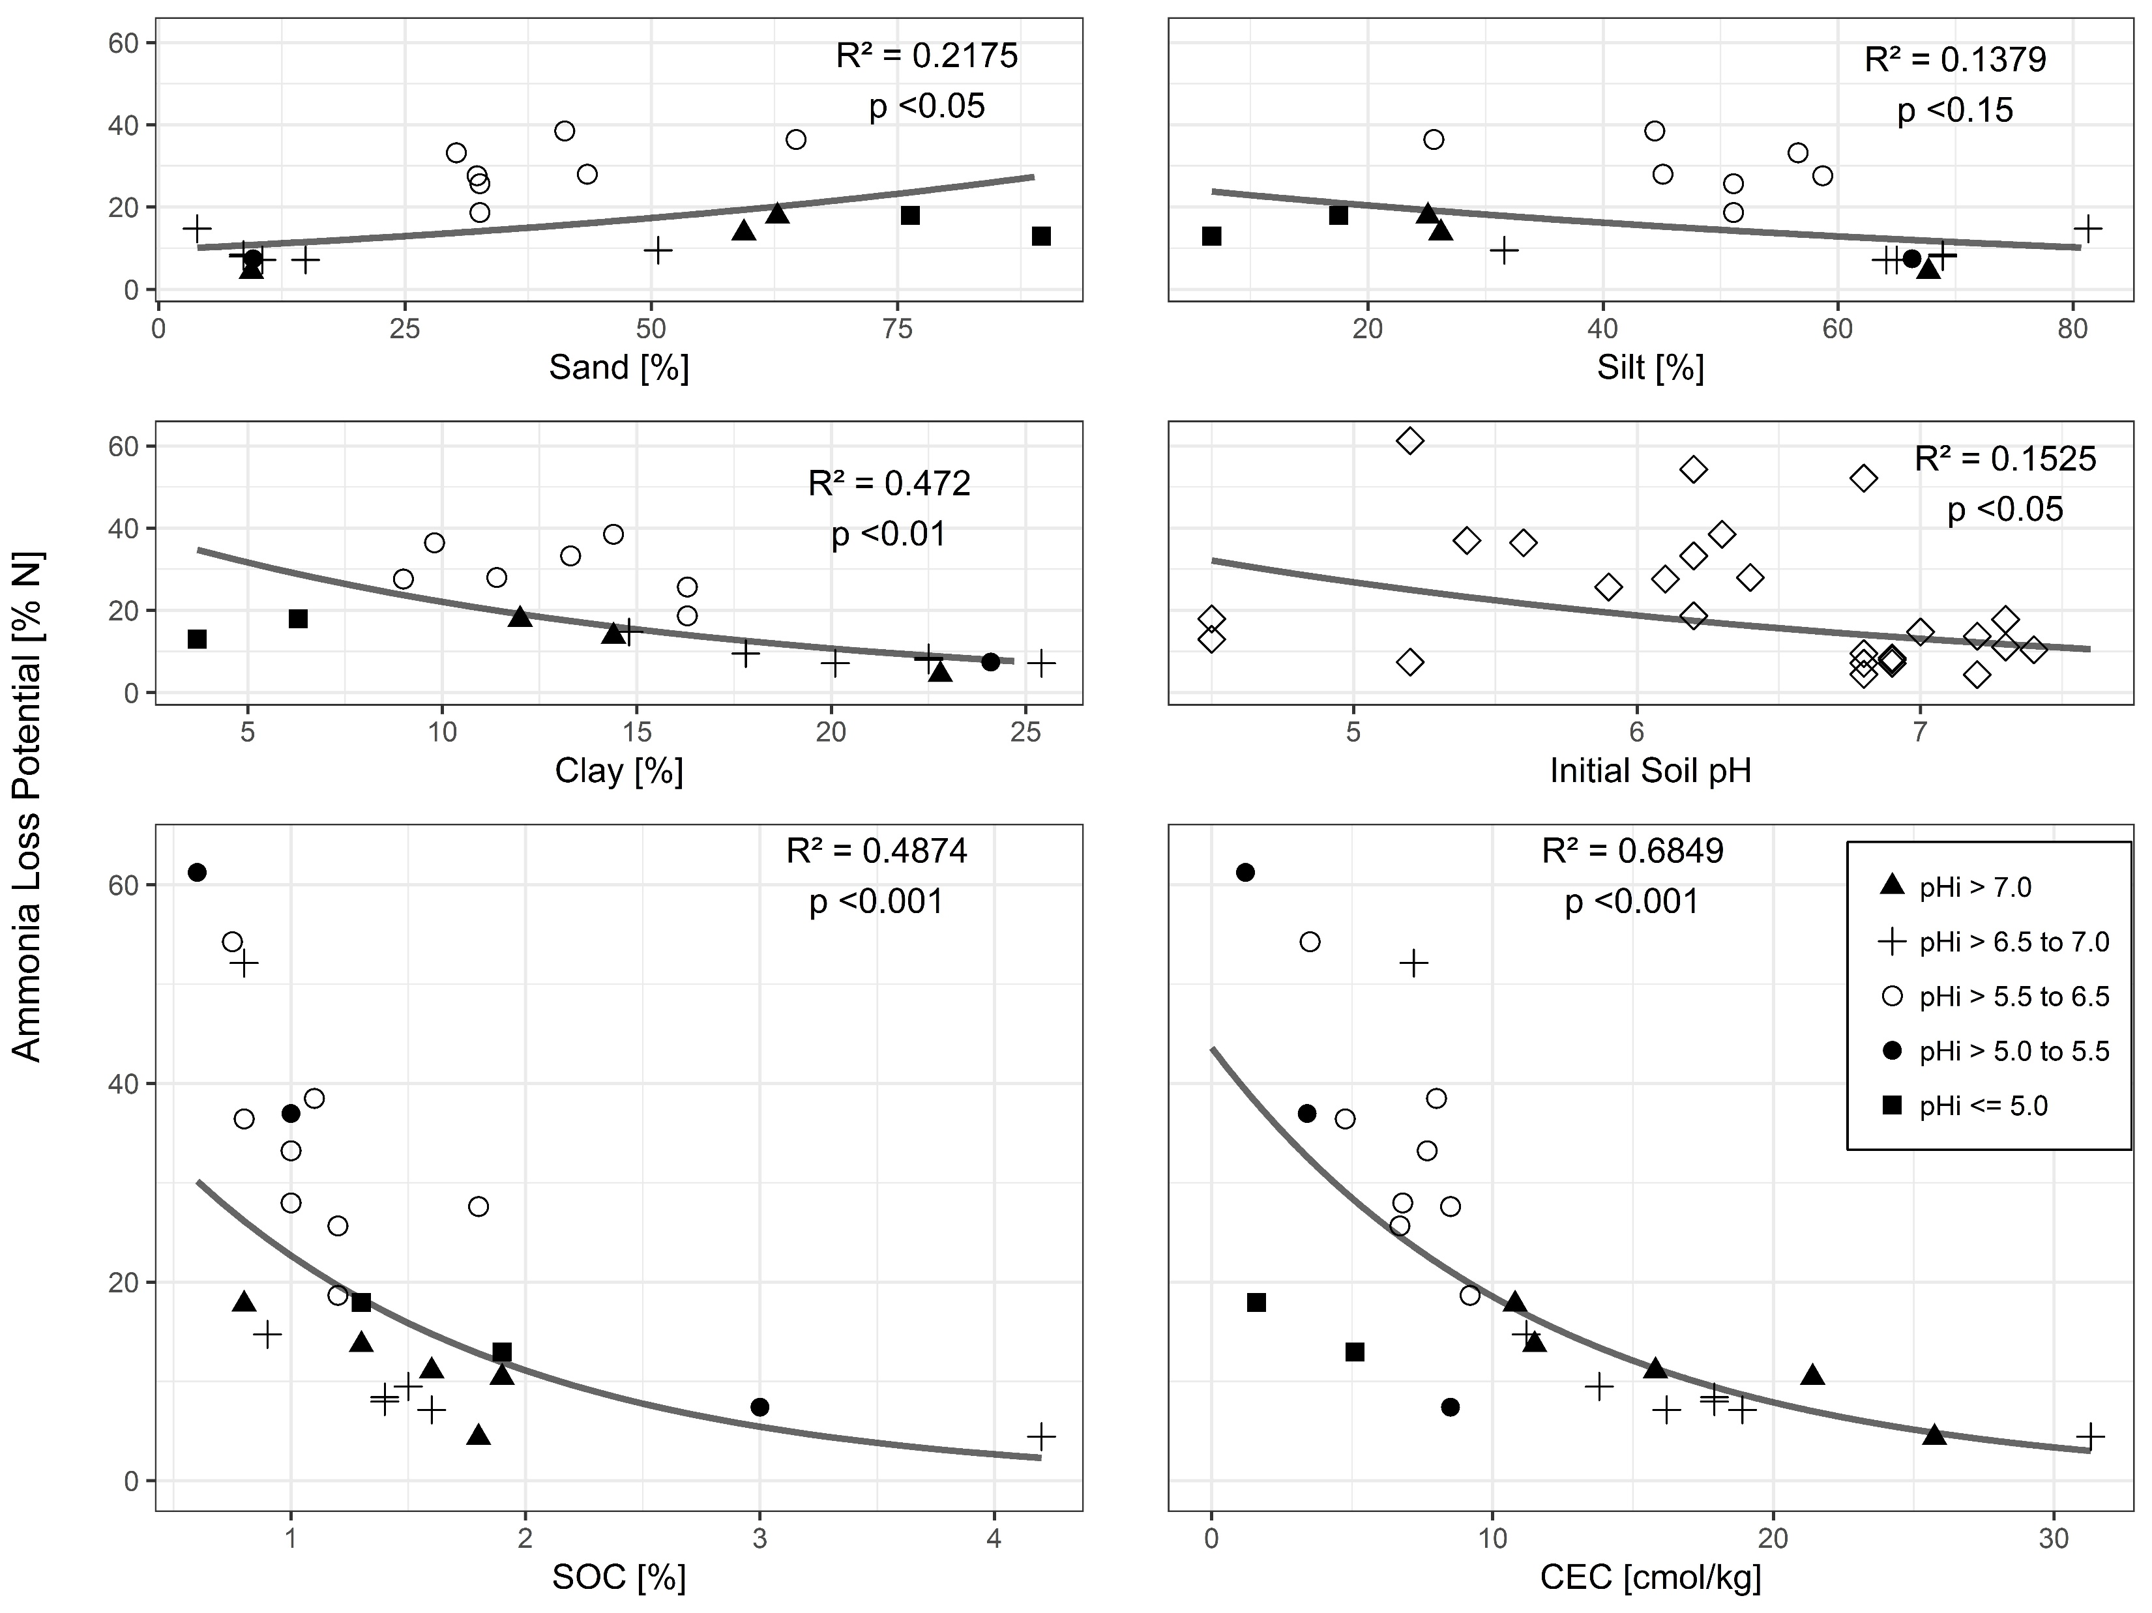
Urea induced NH₃ loss potential at lab scale
CEC and SOC determine widely varying NH₃ loss potentials
Fig. 2: NH₃ loss potentials from 26 cropland soils
Fig. 3: Correlations between soil parameters and the respective NH₃ loss potentials
Notes:
So, in the laboratory for 26 soils we found widely ranging emission potentials, from around 4 to 61 % N, already contradicting the 15.5 – 21 % N of the EEA.
And we could see that CEC and SOC showed relevant correlations to the NH3 loss potential, the initial soil pH – I will talk about what „initial“ means in a minute – did not, again contradicting the EEA. But, how can there be no influence? We just saw how pH controls the NH4+/NH3 equilibrium!

Slide 7
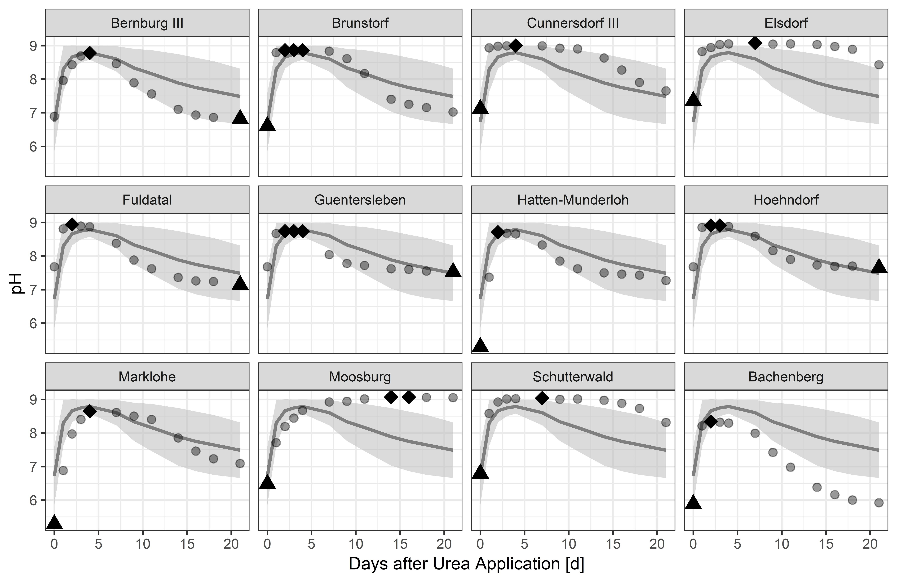
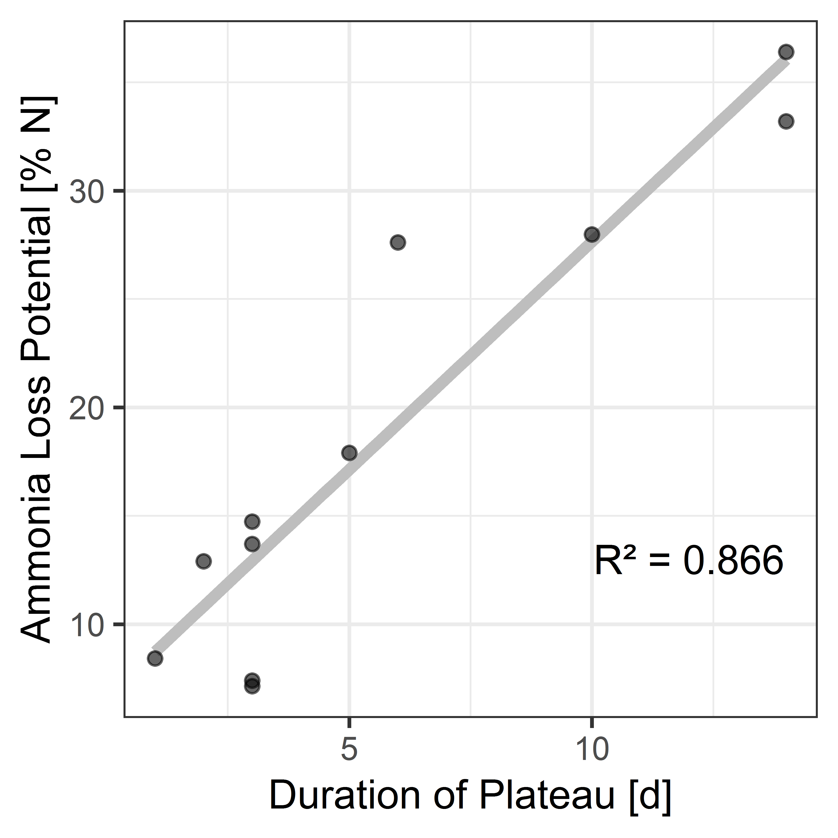
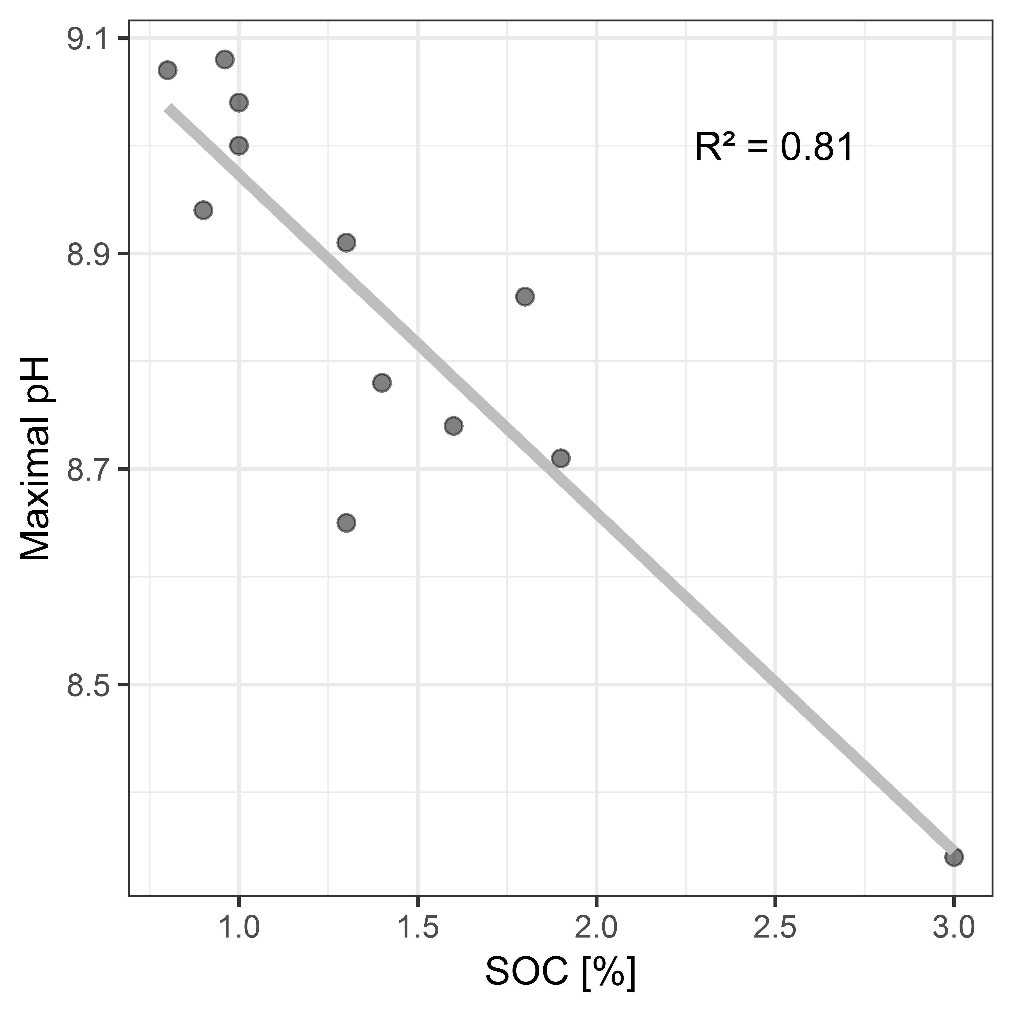
Dynamic of soil pH after urea application
Fig. 5: Plateau around pH_{max} correlates strongly with NH₃ loss potentials
Fig. 6: SOC determines the pH_{max} value
SOC and pH_{i} determine the emission-relevant pH_{max} value
Fig. 4: pH evolution after urea application, triangles mark day of minimal pH value, diamonds mark highest
pH value. Lines delineate mean, the grey band standard deviation
Notes:
On this account, we conducted another experiment, because pH changes after application of urea. This experiment was conducted for 12 soils, and we can see a rather uniform, fast rise in pH starting with application leading to a maximum pH value, shown as diamonds.
Due to a strikingly high correlation between the duration of the pH plateau and the NH3 loss potential we could identify this phase as the main emission phase. So, it is actually this pHmax value that determines the NH3/NH4+ equilibrium, not the initial pH. We can also see that SOC determines the pHmax value, with high SOC leading to low pHmax. Furthermore, we could see that the soils with the lowest pHi value also lead to the lowest pHmax values, but we were not yet able to describe this relation mathematically, more data would be needed.
The plateau duration varies widely and we see the nitrification as the relevant process that brings the pH down. The earlier and stronger nitrification is, the earlier the plateau is left and the lower NH3 loss.
Nitrification is facilitated by higher CEC. We can also describe the influence of the CEC in another way…

Slide 8
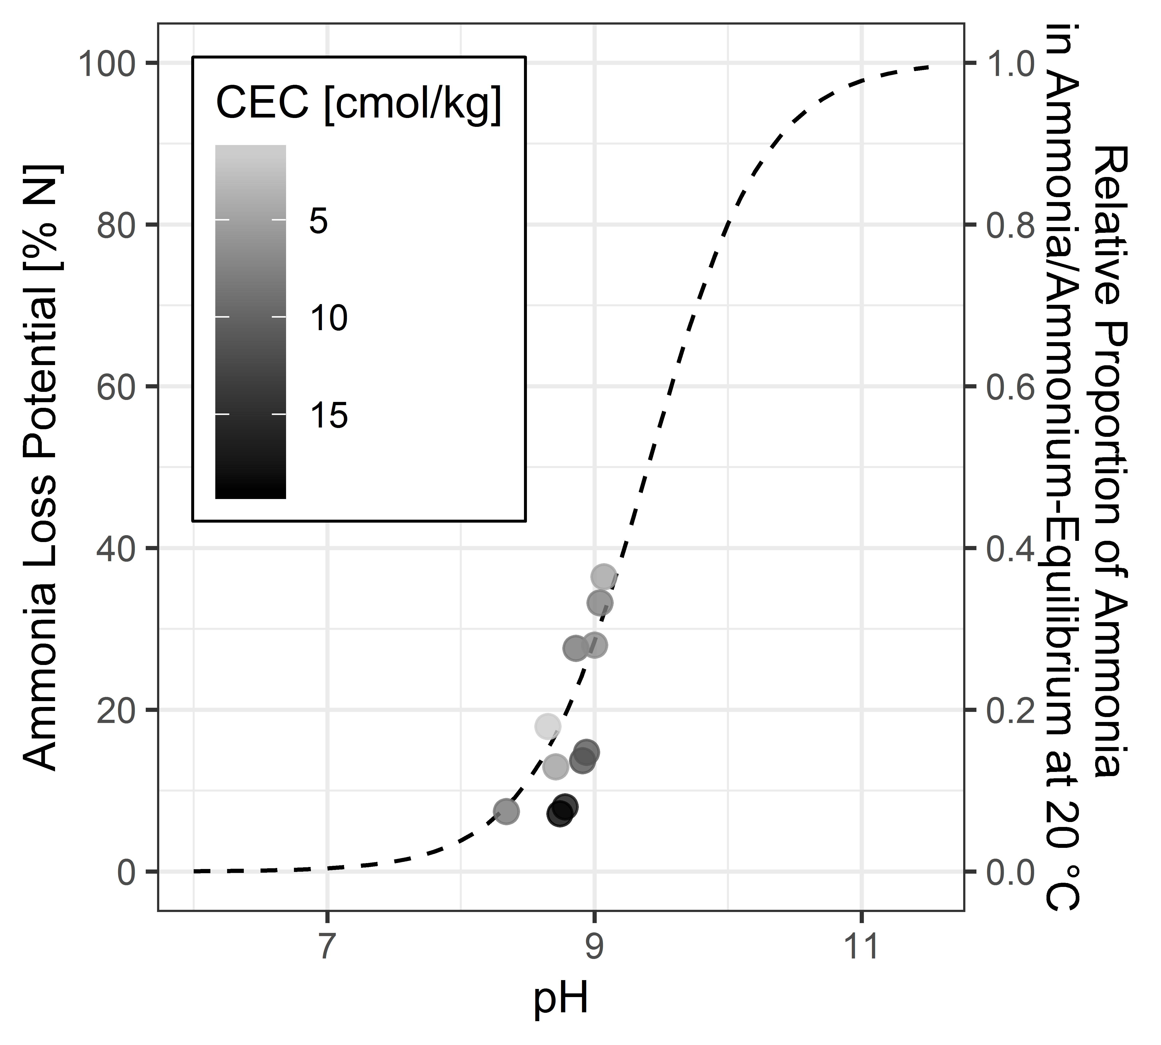
Influence of CEC
CEC explains the deviations from the NH₃/NH₄⁺ equilibrium line
Fig. 7: The observed NH₃ loss potentials align along the ammonia/ammonium equilibrium at 20 °C
Notes:
In this plot, the dashed line is the ammonia-ammonium equilibrium at 20 °C, the same temperature as the laboratory experiments. We plotted pHmax against the NH3 loss potentials. The dots align along that equilibrium line, as they should if pHmax is the relevant pH value for the NH3 loss. However, we can see that the soils with the highest CEC value show the strongest deviation from that equilibrium line. In consequence, we could phrase this as: High CEC leads to NH3 losses that are lower than the pH suggests.

Slide 9
CEC and SOC determine widely varying NH₃ loss potentials
SOC and pH_{i} determine the emission-relevant pH_{max} value
CEC explains the deviations from the NH₃/NH₄⁺ equilibrium line
1
Identify emission- relevant soil parameters
Take Home Messages from the Lab Experiments
Notes:
Based on these key messages from the lab, we can go into the modelling

Slide 10
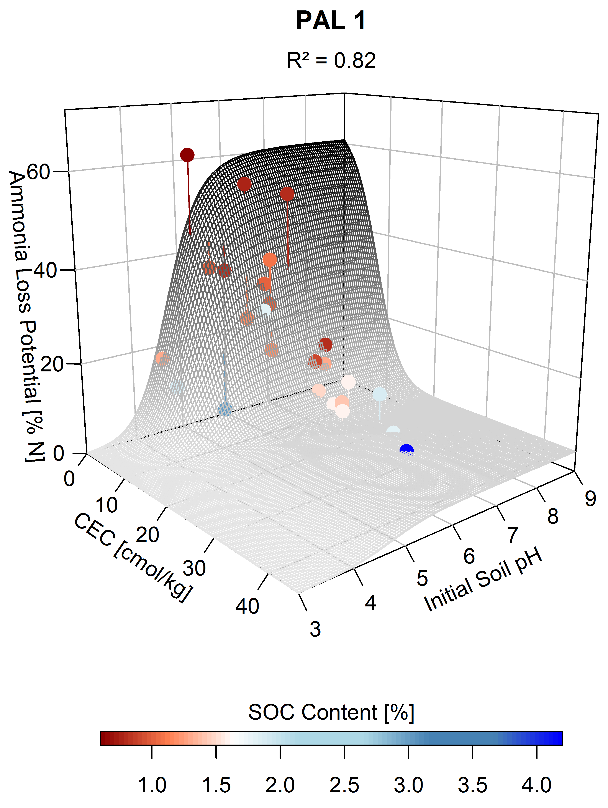
Modelling
2
Model NH₃ loss potentials
Fig. 8: Model PAL 1 predicting NH₃ loss potential based on pH_{i} and CEC
Notes:
Here, we see the model PAL 1, using CEC and pHi to predict NH3 loss potentials.
Based on this knowledge we went to develop models to estimate NH3 loss potential from CEC, pHi and SOC. The model shown here is only the 2nd most conclusive model we could develop. In the model PAL1 only CEC and pHi are used to estimate and predict NH3 loss potential. The dots represent the values of the soil samples, the grey-blackish surface shows the model estimates for different CEC and pHi combinations.
So, firstly, we see that CEC is the most dominant factor, with NH3 loss rapidly declining from CEC ~5 to 10, and if CEC values are above 10 the loss potential is quite small, no matter the initial soil pH. The bottom line here is, that if CEC > 10, CEC‘s influence is so dominant that the influence of pHi can be neglected. The assumption thusly: high CEC will lead to the pH plateau being left quickly. For low CEC values, low pHi values can have an emission-diminishing effect. What was striking to us is, that the estimation of 2 samples with very low SOC and one with very high SOC content was pretty far off their actual values, while in general the estimation was very precise. So, a second model, PAL2 was developed, including the influence of SOC on NH3 loss, but the spatial data for SOC were not sufficient to map it to German cropland soils, so it‘s not shown here.

Slide 11
Model PAL 2
Notes:
PAL2 has higher predictive power due to the incorporation of the SOC content. High SOC likely interfers with the system due to more organic acids being released, reducing pHmax, thus lowering NH3 loss potentials. Contrary, low SOC content should increase NH3 loss potentials.

Slide 12
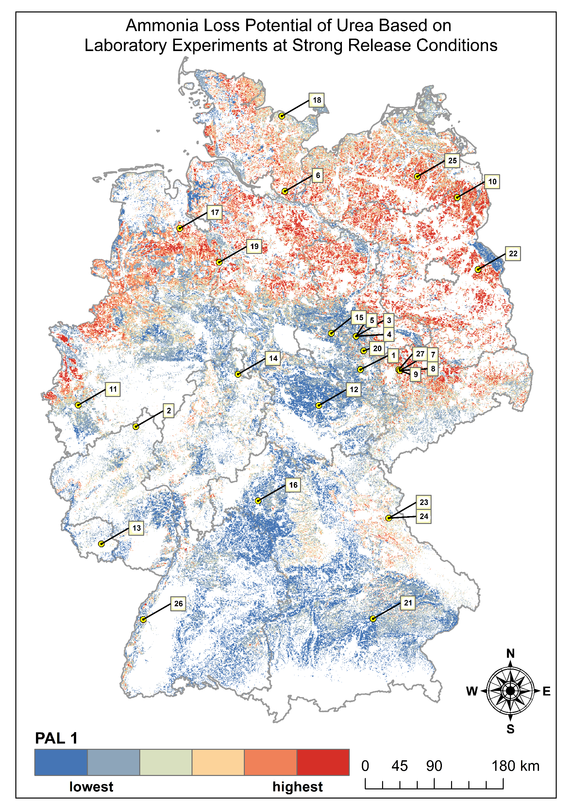
NH₃ loss potential for German cropland soil
Fig. 9: NH₃ loss potentials for German cropland soils
3
Map spatial NH₃ loss potentials
Notes:
Applying this model to raster data for Germany, we could clearly identify a strong spatial heterogeneity in NH3 loss potentials. The potentials ranged from 0.12 to 59.13 % N, with highest emissions potentially in the sandy areas in the glacier forelands. The mean emission potential for German cropland soils is ~13 % N. The lab conditions equal the average temperature of August 2020 in Germany (statista.de)
Under field conditions, these potentials are rarely ever met in Germany, climatic conditions mainly lead to reduction of emissions compared to these specific lab conditions applied.

Slide 13
Key take aways
Contradicting EMEP/EEA acidic soils usually show higher NH₃ loss potentials
CEC controls NH₃ loss from cropland soil, superimposed by pH (pH_{max}) and SOC
SOC geodata for Germany was insufficient
NH₃ loss from cropland soil in Germany very heterogenous
Field NH₃ emissions likely to be notably lower than the EMEP/EEA estimates
Outlook: improving estimation of pH_{max} will clearly improve prediction of NH₃ loss – more data required; further regionalization urgent

Slide 14
Supplement
25.05.2022

Slide 15
Soil sampling
Statistical Values | Sand [%] | Silt [%] | Clay [%] | pH (CaCl₂) [-] | CEC [cmol kg⁻¹] | SOC [%]
range | 3.9 – 89.6 | 6.7 – 81.5 | 3.7 – 25.4 | 4.5 – 7.4 | 1.2 – 31.3 | 0.6 – 4.2
mean | 34.44 | 50.17 | 15.41 | 6.37 | 11.28 | 1.42
SD | 25.91 | 21.66 | 6.09 | 0.83 | 7.37 | 0.75
Table 1: Range, mean and standard deviation (SD) of analyzed soil parameters (for pH_{CaCl}², CEC and SOC n = 27, for soil texture n = 20)

Slide 16
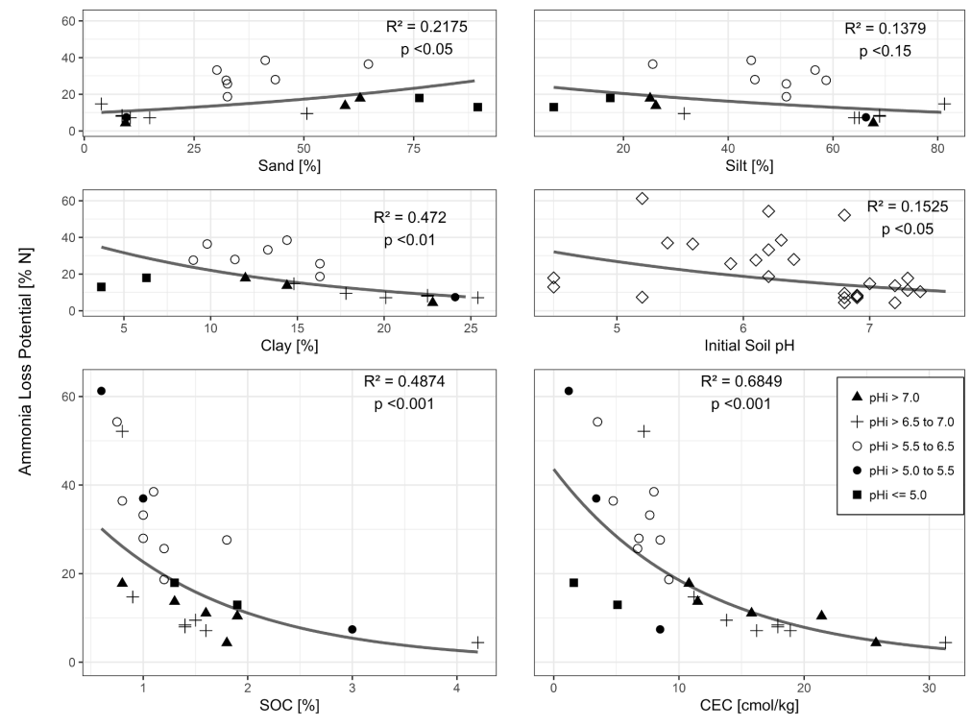
Soil Parameters and NH₃ Loss Potentials

Slide 17
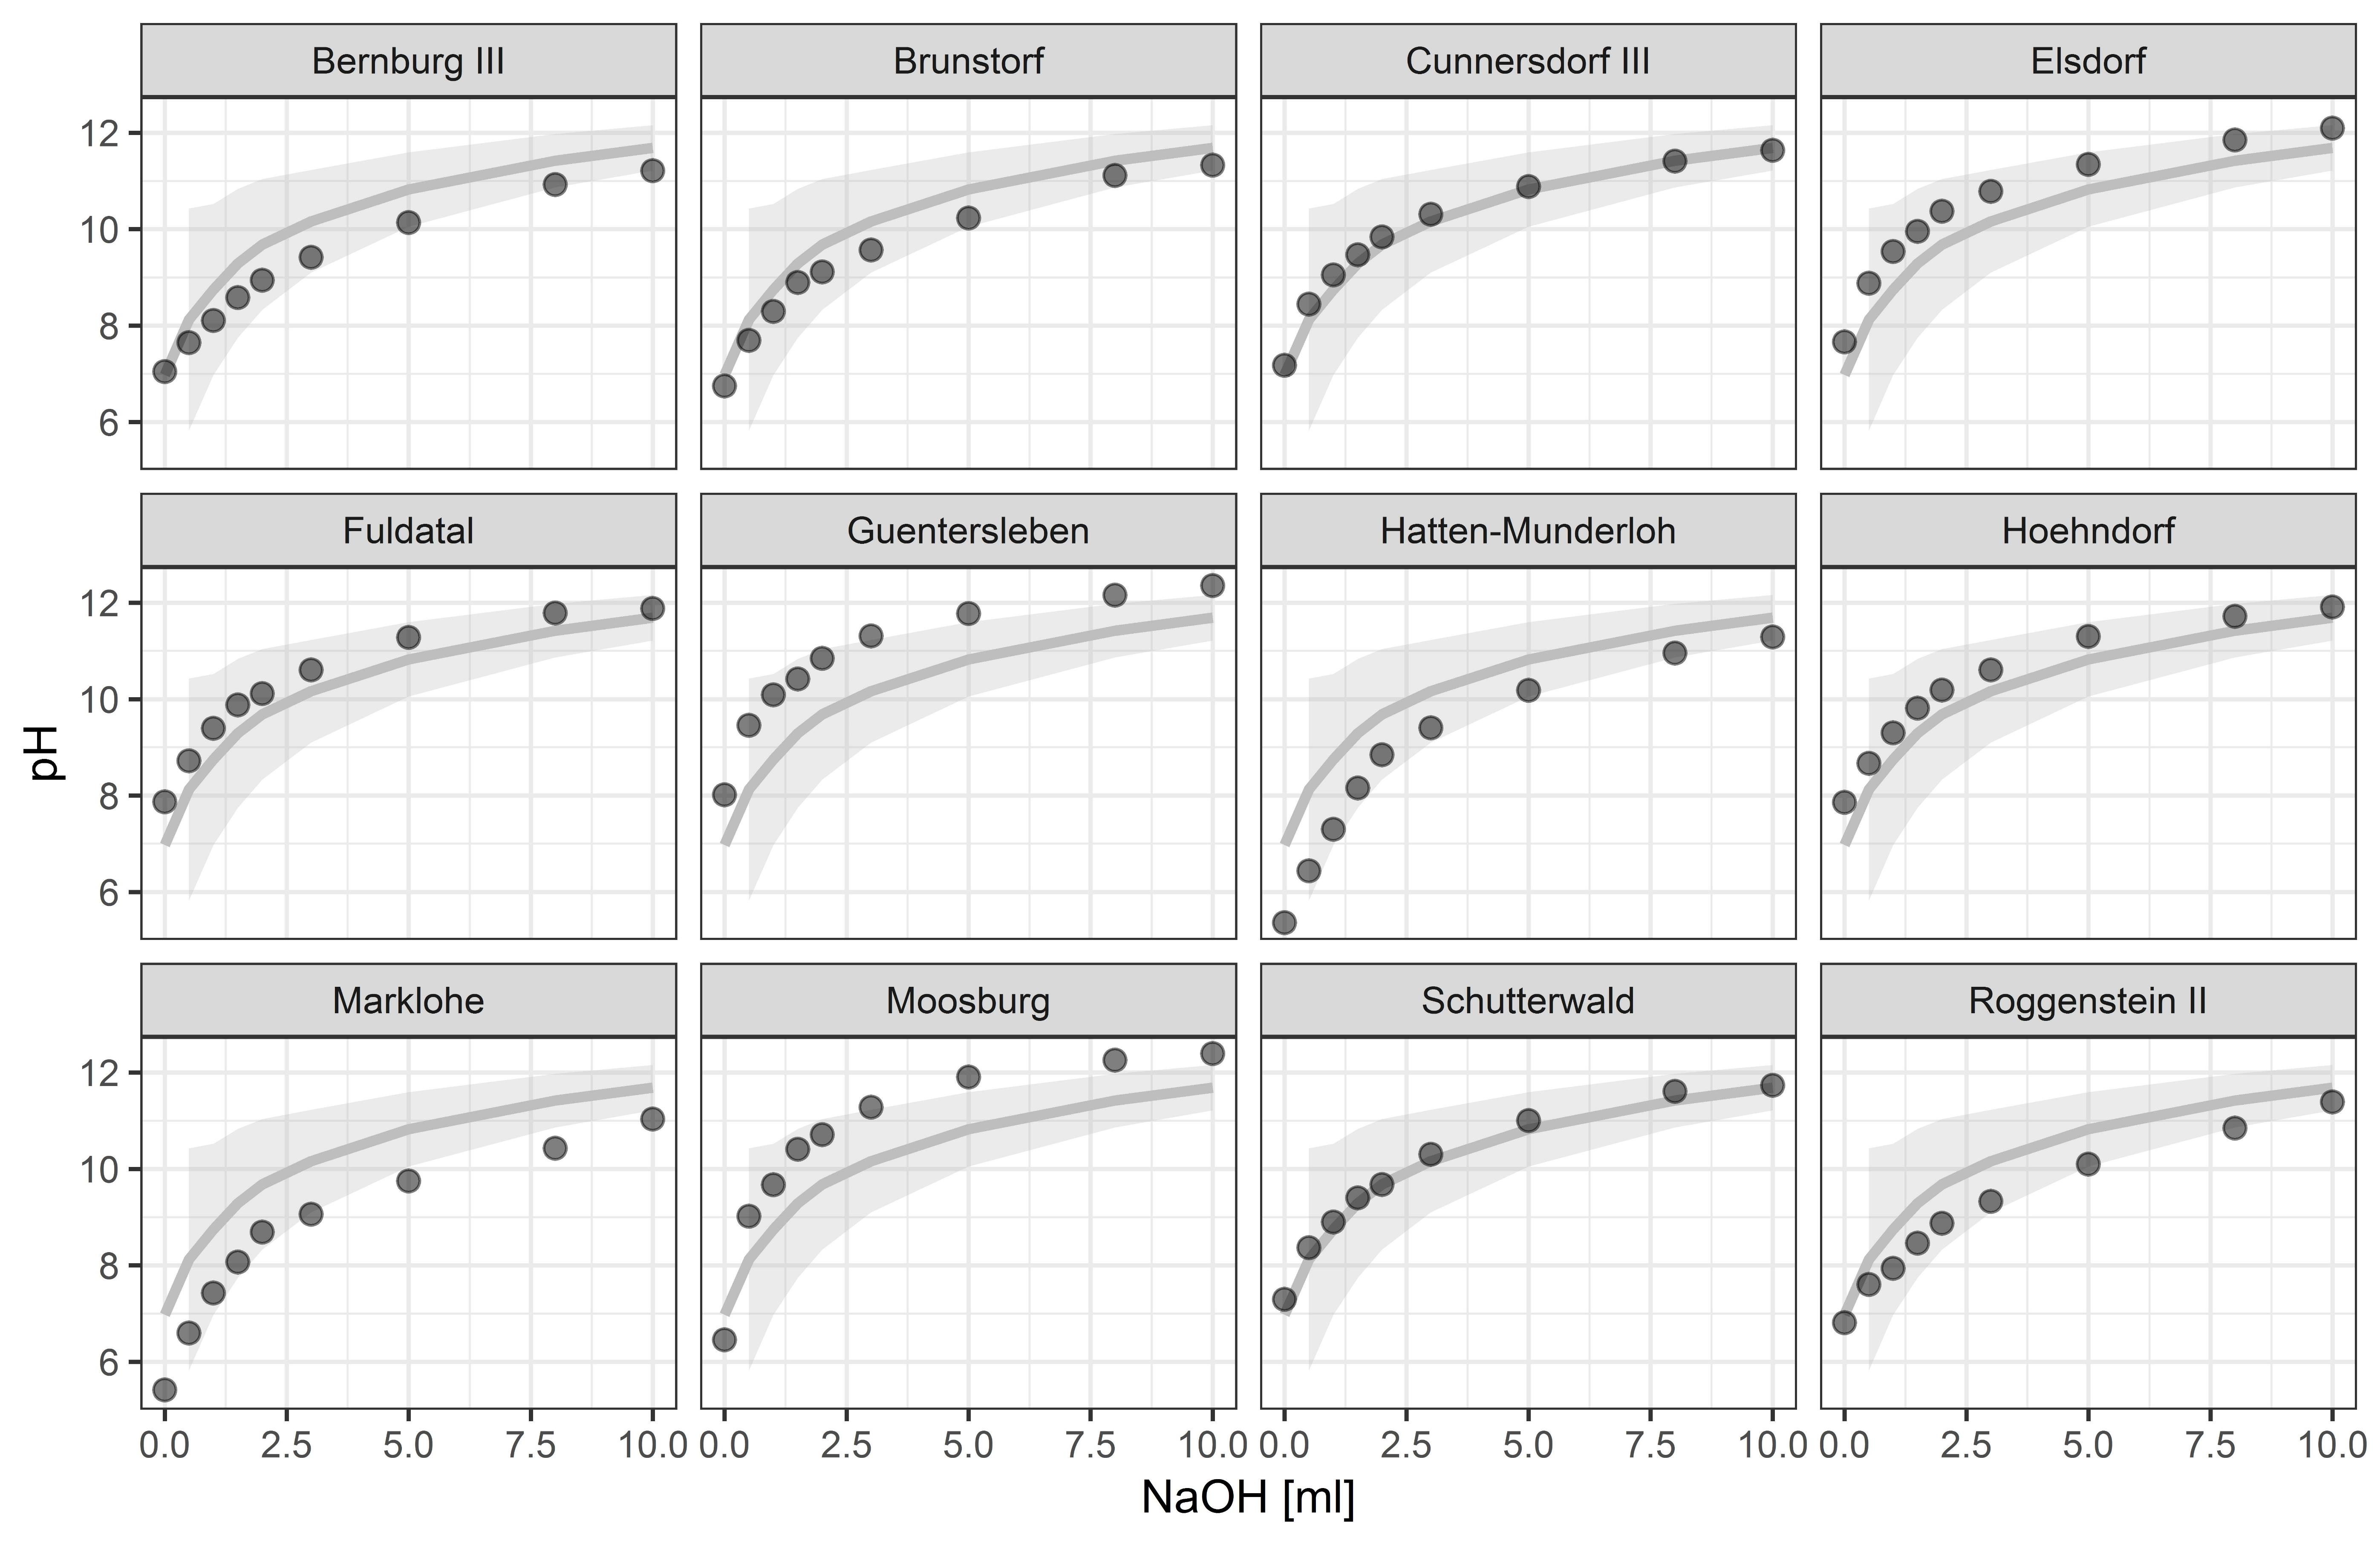
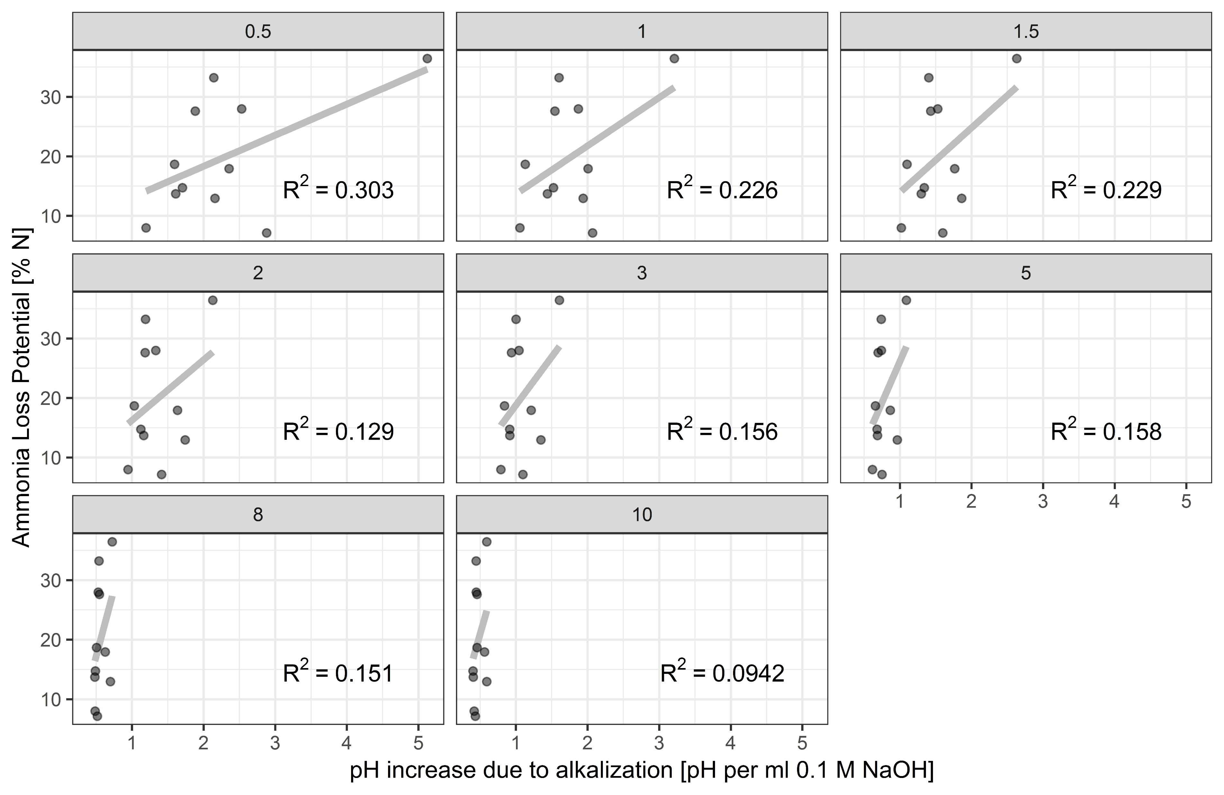
Soil buffer capacity to resist alkalization

Slide 18
Quality of required spatial Data

Slide 19
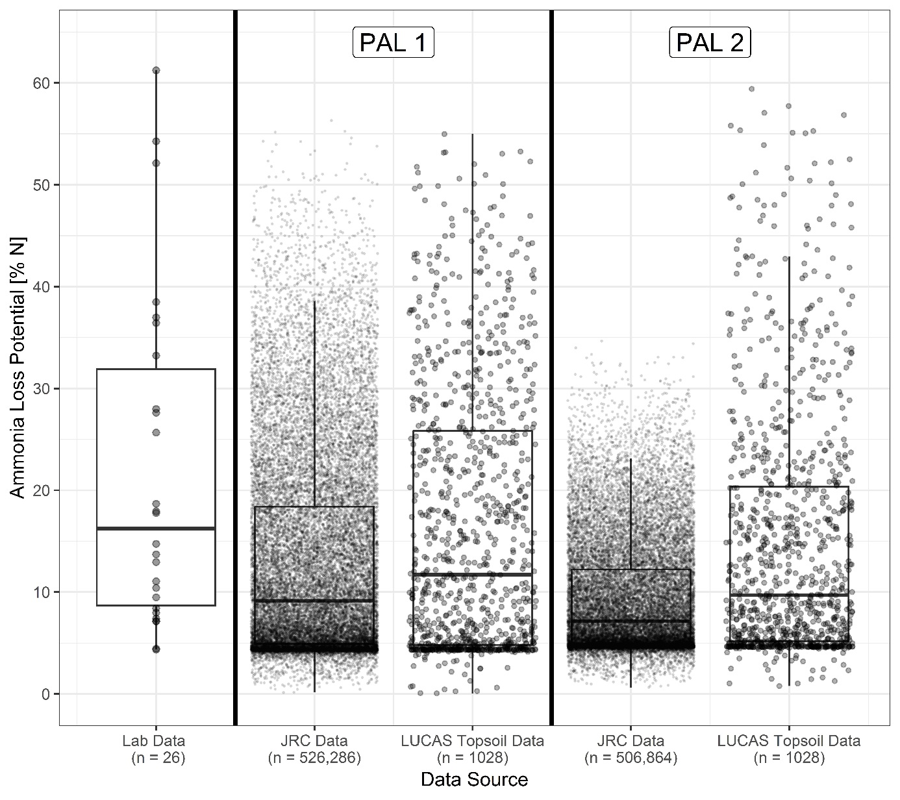
Quality of PAL1 and PAL2 in dependence on available geodata
Notes:
To illustrate the data quality, we can see how the results for the two different models change based on the input parameters

Slide 20
Model: pH and SOC functions
Notes:
These pH and SOC-Functions underlie tha PAL1 and PAL2 models.

Slide 21
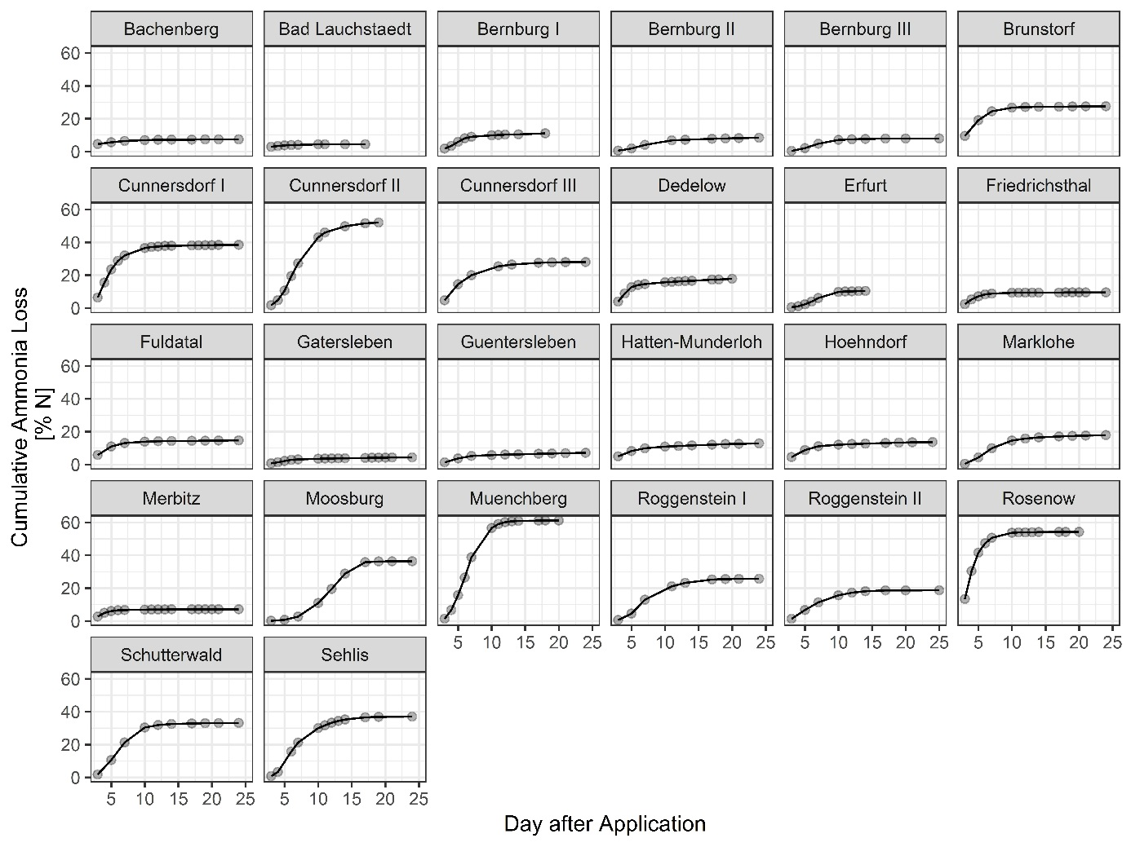
NH₃ loss dynamics

Slide 22
NH₃ loss potential for German cropland soil
NH₃ loss potentials [% N] | Area [km²] | Coverage [%]
<= 5 | 33,890 | 25.76
>5 - 10 | 36,060 | 27.41
>10 – 15 | 18,831 | 14.31
>15 - 20 | 13,985 | 10.63
>20 - 30 | 18,329 | 13.93
>30 – 60 | 10,478 | 7.96
Total | 131,572 | 100
Notes:
Finally, here we have the map that has been the ultimate goal of this work. You can see here the locations of all 27 samples taken for this study. The loss potential spreads very widely and is well different to the narrow range from 15,5 – 21 % N given by EEA based on pH and temperature. Here, the climate is 20 °C, equalling the average temperature in Germany for August 2020 (statista.de). We found NH3 loss potentials ranging from 0.12 to 59.13 % N, with a mean of 12.95 % N. With the method used here, loss potentials will be clearly higher than actual losses, so our mean of 12.95 % N under warm conditions is a fair bit lower than the value suggested by EEA.
Also, we see a clear heterogeneity, with high emission potentials mostly confined to the sandy soils of Northern Germany with partly intense agricultural use, but also to smaller parts of Bavaria and Hesse. However, our results show that a generalized approach as presented by EEA is not viable at all to estimate NH3 losses.

