Slide 1

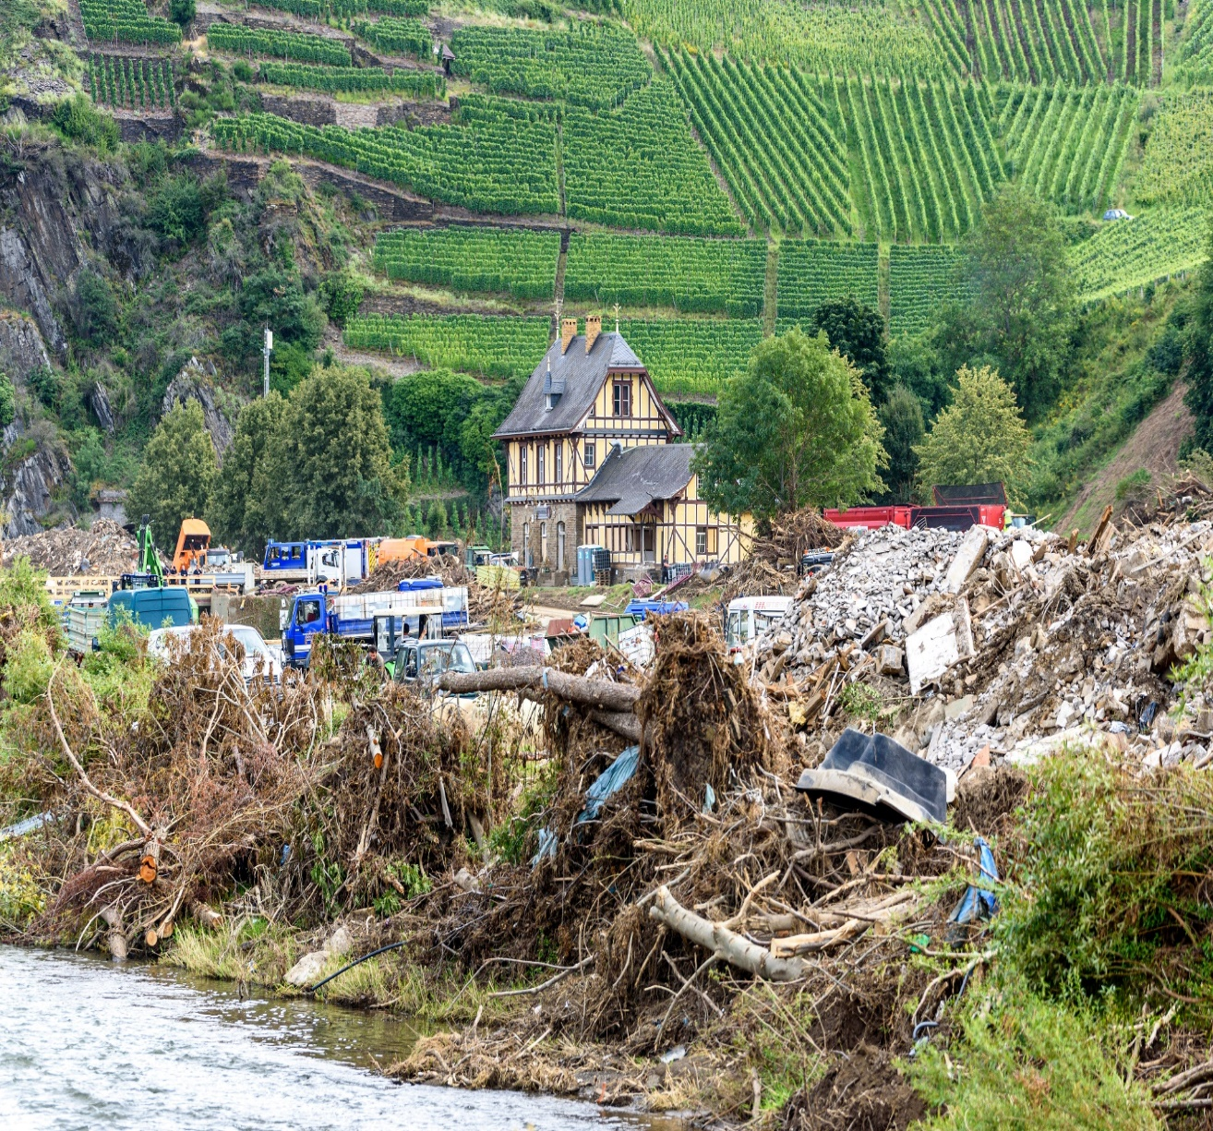
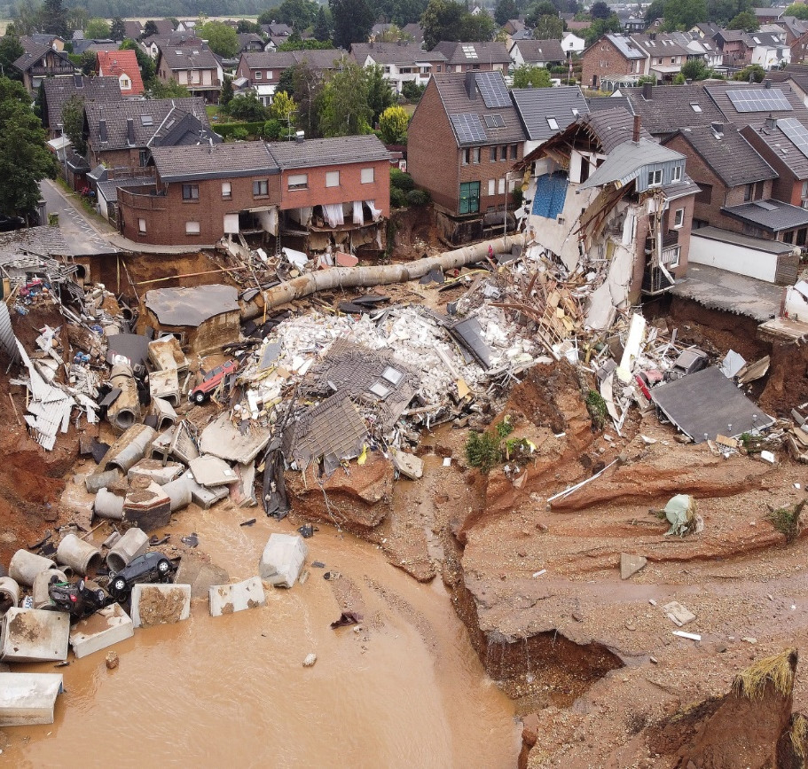

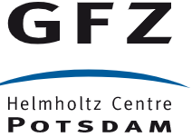
Text-mining of natural hazard impacts (TM-Impacts): an application to the 2021 flood in Germany
Mariana M. de Brito
Jan Sodoge
Heidi Kreibich
Christian Kuhlicke
Department of Urban and
Environmental Sociology
450305097: © Dwi / AdobeStock

Slide 2


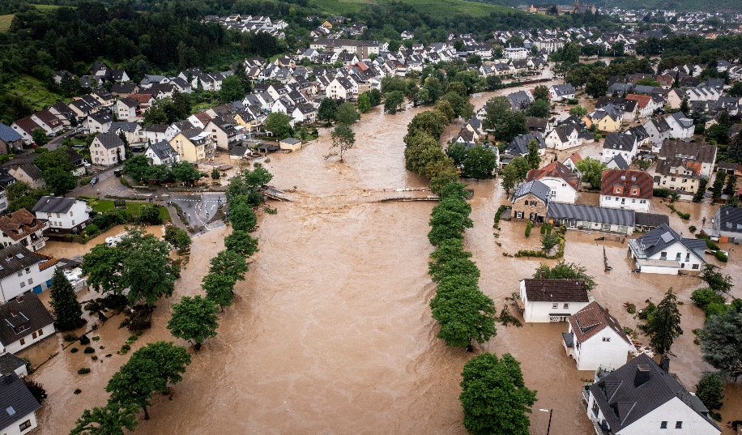
Several gaps persist in the assessment of flood impacts
1st- Focus on physical aspects (e.g. water level, flow) not on socio-economic ones
2nd- Single impact assessments (e.g. economic losses)
3rd- Dependencies between impacts are ignored
->underestimation of impacts and consequent maladaptation
158665720: © Romolo Tavani / AdobeStock
447651775: © Christian / AdobeStock

Slide 3

News as a proxy for how impacts are felt
cover large areas
broad time periods without interruptions
news from local communities can provide detailed location-specific accounts of impacts
Hilbert & López (2011) Science

Slide 4
Text-mining of natural hazard impacts (TM-Impacts)
Newspaper aggregator database: Wiso.de
>26000 news between 01.07.2021 and 31.12.2021 reporting about the 2021 flood
~ 250 German newspapers
14888 news after removing duplicates

Slide 5
TM-Impacts: hand-crafted rules
Physical injuries
injured
NOT
„not injured“ OR ((„no one“ OR „animal*“AND injured)
Article ID | Impact A | Impact B
1 | 0 | 1
2 | 1 | 1
3 | 1 | 0
Example of a word co-occurence network

Slide 6



TM-Impacts: location extraction
Jan Sodoge

Slide 7
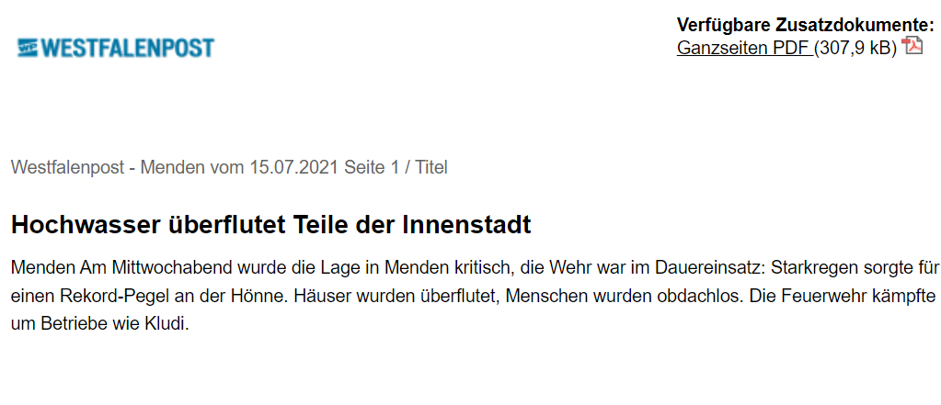
Flood impact statements (FIS)

Slide 8
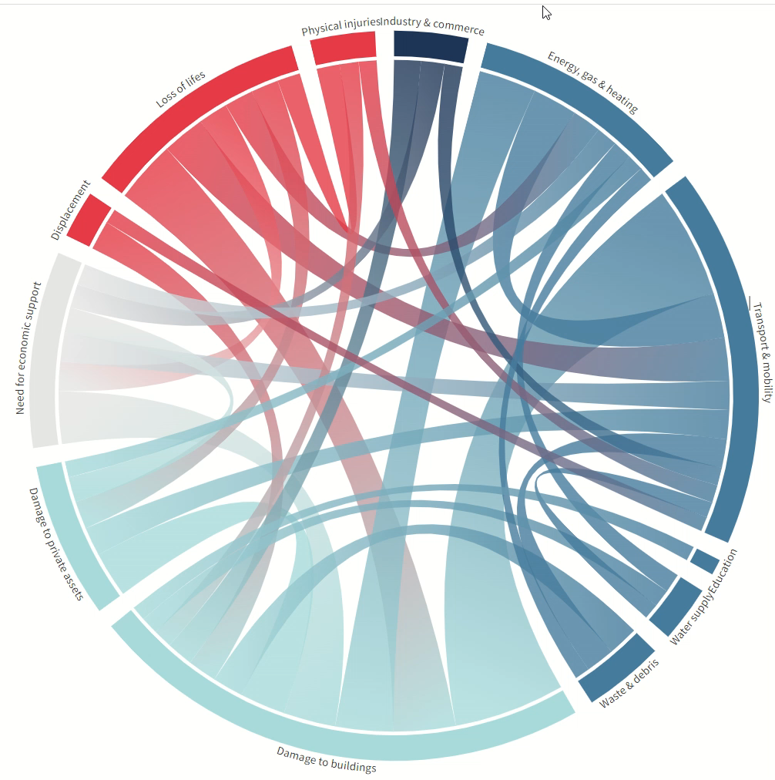
Flood impact
Statements (FIS)
co-occurence

Slide 9
Flood impact statements (FIS) over time

Slide 10
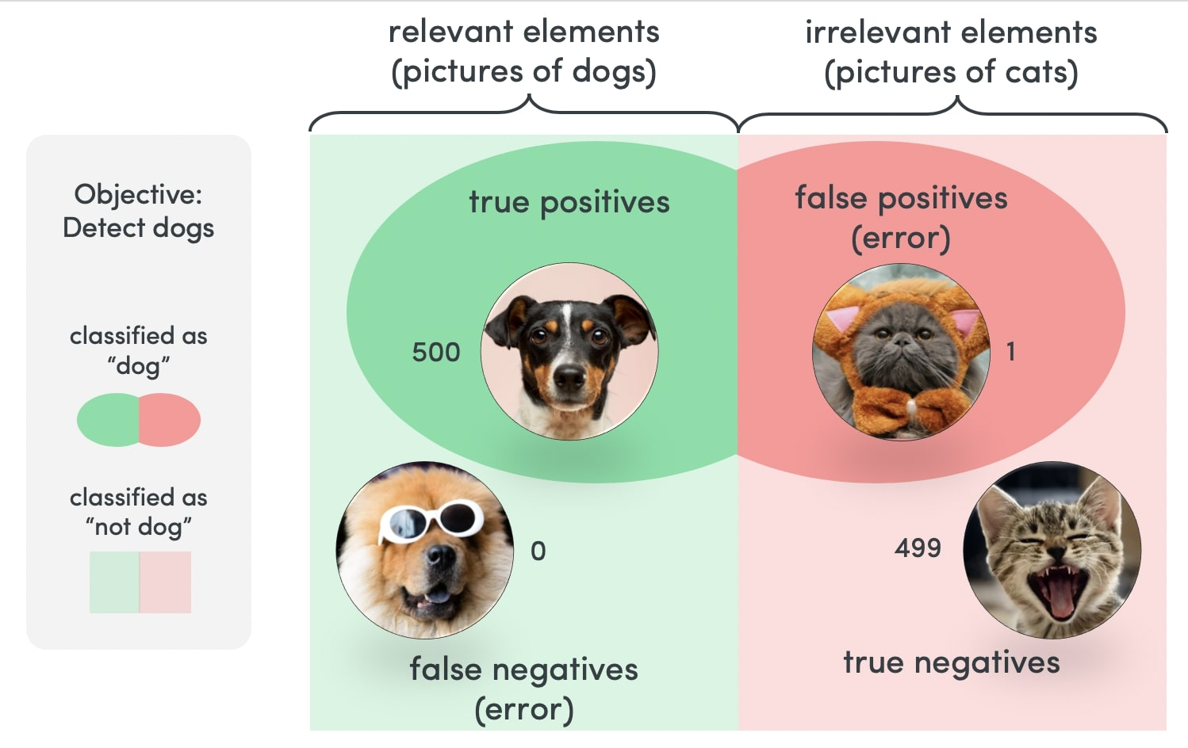
Performance metrics
48
0
e.g. Water contamination
2
590
Avg. accuracy: 0.98
Avg. recall: 0.92
Avg. precision: 0.90
Huellmann (2022)
Notes:
Accuracy is a measure for how many correct predictions your model made for the complete test
A low recall means that you have a high number of false negatives (should have been positive but labeled negative).

Slide 11
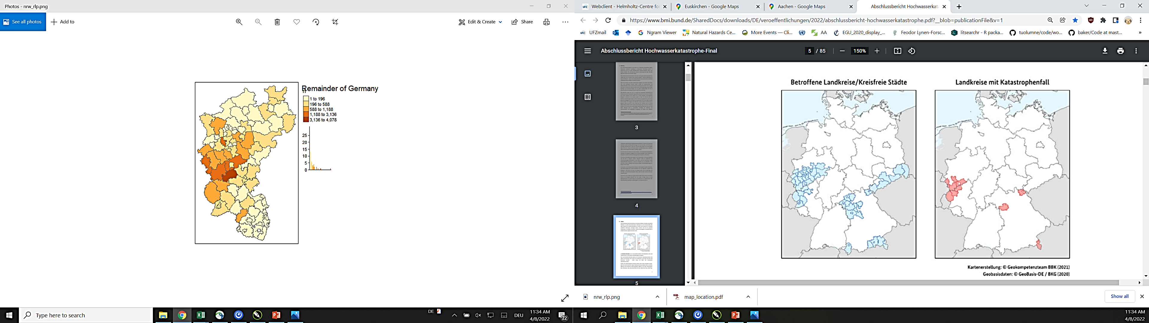
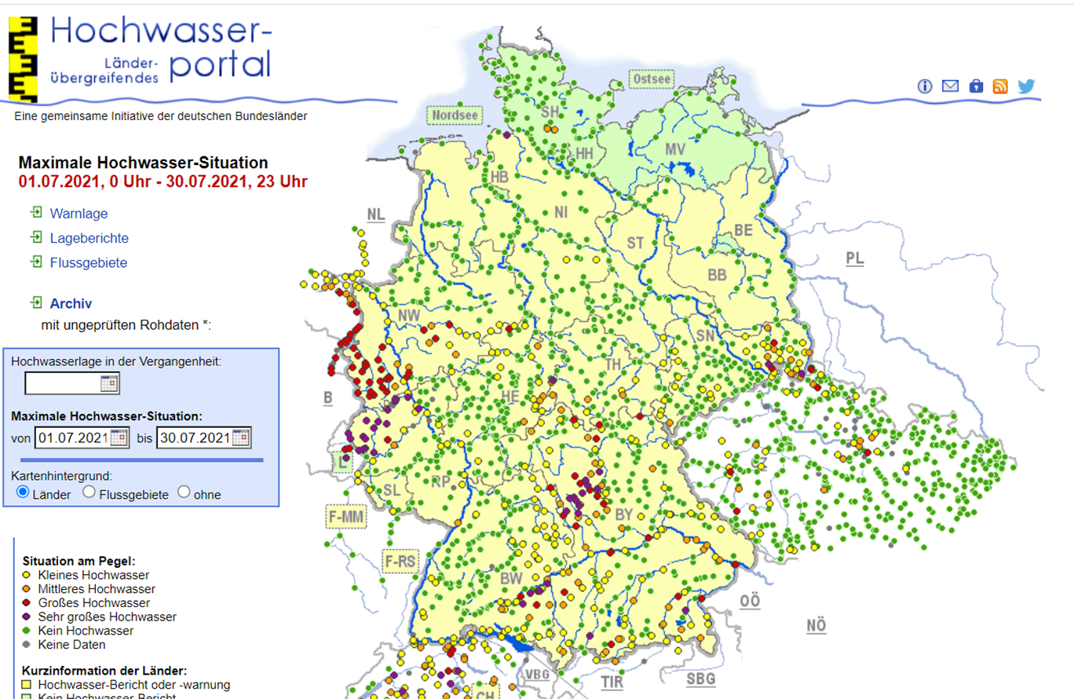
Preliminary validation
Affected NUTS 3
ANOVA
(f(1)=189.7, p < 0.0001)
Catastrophe NUTS 3
BBK (2021)
Notes:
The F-value in an ANOVA is calculated as: variation between sample means / variation within the samples. The higher the F-value in an ANOVA, the higher the variation between sample means relative to the variation within the samples.

Slide 12

Summary
Questions?
mariana.brito@ufz.de
TM-Impacts allows for assessing multi-sector impacts
It can be used for near-real time analyses
Next steps include validation and expansion of the dataset
@m_de_Brito
?

