Slide 1


Investigating Roles of Baseflow on Water Level in Urmia Lake, Iran
Somayeh Moghimi Nezhad¹, Changhyun Jun^{1,2}, Roya Narimani², Jongyun Byun², Jongjin Baik², Jinwook Lee²
¹ Department of Smart Cities
² Department of Civil and Environmental Engineering
Chung-Ang University, Seoul, Republic of Korea
May 25, 2022
https://www.hymets.org

Slide 2
Ⅰ
Introduction
Contents
Ⅱ
Methodology
Ⅲ
Results and Discussion
Ⅳ
Conclusion

Slide 3
Research Background
Factors of Water Level Reduction in the Urmia Lake
Vaheddoost and Aksoy (2018) demonstrated that the water level of Urmia Lake depends on the discharge of groundwater and that 70% of the runoff from rivers that drain into the lake is composed of baseflow caused by groundwater discharge.
The Importance of Accurate Baseflow Estimates
Precipitation Reduction
Water Resources Management
Temperature Increase
Water Consumption Prediction
Water Consumption Increase in the Agricultural Area
Water Flow Forecasting
Overuse of Groundwater Resources for Irrigation Purpose
Water Quality Control

Slide 4
Types of Baseflow Separation Methods with the Main Objective of This Study
Types of Baseflow Separation Methods
Baseflow Separation Methods
Tracer Method
Mass Balance Filter (MBF)
Non-Tracer Method
Graphical Method
Digital Filter Method
Eckhardt Method
The Main Objective of This Study
To investigate roles of baseflow on water level in the Urmia Lake, based on the interaction between changes in baseflow, groundwater level and lake water level.

Slide 5
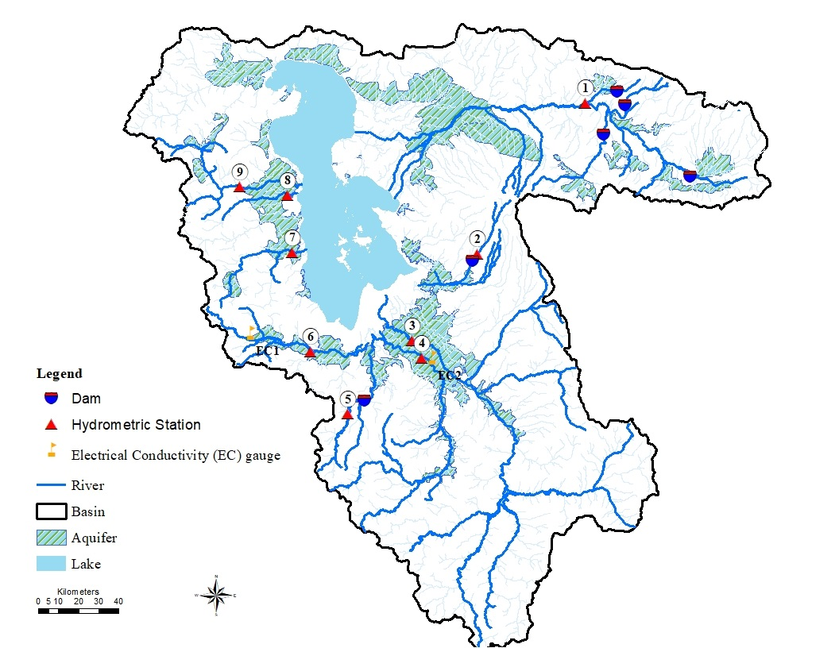
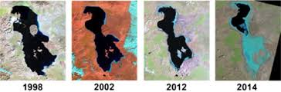
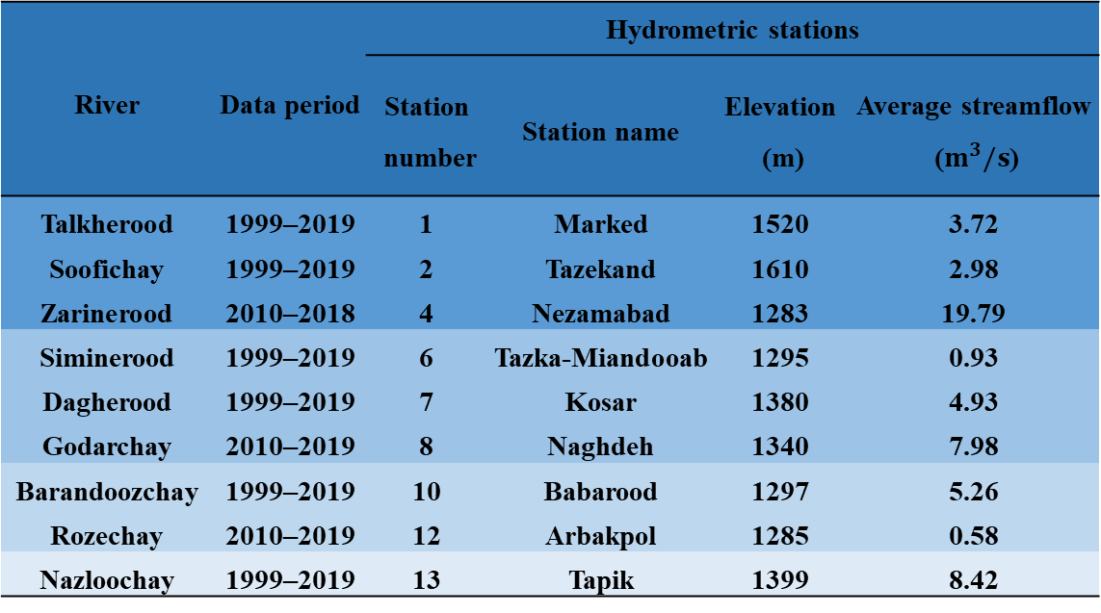
Study Area with Basic Information about Data
Table 1. Average streamflow during the considered data period at nine hydrometric stations in the Urmia Lake basin
Figure 1. Location of Hydrometric Stations in the Urmia Lake Basin

Slide 6

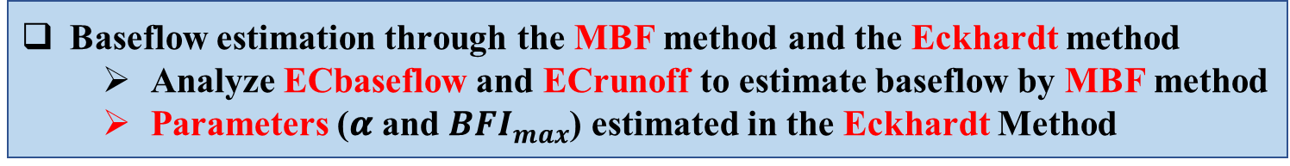

Parameters Estimated in Eckhardt Method
Baseflow Separation, Evaluation, and Relationships with Groundwater and Lake Water Level
Methodology of this Study, Focusing on Evaluating Baseflow Separation Methods
1
Baseflow estimation through the MBF method and the Eckhardt method
Analyze ECbaseflow and ECrunoff to estimate baseflow by MBF method
Parameters (𝜶 and ${BFI}_{max}$) estimated in the Eckhardt Method
2
BFI is the ratio of the total daily baseflow to the total daily streamflow:
Analysis on comparison results in baseflow separation methods with the BFI values
Analyze statistics of BFI value estimated using two selected methods
Comparison amount of BFI value for MBF and the Eckhardt methods at different stations
BFI= $\frac{\sum{mean daily Q_{b}}}{\sum{mean daily Q_{t}}}$
Kendall-Tau coefficient:
$$d=\sqrt{\left(C\left(n,2\right)−n_{x}\right).(C\left(n,2\right)−n_{y})}$$
3
Evaluation of relationships between baseflow, groundwater, and lake water level from the Kendall-Tau coefficient.
where n_{x} is the number of pairs with a tie in variable x, and n_{y} is the number of pairs with a tie in variable y.

Slide 7
Baseflow Separation Methods
Baseflow Estimation by the Mass Balance Filter (MBF)
$$Q_{baseflow,t}=Q_{streamflow,t}\frac{{EC}_{t}−{EC}_{runoff}}{{EC}_{baseflow}−{EC}_{runoff}}$$
Q_{streamflow,t} and EC_{t} are the streamflow and conductivity of the streamflow at time t, respectively.
ECrunoff and ECbaseflow in the equation correspond to the EC values of the runoff and baseflow components.
ECbaseflow and ECrunoff can be estimated during periods of extreme low-flow and high-flow, respectively.
Figure 2. Daily average streamflow and
stream conductivity (Stewart et al., 2007)

Slide 8
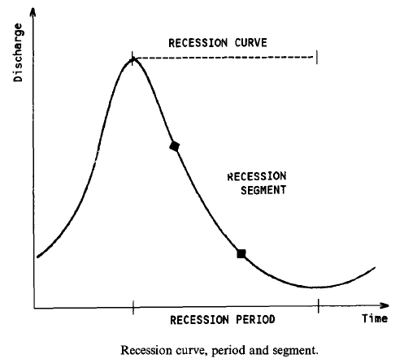
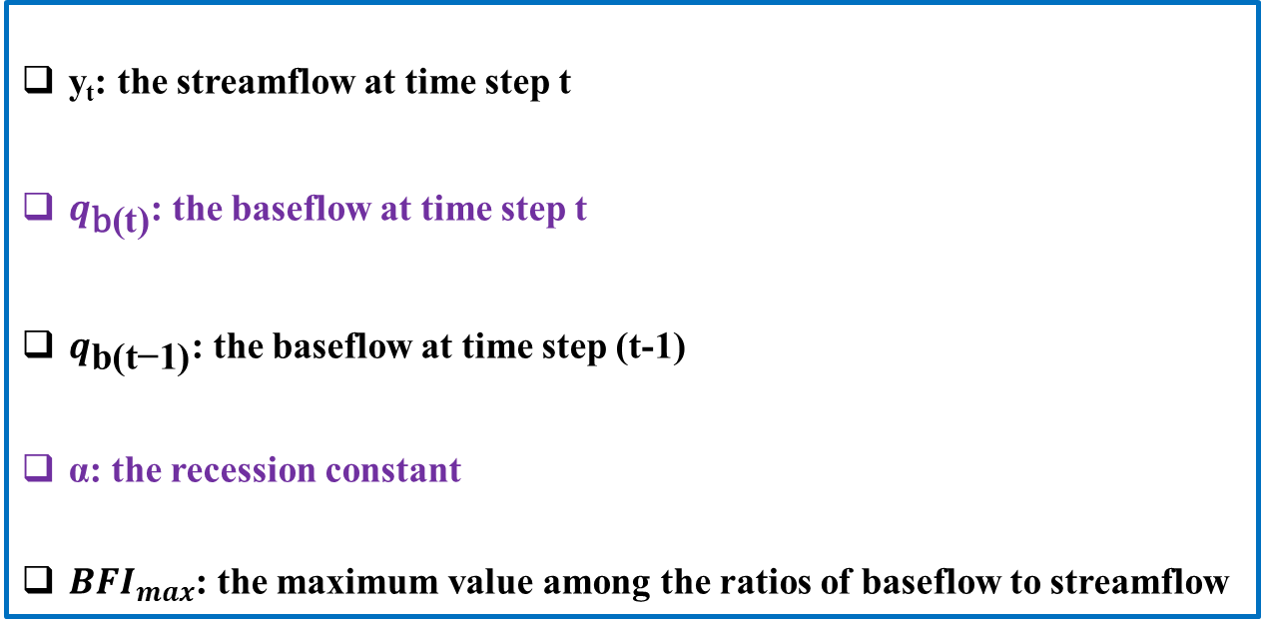
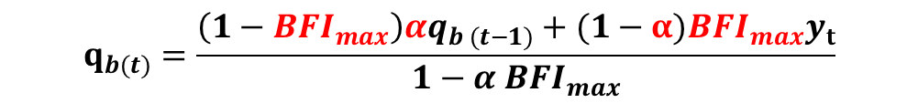

Baseflow Separation Methods
Baseflow Estimation by the Eckhardt Method
$$q_{b(t)}=\frac{\left(1−{BFI}_{max}\right)αq_{b (t−1)}+(1−α){BFI}_{max}y_{t}}{1−α {BFI}_{max}}$$
y_{t}: the streamflow at time step t
$q_{\text{b}\text{(}\text{t}\text{)}}$: the baseflow at time step t
$q_{\text{b}\text{(}\text{t}\text{−}\text{1}\text{)}}$: the baseflow at time step (t-1)
α: the recession constant
${BFI}_{max}$: the maximum value among the ratios of baseflow to streamflow
Figure 3. Recession Constant ($α$)

Slide 9
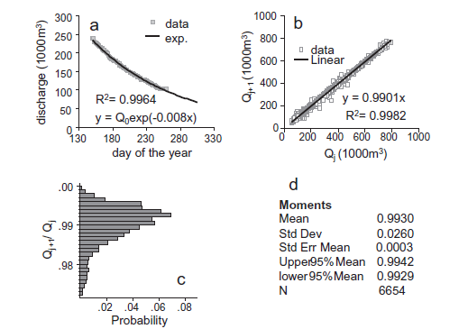
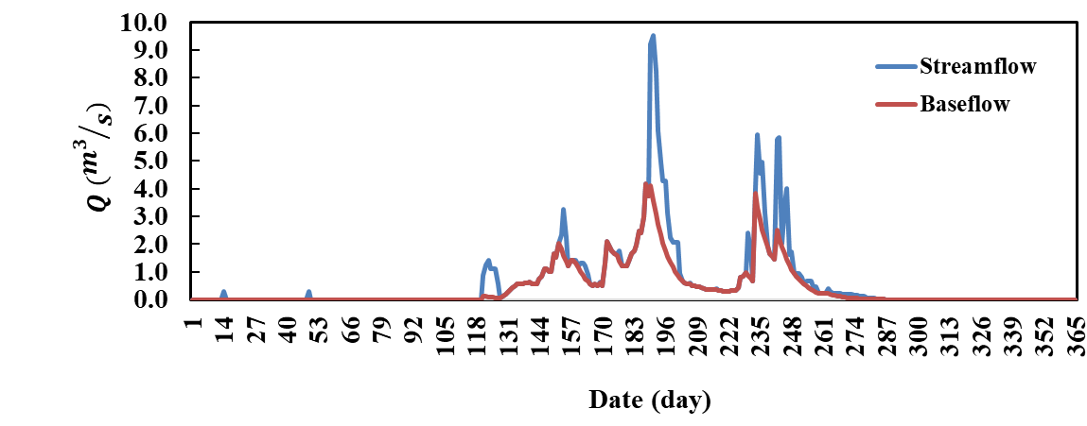
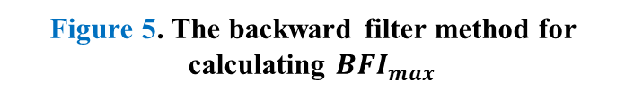
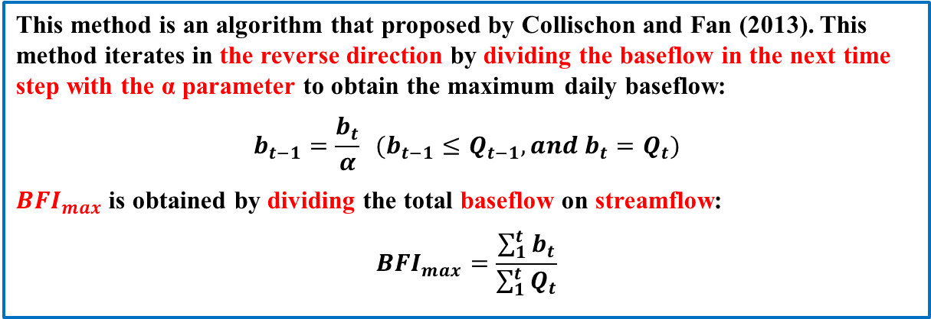
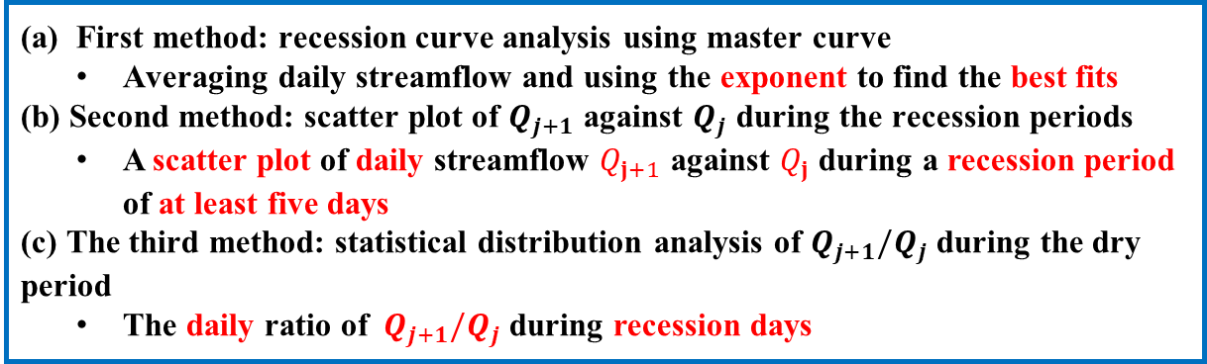
Parameters Estimated in the Eckhardt Method
Methods to Estimate 𝜶
First method: recession curve analysis using master curve
Averaging daily streamflow and using the exponent to find the best fits
(b) Second method: scatter plot of $Q_{j+1}$ against $Q_{j}$ during the recession periods
A scatter plot of daily streamflow $Q_{j+1}$ against $Q_{j}$ during a recession period of at least five days
(c) The third method: statistical distribution analysis of $Q_{j+1}/Q_{j}$ during the dry period
The daily ratio of $Q_{j+1}/Q_{j}$ during recession days
Figure 4. Methods to estimate 𝜶
The Backward Filter Method for Calculating ${BFI}_{max}$
This method is an algorithm that proposed by Collischon and Fan (2013). This method iterates in the reverse direction by dividing the baseflow in the next time step with the α parameter to obtain the maximum daily baseflow:
$$b_{t−1}=\frac{b_{t}}{α} (b_{t−1}≤Q_{t−1}, and b_{t}=Q_{t})$$
${BFI}_{max}$ is obtained by dividing the total baseflow on streamflow:
$${BFI}_{max}=\frac{\sum_{1}^{t}{b_{t}}}{\sum_{1}^{t}{Q_{t}}}$$
Figure 5. The backward filter method for calculating ${BFI}_{max}$

Slide 10
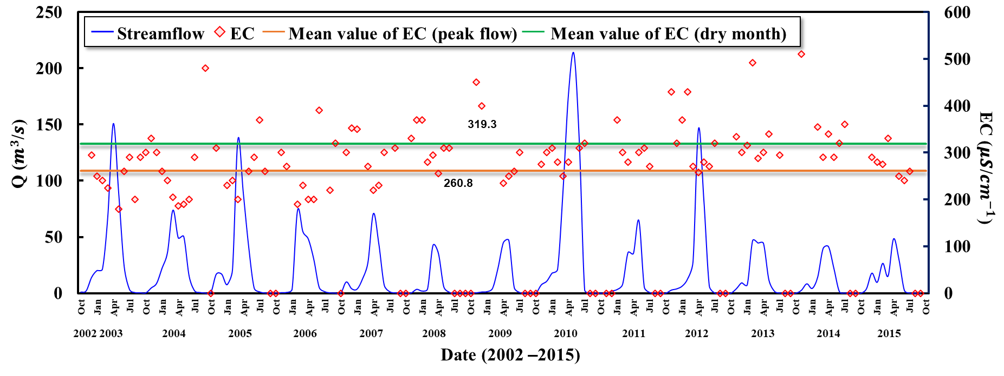
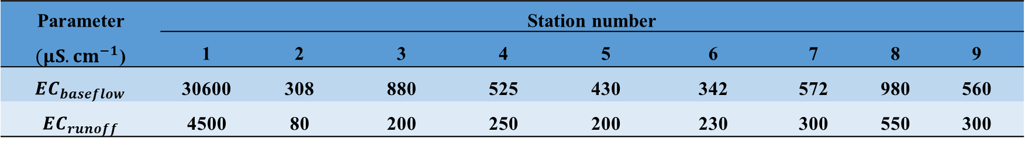
The Relationship between EC and Streamflow
Analyze on ECbaseflow and ECrunoff to estimate baseflow by the MBF Method
There was the inverse relationship between streamflow and EC, the EC values were lower during the high flow than the low flow.
The amount of monthly streamflow from March to May was higher than the mean annual streamflow, and that from November to February was lower than the mean annual streamflow.
The lowest EC during the high flow was considered as the ECrunoff and the highest EC during the low flow was considered as the ECbaseflow
Figure 6. The relationship between EC and streamflow during extreme low and high flow using the monthly observation data for EC and streamflow data at station 3 from Oct. 2002 to Oct. 2015
Table 2. Estimated results for Ecbaseflow and Ecrunoff in the MBF method
Parameter $(μS.cm^{−1}$) | Station number
 | 1 | 2 | 3 | 4 | 5 | 6 | 7 | 8 | 9
${EC}_{baseflow}$ | 30600 | 308 | 880 | 525 | 430 | 342 | 572 | 980 | 560
${EC}_{runoff}$ | 4500 | 80 | 200 | 250 | 200 | 230 | 300 | 550 | 300

Slide 11
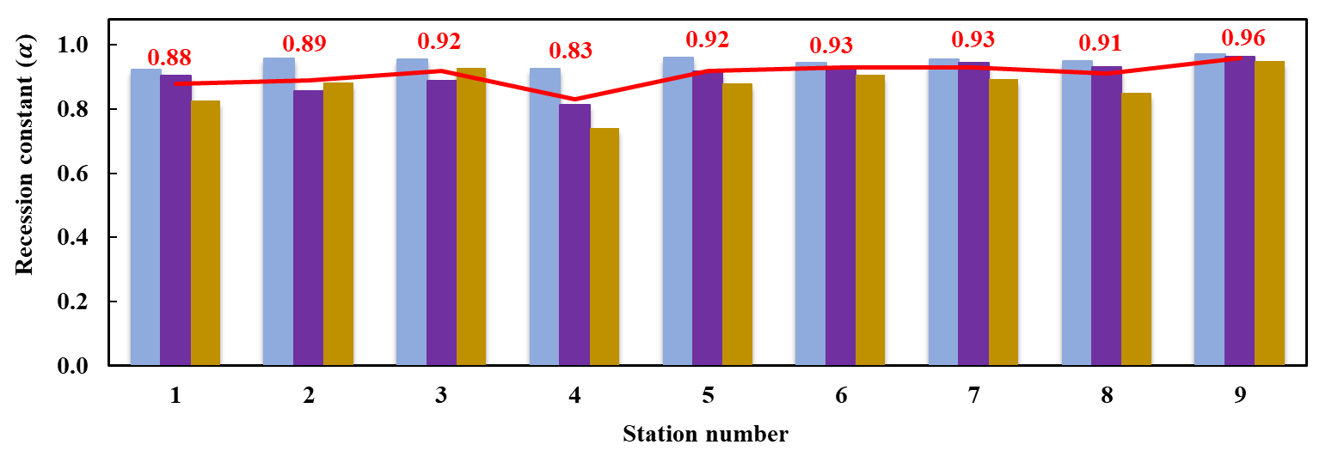
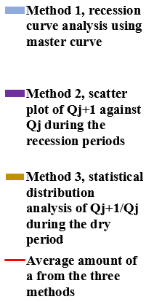
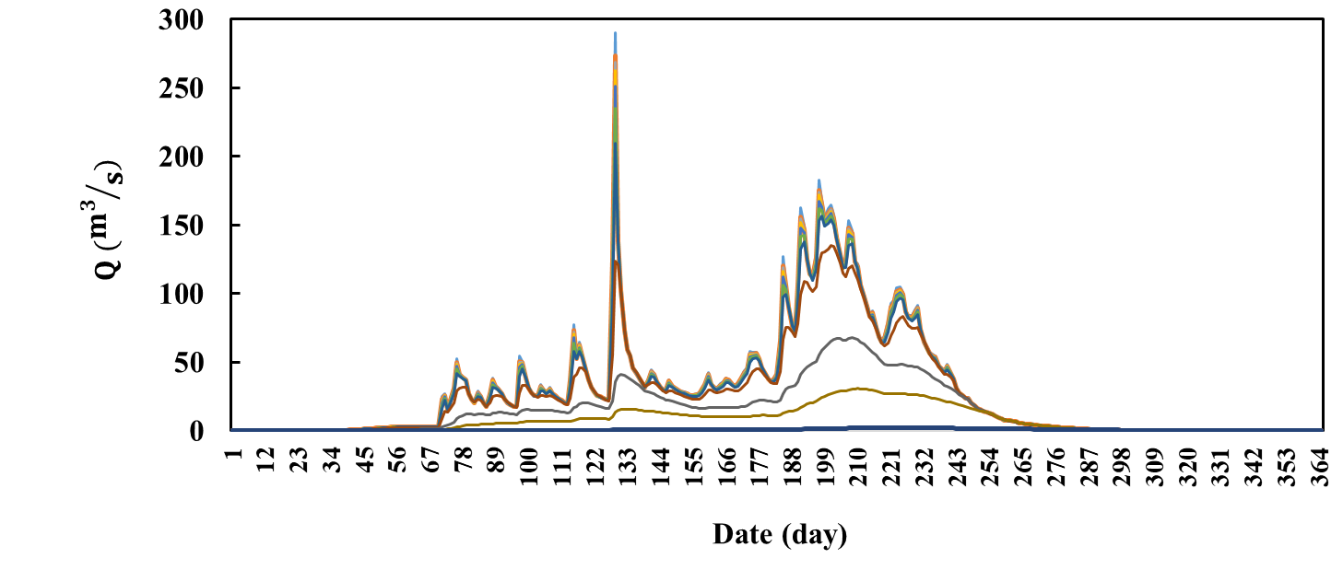
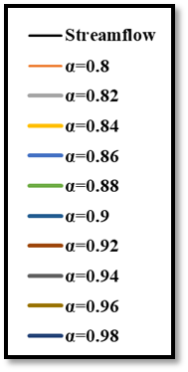
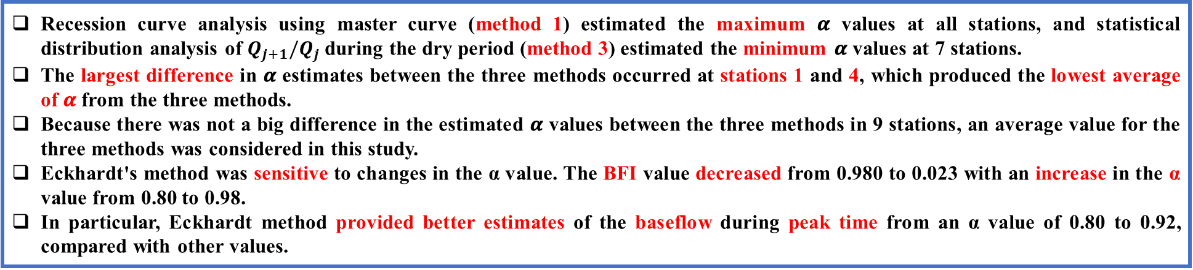
Parameters Estimation in the Eckhardt Method
Comparison Results in Recession Constants (𝜶) for Different Stations
Figure 7. Estimated Results for recession constants ($α$)
Figure 8. Sensitivity analysis of the α value
in the Eckhardt method
Recession curve analysis using master curve (method 1) estimated the maximum 𝜶 values at all stations, and statistical distribution analysis of $Q_{j+1}/Q_{j}$during the dry period (method 3) estimated the minimum 𝜶 values at 7 stations.
The largest difference in 𝜶 estimates between the three methods occurred at stations 1 and 4, which produced the lowest average of 𝜶 from the three methods.
Because there was not a big difference in the estimated 𝜶 values between the three methods in 9 stations, an average value for the three methods was considered in this study.
Eckhardt's method was sensitive to changes in the α value. The BFI value decreased from 0.980 to 0.023 with an increase in the α value from 0.80 to 0.98.
In particular, Eckhardt method provided better estimates of the baseflow during peak time from an α value of 0.80 to 0.92, compared with other values.

Slide 12
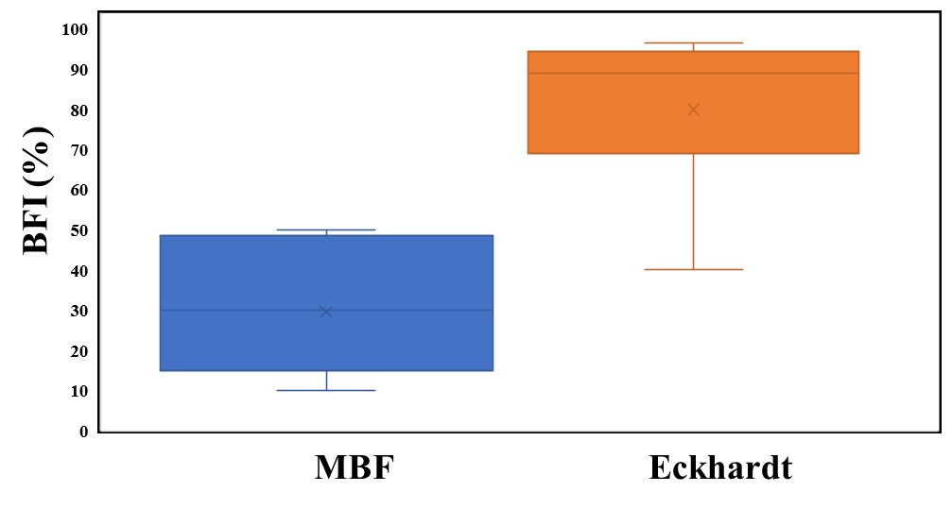
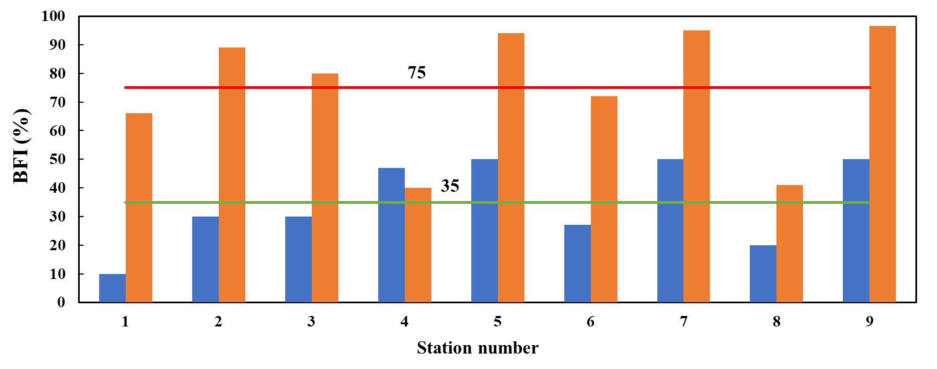
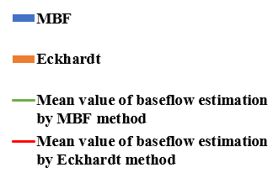
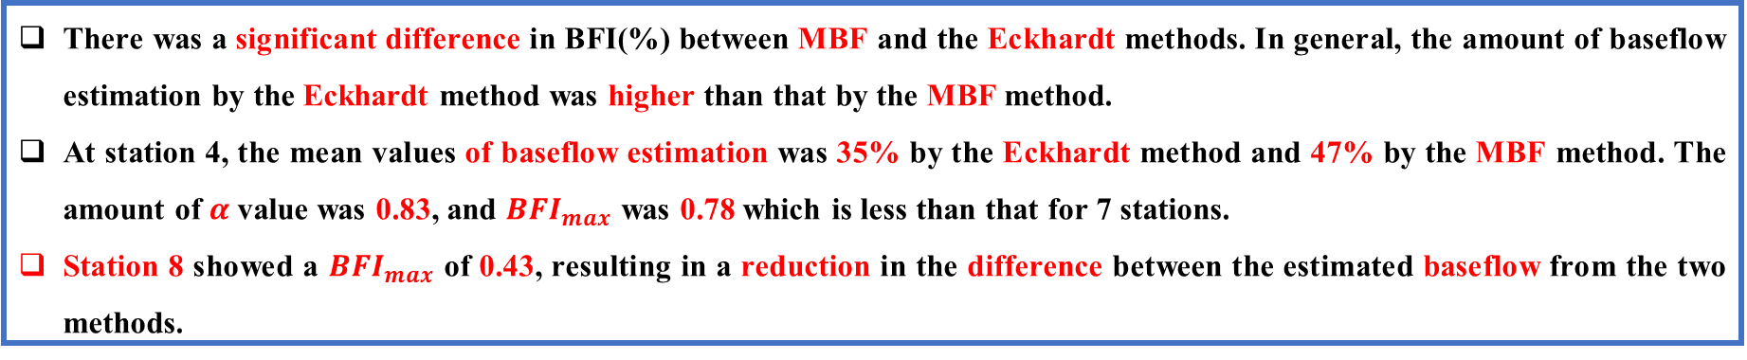
Evaluation of Baseflow Separation Methods
Comparison of the BFI Value of MBF and the Eckhardt Method
Figure 9. Comparison of the boxplots of the baseflow separation methods
Figure 10. Comparison results in BFI values
for the MBF and Eckhardt method
There was a significant difference in BFI(%) between MBF and the Eckhardt methods. In general, the amount of baseflow estimation by the Eckhardt method was higher than that by the MBF method.
At station 4, the mean values of baseflow estimation was 35% by the Eckhardt method and 47% by the MBF method. The amount of $α$value was 0.83, and ${BFI}_{max}$ was 0.78 which is less than that for 7 stations.
Station 8 showed a ${BFI}_{max}$ of 0.43, resulting in a reduction in the difference between the estimated baseflow from the two methods.

Slide 13
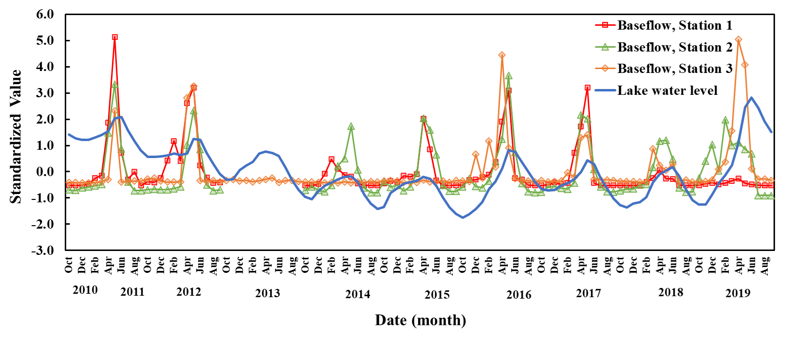
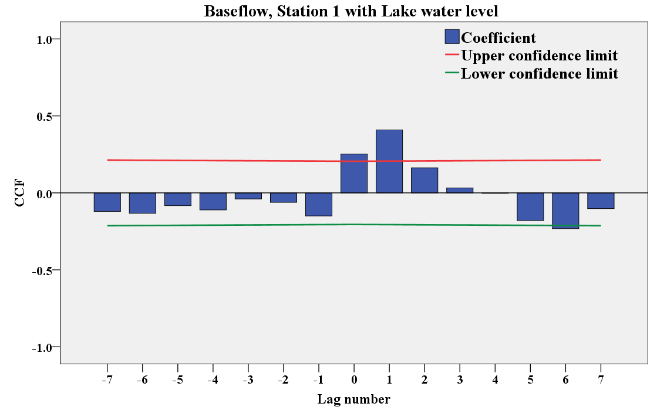
Evaluation of relationships between baseflow, groundwater, and lake water level
Interaction between Baseflow and Lake Water Level
Figure 12. Temporal analysis of cross‐correlation coefficient (CCF) between average monthly baseflow and lake water level
Figure 11. Interaction between baseflow
and the water level in Urmia Lake
There was the one-month lag time between baseflow and lake water level.
Correlation between baseflow and lake water level at all stations with one month lag-time was significant at the 0.01 level
Correlation between baseflow and lake water level at all stations without lag-time was significant at the 0.01 level except stations 3 and 4 which was significant at the 0.05 level.
Correlation between baseflow and lake water level at stations in the western part of Urmia Lake (i.e., stations 7, 8, and 9) was larger than that at other stations.

Slide 14
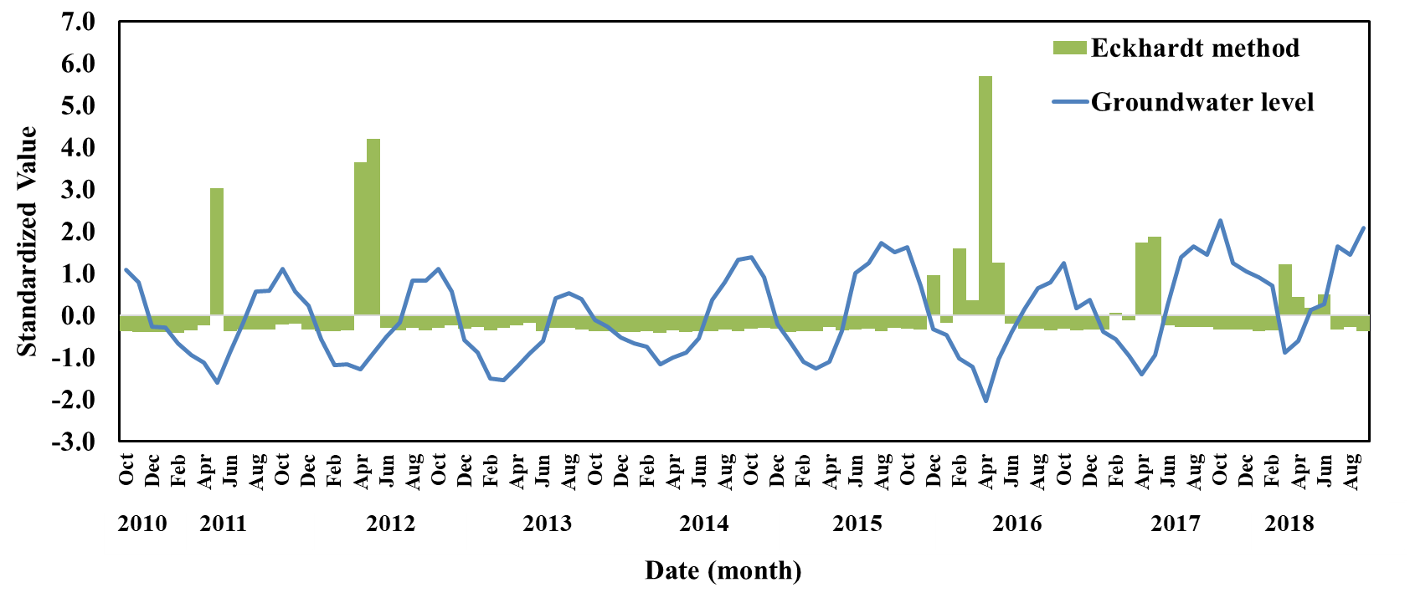
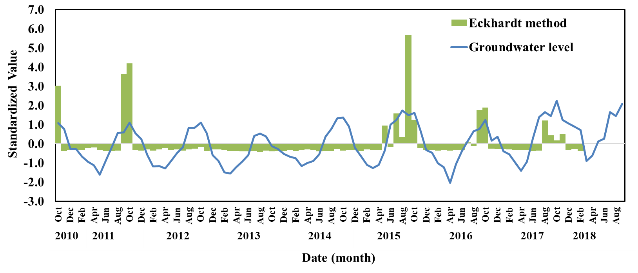
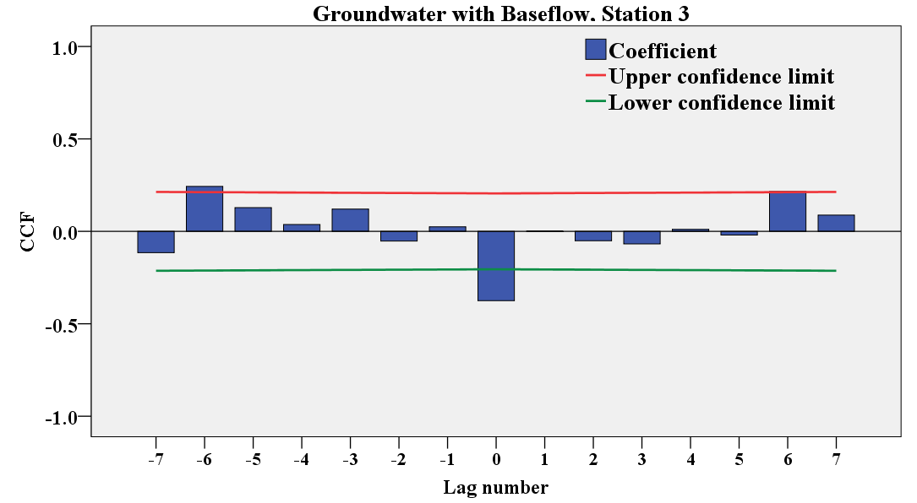
Evaluation of relationships between baseflow, groundwater, and lake water level
Interaction between Baseflow and Groundwater Level
(a)
(b)
Figure 13. Interaction between baseflow and groundwater level: (a) without lag-time, (b) with six months lag-time
There was six months lag-time between groundwater and baseflow.
Correlation between groundwater and baseflow was significant at 0.01 level.
Figure 14. Temporal analysis of cross‐correlation coefficient (CCF) between average groundwater level in selected well and baseflow

Slide 15
using daily streamflow and monthly EC data at nine stations in the Urmia Lake basin, Iran between 2015 to 2019
basedflow estimation by MBF and the Eckhardt methods
investigating relationship between baseflow, lake water level, and groundwater level
appropriate ECrunoff measring time is March, April, and May and for ECbaseflow July to November
share of baseflow in inflow into the lake (70%) which resulted in groundwater levels threat to baseflow
sensitivity of Eckhardt method to the α value and basin characteristics

Slide 16
one month lag-time between baseflow and lake water level, and six months lag-time between baseflow and groundwater.
statistically significant correlation between baseflow and lake level with one month lag-time and between baseflow and groundwater level with six months lag-time
providing information for catchment ecological protection and water resources management
recommending a calibrated version of the Eckhardt method as a high potential approach for other regions

Slide 17
Collischonn, W., & Fan, F. M. (2013). Defining parameters for Eckhardt's digital baseflow filter. Hydrological Processes, 27(18), 2614-2622.
Eckhardt, K. (2005). How to construct recursive digital filters for baseflow separation. Hydrological Processes: An International Journal, 19(2), 507-515.
Eckhardt, K. (2008). A comparison of baseflow indices, which were calculated with seven different baseflow separation methods. Journal of Hydrology, 352(1-2), 168-173.
Hosseini-Moghari, S. M., Araghinejad, S., Tourian, M. J., Ebrahimi, K., & Döll, P. (2020). Quantifying the impacts of human water use and climate variations on recent drying of Lake Urmia basin: the value of different sets of spaceborne and in situ data for calibrating a global hydrological model. Hydrology and Earth System Sciences, 24(4), 1939-1956.
Kissel, M., & Schmalz, B. (2020). Comparison of baseflow separation methods in the german low mountain range. Water, 12(6), 1740.
Rumsey, C. A., Miller, M. P., & Sexstone, G. A. (2020). Relating hydroclimatic change to streamflow, baseflow, and hydrologic partitioning in the Upper Rio Grande Basin, 1980 to 2015. Journal of Hydrology, 584, 124715.
Rimmer, A., & Hartmann, A. (2014). Optimal hydrograph separation filter to evaluate transport routines of hydrological models. Journal of Hydrology, 514, 249-257.
Sloto, R. A., & Crouse, M. Y. (1996). HYSEP: A computer program for streamflow hydrograph separation and analysis. Water-resources investigations report, 96, 4040.
Stewart, M., Cimino, J., & Ross, M. (2007). Calibration of base flow separation methods with streamflow conductivity. Groundwater, 45(1), 17-27.
Vaheddoost, B., & Aksoy, H. (2018). Interaction of groundwater with Lake Urmia in Iran. Hydrological processes, 32(21), 3283-3295.
Wang, D., & Wu, L. (2013). Similarity of climate control on base flow and perennial stream density in the Budyko framework. Hydrology and Earth System Sciences, 17(1), 315-324.
Xie, J., Liu, X., Wang, K., Yang, T., Liang, K., & Liu, C. (2020). Evaluation of typical methods for baseflow separation in the contiguous United States. Journal of Hydrology, 583, 124628.
Yang, W., Xiao, C., Zhang, Z., & Liang, X. (2021). Can the two-parameter recursive digital filter baseflow separation method really be calibrated by the conductivity mass balance method?. Hydrology and Earth System Sciences, 25(4), 1747-1760.
Zhang, J., Zhang, Y., Song, J., & Cheng, L. (2017). Evaluating relative merits of four baseflow separation methods in Eastern Australia. Journal of hydrology, 549, 252-263.

Slide 18
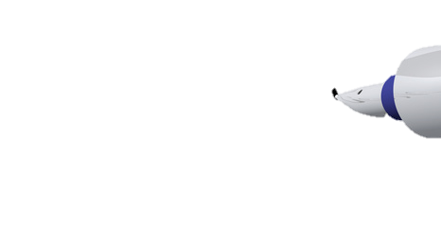

Thank you for your attention!

Slide 19

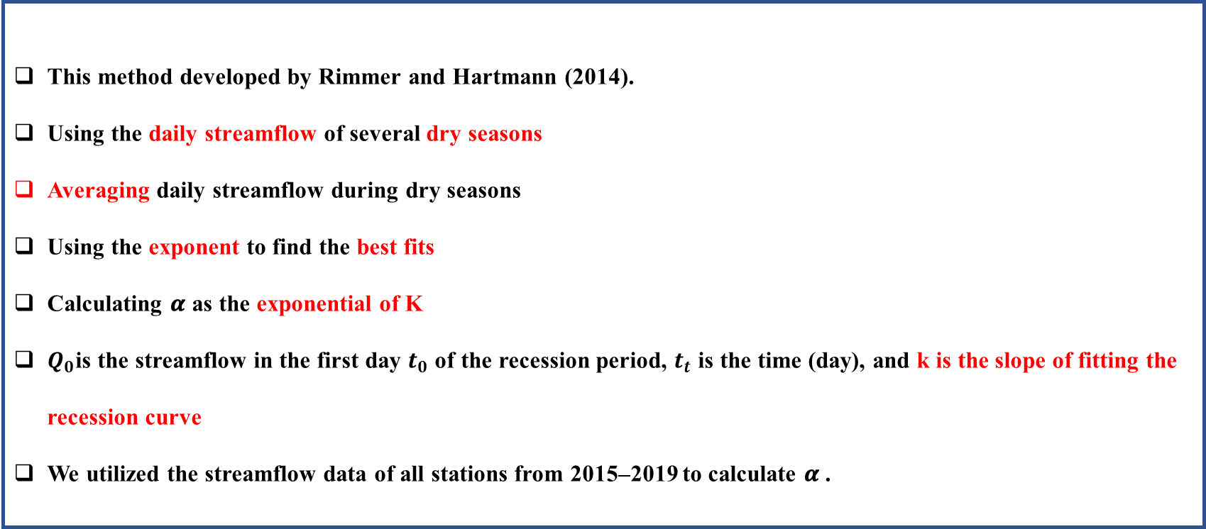

Parameters Estimated in Eckhardt Method
Methods to Estimate 𝜶
First method: recession curve analysis using master curve
This method developed by Rimmer and Hartmann (2014).
Using the daily streamflow of several dry seasons
Averaging daily streamflow during dry seasons
Using the exponent to find the best fits
Calculating 𝜶 as the exponential of K
$Q_{0}$is the streamflow in the first day $t_{0}$ of the recession period, $t_{t}$ is the time (day), and k is the slope of fitting the recession curve
We utilized the streamflow data of all stations from 2015–2019 to calculate 𝜶 .
Figure A1. Recession curve analysis using master curve
$Q_{t}=Q_{0} exp⁡[−k\left(t_{t}−t_{0}\right)]$
$$α=\exp\left[−k\right]$$

Slide 20

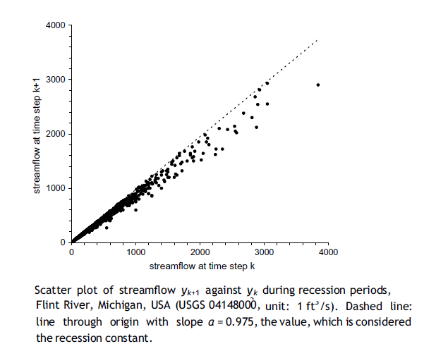
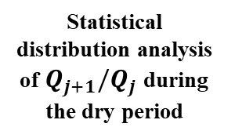
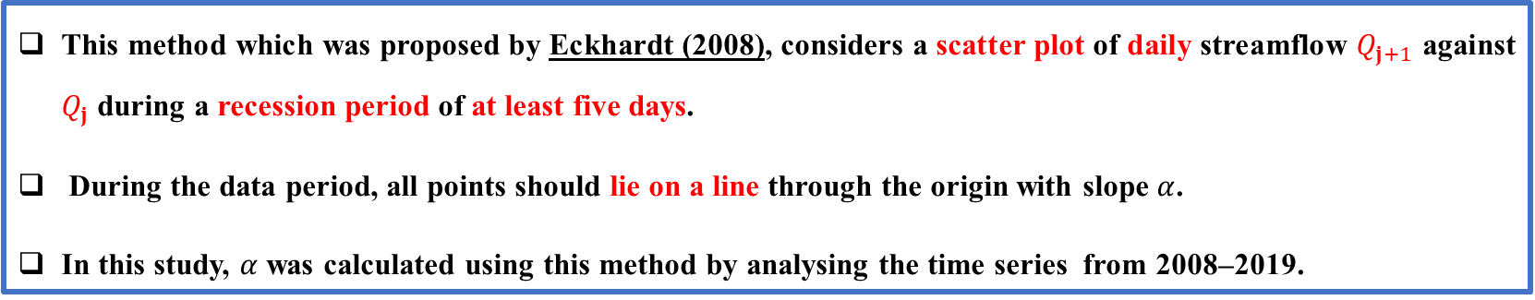

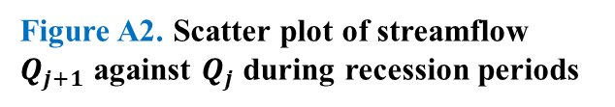
Parameters Estimated in Eckhardt Method
Figure A2. Scatter plot of streamflow $Q_{j+1}$ against $Q_{j}$ during recession periods
Methods to Estimate 𝜶
Recession constant (𝜶)
Recession curve analysis using master curve
Statistical distribution analysis of $Q_{j+1}/Q_{j}$during the dry period
Scatter plot of $Q_{j+1}$ against $Q_{j}$ during the recession periods
Second method: scatter plot of $Q_{j+1}$ against $Q_{j}$ during the recession periods
This method which was proposed by Eckhardt (2008), considers a scatter plot of daily streamflow $Q_{j+1}$ against $Q_{j}$ during a recession period of at least five days.
During the data period, all points should lie on a line through the origin with slope $α$.
In this study, $α$ was calculated using this method by analysing the time series from 2008–2019.

Slide 21
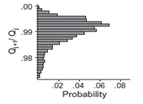
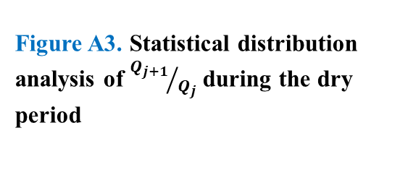
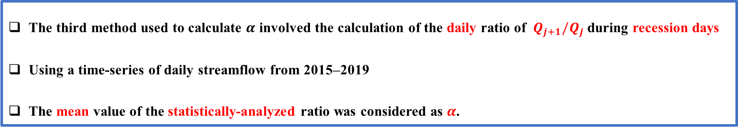

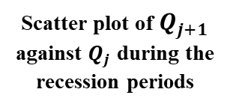
Parameters Estimated in Eckhardt Method
Figure A3. Statistical distribution analysis of ${Q_{j+1}}/{Q_{j}}$ during the dry period
Methods to Estimate 𝜶
Recession constant (𝜶)
Recession curve analysis using master curve
Statistical distribution analysis of $Q_{j+1}/Q_{j}$during the dry period
Scatter plot of $Q_{j+1}$ against $Q_{j}$ during the recession periods
The third method: statistical distribution analysis of $Q_{j+1}/Q_{j}$ during the dry period
The third method used to calculate $α$ involved the calculation of the daily ratio of $Q_{j+1}/Q_{j}$ during recession days
Using a time-series of daily streamflow from 2015–2019
The mean value of the statistically-analyzed ratio was considered as $α$.

Slide 22
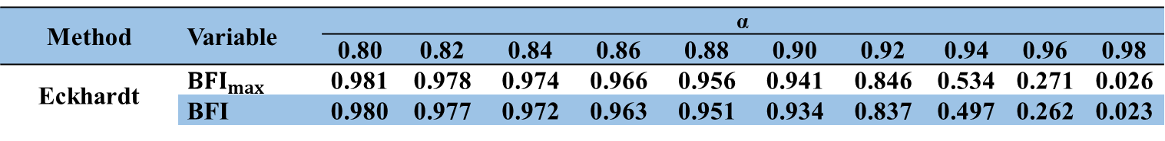
Sensitivity Analysis of the α Value in Eckhardt Method
Table A1. Eckhardt method performance with sensitivity analysis of the α value
Method | Variable | α
 |  | 0.80 | 0.82 | 0.84 | 0.86 | 0.88 | 0.90 | 0.92 | 0.94 | 0.96 | 0.98
Eckhardt | $${BFI}_{max}$$ | 0.981 | 0.978 | 0.974 | 0.966 | 0.956 | 0.941 | 0.846 | 0.534 | 0.271 | 0.026
 | BFI | 0.980 | 0.977 | 0.972 | 0.963 | 0.951 | 0.934 | 0.837 | 0.497 | 0.262 | 0.023
Comparison of the BFI Value of MBF and Eckhardt Method
Table A2. The percentage of BFI value for selected methods
Method | BFI (%)
Method | Maximum | Minimum | Mean | Median
MBF | 50 | 10 | 35 | 30
Eckhardt | 97 | 40 | 75 | 80

