Slide 1
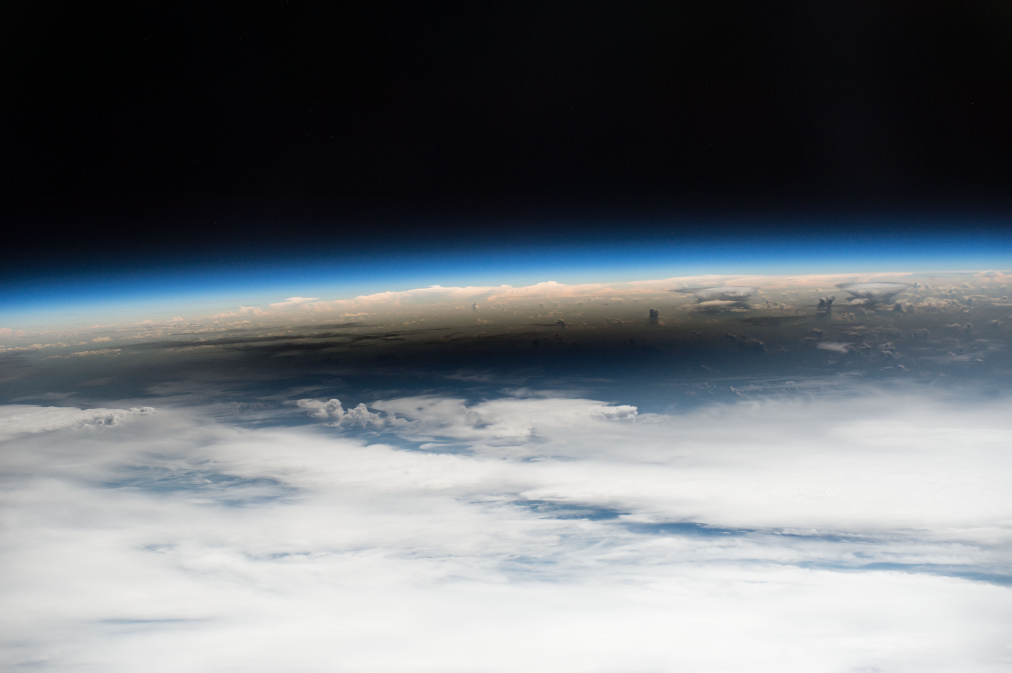
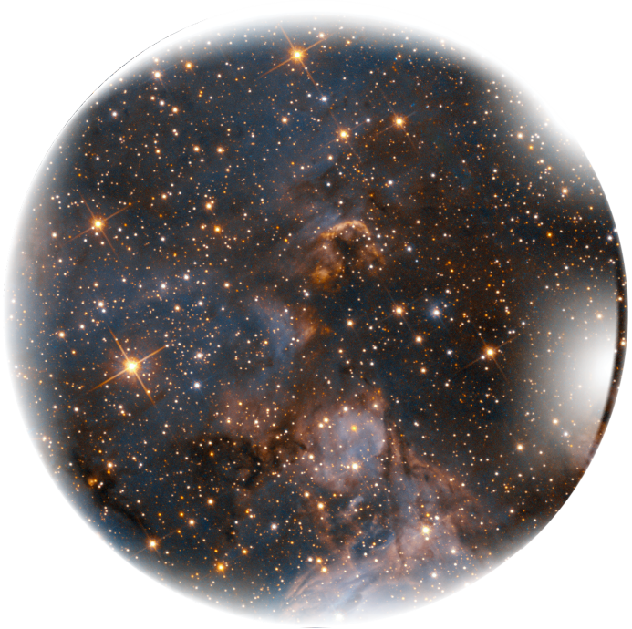
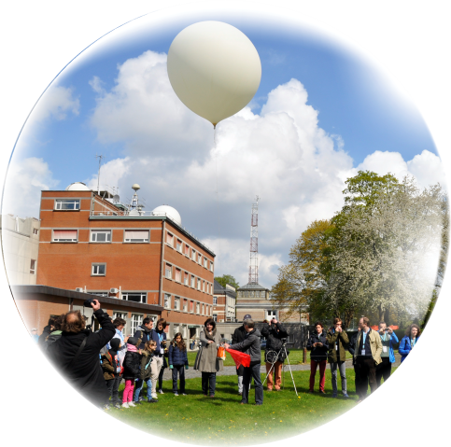




SO₂, SO₃, OCS, H₂S, and other trace gases in the Venus mesosphere from SOIR on board Venus Express: detection and upper limit profiles

Slide 2
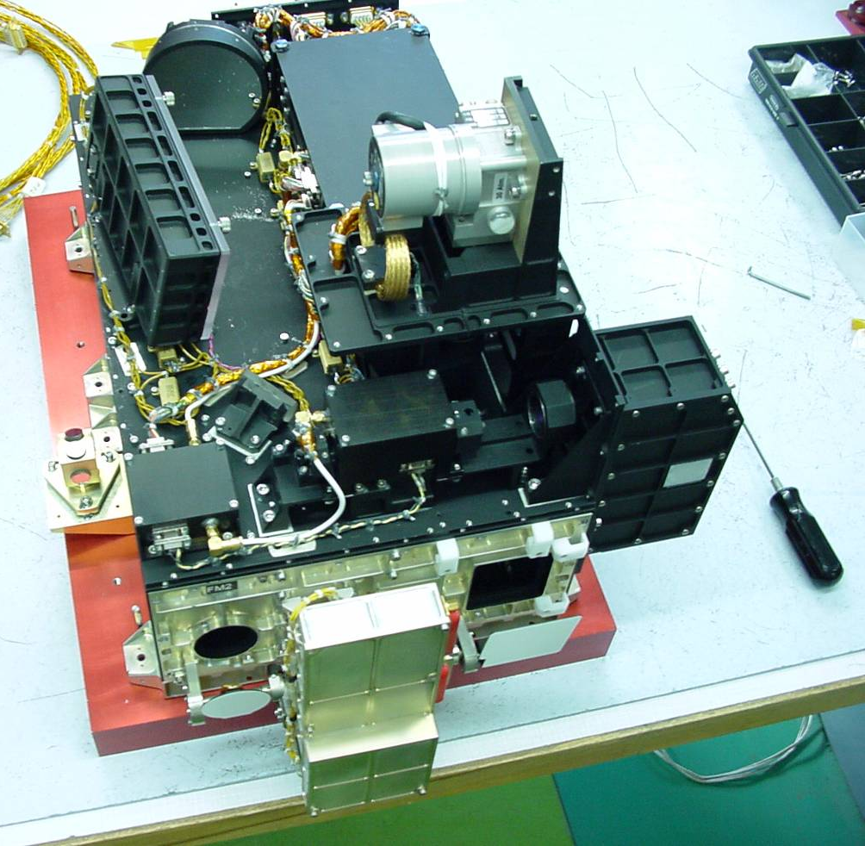
Introduction: SOIR/VEx
SOIR/VEx was an infrared spectrometer
Echelle grating spectrometer, very high orders (101 to 194)
Sensitive in the 2.2 - 4.4 µm (2200 - 4400 cm⁻¹)
Spectral sampling 0.06 – 0.12 cm⁻¹
Spectral resolution 0.11 – 0.21 cm⁻¹
SOIR/VEx performed solar occultations
Terminator (6AM and 6PM), all latitudes covered
Four spectral regions scanned simultaneously
Previously measured CO₂ & T°, CO, H₂O/HDO, HCl, HF, SO₂ & aerosols
In this work: SO₂, OCS, SO₃, H₂S, & no detection: HOCl

Slide 3
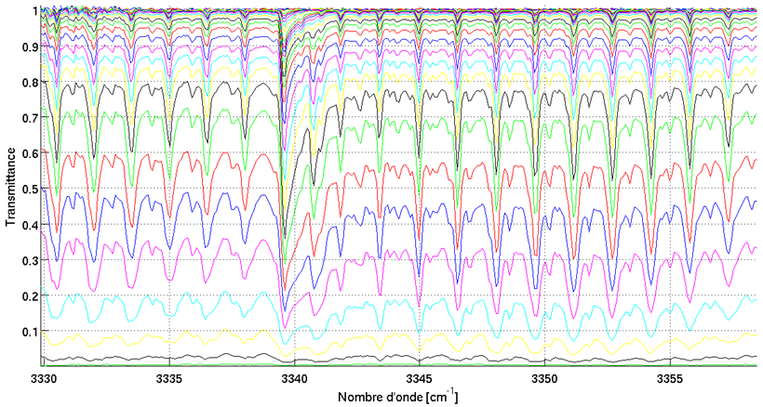
Retrieval procedure
Fit of the slant density from each spectrum
Criterions for detection:
Adding the minor species reduces the RMS by 5%
Retrieved slant column of minor species is larger than upper limit of detection by factor 2.3
The spectral correlation between measured and fitted spectra adding the minor species is larger than without it
The mean measured transmittance is larger than 0.01
Tikhonov regularization method to compute local number density + uncertainty

Slide 4
Example of retrieval for SO₃

Slide 5
Vertical profiles
SO₂ literature: Belyaev et al. (2012), Evdokimova et al. (2020), Sandor et al. (2010)
OCS literature: Krasnopolsky (2018)
Color code: Red for Equatorial, Blue for Polar.
Covers 2006 – 2014 time period.

Slide 6
Conclusions and future work
SOIR was sensitive to SO₂, OCS, SO₃, H₂S
Detections are 13% for SO₂, 17% for OCS, 23% for SO₃, and 9% for H₂S of the whole database
No HOCl detection (only 4 observations)
Paper to be published over summer: Detection of SO₂, OCS, H₂S, and SO₃, and upper limits of HOCl, CS, and CS₂ in the Venus lower-mesosphere using SOIR on board Venus Express @ Icarus
Future work include study of H₂CO, O₃, NH₃, HCN, N₂O, NO₂, HO₂

Slide 7
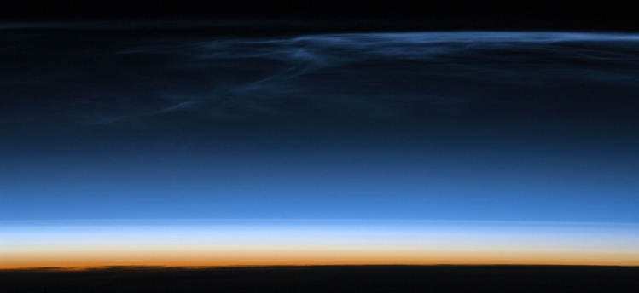

thank you! more info?
planetary.aeronomie.be
arnaud.mahieux@aeronomie.be

