Slide 1
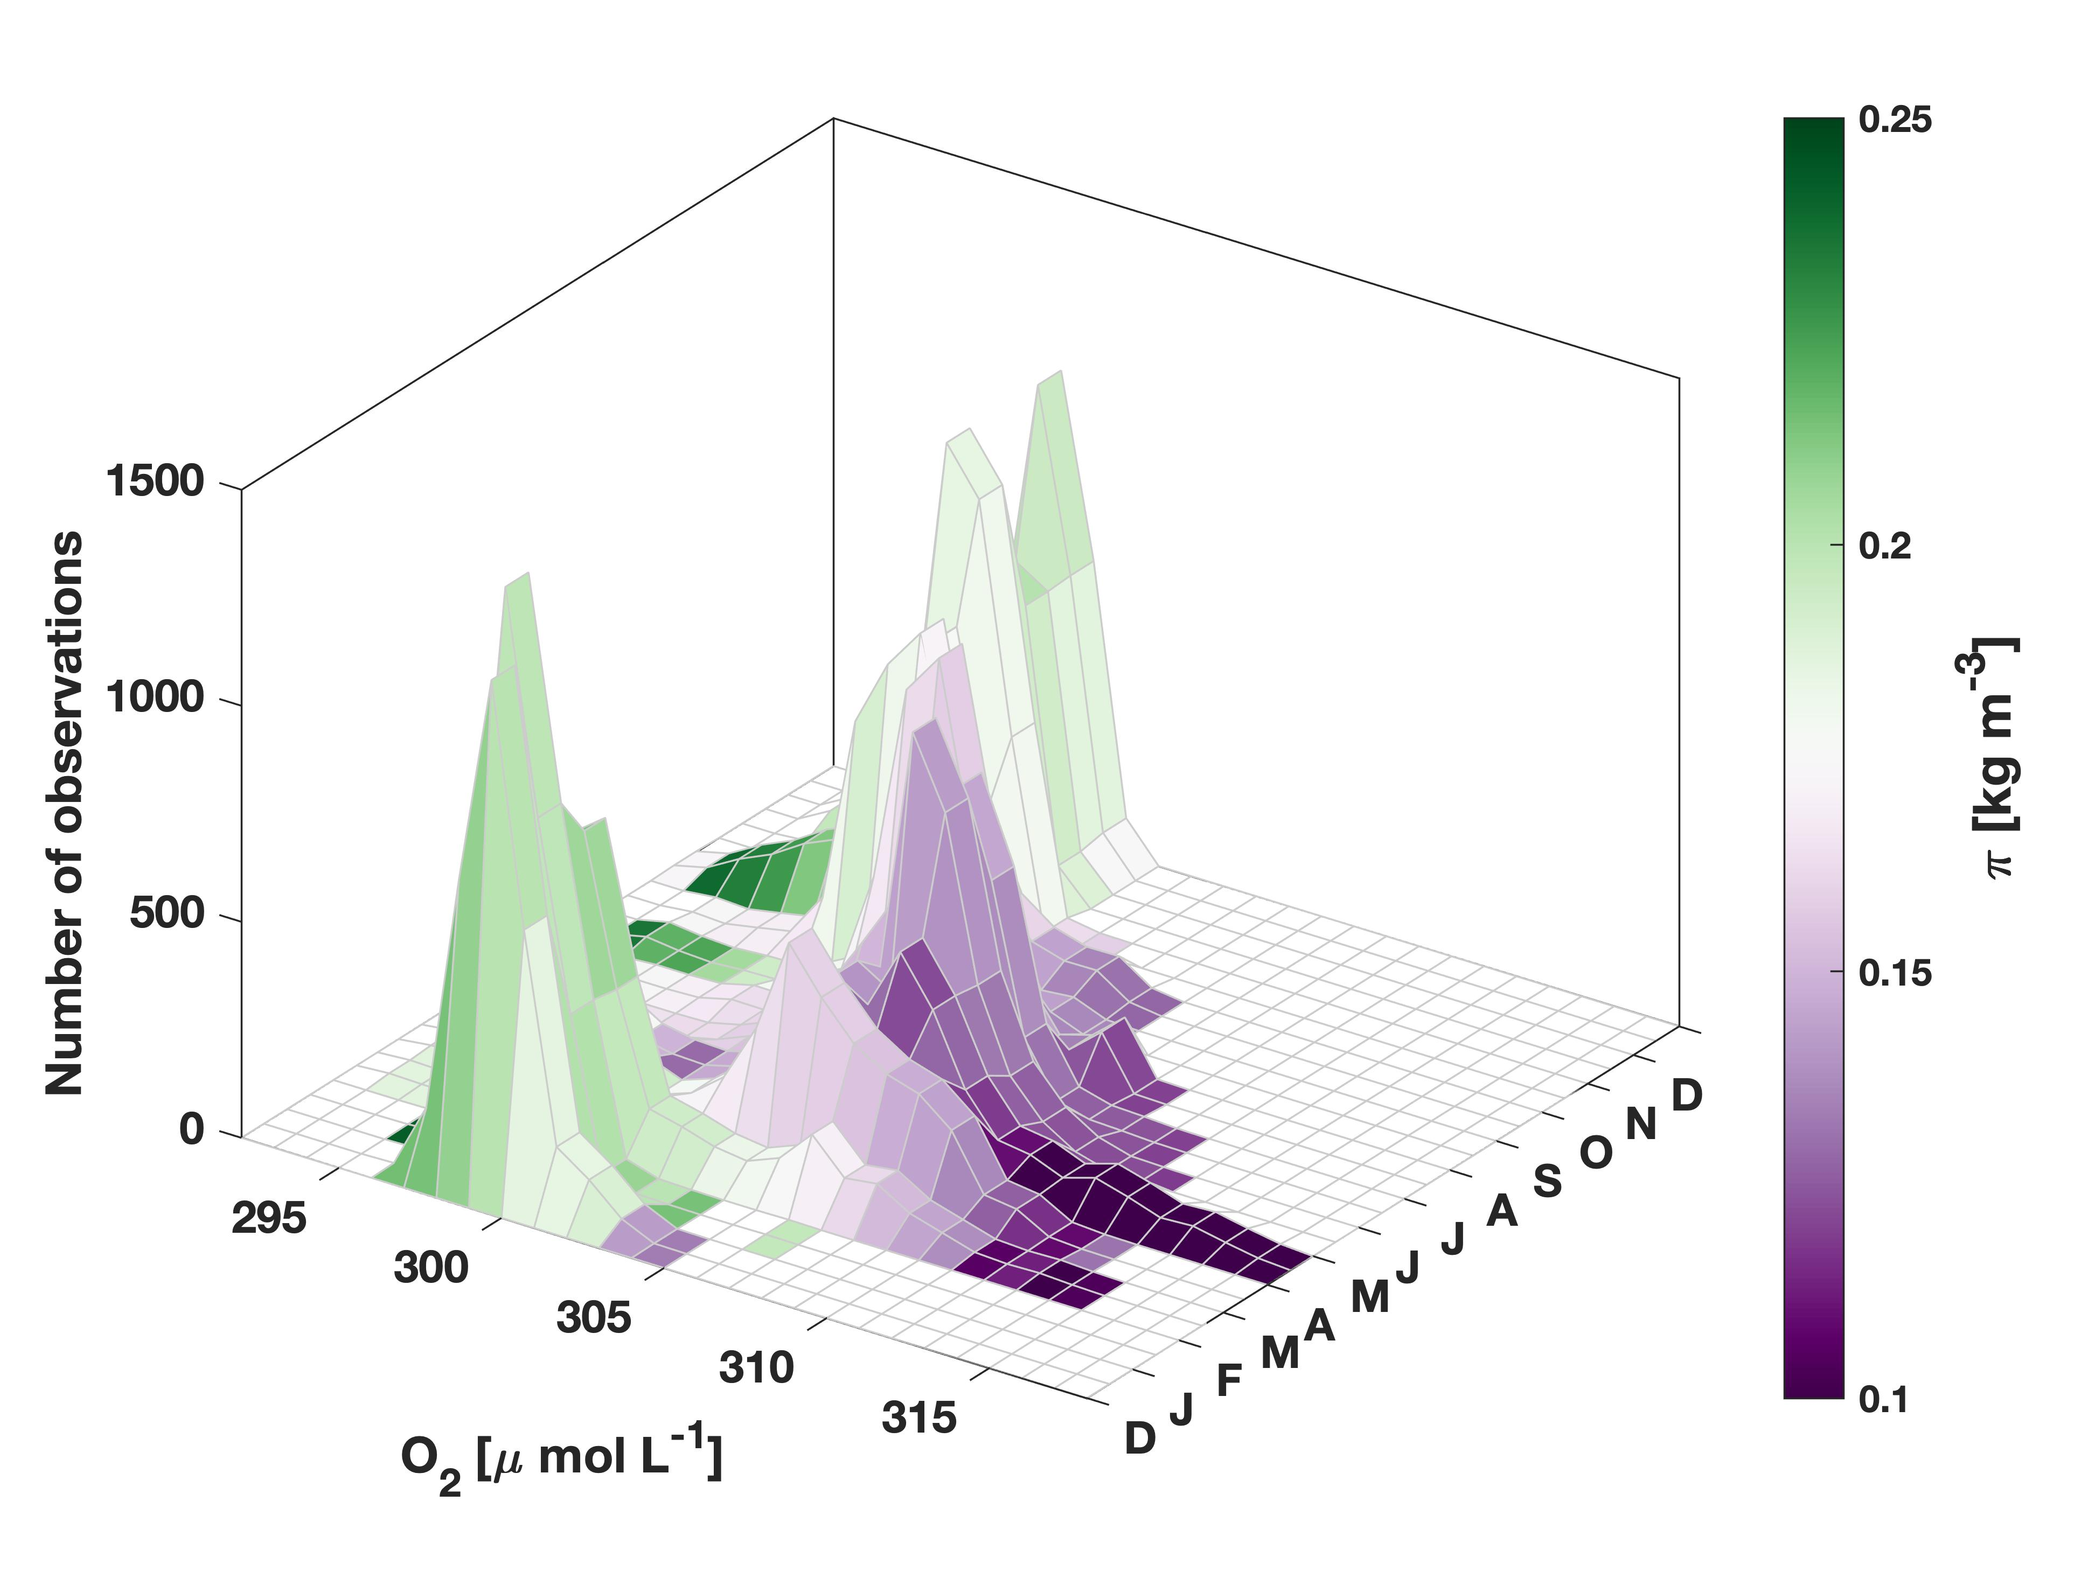
Ventilation and oxygen export in the Labrador Sea
Jannes Koelling¹ (j.koelling@dal.ca), Dariia Atamanchuk¹, Johannes Karstensen², Patricia Handmann², Douglas Wallace¹
¹ Department of Oceanography, Dalhousie University, Canada; ² GEOMAR Helmholtz Centre for Ocean Research Kiel, Germany
Acknowledgements:
This research has been supported by the Canada Excellence Research Chairs, Government of Canada (Ocean Science and Technology grant), the Canada First Research Excellence Fund (Ocean Frontier Institute grant), the Horizon 2020 (Blue-Action (grant no. 727852) and EuroSea (grant no. 862626)), and the Bundesministerium für Forschung und Technologie (RACE grant). Jannes Koelling was funded by the Ocean Frontier Institute through the International Postdoctoral Fellowship.

Slide 2
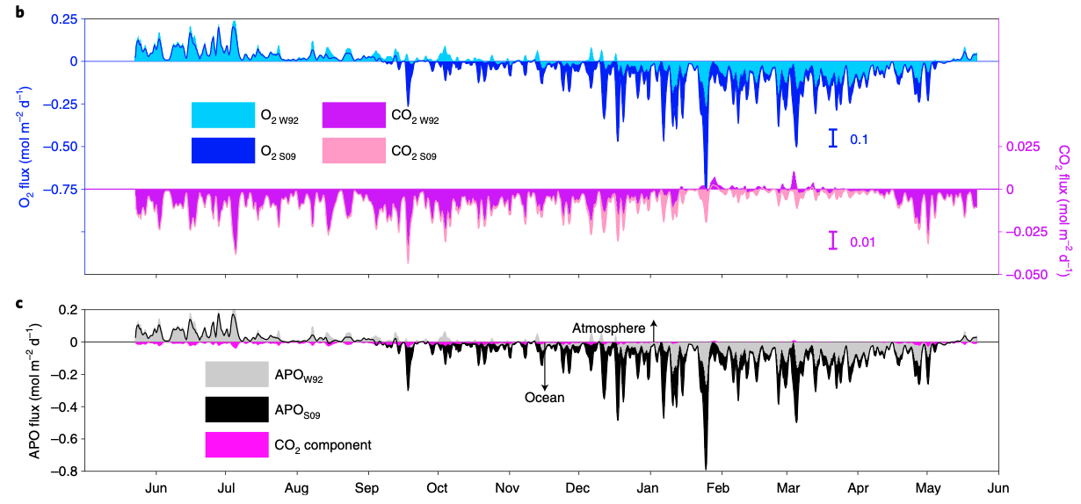
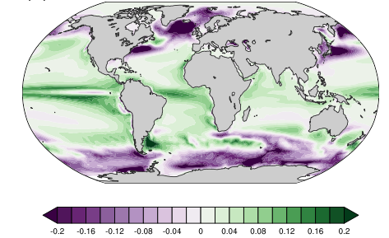
Introduction
Top: O2 and CO2 uptake from Atamanchuk et al. (2020)
Right: Modeled mean O2 uptake, from Huang et al. (2018)
Lab Sea is one of a few regions where atmospheric oxygen can reach deep ocean
Strong wintertime uptake during convection
Important for global ventilation

Slide 3
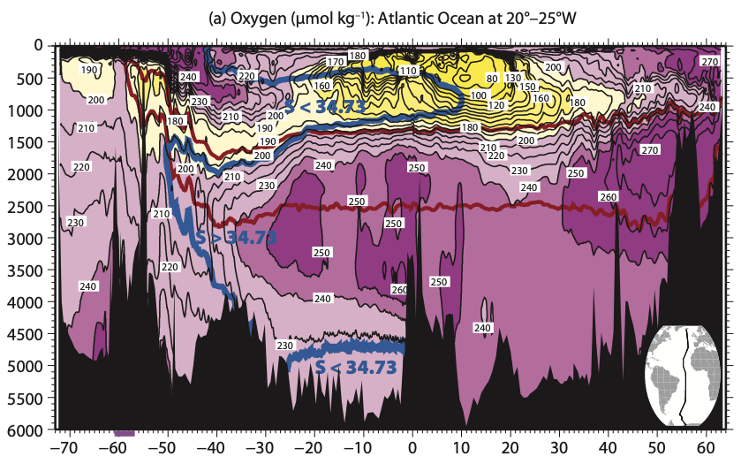
Introduction
Top: O2 and CO2 uptake from Atamanchuk et al. (2020)
Right: Atlantic O2 section, from Talley (2013)
Lab Sea is one of a few regions where atmospheric oxygen can reach deep ocean
Strong wintertime uptake during convection
Important for global ventilation

Slide 4
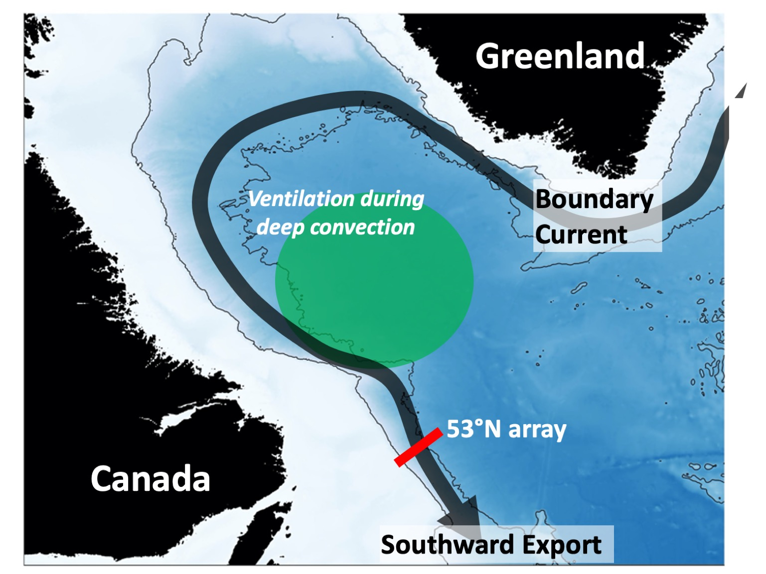
Ventilation (O2 uptake) during deep convection
Körtzinger et al. (2004, 2008)
Koelling et al. (2017)
Wolf et al. (2018)
Atamanchuk et al. (2020)
O2 uptake: 3.2 Tmol/yr
Schematic showing the boundary current (black) and region of ventilation (green shading)

Slide 5

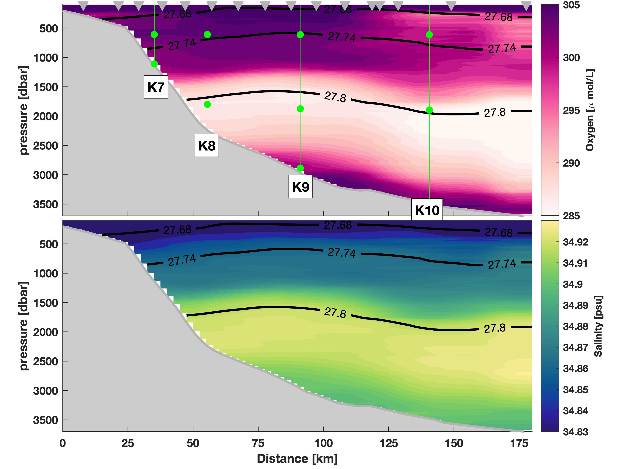
O2 at 600m (LSW layer) at exit of Labrador Sea
How/when is LSW exported out of the basin?
What is the associated oxygen export?
Interannual/decadal variability?
O2 uptake: 3.2 Tmol/yr
O2 export: ? Tmol
Schematic showing the boundary current (black) and region of ventilation and LSW input into boundary current (green shading and arrows)
Mean O2 and S along mooring section and location of O2 sensors

Slide 6
Koelling, J., Atamanchuk, D., Karstensen, J., Handmann, P., and Wallace, D. W. R.: Oxygen export to the deep ocean following Labrador Sea Water formation, Biogeosciences, 19, 437–454, https://doi.org/10.5194/bg-19-437-2022, 2022.
IW
“Pulse” of newly ventilated LSW
LSW
Monthly histograms of O2 concentrations; color shows spiciness (measure of T/S variability)
Monthly histograms of O2 at K9 show annual cycle
Shift from primarily IW to primarily LSW

Slide 7
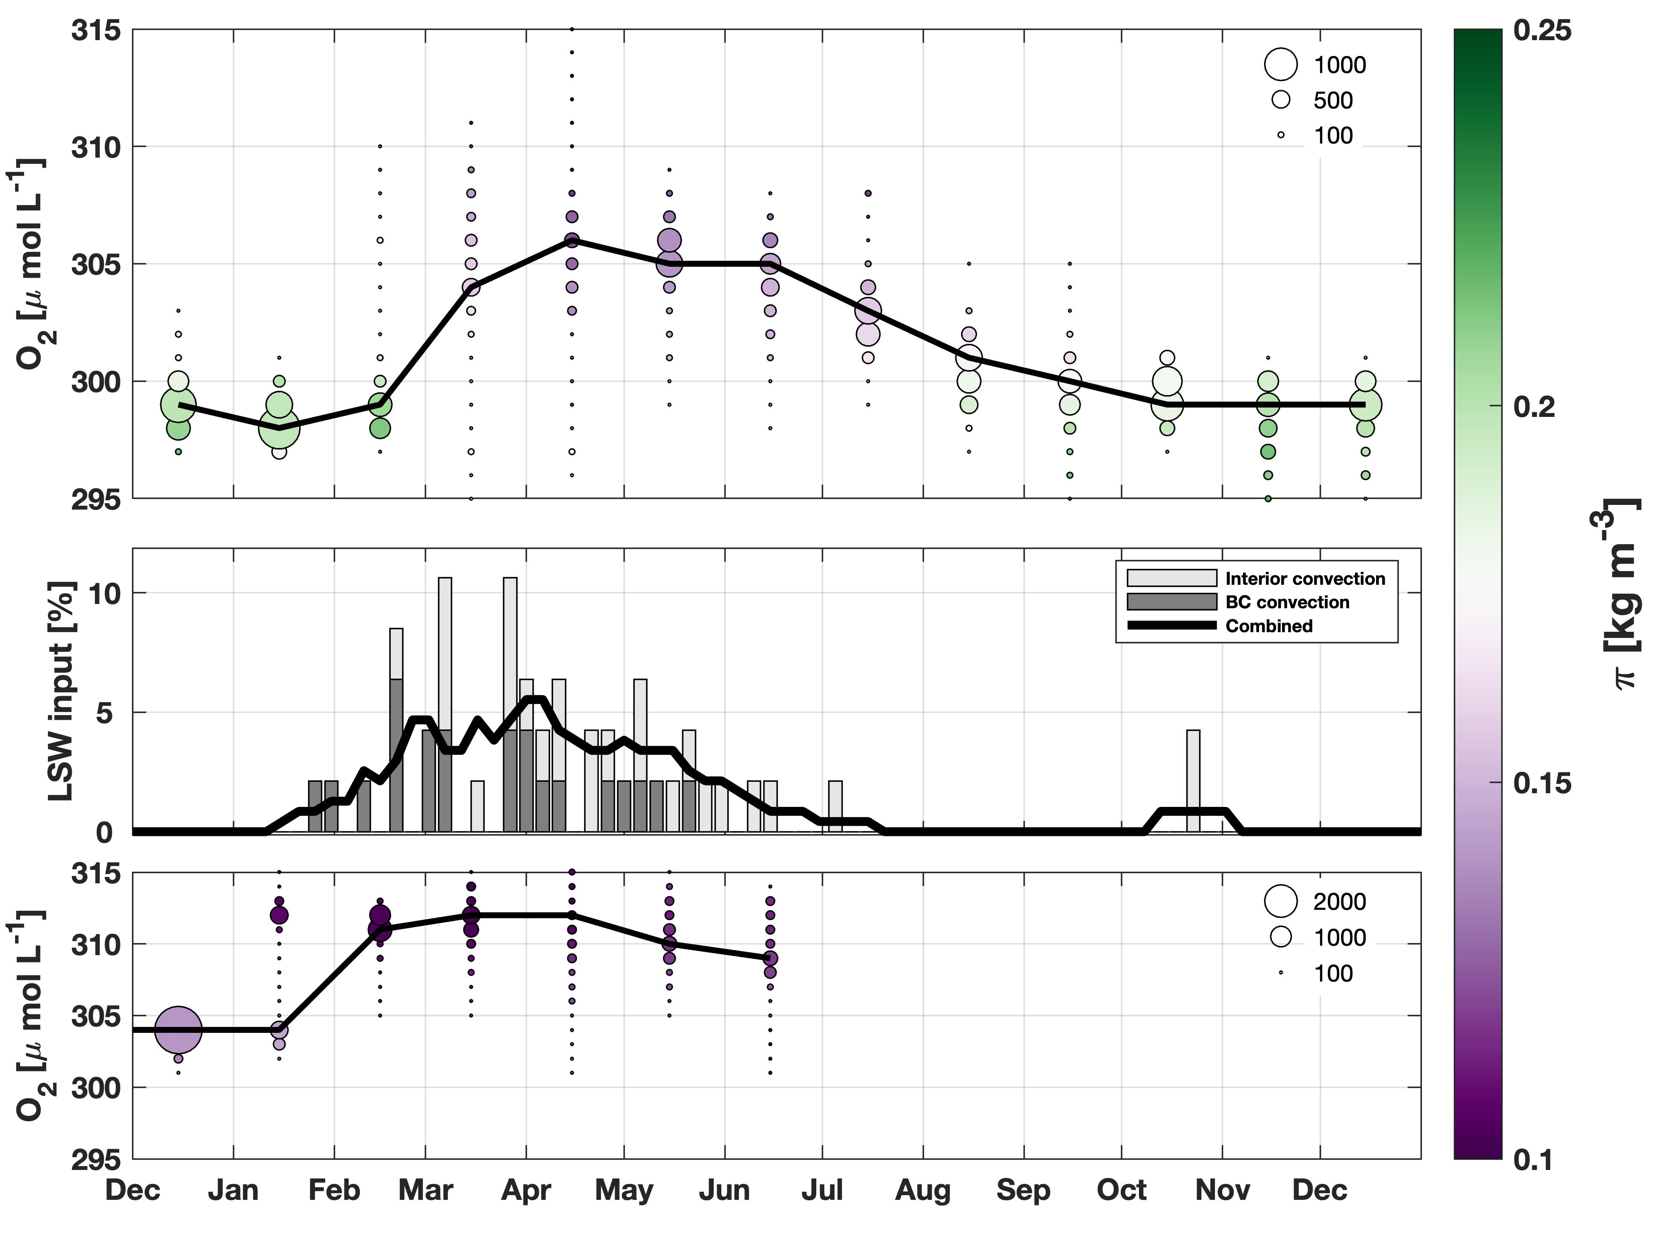
K9 (boundary current)
Annual cycle of O2 at Seacycler mooring in the interior Lab Sea (top) and K9 (bottom), and time series of percent of total LSW export into boundary current (middle)
Onset of convection in Lab Sea ->
Input of LSW into BC ->
Arrival of LSW (high O2) at 53N
LSW Input from Argo
Seacycler (interior LS)
Estimate of oxygen export from LS: 1.6 Tmol/year (50% of uptake in interior)
Supplies an estimated 42-71% of of oxygen demand in the uNADW layer in N. Atlantic

Slide 8

Annual Oxygen budget
O2 uptake: 3.2 Tmol
O2 export: -1.6 Tmol

Slide 9

Annual Oxygen budget
O2 uptake in Irminger Sea: ? Tmol
O2 uptake: 3.2 Tmol
Other O2 export: ? Tmol
Biology: ? Tmol
O2 export: -1.6 Tmol

Slide 10
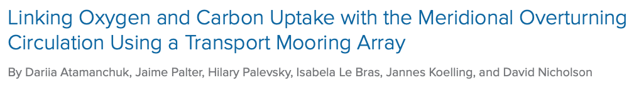
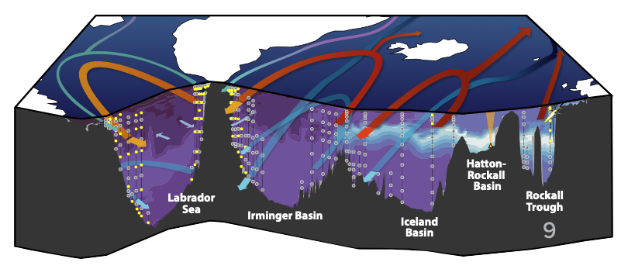
Atamanchuk et al., (2021)

Slide 11
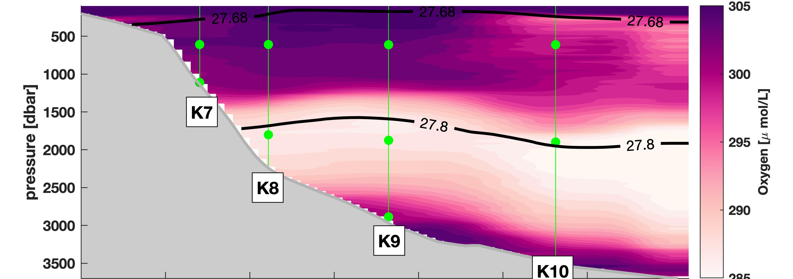
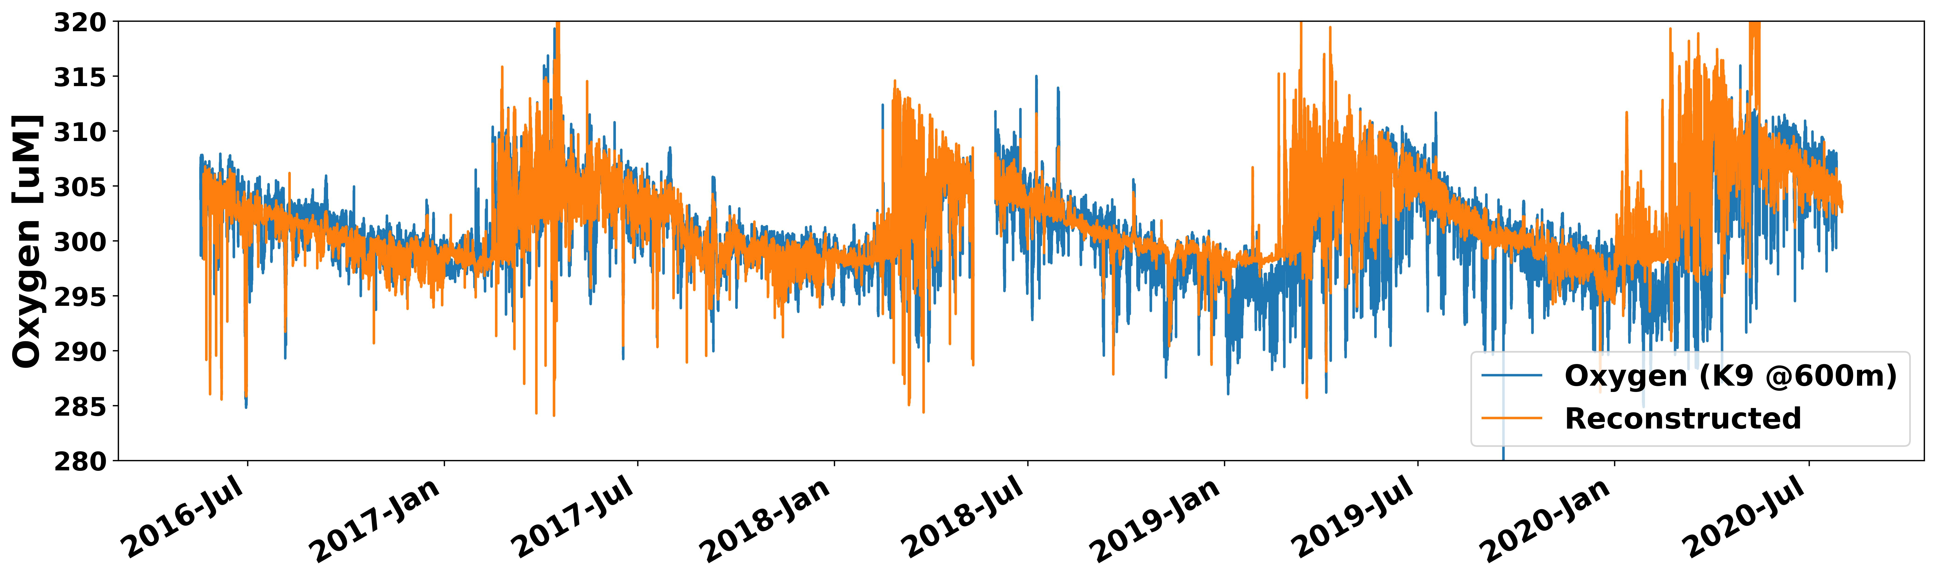
Interannual variability
What is the variability of O2 (and O2 transport) in the LSW layer?
Use data at sensor depths to fill in at depths between

Slide 12
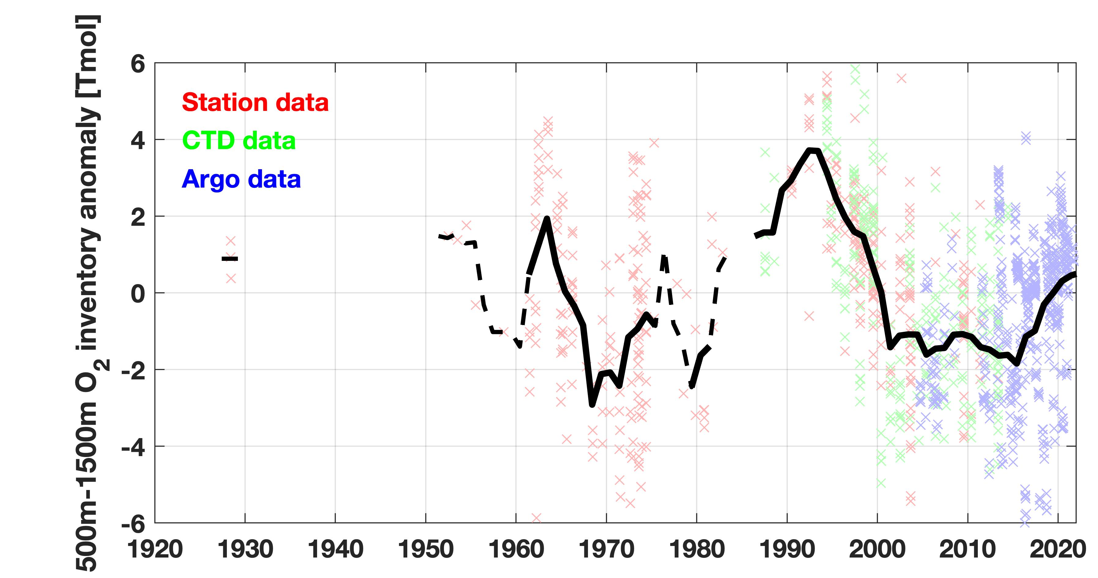
Decadal variability
Gas exchange > O2 export
Gas exchange < O2 export
Central Labrador Sea
Decadal variability in oxygen content (see also: Stendardo & Gruber, 2012, van Aken et al., 2011)
“Reservoir” effect – implications for gas exchange and export?

Slide 13
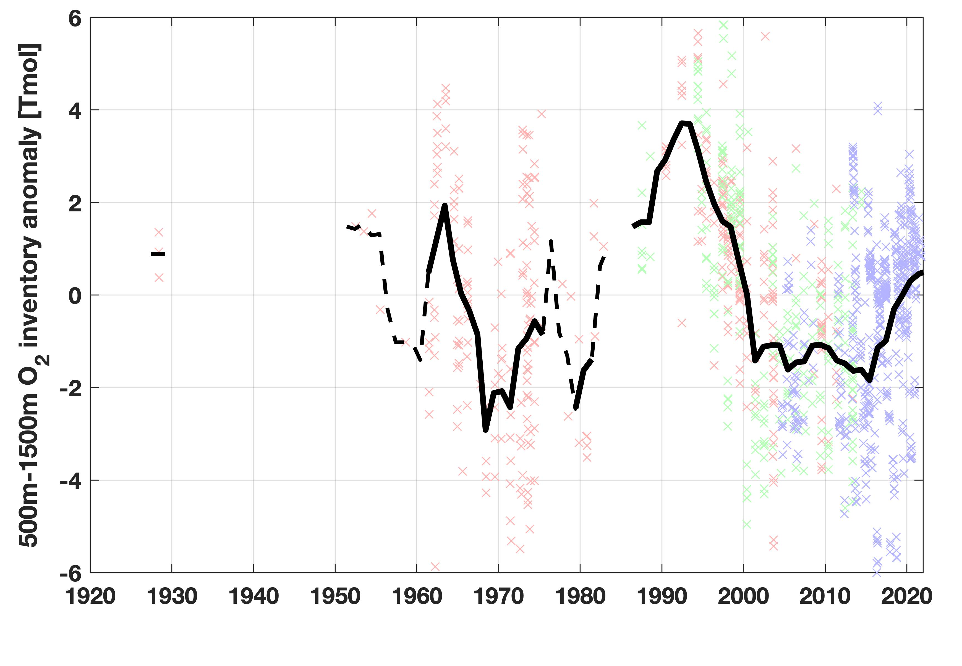
Summary
Oxygen measurements at 53N - exit of the Labrador Sea
Property changes at 600m indicative of different water masses: Irminger Water (IW) and Labrador Sea Water (LSW)
Increased oxygen levels due to direct export of new Labrador Sea Water
1.6 Tmol/year of southward oxygen export from recently ventilated LSW (50% of uptake)
Interannual/decadal variability
O2 uptake: 3.2 Tmol
O2 export: -1.6 Tmol

Slide 14
Thank you!
References
Atamanchuk, D., Koelling, J., Send, U. and Wallace, D.W.R., 2020. Rapid transfer of oxygen to the deep ocean mediated by bubbles. Nature Geoscience, 13(3), pp.232-237.
Atamanchuk, D., J. Palter, H. Palevsky, I. Le Bras, J. Koelling, and D. Nicholson. 2021. Linking oxygen and carbon uptake with the meridional overturning circulation using a transport mooring array. Supplement to Oceanography 34(4), https://doi.org/10.5670/oceanog.2021.supplement.02-03.
Huang, J., Huang, J., Liu, X., Li, C., Ding, L. and Yu, H., 2018. The global oxygen budget and its future projection. Science Bulletin, 63(18), pp.1180-1186.
Koelling, J., Wallace, D.W., Send, U. and Karstensen, J., 2017. Intense oceanic uptake of oxygen during 2014–2015 winter convection in the Labrador Sea. Geophysical Research Letters, 44(15), pp.7855-7864.
Koelling, J., Atamanchuk, D., Karstensen, J., Handmann, P. and Wallace, D.W., 2022. Oxygen export to the deep ocean following Labrador Sea Water formation. Biogeosciences, 19(2), pp.437-454.
Kortzinger, A., Schimanski, J., Send, U. and Wallace, D., 2004. The ocean takes a deep breath. Science, 306(5700), pp.1337-1337.
Körtzinger, A., Send, U., Wallace, D.W., Karstensen, J. and DeGrandpre, M., 2008. Seasonal cycle of O2 and pCO2 in the central Labrador Sea: Atmospheric, biological, and physical implications. Global Biogeochemical Cycles, 22(1).
Stendardo, I. and Gruber, N., 2012. Oxygen trends over five decades in the North Atlantic. Journal of Geophysical Research: Oceans, 117(C11).
Talley, L.D., 2013. Closure of the global overturning circulation through the Indian, Pacific, and Southern Oceans: Schematics and transports. Oceanography, 26(1), pp.80-97.
van Aken, H.M., de Jong, M.F. and Yashayaev, I., 2011. Decadal and multi-decadal variability of Labrador Sea Water in the north-western North Atlantic Ocean derived from tracer distributions: Heat budget, ventilation, and advection. Deep Sea Research Part I: Oceanographic Research Papers, 58(5), pp.505-523.
Wolf, M.K., Hamme, R.C., Gilbert, D., Yashayaev, I. and Thierry, V., 2018. Oxygen saturation surrounding deep water formation events in the Labrador Sea from Argo‐O2 data. Global Biogeochemical Cycles, 32(4), pp.635-653.

